Slide 1
Special Education Leaders Meeting
Friday, May 26, 2023

Slide 2
AGENDA
Special Education Updates
Connecting School Health and Special Education Through Staffing Solutions
Q&A

Slide 3
Special Education Updates

Slide 4
Planning for the FY2024 Federal Grant Application
Conditions of Assistance: IDEA Part B Funding
Submitted annually
Certification Section - The Superintendent (or school leader), Special Education Administrator, School Business Official, and School Committee Chairperson/Board of Trustees Chairperson
Maintenance of Effort (MOE)
Budget and student data for the upcoming school year
Making Money Matter (M3) Budget
LEAs that were identified in 2022-2023 as Needing Intervention on LEA Determinations
At least 2% of IDEA Funds

Slide 5
Planning for the FY 2024 Federal Grant Application
Comprehensive Coordinated Early Intervening Services (CCEIS)
Mandatory 15% reserve (districts identified in the fall 2022)
Coordinated Early Intervening Services (CEIS)
Optional
Equitable Services
Proportionate Share (fall 2022 child count)
Resolution Funds (Year 3 allocations for fund code 240)
Written Affirmation (including Resolution Funds)
Carryover Questionnaire
General Education Provision Act (GEPA) Statement

Slide 6
Federal Grant Application Assurances
General GEPA Question
Describe how your entity’s existing mission, policies, or commitments ensure equitable access to, and equitable participation in, the proposed project or activity (in the general federal grant section to be answered once by the district).
The Department’s GEPA Statement was filed with the IDEA State Application.

Slide 7
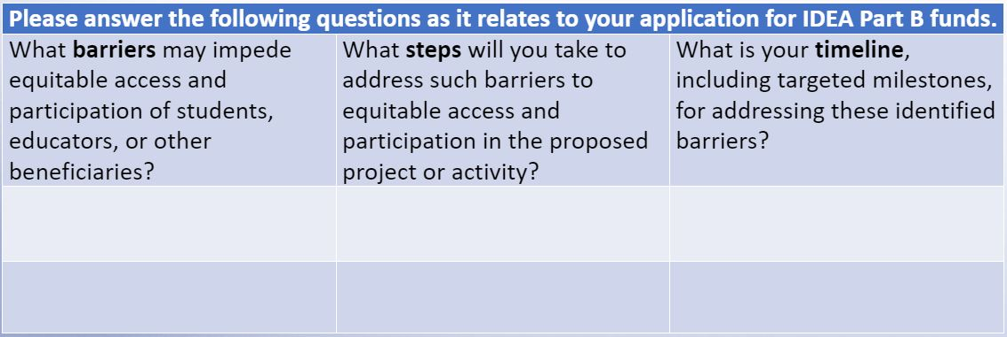
Federal Grant Application IDEA Related Questions

Slide 8
IEP Improvement Project Updates
Check out the updated website!
Save the date
IEP Office Hours – June 15 2:00-3:00 PM
Reminder for schools and districts that will be implementing in 2023-2024
Training of Trainers Symposium May 31 and June 1 12:00-3:00 PM
Registration Closed!
Vendor Communication and Support
Upcoming Additional Office Hours Session – PLEASE NOTIFY YOUR VENDORS!
June 8 11:00-12:00 (Please have vendors email SpecialEducation@doe.mass.edu if they are interested in attending
Notes:
Updates to website:
Removed outdated materials
Posted fillable PDF of IEP
Posted translated versions of IEP, Admin Data Sheet, Invitation
Updated Business Rules for vendors – COMING SOON (note – very few, minor updates that align to the final updates to the IEP form
PLEASE ask directors to either send questions to us OR have the vendors submit questions to the special ed inbox beforehand!!!!

Slide 9
Special Education Leadership Institutes
Focus on the key principles of state and federal priorities for student and educator success.
Provides educator development
Provides opportunities to:
network
apply concepts of systemic change to improve student outcomes
better understand federal and state legal requirements
implement evidence-based practices for creating inclusive environments

Slide 10
What are the Leadership Institutes?
Special Education Administrative Leadership Institute – Year-long - William James College
Designed to enhance and enrich the already well-established knowledge base of the seasoned Special Education Administrator. Through seminars, communities of practice, personalized coaching, and problem-solving experiences and projects, participants will develop strategies and solutions to challenging issues and dilemmas
Learn more about this Institute
New Special Education Directors Leadership Institute – Two Year-Long - ACCEPT Collaborative
Participants will develop and strengthen proactive management and leadership skills to implement a responsive and legally compliant special education service delivery system in their districts. A mentor will be assigned to help guide you through your learning opportunities. Additionally, you will meet fellow new Directors and create lasting bonds and friendships.
Apply for this Institute
Early Childhood Coordinators Administrative Leadership Institute – Year-long – AnLar
Provides an opportunity for participants to examine and increase their competency in the components of effective leadership of early childhood special education programs, including instructional leadership, management and operations, professional culture, and family and community engagement
Apply for this Institute
Special Education Team Leader Institute – Year-long – Collaborative for Educational Services
Designed to equip special educational team leaders with tools to foster family and community engagement and improve student outcomes by facilitating team meetings that are collaborative and compliant with regulations and best practices in the field
Registration for this Institute is closed

Slide 11
New Special Education Directors Leadership Institute
The New Special Education Directors Leadership Institute is accepting applications for Directors and Assistant Directors from Districts, Collaboratives and Charter Schools
Contact Dana Mullaley at dmullaley@accept.org

Slide 12
Upcoming Special Education Leaders Meetings
2023 Meetings
No July Meeting
Friday, August 18, 2023 (12-1 pm)
Friday, September 15, 2023 (12-1 pm)
October (Regional In-Person Mtgs)
Friday, November 17, 2023 (12-1 pm)
Friday, December 15, 2023 (12-1 pm)
2024 Meetings
Friday, January 26, 2024 (12-1 pm)
Friday, February 9, 2024 (12-1 pm)
Friday, March 29, 2024 (12-1 pm)
April (Regional In-Person Mtgs)
Friday, May 17, 2024 (12-1 pm)
Friday, June 21, 2024 (12-1 pm)

Slide 13
Connecting School Health and Special Education Through Staffing Solutions
May 26, 2023

Slide 14
Today’s Panel
Karen Robitaille, MBA, MSN, RN, NCSN: Director, School Health Services, Massachusetts Department of Public Health (DPH)
Cynthia Carbone, MEd, MSN, RN: Director of Health, Wellness, and Nursing, Holyoke Public Schools
Jeanne Clancy MEd, BSN, RN: Senior Administrator of Nursing, Springfield Public Schools
Patricia A. Kenney, MEd, BSN, RN, NCSN: Nurse Liaison for Children with Special Health Care Needs, Boston Public Schools

Slide 15
Agenda:
Considerations Under the Individuals with Disabilities Education Act (IDEA) and Key Resources
State Requirements: Massachusetts
Panel Discussion: Meeting Challenges

Slide 16
Key Considerations
Information shared during this panel is being provided for informational purposes only and does not constitute medical, healthcare, or legal advice.
Each district and school should consider the specific needs of its students and communities when making decisions about health services.

Slide 17
IDEA Considerations and Key Resources

Slide 18
Connection Between Special Education and Health Services
Federal special education regulations specify that “school health services and school nurse services mean health services that are designed to enable a child with a disability to receive FAPE as described in the child’s IEP.” 34 C.F.R. § 330.34(13).

Slide 19
Qualifications of Personnel Under IDEA
Federal special education regulations further specify that “school nurse services are provided by a qualified school nurse” and “school health services” may be provided by “either a qualified school nurse or other qualified person.” 34 C.F.R. § 330.34(13) (emphasis added).

Slide 20
Other Qualified School Personnel
When the federal regulations were promulgated, in response to public comments, the U.S. Department of Education explained that “many schools rely on other qualified school personnel to provide school health services under the direction of a school nurse.” 71 Fed. Reg. 46574 (Aug. 14, 2006).

Slide 21
OSEP’s “IDEAs That Work” Resource
Resources about a broad range of topics available at: https://osepideasthatwork.org/
Highlighted Colorado Department of Education’s School Nursing Mentor Program that "aims to address the shortage of school nurses by matching new school nurses with expert mentors who provide onsite or virtual mentoring during their first year working in a school.”
The program helps with the recruitment and retention of school nurses.

Slide 22
Massachusetts Requirements and Resources

Slide 23
DESE’s Licensure Regulations
The Department’s licensure regulations include requirements for obtaining a “school nurse” license. 603 CMR 7.11(2).
Must have a “valid license to practice as a registered nurse in Massachusetts” for licensure as a “school nurse.” 603 CMR 7.11(2).

Slide 24
Public Comment on Proposed Amendments to 603 CMR 7.00
Proposed amendments would:
Allow Initial and Professional license holders to obtain a Provisional license in special education fields and English as a second language;
Create two new special education licenses at the PreK–2 level;
Allow an additional method for candidates to satisfy a licensure requirement; and
Create a new Provisional license for school nurses.
The deadline for submission of public comment is June 2, 2023.

Slide 25
Key Points
Role of the school nurse
Supporting school health personnel
School nurses and other nurses in the school

Slide 26
Key Resource
Massachusetts Department of Public Health’s School Health Manual
(https://www.mass.gov/files/documents/2018/07/12/School_Health_Manual_July2017.pdf

Slide 27
Licensed Practical Nurses
While Licensed Practical Nurses (LPNs) do not meet the DESE licensure requirements for “school nurse” under 603 CMR 7.11(2), they may serve as an integral member of your school’s or district’s health services team.
In some schools and districts, an LPN may serve an important role in providing health services to a child with disabilities, who needs such services to access FAPE.

Slide 28
LPNs and Medication Administration
DPH has regulations relating to Administration of Prescription Medications In Schools, 105 CMR 210
“For the purposes of 105 CMR 210.000, a Licensed Practical Nurse functions under the general supervision of the school nurse who has delegating authority.” 105 CMR 210.005(I).
DPH has stated that LPNs may administer prescription medications and over-the-counter medications, but LPNs may not delegate medication administration to unlicensed staff.

Slide 29
Other Considerations
Additional staff may include health aides/assistants, technology and clerical support.
In some schools, a health aide/assistant performs support activities under the supervision of the school nurse.
As management information technology and data requirements expand, many school districts are also obtaining additional technical assistance for the program data and evaluation systems.

Slide 30
Panel Discussion: Meeting Challenges

Slide 31
Key Questions for the Panel
Please describe the staffing solutions you have employed to meet the needs of students with disabilities in your district.
What have you done to facilitate both the recruitment and retention of nurses in your district?
What advice would you give to special education and school health leaders in supporting students with a wide range of disabilities?

Slide 32
Q&A

