Slide 1
Information for Parents
Rebecca Bennett, NAEP State Coordinator
rbennett@doe.mass.edu
(781)338-3617

Slide 2
What is NAEP?

Slide 3
What is NAEP?
The only assessment that measures what U.S. students know and can do in various subjects across the nation, states, and in some cases, urban districts.
NAEP results are released as “The Nation’s Report Card”
www.nationsreportcard.gov
Notes:
NAEP is the National Assessment of Educational Progress.

Slide 4
What is NAEP?
Often called the gold standard of assessments.
First administered in 1969.
The subjects most frequently assessed are:
mathematics,
reading,
science,
and writing.
Accommodations are provided so that as many students as possible can participate.

Slide 5
NAEP Subjects
Notes:
Mathematics and reading results are released every two years for the nation, states, and urban districts.

Slide 6
Does everyone take the NAEP test?
No! Only a few students are selected for NAEP.
First, schools are selected to represent other schools across the nation.
Then, a small group of students is randomly selected.
The results are anonymous, and student grades are not affected.
When students participate, they represent hundreds of other students all across the county.

Slide 7
What is a NAEP State Coordinator?

Slide 8
The Massachusetts NAEP State Coordinator
What is a NAEP State Coordinator?
Staff member of state Department of Education
Responsible for coordinating NAEP activities in their state
Notes:
Staff member of state Department of Education who works with NAEP representatives in the field to coordinate all NAEP activities in the state.
Responsible for coordinating NAEP activities in their state including promoting understanding of NAEP, coordinating assessment administrations, and ensuring the quality of NAEP data.

Slide 9
NAEP Resources for Parents

Slide 10
Resources for Parents: What Every Parent Should Know About NAEP

Slide 11
Resources for Parents: What Every Parent Should Know About NAEP

Slide 12
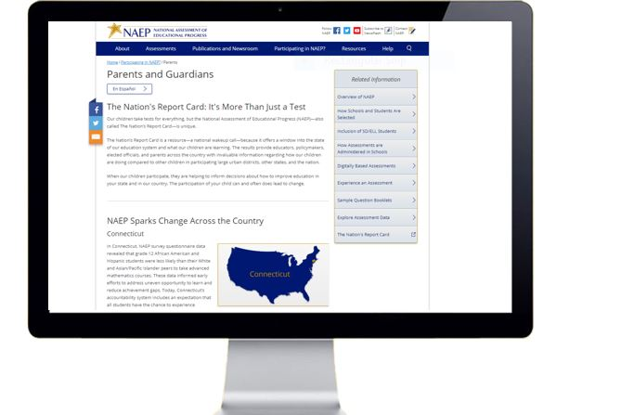
Resources for Parents: FAQs for Parents (NAEP Website)

Slide 13
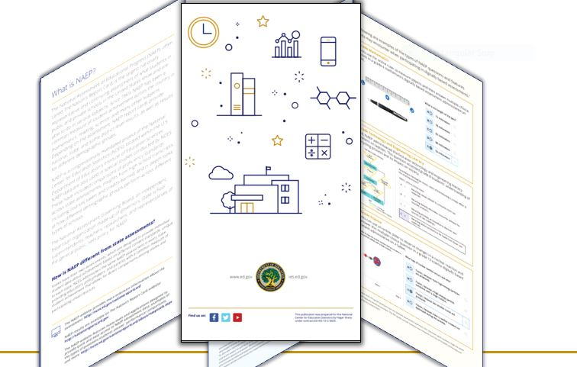
Resources for Parents: An Overview of NAEP

Slide 14
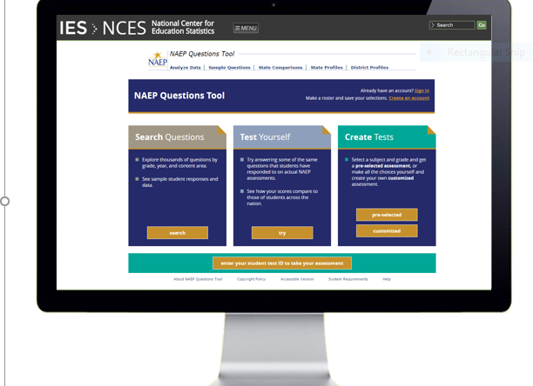
Resources for Parents: The NAEP Questions Tool

Slide 15
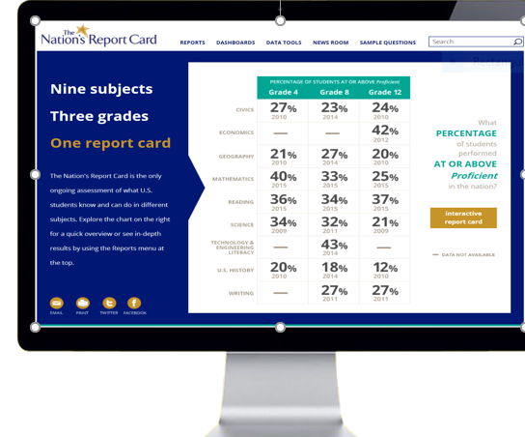
Resources for Parents: The Nation’s Report Card Website

Slide 16
Does NAEP replace the state tests that my child takes every year?

Slide 17
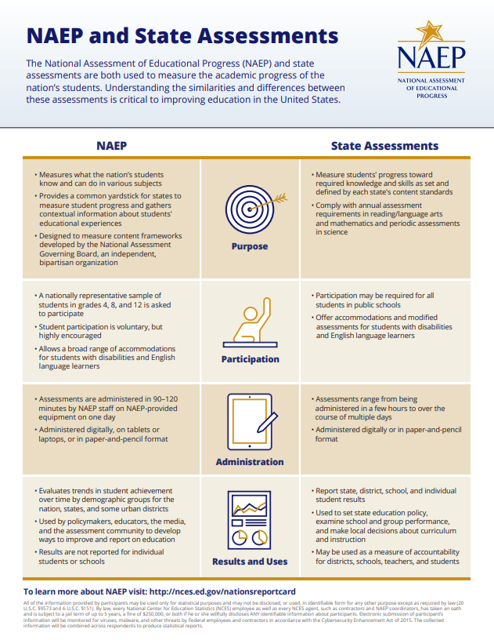
NAEP and State Assessments
No. Most state tests measure student performance using the state's own curriculum standards.
Notes:
No. Most state tests measure student performance using the state's own curriculum standards (i.e., what the state considers important for its students to know).
State tests assess almost all students in the state, provide individual student results, and enable the comparison of student results over time within the state. However, because state tests are created according to each state's individual curriculum standards, they do not allow comparisons of results with other states or the nation.

Slide 18
NAEP and State Assessments
NAEP helps states answer such questions as:
How does the performance of students in my state compare with the performance of students in states with similar resources or demographics?
How does my state's performance compare with the nation's?
Are my state's gains in student performance keeping up with the pace of improvement in other states?
Notes:
NAEP asks the same questions and is administered in the same way in every state nationwide, providing a common measure of student progress and making comparisons between states possible.

Slide 19
NAEP and State Assessments
While the two assessment types differ in substantial ways, state tests and NAEP work together to give educators and policymakers a comprehensive picture of student performance.

Slide 20
How does NAEP assess students?

Slide 21
Digitally Based Assessments
New technologies are improving NAEP’s ability to offer accommodations to increase participation and provide universal access to students of all learning environments, including students with disabilities and English language learners.

Slide 22
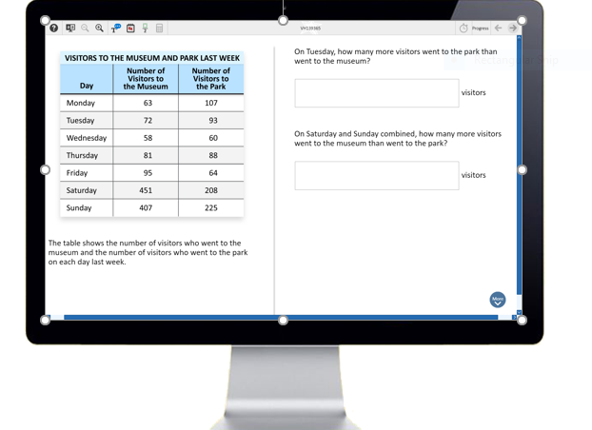
Digitally Based Assessments
Notes:
In a digital environment, what used to be an accommodation for paper-based testing becomes a seamless part of universal design, available to all students. That means that things like adjusting font size, having test questions read aloud in English (text-to-speech), using higher contrast to improve readability, and using a highlighter tool are available to all students during the assessment.

Slide 23
Digitally Based Assessments
NAEP representatives bring all the equipment to the school on assessment day.

Slide 24
Digitally Based Assessments
NAEP representatives work with the school to find the best assessment location and set up all the equipment on assessment day. Schools do not need to provide internet access.

Slide 25
Digitally Based Assessments
NAEP representatives administer the assessment to students.

Slide 26
Is NAEP coming up soon?

Slide 27
NAEP 2019 Program
NAEP assessed approximately 800,000 students in 19,000 schools across the country.
In Massachusetts, NAEP assessed approximately XX students in 387 public schools across the state.
The administration window was January 28 – March 8, 2019.

Slide 28
NAEP 2019 Program
In 2019, the NAEP assessments were administered to students throughout the nation on NAEP-provided tablets. The following grades and subjects were assessed:
Grade | Operational Subjects | Pilots and Special Studies
4 | Mathematics, Reading, Science | Pilots in Mathematics and Reading National Indian Education Study Extended Student Questionnaire Computer Access and Familiarity Study
8 | Mathematics, Reading, Science | Pilots in Mathematics and Reading National Indian Education Study Extended Student Questionnaire Computer Access and Familiarity Study
12 | Mathematics, Reading, Science | Computer Access and Familiarity Study High School Transcript Study
Notes:
Most fourth-, eighth-, and twelfth-grade students will be assessed on tablets with keyboards. A small number of students at all three grades will take paper-and-pencil versions of the science assessments and a small number of twelfth-grade students will take paper-and-pencil versions of the mathematics and reading assessments to evaluate any difference in student performance between the two types of administration.

Slide 29
If my student has been selected to participate, what will his or her day look like?

Slide 30
Assessment Day
Students selected to participate in NAEP will be directed to the testing location.
The assessment takes about 90 to 120 minutes for most students.
Notes:
The assessment also asks students questions about their daily routine and their educational experiences. For example, students are asked if there is a computer at home and about the amount of reading they do. Student responses are anonymous, and they provide context and meaning to the assessment results.

Slide 31
What does NAEP tell me about Massachusetts?

Slide 32
NAEP Results in Massachusetts
SOURCE: U.S. Department of Education, Institute of Education Sciences, National Center for Education Statistics, National Assessment of Educational Progress (NAEP) 2017 Mathematics and Reading Assessment.

Slide 33
NAEP Results in Massachusetts
SOURCE: U.S. Department of Education, Institute of Education Sciences, National Center for Education Statistics, National Assessment of Educational Progress (NAEP) 2017 Mathematics and Reading Assessment.

Slide 34
NAEP Results in Massachusetts
SOURCE: U.S. Department of Education, Institute of Education Sciences, National Center for Education Statistics, National Assessment of Educational Progress (NAEP) 2017 Mathematics and Reading Assessment.

Slide 35
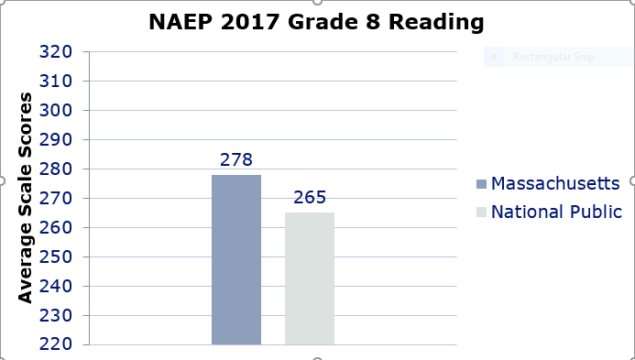
NAEP Results in Massachusetts
SOURCE: U.S. Department of Education, Institute of Education Sciences, National Center for Education Statistics, National Assessment of Educational Progress (NAEP) 2017 Mathematics and Reading Assessment.

Slide 36
Resources
What Every Parent Should Know About NAEP (Video)
http://nces.ed.gov/nationsreportcard/videos/parentvideo/
What Every Parent Should Know About NAEP (Printable Document)
https://nces.ed.gov/nationsreportcard/pdf/parents/2012469.pdf
Frequently Asked Questions for Parents (NAEP Website)
https://nces.ed.gov/nationsreportcard/parents/
An Overview of NAEP (Printable Document)
https://nces.ed.gov/nationsreportcard/subject/about/pdf/NAEP_Overview_Brochure_2018.pdf
The NAEP Questions Tool (Website)
http://nces.ed.gov/nationsreportcard/nqt/
Massachusetts NAEP Website
http://www.doe.mass.edu/mcas/natl-intl/naep/

Slide 37
Key Points, Questions, and Comments
NAEP is the gold standard of assessments.
In 2019, students are taking NAEP in mathematics, reading, and science.
Unlike state assessments, not every student will be selected to participate.
Learn more about NAEP in Massachusetts at www.doe.mass.edu/mcas/natl-intl/naep/ or www.nces.ed.gov/nationsreportcard.

Slide 38
Massachusetts NAEP State Coordinator Contact Information
Rebecca Bennett
rbennett@doe.mass.edu
781-338-3617

