Slide 1
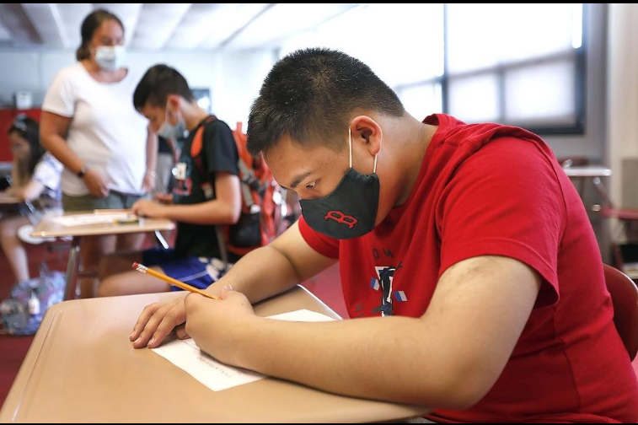
Blank
Advancing Student Learning During COVID-19
Presented to:
The Board of Elementary and Secondary Education
September 29, 2020

Slide 2
Advancing Student Learning During COVID-19
Problem
Feedback from parents that the end of the year remote learning model was not effective
Students with disabilities in danger of regression and unable to participate in the remote learning model
How could we as a district reach as many students as possible while also preparing our staff, families and students for in-person instruction during the next school year?

Slide 3
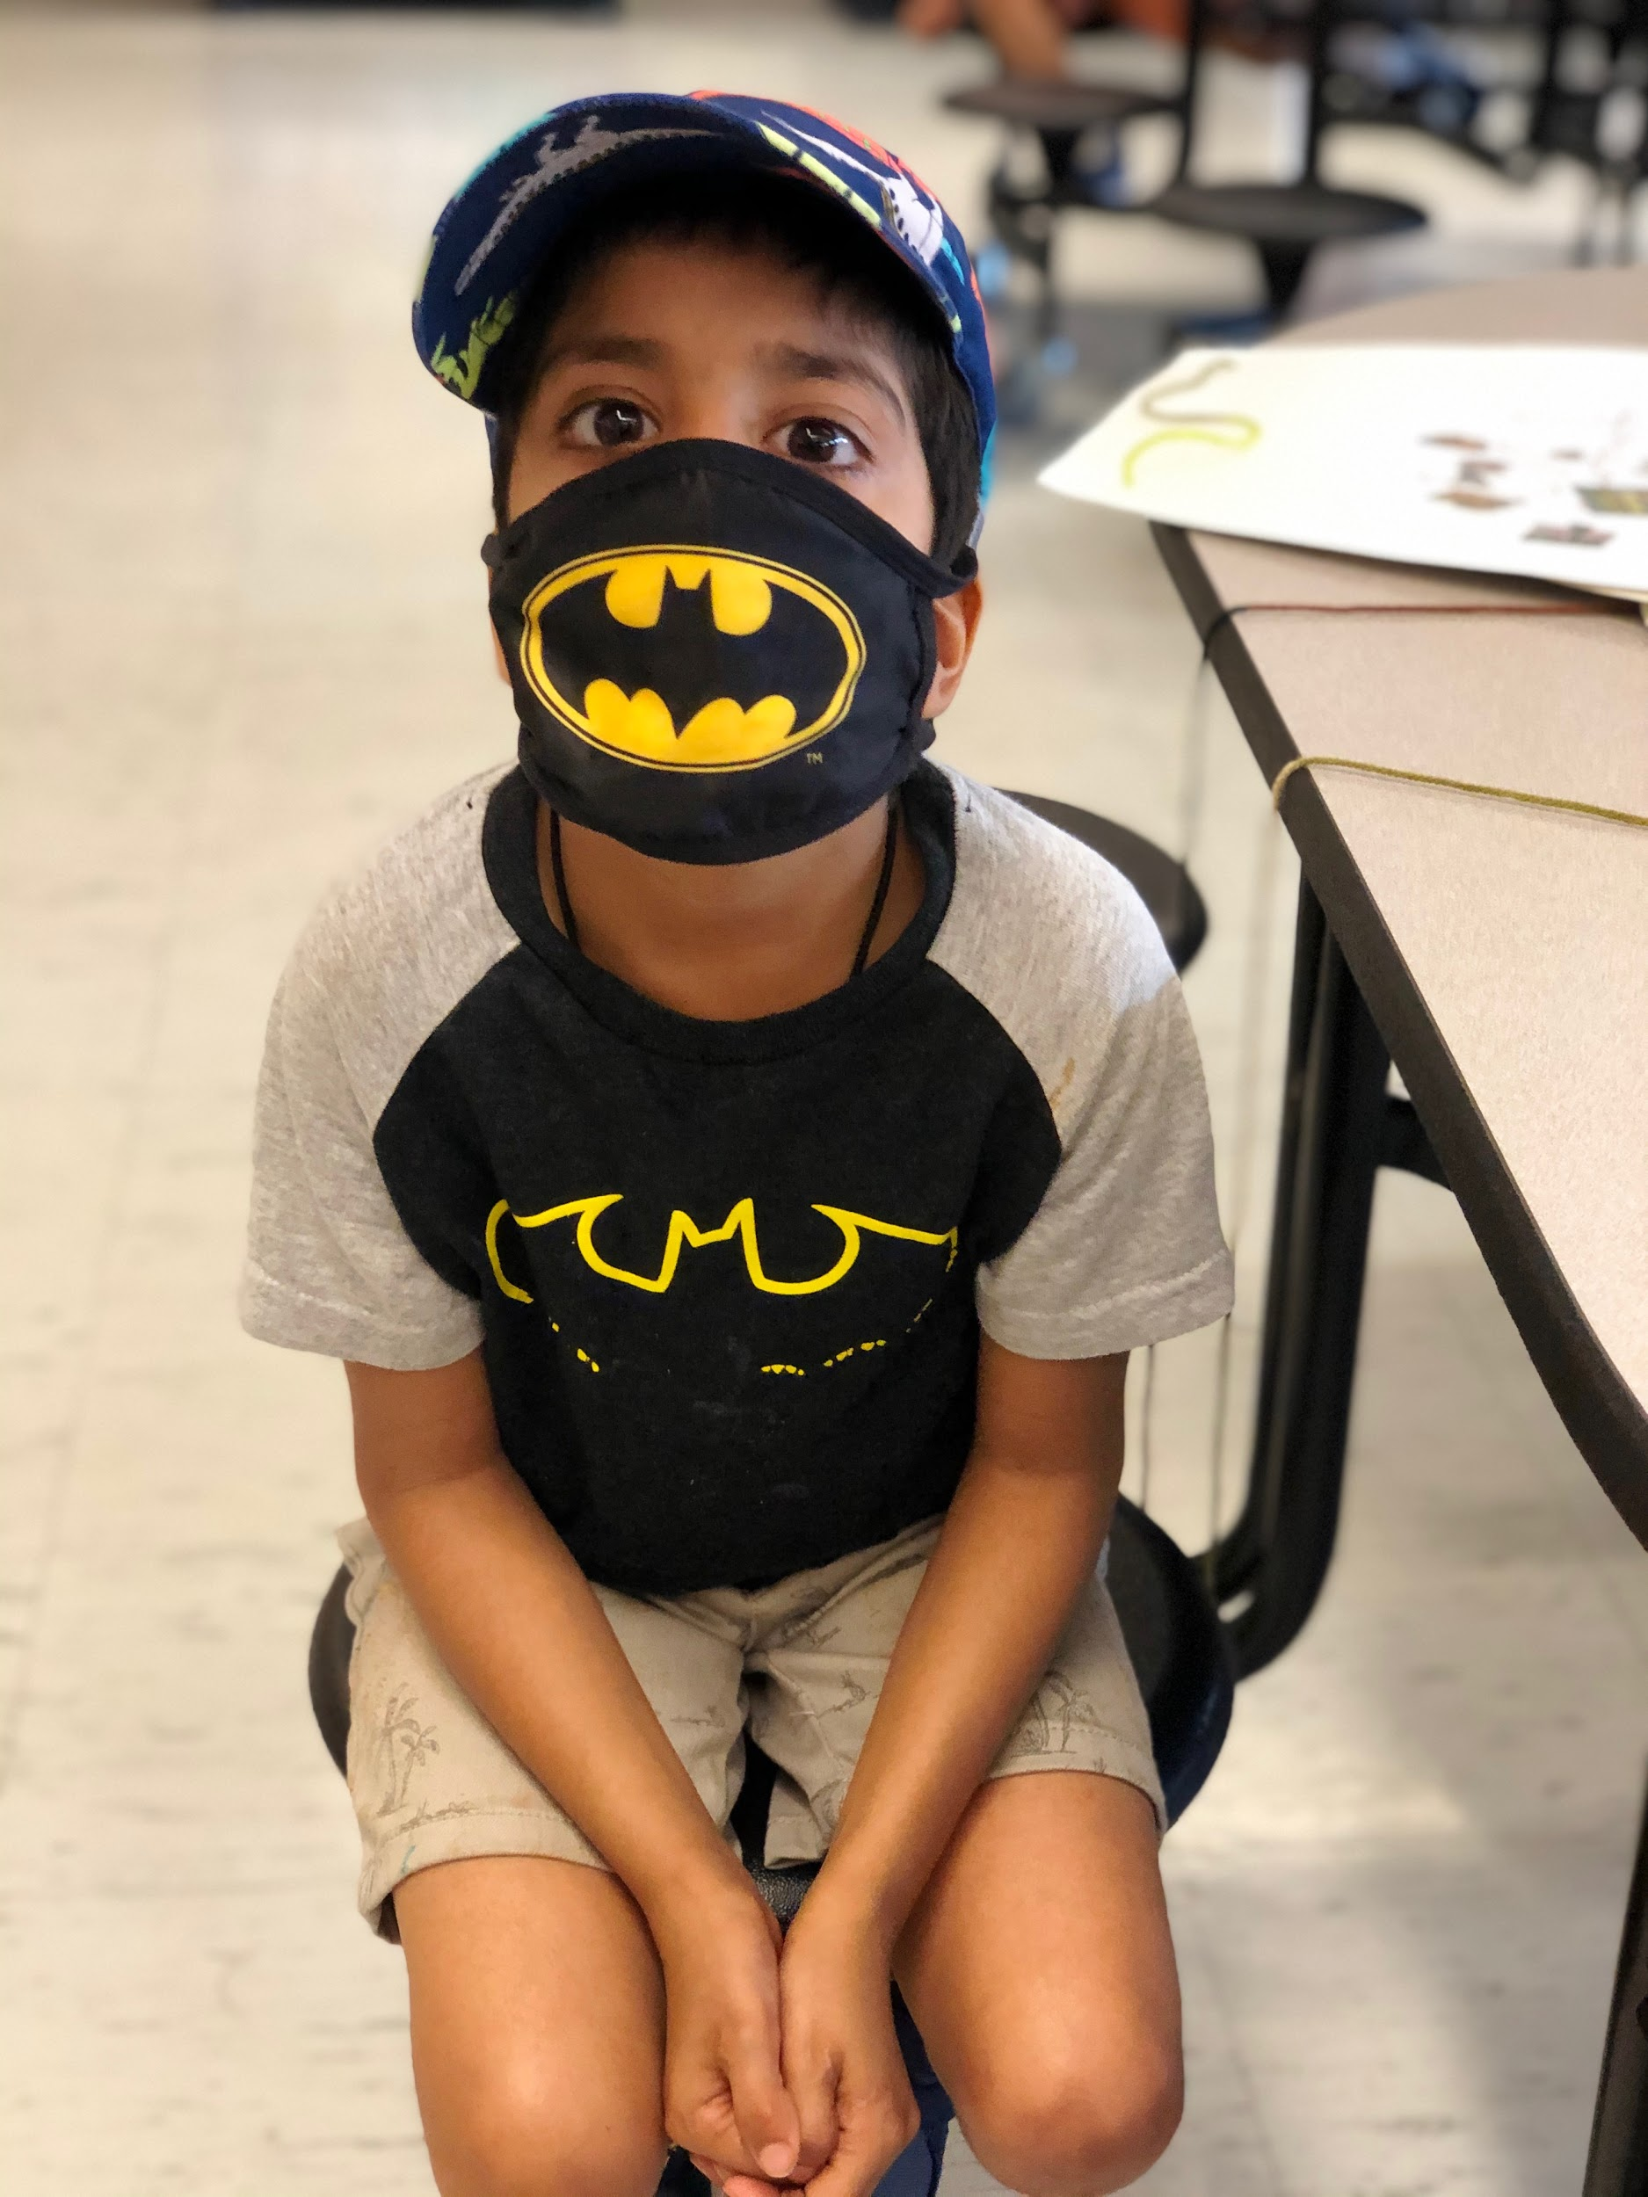
Finding Solutions …..
As a district we were committed to the following:
Creating a safe, in-person model for our most vulnerable students
Providing a remote alternative for those families that were not yet comfortable sending their children back in person
Reaching as many students district wide as possible to provide them with a high quality synchronous summer program focused on the prerequisite standards
Developing well a trained teaching staff ready to tackle the challenges of both in-person and remote learning
Superhero Day!

Slide 4
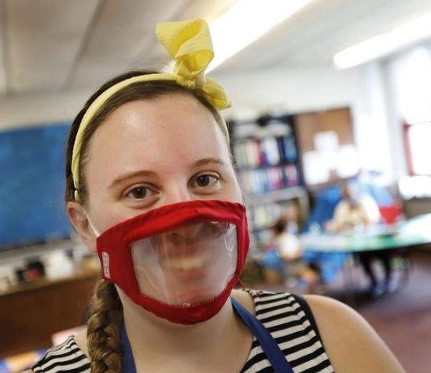
As a Result …...
Quincy provided:
An in-person summer program for 136 students with the support of 50 dedicated staff
A remote learning summer program for 2,300 students instructed by 122 staff
2,074 students started the school year with in-person instruction (hybrid or full in-person)

Slide 5
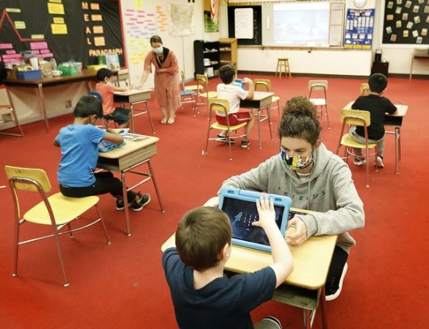
Summer In-Person Model
Targeted students in substantially separate programs
Converted high school classrooms into elementary classrooms to support our youngest learners
Kept students in small cohorts
Masks were worn by all staff and students when they could tolerate them
Rethought the way we provided transportation
Hired paraprofessionals to ride the buses with our students to assist with social distancing
A converted classroom at North Quincy High

Slide 6
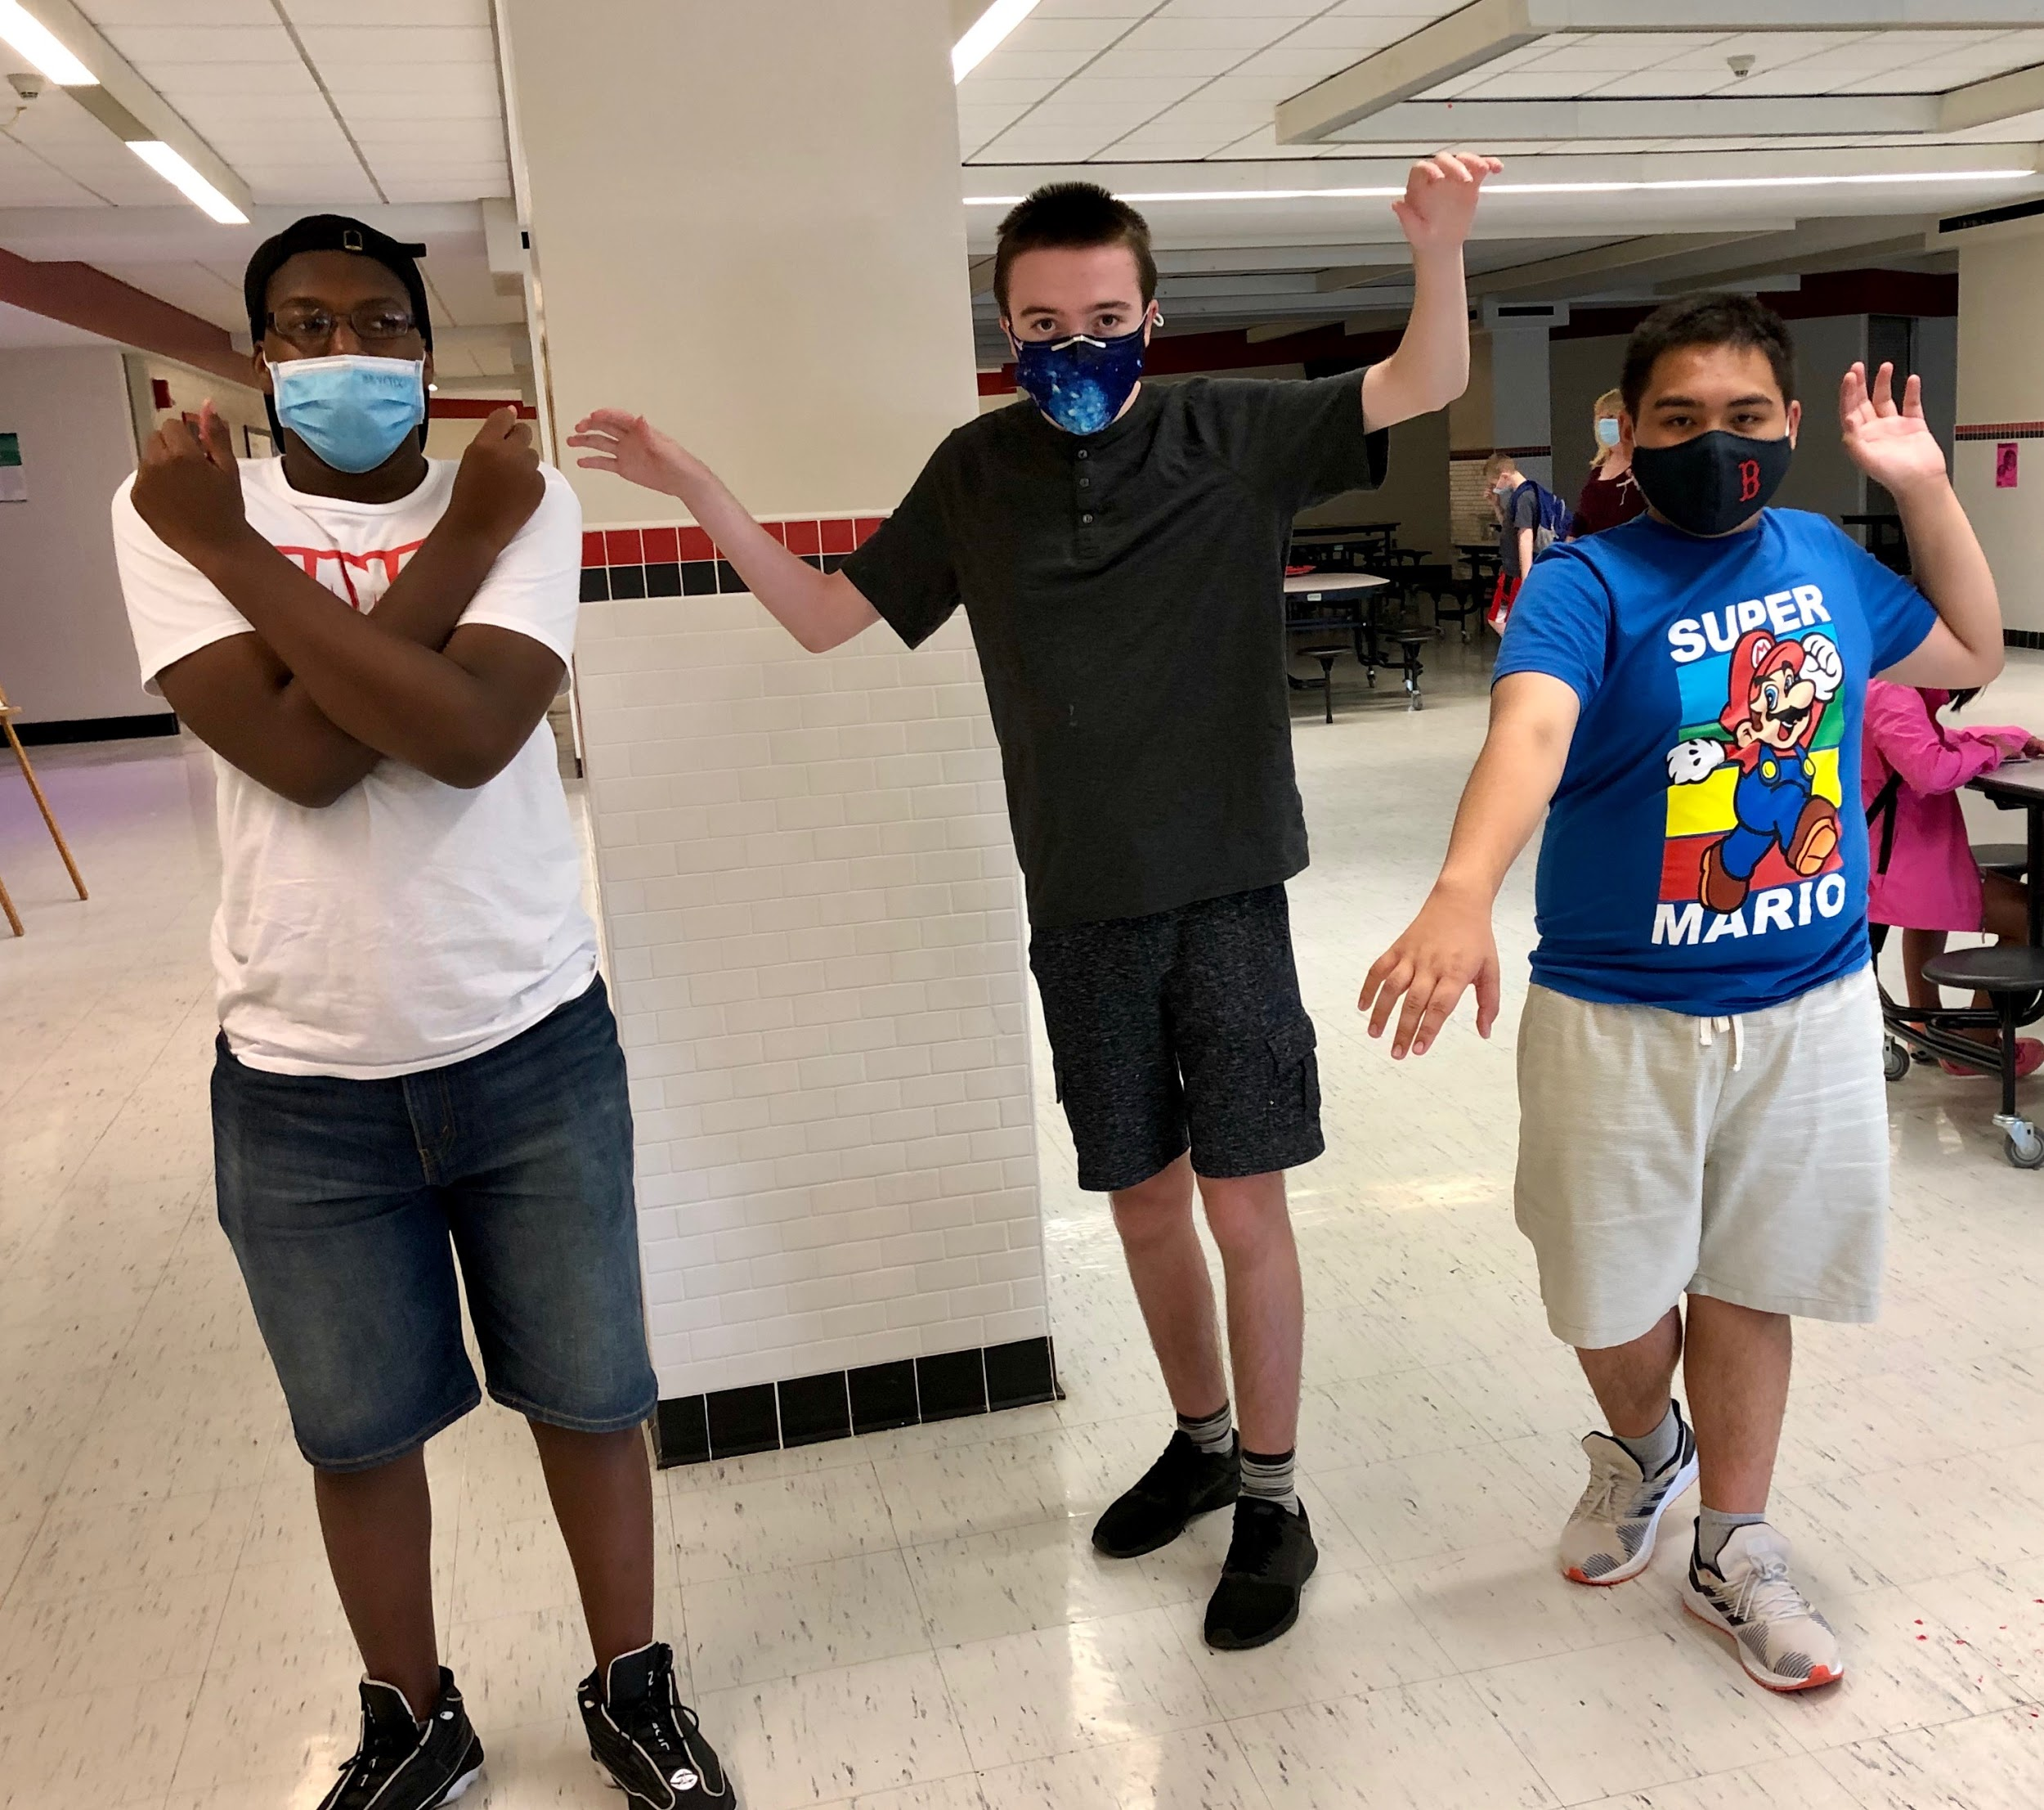
Remote Summer Programming
All instruction was synchronous, live instruction
Included weekly live lessons in gym, art and social and emotional wellness
Programs for English language learners at all levels
Advanced placement programming
Transition programs for students entering grade 6 and grade 9
SAT prep
Credit recovery

Slide 7
School Year 2020
High Needs Students
All students in substantially separate programs began school on September 16, 2020 (5 days per week)
Students receiving special education services, English language education, or who do not have access to technology began school on September 17, 2020 (4 days per week M, T, Thur, F)
Crazy Hat Day!

Slide 8
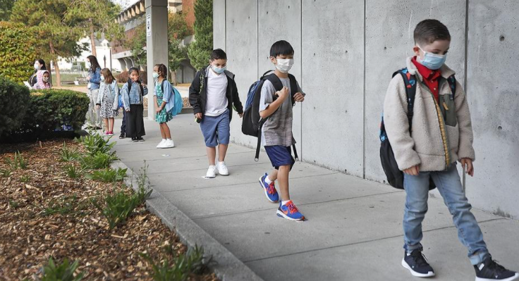
School Year 2020
Hybrid Model
Phase I
Students in pre-kindergarten through grade 3 attend school 2 days per week with the rest of the week being remote (M/T or Thur/F)
Phase II
Students in grade 4 through 12 will begin school in a cohort model on October 13, 2020
Cohort B entering class September 9, 2020

Slide 9
Funding Sources
Thanks to the generous support from Mayor Thomas Koch and the Quincy School Committee, Quincy Public Schools was able to provide a robust summer program for any student that chose to participate.
City of Quincy CARES funding
$ 426,840 spent on staffing and program development
$ 3,000,000 spent on technology for students and teachers
$ 384,425 spent on PPE

