Slide 1
MA IEP Improvement Project:
Update to the Board of Education
Presented by:
Russell Johnston, Deputy Commissioner
Jamie Camacho, Director Office of Special Education Planning and Policy Development

Slide 2
Agenda
Overview and Rationale
Referral, Evaluation, and Eligibility Guidance (REE)
Stakeholder Engagement
Improvements to the Current Form

Slide 3
Overview and Rationale

Slide 4
The IEP Improvement Project
To improve outcomes for all students with disabilities by providing guidance, technical assistance, and tools on equitable processes to school and district professionals, families, and students so that all students with disabilities have meaningful access to the curriculum frameworks and life of the school.
If students with disabilities have meaningful access to the curriculum frameworks and the skills to engage in all aspects of the life of the school, then we will begin to close the opportunity and achievement gaps between students with disabilities and their age-appropriate non-disabled peers.
Project Goal
Improve Outcomes
Meaningful Access
Theory of Change
Close Opportunity & Achievement Gaps
Notes:
On the left are the stated Project Goal and Theory of Action (see https://www.doe.mass.edu/sped/improveiep/ )
These can are summarized in the graphic on the right
Points to make:
The purpose of this project is not simply to create newer, prettier documents.
The purpose is to implement a newly reimagined process that truly focuses on OUTCOMES, ACCESS, and CLOSING GAPS.
The goal is that the IEP process is viewed as a transition document from eligibility to “graduation” (from the IEP, from HS, or at age 22).

Slide 5
MA DESE Special Education Forms
Referral, Evaluation, Eligibility Guidance
Parent’s Guide to Special Education
MA DESE Special Education Forms
Systems Improvement Playbook
IEP Process Guide
Notes:
This graphic represents the four major “products” that will be created OR updated as part of the IEP Improvement Project
NOTE: the placement of the forms in the center - - the forms are a PRODUCT of the PROCESS, not the DRIVER of the process
**Do not need to go over components just reference that they will be explained

Slide 6
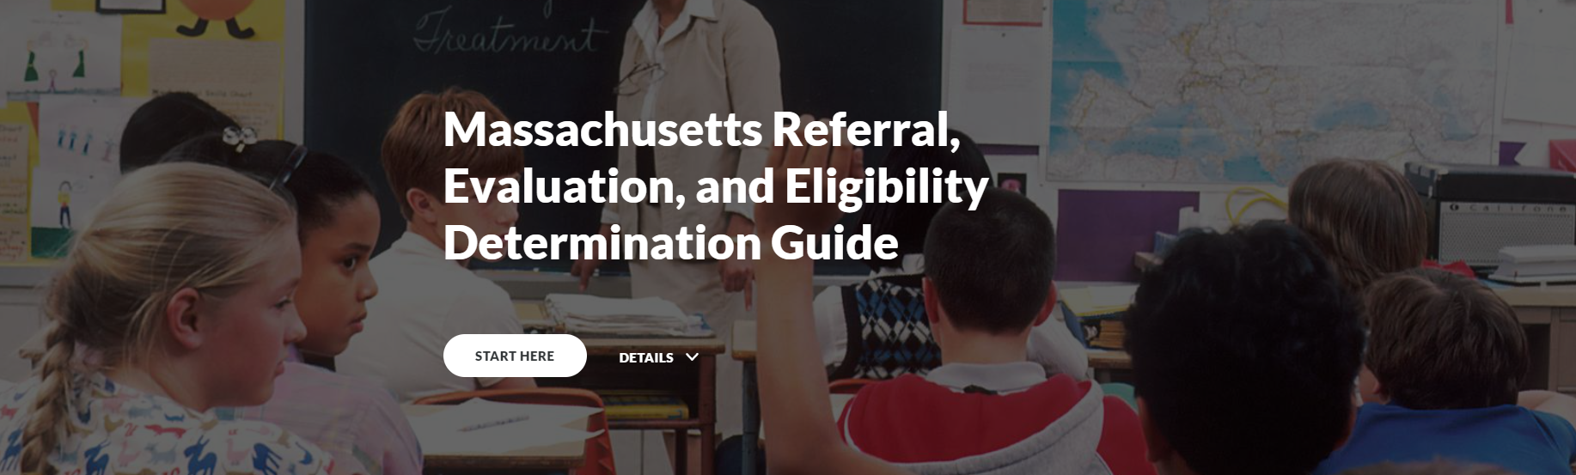
MA Referral, Evaluation, and Eligibility Determination Guide
https://www.doe.mass.edu/sped/ImproveIEP/guidance-rlo/index.html#/
Notes:
What currently exists
What is coming

Slide 7
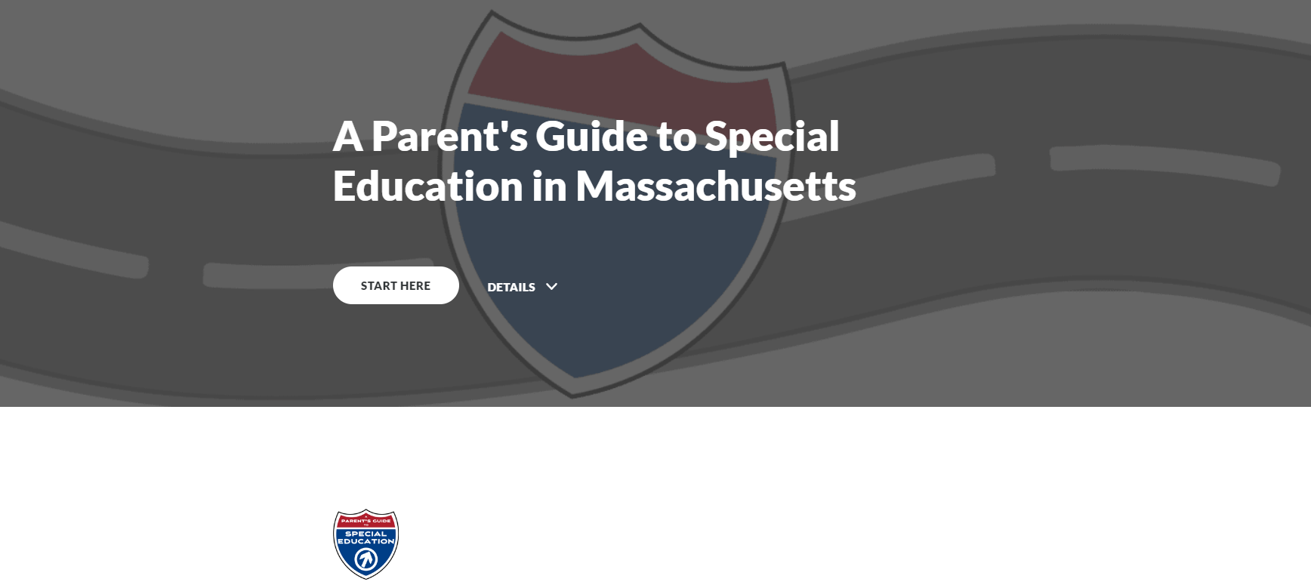
A Parent’s Guide to Special Education in MA
https://www.doe.mass.edu/sped/videos/parents-guide/index.html#/
Notes:
What currently exists
What is coming

Slide 8
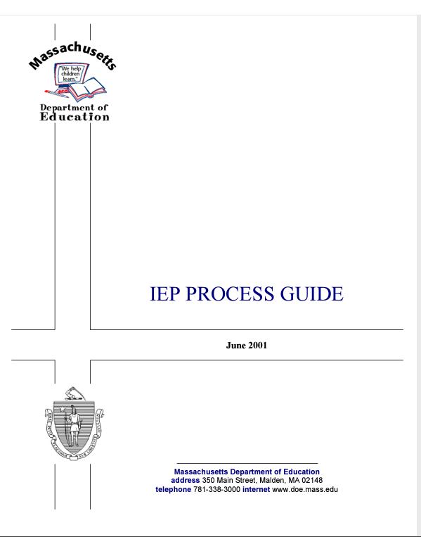
IEP Process Guide
https://www.doe.mass.edu/sped/iep/proguide.pdf
Notes:
What currently exists
What is coming

Slide 9
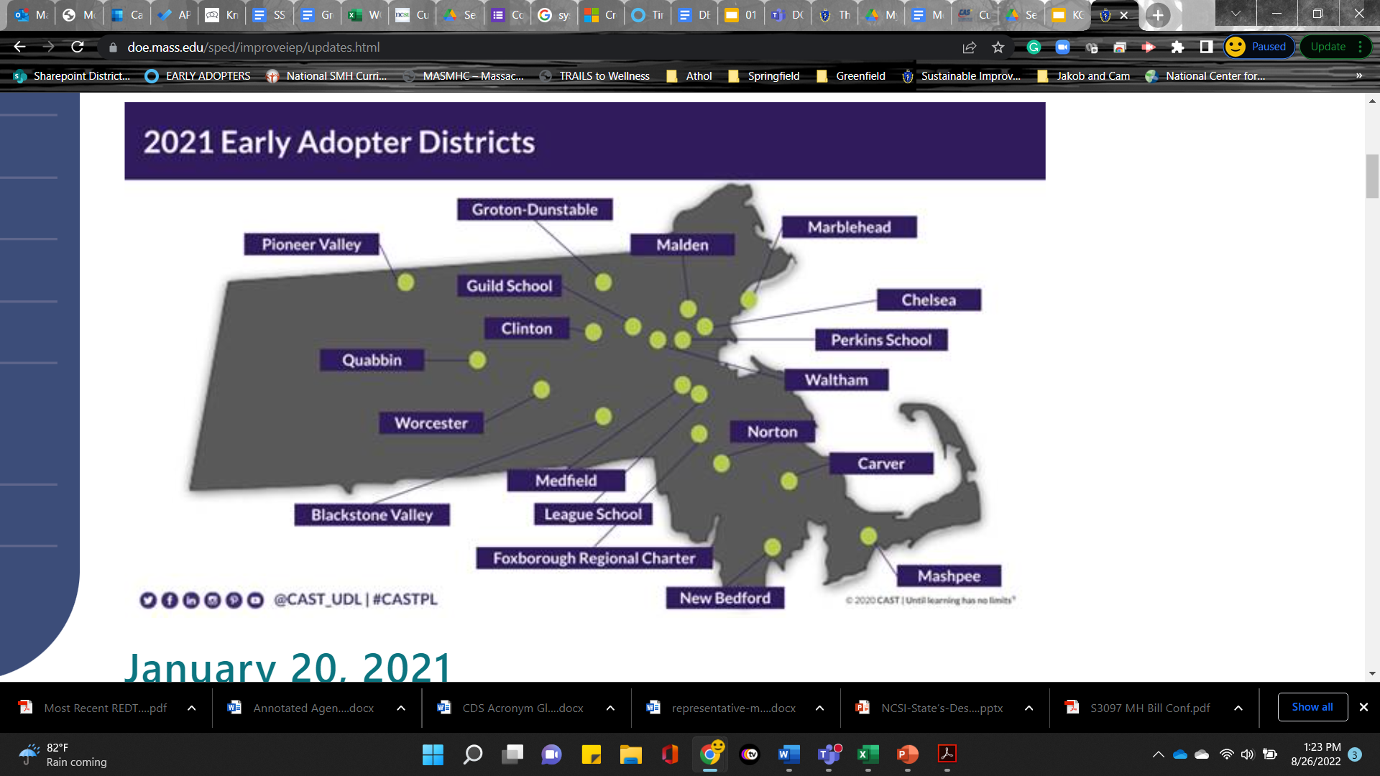
Systems Improvement Playbook:
Early Adopters
https://rise.articulate.com/share/BU7U8SgIwotbxte-6aEJ9wLLS21D-HZL#/lessons/w-MTpdQdMljwiGq95NSk34H7EuBo9s1g
Notes:
17 Schools from 12 public school districts and 3 private schools
Students were involved
The EA’s have been working on for three years to ID systemic problems of practice involving SWD and implementing a PDSA cycle of inquiry and improvement
This work will inform a future “Systems Improvement Playbook” that will help schools and districts across the Commonwealth to design more equitable, effective systems for SWD
This playbook will contain lessons they have learned and processes and practices that will help others to apply to their contexts
They were the first group of educators to pilot the DRAFT form
This work will provide the state with valuable feedback that will allow us to update the form
It’s possible that through this pilot you may come across the forms
Other schools and districts have been field testing (unofficially) some portions of the form, so you may see them as they do so

Slide 10
Stakeholder Engagement

Slide 11
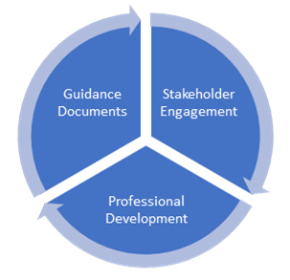
Engaging Stakeholders
How have we worked to ensure representation in the development of documents and guidance?
Notes:
Each portion of the project has been or are currently being created, vetted, and/or updated by multiple groups of stakeholders
As you can see in the graphic above, stakeholder engagement is one of the key drivers of this project

Slide 12
Initial Stakeholder Feedback
Purpose:
Gather initial feedback to guide the revision of guidance documents and the IEP forms. Provide detailed feedback regarding referral, evaluation, and eligibility. Inform planning for additional stakeholder engagement and outreach.
Process:
  Fourteen-Month Stakeholder Process
  Two Cohorts of Stakeholders
    Non-School Based Stakeholders (89)
    School-Based Stakeholders (141)
  Meetings
    3 Orientation Meetings
    12 Feedback Meetings
    All Meetings included 70-90+ People
Notes:
Student involvement
Extensive process of vetting and stakeholder feedback led by EDCO
Fourteen-month period of stakeholder engagement (2020) EDCO Collaborative convened approximately 300 stakeholders
parents, teachers, administrators, related service providers, advocates, students, and other interested individuals

Slide 13




Students and Families Coalition
Students and Families First Coalition: Providing Training, Oversight, and Guidance to “Early Adopters” and DESE
Notes:
Implementation science (outcomes), students and families, research to practice, and equity focus
The playbook is being created by a group of organizations (Students and Families First Coalition) and teams of school-based staff (Early Adopters).
SFFC was formed in 2020 to lead the work of 30+ school-based teams in making structural improvements to their special education and IEP processes while piloting and implementing new guidance and forms from the MA Department of Elementary and Secondary Education
This is a multi-year process that engages these schools in a PDSA cycle around the IEP process. Lessons learned will be documented in a playbook for districts/schools for rebuilding systems
The EA’s have been working on for three years to ID systemic problems of practice involving SWD and implementing a PDSA cycle of inquiry and improvement
This work will inform a future “Systems Improvement Playbook” that will help schools and districts across the Commonwealth to design more equitable, effective systems for SWD
This playbook will contain lessons they have learned and processes and practices that will help others to apply to their contexts
ALSO, this fall they will be the first group of educators to pilot the DRAFT form
This work will provide the state with valuable feedback that will allow us to update the form
It’s possible that through this pilot you may come across the forms
Other schools and districts have been field testing (unofficially) some portions of the form, so you may see them as they do so

Slide 14
Public Survey
Posted to website June-August 2022
339 responses
Reviewed and synthesized responses to inform further drafts of IEP documents
Notes:
Which aspects of the IEP appear to be improved with this new version?
Is there anything that is potentially missing from the draft IEP?
Do you have any suggestions for improving the draft IEP?
What feedback do you have on the format of the draft IEP, including overall length and the language we used? What, if anything, can we do to improve the format?
What feedback do you have on the extent to which we attempt to engage students and families/caregivers in the IEP process? What, if anything, can we do to improve the inclusion of student and family/caregiver voice?
What feedback do you have on the way in which transition planning is built into this new form? What, if anything, can we do to improve transition planning in this new IEP?
What feedback do you have on the way in which data is included in the development of the IEP using this form? What, if anything, can we do to improve the use of data in the IEP?
What feedback do you have on the draft IEPs focus on LRE? What, if anything, can we do to improve the focus on LRE?

Slide 15
Stakeholder Feedback Sessions
Parent groups and organizations
Educator organizations
Administrator organizations
Advocacy organizations
DESE internal feedback session
Special education leadership meetings
Notes:
1. initial draft form
2. Early Adopter Version
Communication, Concerns, Vision
Present Levels, Community Planning, Transition Planning
Special Factors, Accommodations, Specially Designed Instruction
Schedule Modifications and Transportation
Focus on historically marginalized schools/districts, students, families (SEPAC)
Parent Orgs:
Educator Orgs:
Admin Orgs:
Advocacy Orgs:
DESE Internal Offices:
Special Ed Leadership Meeting Updates

Slide 16
Improvements to Current Form

Slide 17

IEP Improvement Process Timeline
Winter 2023
Spring 2023
SY 23-24
Fall 2023
Fall 2024
Finalize Forms and Tech Specs
Initial Training for Schools and Districts
Continued Training and Technical Assistance
Initial Adoption (at discretion of schools and districts)
Full Adoption Statewide
Notes:
As you can see, the FORM will be finalized AFTER the work is completed with the EA’s on the pilot
Their feedback, along with the feedback gathered from thousands of stakeholders will help to update the forms
We anticipate the final form to be completed in the Winter of this year
We are currently working on the possibility of getting a vendor to develop professional development resources, modules, and training to begin in late winter 2023 and go through implementation
As it stands now, full implementation across the state is expected to happen during the 2023-2024 school year
Districts will have flexibility to begin implementing, so it is safe to say that you will have some districts using the OLD forms and some using the NEW forms as they begin to transition
The best thing you can do is be prepared, which is why we have been working on mini-training sessions such as this

Slide 18
Areas of Focus For Improved IEP Form
Family and student voice
Form documents process
Least Restrictive Environment
Integrated transition planning
Accessibility of language
Notes:
The forms need to reflect the “new” process that we will expect schools and districts to implement
Student and family voice front and center in the IEP process
Transition planning will be a driver of the IEP process
Lastly, we intend to simplify the forms so that they are user-friendly for all Team participants

Slide 19
Vision Statement

Slide 20
Transition Planning Form (TPF)

Slide 21
Present Levels of Educational Performance

Slide 22
Nonparticipation Justification

Slide 23
Schedule Modification

Slide 24
Parent Options/Respomse

Slide 25
Q&A

