Slide 1
Elementary ELA Curriculum
November, 2023
Notes:
listen for connection between listening and learning themes, SP and DIP, state evaluation systems

Slide 2
Desired Outcome
Desired Outcome
Select an elementary ELA curriculum that supports the evidence-based teaching of English Language Arts standards in grades K-6 for implementation in SY24
Notes:
Magdalena

Slide 3
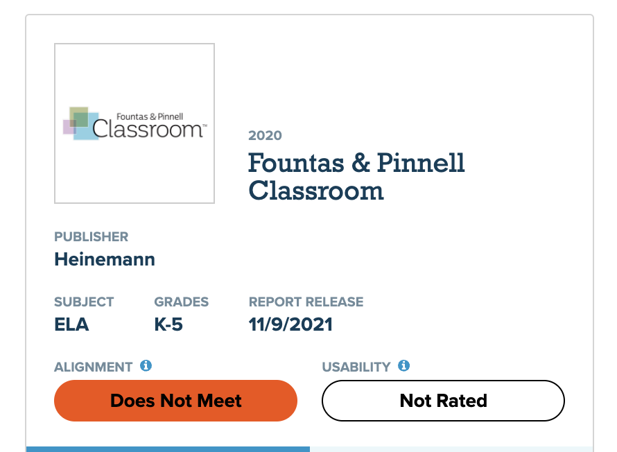
Urgency for New ELA Curriculum Program
WPS teacher feedback survey in May 2022 about current curricular materials indicated gaps with current curriculum (i.e., Fountas & Pinnell Classroom)
Current curriculum “Does Not Meet Expectations” on EdReports
MCAS ELA performance reflects low performance in 2021 and 2022; not recovering since COVID
Notes:
Magdalena
Initial F&P adoption was in 2019 - prior to EdReports review

Slide 4
Initial Program Overview
All elementary staff were invited to an open review of the following programs that “Meet Expectations” on EdReports.
American Reading Company Core Knowledge Language Arts EL Education Into Reading myView Wit & Wisdom Wonders
Notes:
Magdalena
Pilot considerations:
Scope
Materials
Training
Evaluation

Slide 5
Initial Program Overview - Pilot Program Selection
Staff were asked to give feedback on the following criteria:
Curriculum alignment
Systematic and explicit phonics instruction
Content skills and understanding
Universal Design for Learning
Multilingual supports strategically embedded
Special Education supports and scaffolds
Culturally Responsive Pedagogy
Quality of formative and summative assessments
Programs selected for piloting
Core Knowledge Language Arts (CKLA) Wit & Wisdom
Notes:
Magdalena
Pilot considerations:
Scope
Materials
Training
Evaluation

Slide 6
Elements of CKLA from Amplify
Aligns to standards and research-based practices for foundational skills instruction with a synthetic approach to phonics and a clear and an explicit and systematic instructional sequence in K-2
Included texts are rich and rigorous, offering a balance of informational and literary reading over the course of the school year
Texts are organized to support students' building knowledge of different topics, and sets of text-dependent questions and tasks provide opportunities for students to analyze ideas and grow their vocabulary
Writing instruction is integrated, consistent ,and organized to support students’ development of different types of writing
Offers resources and tools to collect ongoing data about student progress
Provides teachers with strategies for meeting the needs of a range of learners
Supports effective use of technology to enhance learning
Notes:
Amanda

Slide 7
Elementary ELA Pilot Structure
All elementary schools were given the opportunity to request to pilot one of the programs in grades K, 2, 4
Selected schools received grade level materials and targeted training
Ongoing supports from OCPL were provided for piloting teachers and coaches
Data collection from teachers and principals - biweekly survey; classroom visits; feedback sessions for final recommendations used for evaluation of the programs
Notes:
Marco

Slide 8
Implementation Plan
Implementation PLAN
Year 1
Initial Training and Implementation
Year 2
Ongoing Supports & Continued Professional Learning
Year 3
Enhanced Instruction & Implementation
Notes:
Amanda & Magdalena
Shift from Balanced Literacy Model to a Science of Reading Informed Lens
Implementation Plan
Adoption
Launch
Ongoing support for teachers
Leadership

Slide 9
Year 1 – How is it going?
Year 1- How is it going?
district pacing guides developed by teacher-led curriculum teams
integration with student information system
core Amplify programs (CKLA or ELA) implemented in PreK-6 classrooms
BOY DIBELS/mCLASS assessments administered to all K-6 students
targeted, skill-focused RTI block implemented with regular progress monitoring for students performing below grade-level on BOY assessments
ongoing professional learning opportunities for teachers and administrators
ongoing review of data and reports on the mCLASS platform
continued coaching cycle in classrooms
preparing curriculum teams to review materials with culturally responsive rubric
ongoing implementation check-in with Amplify

Slide 10
Thank you
Thank You

