Slide 1
CVTE / Perkins V – Data Webinars
Welcome & Introductions
In the chat, please let us know –
  Your Name & Role
Webinars –
  Using new Perkins Reports – part 1 9/23
  Data Collection 9/30
  Using new Perkins Reports – part 2 10/7

Slide 2
Using new Perkins Reports – Part 2: Indicators
Basics about Indicators
Where to find CVTE Reports & other Indicator trends
How to use these
Q&A
For more:
http://www.doe.mass.edu/ccte/cvte/data/
Using DESE's CVTE Data Resources
Using Performance Outcomes to Improve CVTE Programming for Students
https://gateway.edu.state.ma.us/
Security Portal

Slide 3
Chat:
Do you have a ‘burning question’ which might be answered with Indicator data?

Slide 4
Why?
There are reporting, performance, accountability and monitoring requirements associated with Perkins.
Notes:
Districts, collaboratives and institutions progress toward implementation of equal access to high-quality career and technical education courses and programs of study for all students.
Districts and institutions are required to disaggregate data for each of the indicators of performance for the subpopulations of interest and identify and quantify any disparities or gaps in performance.

Slide 5


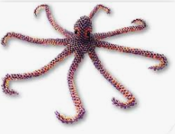



Enrollment is like … an octopus?
Preparing Students for Careers & College
Program Development
Enrollment
Access to Programs
Disaggregate by Race, Gender, other populations*
SIMS

Slide 6
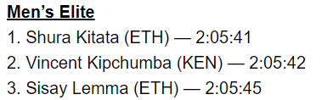
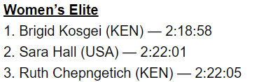
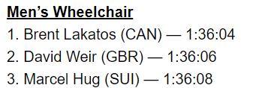
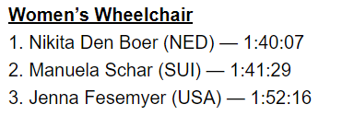
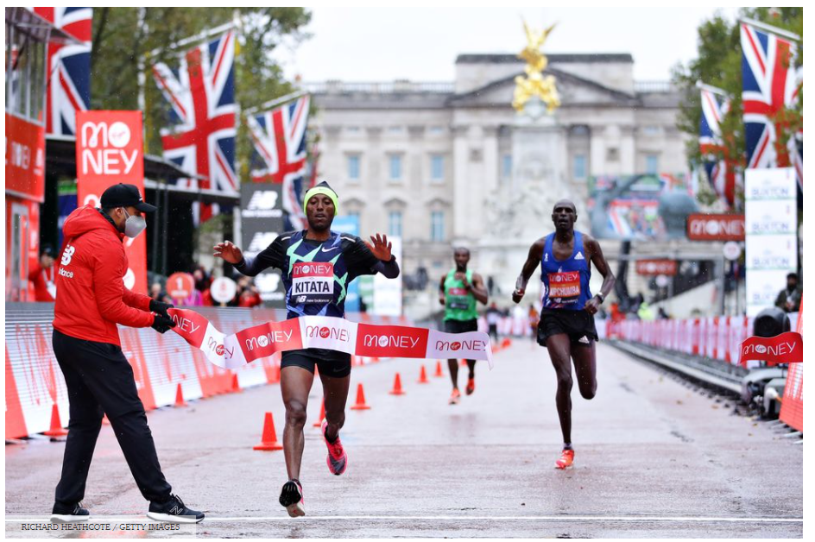
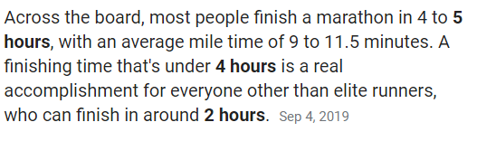
Indicators are like … race times?
Notes:
Run own race

Slide 7
Here’s where this can take us –
“How can we support more _____ students to succeed in _______?”
“How can we strengthen _____ students in _______?”

Slide 8
Core Indicators of Performance
This is the accountability system for federally funded Perkins programs.
Secondary Core Indicator | NOTES
1S1: Four-Year Graduation Rate | Like Perkin IV 4S1
2S1: Academic Attainment in ELA | 11th grade concentrators and their 10th grade MCAS (next gen)
2S2: Academic Attainment in Mathematics | 11th grade concentrators and their 10th grade MCAS (next gen)
2S3: Academic Attainment in Science | 11th grade concentrators and their HS SCI MCAS (incorporate next gen as available)
3S1: Postsecondary Placement | timing of survey & reporting to DESE moves in changes to outcome categories
4S1: Nontraditional Program Enrollment | Similar to Perkins IV 6S1 and 6S2
5S3: Program Quality – Participated in Work-Based Learning | NEW
Perkins Core Indicators & Targets

Slide 9
How Secondary Core Indicators are Calculated
1S1 Four-year grad rate
# of concentrators in grad cohort who graduated
# of concentrators in grad cohort
2S1 ELA
Meet/Exceed in 10th grade ELA MCAS
# of concentrators
2S1 Math
Meet/Exceed in 10th grade Math MCAS
# of concentrators
2S3 Science
Prof/Adv in Sci and Tech/Eng MCAS by end of 10th grade
# of concentrators
#
#
3S1 Postsecondary Placement
# of concentrators who graduated & positively placed
# of concentrators who graduated
4S1 Nontraditional Enrollment
# of concentrators in a program nontraditional for their gender
# of concentrators in nontraditional programs
5S3 Program Quality: WBL
# of concentrators who graduated & participated in WBL
# of concentrators who graduated
Notes:
Conc - 2 consecutive
[1S1 - 2 out of 3 years; grad cohort calc]

Slide 10
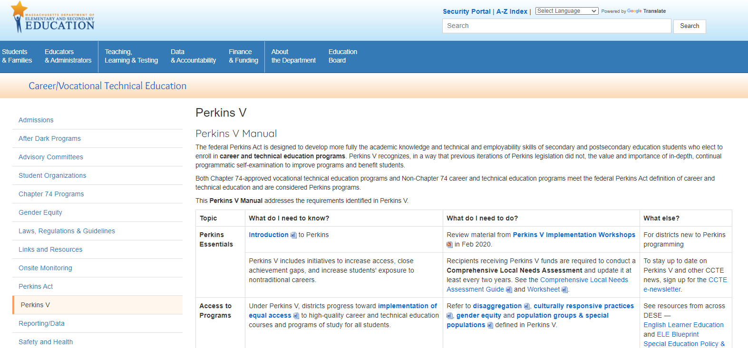
Find the Security Portal from any DESE web page.

Slide 11
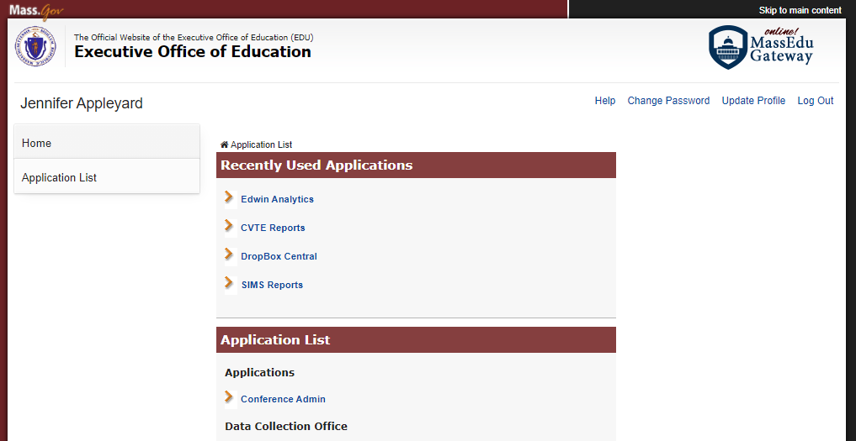
Once there, find CVTE Reports.

Slide 12
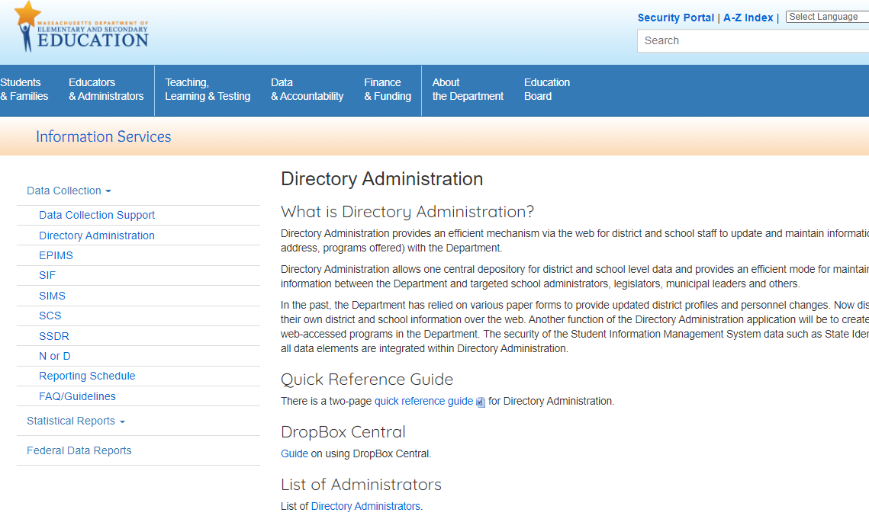
Don’t have access? Check with the DA for your district.
http://www.doe.mass.edu/infoservices/data/diradmin/

Slide 13
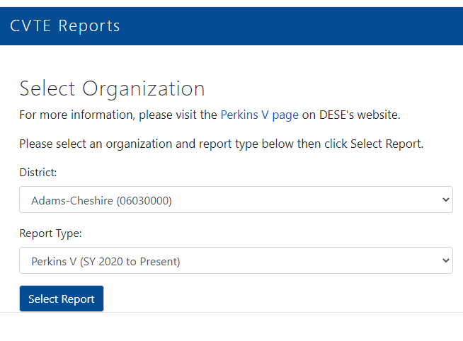
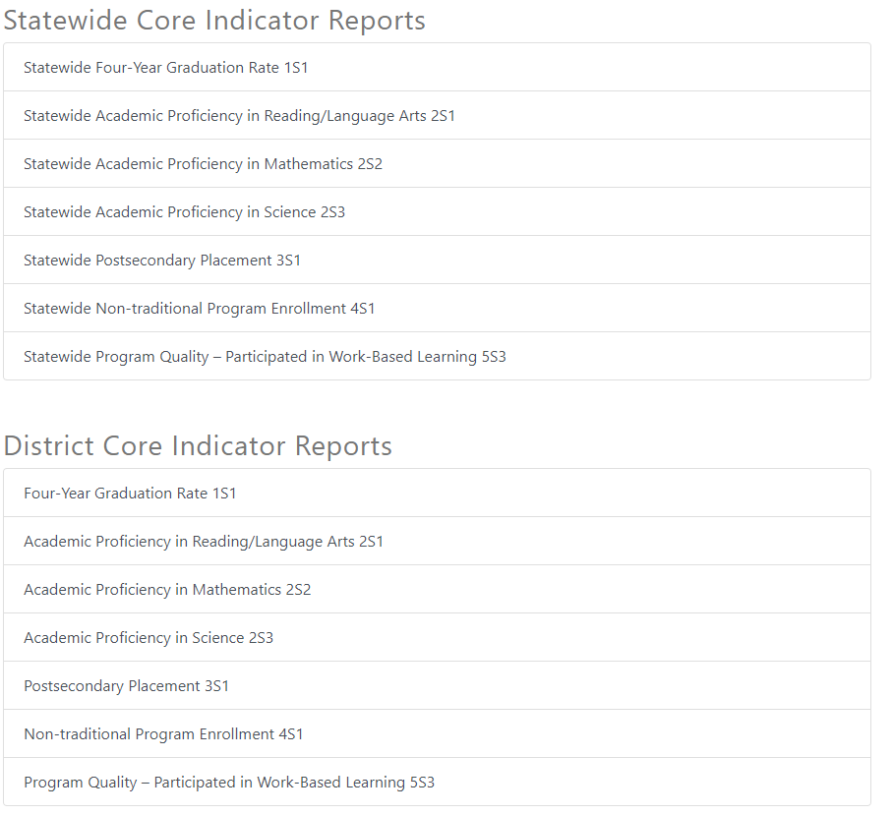
Once in CVTE Reports, use the menus to select specifics.

Slide 14
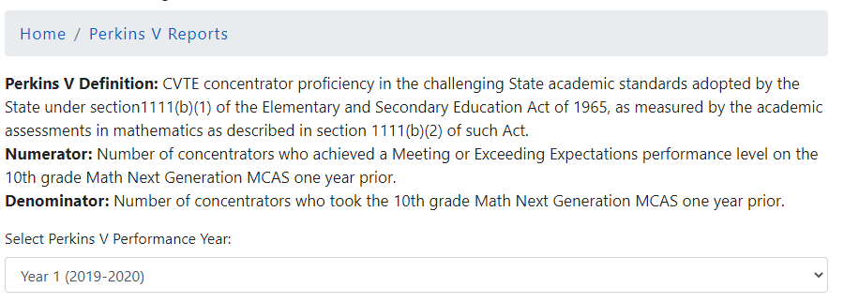
Select an indicator and see the definition –

Slide 15
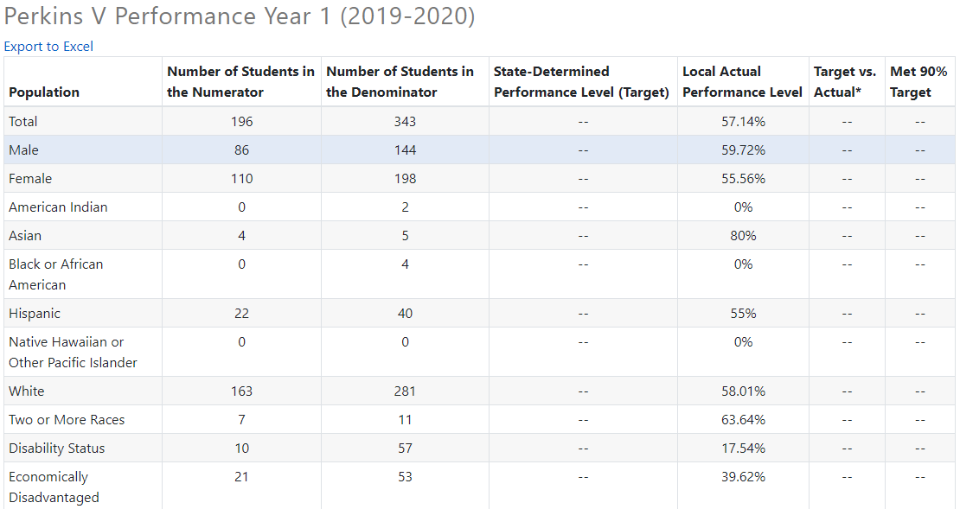
Examine the Indicator overall & by population –
10%
Notes:
See the performace level vs target
Doesn’t tell WHY – just WHAT

Slide 16
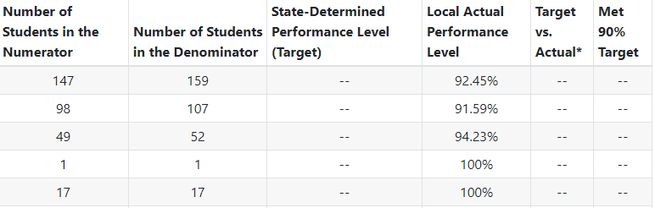
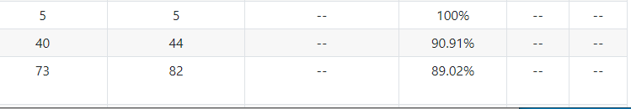
Examine the Enrollment overall & by program
Gaps
Notes:
If none 10%, look at largest delta
(or largest ones where not meeting in the past)
AND: for groups with small #s of students – not specifically a concern in terms of INDICATOR, but is in terms of ENROLLMENT
consider in ENROLLMENT analysis –

Slide 17
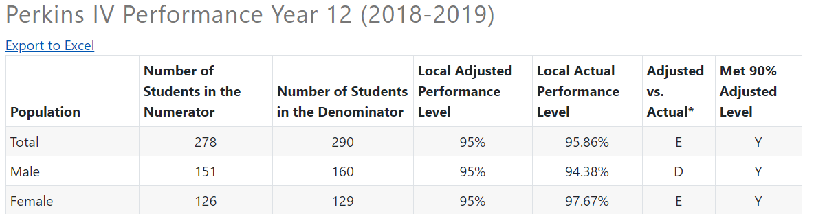
Examine the Indicator overall & by population –
Actual & Perf Level
Notes:
See the performance level vs actual
Doesn’t tell WHY – just WHAT

Slide 18
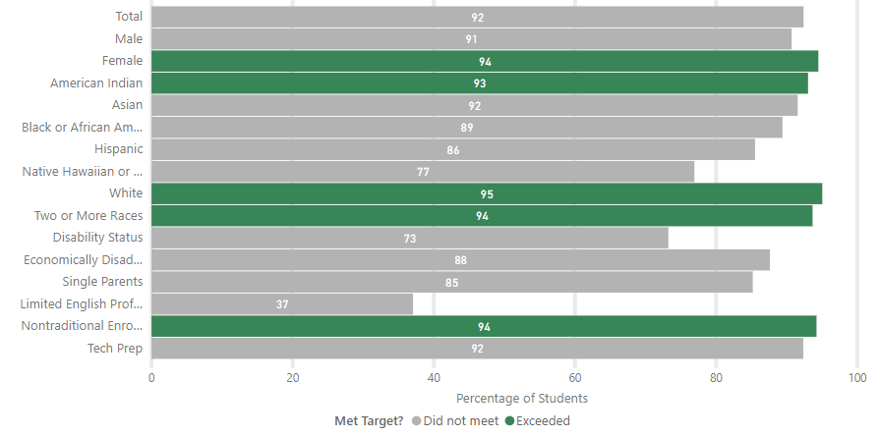
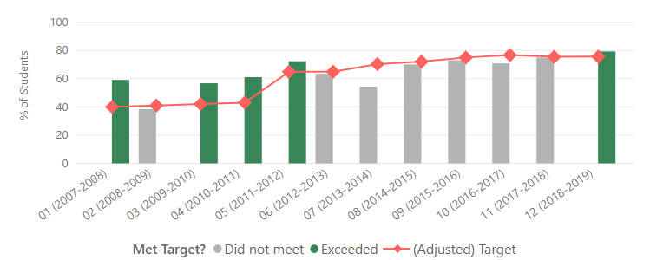
Indicators visuals –
Notes:
https://app.powerbigov.us/view?r=eyJrIjoiN2YwN2EzMWEtZmFhNy00MWU5LWJiZTAtNWU0YWNhM2ZjZjRkIiwidCI6IjNlODYxZDE2LTQ4YjctNGEwZS05ODA2LThjMDRkODFiN2IyYSJ9

Slide 19
Perkins in 2020
Winter 2020: Core Indicators for Perkins V Transition Year will be calculated (to submit to feds via 2020 CAR).
Winter
Performance on Core indicators Released
(Dec – CAR complete)
[ASSESS PROGRESS]
Spring
Comprehensive Local Needs Assessment
[REFLECTION]
Summer
Application
(Sept)
[ACTION]
Fall
Performance Levels
(Oct LEA propose, Nov DESE accept/not accept)
[TARGET-SETTING]
[Start here]
Spring 2020: Districts/institutions/collaboratives complete CLNAs. CLNA informs the Perkins Grant Application.
CLNA does not need to be submitted, but rather kept on file at each site, for review during Monitoring and for strategic development.
Fall 2020: Districts/institutions/collaboratives may propose Locally Determined Performance Levels (LDPLs) for Perkins V Year 1-4 (2021-2024 CAR). If accepted, they will be used for subsequent years.
See Perkins V website for more.
CCTE reviews and accepts/does not accept institution’s proposed LDPLs.
Due in OCT (optional).
Summer 2020: Districts/institutions/collaboratives work on the FY21 Application. This draws on the CLNA. May also propose Performance Levels.
Calendar Year

Slide 20
Locally Determined Performance Levels
Perkins Core Indicators have changed from Perkins IV to Perkins V. Please review the indicator definitions on the Perkins V website.
Refer to district's historical data for learning and to establish expectations for changes in the future.
Each Core Indicator has a single Performance Level for all students; separate Performance Levels for population groups are not allowed.
Performance Levels shall require the eligible recipient to continually make meaningful progress toward improving the performance of all CTE concentrators, including subgroups of students and special populations.
If a district meets the State Determined Performance Level for a core indicator, the state will not accept a lower Locally Determined Performance Level for the subsequent year.
If a district has not met the State Determined Performance Level in the past, the district may want to propose an alternative.
The state submits a Consolidated Annual Report (CAR) annually to US ED in which local information is consolidated for a statewide view. State Determined Performance Levels have been accepted by US ED.

Slide 21
1S1 Example
For 1S1, the SDPL is 94.68.
Considerations:
Check the SDPL
Compare that to historical data, for TOTAL students and populations
Consider changes due to –
  the indicator
  the CLNA and local plans
  other impacts
Year | Actual Performance [EXAMPLE 1] | Actual Performance [EXAMPLE 2] | Actual Performance [EXAMPLE 3]
2018-19 | 85 | 92 | 100
2017-18 | 85 | 93 | 99
2016-17 | 84 | 91 | 99
2015-16 | 85 | 89 | 99
2014-15 | 84 | 90 | 99
2013-14 | 83 | 90 | 99
2012-13 | 84 | 89 | 98
2011-12 | 83 | 89 | 97

Slide 22
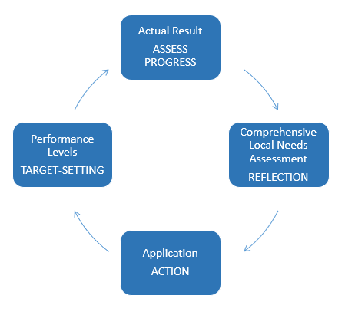
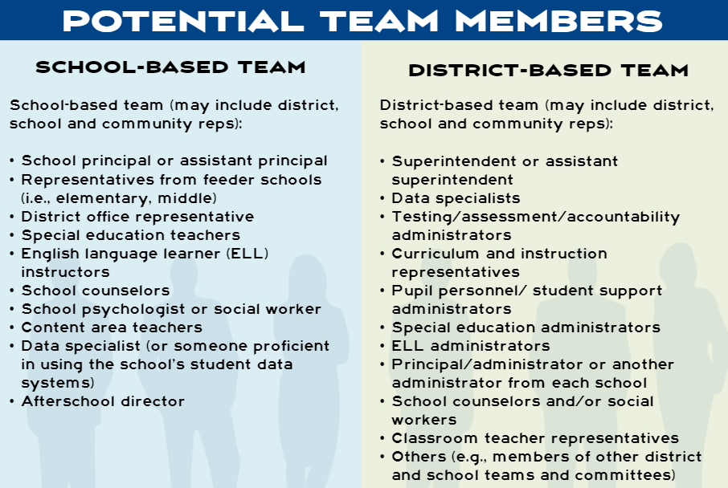
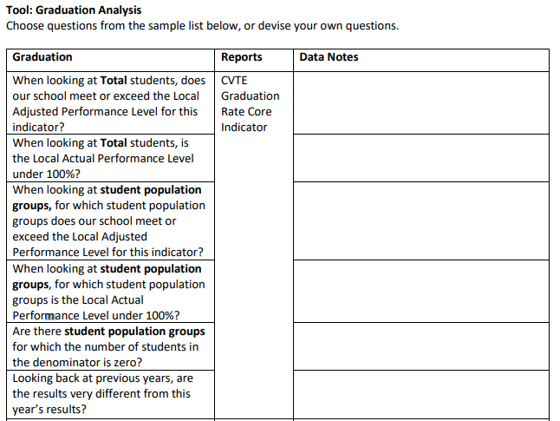
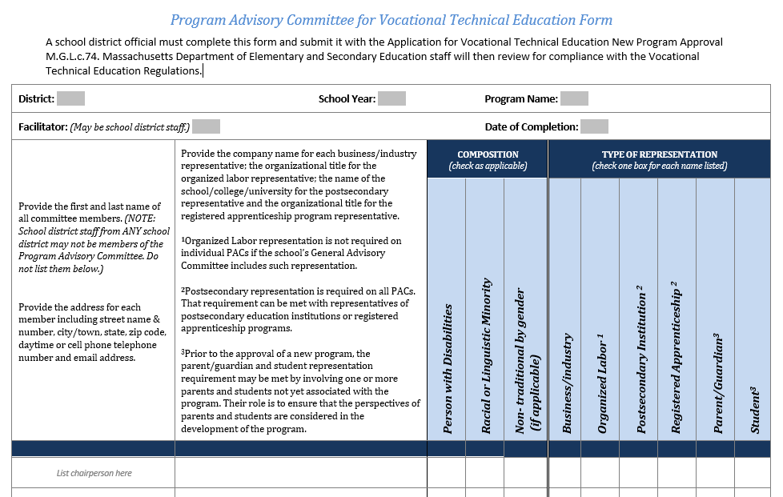
Connections…
Perkins Accountability Cycle CLNA, Application & more
CVTE Analysis Tools
Data Review Teams
Advisory Committees

Slide 23
Using new Perkins Reports – Part 2: Indicators
Questions?

