Slide 1
June 17, 2020
Planning and Adjusting your Instruction in Science & Technology/Engineering (STE)

Slide 2
Thank You!
We are in a state of crisis management, and as such educators are working harder than ever before.
We appreciate all that you do and will continue to do for students.
We are here to support you.

Slide 3
Challenges and unknowns for fall re-entry
Remote learning has placed new strains and challenges on students, families, and educators.
The closure of school buildings dramatically impacted teaching and learning.
Access to technology remains a challenge for educators and families.
We are all working with limited planning time and reacting to changing information as quickly as possible.
This crisis disproportionately affects our most vulnerable students in terms of their physical and mental health and also academically. Equity needs to be a top consideration.
Teaching and learning has taken place over a spectrum this spring that is making Fall planning and re-entry challenging.

Slide 4
Webinar goals
Provide strategies for structuring curriculum planning for fall re-entry and beyond
Provide strategies to adjust instruction and classroom assessment for fall re-entry and beyond, while maintaining grade level expectations
Ask and answer questions and offer support

Slide 5
Planning Instruction
1
Introductions and Welcome
2
3
Utilizing Assessments
Agenda
4
Q+A
Please type questions into the Chat at any time.

Slide 6
Introductions
Nicole Scola: Science Content Support Lead, DESE
(nicole.scola@mass.gov)
Alicia Wedderburn: Science Content Support Specialist, DESE
(alicia.wedderburn@mass.gov)
Hillary Paul Metcalf: Science Content Support Specialist, DESE
(hillary.paulmetcalf@mass.gov)
Alex Grace, STEM Intern

Slide 7
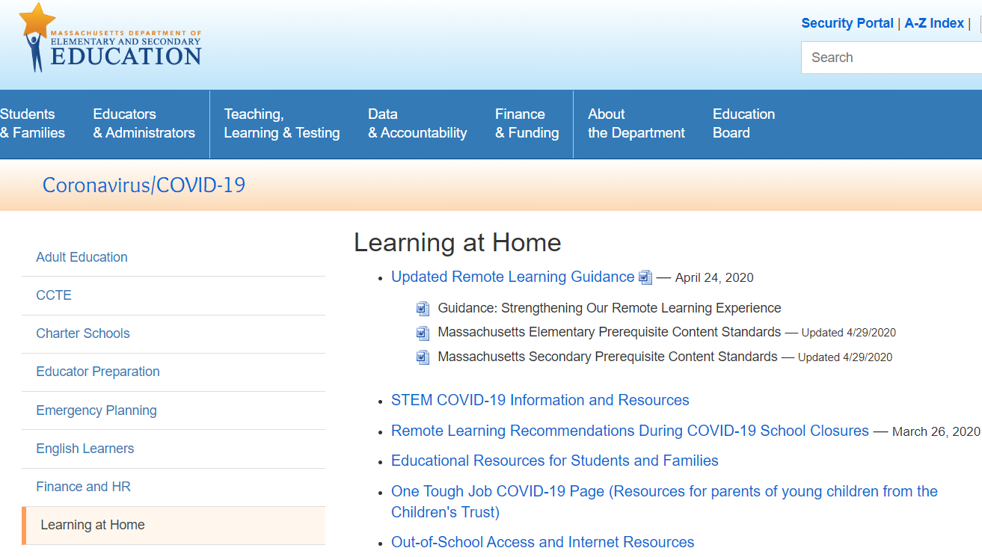
Remote Learning Recommendations
http://www.doe.mass.edu/covid19/learn-at-home.html

Slide 8
Guiding principles for our work
The safety and well-being of students, families, and staff must be our top priority.
This crisis disproportionately affects our most vulnerable students in terms of their physical and mental health and also academically. Equity needs to be a top consideration.
Maintaining connections between school staff, students, and families is paramount.

Slide 9
Importance of engagement
Teaching and learning has taken place over a spectrum this spring impacting student and families differently. There were many factors that impacted low or limited student participation. Reflect on the engagement of your students and their families in the spring, and consider how to build community and family engagement in the fall.
Low to no student participation
Limited student participation
Variable participation
Regular and ongoing communication between teacher and student
Majority of student likely have not engaged with on grade level material since school closures began
Intermittent and/or only initial student participation.
Some students regular participated and other did not
Near full coverage/learning of prerequisite standards and beyond

Slide 10
What does this mean for student learning?
“The typical approach to remediation—providing work better suited for earlier grades—won’t come close to catching students up and will likely compound the problem….The students stuck in this vicious cycle are disproportionately the most vulnerable: students of color, from low-income families, with special needs, or learning English.”
COVID-19 School Response Toolkit (2020) by TNTP, Inc.,
Notes:
https://tntp.org/covid-19-school-response-toolkit

Slide 11
Planning Instruction

Slide 12
Key messages for planning and instruction
Focus on Equity.
Instructional materials and instruction bring forward and value all students’ voices and surface all ideas & value the lived experiences of students as their prior knowledge
Support diversity of learners and needs
Prepare to support for the range of student engagement from the spring and why
Maintain & Support Grade Level Expectations.
Align scope and sequence with grade level standards and look for gaps
Most topics/standards span and build through multiple grade levels
Support, scaffold and integrate prior content/skills as needed
Check-in with curriculum publishers for any additional materials they have released
Utilize Purposeful Assessments Practices All Year Long.
Gauge prior knowledge yearlong instead of frontloading in the beginning of the year
Avoid assessments without a clear purpose and intended target
Use actionable data to make decisions
Start with curriculum embedded assessments from high quality instructional materials

Slide 13
Access to grade-level instruction
An exploration of five diverse districts.
30,000 student surveys
20,000 student work samples
5,000 assignments
1,000 classroom observations
TNTP’s Opportunity Myth (2018)
Notes:
link to opportunity myth https://opportunitymyth.tntp.org/ ,

Slide 14
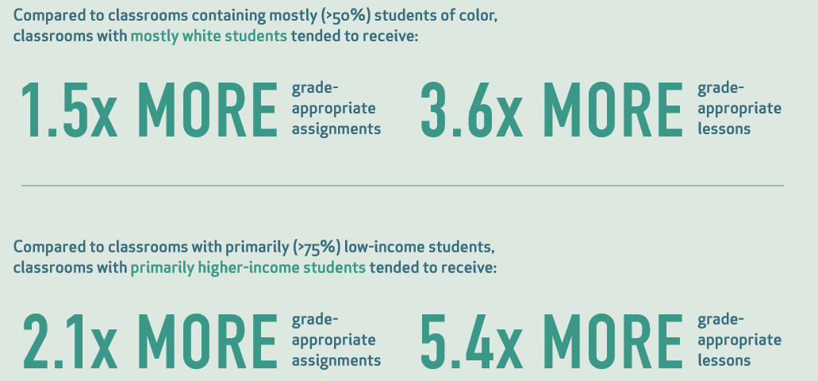
Access is equity

Slide 15
Importance of access to grade-level instruction
Students starting the year below grade level benefit the most from on-grade level instruction:
“In classrooms where students had greater access to grade-appropriate assignments, they gained nearly two months of additional learning compared to their peers.”
“When students who started the year behind had greater access to grade-appropriate assignments, they closed the outcomes gap with their peers by more than seven months (Figure 3).
(Opportunity Myth, 2018)
Notes:
link to opportunity myth https://opportunitymyth.tntp.org/

Slide 16
What were the experiences of my students in 2019-2020?
What was the communication with students and families like?
How did you communicate with teachers (horizontally and vertically)?
What changes were made to your typical scope and sequence?
What concepts/standards were unfinished?
What types of supports will be needed for the following grades?
20-21 Typical foundation building will likely be sufficient next year
Many students struggled with a concept regardless of school closures
20-21 Targeted coverage of concepts/standards will need to be integrated over the next year
Not sufficiently covered and will affect learning the next grade is responsible for
21-22 and beyond: Targeted coverage of concepts/standards will need to be integrated over the next year
Not sufficiently covered and will affect learning the later grades are responsible for

Slide 17
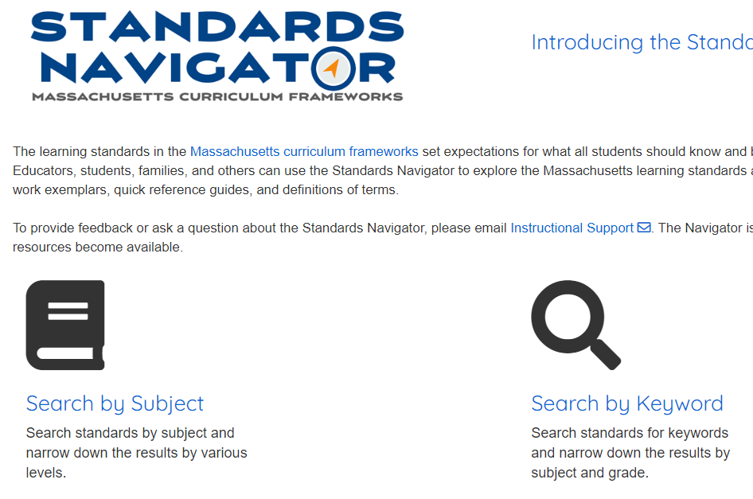
Vertical alignment: Strategy for adjusting scope and sequences
Ensures continuity of standards within a school and among schools.
Ensure progressive skill development
Avoids unnecessary instructional overlaps, prevents gaps
Strategy for vertical planning - Ins and Outs
Use the Standards Navigator or Strand Maps to review the progression of standards. Choose a grade level standard.
Identify 3-5 “outs” or knowledge/skills students will master by end of grade. These “outs” become the “ins” for the next grade level.
Use the new “ins” for the next standard in the progression to determine missing knowledge/skills
Match units in curriculum to the “ins” and “outs” to determine gaps and redundancies

Slide 18
2019-20 Scope and sequence and experience: example grade 5
Unit 1
Unit 2
Unit 3
Unit 4
Unit 5
Unit 6
Unit 7
Unit 8
Before Closures
Typical foundational building will likely be sufficient
Not Covered
Have awareness of unfinished learning
OR
During Closures
Integrate with grade level topic
Typical foundation building will likely be sufficient
OR
Will likely need targeted foundation building

Slide 19
2020-21: Adjusting Scope and Sequence: example grade 6
Unit 1
Unit 2
Unit 3
Unit 4
Unit 5
Unit 6
Unit 7
Unit 8
Targeted foundation building and integration of unfishinied learning
Typical foundation building will likely be sufficient
Where do these previous grade standards naturally align with our own grade scope and sequence?
Resource: Standards Navigator or Science Strand Maps

Slide 20
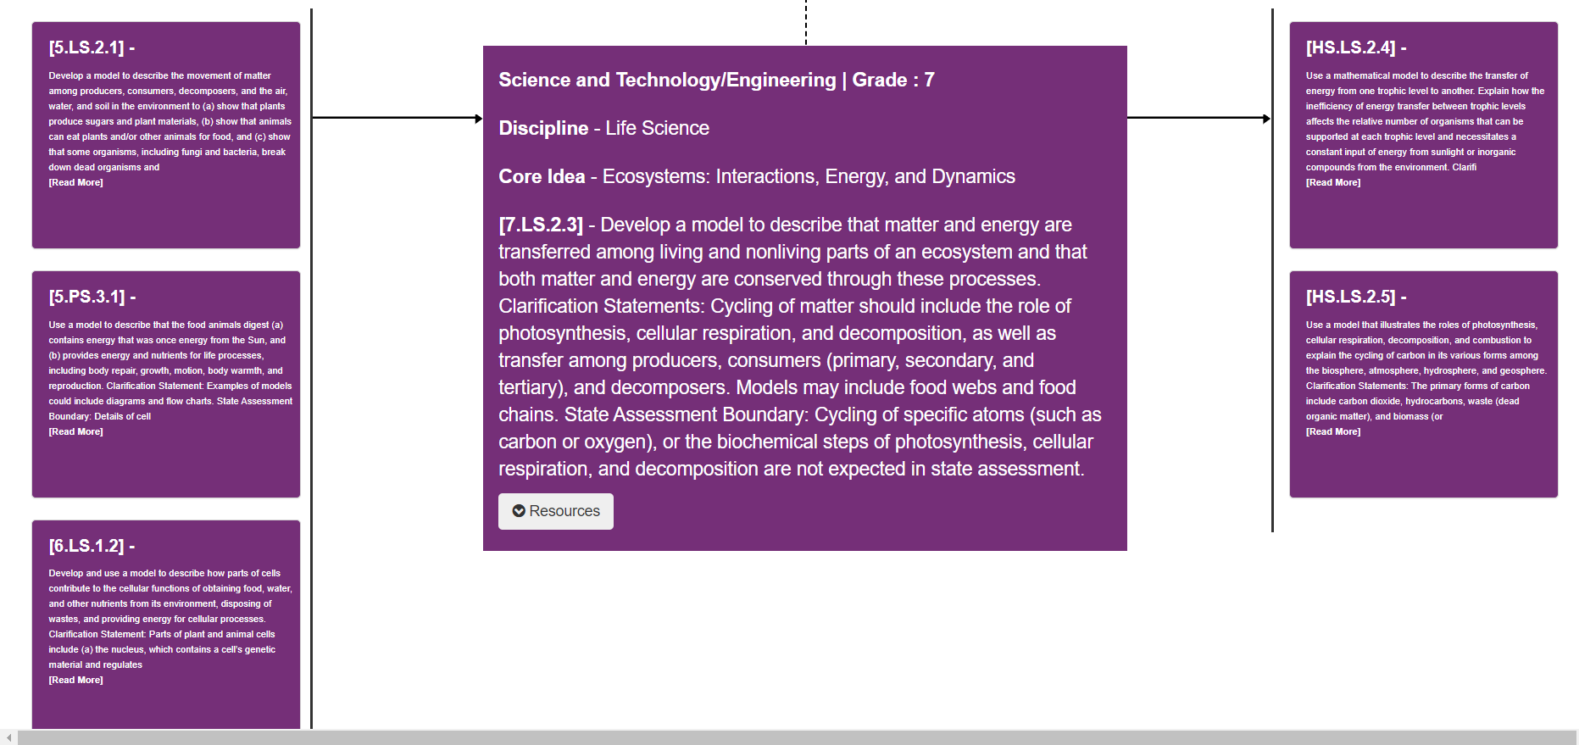
Vertical alignment example: Standards Navigator

Slide 21
Vertical alignment: Strand Maps
Arrows highlight conceptual connections (needed for learning)

Slide 22
Planning and instruction considerations
Build off of the knowledge of your colleagues, families, and students
Work from existing resources (instructional materials, pacing guides, curriculum maps, assessments, etc)
Integrate concepts/standards from unfinished learning into appropriate units throughout the school year, focusing on “just in time” supports
Recognize the emotional, safety, trauma students experienced this spring
This crisis disproportionately affects our most vulnerable students. Equity needs to be a top consideration.
Build consistency in classroom routines, norms and within the curriculum to set students up for success

Slide 23
Unit Level Planning

Slide 24
Key messages for unit level planning and instruction
Focus on Equity.
Maintain high expectations
Valuing student voice and experiences
Lessons/tasks provide multiple entry points and use different modalities
Monitor student engagement throughout the unit and adjust practice
Maintain & Support Grade Level Expectations in Unit Planning.
Provide access to grade-level, standards-aligned tasks
Each learning objective should lead with how students engage with science and engineering practices (see SEP Matrix and Instructional Guides)
Units use an anchoring phenomena to build student understanding
Build in supports and scaffolds to integrate prior content/skills as needed
Utilize Purposeful Assessments Practices.
Multiple types of assessments are used throughout unit in varied means for students to demonstrate their learning
Use formative assessments regularly to guide and advance learning

Slide 25
Modifying unit level planning for unfinished learning
Will likely need review
Covered before closures in an earlier grades (not the previous year)
Typical foundational building will likely be sufficient
Review previous standards on maps to to determine if:
WIll likely need review
Grade level standards in an unit
Covered during closures
Typical foundational building will likely be sufficient
Must be integrated in as support for unit that depends on this standard
Not covered during closures
Consider opportunities to integrate as support into other units

Slide 26
Utilizing Assessments

Slide 27
The role of assessments
Purposeful:
How will the assessment help adapt instruction?
Is the assessment aligned to the specific content of interest?
Provides Actionable Data:
Is the data specific, clear, and practically actionable in the classroom?
Student and classroom level
Communication of Results to students, families, and other stakeholders:
Are the results communicated timely, specific, and understandable?
Are the results actionable for students and/or families?

Slide 28
Assessment types
Pre-assessment
Self assessment
Peer assessment
Formative
Multi-component tasks - “tasks that are organized around a scenario presented to students that tests their ability to apply understandings of core ideas to explain a Phenomenon or solve a problem using science and engineering practices.“
Summative - examples; transfer tasks (where students are asked to make sense of a new phenomenon), final models, arguments or explanations of the phenomenon explored in the class
OpenSciEd 2019 and National Research Council (2014) report, Developing Assessments for the Next Generation Science Standards.
Additional Resource: STEM Teaching Tools Assessment Briefs

Slide 29
Components of science classroom assessments
Focused on a phenomenon or problem
Require students to engage in sense-making
Require students to use both science ideas and practices
Is coherent and understandable for students
Supports the intended purpose and use
Use the Science Task Prescreen tool to help identify major red flags in assessments, and the Science Task Screener to support an in-depth analysis of assessment tasks.
Source: Task Annotation Project in Science (TAPS)

Slide 30
Assess prior knowledge
Activate and build students' background knowledge
Provides teachers with evidence for what science ideas and practice competencies students are coming into the unit with
Provides a diverse set of ideas on the table that teachers can leverage throughout the unit to support sensemaking
Engages students in the science and engineering practices to show initial understandings of a science idea
Examples of pre-assessments include initial models, student questions, discussions, etc.
Resource: ​Instructional Leadership for Science Practices (ILSP) Science and Engineering Practices Tools

Slide 31
Making thinking visible through models
Developing models is a way for students to show their progress from partial to full understanding
Supports students’ own sensemaking
Students can use models to share their ideas with each other to reach consensus
Students can use models to track their progress of what they have figured out
A model
is an abstract representation of phenomena that is a tool used to predict or explain the world
includes the phenomenon’s components, relationships, and explanatory mechanisms
can be represented as diagrams, 3-D objects, mathematical representations, analogies, or computer simulations.

Slide 32
Example 1: Use initial models to assess prior knowledge
Pre-assessment: Have students create an initial drawing (or model) about what they think is happening of the selected phenomena or problem and share with you and other students.
Assessment goal is to elicit students initial ideas and prior knowledge:
To get students’ initial ideas, prior knowledge and experiences on the table
To provide a supportive opportunity for students to make sense of what may not be fully formed ideas (either their own ideas or those of others).
Help students realize that there are gaps in our understanding to promote curiosity and what we could do next to figure something out.

Slide 33
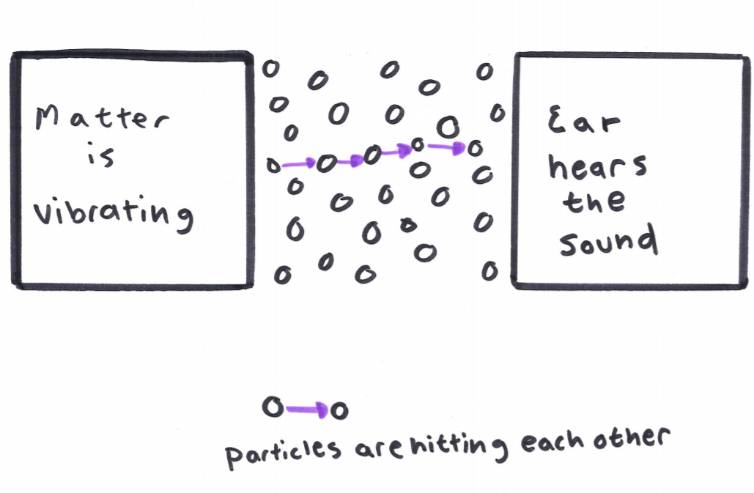
Example 1: Assessing Initial models
Use the models to
indicate students’ areas of strengths and challenges
highlight areas where students may need additional support or practice
inform next steps for instruction and student learning

Slide 34
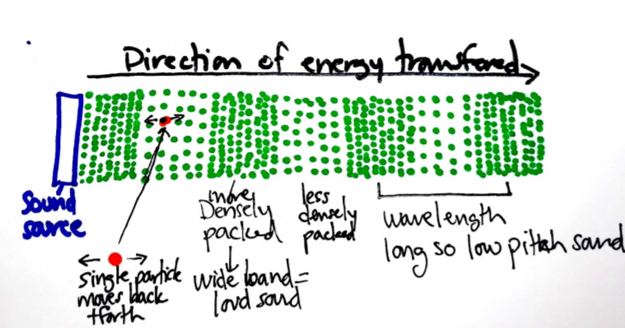
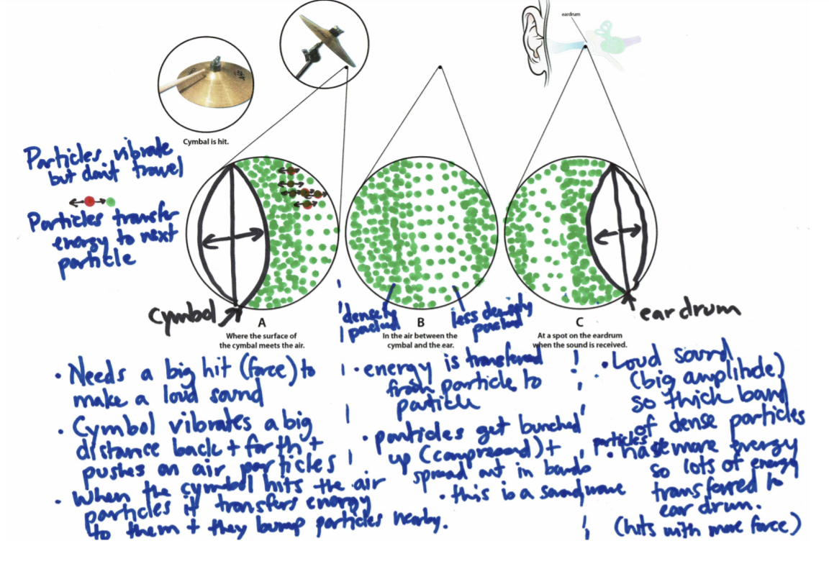
Example 2: Moving from Initial ideas to greater understanding
Summative Assessment
Pre-Assessment
Formative Assessment

Slide 35
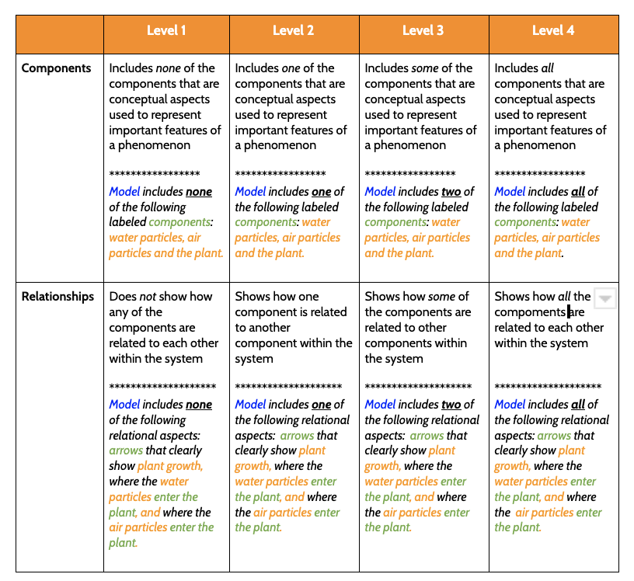
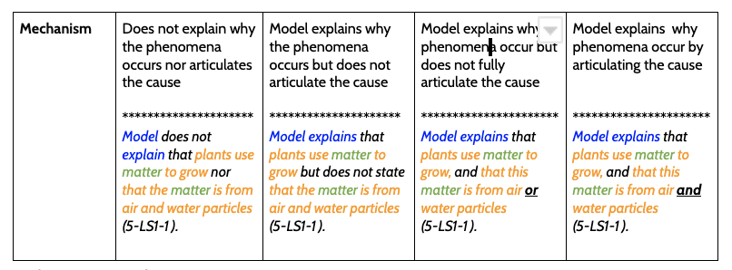
Example 3: Rubric to assess models
Assessing Standard: 5-LS1-1. Ask testable questions about the process by which plants use air, water, and energy from sunlight to produce sugars and plant materials needed for growth and reproduction.
Source: OpenSciEd

Slide 36
Provide opportunities for students to track and assess their progress
Student notebook example
Use student notebooks to formatively assess student progress.
Students can also use notebooks as self-assessments as they track and document their progress to access to build their understanding.
Use the

Slide 37
Resources
General Curriculum Planning
DESE- Standards Navigator
Rennie Center - Back-to-School Blueprint: Accessing Grade-Level Content
TNTP- COVID-19 SCHOOL RESPONSE TOOLKIT, and Opportunity Myth
EdWeek- 5 Tips for Measuring and Responding to COVID-19 Learning Loss
Science Resources:
National Research Council report, Developing Assessments for the Next Generation Science Standards (2014) and Science and Engineering for Grades 6–12: Investigation and Design at the Center (2019)
Improving Elementary Science: Equipping Students Through Inquiry and Integration Confirmation policy brief
STEM Teaching Tools
Task Annotation Project in Science (TAPS)

Slide 38
Resources for Thinking about Remote Learning
The following tools are helpful resources for ideas to transition your teaching to a remote setting
Resource | Description
National Science Teaching Association | NSTA/NGSS Classroom Resources can be sorted by standard. Each day, they share a sensemaking task, NSTA Daily Do , teachers and families can use to engage students in authentic, relevant science learning. and
Next Generation Science | Collection of open-source NGSS-aligned units reviewed by Achieve.
Concord Consortium | A library of simulations, models, and lessons. Educators can create a class and assign resources to students.
Council for State Science Supervisors and STEM Teaching Tools | Suite of resources, tools and ideas for teaching remotely.
Massachusetts STEM@Home List of Resources | This spreadsheet includes linked resources are intended for use by families, educators, and/or students to support enrichment and continuity of learning during the COVID-19 crisis. These resources are free and open to the public, and may or may not be aligned to a student's specific coursework. The State and the Department do not endorse any of the following curricula or resources.

Slide 39
Submit Your STEM Highlights to the Newsletter!
Inviting educators and leaders to submit photos highlighting the wonderful STEM remote learning experiences your students are engaged in.
Students must have a signed photo release form on file with your district.
Email STEM Remote Learning Highlight to Alicia Wedderburn at alicia.wedderburn@mass.gov.
To subscribe to the STEM newsletter, visit:
www.doe.mass.edu/resources/newsletter-signup.aspx
Email: Alicia.Wedderburn@mass.gov

Slide 40
Questions

Slide 41
Exit Ticket
Please take a moment to answer this very brief anonymous survey.
This will help us provide useful information and support.
Notes:
If you have additional questions, please place them in the chat and we will respond as the meeting wraps up. You can also include more questions in the brief survey linked above.

Slide 42
Nicole Scola, Science Content Support Lead, DESE, nicole.scola@mass.gov
Alicia Wedderburn, Science Content Support Specialist, DESE, alicia.wedderburn@mass.gov
Hillary Paul Metcalf, Science Content Support Specialist, DESE, hillary.paulmetcalf@mass.gov
THANK YOU
The Science & Technology/Engineering Team
Nicole, Hillary, Alicia
http://www.doe.mass.edu/stem/

