Slide 1
Special Education Leaders Meeting
November 18, 2022

Slide 2
Agenda
Massachusetts Commission for the Deaf and Hard of Hearing Updates
Special Education Updates
Q&A

Slide 3
Massachusetts Commission for the Deaf and Hard of Hearing
Updates

Slide 4
Today's Presenters
Margaret Lee, Director of Social Services
Roberta J. Perry, MCDHH/DESE Liaison
Terri Pancare, Children’s Specialist
Emily Graves-Harrison, Children’s Specialist
Melissa Adams, Children’s Specialist
Melissa Dowler, Children’s Specialist
Aurora Wilber, Project Coordinator/Communications Liaison

Slide 5

WHAT CAN MCDHH DO FOR YOU?
Important Considerations for Educating Deaf and Hard of Hearing Students

Slide 6
List of Presenters from MCDHH
Presentation by:
Roberta Perry
Former Children’s Specialist/Supervisor
MCDHH/DESE Liaison
617-851-0152 [cell]
Roberta.J.Perry2@mass.gov
Collaboration with:
Peggy Lee Aurora Wilber
Director of Social Services Project Coordinator/Communications Liaison
MCDHH MCDHH
617-894-4169 [cell] 857-488-5477
Margaret.Lee@mass.gov aurora.wilber@mass.gov

Slide 7
MCDHH
Massachusetts Commission for the Deaf and Hard of Hearing – Principal state agency to support Deaf and Hard of Hearing
Children’s Specialists:
  Positions created in 1999 to support Newborn Hearing Screening Law
  Specialized professionals to work with families and agencies
  Identify communication, developmental and educational needs of children diagnosed with hearing loss
  Provide technical assistance to Early Intervention and Educational Programs with focus on communication and cultural needs of Deaf and Hard of Hearing Children
  Provide comprehensive coordination of care from birth through high school graduation or 22 years of age

Slide 8
Children’s Specialists and Service Areas
Northeast/Boston Region
  Melissa Dowler 617-694-9781
  melissa.dowler@mass.gov
Southeast Region – Cape and Islands
  Melissa Adams 617-872-4087
  melissa.adams@mass.gov
  Central Region
  Terri Pancare 508-395-3634
  terri.pancare@mass.gov
  Western Region
  Emily Graves-Harrison 857-208-8009
  emily.graves-harrison@mass.gov

Slide 9
Factors that Impact Communication, Language & Academic Development
Age of Diagnosis
Access to Visual Language
Degree of Hearing Loss
Types of Hearing Loss
Hearing Assistive Technology – Hearing Aids; Cochlear Implants; FM
Access to Pre-school programs and Professional Supports
Family Support
Additional Needs
Communication and language are the foundations of learning

Slide 10
Age of Diagnosis
Age of Diagnosis:
  The Newborn Hearing Screening has increased significantly the number of children identified with hearing loss at early age. There are still, however, hearing losses that are undiagnosed until later in childhood.
  A later diagnosis impacts critical language development with reduced access to the speech and language in their environment
  Language deprivation occurs due to a chronic lack of full access to a natural language – SPOKEN OR MANUAL - during the critical period of language acquisition. There is an elevated neurological sensitivity for language development during the first five years of a child’s life. The developing brain responds to language no matter how it is presented, so exposure to ASL is equivalent to exposure to a spoken language.

Slide 11
Degree of Hearing Loss
Degree of Hearing Loss:
The severity of hearing loss impacts the amount of auditory information available to the child. It impacts:
Auditory curriculum [what, why, how and how well students acquire language through access to sound throughout their day]
Social language and interaction with peers
Incidental language learning [*through which 80-90% of vocabulary is attained]

Slide 12
Degree of Hearing Loss
Degree of hearing loss refers to the severity of the loss and is generally described as: MILD, MODERATE, SEVERE OR PROFOUND. Hearing loss that borders between two categories is typically labeled as a combination of the two categories [e.g. losses at 60 dB HL might be called MODERATE-TO-SEVERE]
Degrees of loss are measured in units called DECIBELS or dB. The measures relate to how loud [in DECIBELS] a sound must be presented before it is detected.
MILD HEARING LOSS: 26 – 40 dB
MODERATE HEARING LOSS: 41 – 55 dB
MODERATELY SEVERE HEARING LOSS: 56 – 70 dB
SEVERE HEARING LOSS: 71 – 90 dB
PROFOUND HEARING LOSS: 91 – 100+ dB
See link below: Relationship of Hearing Loss to Listening and Learning Needs
https://www.wyomingehdi.org/wp-content/uploads/2012/04/Relationship-of-Hearing-Loss-to-Listening-and-Learning-Needs.pdf

Slide 13
AUDIOLOGIST
An Audiologist is professionally trained and licensed. The Audiologist measures hearing loss and makes recommendations about assistive technology.
An Audiogram is a chart that shows the results of the hearing test. It shows how well the person hears a sound across a spectrum of frequencies, or pitches, from low to high. It also shows the intensity, or loudness, before a sound is detected.
Speech is comprised of sounds that fall into the range of frequencies. The following chart shows how speech and everyday sounds in the environment are impacted, depending on the severity of loss and at which frequencies.

Slide 14
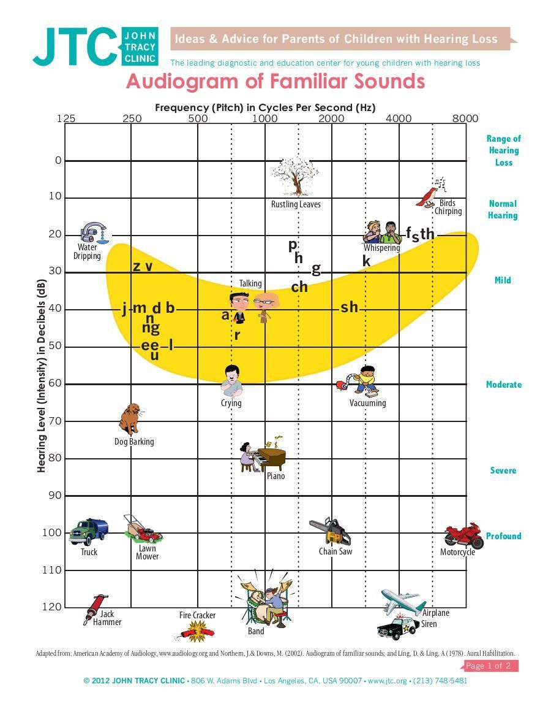
Audiogram of Familiar Sounds

Slide 15
TYPES OF HEARING LOSS
Four types of hearing loss:
Sensorineural: when the inner ear or hearing nerve are damaged. This loss is permanent.
Conductive: occurs in the outer or middle ear and sound waves are unable to carry sound to the inner ear. This loss often is reversible.
Mixed: as the word implies… it is a combination of Sensorineural and Conductive.
Auditory Neuropathy Spectrum Disorder: this loss is characterized by compromised signal processing along the auditory nerve and by deteriorated speech perception.

Slide 16
Reduced Access To Language –
Spoken or Manual
Reduced access affects the foundations of language, vocabulary and literacy including:
Background knowledge [which includes new concepts and vocabulary; multiple meanings and idiomatic language]
Functional language [misunderstanding or misuse of verb tense, pluralization, non agreement of subject and verb and possessives]
Curriculum [vocabulary; number concepts; language and problem-solving skills]
Possibly reading comprehension and written expression

Slide 17
Reduced Access continued
Students with hearing loss tend to have “Swiss cheese language” with unpredictable knowledge gaps in vocabulary and concepts
Students with hearing loss do not access verbal communication as fully as their hearing peers
Students with hearing loss are at high risk for delayed vocabulary acquisition, vocabularies of smaller size and sophistication, experience struggles with the English verb system and lack access to morphological information
Important to keep in mind that Hearing Aids and Cochlear Implants do not restore hearing to normal

Slide 18
Reduced Access continued
Listening and learning in the classroom can be very challenging for students with hearing loss
Listening effort required by students with hearing loss often results in reduced retention, fatigue and attention challenges. When a person has hearing loss the brain has to compensate and work harder to process the same information as hearing peers…. Leading to additional stress and fatigue
Although two children might have similar hearing loss on paper, their history and experience will play a huge part in their success
Outcomes are based on a number of variables

Slide 19
Signs That Child May Have Hearing Loss
Things to watch for:
Having limited or unclear speech
Not following directions or paying attention
Hearing only parts of a conversation; asking for information to be repeated
Not being able to hear everyday sounds [such as a school bell or morning announcements]
Struggles to learn new information and concepts

Slide 20
Unfair Spelling Test
Below is a simulation of how/what a child may hear during a spelling test, based on varying degrees of hearing loss:
https://www.youtube.com/watch?v=l29yLTM3gFw

Slide 21
DISCUSSION
What did YOU perceive with this simulation? Even listening with the “mild” loss there was a struggle to “hear” the words clearly
How many tried to increase the volume…thinking it would help to “hear”?
If you did turn up the volume, did it make anything clearer?

Slide 22
Least Restrictive Environment [LRE]
The goal of this presentation was to highlight the many challenges that Deaf/Hard of Hearing students face in school and why programming is so important. It is hoped that the information presented gives you a better understanding as to why the regular classroom may not be the “Least Restrictive Environment” for the deaf or hard of hearing student.
For more information we have identified a number of valuable resources for further review.
https://fcsn.org/guidance-on-application-of-least-restrictive-environment-lre-for-students-who-are-deaf-or-hard-of-hearing/ ]
https://www.nad.org/resources/education/k-12-education/additional-resources/
Hands & Voices (handsandvoices.org)
Relationship of Hearing Loss to Listening and Learning Needs
https://www.wyomingehdi.org/wp-content/uploads/2012/04/Relationship-of-Hearing-Loss-to-Listening-and-Learning-Needs.pdf
Unfair Spelling Test
https://www.youtube.com/watch?v=l29yLTM3gFw

Slide 23
Wrap Up
This presentation was meant to give you an overview of challenges Deaf and Hard of Hearing students face during their school day. The impact a child’s hearing loss has on day to day life activities can be overlooked because it is invisible.
“WHAT CAN MCDHH DO FOR YOU”… the best resources are the Children’s Specialists at MCDHH. Contact information has been provided on an earlier slide. There is no charge for their services and they look forward to partnering with your schools.
MCDHH also has a Communication Access Trainer who can provide assessment of the learning environment with recommendations for ensuring access.
MCDHH screens and maintains a registry of qualified Educational Interpreters.

Slide 24
Special Education Updates

Slide 25
Ensuring a High-Quality Education for Highly Mobile Children
On November 10, 2022, the U.S. Department of Education’s Office of Special Education and Rehabilitative Services issued a letter to state special education directors that provides guidance and resources on supporting highly mobile children and their families
Highly mobile children include children and youth experiencing frequent moves into new school districts, such as military-connected children, migratory children, children who are homeless, and children in the foster care system

Slide 26
The November 10 Letter
Two main issues identified:
  Issue #1: Highly mobile children should have timely and expedited evaluations and eligibility determinations
  Issue #2: Comparable services include services during the summer, such as Extended School Year (ESY) services
  Outlines the requirements related to each of those issues and provides an analysis of how those issues are manifesting in schools and districts
  Provides key resources for additional information

Slide 27
Celebrations!
National Special Education Day is December 2nd!
National Special Education Day marks the anniversary of the nation's first federal special education law--signed by President Gerald Ford on December 2, 1975.
Celebration of the day officially began in 2005--marking the 30th anniversary of the Individuals with Disabilities Education Act (IDEA).
Friday, December 2 is a day to celebrate our accomplishments, as teachers, administrators, students and parents...please use this day to recognize those who do so much to support our students!

Slide 28
Special Education Leaders Meetings for SY2022-2023
2022
2023
No meeting in December 2022
Friday, January 20, 2023 – Noon to 1pm
Friday, February 10, 2023 – Noon to 1pm
Friday, March 24, 2023 – 11am to noon
Friday, April 28, 2023 – 11am to noon
Friday, May 26, 2023 – 11am to noon
Friday, June 23, 2023 – 11am to noon

Slide 29
Q&A

Slide 30

Thank you!

