Slide 1
K-12 COVID Response Update
December 2, 2021

Slide 2
Today’s Presentation
Department of Elementary and Secondary Education
Shah Foundation
COVID-19 Command Center
Russell Johnston, Deputy Commissioner
Lauren Woo, Strategic Transformation Director
Ross Wilson, Executive Director
Eliza Novick, Project Manager
Marisa Meldonian, Associate Director
Lizzie Gordon, Project Associate
Jeremiah Hay, Deputy Strategy Director, COVID-19 Command Center
Sean Burpoe, Strategy Manager, COVID-19 Command Center
Amar Parikh, Strategy Analyst, COVID-19 Command Center
Notes:
Russell

Slide 3
CONTENTS
01
Surge planning and preparation
02
Scheduling vaccine clinics
03
BinaxNOW and Program updates
04
Contact tracing
05
Shah Family Foundation resources
06
Next Steps
Notes:
Lauren

Slide 4
Surge planning and preparation
01

Slide 5
Multiple supports to respond to a potential surge
MA National Guard support
Mobile testing unit
Additional staffing
Follow up consultation and support
DESE, HHS, CIC data monitoring

Slide 6
Scheduling vaccine clinics
02

Slide 7
Reminder: Mobile Vaccination Program Process
We are accepting mobile vaccination clinic requests, with priority given to clinics for 5-11 year-olds
Mobile vaccination clinic requests must be submitted:
  Through the online form (mass.gov/mobilevaccineform), and
  At least 14 business days before the desired clinic date
If a clinic request can be accommodated, an approval notification email will be sent to introduce the clinic requestor to the designated vaccination provider
If you previously worked with a provider and enjoyed that experience, please note that in the request
Once you are connected with a provider, they will provide consent forms and a scheduling platform. We encourage as much pre-registration as possible to streamline the process

Slide 8
BinaxNOW and program updates
03

Slide 9
Program results to date

Slide 10
Ordering BinaxNOW tests for January 2022
Many tests currently in schools expire by the end of this year (or earlier). Currently, we do not foresee another extension of expiration dates.
As of today, DPH has started to ship tests with 2022 expiration dates.
All orders placed in the CIC ordering system from this point forward will have expiration dates in 2022.
  A recap of how to use the ordering system can be found on the next slide.
Important: if a school/district have tests with expiration dates in both 2021 and 2022, they should use the tests with the 2021 expiration dates first.
For the time being, we recommend that schools do not dispose of expired tests in the event of further guidance from Abbott.

Slide 11
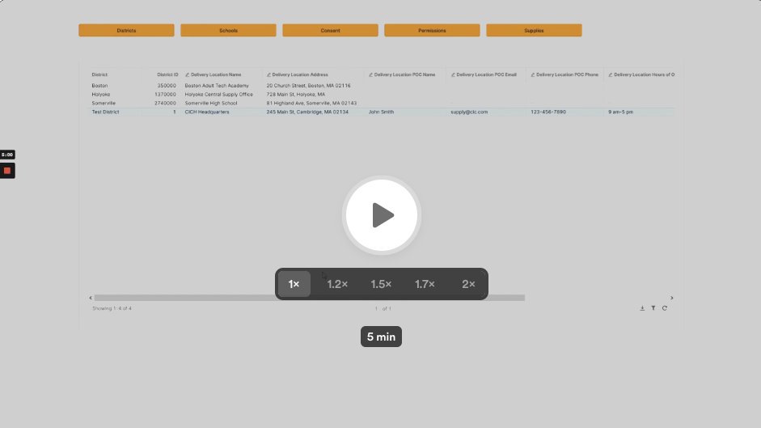
How-to video: Process for ordering tests & supplies
Instructions
Log in to CIC Health Portal: cich-ma.zendesk.com
Go to "School & Consent Database"
Click on "Supplies" tab, then "Request Supplies" blue button
Fill out the order form:
  Confirm your delivery address & info
  Request supplies:
    Pooled testing supplies
    Cryoboxes, bags, scanners, extra swabs
    BinaxNOW
    eMed
Click blue “submit” button at the bottom of the form
View your orders in the "Supplies" tab to track processing, fulfillment, and delivery status
Click the image to open the video

Slide 12
Notes regarding rapid test supply
Given the increase in shipping demand around the holidays, UPS shipments may experience a 1-2 day delay.
  To compensate, we encourage districts to place orders in advance of need.
As a reminder, districts must log all BinaxNOW results – both positive and negative – in the testing software.
Due to supply restrictions, eMed at-home kits with 2022 expiration dates will not be shipped until late December.
  Schools will receive notice when these tests are available for shipment.

Slide 13
Testing schedule during winter weather event
In the event of winter weather, schools should anticipate changes in their testing schedules
While the testing schedule is at the discretion of the school and the on-site support team, we would recommend setting the following expectations:
  If there is a delayed opening:
    Testing that is scheduled to take place before opening should not occur
    Testing that is scheduled for after opening should take place as scheduled
  If there is a snow day:
    Testing that is scheduled to take place on the snow day should not occur
    Testing should continue the normal schedule when school re-opens

Slide 14
New FAQ: Test and Stay over extended breaks
What happens if the 7th day of Test and Stay falls over an extended break (e.g., long weekend, vacation, holiday break)?
  The duration of the Test and Stay program is 7 days from the date of exposure. Some of these days could be non-school days (i.e., weekends or holidays). Testing is only required on school days unless the individual participates in school-sponsored sports or extracurricular activities that fall on a non-school day. If the 7th day falls over an extended break (e.g., long weekend, vacation, holiday break), the individual must be tested on the morning of their return to school so long as the first day back is within 10 days of the date of exposure. If the first day back to school following an extended break is day 11 or later from the date of exposure, the individual does not need to be tested upon return to school provided that they have not experienced any symptoms, as aligned to Protocol B-3.

Slide 15
Participation in testing by vaccinated individuals
As a reminder, the DESE protocols outline the following recommendations for vaccinated students and staff:
  Asymptomatic, fully vaccinated close contacts are exempt from testing and quarantine response protocols.
  Vaccinated staff and students may participate in pooled testing if they submit consent forms; however, this is not recommended.
In all cases, fully vaccinated individuals are expected to monitor for symptoms and stay home and get tested if they experience symptoms, in alignment with statewide guidance and the DESE protocols.

Slide 16
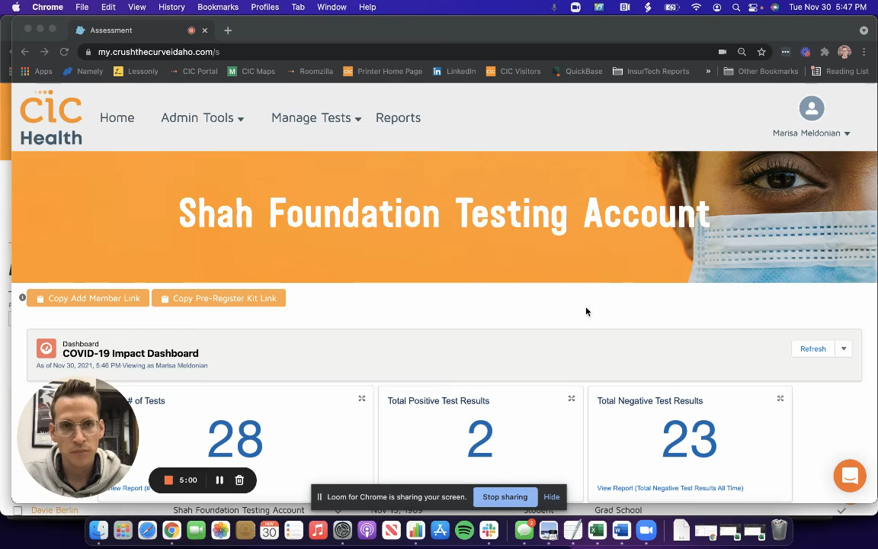
Optional tracking vaccination status in the CIC portal
Instructional video for adding vaccination status to an individual’s Crush the Curve profile
Video also may be found at the link here: https://www.loom.com/share/1ca06cc726bc43b2bf27e9dcf0e70b66

Slide 17
Contact tracing
04

Slide 18
Protocol for in-school vs out-of-school close contacts
Household close contacts (i.e., siblings) must quarantine and follow protocol B2 or B3. In-school close contacts may participate in Test and Stay.
  For example, Student A and Student B live in the same household. Student A is in grade 4; Student B is in grade 2. Student A tests positive for COVID-19 and must isolate. Student B should be identified as an “out-of-school close contact” and must quarantine. Student B must follow protocol B2 or B3. Student B may not participate in Test and Stay because they are not an in-school close contact.

Slide 19
Contact tracing data collection
In spring 2021, physicians from MGH studied the prevalence and risk factors for in-school transmission of COVID-19 in MA K-12 public schools. The research has continued into school year 2021-22.
To support this work, we are recruiting additional districts to submit a standardized spreadsheet for reporting de-identified information about COVID-19 cases in schools and their school-based close contacts.
  By December 10, interested districts should submit data on any index cases who were in school during their infectious period, identified from the beginning of this school year through November 24th (the day prior to Thanksgiving) and their close contacts through December 8th (14 days later).
  Districts may submit to Dr. Sandra Nelson (sbnelson@mgh.harvard.edu) and Dr. Andrea Ciaranello (aciaranello@mgh.harvard.edu)

Slide 20
Shah Family Foundation resources
05

Slide 21
Software Platform Cheat Sheet
Platform | What It’s Used For | Link
CIC Electronic Consent | Consent Forms, Logging Paper Forms | https://www.cic-health.com/consent/ma *each district/school can send an individualized link
CIC Zendesk Portal | How-To Materials, Re-Ordering Supplies, Student Consent & Database Portal | https://cich-ma.zendesk.com/hc/en-us
Crush the Curve | Recording Tests: single/double swab, BinaxNOW | https://covid.cic-health.com/s/login/
Veritas | Recording Tests: Saliva | https://secure.veritasgenetics.com/user/login
Project Beacon | Recording Tests: LEGACY CLIENTS ONLY (single/double swab, BinaxNOW) | https://app.beacontesting.com/login
The Shah Foundation has also created cheat sheets that district personnel can use to keep track of usernames and passwords for Crush the Cuve, Veritas Genetics, and Project Beacon.

Slide 22
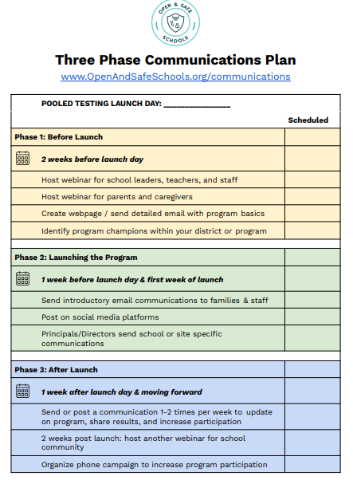
Open and Safe Schools website
www.openandsafeschools.org has vital information for schools that are launching/have launched their school testing program, including:
  Sample communication plans that highlight key messages for students, families, educators and school staff
  Template program FAQs
  Example webinars
  Peer-to-peer sharing resources

Slide 23
Next steps
06

Slide 24
Important links on DESE website
Order supplies: cich-ma.zendesk.com
COVID-19 Testing Program: https://www.doe.mass.edu/covid19/testing/
  Authorized School Application
  COVID-19 Testing FAQs
  Webinar recordings and slides
  Consent forms and parent letters
On the Desktop: https://www.doe.mass.edu/covid19/on-desktop.html
  Protocols for Responding to COVID-19 Scenarios
  Protocols Flowcharts
General FAQs: https://www.doe.mass.edu/covid19/faq/
  Protocols and other reopening FAQs (also sent out in the Commissioner’s Weekly Update)

Slide 25
Have a question? Need help?
Here’s how to get in touch:
  First, contact your Program Coordinator
    They are your best first line of defense.
  If you don’t hear back, contact CIC support
    support@cic-health.com
    Please allow a few hours for a response during the next few weeks
  Still don’t have what you need? Send us a note!
    DESE: k12covid19testing@mass.gov
    Shah Foundation: CovidEdTesting@ShahFoundation.org
Please note:
If you need help, please reach out as early as possible. All teams are experiencing a high volume and the sooner we hear from you the better.

