Slide 1
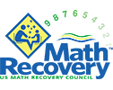
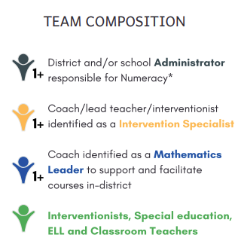
TIERED MATH ACADEMY
Center for School & District Partnership
Program Description
Math Recovery® transforms numeracy education through customized and unique professional learning with meaningful assessment and instruction. Educators learn to design, implement, and analyze mathematics instruction based on individual student learning. Research based diagnostic assessments, learning progressions, and high quality instructional tools help participants increase student understanding and achievement.
Dina Mendola
dina@mathrecovery.org
Kristin Frang
kfrang@mathrecovery.org
To learn more, watch our video overview here.
Goals/Outcomes
The content of the Mathematics Academy coursework and support will focus on:
Developing educators' math content and pedagogical knowledge through a series of professional development courses and follow-up support
Increasing capacity at the school and district level by developing an in-district trainer/coach
Supporting distributed leadership
Establishing routines and structures that support continuous improvement in instructional practices
Improving student outcomes by utilizing data and enhancing teacher practices
Alignment to DESE Strategic Priority #2:
Promote deeper learning so that all students engage in grade-level work that is real-world, relevant, and interactive.
Team Composition
Readiness Requirements
- Monthly meeting time set aside for core team to focus on action planning
- Dedicated time for staff to attend courses and/or sessions
- culture of inquiry stance towards growth and readiness to incorporate new practices
For more details, please see our Math Academy Flyer.
Notes:
PLEASE MAKE A COPY FOR YOURSELF!

Slide 2
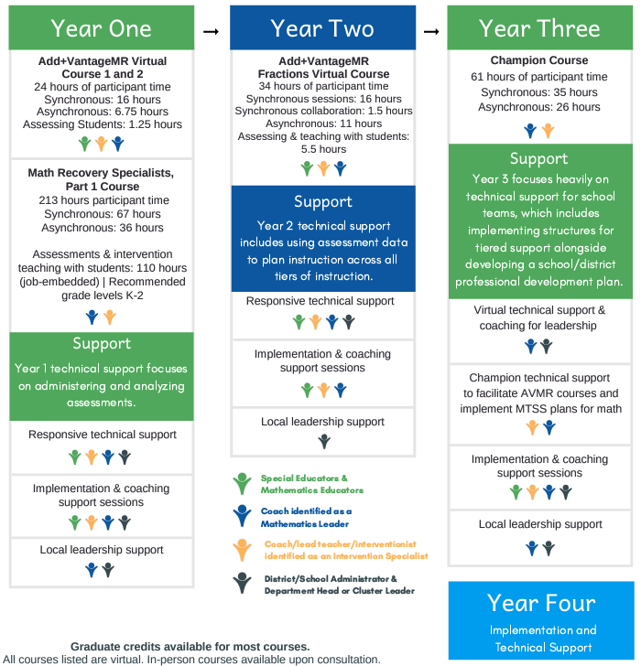
TIERED MATH ACADEMY
Center for School & District Partnership
Dina Mendola
dina@mathrecovery.org
Kristin Frang
kfrang@mathrecovery.org
Program Expectations and Commitments
Participation in the Academy begins with a series of courses where each team member learns how to administer and analyze diagnostic assessments and plan instruction based on assessment results. Schools may take different routes when choosing where to start, but all will end at the same destination.
The graphic to the right is shows one example of what a possible timeline and support offered from the US Math Recovery Council® might look like.
To learn more, watch our video overview here
“I have sat in many grade level data meetings and it has been mentioned in every one that there is a big trend upwards for math achievement and progress! Many teachers have stated, “I think we are doing so well in math because we are so well trained in Math Recovery and it is working with our curriculum.” <administrator>

