Slide 1
Candidate Assessment of Performance
Using the CAP Rubric
Workshop for Program Supervisors and
Supervising Practitioners

Slide 2
Workshop Agenda
Warming Up (7 minutes )
Learning (34 minutes)
Practicing (34 minutes)
Calibrating (25 minutes)
Recapping (5 minutes)
Total workshop time: 1 hour and 45 minutes

Slide 3
Warming Up

Slide 4
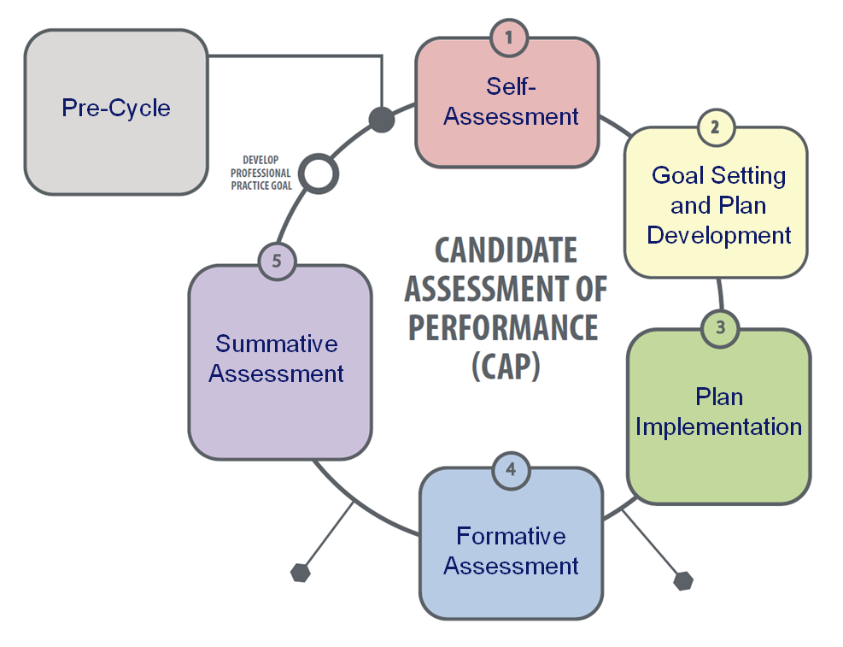
Warm Up
Turn to a partner:
Think about the 5-Step Cycle used in CAP.
For each step in the cycle, list the ways that you could use the CAP rubric to support the activities that comprise that step.
As a whole group:
Share and chart your ideas.

Slide 5
Learning
Understanding the CAP Rubric

Slide 6
Goals of CAP
Provide candidates with opportunities to demonstrate the knowledge and skills they have gained in preparation.
Support candidates’ growth and development through consistent, high quality feedback and evaluation.
Ensure candidates are ready to make impact with students on day 1.

Slide 7
Purpose of the CAP Rubric
Designed to help candidates and assessors:
Develop a consistent, shared understanding of what performance looks like at the four performance levels;
Develop a common terminology of practice and structure to organize evidence; and
Make evidence-based professional judgments about performance ratings.
Serves as the content anchor throughout the process.

Slide 8
The CAP Process
CAP takes place throughout the practicum.
Program supervisors, supervising practitioners, and candidates collect evidence of practice, which informs CAP ratings.
CAP ratings are determined using the CAP Rubric at three points in the process:
When? | Who? | Why?
Self-Assessment | Candidate alone | To reflect on pre-practicum and coursework performance and prepare for goal-setting.
 | Program Supervisor and Supervising Practitioner together | To establish a baseline that will inform goal-setting.
Formative Assessment | Program Supervisor and Supervising Practitioner together | To provide feedback on interim progress; “no surprises” at the summative evaluation.
Summative Assessment | Program Supervisor and Supervising Practitioner together | To determine whether candidate passes CAP and is ready to teach.

Slide 9
Alignment to Educator Evaluation
The CAP Rubric uses the performance descriptors from the MA Educator Evaluation Framework model rubric for each of the 6 essential elements in CAP.
Essential Element | Standard
Well-Structured Lessons | Standard I: Curriculum Planning, and Assessment
Adjustments to Practice
Meeting Diverse Needs | Standard II: Teaching All Students
Safe Learning Environment
High Expectations
Reflective Practice | Standard IV: Professional Culture

Slide 10
Alignment to Educator Evaluation
…BUT goes one step deeper to unpack each descriptor into three dimensions:
Quality
Scope
Consistency
These dimensions allow CAP assessors (SPs and PSs—you!) to provide more nuanced feedback to candidates and recognize that full proficiency for each element is not the expectation for beginning teachers.

Slide 11
Quality, Scope, and Consistency
Quality: ability to perform the skill, action or behavior as described in the proficient performance descriptor.
The minimum threshold for the quality dimension is performance at the proficient level.
Quality is a gatekeeper. Candidates who fail to demonstrate quality at the proficient level should not be rated on scope or consistency and do not pass CAP.
For example, if the quality of a candidate’s practice on the meeting diverse needs element is at the needs improvement level at the formative assessment stage, the assessors should not provide ratings on scope or consistency.

Slide 12
Quality, Scope, and Consistency
Scope: the scale of impact to which the skill, action or behavior is demonstrated with quality.
Assessors should consider whether the candidate is able to demonstrate quality with all students, only a subset of students, one student, or no students.
The minimum threshold for the scope dimension is performance at the needs improvement level.

Slide 13
Quality, Scope, and Consistency
Consistency: the frequency that the skill, action or behavior is demonstrated with quality.
Assessors should consider whether the candidate is able to demonstrate quality all the time, sometimes, once, or never.
The minimum threshold for the consistency dimension is performance at the needs improvement level.

Slide 14
CAP Rubric Architecture
Provides descriptors of 4 performance levels for each of the 6 essential elements measured by CAP:
Exemplary
Proficient
Needs Improvement
Unsatisfactory

Slide 15
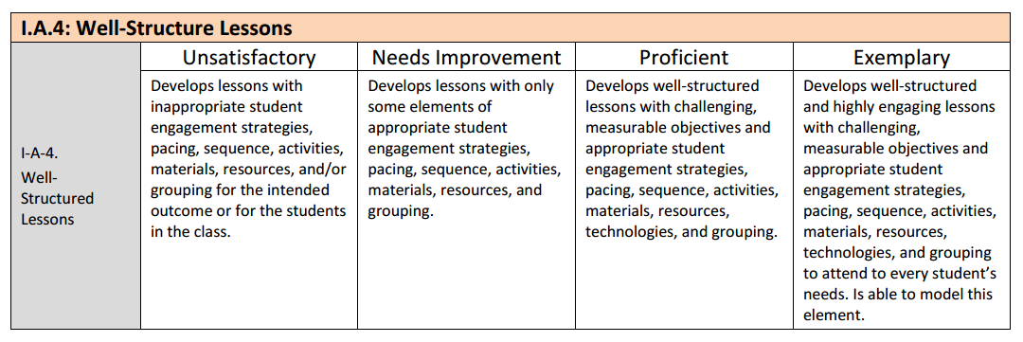
Rubric Performance Descriptors
Provides performance descriptors for each of the 6 essential elements measured by CAP.
Example:

Slide 16
CAP Rubric Architecture
Provides space for assessors to:
Document formative and summative ratings.
Record a summary of evidence to support each rating.
Indicates the minimum thresholds for quality, scope, and consistency.

Slide 17
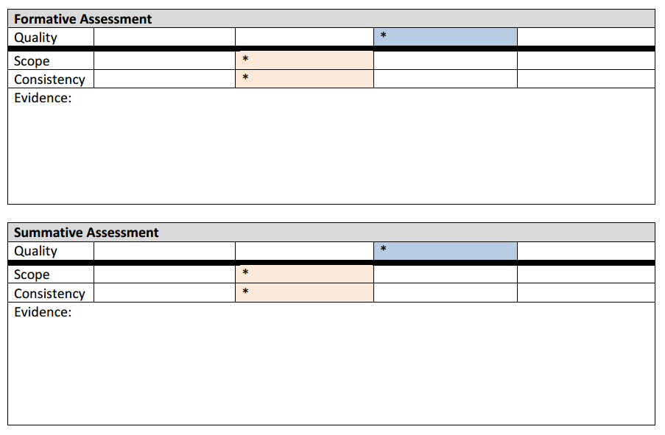
CAP Rubric Architecture
Minimum threshold reminders
Space to provide formative and summative ratings
Record of evidence to support ratings.

Slide 18
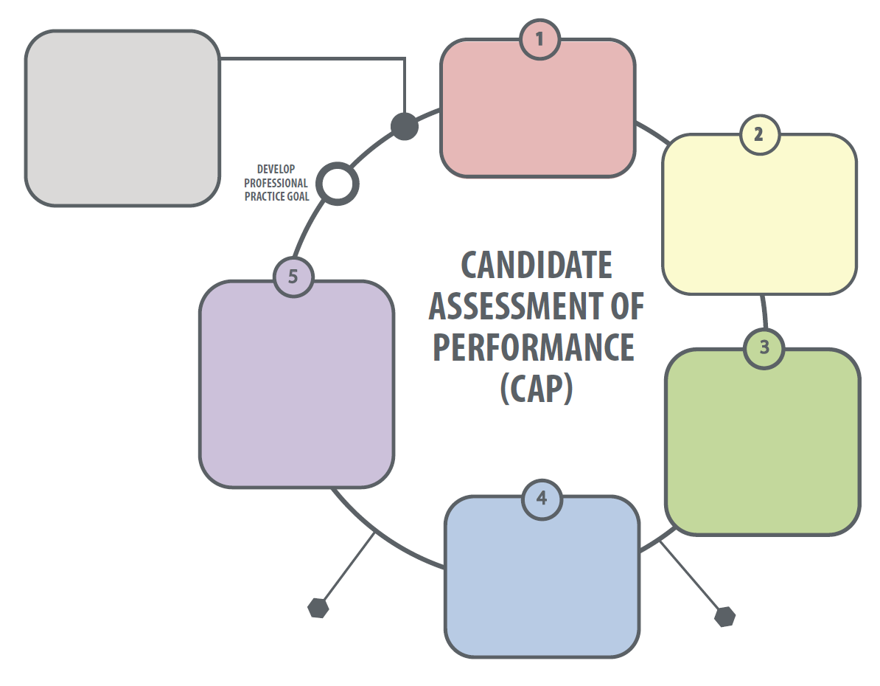
Using the CAP Rubric Throughout the CAP Cycle
Self-Assessment
Pre-Cycle
Goal Setting and Plan Development
Summative Assessment
Plan Implementation
Click here
Formative Assessment

Slide 19
Using the CAP Rubric Throughout the CAP Cycle
Self-Assessment
Candidate (C) uses performance descriptors to self-assess performance in pre-practicum, coursework, and Announced Observation #1.
Program Supervisor (PS) and Supervising Practitioner (SP) use performance descriptors to establish baseline ratings; shared with Candidate at first Three-Way Meeting.
PS and SP use rubric to analyze evidence collected during Announced Observation #1
Goal-Setting and Plan Development
Plan Implementation
Formative Assessment
Summative Assessment

Slide 20
Using the CAP Rubric Throughout the CAP Cycle
Self-Assessment
PS and SP may reference the rubric in the post-conference for Announced Observation #1 (e.g., “Based on how the lesson went, tell me about any areas of the rubric that you are currently working to strengthen.”).
C, PS, and SP consult the rubric when finalizing the professional practice goal to understand how current practice relates to the level of practice necessary to attain the goal – the proficient descriptors may be especially helpful here.
Goal-Setting and Plan Development
Plan Implementation
Formative Assessment
Summative Assessment

Slide 21
Using the CAP Rubric Throughout the CAP Cycle
Self-Assessment
PS and SP may reference the rubric in pre- and post-conferences (e.g., “Tell me about any areas of the rubric that you are currently working to strengthen.”).
PS and SP use the rubric to categorize evidence collected during Unannounced Observation #1 and Announced Observation #2.
Evidence should explain what happened in the observation that shows/does not show that a skill has been demonstrated.
Evidence statements should not simply restate the performance descriptors in the rubric.
Goal-Setting and Plan Development
Plan Implementation
Formative Assessment
Summative Assessment

Slide 22
Using the CAP Rubric Throughout the CAP Cycle
Self-Assessment
PS and SP use rubric performance descriptors to jointly establish formative assessment ratings for each element; shared with C at the second Three-Way Meeting.
Goal-Setting and Plan Development
Plan Implementation
Formative Assessment
Summative Assessment

Slide 23
Using the CAP Rubric Throughout the CAP Cycle
Self-Assessment
PS and SP may reference the rubric in the post-conference for Unannounced Observation #2.
PS and SP use rubric performance descriptors to jointly establish summative assessment ratings for each element to determine whether the C has passed CAP; shared with C at the third Three-Way Meeting.
Goal-Setting and Plan Development
Plan Implementation
Formative Assessment
Summative Assessment

Slide 24
Mapping Evidence
At the Formative Assessment step, the PS and SP should review the evidence collected to date and identify any gaps.
Action steps should be taken prior to the Summative Assessment to fill gaps (i.e., if evidence is weak for well-structured lessons, the candidate is asked to produce artifacts to bolster the evidence).
Leading up to the Summative Assessment step, the PS and SP review all of the evidence collected and make sure to adhere to the minimum evidence requirements for each essential element.

Slide 25
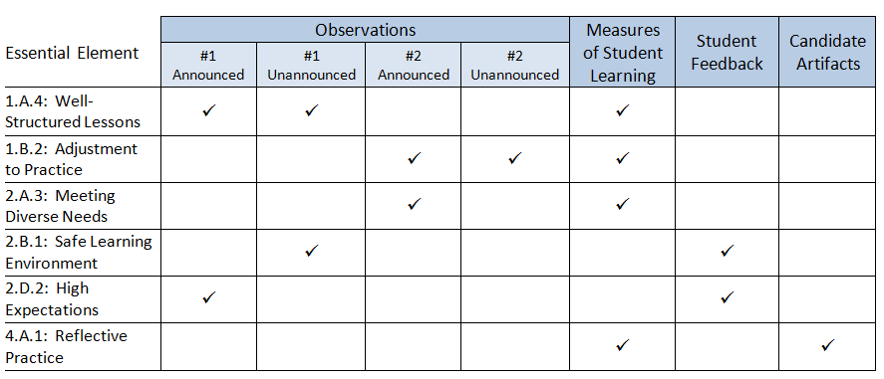
Mapping Evidence
Minimum evidence requirements are as follows:

Slide 26
Determining Ratings
Scoring CAP relies on the professional judgment of the PS and SP
The body of evidence is applied to the rubric for each element. The PS and SP must articulate the evidence that supports each rating.
There are no pre-determined weights or algorithms in CAP.
Candidates must demonstrate performance at each readiness threshold level in order to pass CAP.

Slide 27
Practicing

Slide 28
Formative Assessment Simulation
On your own:
Review the evidence provided and use professional judgment to determine formative assessment ratings for the following elements:
Well-structured lessons
Safe learning environment
Sample evidence includes:
Completed observation forms from Unannounced Observation #1 and Announced Observations #s 1 and 2.
Results from a measure of student learning.
Student survey results.

Slide 29
Formative Assessment Simulation
With a partner:
Simulate PS and SP calibration of ratings.
Each person shares his/her rating and rationale for each dimension of both elements.
Where ratings match, co-author and chart an evidence statement.
Where ratings are discrepant, revisit the performance descriptors and the evidence together.
If consensus is reached, co-author and chart an evidence statement.
If consensus cannot be reached, chart both ratings and two separate evidence statements.

Slide 30
Formative Assessment Simulation
As a whole group:
Listen to each pair share out its ratings and evidence statements.
Note where ratings:
Matched.
Were discrepant, but resolved.
Were discrepant, and not resolved.
Zoom in on the 2-3 ratings that resulted in the most matches. Discuss what about the evidence was likely responsible for the high degree of consensus.
Now discuss the 2-3 ratings that resulted in the highest number of discrepancies. Discuss whether the discrepancies are the result of differences in judgment or the product of insufficient evidence?

Slide 31
Calibrating

Slide 32
Assessor Calibration
Calibration is the result of ongoing, frequent collaboration of groups of educators to:
Come to a common, shared understanding of what practice looks like at different performance levels and
Establish and maintain consistency in aspects of the evaluation process including analyzing evidence, providing feedback, and using professional judgment to determine ratings

Slide 33
Assessor Calibration
Calibration between program supervisors and supervising practitioners, which we just simulated in pairs, is essential in CAP to provide candidates with consistent feedback.
Calibration across all program supervisors at a preparation program is also important to establishing a common set of expectations for teacher candidates. Let’s practice that now as a group.

Slide 34
Summative Assessment Simulation
On your own:
Review the additional evidence provided and use professional judgment to determine summative assessment ratings for the following elements:
Adjustments to practice
Reflective practice
New sample evidence includes:
Completed observation forms from Unannounced Observation #2.
Candidate artifacts.

Slide 35
Summative Assessment Simulation
In teams of 3-4, conduct a peer review of a group member’s summative assessment ratings:
Choose 1 person to be the “subject.”
The subject will read aloud his/her ratings and associated evidence statements.
The remaining team members discuss their assessment of the ratings and evidence statements using the rubric performance descriptors. The subject listens silently.
The subject then responds to the team members’ assessment, explaining his/her rationale more deeply. The group listens silently.
Together the team brainstorms specific ways to better connect the subject’s evidence statements to the rubric performance descriptors.
*Choose a new subject and repeat the process as time permits.

Slide 36
Summative Assessment Simulation
As a whole group:
Discuss how the sample evidence provided could be supplemented to better support ratings.
Develop one new strategy for promoting consistent ratings across all program assessors.

Slide 37
Recapping

Slide 38
Recap
The CAP Rubric is the content anchor for the entire process.
The rubric is used at each step of the 5-step cycle.
The rubric promotes a shared understanding of practice and helps assessors make informed judgments.
Assessors consider the body of evidence (adhering to minimum requirements) and use professional judgment to apply evidence to the rubric and determine ratings.
Calibration is important to ensure consistent feedback, grounded in the rubric.

Slide 39
Questions?

