Slide 1
Early Literacy Observation Form
Informational Webinar
August 22, 2023
Notes:
Good morning and welcome, thank you for joining us today. My name is Shannon Clancy and I’m joined by my colleague Siobhan Allen. We’re going to provide information about the Early Literacy Observation Form, a new required component of the CAP for teacher candidates in elementary, early childhood, and moderate disabilities programs. This session will be recorded and shared back with everyone who has registered.

Slide 2
Agenda
Background and context
Early Literacy in Educator Preparation
Purpose of the Early Literacy Observation Form
Development and implementation timeline
Early Literacy Observation Form Content and Structure
Implementation in CAP
Resources and supports
Notes:
Here is our agenda. We will provide some background and context about the purpose and development of the form, I’ll share more about its content and structure, implementation in CAP, and then we’ll review some available resources and supports. Please feel free to ask questions through the Q&A feature in the webinar. We’ll try to answer them as we go and there wil lalso be dedicated Q&A time later on.

Slide 3
Background and context
Notes:
Siobhan
Many of you on the call today are deeply familiar with this work, but if you’re not, I’ll briefly share a little bit of background and context.

Slide 4
Ensuring Educators are Prepared in Evidence-Based Early Literacy Instruction
By SY2024-2025, all Early Childhood, Elementary, and Moderate Disabilities teacher candidates in Massachusetts will be prepared, through coursework and opportunities for practice and high-quality feedback, in evidence-based early literacy as outlined in the Mass Literacy Guide.
Foundations of Reading MTEL (2021)
Formal Reviews (2024)
Classroom Observation & Feedback Protocol (2023)
Program Expectations & Formative Reviews (2022-2024)
New Program Approval Requirements for Early Literacy Licensure Programs
Notes:
Siobhan
The early literacy observation form is one component of our work to ensure that that by School Year 2024-25, aspiring teachers are being prepared in early literacy instructional practices that are evidence-based and culturally and linguistically sustaining as outlined in the Mass Literacy Guide, through coursework and field-based placements.

Slide 5
Focus Areas of Mass Literacy Initiative
Mass Literacy Vision
Every student in Massachusetts will develop the language comprehension, fluent word reading, and writing skills needed by the end of grade 1, and will continue to increase literacy proficiency through the end of grade 3. Students will have affirming and enriching experiences with literacy.
Guidance, Resources, Information
High Quality Instructional Materials
Professional Learning
Funding
Educator Preparation
Notes:
Siobhan
We know that in MA and nationwide, many children do not receive the instruction and support they need to develop a strong foundation for literacy in grades preK–3.
Mass Literacy is a statewide effort to empower educators with the evidence-based practices for literacy that all students need. Evidence-based instruction, provided within schools and classrooms that are culturally and linguistically sustaining, will put our youngest students on a path toward literacy for life.
Educator preparation plays an important role in reaching this vision.

Slide 6
Purpose of the Early Literacy Observation Form
Foundations of Reading MTEL (2021)
Formal Reviews (2024)
Classroom Observation & Feedback Protocol (2023)
Program Expectations & Formative Reviews (2022-2024)
Ensuring that teacher candidates have opportunity to demonstrate their knowledge and skills in evidence-based early literacy during field-based placements
Providing candidates with high-quality feedback to support them in being fully ready as early literacy teachers
Supporting SO’s data-driven continuous improvement
Notes:
Siobhan
The Early Literacy Observation and Feedback Tool is designed to ensure that teacher candidates not only have opportunities to demonstrate their knowledge and skills in evidence-based early literacy during field-based placements but also that all candidates receive high-quality feedback to support them in being fully ready as early literacy teachers. Additionally, the Observation Tool is mean to support sponsoring organization's data-driven continuous improvement by providing important insights into trends in candidate practice and areas for continued or increased investment in program supports.

Slide 7
Development & Implementation Timeline
New Program Approval Expectations in place
2020-21: Development with Early Lit Ed Prep Network
2022-23:
Observation Form available as a resource
2021-22:
Pilot and refinement of the tool
2023-24:
Partial statewide implementation
2024-25
Full statewide implementation
Notes:
Siobhan
The Early Literacy Observation Form is the product of multiple years of input, piloting, and refinement. First in 2020-21, some of you joined us in the Early Literacy Ed Prep Network, where we first drafted Look Fors and began to build out the form. The following year a group of you piloted the tool and gave us additional feedback that helped further develop the form. Last year, while we released the draft program approval criteria and kicked off formative feedback reviews, the observation form was available as a resource to begin incorporating into programs. This coming year in 2023-24 will be a partial statewide implementation year, which we’ll talk about in a moment, and in 2024-25 the form will be fully implemented statewide.

Slide 8
Overview of the Early Literacy Observation Form
Notes:
Shannon
Thanks, Siobhan. So now I will walk you through the components of the form itself.

Slide 9
What is the Early Literacy Observation Form?
Comprehensive of a full core literacy block
Evidence-based, culturally and linguistically sustaining practices
Direct links to resources and guidance from Mass Literacy
Culturally and Linguistically Sustaining Practices
https://www.doe.mass.edu/edprep/resources/early-literacy-observation.html
Notes:
Effective core literacy instruction includes the teaching of foundational skills, engaging with complex text, and writing, with oral language developed throughout. Evidence-based instruction, provided within schools and classrooms that are culturally responsive and sustaining, is necessary for all our students to thrive.
The Early Literacy Observation Form includes all of these components, with direct links to resources and guidance from Mass Literacy.
You can find the Early Literacy Observation Form at this link: https://www.doe.mass.edu/edprep/resources/early-literacy-observation.html

Slide 10
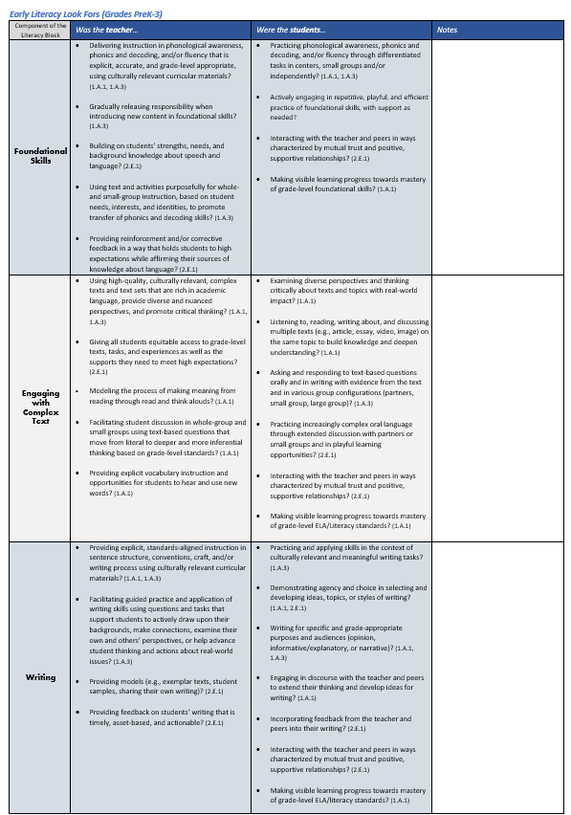
Look Fors
Teacher and student actions
Observable, evidence-based, culturally and linguistically sustaining practices
Aligned with CAP elements:
1.A.1 Subject Matter Knowledge
1.A.3 Well-Structured Units and Lessons
2.E.1 High Expectations
Grades PK-3 and 4-6
Each component of the core literacy block (oral language developed throughout)
Notes:
As you can see, the tool includes a set of Look Fors that identify observable, evidence-based teacher and student actions during each component of the core literacy block. Culturally and linguistically sustaining practices are integrated throughout as critical to our definition of effectiveness.
There are two versions of the Look Fors included in the observation form – one for candidates that are placed in PK-3 classrooms and one for candidates completing their practicum in Grades 4-6. The Look Fors are very similar but adapted to meet the needs of each of those grade-spans.
These Look Fors provide a supervisor with a guide for what they should expect to see during the observation. They help the observer focus in on important, evidence-based practices for an early literacy teacher. We recommend that supervisors read through these Look Fors before the observation, and then during the observation, capture notes based on what they see and hear. There is a “Notes” space on the form that is for this purpose.
Each Look For is aligned with one or more CAP elements – Subject Matter Knowledge, Well Structured Units and Lessons, and High Expectations.

Slide 11
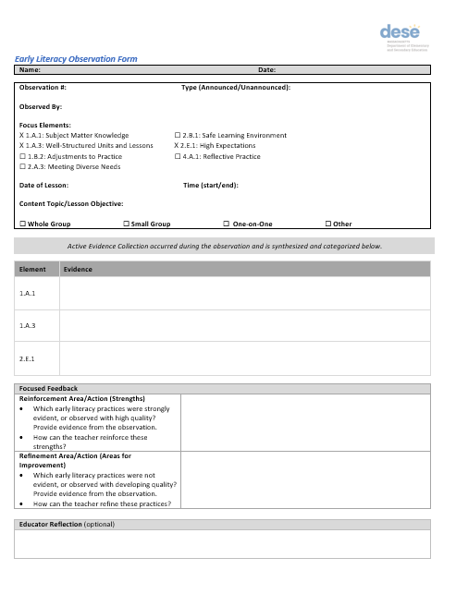
Observation Form Template
Mirrors general observation form
Synthesize and record evidence for each focus element (based on Look Fors)
Provide feedback focused on evidence-based early literacy practices
Space for educator reflection (optional)
Notes:
The final component of the tool is the Observation Form template itself. This part should be familiar to supervisors because it was designed to mirror the general observation form in CAP. There is the general observation information up top, and then in the middle is a place to synthesize and record evidence for each focus element. This is where the supervisor should draw from what they saw and heard relative to the Look Fors. As I mentioned before, each Look For is tagged to an element, which is meant to help with sorting and synthesizing the evidence that is shared back with the candidate. As we recommend with the general CAP observation form, the intention is not to include every moment of evidence from the observation, but to synthesize and summarize the most salient information for the candidate.
After the evidence section is where the supervisor enters feedback – again these parallel the general observation form with Reinforcement and Refinement areas, but we’ve included some prompts more specific to early literacy.
Finally, there’s an optional space at the bottom for the educator to share their reflection on the observation and feedback.

Slide 12
Overview of Implementation in CAP
Notes:
Shannon
I’ll shift now to more information on implementation in CAP.

Slide 13
2023-24 Partial Implementation
Goal: Begin implementing across programs in order to identify systems and supports necessary for full implementation in 2024-25.
Use with at least 10 candidates in each relevant program (Early Childhood, Elementary, and Moderate Disabilities) during CAP
Notes:
In the 2023-24 school year, we will begin partial implementation of the form, with the goal of identifying systems and supports necessary for full implementation in 2024-25. All SOs are expected to use the form during CAP with at least 10 candidates in each relevant program.
This phase is intended to provide flexibility for supplemental work like strengthening content knowledge/skills of supervisors before full implementation. While the form is being implemented with some candidates and supervisors, SOs can be working to ensure that all candidates and supervisors will be prepared to implement the following year.

Slide 14
Implementation in CAP
Announced Observation 1 | Unannounced Observation 1 | Announced Observation 2 | Unannounced Observation 2
1.A.1 Subject Matter Knowledge 1.A.3 Well-Structured Units and Lessons 2.E.1 High Expectations | 1.A.1 Subject Matter Knowledge 1.A.3 Well-Structured Units and Lessons 2.B.1 Safe Learning Environment | 1.B.2 Adjustments to Practice 2.A.3 Meeting Diverse Needs | 1.B.2 Adjustments to Practice
1.A.1 Subject Matter Knowledge 2.A.3 Meeting Diverse Needs 2.E.1 High Expectations | 1.A.1 Subject Matter Knowledge 1.A.3 Well-Structured Units and Lessons 2.B.1 Safe Learning Environment | 1.A.1 Subject Matter Knowledge 1.A.3 Well-Structured Units and Lessons 2.E.1 High Expectations | 1.B.2 Adjustments to Practice
Traditional (CAP Guidelines)
Alternative for Early Literacy
Notes:
There are a couple of logistical considerations for implementing the form in CAP that I want to highlight for you.
First, the form is designed to be used during AO2 because a candidate will need to have responsibility for a full core literacy block. This means that it will be necessary to switch the order of focus elements, as you can see in this chart. The dark blue row is the traditional sequence of observed elements based on the CAP Guidelines, and the light blue row on the bottom is an alternative sequence for candidates participating in this early literacy observation.
If your program uses paper forms for CAP, The Early Literacy Observation Form will replace the general observation form. If you use the Online Platform, you can continue to use the system with some modifications, which I’ll share on the next slide.

Slide 15
Considerations for Online Platform users
The Early Literacy Observation Form (in its entirety) is not directly integrated into the CAP Online Platform
The full protocol should be provided to PSs separately to ensure integration of Look Fors into evidence and feedback
However, PSs can complete the observation forms in the Online Platform, with minor adjustments:
Use Look Fors to guide observations/feedback
Different focus elements for announced observations → “required” fields will not align with focus elements.
Will need to enter text in all “required” fields for forms to be “complete” in the system
Notes:
While you can continue to use the online platform for this observation, its important to note that the Early Literacy Observation Form is NOT directly integrated. This means that supervisors will continue to see the general observation forms when they are using the Online Platform, but the content of the early literacy observation look fors will not be there so they will need to refer to the protocol itself to guide observations and feedback.
Also, because the focus elements for announced observations will be different, the “required fields” in the system will not align with the focus elements. Supervisors will need to enter text into all required fields, even if they aren’t identified as focus elements, in order for the form to be completed according to the requirements of the platform.
The full protocol should be shared with PS’ separately from the online platform to ensure that they are able to integrate the Look Fors into the evidence and feedback. We will communicate that on the platform itself as clearly as we’re able to, but it will be best if SOs can also support that communication to ensure that the form is being implemented.
I know that you may have questions at this point so please feel free to drop them in the Q&A and we will be sure to address them.

Slide 16
Resources and Supports
Notes:
There are a few resources and supports for implementing this observation form that we want to highlight with you today.

Slide 17
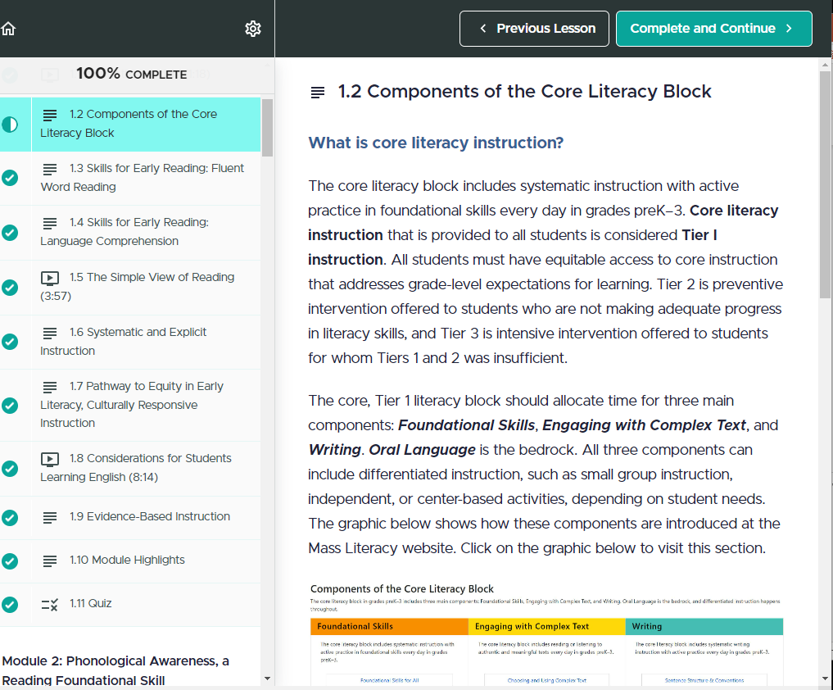
Mass Literacy Online Overview Course
Companion course to the Mass Literacy Guide, which houses an extensive collection of resources for educators that includes links to articles, videos, literacy websites, and much more
7 modules
Participants who complete the course are eligible for 15 PDPs.
Notes:
First is the Mass Literacy Online Overview Course.
To support all educators in getting to know the wealth of information and resources within the Mass Literacy Guide, DESE is providing an asynchronous online course, available at no cost to any educator who works in a Massachusetts education organization.
This course includes 7 modules and is an opportunity to gain a deeper understanding of the information and resources available in the Mass Literacy Guide.
Here is the link to register: https://keystoliteracy.com/mass-literacy-online-course/

Slide 18
Community of Practice for Program Supervisors
For Program Supervisors of Early Childhood, Elementary, and Moderate Disabilities programs
Goals:
Build understanding of evidence-based early literacy practices aligned to Mass Literacy (by completing the Mass Literacy Online Course and discussing with colleagues)
Strengthen skills in observing and providing high-quality feedback in early literacy
Collaborate with other PS’ across organizations
Notes:
As a complement to the online course, we are offering a Community of Practice for supervisors who would like to build their understanding of evidence based early literacy practices and strengthen their skills in observing and providing feedback to candidates. The Community of Practice will meet four times throughout the year. In between sessions, participants will complete modules from the Mass Literacy Online Overview Course. We’ll then come together to discuss learnings and how it applies to their role as supervisors.
The intended participants for this opportunity are Program Supervisors, so please consider forwarding this registration link to those in your org:
CoP Schedule and Registration: https://survey.alchemer.com/s3/7384150/Early-Literacy-Community-of-Practice-for-Program-Supervisors

Slide 19
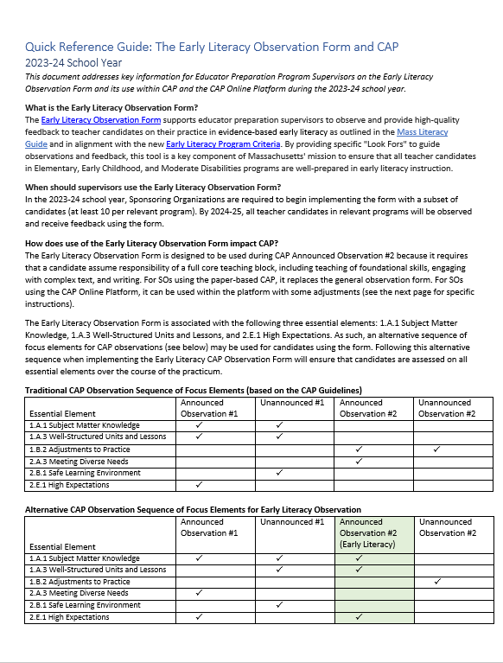
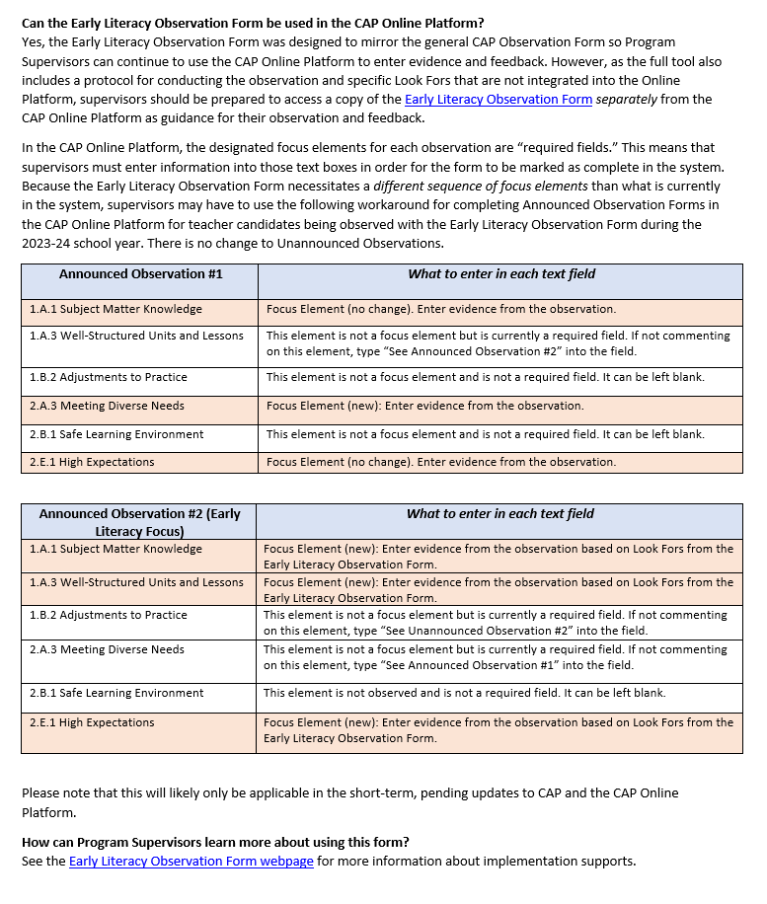
Quick Reference Guide
2-page overview of Early Literacy Observation Form and its use during CAP
FAQs for Program Supervisors
Access it here: https://www.doe.mass.edu/edprep/resources/qrg.docx
Notes:
Another resource available to share with PS’ is this 2-page Quick Reference Guide, which includes background and context about the Early Literacy Observation Form as well as some guidance on implementation during CAP and with the Online Platform.
Access it here: https://www.doe.mass.edu/edprep/resources/qrg.docx

Slide 20
Q&A
Notes:
FAQ:
Full core literacy block?
We know that teaching a full core literacy block is an important part of readiness.. This observation can occur in 1-2 parts but must encompass all three components of the core literacy block (teaching of foundational skills, engaging with complex text, and writing).
Implement with fewer than 10?
This year is a partial implementation phase, which is intended to provide flexibility for supplemental support work like strengthening content knowledge/skills of supervisors before full implementation. our goal is that SOs implement the form with enough candidates to be ready to fully implement it with all candidates by 2024-25. If piloting with less than 10 candidates per program is more appropriate in a given context, please let us know and we can be flexible. So while the form is being implemented with some candidates and supervisors, SOs can be working to ensure that all candidates and supervisors will be prepared to implement the following year.
Example of CLSP?

Slide 21
Resources
Early Literacy Observation Form
Quick Reference Guide: Early Literacy Observation Form and CAP
Registration Form for CoP
Early Literacy in Educator Preparation Initiative
Mass Literacy Guide
Mass Literacy Online Course

Slide 22
Thank you!
Shannon Clancy
Educator Effectiveness Coordinator
Shannon.Clancy@mass.gov
Siobhan Allen
Educator Effectiveness Specialist
Siobhan.M.Allen@mass.gov
https://www.doe.mass.edu/edprep/resources/early-literacy.html

