Slide 1
Web-Based Monitoring System​ English Learner Education ​ Self-Assessment for​ 2023-2024 TFM Reviews​
January 2023

Slide 2
What is WBMS?
Web-Based Monitoring System ​
A web-based electronic environment containing templates, checklists, and other materials that are used by school districts and DESE staff throughout PSM and OLA’s Program Review monitoring process.​
​
A shared electronic repository where both district/schools, PSM and OLA can communicate and review self-assessments, materials, reports and documents. It provides easy access and more efficient communication between the district/schools and PSM/OLA. ​
A tool to make the monitoring process consistent, more transparent and cost-effective.​
Notes:
https://gateway.edu.state.ma.us/edu/myportal/meoe

Slide 3
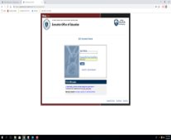
How to find WBMS?
Please go to the Security Portal.​
Click on PQA Monitoring.​
You need WBMS - ELE District Authorizer, WBMS - ELE District Updater, WBMS . If you need access, contact your district’s Directory Administrator. ​
Notes:
https://gateway.edu.state.ma.us/edu/myportal/meoe
https://www.doe.mass.edu/infoservices/data/diradmin/list.aspx

Slide 4
Why Self-Assessment?
Promote district/charter school ownership of ongoing continuous improvement and compliance with current federal and state regulatory requirements.​
​
Opportunity for the district/charter school​
to review their current compliance;​
to immediately remedy any issues or concerns to ensure 100% compliance; ​
reduce the number of published findings of non-compliance resulting in a reduction of required corrective action activities and reporting;​
reduce the number of days and staff that may be tied up with the on-site visits;​
focus on better outcomes for students.​

Slide 5
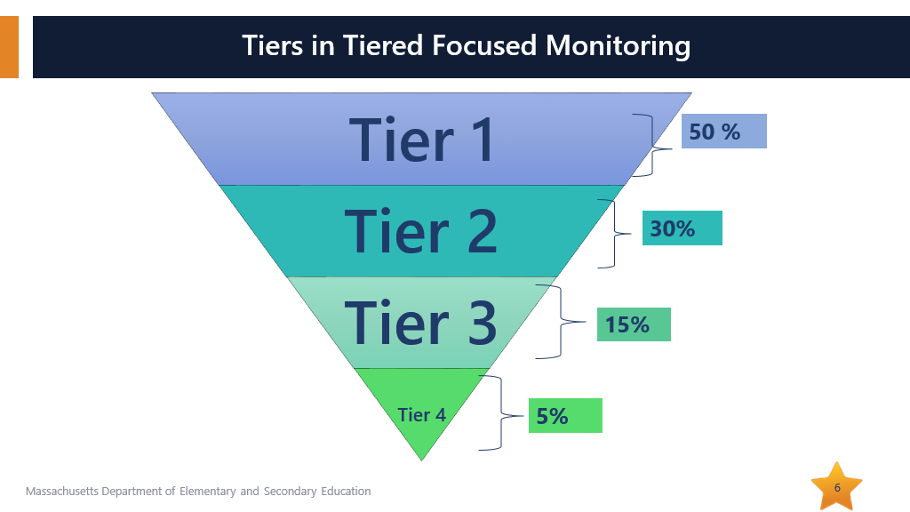
Tiered Focused Monitoring

Slide 6
EOE EL Page
Notes:
https://gateway.edu.state.ma.us/eaportal/browse/Edwin%20Analytics#Z7_L90EHCC0K0VQ50AB943R1300G5

Slide 7
Data
Core Indicators​
Additional Indicators
Growth in English Language Acquisition: The number and percentage of ELs who are making progress toward achieving English language proficiency
FEL and ever-FEL performance on MCAS compared to non-EL performance on MCAS​
Drop-out rate: What percentage of ELs drop out and does the number mimic the rate for non-ELs?​
Graduation Rate for ELs: What percentage of ELs does not graduate in four/five years and does it mimic the rate for non-ELs?​
Proportion of Identification of ELs for Special Education Services: What percentage of ELs is identified as requiring Special Education services and does it mimic the rate for non-ELs? Is there over-identification of ELs with disabilities?​
Suspension Rates: Are ELs more likely to be suspended than non-ELs?​

Slide 8
Phases in the WBMS
District Self-Assessment on all ELE Criteria:​
EL student record review and submission​
EL document review and submission​
OLA Desk Review: ​
Review of district/school self-assessments​
Review of district/school – specific data for tier placement​
Review of student record documents ​
Identify Review Activities​
Range of Onsite/Virtual Review Activities:​
Interviews and Observations (or phone/ZOOM interviews for Tier 1 and Tier 2 districts)​
Parent Surveys, Parent and Student Panels​
Report Preparation and Dissemination​
CAP/CIMP (Continuous Improvement and Monitoring Plan) Development and Approval:​
Onsite technical assistance​
Electronic transmittal, review and approval​
Progress Reports:​
Electronic transmittal, review and approval​

Slide 9
English Learner Education Self-Assessment​
The district/school will perform the following activities during their self-assessment:​
Select a sample of EL student records​
Review each individual student record​
Enter the individual student results into the WBMS system​
Review the individual Student Record Review results​
Enter the overall Summary Responses from individual Student Record Review ​
Conduct the EL Document Review ​
Submit Self-Assessment to OLA​

Slide 10
The Most Important Resource
Program Compliance Criteria
Notes:
https://www.doe.mass.edu/ele/cpr/program-critieria.docx

Slide 11
Basic Navigation

Slide 12
Document Review​ Forms – Document Library​

Slide 13
About the forms….​
Please do not simply upload your district’s or program’s handbook when a specific form needs to be completed.​
Please do not just copy and paste language from the “Guidance” document when you answer questions for the Castañeda Test. Explain the ELE program(s) as you implement it in the district providing as much detail as possible.

Slide 14
District/School Self-Assessment Document Review​
This process begins with a review of selected policies and procedures for addressing requirements of state and federal English Learner Education laws and/or regulations.​
In most instances for English Learner Education there will be an upload requirement which may include a policy, procedure, specific forms, staff list/licensure information, student rosters, professional development or other relevant documents.​

Slide 15
What Document Review Looks Like…​

Slide 16
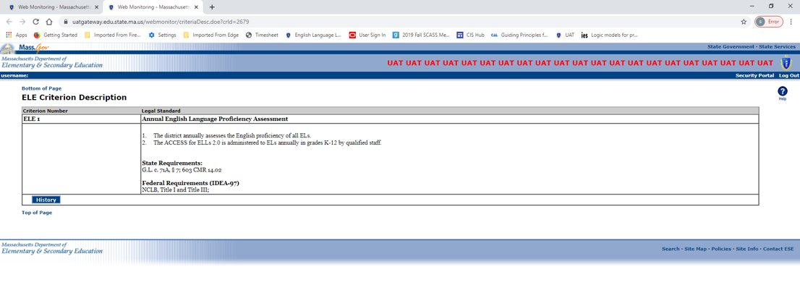
Legal requirements
What are the legal requirements?​

Slide 17
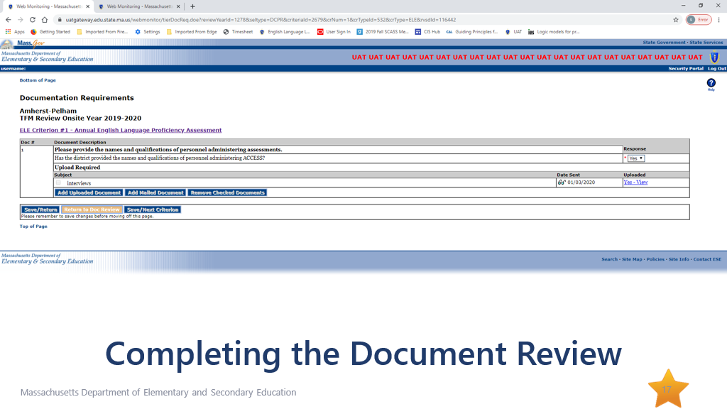
Completing the Document Review

Slide 18
Castañeda Test

Slide 19
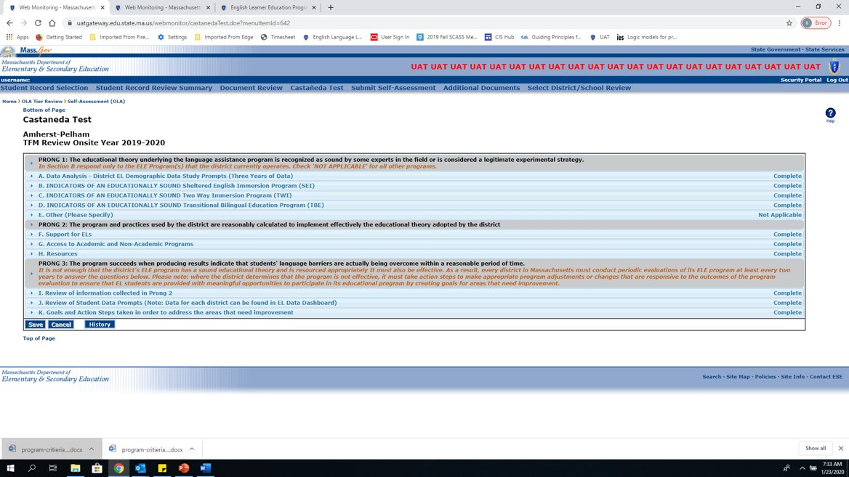
Castaneda Test

Slide 20
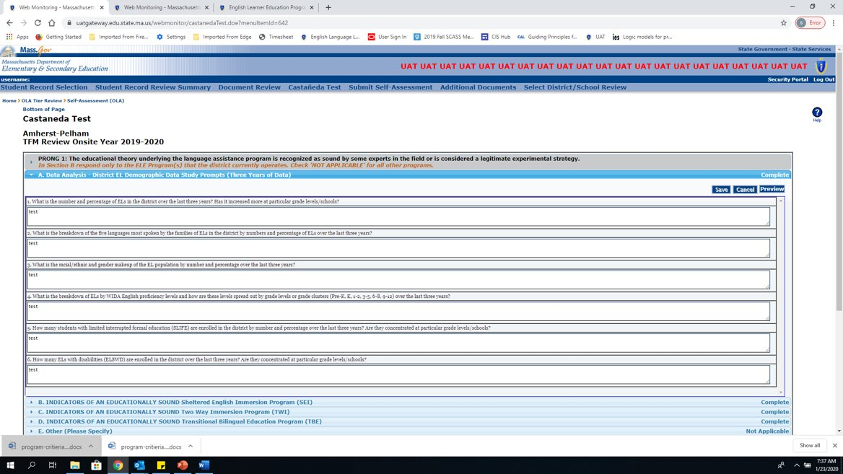
Castaneda test 2

Slide 21
Student Record Review for ELE
Select a sample of student records to review using guidance provided by OLA that specifies quantity and profile. ​
Using the WBMS system, complete an extensive review of identified individual student records.​
The results of the record review will be synthesized and be entered into the WBMS via the Student Record Summary Response section.​

Slide 22
Record Selection Procedures​
Select a sample of EL records to review. Based upon the total number of ELs enrolled in the district, the minimum number of records that will be selected include:​
​
10 student records for LEAs with up to 150 ELs​
15 student records for LEAs with 151-500 ELs​
20 student records for LEAs with 500 and more ELs​

Slide 23
EL Focus Areas
There are five EL focus areas:​
EL​
FEL​
Opt-out​
Translation/Interpretation​
ELs with Disabilities​
It is important that selected records have a proportional representation of all EL focus areas, grades and languages.​

Slide 24
Entering Student Records​

Slide 25
ELE Student Record Detail​

Slide 26
Do not leave it like that!
Please don’t forget to click on the “X” sign to answer the questions for this focus area. ​

Slide 27
Student Record Selection Review
Please make sure that all the “X” signs” are now “√” after you answered all the focus area questions. ​

Slide 28
Reviewing the Individual Record

Slide 29
Student Record Review Summary

Slide 30
Submitting you ELE Self-Assessment​

Slide 31
What if our district/charter has no EL students to review?​

Slide 32
Next Steps
The self-assessment will be available for districts on February 1, 2023.​
You will receive email notification as to when you may begin your self-assessments in the WBMS system. ​
Your English Learner Education Self-Assessment must be submitted to the Department by May 31, 2023.​

Slide 33
Questions?
Sibel Hughes Samantha Kodak
Judith Magloire Andy McDonie David Parker David Valade

