Slide 1
ESSER Data Collection
FY23 Annual Report
RASP/DESE Federal Grant Programs
April 2024

Slide 2
Welcome to the ESSER Data Collection Webinar
Housekeeping items before we begin:
  The slides will be emailed to all registrants.
  To preserve bandwidth, your video and microphone are turned off.
  Use the Q & A feature at the bottom of the screen to ask questions (not Chat feature).

Slide 3
CONTENTS
01
ESSER Data collection: Where We’ve Been
02
ESSER Data Collection: Moving into “Year 4” FY23
03
Major Change #1 – Activities Dimension
04
Major Change #2 – Student Participation
05
A Walk-through of the Collection Tools
06
Q&A and Helpful Resources

Slide 4
ESSER Data collection: Where We’ve Been
01

Slide 5
Context – Where We’ve Been : Year 1
In July 2021, districts submitted data on ESSER-I spending from March 13, 2020 (beginning of the pandemic) through September 30, 2020 (end of the federal fiscal year)
  100% participation from districts
  11 pages of questions

Slide 6
Context – Where We’ve Been : Year 2
In May 2022, districts submitted data on ESSER-I and ESSER-II spending from October 1, 2020 through June 30, 2021
  100% participation from districts
  Reduced the 39-page survey down to ~14 pages

Slide 7
Context – Where We’ve Been : Year 3
In April 2023, districts submitted FY22 data on ESSER-I, ESSER-II, and ESSER-III spending from October 1, 2021 through June 30, 2022
  100% participation from districts
  Reduced the 39-page survey down to ~14 pages

Slide 8
ESSER Data Collection: Moving into “Year 4” FY23
02

Slide 9
US Dept of Ed – Data Collection Requirements for FY23
The performance reporting period for this collection will be based on activities administered between July 1, 2022 and June 30, 2023 (FY23).
The data collection window will open Monday April 15th and close Friday May 10th.

Slide 10
US Dept of Ed – Data Collection Requirements for FY23
This year’s survey form is longer and more complicated than last year’s
  It asks for more detail around types of expenditures (in ESSER I, II, and III surveys)
  It asks for more detail around student participation (in the CrossAct survey)

Slide 11
US Dept of Ed – Data Collection Requirements for FY23
To reduce as much burden as possible, DESE will be:
  Using SIMS, EPIMS, and other existing data sources to populate dozens of required fields
  Eliminating the reporting requirements for the dozens of smaller grants that used ESSER I, II, or III funds

Slide 12
ESSER Grants Data Collection – FY23
Fund Code 113 – ESSER I Main allocation to all districts
  Note – July 1, 2022 through September 30, 2022 – FINAL COLLECTION
  If you have unreported spending, you must report on all of it (see Survey Summary Spreadsheet for exact figures).
Fund Code 115 – ESSER II Main allocation to all districts
  July 1, 2022 through June 30, 2023
Fund Code 119 – ESSER III Main allocation to all districts
  July 1, 2022 through June 30, 2023
CrossAct – applicable to districts that spent any ESSER I, II, or III $ in FY23
  July 1, 2022 through June 30, 2023

Slide 13
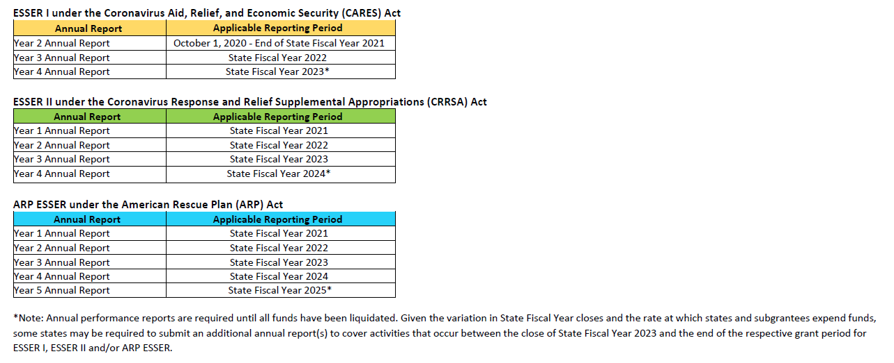
A Note about Future Data Collection Requirements
2
3
4
5*

Slide 14
What numbers to report?
Expenditures may be reported on a cash or accrual basis, whichever form of accounting you use.
  Please use the method you used last year.
Expenditures means “The actual spending of money; an outlay. Charges made by a non-Federal entity to a project or program for which a Federal award was received.”

Slide 15

Submission will be through Alchemer Platform
In the coming days, school business officials, superintendents, and ESSER-III grant administrators will receive an email with all the information you need, including:
  Survey summary spreadsheet with links
  Microsoft Word versions of the surveys
  This PowerPoint
  A recording of this webinar (depending on how quickly we can transcribe)
  Other helpful information

Slide 16
Submission will be through Alchemer Platform
Please coordinate with one another re who’s submitting.
Multiple people in the district may use the link and the password.
Surveys, however, must be completed in order (i.e., 1 through 10, then 11 through 15, etc.). Users cannot skip around.
Like last year, the password to access the data collection forms will be your 4-digit district code.

Slide 17
Major Change #1 – The Activities Dimension in ESSERs I, II, and III
03

Slide 18
US Dept of Ed – Data Collection Requirements for FY23
USED has added an “activities” dimension for ESSERs 1, 2, and 3*.
  From: 4 broad categories and “object codes”
  To: “object codes” and “activities” within each of the 4 broad categories
* Reminder that ESSER 3 is essentially treated like 2 grants, because USED asks for specific data on both the “at-least 20% Learning Loss set-aside” as well as those exclusive of the “20% Learning Loss set-aside”

Slide 19
US Dept of Ed – Data Collection Requirements for FY23
FY21 and FY22 Collections
 | Health/Safety | Academic/SEL | Mental Health | Operational Continuity
Personnel Salaries
Personnel Benefits
Professional Services
Property Services
Other Services
Supplies
Property
Debt Service
Other

Slide 20
US Dept of Ed – Data Collection Requirements for FY23
FY21 and FY22 Collections
 | Health/Safety | Academic/SEL | Mental Health | Operational Continuity
Personnel Salaries
Personnel Benefits
Professional Services
Property Services
Other Services
Supplies
Property
Debt Service
Other

Slide 21
US Dept of Ed – Data Collection Requirements for FY23
FY23 Collection – Health and Safety
 | Buildings | Meals | Cleaning | Temp space | Disaster Prep | Other Health
Personnel Salaries
Personnel Benefits
Professional Services
Property Services
Other Services
Supplies
Property
Debt Service
Other

Slide 22
US Dept of Ed – Data Collection Requirements for FY23
Note for ESSER III
Summer/Extra is broken into 3 separate columns (Summer, Afterschool, Extended time).
Staffing/Other is broken into 2 columns (Classroom Teachers and Other)
FY23 Collection – Academic and SEL
 | Summer or Extra Time | Tutoring | Staffing or Other | Screenings | Service coord. | Early Childhood | Hardware or Software | Internet | Curricula | PD | Educator Pipeline
Personnel Salaries
Personnel Benefits
Professional Services
Property Services
Other Services
Supplies
Property
Debt Service
Other

Slide 23
US Dept of Ed – Data Collection Requirements for FY23
FY23 Collection – Mental Health
 | Mental Health - all
Personnel Salaries
Personnel Benefits
Professional Services
Property Services
Other Services
Supplies
Property
Debt Service
Other

Slide 24
US Dept of Ed – Data Collection Requirements for FY23
FY23 Collection – Operational Continuity
 | Other McKinney Vento | Other ESSA | Other IDEA | Other Adult Ed | Other Perkins | Other
Personnel Salaries
Personnel Benefits
Professional Services
Property Services
Other Services
Supplies
Property
Debt Service
Other

Slide 25
Major Change #2 – Student Participation - CrossAct
04

Slide 26
US Dept of Ed – Data Collection Requirements for FY23
In the CrossAct Survey, if your district used any ESSER I, II, or III funds during FY23 on 7 specific interventions, USED is asking for student participation.

Slide 27
US Dept of Ed – Data Collection Requirements for FY23
Those seven FY23 interventions are:
  Evidence-based summer learning or summer enrichment programs
  Evidence-based after-school programs
  Extended Instructional Time (including extended school day or school week or school year)
  Evidence-based high dosage tutoring
  Early childhood education program expansion or enhancement
  Full-Service Community Schools
  Purchasing educational technology
  *Specific definitions for these interventions are in the notes section of this slide.
Notes:
Evidence-based summer learning or summer enrichment programs = “Evidence-based intervention and/or enrichment programs that support accelerated learning in the core curriculum based on the state’s challenging academic standards during the summer months.”
Evidence-based after-school programs = “Voluntary programs that assist students in meeting the challenging State academic standards by providing students with academic enrichment activities and other activities during non-school hours or periods when school is not in session (not including summer months).”
Extended Instructional Time = “Using a longer school day, week, or year schedule to significantly increase the total number of school hours to include additional time for a) instruction in core academic subjects including English, reading or language arts, mathematics, science, foreign languages, civics and government, economics, arts, history, and geography; and/or b) instruction in other subjects and enrichment activities that contribute to a well-rounded education. Participation is considered mandatory.”
Evidence-based high dosage tutoring = “Voluntary intensive tutoring aligned with an evidence-based core curriculum and led by highly trained tutors or certified teachers that occurs one-to-one or in very small groups at least 3 days per week on a sustained basis to help students accelerate their learning in the core curriculum based on the state's challenging academic standards.”
Early childhood education program expansion or enhancement = “Programs that expand opportunities for all students, particularly traditionally underserved students, to attend high-quality early childhood education programs or that support the improvement of existing early childhood education programs in implementing the best practices of high-quality early childhood education programs.”
Full-Service Community Schools = “A full-service community school is defined as a public elementary or secondary school that works with its local educational agency and community-based organizations, nonprofit organizations, and other public or private entities to provide a coordinated and integrated set of comprehensive academic, social, and health services that respond to the needs of its students, students’ family members, and community members. In addition, a full-service community school promotes family engagement by bringing together many partners in order to offer a range of supports and opportunities for students, students’ family members, and community members.”
Purchasing educational technology = “Educational technology is defined as any of the following: mobile technology devices such as tablets and laptops; providing off-campus access to reliable, high-speed internet for students and teachers through the purchase of internet-connected devices/equipment, mobile hotspots, wireless service plans, or installation of Community Wi-Fi Hotspots, especially in underserved communities; teleconferencing applications or programs; software/online/virtual programs, screen capture/recording software, online/virtual cultural curriculum/programs, online/virtual tutoring curriculum/programs, learning management systems; technology accessories, such as headphones, speakers, laptop cameras; and assistive technology devices, such as dedicated communication devices and applications for text-to-speech, graphic organizers, or word prediction.”

Slide 28
US Dept of Ed – Data Collection Requirements for FY23
Selecting “YES” to any of those 7 will require you to submit:
  Capacity and availability of that program
  Unique headcount of students who participated
  Percentage of students who participated who belong to any of the federally-reported groups:
Students with disabilities | American Indian or Alaskan Native
Low income | Asian
ELs | Black or African American
Foster | Hispanic/Latino
Migratory | Native Hawaiian or Other Pacific Islander
Homeless | White
Multiracial | Other

Slide 29
US Dept of Ed – Data Collection Requirements for FY23
If you select yes for any of those 7, but you don’t have specific numbers or percentages of students, you may estimate, provided that you document how you came to those estimates and keep those on file in case of audit, USED review, etc.

Slide 30
A Walk-through of the Survey Summary Spreadsheet and the Collection Tools
05

Slide 31
Q&A and Helpful Resources
06

Slide 32

QUESTIONS and ANSWERS

Slide 33
Next steps
In the coming days, all registrants will receive:
  Links to all surveys (access using your 4-digit district code)
  A list of all districts, and which collections they need to complete (Survey Summary Spreadsheet)
  Microsoft Word versions of each data collection survey
  This PowerPoint
As soon as possible, we will have these resources posted to the ESSER Data Collection website

Slide 34
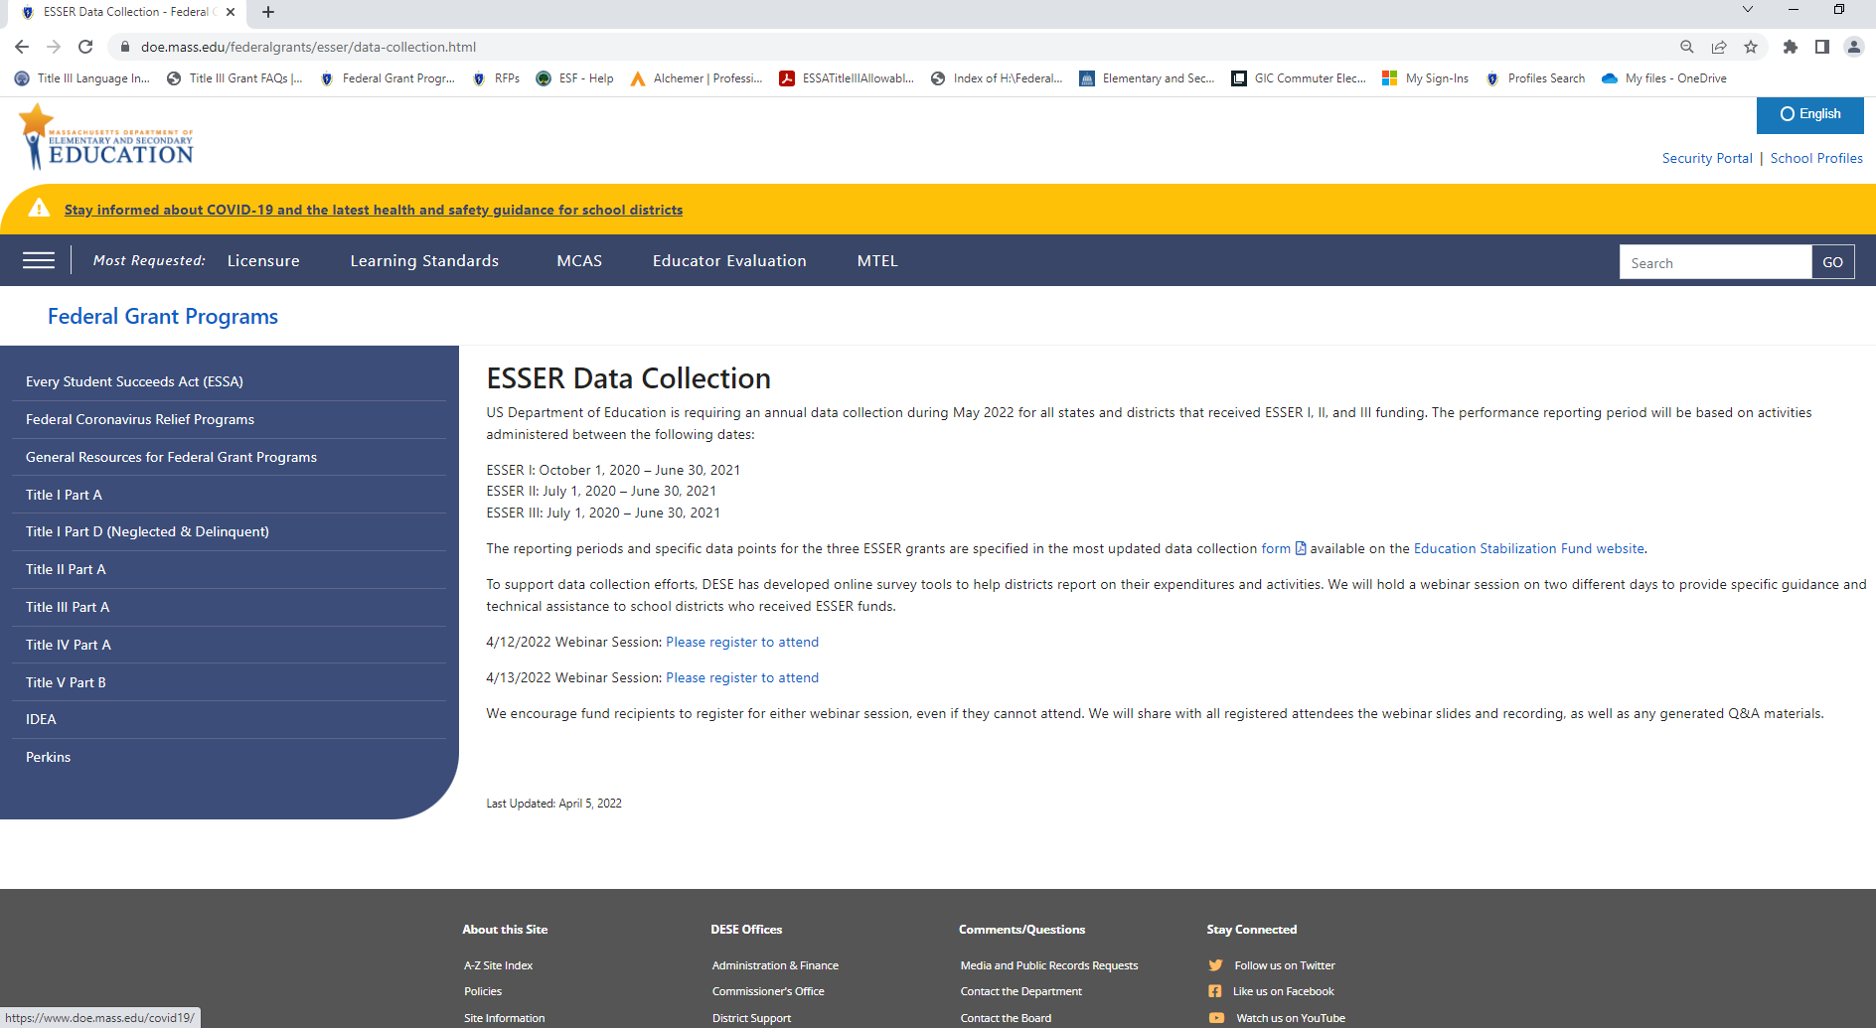
DESE’s Federal Grants Office
Contact Information
Email: federalgrantprograms@mass.gov
Website: https://www.doe.mass.edu/federalgrants/esser/data-collection.html
Hotline: 781-338-6230

Slide 35




Thank you
THANK YOU
781-338-6230
federalgrantprograms@mass.gov
www.doe.mass.edu/federalgrants
135 Santilli Highway, Everett, MA 02149

