Slide 1
Funding EdTech to Support District Priorities
November 2022
Jackie Gantzer​
Director of EdTech and School Support​
jacqulyn.m.gantzer@mass.gov ​
AJ Coté, CETL​
Assistant Director of EdTech
andrea.j.cote@mass.gov ​

Slide 2
Office of EdTech
Expand equitable access to technology, including sufficient bandwidth, 1:1 devices, and high-quality digital materials and experiences.
OET provides guidance, resources, and support in three primary areas:
Identify, evaluate, and promote effective uses of edtech that serve to enhance student learning.
Leverage research and innovation in K–12 edtech that may provide solutions to persistent problems and support next generation learning.

Slide 3
Agenda
Technology in Schools
Aligning to District Priorities
Technology in Titles I-IV
Application to your context
Closing & Resources

Slide 4
Technology Access in Schools
What % of students have access to a device they can use for learning?
SY19-20
SY20-21
Data based on survey to MA districts in Spring and Winter 2020

Slide 5
“[Access to] educational technology is not a ‘nice to have for some students in some classes with some teachers who might think it’s important.’ It’s critical for student participation in an innovation economy, to fully participate in our democracy, and to engage in a global society.”
-Roberto Rodrìguez
USED Assistant Secretary of Planning, Evaluation, & Policy Development
Notes:
“Technology itself is only as valuable as its strategic and purposeful application.” -- -yet when you get a fund request… it may just be conveyed to you as – I need devices, I need a subscription to this software….we need more tech staff for repairs…. How can we build an equitable and sustainable system….

Slide 6
Technology Use in Schools
How many technology tools (programs, applications, platforms, etc.) does the average district access on a monthly basis?
Data gathered from LearnPlatform

Slide 7
“Technology itself is only as valuable as its strategic and purposeful application.”
I need more laptops!
We need to renew this subscription!
UMass Donahue Institute
Remote Learning Technology Media Scan
I’d like to buy this new software!
More staff please!
Notes:
Raise your hand if you’ve heard one or more of these this past year.
Digital Equity + Strategic and Purposeful Use is the goal
But what does it mean to be strategic and purposeful with technology?

Slide 8
Agenda
Technology in Schools
Aligning to District Priorities
Technology in Titles I-IV
Application to your context
Closing & Resources

Slide 9
School systems that are successful in creating sustainable improvement establish a clear vision for equitable student experiences and build ownership and shared purpose across all stakeholders.
Essentialism, Greg Mckeown
Notes:
Once you are clear on your system’s priorities and goals, you can make purposeful investments in technology that will support digital equity and enhance the student experience.

Slide 10
Agenda
Technology in Schools
Aligning to District Priorities
Technology in Titles I-IV
Application to your context
Closing & Resources

Slide 11
Titles I-IV Quick Look
Title & Fund Code (FC) | Description
Title I – FC 305 | Improving Basic Programs Operated by Local School Districts funds to districts and schools with high numbers or high percentages of children from low-income families to help ensure that all children meet challenging state academic standards
Title II- FC 140 | Building Systems of Support for Excellent Teaching and Leading supplemental resources to school districts to support systems of support for excellent teaching and leading
Title III – FC 180 | Providing Supplemental Funds to Improve the Education of English Learners funds to help English learners, including immigrant children and youth succeed in school by assisting them in becoming fluent in English and meeting challenging state academic content and student academic achievement standards
Title IV – FC 309 | Creating Safe, Healthy and Supportive, High-Quality Educational Learning Environments for All funds to build capacity and ensure that all students have access to a high-quality educational experience
Notes:
Title I priorities
Strengthen the core program in schools and provide academic and/or support services to low-achieving students at the preschool, elementary, middle, and high school levels;
Provide evidence-based programs that enable participating students to achieve the learning standards of the state curriculum frameworks;
Elevate the quality of instruction by providing eligible staff with substantial opportunities for professional development; and,
Involve parents/guardians of participating public and private school children as active partners in their children's education at school through open, meaningful communication, training, and, as appropriate, inclusion in decision-making processes.
Title II priorities
Increase student achievement consistent with the challenging State academic standards;
Improve the quality and effectiveness of teachers, principals, and other school leaders;
Increase the number of teachers, principals, and other school leaders who are effective in improving student academic achievement in schools; and
Provide low-income and minority students greater access to effective teachers, principals, and other school leaders.
Title III priorities
Increase the English language proficiency of English learners (ELs) by providing effective language instruction educational programs that meet the needs of ELs and increase English language proficiency and student academic achievement
Provide effective professional development designed to improve the instruction and assessment of ELs, to enhance the ability of teachers and school leaders to understand and implement curricula and assessment practices and measures, and to increase children's English language proficiency or substantially increase the subject matter knowledge, teaching knowledge, and teaching skills of teachers
Provide and implement other effective activities and strategies that enhance or supplement language instruction educational programs for ELs which shall include parent, family, and community engagement activities
Title 4 priorities
Support well-rounded educational opportunities;
Support safe and healthy students; and
Support effective use of technology

Slide 12
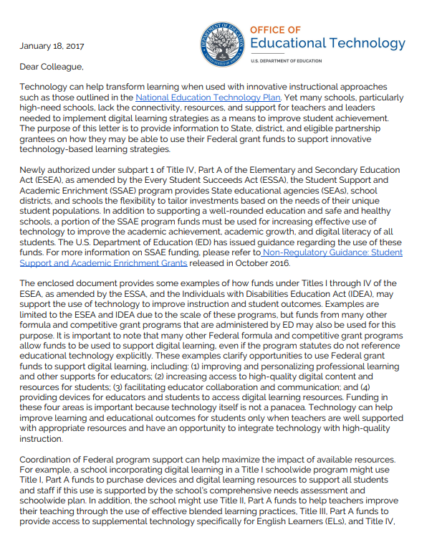
2017 Dear Colleague Letter: Federal Funding for Technology
Provides examples of how funds under Titles I through IV may support innovative technology-based learning strategies to improve instruction and student outcomes.
Categories include:
supporting teaching and learning with technology through professional development,
the development and acquisition of digital materials and resources for students,
educator communication and collaboration online, and
providing devices for educators and students to access digital learning resources.

Slide 13
Professional Development
Support Teachers’ Use of Digital Learning Tools
Provide Online Professional Development
Implement Systems to Collect, Manage, and Analyze Data
Adopt Digital Competency-Based Professional Development
Provide Professional Development on Blended Learning

Slide 14
Student Materials, Resources, and Support
Provide Access to Digital Resources
Enhance Instruction for English Learners with Digital Resources
Support the Use of Technology in the Classroom

Slide 15
Educator Communication and Collaboration
Use Technology to Communicate with Parents
Use Technology to Connect Educators with Science, Technology, Engineering and Mathematics (STEM) Professionals
Participate in English Learner-Focused Communities of Practice

Slide 16
Devices
Provide Students with Mobile Learning Devices
Provide Students with Assistive Technology Devices
Address Readiness Shortfalls

Slide 17
Other Federal Funding Sources for Technology
E-Rate
Provides funding towards eligible services for schools and libraries
Apply for discounts on eligible services (e.g., internet access, telecommunications services, and related equipment)
Affordable Connectivity Program
$14.2b to provide eligible households $30/month for monthly internet
School systems can help communicate and support applications

Slide 18
Agenda
Technology in Schools
Aligning to District Priorities
Technology in Titles I-IV
Application to your context
Closing & Resources

Slide 19
Application to Your Context
Discuss with someone at your table
How is the information presented today making you think about technology investments in your school system?
What questions do you still have?

Slide 20
Agenda
Technology in Schools
Aligning to District Priorities
Technology in Titles I-IV
Application to your context
Closing & Resources

Slide 21
“Technology alone isn’t going to improve student achievement. The best combination is great teachers working with technology to engage students in the pursuit of the learning they need.”
-Arne Duncan
Former U.S. Secretary of Education
Notes:
“Technology itself is only as valuable as its strategic and purposeful application.” -- -yet when you get a fund request… it may just be conveyed to you as – I need devices, I need a subscription to this software….we need more tech staff for repairs…. How can we build an equitable and sustainable system….

Slide 22
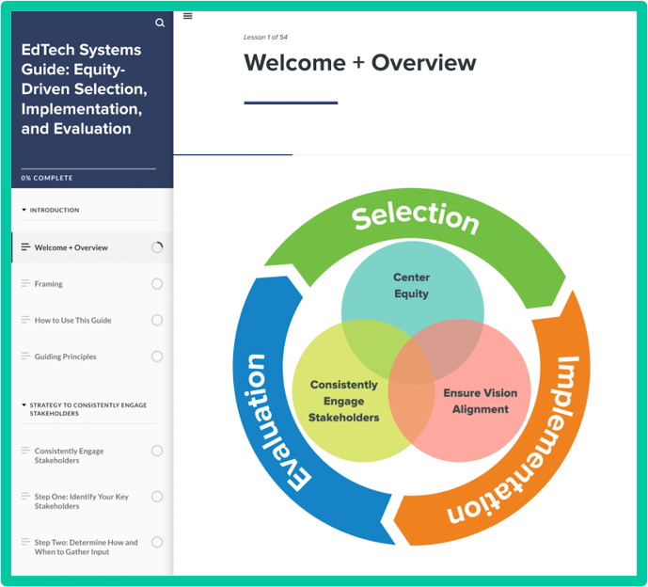
Resources
2017 Dear Colleague Letter
EdTech Systems Guide: Equitable selection, implementation, and evaluation of edtech in schools
Sustaining Access and Equity: EdTech Strategic Planning Guide

