Slide 1
Is it working? Tracking outcomes of Professional Development
Title I & Title IIA Statewide Conference
June 3, 2016

Slide 2
Agenda
Overview of PD cycle
Approaches to measuring outcomes
Leicester Public Schools
Cohasset Public Schools
Questions
Notes:
Excited to be able to include presentations from school districts
Remember that question from last year’s application about how you measure effectiveness of PD? We do use that information.

Slide 3
Context
Nationally, measures of PD quality are not reassuring
There are useful practices in MA and elsewhere
Upcoming TIIA workbook:
Standard 4: “High-quality PD is assessed to ensure that it is meeting the targeted goals and objectives”
Notes:
As Deb mentioned, there’s a question on budget page about how you’ll be tracking outcomes of PD
Adding this to gain information, encourage districts to think about this for a variety of PD, particularly to learn about innovative practices or “other”

Slide 4
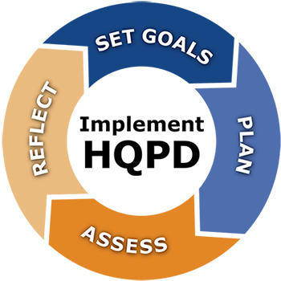
PD Cycle
After selecting PD initiatives…
Create/select the assesment
instruments
Analyze formative PD assessment
data
Collect and analyze final outcome
data
www.doe.mass.edu/pd/PlanAssess/
Title IIA can fund initiatives to determine the effectiveness of PD, as this is part of the Needs Assessment process

Slide 5
Who measures it?
While some districts hire consultants, or have data anlysts track PD outcomes, others may want to increase their current staff’s capacity.
How do we measure it?
May supplement quantitative data with qualititative data
Keep in mind the data that informed the decision to fund this PD in the first place
Notes:
Districts both small and large noted how they take a structured approach to using formal and informal observations to look for changes in teacher practice – especially when it’s not something that’s easily measured by typical assessments (like social-emotional skills)
Who measures it?
Call on Old Colony Voc Tech

Slide 6
What’s the metric?
How some districts measure levels 4 & 5:
Look-fors
Impact on achievement gaps for SPED & ELLs
Pre- and post-assessments of students, purposefully aligned to PD
Student work
Evaluations pertinent to PD initiatives
1. Participant reactions/satisfaction
2. Participants’ learning
3. Organizational change & support
4. Participants’ application of new skills
5. Student outcomes
This doesn’t tell us whether PD met its goals, but it’s a start
Changes showing up in observations
End goal of the PD
It’s not about proving 100% causality
Adapted from Guskey, T. Does it make a difference? Evaluating professional development.
Notes:
We can see that progression up to student outcomes here, with these evaluation levels
Refer to handouts
TEACHER OR STUDENT OUTCOMES?
Often makes more sense to use teacher outcome data; can be better matched to the objectives of the PD
May depend on year of implementation; changes in teacher behavior can manifest earlier than changes in student performance
End goal is to see student outcomes
You’ll see this is adaprted from an article; in that same article, the author notes that it’s not about proving 100% causality, it’s about collecting the evidence that’s available

Slide 7
Purposeful Professional Development
Leicester Public Schools

Slide 8
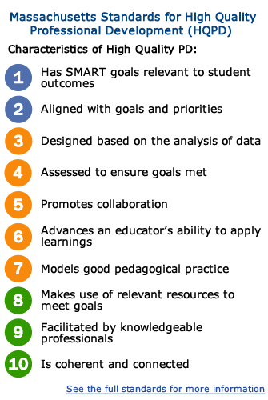
Getting started
We have a Professional Development Committee made up of central office staff, administrators, and teachers that meet on a regular basis to discuss district PD
The PD Committee began by looking at the Massachusetts Standards for High Quality Professional Development
Using sticky notes, members of the committee were asked prioritize the High Quality Indicators
A sideways bar graph showed immediate trends in 4 areas (2, 5, 6 & 10)
The consensus for these areas shaped our district’s HQPD Focus Goals

Slide 9
We have our Focus Goals...now what?
Our next step was determining how to use PD to best meet the needs of our schools
Lesson Study in ¾ of our buildings
Learning Walks in all 4 buildings with a district focus of inquiry: “Students articulate their thinking and reasoning using multiple means of expression”
Differentiation in the area of Mathematics through Looney Consulting in ¾ of our buildings

Slide 10
Feedback
We provided our staff with Professional Development Feedback Sheets that directly correlated with HQPD indicators.
Feedback from all schools was reviewed at Professional Development Committee Meetings.
Learning Walk findings and trends were communicated with staff in 1-2 days.

Slide 11
Next Steps… Increasing Two Way Communication
Root Cause Analysis
Fish Bone Activity
Progress Monitoring Matrix
Completing these analysis activities with our Teacher Leaders, who will in turn bring the information to their grade level teams for feedback

Slide 12
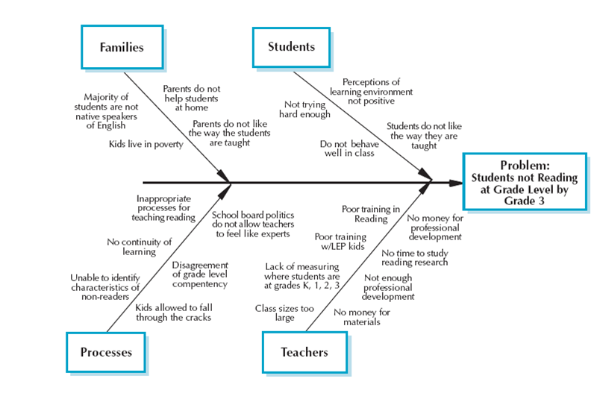
Fishbone Activity

Slide 13
Progress Monitoring Model/Graph
Action Step Progress Indicator | Benchmark/ Progress Monitoring Data | Results | Questions | Next Steps

Slide 14
COHASSET PUBLIC SCHOOL DISTRICT
TITLE IIA
ASSESSMENT OF PROFESSIONAL DEVELOPMENT

Slide 15
ASSESSMENT OF PROFESSIONAL DEVELOPMENT
Enduring Understandings:
All participants are part of the decision and planning of the Professional Development
The initiative fits into the district global needs and other initiatives (Strategic Plan)
All Professional Development initiatives are periodically reviewed and repeated if needed
All Professional Development must either have a resulting product or data evaluation

Slide 16
INITIAL STEPS:
Survey, email, etc. of staff and/or have committees identify major professional development needs
Initiatives selected address district goals
Educators who are involved in the Professional Development are aware and in agreement: it is strongly supported or initiated by educators
ESSENTIAL QUESTION THAT DRIVES PD:
How do we know that the Professional Development plan includes all stakeholders’ input, impacts teaching and learning, is measurable, and is sustainable?

Slide 17
PD Initiatives
Wilson Reading
Technology
Positive Behavior Intervention Support
I AM (PBIS: FISH)

Slide 18
Questions?

Slide 19
Parting words
“Keep in mind, too, that good evidence is not that hard to come by if you know what you're looking for before you begin. If you do a good job of clarifying your goals up front, most evaluation issues pretty much fall into line. The reason many educators think evaluation at Levels 4 and 5 is so difficult, expensive, and time-consuming, is because they are coming in after the fact to search for results. It is as if they are saying, ‘We don't know what we are doing or why we are doing it, but let's find out if anything happened.’ If you don’t know where you are going, it’s very difficult to tell if you’ve arrived.” -Guskey, T. Does it make a difference? Evaluating professional development. ASCD 59(6) March 2002 p. 45-51

Slide 20
Parting words
“There is no question that evaluating the impact of professional development is more complex than evaluating the effectiveness of a new drug or medical treatment. There are more intervening steps… But hard is not impossible.”
“The payoff will come not only in increased teacher productivity and satisfaction, but also, and more importantly, in increased student learning and growth.” – Noyce, P. Sept. 12, 2006. Professional Development: How Do We Know if it Works? Education Week. 26 (3) pp. 36-37.
Notes:
Pendred Noyce, BESE member
Yes, these two authors do have differing opinions about just how difficult it is to do this

Slide 21
Thank you!
TitleIIAGrants@doe.mass.edu

