Slide 1
FY23 Chapter 70 aid and Charter reimbursements
July 28, 2022

Slide 2
FY23 Chapter 70 funding
01

Slide 3
FY23 Chapter 70 continues implementation of the Student Opportunity Act (the Act)
FY23 Chapter 70 is $5,998,209,887, a $494.9 million increase (9.0%) over FY22
The Act establishes new, higher foundation budget rates in 5 areas:
Benefits and fixed charges
Guidance and psychological services
Special education out-of-district tuition
English learners
Low-income students
FY23 Chapter 70 includes rate changes above inflation toward the goal rates in these 5 areas and closes 2/6th of the gap
Notes:
Rob O.

Slide 4
The low-income threshold is set at 185% of the federal poverty level in accordance with the Act
The Act restores the definition of low-income enrollment used prior to FY17, based on 185% of the federal poverty level, up from the 133% threshold used for the economically disadvantaged match from FY17 to FY22
Statewide low-income enrollment for FY23 is 407,501, compared to 382,088 for FY22
For FY23, the Department designates a student enrolled on October 1st as low income if the student is:
Identified as participating in state public assistance programs, including the Supplemental Nutrition Assistance Program, Transitional Aid to Families with Dependent Children, MassHealth, and foster care; or
Verified as low income through the new supplemental data collection process; or
Reported by a district as homeless through the McKinney-Vento Homeless Education Assistance program application

Slide 5
The Act also increases the assumed in-district special education enrollment percentages
The Act increases the rate for vocational students from 4.75% to 5% and from 3.75% to 4% for non-vocational students
Proposed rate increases for FY23 close an additional 1/6th of the gaps, so the factors used for FY23 are 4.86% and 3.86%, respectively

Slide 6
On top of the targeted rate increases, all foundation budget categories have been adjusted upward to account for inflation
An employee benefits inflation rate is applied to the employee benefits and fixed charges category
Based on the enrollment-weighted, three-year average premium increase for all GIC plans
For FY23 the increase is 4.51%
An inflation increase of 4.50% has been applied to all other foundation budget rates, based on the U.S. Department of Commerce’s state and local government price deflator and capped at the 4.50% maximum set in the Act

Slide 7
The Act also adds a new minimum aid adjustment to the formula
This provision provides hold harmless aid to operating districts that otherwise would have lost aid due to the new foundation budget factors
Determines the aid that these districts would have received if foundation budget rates were only increased by inflation
If this amount is higher than the revised formula amount, districts get the higher amount

Slide 8
The Act codified the aggregate wealth model for determining local contribution requirements
For municipalities with required contributions above targets, the requirement is reduced by 100% of the gap
Cities and towns with combined effort yields greater than 175% of foundation have required local contributions set at not less than 82.5% of foundation
Due to rapid increases to foundation, many communities are below target and fewer are eligible for excess effort reductions
247 communities are subject to below effort increments to bring their contributions closer to target compared to 52 in FY22
27 communities are eligible for excess effort reduction compared to 200 in FY22

Slide 9
Charter school tuition and reimbursements
02

Slide 10
Tuition rates for Commonwealth charter schools are based on the same foundation budget rates used in Chapter 70
Foundation budget rate increases being implemented in FY23 have been incorporated into our projected FY23 tuition rates
In addition, charter school low-income enrollment for FY23 has been identified using the same eligibility criteria used for districts (see slide 4)
Notes:
Updated 1/20/22

Slide 11
FY23 budget implements the 3-year (100%/60%/40%) schedule for transition aid tied to year over year tuition growth
Funding for first year reimbursements is prioritized over funding for second year reimbursements
The reimbursement formula for transitional aid to districts reflects the change enacted by Section 38 of the FY20 budget, with an entitlement of 100% of any tuition increase in the first year, 60% in the second year, and 40% in the third year
The Act requires that 90% of the total state obligation to be funded in FY23 and 100% in FY24 and subsequent years
FY23 budget allocates $243.8 million for these reimbursements
This appropriation level is expected to meet or exceed the 90% requirement when tuition assessments are updated to reflect actual enrollments and district spending levels
The facilities component of the tuition rate is $1,088 per pupil, with this cost fully reimbursed by the state as in prior years
Notes:
Updated 6/16/22

Slide 12
Calculating Chapter 70 local contribution requirements and state aid
03

Slide 13
Goal of the Chapter 70 formula
To ensure that every district has sufficient resources to meet its foundation budget spending level, through an equitable combination of local property taxes and state aid.

Slide 14
The updated formula includes three parameters to be specified in each year’s general appropriations act
For FY23, these are specified as:
Total state target local contribution = 59%
Effort reduction = 100%
Minimum aid = $60 per pupil
Notes:
Updated 5/16/22

Slide 15
There are 6 factors that work together to determine a district’s Chapter 70 aid
Foundation Budget
Enrollment
Wage Adjustment Factor
Inflation
Local Contribution
Property value
Income
Municipal Revenue Growth Factor

Slide 16
There are three primary steps in determining each district’s Chapter 70 aid
Determine an equitable local contribution requirement, how much of the foundation budget that should be paid for by each city and town’s property tax, based upon the relative wealth of the municipality
Define and calculate a foundation budget for each district, given the specific grades, programs, and demographic characteristics of its students
Calculate state aid, providing necessary funds to reach foundation or mandated minimum aid increases
Local Contribution + State Aid = a district’s net school spending (NSS) requirement
This is the minimum amount that a district must spend to comply with state law

Slide 17
Each district's foundation budget is calculated by multiplying the number of pupils in 13 enrollment categories by cost rates in 11 functional areas
FY23 Chapter 70 Foundation Budget
239 | Plymouth |  |  |  |  |  | 6 | 8 |  | 9 | 10 | 11 | 12 | 13 | 14
 |  | Base Foundation Components |  |  |  |  |  |  |  | Incremental Costs Above the Base
 |  | 1 | 2 | 3 | 4 | 5 | 6 | 7 |  | 8 | 9 | 10 | 11 | 12 | 13 | 14
 |  |  | ------ Kindergarten ------ |  |  | Junior/ | High |  |  | Special Ed | Special Ed | English learners | English learners | English learners
 |  | Pre-school | Half-Day | Full-Day | Elementary | Middle | School | Vocational |  | In-District | Tuitioned-Out | PK-5 | 6-8 | High School/Voc | Low income | TOTAL
 | Foundation Enrollment | 191 | 0 | 548 | 2,639 | 1,744 | 2,061 | 680 |  | 303 | 70 | 164 | 55 | 45 | 2,693 | 7,768
1 | Administration | 41,953 | 0 | 240,727 | 1,159,269 | 766,111 | 905,363 | 298,713 |  | 918,630 | 236,845 | 17,204 | 6,090 | 4,649 | 181,773 | 4,777,328
2 | Instructional Leadership | 75,767 | 0 | 434,777 | 2,093,751 | 1,383,669 | 1,635,173 | 539,504 |  | 0 | 0 | 30,105 | 10,656 | 8,136 | 861,167 | 7,072,703
3 | Classroom & Specialist Teachers | 347,419 | 0 | 1,993,569 | 9,600,280 | 5,583,107 | 9,702,762 | 5,442,249 |  | 3,031,244 | 0 | 210,730 | 74,592 | 56,948 | 8,406,687 | 44,449,587
4 | Other Teaching Services | 89,102 | 0 | 511,312 | 2,462,322 | 1,171,366 | 1,152,409 | 380,222 |  | 2,830,230 | 3,618 | 30,105 | 10,656 | 8,136 | 0 | 8,649,478
5 | Professional Development | 13,740 | 0 | 78,882 | 379,928 | 272,165 | 311,869 | 170,120 |  | 146,224 | 0 | 8,600 | 3,045 | 2,324 | 407,837 | 1,794,735
6 | Instructional Materials, Equipment & Technology* | 48,489 | 0 | 278,252 | 1,339,979 | 885,533 | 1,674,356 | 966,749 |  | 123,076 | 0 | 20,735 | 7,340 | 5,603 | 60,296 | 5,410,409
7 | Guidance & Psychological Services | 30,336 | 0 | 174,091 | 838,371 | 655,935 | 910,343 | 300,356 |  | 0 | 0 | 12,901 | 4,567 | 3,486 | 340,395 | 3,270,782
8 | Pupil Services | 10,054 | 0 | 57,714 | 416,845 | 449,980 | 1,226,251 | 404,586 |  | 0 | 0 | 4,303 | 1,522 | 1,162 | 1,768,859 | 4,341,276
9 | Operations & Maintenance | 96,474 | 0 | 553,586 | 2,665,901 | 1,909,986 | 2,188,551 | 1,351,418 |  | 1,026,150 | 0 | 51,607 | 18,267 | 13,946 | 0 | 9,875,888
10 | Employee Benefits/Fixed Charges* | 124,454 | 0 | 714,132 | 3,439,118 | 2,388,425 | 2,527,116 | 1,137,620 |  | 1,122,251 | 0 | 45,620 | 16,147 | 12,328 | 1,311,329 | 12,838,541
11 | Special Education Tuition* | 0 | 0 | 0 | 0 | 0 | 0 | 0 |  | 0 | 2,168,486 | 0 | 0 | 0 | 0 | 2,168,486
12 | Total | 877,788 | 0 | 5,037,043 | 24,395,765 | 15,466,277 | 22,234,193 | 10,991,536 |  | 9,197,806 | 2,408,949 | 431,910 | 152,881 | 116,719 | 13,338,344 | 104,649,212
13 | Wage Adjustment Factor | 103.7% |  |  |  |  |  |  |  |  |  |  | Foundation Budget per Pupil |  |  | 13,472
 | *The wage adjustment factor is applied to underlying rates in all functions except instructional equipment, benefits and special education tuition.
14 | Low-income percentage | 35.54% |  |  |  |  |  |  |  |  | English learner foundation budget as % total foundation budget |  |  |  |  | 0.7%
15 | Low-income group | 6 |  |  |  |  |  |  |  |  | Low-income foundation budget as % total foundation budget |  |  |  |  | 12.7%
All of your students are counted in categories 1−7; special education, English learner, and low-income costs are treated as costs above the base and are captured in 8−13
Notes:
Updated 1/26/22

Slide 18
Foundation budgets vary based on student needs, including concentrations of low-income students
Note: Chart excludes vocational and agricultural districts.
Notes:
Updated 1/26/22

Slide 19
Determining each municipality’s target local share starts with the local share of statewide foundation
Calculate statewide foundation budget
Determine target local share of statewide foundation
Statewide, determine percentages that yield ½ from property and ½ from income
Statewide foundation budget
$12.890B
41% State aid
$5.285B
59% Local contribution
$7.605B
Income effort
1.5242%
$3.803B
Property effort
0.3624%
$3.803B
Property and income percentages are applied uniformly across all cities and towns to determine the combined effort yield from property and income.
Notes:
Updated 1/11/22

Slide 20
An individual municipality’s target local share is based on its local property value, income, and foundation budget
The sum of a municipality’s local property and income effort equals its Combined Effort Yield (CEY)
Target Local Share = CEY/Foundation budget (calculated at the city/town level)
Capped at 82.5% of foundation (168 municipalities or 48% are capped)
2019 aggregate income X Statewide Income % 1.5242%
2020 EQV X Statewide Property % 0.3624%
CEY
Notes:
Updated 1/11/22

Slide 21
Next the formula calculates each municipality’s preliminary local contribution (PLC) and makes adjustments relative to target to determine the required local contribution (RLC)
Preliminary contribution Required contribution
Increase last year’s required local contribution by the MRGF
If the PLC as a % of foundation< target
If the difference is < than 2.5%, the PLC is the new requirement
If the difference is > 7.5%, add 2% to PLC
If the PLC as a % of foundation > target
Reduce PLC by 100% of the gap
If the difference is between 2.5% and 7.5%, add 1% to PLC
Municipal Revenue Growth Factors (MRGF) are calculated annually by the Department of Revenue. MRGFs quantify the most recent annual % change in each municipality’s local revenues, such as the annual increase in the Proposition 2½ levy limit, that should be available for schools
Notes:
All set 1/11/22

Slide 22
Once a city or town’s required local contribution is calculated, it is allocated among the districts to which it belongs
Town of Dartmouth
Notes:
Updated 1/11/22

Slide 23
Foundation aid provides additional funding for districts to spend at their foundation budgets
Foundation budget – Required local contribution = Foundation aid
Start with prior year’s aid
Add together the prior year’s aid and the required local contribution
If this year’s foundation aid exceeds last year’s total Chapter 70 aid, the district receives the amount needed to ensure it meets its foundation budget
(2) This year’s required local contribution
Prior year’s aid
(3) Foundation aid increase
(1) Foundation budget

Slide 24
Calculating Chapter 70 aid: Districts are held harmless to previous aid levels and the Act guarantees at least a $30 per pupil increase
Districts are held harmless to the previous year’s level of aid
In HWM and SWM budgets, 142 districts receive minimum aid increases of $60 per pupil over FY22
FY23 Chapter 70 Summary
670 | Frontier
Aid Calculation FY23
Prior Year Aid
1 | Chapter 70 FY22 | 2,872,335
Foundation Aid
2 | Foundation budget FY23 | 6,777,309
3 | Required district contribution FY23 | 5,342,316
4 | Foundation aid (2 -3) | 1,434,993
5 | Increase over FY22 (4 - 1) | 0
Minimum Aid
6 | Minimum $60 per pupil increase | 30,900
7 | Minimum aid amount
 | (if line 6 - line 5 > 0, then line 6 - line 5, otherwise 0) | 30,900
Subtotal
8 | Sum of 1,5,7 | 2,903,235
Minimum Aid Adjustment
9 | Minimum aid adjustment | 2,887,785
10 | Aid adjustment increment
 | (if line 9 - line 8 > 0, then line 9 - line 8, otherwise 0) | 0
Non-Operating District Reduction to Foundation
11 | Reduction to foundation | 0
FY23 Chapter 70 Aid
12 | Sum of 1,5,7,10 minus 11 | 2,903,235
Notes:
Updated 5/11/22

Slide 25
Districts receive different levels of Chapter 70 aid because their municipality’s ability to pay differs
Notes:
Updated 5/12/22

Slide 26
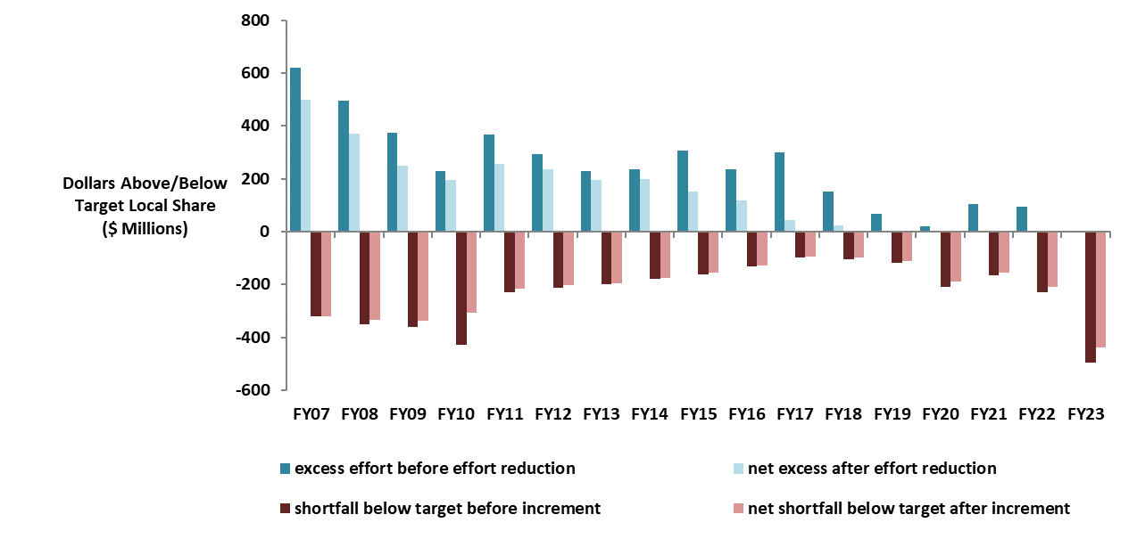
The aggregate wealth model has eliminated required excess effort, but in recent years effort shortfalls have increased
For communities that are below target, recent expansions in foundation budgets have resulted in required contributions not keeping pace with the foundation budget increases
Notes:
Updated 1/26/22

Slide 27
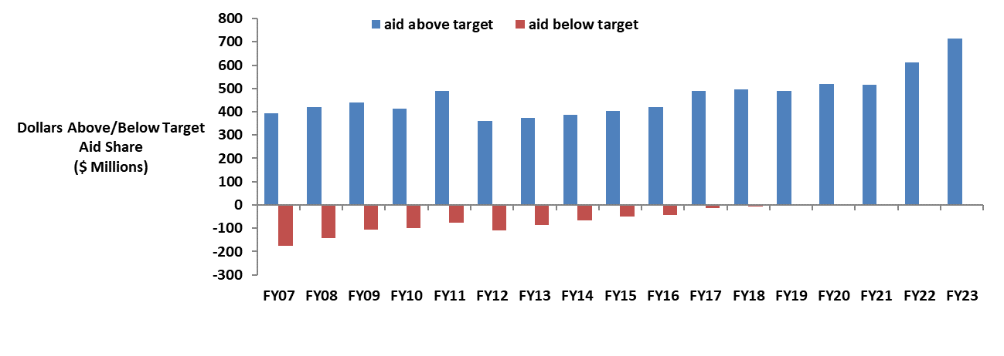
There are no longer any districts funded below target, while above target aid has increased
Notes:
Updated 5/11/22

Slide 28
Questions?
QUESTIONS?
Rob O’Donnell, Director of School Finance
Rob Hanna, State Aid Programs Manager
Robert.F.O’Donnell@mass.gov
781.338.6512
Robert.Hanna@mass.gov
781.338.6525

