Slide 1
Data Collection Changes for 2018-19 school year Melissa Marino, Data Collection Supervisor June 2018

Slide 2
Contents
01
Reminders
02
SIF Expectations for 2018-19
CONTENTS
03
SIMS, EPIMS & SSDR changes
04
SIF specific changes
05
Questions

Slide 3
Reminders
01

Slide 4
Things to remember
Updated versions of the data handbooks will be posted this summer. For October, remember to refer to the updated data handbooks and error lists to help with your data submissions.
Add ‘SIMS Contact’, ‘EPIMS Contact’, and/or ‘SSDR Contact’ functions to your security portal access if you want to be included in data collection related communication from DESE on these topics.
Remember to do a clean up of Directory Administration for your district to reflect any necessary changes for the new school year.

Slide 5
SIF Expectations for 2018-19
02

Slide 6
SIF Timeline & Expectations
88% of districts (380 total) are now live in SIF. Most of these districts are SIF in all collections (SIMS, SCS, EPIMS, SSDR)
Of the 12% of districts remaining (51 total), 34 already use a MA SIF certified SIS vendor and are expected to onboard to SIF for the October 2018 collection period.
The remaining 4% of districts do not have a MA SIF certified SIS. Our focus next year will be working with these remaining districts on a plan/path toward SIF.

Slide 7
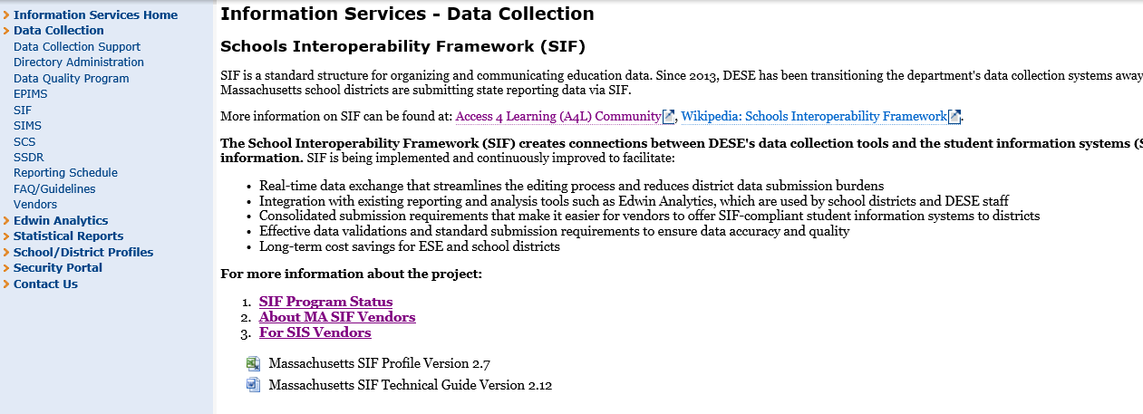
More information on SIF
http://www.doe.mass.edu/infoservices/data/sif/

Slide 8
SIMS, EPIMS & SSDR changes
03

Slide 9
SIMS DOE026: English Language Education Program Status
This element will have one additional acceptable value
Acceptable Values:
00 Not enrolled in an English language education program
01 Sheltered English Immersion
02 Two-Way Bilingual
03 Other Bilingual Education
04 Parent/guardian consented to opt out of all ELE programs offered
05 Transitional Bilingual Education **new value**
Transitional Bilingual Education = An instructional program in which the native language of the EL student is used to support the student’s development of English and content learning and is then gradually phased out of instruction as a student’s English proficiency increases.

Slide 10
SIMS DOE028: Seal of Biliteracy
This is a new data element
Acceptable Values:
00 Student does not have the Seal of Biliteracy
01 Student has earned the Seal of Biliteracy
The Seal of Biliteracy is a state seal that certifies attainment of biliteracy skills.
This element will identify students who have earned the seal on their high school diploma.
In addition to meeting graduation requirements, the student must meet state criteria in attaining a high level of proficiency in English and at least one other language in order to earn the seal. More specific information on this criteria coming soon.

Slide 11
SIMS DOE031: CVTE Competency Attainment
This element will have nine values removed
Acceptable Values:
01 Completed Chapter 74 Program (note: language changing from “Chapter 74 Certificate” to “Completed Chapter 74 Program”)
11 Completed Non-Chapter 74 Program
500 Does not apply
This element is being consolidated into two categories – one for students who have completed a Chapter 74 Program, and one for students who completed a Non-Chapter 74 Program
The other nine values are being removed because they are redundant to the new Industry Recognized Credentials elements (DOE047, DOE048, DOE049) that are being added to SIMS for 2018-19.

Slide 12
SIMS DOE045: High Quality Career Pathways Program Type
This is a new data element
Acceptable Values:
500 Does not apply to student
01 Innovation Pathway
02 Early College
Innovation Pathway = Structures within our high schools that are designed to connect student learning to a broadly-defined industry sector that is in demand in the regional and state economy.
Early College = Structured partnerships between at least one institution of higher education and one K-12 partner
** This field is only applicable to districts that have received a designation for one of these new structures. For more information on these pathways, and how to apply for designation: http://www.doe.mass.edu/ccte/ccr/hqccp

Slide 13
SIMS DOE046: High Quality Career Pathways Program Participation
This is a new data element
Acceptable Values:
500 Does not apply to student 54 Scientific Research and/or Engineering
11 Agriculture and/or Environmental Science 55 Business Administration
22 Utilities and Clean Energy 61 Education
23 Construction 62 Health Care and Social Assistance
31 Manufacturing 71 Arts, Entertainment, and Recreation
44 Retail 72 Accommodation and Food Services
48 Transportation 81 Other Industry Sector
51 Information Technology 91 Public Administration
52 Finance and Insurance 95 No Industry Sector
53 Real Estate
This element will capture the industry concentration for students enrolled in a High Quality Career Pathway.

Slide 14
SIMS DOE047,048,049: Industry Recognized Credentials
These are a new data elements. The three elements are identical, allowing for up to 3 credentials to be reported per student
These three elements are identical, allowing for up to three Industry Recognized Credentials (IRC’s) to be reported per student.
These credentials fields will be applicable to any student in grades 9 through 12.
There are approximately 200 reportable values for these fields, representing certifications from several industries (agriculture, business, construction, health, education, manufacturing, technology etc.)

Slide 15
SIMS DOE050: Early Childhood Education Experience
This is a new data element
Reportable Values:
99 Not Applicable
00 Information not provided
01 No formal early childhood program experience
02 Family Support: Coordinated Family and Community Engagement (CFCE)
03 Family Support: Parent Child Home Program (PCHP)
04 Family Support: Both CFCE & PCHP
05 Formal: Licensed Family Child Care Provider < 20 hours per week
06 Formal: Licensed Family Child Care Provider =>20 hours per week
07 Formal: Center Based Program < 20 hours per week
08 Formal: Center Based Program => 20 hours per week
09 Formal: BOTH Family Child Care Provider and Center Based Program < 20 hours per week
10 Formal: BOTH Family Child Care Provider and Center Based Program => 20 hours per week

Slide 16
SIMS DOE050: Early Childhood Education Experience
This element will identify the type of early childhood education experience a student has in the school year prior to Kindergarten.
This element is specifically applicable to Kindergarten students. Kindergarten students must be reported with a value other than 99. Sample survey for collecting this information from families will be available.
PK students should be reported as 99.
Students grades 1 through SP can be reported with any value in this field.

Slide 17
EPIMS SR36 & SR37: Staff Attendance
These elements will have one additional acceptable value
New value:
999 Not applicable
This N/A value will be added to allow districts to not report attendance data for active working staff in October. Attendance data will not be required in October for active staff, but will be required for exited staff.
In EOY, attendance data will be required for all staff.

Slide 18
EPIMS WA07: Job Classification
This element will have three additional acceptable values
New values:
1208 Human Resources Director (Manages human resource functions in the district. Reportable at district level only.)
3331 School Resource Officer (Responsible for providing a safe, supportive, and secure learning environment by building and establishing meaningful relationships with students and staff and proactively interacting with the school community. Reportable at district or school level.)
3332 Family Engagement Coordinator (Serves as a liaison between schools and families with the goal of improving communication, promoting parent/guardian engagement, and encouraging greater community involvement. Reportable at district or school level.)

Slide 19
SSDR Discontinued Elements
These elements will be discontinued and no longer collected starting in 2018-19
APPEAL: Appeal Indicator
NAE: Education Services Not Provided
AEX: Education Services Description

Slide 20
SSDR AE: Alternative Education
This element will have additional acceptable values (a consolidation of the multiple alternative education fields)
Reportable values:
0 Education Services plan not offered (only applicable for disciplines 10 days or less)
1 Home tutoring
2 In-district education services
3 Out-of-district education services
6 Distance learning
7 Saturday school
9 Student refused services
10 Student did not respond to offer
11 Student moved or transferred

Slide 21
SSDR OT1-OT5: Offense Type
This element will have two values removed
The values being removed:
MA04 Threat of Robbery
MA14 Rifle
These categories are covered by other reportable values, and are being removed to streamline the code set and remove redundancies.

Slide 22
SSDR ARREST: School Related Arrest
This is a new data element
Reportable values:
No
Yes
This element on the discipline record will indicate when a student is arrested for any activity conducted on school grounds, during school activities, or due to a referral by any school official.

Slide 23
SIF specific changes
04

Slide 24
SASID Requests via SIF
EOE IT is currently testing the process by which SIF will be the vehicle for an incoming SASID request (instead of the manual SSR or MSR process).
The logic will recognize incoming student personal objects with “REQUEST” in the SASID field as a request to apply for a SASID, and the results will be published in a report in the “SIF Reports” area of the Security Portal. The results will also go to the usual landing spot (Publish Manager).

Slide 25
SIF new elements
Two new elements will be mapped to the MA SIF profile to assist in the intake and processing of data. These are not being added to the SIMS official data set - they are just helper fields in the SIF structure.
“Suffix” element will be mapped to the StudentPersonal object in order to facilitate the process of applying for SASIDs via SIF.
“Evaluation Date” data element will be mapped to the SpecialEducationSummary object for validation purposes.

Slide 26
Questions
05

Slide 27
THANK YOU
Melissa Marino DESE Data Collection
mmarino@doe.mass.edu

