Slide 1
Data Collection Changes for 2019-20 school year Rob Curtin - Associate Commissioner, Data and Accountability April 2019

Slide 2
Contents
01
Reminders
02
SIF Expectations for 2018-19
CONTENTS
03
SIMS, EPIMS & SSDR changes
04
Questions

Slide 3
Reminders
01

Slide 4
Things to remember
Updated versions of the data handbooks will be posted this summer. For October, remember to refer to the updated data handbooks and error lists to help with your data submissions.
Add ‘SIMS Contact’, ‘EPIMS Contact’, and/or ‘SSDR Contact’ functions to your security portal access if you want to be included in data collection related communication from DESE on these topics.
Remember to do a clean up of Directory Administration for your district to reflect any necessary changes for the new school year.

Slide 5
SIF Expectations for 2019-20
02

Slide 6
SIF Timeline & Expectations
97% of districts (397 total) are now live in SIF. Most of these districts are SIF in all collections (SIMS, SCS, EPIMS, SSDR)
Per my email to impacted Superintendents on February 5th, all districts will be required to submit October 1, 2019 via SIF
If your district is not in production for SIF, please contact your SIS vendor.

Slide 7
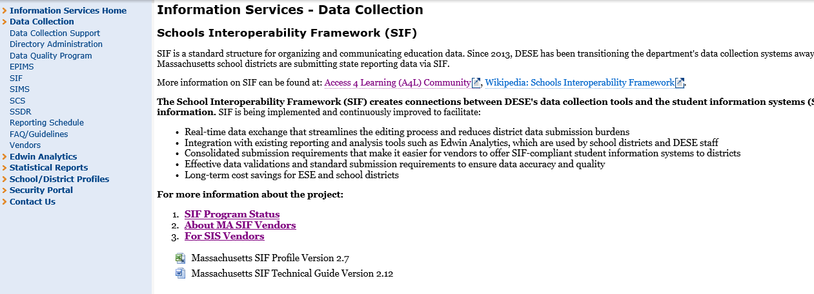
More information on SIF
http://www.doe.mass.edu/infoservices/data/sif/

Slide 8
SIMS, EPIMS & SSDR changes
03

Slide 9
SIMS DOE013: Reason for Enrollment
This element will have one additional acceptable value
Acceptable Values:
Allows for districts that are receiving a foster care student living in another town.
01 | Resident/ Member
02 | School Choice (DOE – School Choice Program)
03 | Charter School
04 | METCO
05 | Tuitioned in — Chapter 74
06 | Tuitioned — Out of State
07 | Tuitioned out — Private school or Collaborative Program
08 | Tuitioned in — Paid by parent/guardian
09 | Tuitioned in — Waived by local agreement
10 | Tuitioned in — Agreement with another in-state district
11 | Foreign Exchange student
12 | Receiving – Foster Care Student

Slide 10
SIMS DOE028: Seal of Biliteracy
This element will have an additional acceptable value
Acceptable Values:
00 – Student does not have a seal of biliteracy
01 – Student has earned a seal of biliteracy
02 – Student has earned a seal of biliteracy with distinction

Slide 11
SIMS DOE033: High School Completer Plans
This element will have a value amended
Acceptable Values:
01 | Four-Year Public College
02 | Two-Year Public College
03 | Four-Year Private College
04 | Two-Year Private College
05 | Other Post Secondary (Trade School)
06 | Work
07 | Military
08 | Other (e.g., travel, family)
09 | Plans Unknown
10 | REGISTERED Apprenticeship
500 | Post-Graduate Plans does not apply to this student at this time

Slide 12
SIMS DOE047-49: Industry Recognized Credentials
This element will have additional acceptable values found in APPENDIX D of the SIMS handbook
Acceptable Values:
Code 193: REPLACE “MA DEP Wastewater Operator certification” with “MA DEP Wastewater Operator license”
Code 196: HIPAA Certification
Code 197: CIW Site development assistant
Code 198: CIW JavaScript specialist
Code 199: CIW Advanced HTMLS and CSS3 specialist
Code 200: MA DEP Drinking Water Supply Facility Operator License

Slide 13
SIMS DOE051: Student zip code
This is a new data element
Acceptable Values: ESE will collect the 5-digit zip code for all students submitted in SIMS.
The zip code will be collected IN ADDITION to town of residence
ESE will not collect the “last four” of the zip code

Slide 14
Reporting Questions on DOE051 Student Zip Code
What if a student’s residence info is prohibited?
We are collecting zip code only, not street address
Should we use residential zip or mailing zip?
Residential zip code
Does DOE51 validate against DOE11, 12, 13 & 14?
DOE051 will be validated against town of residence (DOE014)
We have homeless students that we report with an 'adjusted city' of our district. Zip code will not match the town of residence. Will this error?
No this will not result in error. Students that are reported as homeless (homeless flag set to Y) will be excempt from the DOE051/DOE014 validation.

Slide 15
EPIMS WA07: Job Classification
This element will have an additional acceptable value
New values:
3333 – Pathways Coordinator – available under the Instructional Support job classification category

Slide 16
SSDR – Law Enforcement Referral
This is a new data element required by ESSA for federal reporting purposes
Acceptable Values:
ESE will collect whether each incident reported in the SSDR resulted in a referral to law enforcement (yes or no).
Definition: Is an action by which a student is reported to any law enforcement agency or official, including a school police unit, for an incident that occurs on school grounds, during school-related events, or while taking school transportation, regardless of whether official action is taken. Citations, tickets, court referrals, and school-related arrests are considered referrals to law enforcement.

Slide 17
ADDITIONAL ITEM: Allegations of bullying
State law requires the ESE to collect three things in relation to bullying from all MA districts and schools:
The number of allegations of bullying
The number of substantiated incidents of bullying
The associated disciplines with substantiated incidents of bullying
ESE collects numbers 2 and 3 through the SSDR
Reminder: all incidents of bullying need to be reported through the SSDR regardless of discipline (either no discipline or less than suspension)
Allegation counts will be collected via a different collection mechanism and will not be done at the individual level
MUCH more detail and PD to come on this element.

Slide 18
SSDR Reporting Questions
Will vaping incident codes be added to the SSDR offenses category for 2020? If so, should we differentiate between vaping tobacco versus marijuana?
The offense is the substance and not the mechanism. So vaping should either be reported as a tobacco offense, or a marijuana offense. The fact that it was a vaping device can be indicated in the offense or incident description field.
Will there be notification of the bullying requirement sent out to administrators?
Yes, requirements will be communicated to administrators as well as data contacts
Does the referral to law enforcement data point start in July 2019 or at the start of the19-20 school year?
The start of the 2019-20 school year.

Slide 19
THANK YOU
Rob Curtin – Associate Commissioner, Data and Accountability
Please contact your data support specialist with any questions!

