Slide 1
ELA and Mathematics
Test Designs for
Grades 3–8
December 2016

Slide 2
Presenters
Amy Carithers, Administrator for ELA
Test Development
Simone Johnson, Administrator for Mathematics Test Development
Robert Pelychaty, Accommodations Coordinator

Slide 3
Agenda
Introduction
Spring 2017 Next-Generation MCAS English Language Arts and Mathematics Tests
  Similarities to and differences from the 2016 tests
  New question types and sample questions
    Accessibility features and accommodations
  Questions and answers

Slide 4
What does “next-generation” mean?
Computer-based
Stronger alignment to the current Massachusetts Curriculum Frameworks
New types of test questions that more deeply assess students’ level of knowledge and ability
Will provide clear signals to students, parents, and educators about readiness for the next grade and college/career
Next-generation ELA and Mathematics tests will be a combination of
  Legacy MCAS items
  Newly developed MCAS items
  PARCC items

Slide 5
Transition to Next-Generation Tests for ELA and Mathematics
2017
CBT required* for gr. 4 and 8
CBT optional for gr. 3, 5, 6, and 7
2018
CBT required* for gr. 4, 5, 7, and 8
CBT optional for gr. 3 and 6
2019
CBT required* for 3–8 and 10
* Paper-based testing will be available for students with disabilities who require a paper-and-pencil test as well as for new ELL students unfamiliar with computers.

Slide 6
Number of Sessions
ELA
Grades 3–5:
3 sessions
Grades 6–8:
2 sessions
Mathematics
Gr. 3–6:
2 non-calculator sessions
Gr. 7–8:
  1 non-calculator session
  1 calculator session
See the test schedule (www.doe.mass.edu/mcas/1617schedule.pdf) for details.

Slide 7
MCAS English Language Arts
(ELA) Test Design

Slide 8
What is the same in ELA from spring 2016 MCAS?
Reading passage sets
  Text types still include Literary and Informational texts.
All test questions are still based on passages.

Slide 9
What is different from spring 2016 MCAS ELA tests?
Computer-based
New types of test questions
Writing at all grades embedded within the ELA test
  Not a separate task like Composition

Slide 10
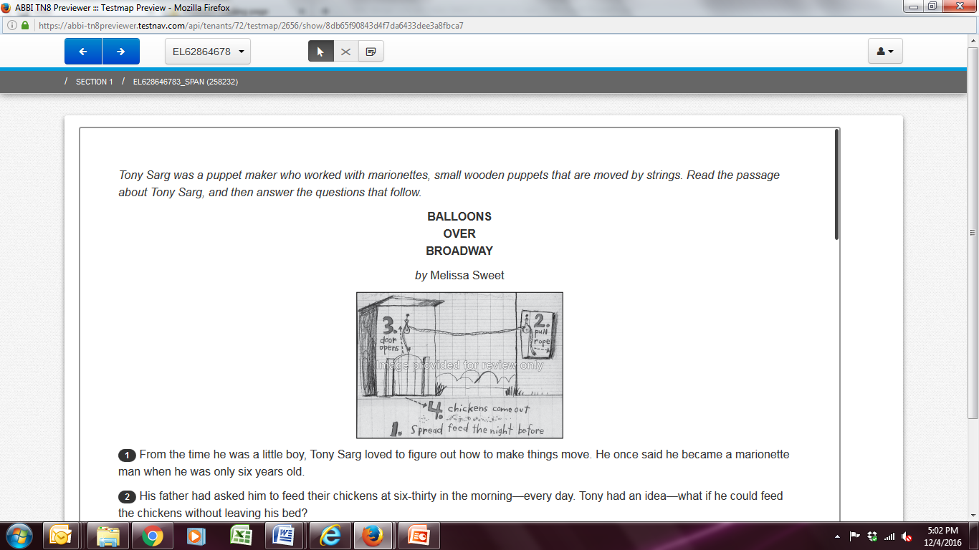
Presentation of Passages for CBT

Slide 11
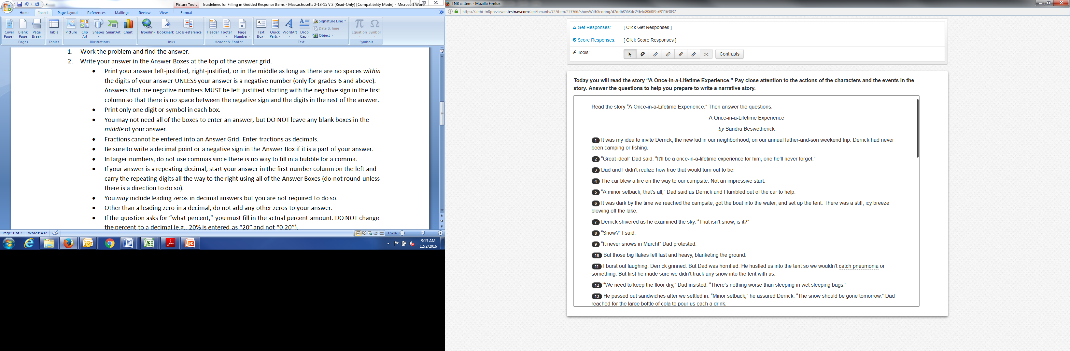
Presentation of Passages

Slide 12
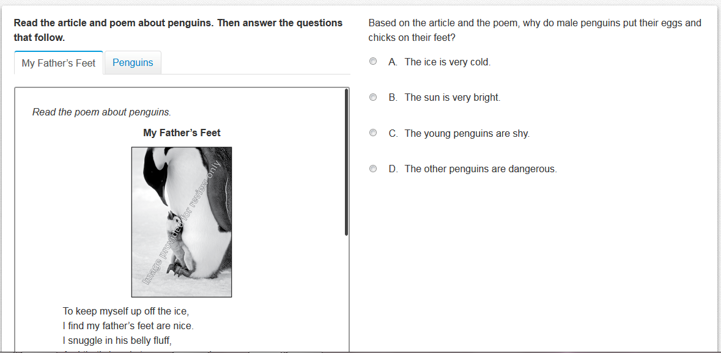
Presentation of Multiple Passages

Slide 13
ELA Item Types
Question Type | Total Points | Domain Assessed | Grade Levels
Multiple Choice Students select the correct answer(s) from among several answer options. | 1 or 2 | Reading Comprehension | Grades 3–8
Technology Enhanced Students taking the computer-based test answer questions using technology such as drag-and-drop or hot spot. | 2 | Reading Comprehension | Grades 3–8
Short Response Students construct a short written response, approximately the length of a paragraph. | 3 | Reading Comprehension | Grades 3 and 4
Narrative Essay* Students write an essay in response to text they have read (expected response length is two pages for grade 3; four pages for grades 4–8). | 6 | Writing | Grades 3–5
 | 7 |  | Grades 6–8
Text-Based Essays Students write an essay in response to text(s) they have read (expected response length is one page for grades 3–5; two pages for grades 6–8). | 7 | Reading Comprehension and Writing | Grades 3–5
 | 8 |  | Grades 6–8
http://www.doe.mass.edu/mcas/tdd/ela.html?section=testdesign

Slide 14
Reading Comprehension Item Types
Multiple Choice: worth one and two points
Technology Enhanced: worth two points
Short Response (SR): a short written response, approximately the length of a paragraph (grades 3 and 4 only) and worth three points

Slide 15
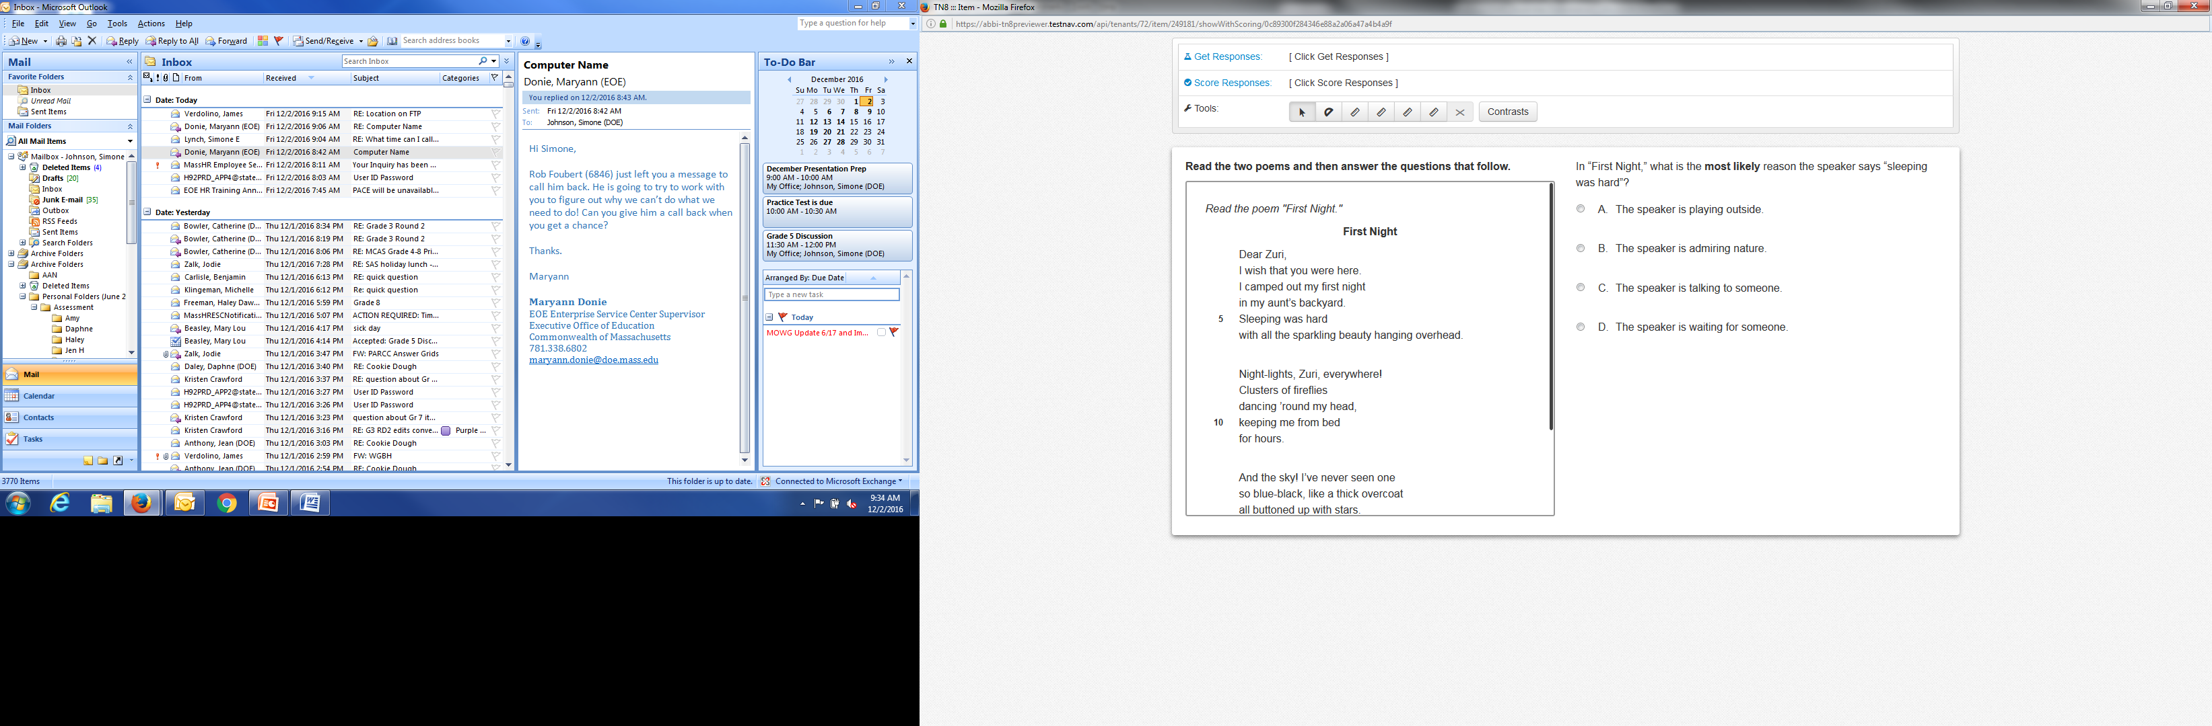
1-Point Multiple-Choice Item

Slide 16
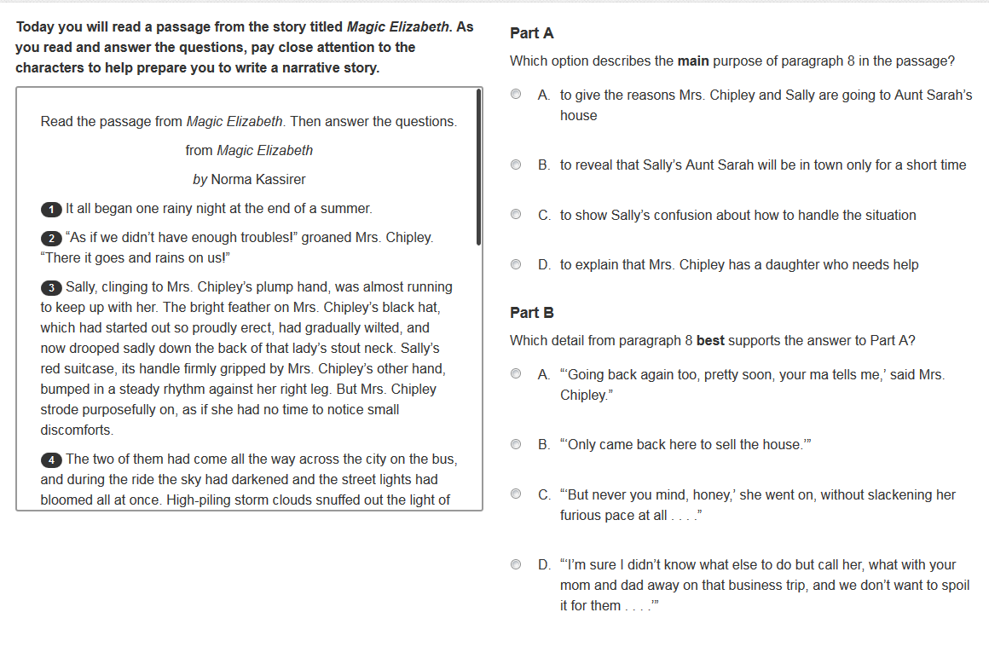
2-Point Multiple-Choice Item

Slide 17
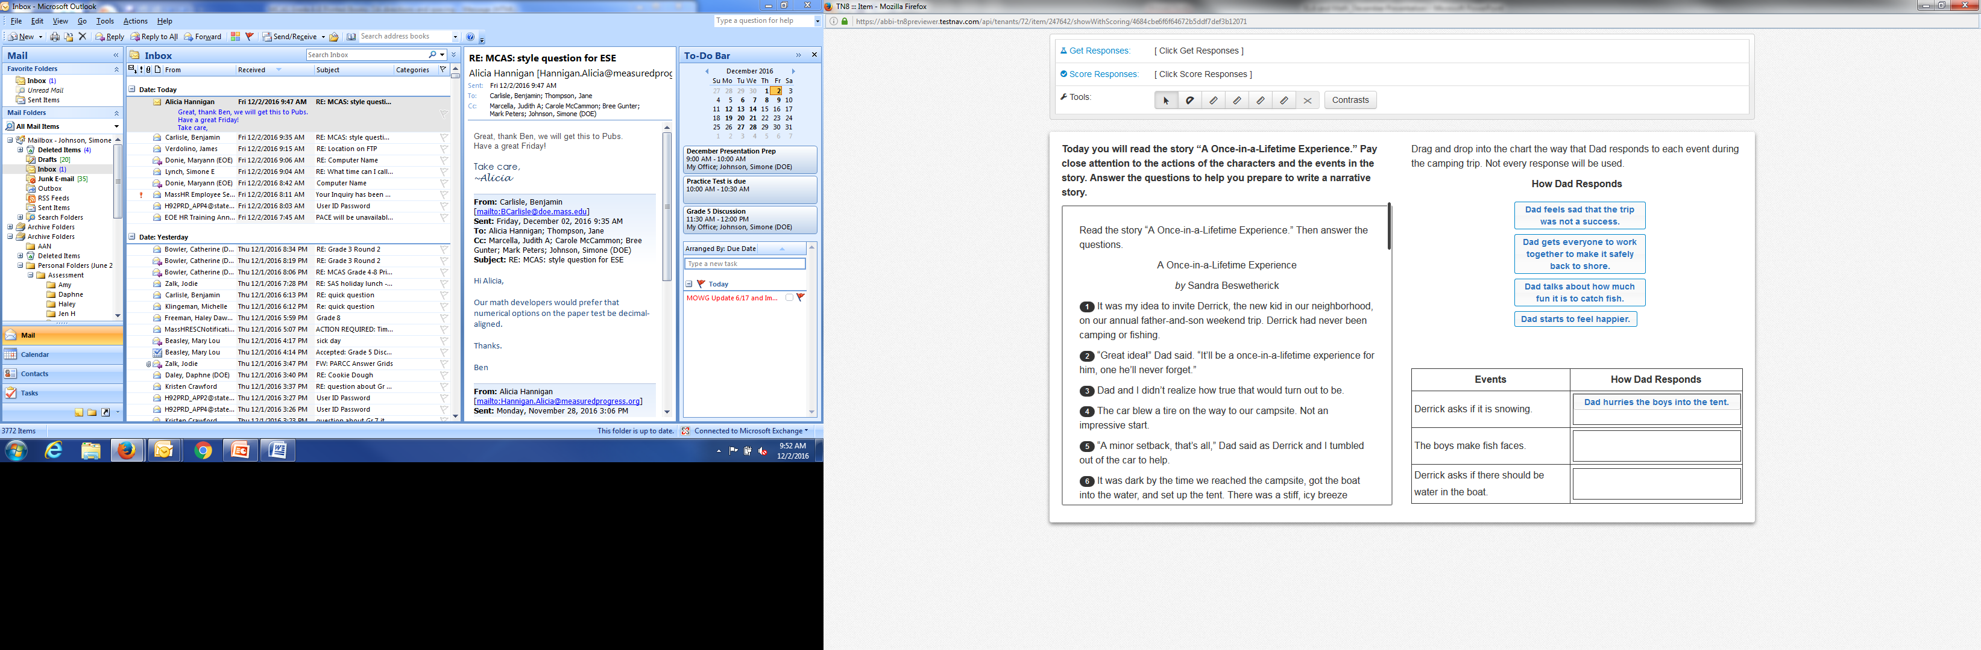
Technology Enhanced Item

Slide 18
Writing Item Types: Grades 3–8
Response to reading, including essays
Scored in both reading comprehension and writing

Slide 19
Writing Expectations
Paper-based test
  Narrative Essay:
    Gr. 3: 2 pages
    Gr. 4–8: 4 pages
  Text-Based Essays:
    Gr. 3–5: 1 page
    Gr. 6–8: 2 pages
Computer-based test
  Students type responses into boxes that provide a similar amount of space to the paper-based test.
  Item-level directions will indicate an estimated amount of space for each response.

Slide 20
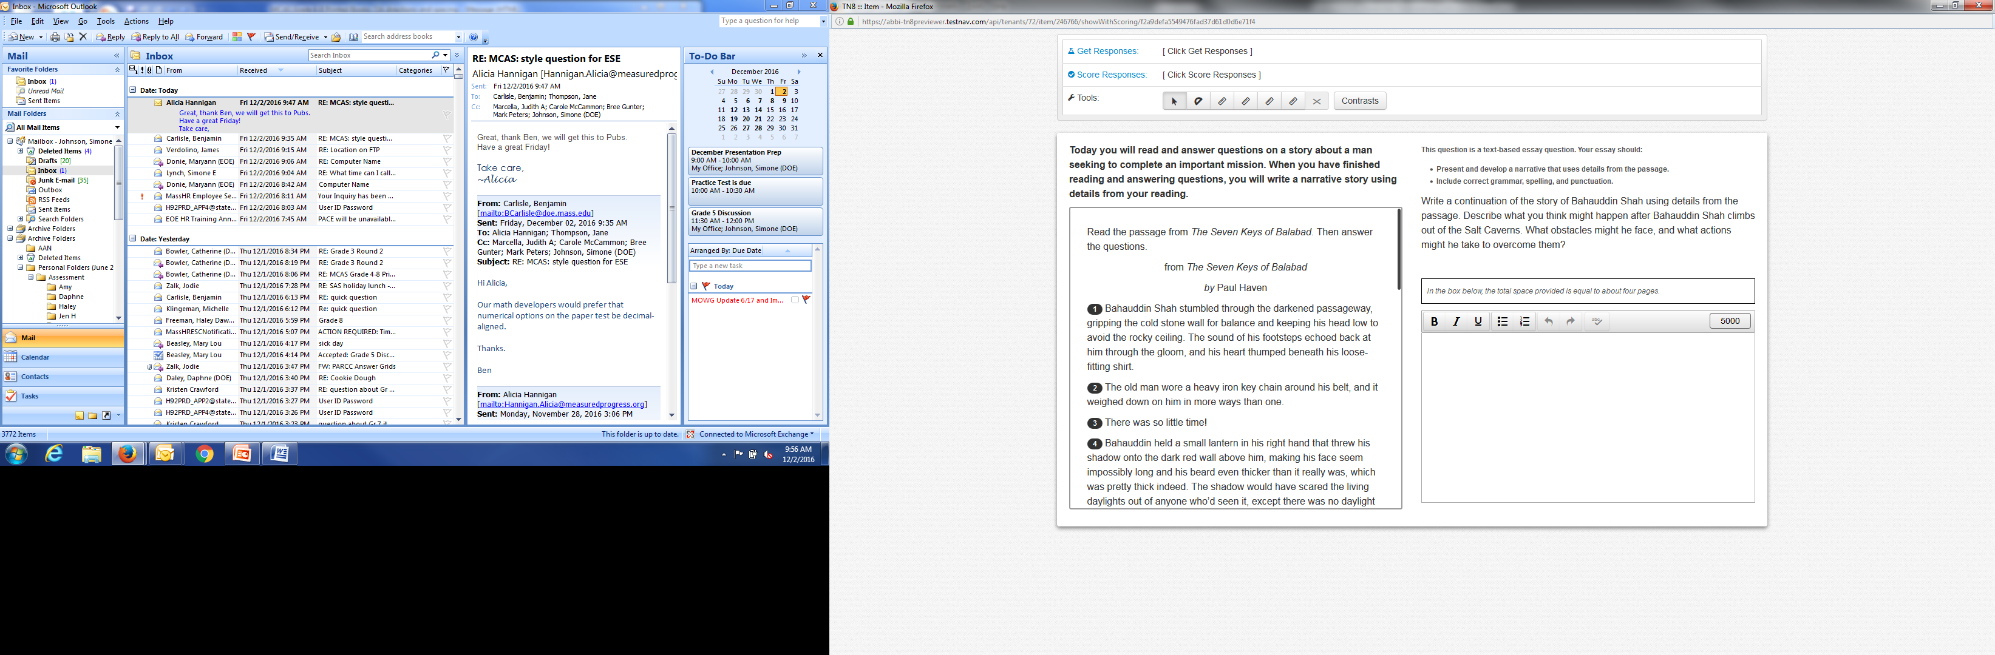
Writing Examples

Slide 21
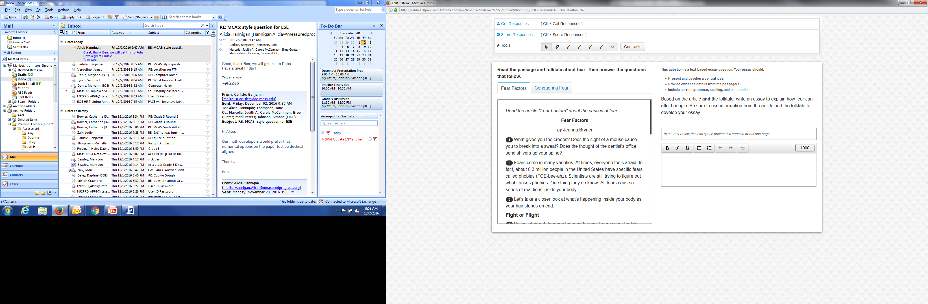
Writing Examples

Slide 22
ELA Matrix Design
In addition to operational questions, students will take a matrix (field test and equating) portion of the test that is embedded within the session designs.
All students will read one additional passage set.
Types of items and writing will vary by grade.

Slide 23
ELA Test Design
Grade | Number of 1- Point Questions (Multiple-choice) | Number of 2-point Questions (Multiple-choice or technology-enhanced) | Number of Short Responses | Number of Essays (includes Narrative and Text-Based Essays)
3 | 18 | 4 | 1 | 2
4 | 18 | 4 | 1 | 2
5 | 18 | 4 | 0 | 3
6 | 18 | 4 | 0 | 3
7 | 18 | 4 | 0 | 3
8 | 18 | 4 | 0 | 3

Slide 24
MCAS Mathematics
Test Design

Slide 25
What is the same in Mathematics from spring 2016 MCAS?
Two Sessions
  Grades 3–6: Both Sessions are non-calculator
  Grades 7–8: Session 1: non-calculator
  Session 2: calculator
Certain item-types: Multiple-Choice, Short-Answer, and Open-Response (OR)
Number of open-response items per grade

Slide 26
What is different from spring 2016 MCAS Math tests?
Computer-based
New item types
Calculator restrictions
Increased number of points in grade 3
No tool kits
Updated reference sheets (grades 5–8)

Slide 27
Calculator Restrictions
Grades 3–6: Calculators are prohibited
Grade 7: A five-function calculator is allowed (Session 2 only)
Grade 8: A scientific calculator is allowed (Session 2 only)
Computer-Based Test
  Calculator is embedded in the testing platform.
  Students can have equivalent handheld calculators.
Paper-Based Test
  Calculator should be equivalent version of calculator that is provided for CBT.

Slide 28
Math Item Types
Question Type | Total Points | Grade Levels
Multiple Choice Students select one correct answer from among several answer options. | 1 | Grades 3–8
Multiple Select Students select more than one correct answer from among several answer options. | 1 | Grades 3–8
Short Answer/Fill-in-the-Blank Students construct a short written response, typically only a word or a number. | 1 | Grades 3–8
Technology Enhanced Students answer questions using technology such as drag-and-drop or hot spot (on the computer-based test only). | 1 or 2 | Grades 3–5
 | 1, 2 or 4 | Grades 6–8
Open Response Students write a response to a multi-part item that includes answers and explanations to all parts. | 2 or 3 | Grade 3
 | 3 or 4 | Grades 4–8
http://www.doe.mass.edu/mcas/tdd/math.html?section=testdesign

Slide 29
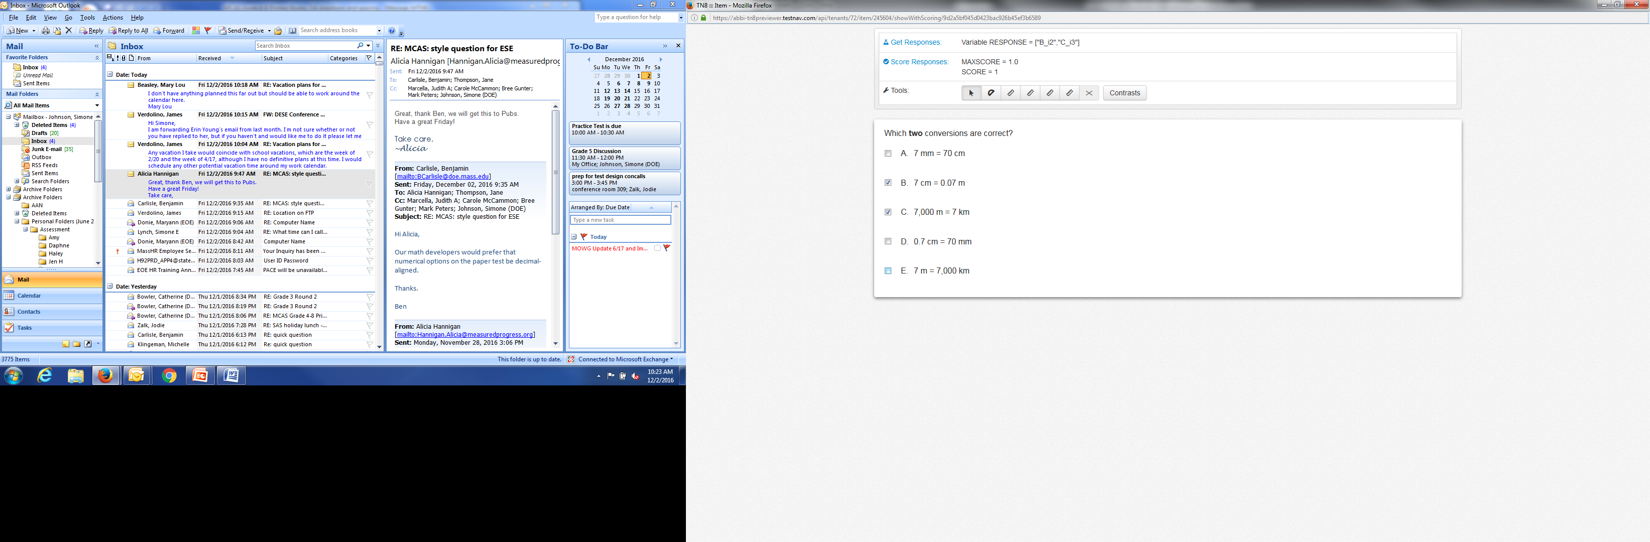
Multiple-Select Item

Slide 30
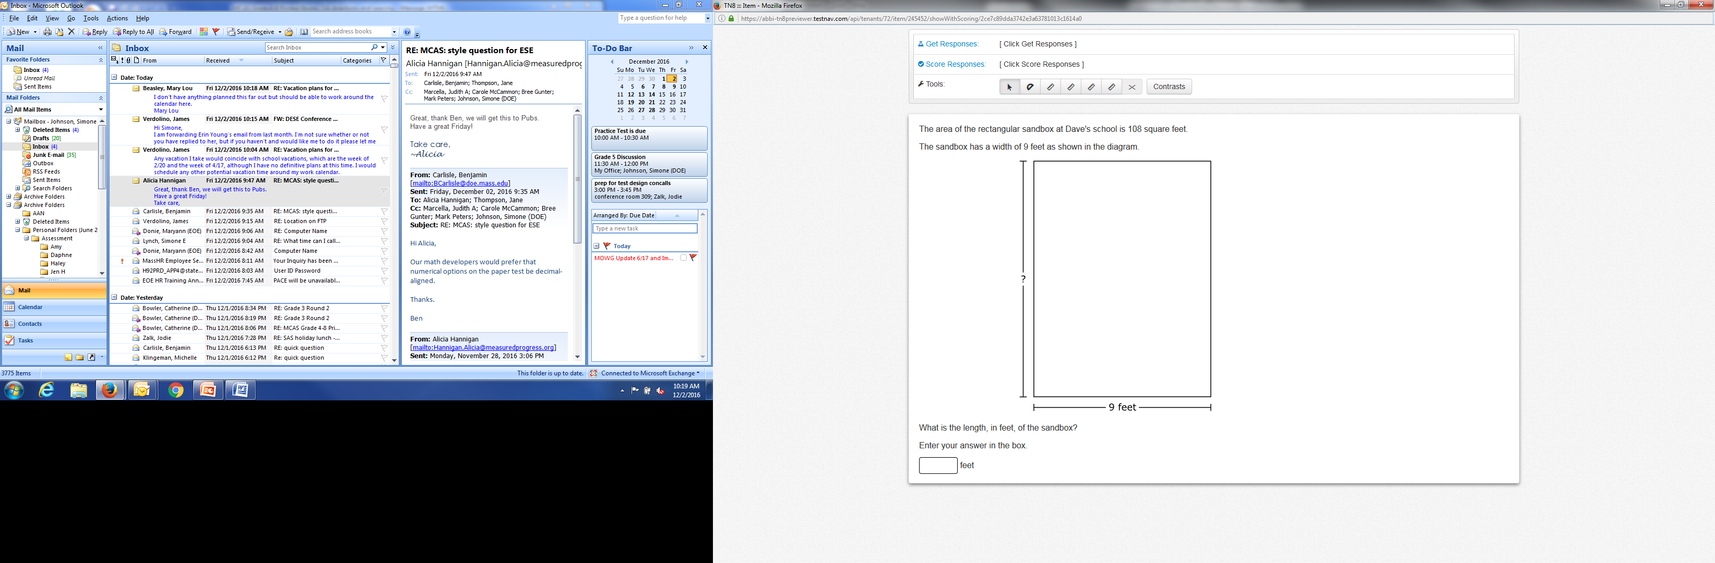
Short Answer/Fill-In-The-Blank Item

Slide 31
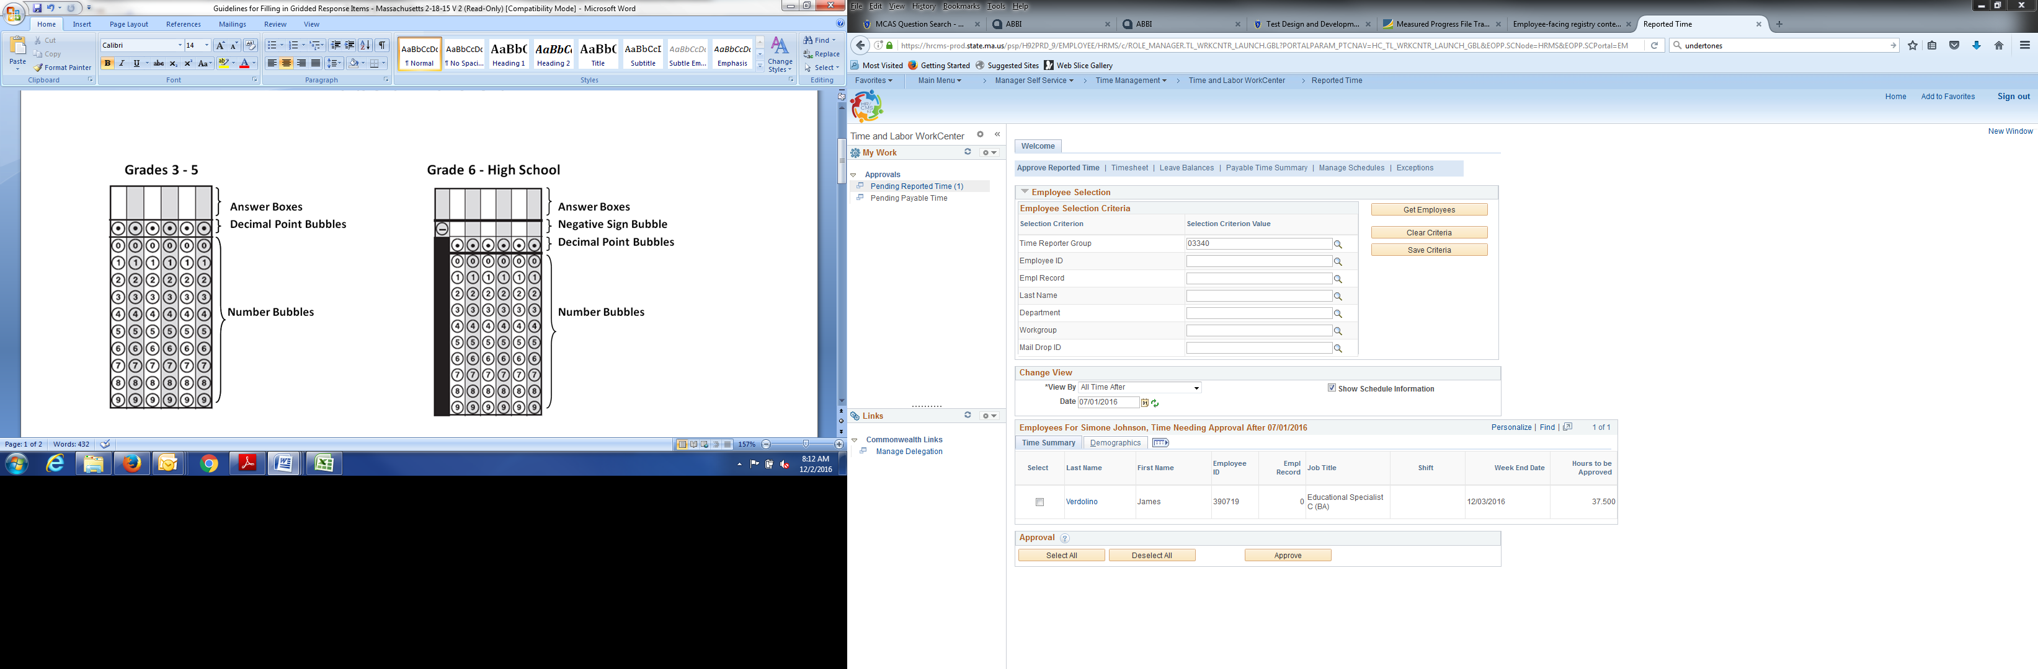
Gridded Response
Grades 3-5
Grades 6-8

Slide 32
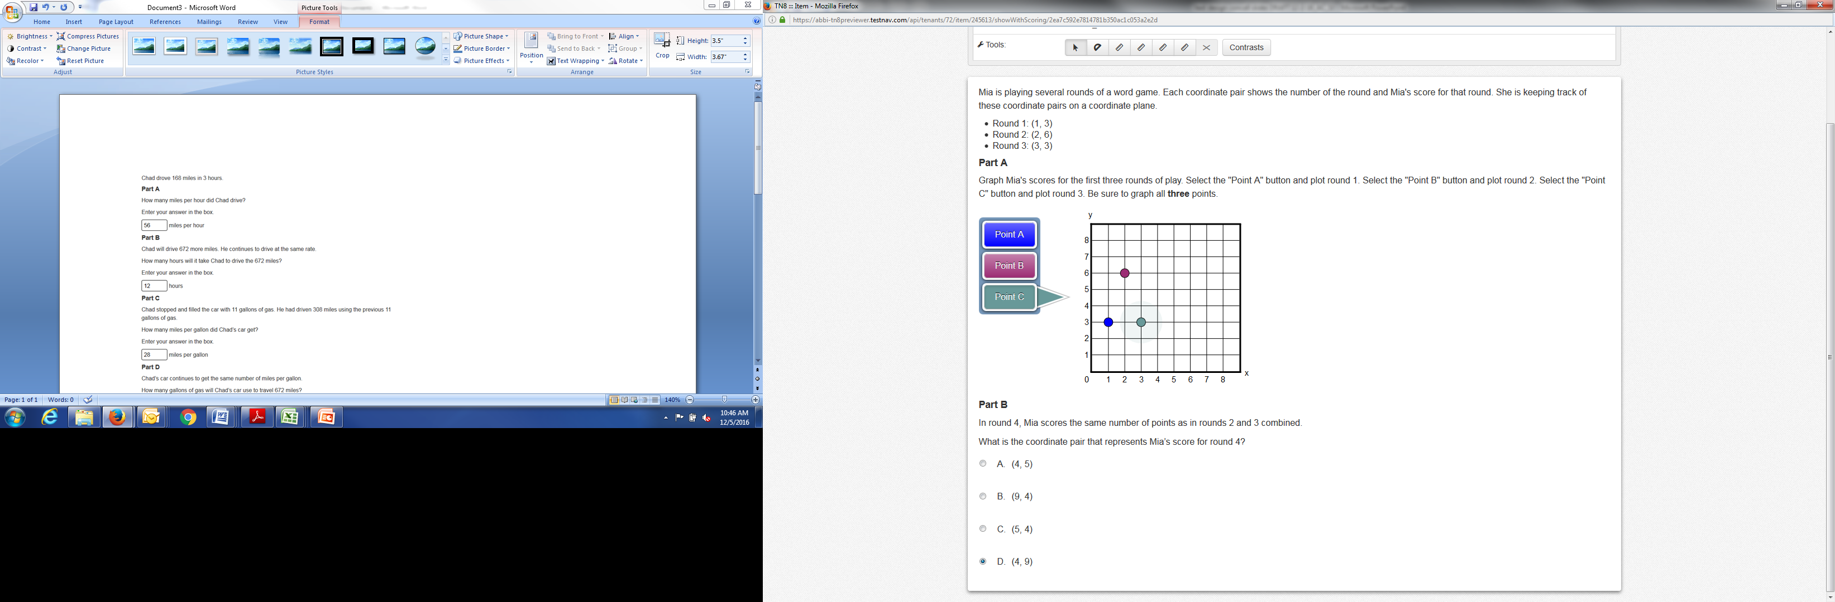
2-Point Item

Slide 33
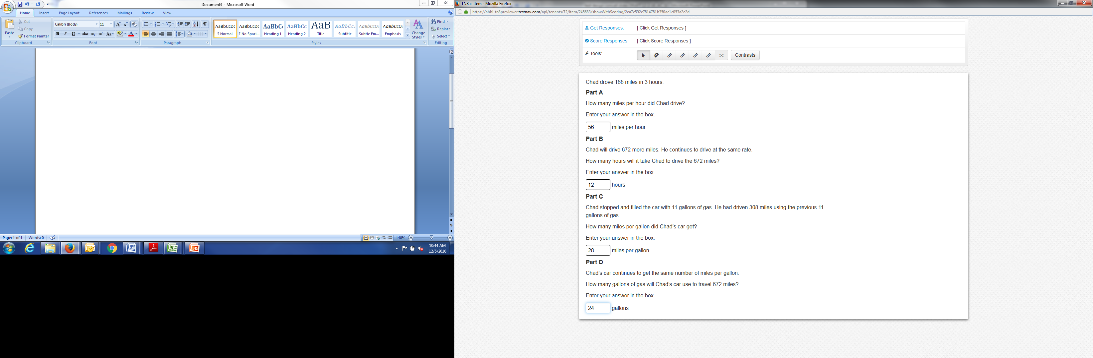
4-Point (Multi-Part) Item

Slide 34
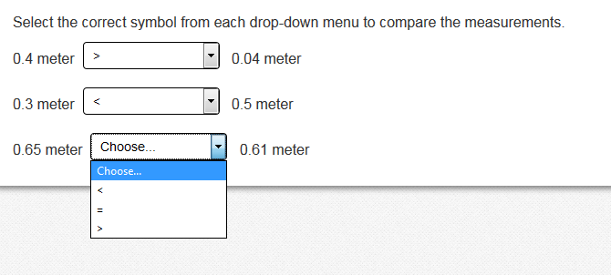
Inline (Drop-down) Item

Slide 35
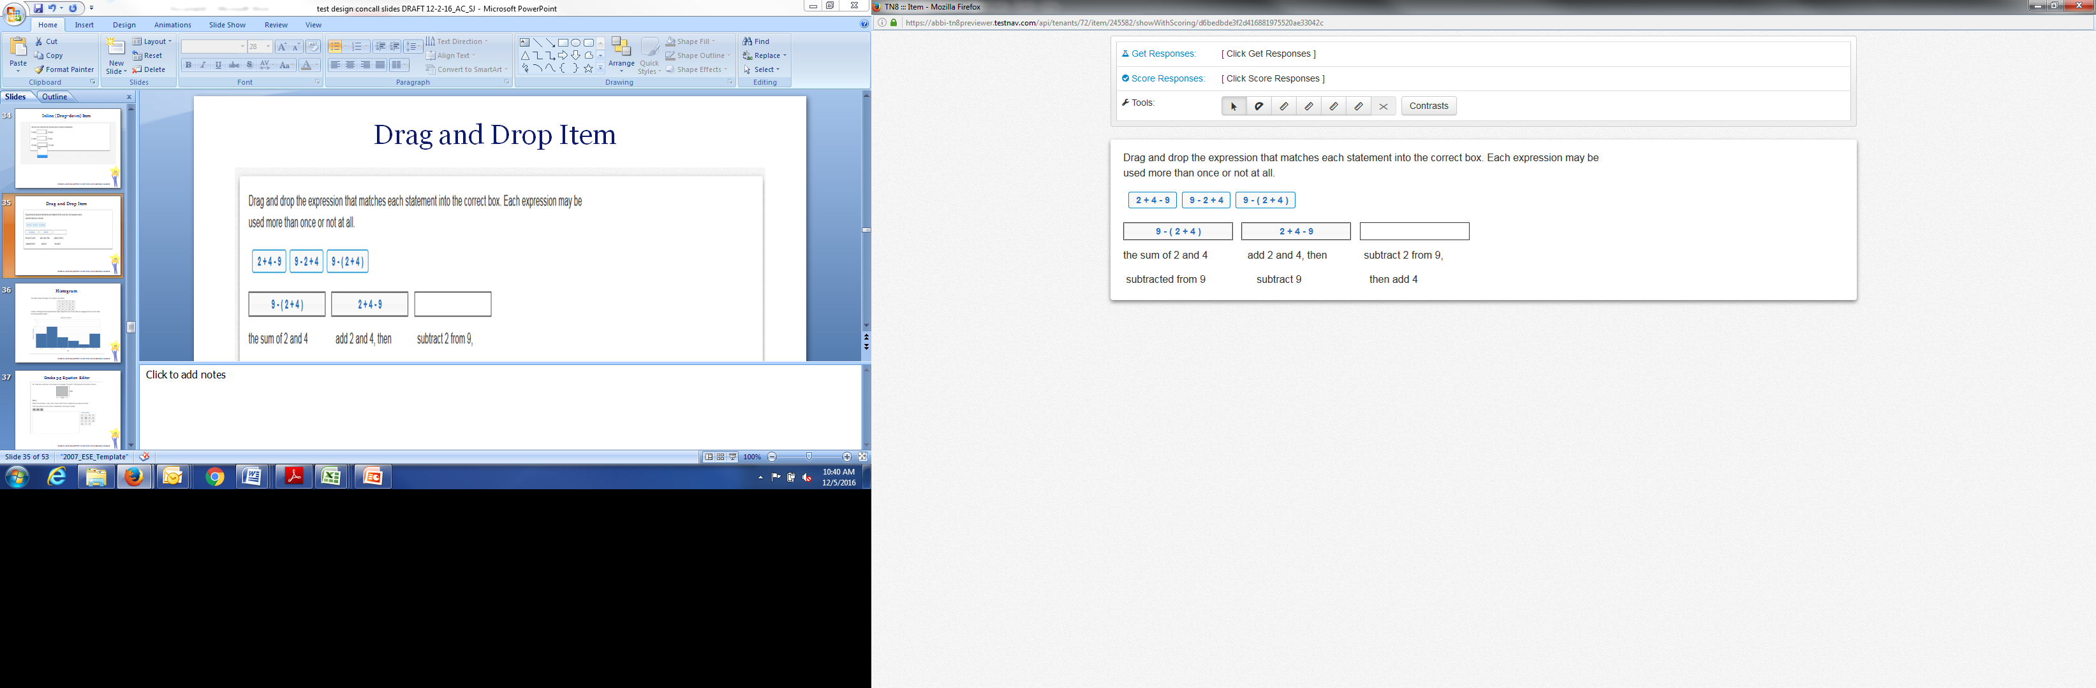
Drag-and-Drop Item

Slide 36
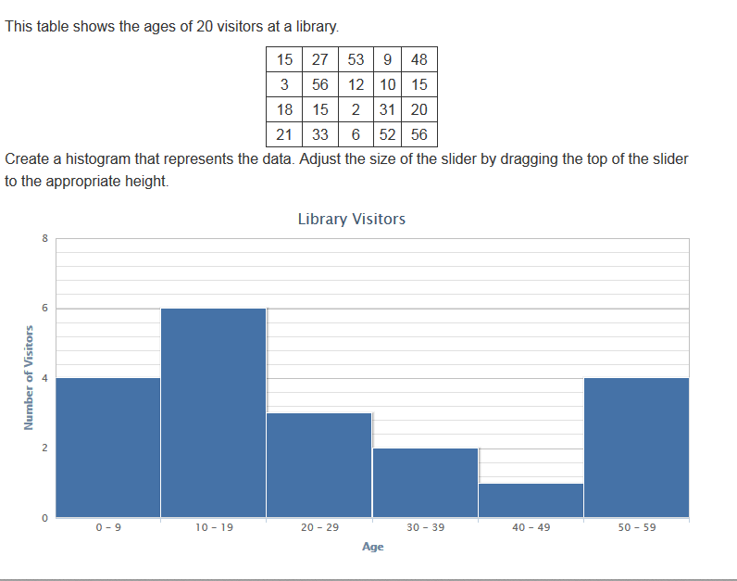
Item with a Histogram

Slide 37
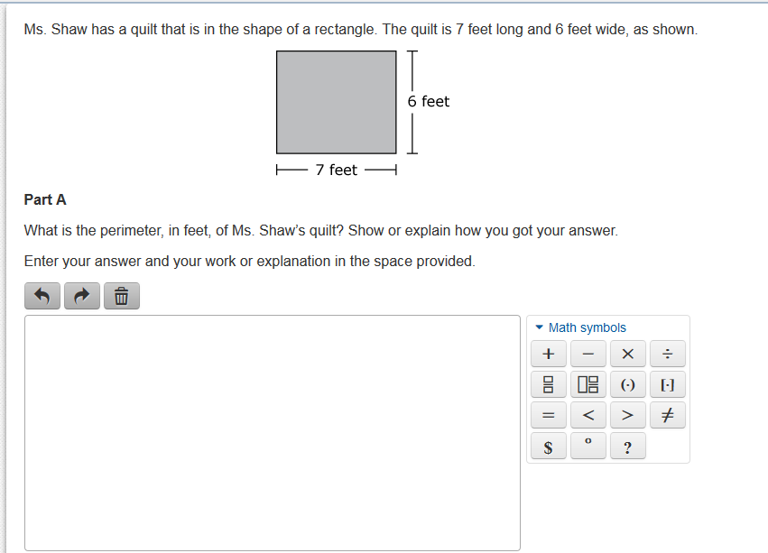
Grades 3–5 Equation Editor

Slide 38
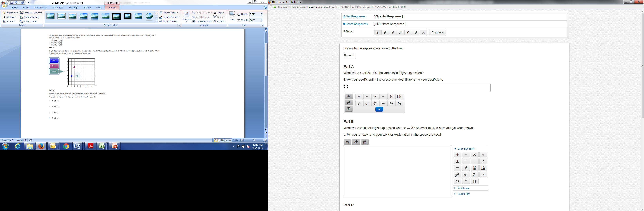
Grades 6–8 Equation Editor

Slide 39
Math Matrix Design
In addition to operational questions, students will take a matrix (field test and equating) portion of the test which is embedded within the session designs.
Types of items will vary by grade.
Number of items will vary by grade.

Slide 40
Math Test Design
Grade | Number of 1- Point Questions (includes Multiple-choice, multiple-select, short answer/fill-in-the-blank, or technology-enhanced) | Number of 2-point Questions (includes Multiple-choice, multiple-select, short answer/fill-in-the-blank, or technology-enhanced) | Number of 4-point Questions (includes Multiple-choice, multiple-select, short answer/fill-in-the-blank, or technology-enhanced) | Number of Open Response Questions
3 | 34 | 2 | 0 | 4
4 | 32 | 4 | 0 | 4
5 | 32 | 4 | 0 | 4
6 | 24 | 4 | 2 | 4
7 | 24 | 4 | 2 | 4
8 | 24 | 4 | 2 | 4

Slide 41
MCAS Accommodations and Accessibility Features

Slide 42
Available to All Students
The following will be available for all students (details to be provided in the Principal’s Administration Manual):
  Untimed test sessions
  Blank scratch paper (including blank lined or graph paper)
  Assistance from a test administrator regarding the use of the computer-based testing platform (only)

Slide 43
Overview of MCAS Accessibility and Accommodations for Gr. 3−8
Accessibility and Accommodations Manual for the Spring 2017 Grades 3–8 MCAS Tests
Many previous MCAS accommodations now called
  Universal Accessibility Features, available to all students on new computer- and paper-based MCAS.
  Designated Accessibility Features can be given to any student at the discretion of the principal.
Accommodations available to students with disabilities and English language learners
  “Nonstandard” accommodations are now called
  Special Access accommodations.

Slide 44
Universal Accessibility Features (UF) available to all students
Computer | Paper
Highlighter
Change background/font color | Colored overlays
Screen magnification/Zoom tool | Magnification device
Line reader tool | Tracking device/straight edge
Answer eliminator | Masking using blank card
Item flag/bookmark | Place marker
Audio aids
Human read-aloud (or sign) selected words on Math or STE, as requested by student
Repeat/clarify test directions
Test administrator redirects student’s attention to test

Slide 45
Designated Accessibility Features (DF), for any student at discretion of Principal
Computer or Paper
Small group test administration (up to 10 students)
Individual (one-to-one) test administration
Separate location
Frequent supervised breaks
Seating in a specified area of room, including study carrel
Adaptive or specialized furniture or lighting
Familiar test administrator
Student reads test aloud to self
Specific time of day
“Stop Testing” policy: If student is not responding to test questions after 15−20 minutes, test administrator may ask if student is finished. If so, collect the student’s test materials. Student may sit quietly or be excused.
45

Slide 46
Accommodations for Students with Disabilities (A)
Test Presentation
Computer-Based | Paper-Based
Paper test, if unable to use computer | N/A
N/A | Large print test
Screen reader for student who is blind | Braille test
Text-to-speech/Human read-aloud for Math, STE | Human read-aloud
Human signer for Math, STE, and test questions only for ELA
Test administrator helps student track test items

Slide 47
Accommodations for Students with Disabilities (Continued)
Response Accommodations
Computer-Based | Paper-Based
ELA graphic organizer or Math/STE reference sheet for grades 3−8 (only those developed by ESE)
Human scribe for Math/STE (Note: 504 plan in place for fractured writing arm)
N/A | Answers recorded in test booklet
N/A | Typed responses (No transcription necessary)
Monitor placement of test responses
Braille writer, note-taker, or refreshable Braille display

Slide 48
Special Access Accommodations for Students with Disabilities (SA)
(formerly Nonstandard Accommodations)
Special Access Accommodations
Computer and Paper
Text-to-speech/Human reader for ELA
Signing the ELA reading passages
Scribe responses (or speech-to-text device) for ELA
Calculator or other mathematics tool, device, or manipulatives (provided by school) on non-calculator session of Math
Spell-checker for ELA
Word prediction for ELA

Slide 49
Accommodations for ELLs (EL)
ELL Accommodations
Approved Bilingual Word-to-Word Dictionary or Glossary
Text-to-speech/human reader for Math and STE (in English)
Scribe for Math and STE
Grade 10 English/Spanish Mathematics Test or Retest, if enrolled fewer than 3 years
Read aloud/repeat/clarify test directions in student’s native language, if native language speaker is available
“Stop testing” policy

Slide 50
Resources Coming This Winter
ELA and Mathematics practice tests: January 2017.
Short response and essay rubrics
Student tutorial to orient students to TestNav testing platform

Slide 51
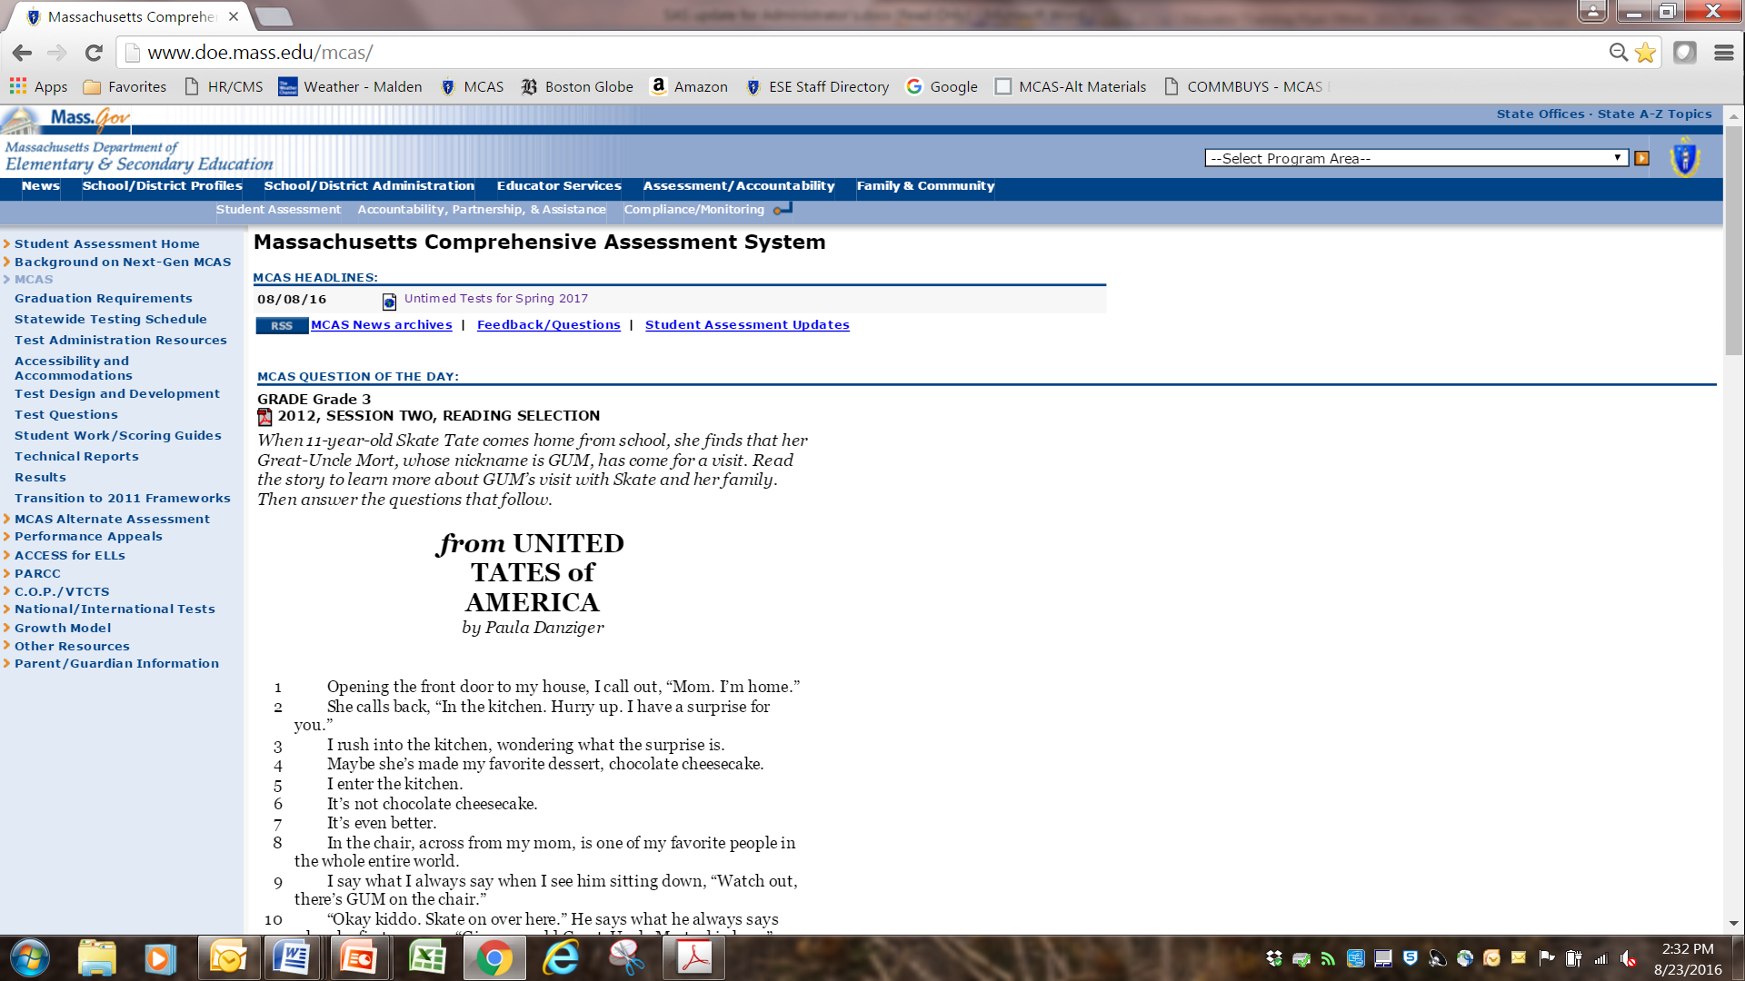
Resources Available: ESE Web Page

Slide 52
Resources and Support
Specific web pages
ELA test design: www.doe.mass.edu/mcas/tdd/ela.html?section=testdesign
Mathematics test design: www.doe.mass.edu/mcas/tdd/math.html?section=testdesign
Accessibility and accommodations: www.doe.mass.edu/mcas/accessibility/
ESE Student Assessment Services
781-338-3625
mcas@doe.mass.edu

Slide 53
Questions & Answers

