Slide 1
Instructions for Using These Slides
These slides are intended to assist principals in preparing their school training for test administrators and others involved in MCAS administration.
There is no requirement to use these slides; however, the information they contain must be conveyed during the training.
Principals may add slides, delete slides, and adjust slides as needed.
Although some slides can be used as is, many are meant to serve as a template to be filled in with school-specific procedures.
Areas where information is meant to be filled in by the school are generally presented in red text.

Slide 2
MCAS Test Administration Training Session
For Test Administrators, Technology Staff, and Other School Personnel
February 2024 Science Tests
Biology and Introductory Physics

Slide 3
Today’s Agenda
Test security requirements – Part I of the Test Administrator’s Manuals (TAMs)
Test administration protocols – Part II of the TAMs
Tasks for test administrators
Local procedures and logistics for MCAS administration
Accessibility and accommodations
Procedures for paper-based testing, if the school is doing PBT
Questions and answers

Slide 4
Goals for This Training
Understanding procedures to follow before, during, and after testing
Understanding test security requirements and test administration protocols
Knowing which resources to review prior to testing, and how to find answers to questions

Slide 5
Training and Documentation Requirement
All school personnel involved in MCAS test administration must participate in a school training session before test administration.
Today the following must be documented:
You are being trained.
You received your Test Administrator’s Manual (TAM)/test security requirements.
How will you document staff participation in training? Will the sample DESE forms be used? Electronic forms?
Before the session, you received the following:
For test administrators: the TAM for the test you will administer
For hallway monitors and others: test security requirements
For technology staff: test security requirements and relevant technology troubleshooting steps
If you did not receive your documents, let us know.

Slide 6
Test Administration Dates
Insert dates for student tutorial, if applicable
Insert dates for practice tests, if applicable
Test Administration Dates
Session 1 – February 6
Session 2 – February 7
Make-up testing dates

Slide 7
Local Procedures related to Testing Times
Insert the school’s length of time for each test session.
See DESE recommended times on the following slide.
Describe the procedure for any students who arrive late.
Will the test administrator read the script quietly to these students in the room, read it to them outside the room, or will the students instead be scheduled for make-up testing?
Describe the procedure for students who finish testing early.
Will they be allowed to leave the room early, or will they stay in the room until the end of the session?
Describe the procedure for students who need extended time.
Will students who need more time stay in the same room to finish, or will they move to a different room?

Slide 8
DESE Recommended Testing Times:
MCAS Subject Area | Number of Sessions | Recommended Testing Time
Biology | 2 | 1½ hours per session
Introductory Physics | 2 | 1½ hours per session

Slide 9
Breaks during a Session
At the test administrator’s discretion, a break of 3–5 minutes is allowed approximately halfway through the session.
Students should not have conversations during the break.
Discuss school procedures and what will be allowed/not allowed during breaks
How will security be maintained during a break?
Closing or lowering laptop lids? Placing something (e.g., manila folders) in front of the screens? Turning off computer monitors? Turning tablets face down?

Slide 10
Secure Content and Materials
Secure content
MCAS questions not publicly released by the Department
student responses to test questions
passages, diagrams, graphics, writing prompts, and other test content
Secure materials
student testing tickets
proctor testing tickets (for test administrators who are administering the Human read-aloud or Human signer accommodation)
used scratch paper (i.e., after students have written on it)
test & answer booklets (for PBT)

Slide 11
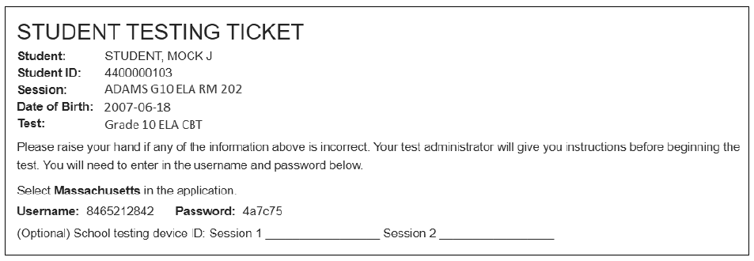
Sample Student Testing Ticket

Slide 12
Test content is confidential. The following things are prohibited:
Viewing test content (on screens or in booklets)
Duplicating or reproducing test content
School personnel may not copy questions by hand or photograph them.
Technology staff may not photograph computer screens even when troubleshooting a problem.
Discussing test content with anyone before, during, or after testing
School personnel may not discuss test content with each other.
Teachers may not review unreleased MCAS questions with students.
(e.g., “Were there any questions that you had on Session 1 that you want me to go over?”)
Exception: students reporting a concern about a test question

Slide 13
If a Student Reports a Concern About a Test Question
If any students report that they have a concern with a test question (i.e., the student thinks there is a problem with the question, or the student is uncomfortable with the content of the question for a non-academic reason)
Note the form number and question number and inform the principal, who will contact DESE for guidance.
Do not reproduce the question itself or the answer choices.
Refrain from discussing the question except as needed to report the issue.
See also page 23 of the CBT TAM.

Slide 14
Exceptions to Prohibition of Test Administrators Viewing MCAS Content
Administering certain accommodations (Nondisclosure Acknowledgment form required)
Accommodations A2, A3.1, A3.2, A3.3, A5, A6.1, A8, A10.1, A10.2, A11, A12, A13, A14, A15
Special access accommodations SA1.2, SA2, SA3.1, SA3.2, SA6
English learner accommodations EL3.2, EL4.1, EL4.2
Reading a word or phrase aloud on the Biology or Introductory Physics test – Universal Accessibility Feature 11 (UF11)
See page 90 of the PAM for the description of UF11.
Assisting a student with the computer interface during testing

Slide 15
Storage of Secure Materials
Secure materials (testing tickets, used scratch paper, PBT booklets) must be stored in a secure central location when tests are not being administered.
Secure materials cannot be stored in classrooms, even if classrooms are locked.
Access to the storage area must be restricted.
After each test session is completed, secure materials must be returned to the test coordinator.
Secure materials may not be left unattended when not in the central secure storage location.

Slide 16
Tracking Secure Materials
The chain of custody of secure materials during test administration must be maintained.
Internal tracking forms must be used whenever secure materials are removed from, or returned to, secure storage.
Test administrators and the test coordinator must independently count testing tickets (or booklets for PBT) and record the separate counts on the tracking form before signing it.
Sheets of scratch paper do not need to be counted; however, the return of used scratch paper must be indicated on tracking forms.
The appropriate box on tracking forms must be checked when testing tickets and used scratch paper are destroyed after testing.

Slide 17
Monitoring Students Outside the Testing Room
Students must be supervised at all times when they are out of the testing room (e.g., going to the restroom, going to the nurse, going to a lunch break, moving to a test completion room).
Describe the school’s plan for monitoring students out of the testing room
Hallway monitors?
Restroom monitors with a view of testing rooms?
Call main office for escort?
Second test administrator escorts student (if two test administrators are used)?

Slide 18
A Secure Environment in the Testing Room
Cover or remove prohibited classroom displays.
Describe how and when this will be done in the school.
See page 24 in the CBT TAM for examples of what must be covered or removed.
Unauthorized persons may not enter testing rooms, including
parents
non-testing students
teachers not assigned to the room as test administrators
Testing rooms may be entered by
school administrators
district staff
DESE observers
technology staff (to troubleshoot technology problems)

Slide 19
A Secure Environment in the Testing Room (continued)
Students must not be able to view any screen (or booklet) but their own.
Describe how rooms will be set up to ensure a secure testing environment, or whether test administrators will set up their own rooms
Set up rooms in advance, if needed, to test out different seating arrangements.
If test administrators will set up their own rooms, who will walk around at the start of testing and check all the rooms?
Will students be separated by enough space to support secure testing?
Will physical barriers (e.g., partitions, privacy screens, carrels) be used?

Slide 20
Prohibited Materials
Make sure students understand that they are not allowed to have
cell phones and other electronic devices (e.g., smartwatches, ear buds)
notes or reference material such as additional reference sheets other than what they have been given (except for certain accommodations)
dictionaries
other instructional materials
A more comprehensive list can be found on page 16 of the CBT TAM.
A poster showing examples of prohibited materials is available at www.doe.mass.edu/mcas/testadmin/biology-physics/forms
Inform staff whether the school will be using this poster during testing (recommended).

Slide 21
Cell Phones
Cell phones give students the ability to communicate with other students, to access the internet, and to access tools such as a calculator, camera, or dictionary.
Inform test administrators how phones will be collected before testing and whether they will read the optional scripts in the TAMs.
Will students put phones in backpacks and backpacks at the side of the room (what the optional TAM script says)?
Will phones be collected and kept by the test administrator at the front of the room?
Will phones be put away in lockers?
Convey to students that they may not have cell phones during testing and that they may not access phones, even to check the time, since their results may be invalidated.
Be aware that some students turn in a spare phone and retain their own.

Slide 22
Allowable Materials
Scratch paper (blank, ruled, or graph)
Students receive one sheet of scratch paper at the start of testing. They may have up to three pieces at one time. If students need more than three pages, they will have to turn in sheets.
See page 13 of the CBT TAM for more information about scratch paper.
Pens, pencils, highlighters, colored pencils (for use on scratch paper)
Handheld calculators
TestNav provides calculators, but students may use a handheld calculator if they want. (See pages 14–15 of the CBT TAM for more information.)
Copies of bilingual word-to-word dictionaries (for students who are currently or were ever reported as ELs)

Slide 23
Allowable Materials (Continued)
Printed reference sheets (for Introductory Physics)
Although the Introductory Physics reference sheet is available in the Exhibits tab within TestNav, the Department recommends that students also be given printed copies of the Introductory Physics reference sheet (available at www.doe.mass.edu/mcas/tdd/phys_formula.pdf)
Students are not permitted to use additional reference sheets from class.
Students should not write on their reference sheets, but rather should use their scratch paper for any figuring they need to do.
Printed copies of equation editor guides and—for students using tablets—symbol keys (for Introductory Physics)
Reference sheets, equation editor guides, and symbol keys are available to print from mcas.pearsonsupport.com/student
Students with accommodation A9 listed in their IEPs or 504 plans—and only these students—may use printed copies of the supplemental reference sheets.
See www.doe.mass.edu/mcas/accessibility/reference/physics.pdf for the Introductory Physics supplemental reference sheet for accommodation A9.
See www.doe.mass.edu/mcas/accessibility/reference/biology.pdf for the Biology sample reference sheet for accommodation A9.
Inform test administrators whether your school is going to give printed reference sheets, equation editor guides, or symbol keys to students.

Slide 24
Test Administrator Day-of-Testing Responsibilities Before Testing Begins
Review the session roster in PearsonAccess Next (PAN) and verify that accommodated forms (e.g., text-to-speech) have been assigned to students who should have them.
Start the PAN Session if the principal/test coordinator has not already done so. (Tell staff whether the principal/test coordinator will start PAN Sessions or whether test administrators are expected to do so.)
Unlock the session.
Include instructions for these steps from the CBT TAM (e.g., page 88) or give a demonstration on the training site.
Ensure that all students have the proper materials.
Verify that students have their correct student testing ticket.
Collect cell phones and any other prohibited devices. Describe the procedures the school plans to use to prevent students from accessing phones.

Slide 25
Avoiding Common Issues during Testing
At the start of testing, check that students do not have
smartwatches
wireless ear buds
Be especially aware of these issues while monitoring the room:
cell phone use
Observe whether students are looking in their laps or have their hands under their desks, even if they turned in a phone (they may have another one with them).
extra reference sheets/notes

Slide 26
Test Administrator Responsibilities During Testing
Read the scripts in the TAMs verbatim to students.
Focus full attention on the testing room for the full test session.
Circulate throughout the room periodically to prevent cheating and the use of prohibited materials.
Monitor students’ testing status in PAN (see pages 125–126 in the CBT TAM).
Resume tests for any students who sign out of, or are inadvertently exited from, TestNav (see page 127 of the CBT TAM for instructions).
Refrain from coaching students or influencing their responses in any way.

Slide 27
Coaching is not permitted on MCAS tests. What is coaching?
Providing hints or clues that might affect a student’s response
“Think about what we studied in class last week.” “What’s the acronym for order of operations?” “Consider it from the main character’s perspective.” “Be sure to use specific examples in your constructed response.” “Try to picture the photosynthesis chart in your mind.”
Indicating in any way that a student has answered a question incorrectly
“You might want to look at that one again.” “You should review number 11.” “Check your work.” (to a particular student working on a particular question – not the class as a whole)
Defining or spelling words
Explaining, simplifying, or paraphrasing any part of the test
Suggesting that a student write more
Influencing a student’s response through gestures, facial expressions, nods, body language, or changes in voice inflection

Slide 28
What is permitted?
Reading a word or short phrase aloud – Universal Accessibility Feature 11 (UF11). See page 90 of the PAM.
Assisting students with technology-related problems (see page 19 of the CBT TAM)
Re-reading part of the TAM script to students
The TAM scripts all contain instructions to students to check their work if they finish early, so it is allowable to remind the whole class to check their work before submitting their tests.
Encouraging students if they ask questions about test content
“Just do your best.” “Give your best effort.” “Do the best you can.” “You can do this.” “You’ve got this.” “Just answer it as well as you can.”

Slide 29
Providing Technology-Related Help to Students
Students should be familiar with computer-based testing through practice tests and the tutorial, but test administrators may assist students during testing with technology-related problems.
Examples of allowable assistance:
Helping students sign in to TestNav (The test administrator may type in students’ usernames and passwords.)
pointing to a tool button that a student cannot find (e.g., the calculator)
explaining how to move through the test using the arrow keys
pointing to the fraction bar in the equation editor if a student does not know how to enter his or her answer as a fraction
Explaining how to navigate to a test question directly from the review screen
Examples of prohibited assistance
telling a student to use the calculator or a specific tool on a question
telling a student which ruler to use
typing any answers into the test or clicking any answer choices (Students should enter or choose all answers themselves.)

Slide 30
Steps to Take in Case of Technology Problems
Who will be the designated technology support staff?
How will the test administrators contact the designated technology support staff?
One technology staff member in each wing of the school building?
Call a technology staff member who is located centrally?
If a student experiences a technology error, resume testing on the same device, if possible.
If the original testing device cannot be used or if the original error is still occurring, then another device should be attempted.
Do not turn off the device.
Make note of which testing device the student was using.
If there is a situation in which a student is waiting for more than 15–20 minutes, then consult with the principal/test coordinator on scheduling the student to complete the session at a later time.

Slide 31
Testing Irregularities
Testing irregularities must be reported to the principal and then to DESE.
Test results may be invalidated if students do any of the following:
duplicating any portion of secure test content
accessing prohibited materials such as cell phones or other electronic devices
communicating with other students (e.g., talking, whispering, writing notes)
looking at any other student’s computer screen or test & answer booklet
asking for or receiving help from anyone
providing help to another student
consulting notes, books, or instructional materials during testing
accessing the internet
Results may also be invalidated if students receive any impermissible assistance from test administrators (coaching), or receive accommodations they are not entitled to, especially special access accommodations.

Slide 32
Responsibilities After the Session is Over
Make sure you have all testing tickets and used scratch paper.
Lock students’ tests in PAN (see, e.g., step 29 on page 40 of the CBT TAM).
Make a list of any students assigned to you that were absent. These students will need to be scheduled for make-up testing.
Describe the procedures for how students who need more time will continue testing.
Continue testing in the same room after other students leave?
Moved into a test completion room?
Return testing tickets and used scratch paper to the test coordinator and sign the tracking form after independent counts are completed.

Slide 33
Other School Procedures
The TAMs contain optional scripts as described below. Inform test administrators at the training session if they will read the scripts or if the school will develop an alternative version.
whether test administrators will read the recommended script instructing students to put away cell phones and other electronic devices in their backpacks at the side of the room or if a locally developed script will be used instead
whether test administrators will read the scripts for students going to a supervised lunch, students moving to a test completion room, and students going to the restroom
Inform staff whether testing tickets will be collected from students after they sign in to TestNav, or students will retain their tickets until the end of the session.
Inform staff whether students will write down the ID numbers of their devices on their testing tickets (see sample ticket on slide 10).

Slide 34
Other School Procedures (Continued)
Inform staff how to contact the school administration if there is a problem during testing.
How will they contact technology staff if there is a technology problem?
Inform staff whether they should come to the central secure storage area to pick up materials, or if materials will be delivered to them.
Inform staff whether students who finish early may be dismissed or must wait until the end of the scheduled session.
If students will wait until the end of the session to be dismissed, inform staff of what they may do and what they are allowed to have with them until then.
Inform staff how lunch will be handled for students whose testing extends into the lunch period.
lunch brought to the room?
supervised lunch in the cafeteria?

Slide 35
Training Resources for Computer-Based Testing
PAN Overview Video – overview of the tasks that Test Administrators will complete in PearsonAccess Next
Printing student testing tickets - support.assessment.pearson.com/PAsup/system-basics/resources/retrieve-resources-for-an-online-test
Printing testing tickets is usually done by the test coordinator, but a test administrator may need to do so in some circumstances. Note that the video at the link also shows how to find seal codes, which do not exist for MCAS testing.
Starting a PAN Session and unlocking a test, resuming a test, and managing student statuses – support.assessment.pearson.com/PAsup/testing
How to Use the “Students in Sessions” Screen – CBT TAM, page 125

Slide 36
Training Resources for Computer-Based Testing
“Sessions Management” module and slides (found at mcas.pearsonsupport.com/training under the Modules to Assist with Tasks to Complete During Testing section)
Resuming Student Tests demonstration
PAN Sessions – Prepare, Start, Lock/Unlock, and Resources demonstration
Troubleshooting steps in Appendix B of the CBT TAM
See page 24 of the CBT TAM and pages 30–31 of the PAM for additional training resources.

Slide 37
Universal and Designated Accessibility Features for All Students
Accessibility Features for All Students
Universal Accessibility Features (UFs) are tools and supports available to all students that are either built into the computer testing platform or provided by a test administrator.
Designated Accessibility Features (DFs) are changes in scheduling, setting, group size, or other conditions of test administration that can be provided to any student at the principal’s discretion.

Slide 38
Universal Accessibility Features (UFs) – Available to All Students
UF1 – Highlighter tool
UF2 – Color contrast
UF3 – Zoom in/out tool
UF4 – Enlarged cursor/Mouse pointer tool
UF5 – Line reader tool
UF6 – Answer masking
UF7 – Answer eliminator
UF8 – Item flag/bookmark
UF9 – Audio aid
UF10 – Notepad
UF11 – Test administrator reads aloud selected words on the Mathematics or STE Tests
UF 12 – Test administrator redirects student’s attention to the test
UF 13 – Test administrator reads aloud, repeats, or clarifies general test administration directions from the Test Administrator’s Manual scripts to student, as needed.
Descriptions of these features can be found in Appendix C of the PAM on pages 89–90.

Slide 39
Designated Accessibility Features (DFs) – Available to All Students, at the Principal’s Discretion
DF1 – Small group test administration
DF2 – Individual (one-to-one) test administration
DF3 – Frequent brief supervised breaks
DF4 – Separate or alternate test location
DF5 – Seating in a specific area of the testing room
DF6 – Adaptive or specialized furniture
DF7 – Noise buffer, such as noise-canceling earmuffs/headphones or white noise
DF8 – Familiar test administrator
DF9 – Student reads test aloud to self
DF 10 – Specific time of day
DF 11 – “Stop Testing” policy
Descriptions of these features can be found in Appendix C of the PAM on pages 90–91.

Slide 40
Preparing to Administer Accommodations
Test administrators who administer certain accommodations (listed on page 94 of the PAM and on slide 13) must
sign a Nondisclosure Acknowledgment Form
receive additional training on what is and is not permitted
Who will provide additional training on accommodations and when?
How will descriptions of students’ accommodations be provided – e.g., will test administrators be given copies of Appendix C of the PAM (available as a separate PDF at www.doe.mass.edu/mcas/testadmin/biology-physics/manual)?
Who should test administrators contact if they discover an accommodation is not given correctly? (There may be some additional steps for CBT.)
How will accommodation refusals be handled? Will the sample DESE form be used? (Refusals by students should be documented in writing and kept on file.)
www.doe.mass.edu/mcas/testadmin/biology-physics/forms

Slide 41
Accommodations for Students with Disabilities
Full descriptions of accommodations can be found in Appendix C of the PAM. Categories are as follows:
Test presentation accommodations
e.g., Braille edition, text-to-speech
Response accommodations
e.g., graphic organizers, scribe
Special access accommodations
e.g., text-to-speech or human read-aloud for the ELA tests
Only provide accommodations listed in a student’s approved IEP or 504 plan.

Slide 42
List of Accommodations for Students with Disabilities
A1 – Paper-based edition of the test
A2 – Large-print edition (only applicable to PBT)
A3.1 – Screen reader; A3.2 – Braille edition; 3.3 – Assistive technology
A4 – Text-to-speech
A5 – Human read-aloud
A6.1 – Human signer
A7 – Human signer for test directions only
A8 – Track test questions
A9 – Graphic organizer, checklist, or supplemental reference sheet
A10.1 – Human scribe; A10.2 – Speech-to-text
A11 – Responses recorded by student on special paper (only applicable to PBT)
A12 – Typed responses (only applicable to PBT)
A13 – Student records responses on an external recording device
A14 – Responses signed onto video
A15 – Monitor placement of responses
A16 – Refreshable Braille display/Braille note-taker
A17 – Braille writer
Descriptions of these accommodations can be found in Appendix C of the PAM on pages 95–101.

Slide 43
Special Access Accommodations
Special access accommodations are intended for use by a very small number of students with the most significant cognitive disabilities who would otherwise not be able to access the test because a disability severely limits or prevents them from performing the skill in question.
SA1.1 – Text-to-speech for ELA; SA1.2 Human read-aloud for ELA
SA2 – Human signer for ELA (passages, not questions)
SA3.1 – Human scribe for ELA; Speech-to-text for ELA
SA4 – Calculation device on a noncalculator session
SA5 – Spell-checker for ELA
SA6 – Word prediction for ELA
Descriptions of these accommodations can be found in Appendix C of the PAM on pages 102–105.

Slide 44
Accommodations for English Learners
Accommodations for EL students
Documentation of EL accommodations must be kept at the school.
Bilingual word-to-word dictionaries available for any student who was identified as an English learner
Be sure that students have an opportunity to practice with the bilingual word-to-word dictionary prior to taking MCAS tests.
Spanish/English editions of the Biology and Introductory Physics tests are available for CBT and PBT.
Who will provide additional training on accommodations and when?
How will test administrators know which accommodations to provide to which students?

Slide 45
List of EL Accommodations
EL1 – Paper-based test
EL2 – Approved bilingual word-to-word dictionary or glossary
EL3.1 – Text-to-speech for Biology or Introductory Physics; EL3.2 – Human read-aloud for Biology or Introductory Physics
EL4.1 – Scribe for Biology or Introductory Physics; EL4.2 – Speech-to-text for Biology or Introductory Physics
EL5 – Test administrator reads aloud/repeats/clarifies general administration directions in English (from TAM)
EL6 – Test administrator reads aloud/repeats/clarifies general administration directions in student's native language
EL7 – Spanish/English edition of the Biology test or the Introductory Physics test
Descriptions of these accommodations can be found in Appendix C of the PAM on pages 112–113.

Slide 46
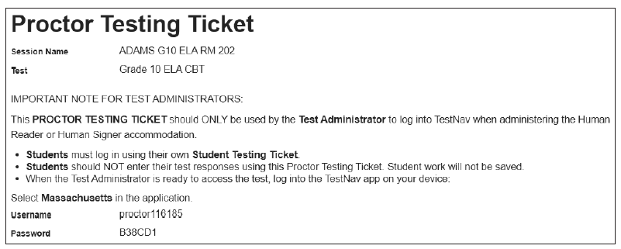
Special Instructions for Human Read-Aloud and Human Signer Accommodations
Special instructions are found in Appendix C of the CBT TAM.
Test administrators who provide these accommodations will use their own computer and print their own proctor testing ticket to access a “test administrator” edition of the test.
A separate “Human Read-Aloud” or “Human Signer” PAN Session must be created.
Students will use their own student testing ticket to log in to their test.
Do not confuse the student’s testing ticket with the proctor testing ticket.

Slide 47
Signing in with a Proctor Testing Ticket
New for 2023–24: When users sign in to TestNav with a proctor testing ticket, they will be prompted to answer the following question: “Are you a student?”
Anyone who selects “yes” will be prompted to exit TestNav and sign in with student credentials (this is to prevent students from testing with a proctor testing ticket). Anyone who selects “no” (test administrators) will be reminded that tests accessed with a proctor testing ticket do not save answers.

Slide 48
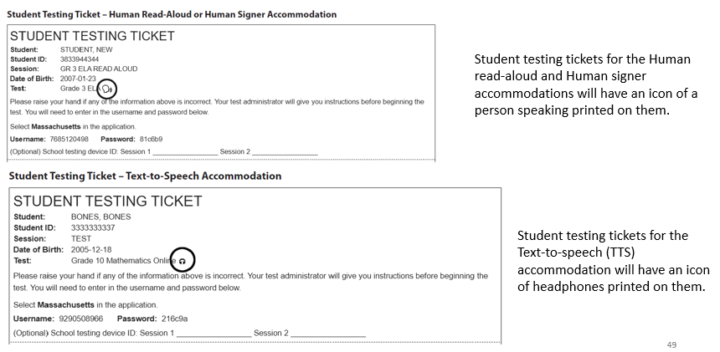
Student Testing Tickets for Human Read-Aloud, Human Signer, TTS

Slide 49
If a Student Refuses an Accommodation
Document the student’s refusal in writing; keep in student’s file.
Sample refusal form — available at www.doe.mass.edu/mcas/testadmin/biology-physics/forms
Do not ask student to sign any forms.
Continue to make accommodation available for remainder of test administration.
Update information in student’s SR/PNP, if an accommodation was entered incorrectly or was not used.
Notify parent/guardian of student’s refusal.
Amend IEP/504 plan for future testing.
If appropriate, list the accommodation in the IEP/504 plan “as requested by student,” or remove it.

Slide 50
Additional Resources for Accommodations
Resource | Link
List of accessibility features and accommodations in Appendix C of the Principal’s Administration Manual | www.doe.mass.edu/mcas/testadmin/biology-physics/manual
Accessibility and accommodations modules and previously offered training session | mcas.pearsonsupport.com/training
Accessibility and accommodations | www.doe.mass.edu/mcas/accessibility

Slide 51
Paper-Based Testing
Discuss the following:
whether Student ID Labels will be applied before test sessions or applied by students after test & answer booklets are distributed
who to contact in the event that test materials become contaminated
MCAS booklets are secure and must be tracked on internal tracking forms.
Yellow highlighters and colored pencils may be used in booklets; however, all answers must be written with a #2 pencil only.
Test administrators must monitor students during testing to ensure that they do not view one another’s booklets.
Test administrators must write their names as well as the school and district name on the board for students to copy onto their booklets at the start of testing.
Most UFs and DFs have paper-based equivalents listed in Appendix C of the PAM.

Slide 52
Paper-Based Testing
Types of Booklets
Subjects | Types of Booklets | Number of Booklets and Description
Biology and Introductory Physics | Combined test & answer booklets | For each subject, one combined test & answer booklet for each session (two booklets total)
Biology and Introductory Physics – Spanish/English editions | Separate test booklets and answer booklets | For each subject, one test booklet and one answer booklet for each session (four booklets total)

Slide 53
Questions and Answers
Opportunity for questions on material covered
Additional topics as needed

