Slide 1
A District’s Perspective: Swampscott Public Schools
November 20, 2019

Slide 2
Presenters
Swampscott MCAS Team:
Lytania Mackey Knowles
Director of Technology & Digital Learning
Catie Porter Roberts
Digital Learning Specialist & Elementary STEM Consulting Teacher

Slide 3
Winter Timeline – Swampscott’s Perspective
December/January:
Map out access points for Wi-Fi coverage for each building.
Often, technology adds new things to the infrastructure of a network that a building principal or leader does not know about.
Book your dates & times district-wide and get organized.
Here is our handout from 2018.
These decisions are made at the district level with all principals together because we have to share tech team resources & time.
February:
Administer student tutorial/scavenger hunt.

Slide 4
Network Planning – Swampscott’s Perspective
Our biggest concern was – Could our network handle the load of students accessing the TestNav app at once?
We often struggle with shared access points when students in two classrooms next to each other are attempting to get online.
We test in five schools, but not at the same time. The maximum number of students testing at a time is only 400.
Solution: We created coverage maps of access points to identify potential areas of weakness before testing (see next slides).

Slide 5
Building with Adequate Wi-Fi Coverage – easily able to identify potential problem areas

Slide 6
Building with Poor Wi-Fi Coverage – will need to add additional access points

Slide 7
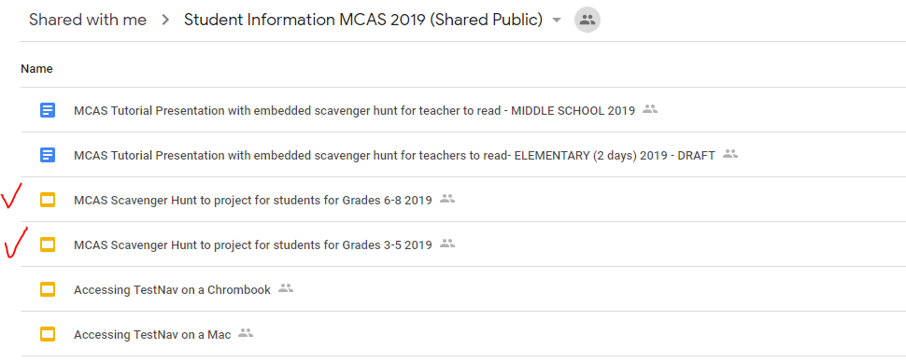
Student Tutorial – Swampscott’s Perspective
Swampscott student tutorial “scavenger hunt” Note: scavenger hunt updated for 2020 for grades 3–5 only
Scavenger hunt keeps students in grades 3–8 engaged and active.
Make sure students know how to navigate the test – e.g.,
bookmark questions
answer different question types
properly sign out

Slide 8
MCAS Scavenger Hunt

Slide 9
MCAS Scavenger Hunt Instructions for Teachers
Have the students access the app on their computers:
Accessing the Student Tutorial for Mac
Accessing Student Tutorial for Chromebooks
You may need to restart the Tutorial on your computer.
Guide the students to select “Start Test Now” and “Start Session.”

Slide 10
Sample from the MCAS Scavenger Hunt
Go to Slide 6
What is one way you can go to slide 6?
What is a different way you can go to slide 6?
Bookmark Slide 6

Slide 11
Resources & Suggestions from the Swampscott Team
Resources
Training slides
Swampscott Infrastructure Trial Guide
Swampscott Infrastructure Trial script for students
Sample Materials for Coordinating MCAS Test Administration
Student Training Materials Folder
Helpful Checklist of principals’ responsibilities vs. the technology department.
Tech team should NEVER answer accommodation or security questions.
Suggestions
Create spreadsheets with test information - color code by test administrator to easily see home room groups.
Despite it being computer-based testing, students still need paper and pencils.
Learn to filter and sort your views in PearsonAccess Next.

Slide 12
Contact Information for Swampscott Team
Lytania Mackey Knowles
Director of Technology, Digital Learning, and Innovation
mackey@swampscott.k12.ma.us
Catie Porter Roberts
Digital Learning Specialist & Elementary STEM Consulting Teacher
porter@swampscott.k12.ma.us

