Slide 1
Educational Stability
5. Transportation

Slide 2
Educational Training Series
Welcome to the Educational Stability Training Series!
All children have a right to a public education.
Some children experience barriers to accessing that education as a result of always being on the move or having high mobility.
This module focuses on ensuring comparable transportation for the highly mobile students who are homeless or in foster care.

Slide 3
The Why and the Who of it.
Ensure unique educational rights for highly mobile students
Every Student Succeeds Act of 2015
Foster Care Students
Homeless Students
Massachusetts Valor Act of 2012
Military Connected Students
Migrant Students

Slide 4
Highly Mobile Students
Students who are in 24-hour out-of-home care, away from their parent(s)/legal guardian(s) and for whom DCF has care and placement responsibilities.
Foster Care
=
Students who lack fixed regular and adequate nighttime residence including those who are sharing the housing of others due to economic hardship, loss of housing or similar reason.
Homeless
=
Students or students’ parent(s)/guardian(s) who are a migratory agricultural worker, fisher, or food/fish processor, are under 21, have not completed high school, and have moved across district lines within the preceding 36 months.
Migrant
=
Students whose parent/guardian is an active member of the uniform services, or has been medically discharged, retired, or died in active duty within the past year.​
Military
=
Please see module 2. Identification for detailed definitions.

Slide 5
Content
1 | Who is Entitled to Transportation?
2 | What is Comparable Transportation?
3 | Who is Responsible for Transportation?
4 | How Long is Transportation Provided?
5 | Special Education Transportation
6 | Contact Information & Resources

Slide 6
Who is Entitled to Transportation?
1

Slide 7
Who is Entitled to Transportation to and from School?
Under McKinney-Vento students who are homeless are entitled to transportation if needed to return to their schools of origin.
Under Title 1 Part A students in foster care are entitled to transportation if needed to return to their schools of origin.
This include students who are sheltered or placed:
in another neighborhood/zone within their school district,
in another Massachusetts school district, or
across state lines (VT, NH, ME, RI, CT, NY).

Slide 8
From Where and To Where?
From the last point of supervision
BEFORE SCHOOL
To the next point of supervision
AFTER SCHOOL
Points of supervision: school community programming (such as the YM/WCA or Boys & Girls club) or the home of a relative/ friend providing daycare.
It is the parent’s/foster parent’s responsibility to drop off/pick up from the daycare provider.

Slide 9
Transportation and Extracurricular Activities
Students who are homeless have the right to access all school courses and activities including extracurricular and summer programming.
To ensure access, school districts must remove barriers that limit participation …including transportation.
Districts are strongly encouraged to provide access to all school activities for students in foster care and arrange transportation accordingly.

Slide 10
Transportation Guidelines
Massachusetts has established guidelines for transportation based on commuting time rather than distance:
Preschool and Kindergarten Students:
Students in 1st grade through Graduation:
Up to…
Up to…

Slide 11
Transportation Guidelines: Consider…
These are guidelines. Several variables may impact transportation and can be considered on a case-by-case basis.
Young children may not be able to sit still – particularly alone on a van.
High school students (particularly those close to graduation) may be able to handle more than an hour.
Rush hour or seasonal traffic, point in the school year, siblings traveling together, supervision before/after school.

Slide 12
Best Practices for Providing Transportation
Best practices – in consultation with the parent/guardian:
Provide access to breakfast and before school activities if the student arrives early.
Provide after school snacks and access to afterschool activities or a place to study while waiting for a sibling.
Siblings often travel best together.
If the district has real concerns that a long commute or timing of transportation may not work for the student discuss a trial period with the parent and revisit the decision later, or
offer to provide transportation to the next break in the school year and work with the parent on a smooth transition to the local school.
Denying transportation may in effect be denying enrollment.
Remember the parent/guardian is the decision maker.

Slide 13
Case-by-Case Decisions
Transportation is set up and considered on a case-by-case basis. In cases where transportation vendors are not able to pick up the route, the districts sharing transportation must make a good faith effort to find a vendor or other alternative to get the student to and from school.
Occasionally a student does not use the transportation when it is provided. Efforts should be made to address student engagement rather than terminating transportation.
.

Slide 14
Disputes
Sometimes a student ends up across the state, cannot handle the commute, or traffic makes transportation impossible. The district should work with the parent/guardian to resolve these issues.
When all else fails and because denying transportation can in effect deny enrollment, districts must extend the right to appeal the denial in the case of students who are homeless or revisit the best interest determination in the case of students in foster care.

Slide 15
What is Comparable Transportation?
2

Slide 16
Comparable Transportation
McKinney-Vento requires students who are homeless be provided with “comparable” transportation. This means that transportation provided to students who are homeless must be the same quality and meet the same safety standards as transportation provided to their peers.
Massachusetts has determined that students in foster care must also be provided comparable transportation.

Slide 17
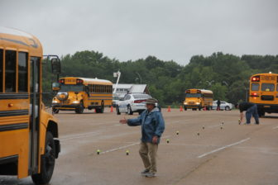
Massachusetts Pupil Transportation
In Massachusetts, vehicles with fourteen or fewer passengers used to transport students must comply with state law Chapter 90, Section 7D. This law ensures that …
…drivers (who are not parents/guardians) are appropriately
…vehicles are inspected and in working order with appropriate
trained, and
licensed.
lights, signage, and
pupil plates.

Slide 18
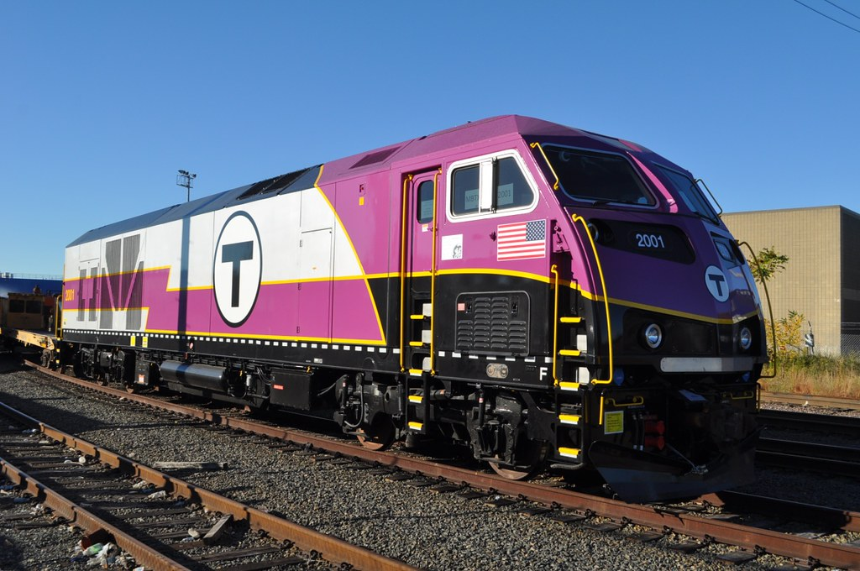
Alternatives
Alternatively, districts may
use public transportation in accordance with district policy, and
reimburse a parent/guardian for the cost of driving the student to and from school.
Not allowed are drivers and vehicles that do not comply with section 7D including but not limited to
taxis and
chauffer driven limousines.

Slide 19
Who is Responsible for Transportation?
3

Slide 20
Who is Responsible for In-district Transportation?
Students sheltered or placed within their school districts should be transported according to district policy including walking distances and access to local school buses.
School bus fees must be waived for students who are homeless or in foster care.
The district is responsible for the logistics and cost of in-district transportation.

Slide 21
Who is Responsible for Foster Care Transportation?
Students in foster care who are placed outside of their school district must be provided with comparable transportation to their school of origin.
For students in foster care, the district where they are enrolled (the district of origin) must collaborate with DCF and ensure that transportation is provided (arranged and paid for).
This may include reimbursing the foster parent or working with program staff or social worker on a short-term basis while other arrangements are made.

Slide 22
Who is Responsible for Homeless Transportation?
Students who are homeless and have found shelter outside of their school district must be provided with comparable transportation to their school of origin.
Responsibility to arrange and pay for “homeless transportation” is shared between the district where the student is enrolled and the district where the student is sheltered.
Districts must communicate clearly and work together to find the most efficient and cost-effective option. Be sure to get an acknowledgement from the district you are sharing responsibilities with … no one wants an unexpected bill at the end of the school year.

Slide 23
Homeless Transportation Across State Lines?
Remember -
McKinney-Vento is a federal law and includes students who end up living and attending school across state lines.
Everyday students are crossing Maine, New Hampshire, Vermont, New York, Connecticut and Rhode Island state lines.
Reach out to the homeless liaison in the appropriate school district to share transportation responsibilities just as you would with a MA school district.
See Special Education Slides below for the Rhode Island exception.

Slide 24
Transportation Funding
Partial reimbursement is available to districts for transporting students who are homeless or in foster care.
Homeless transportation – the state budget includes funding for partial reimbursement for transporting students who are homeless across district lines. The district’s Business Manager should include this expense on the Final End-of-Year Report. Funds are paid to the local municipality.
Foster care transportation- federal funding under Title IV E of the Social Security Act has been made available to partially reimburse districts transporting students in foster care across district lines. Details and forms are posted under Transportation on the School Finance Office’s webpage.
Title 1 funding – both homeless and foster care transportation are allowable expenses under Title 1. However, districts are encouraged to be cautious about using these limited funds.

Slide 25
How Long is Transportation Provided?
4

Slide 26
How Long is Foster Care Transportation Provided?
For a student in foster care, transportation is provided, as long as, the student needs it or until the student leaves foster care.
When a student is reunified or adopted, districts are encouraged to consider maintaining enrollment and transportation if it is in the student’s best interest until the end of the school year or other appropriate break in the school year.

Slide 27
How Long is Homeless Transportation Provided?
For a student who is homeless, transportation must be provided at the request of the parent/guardian through the end of the school year in which the student becomes permanently housed. This includes to and from a designated receiving school that becomes the student’s school origin.

Slide 28
Special Education Transportation
5

Slide 29
Special Education Transportation and the Homeless/Foster Care Student
For students who are homeless or in foster care that have special education individualized education plan (IEP) for which they need transportation to access their programming, their transportation is fully covered by the fiscally responsible district.
One Exception:
Students who are homeless and living and attending school across the Rhode Island state line are the only exception. The districts in the state of Rhode Island share the cost of special education transportation for students who are homeless. Massachusetts has agreed to transport accordingly.

Slide 30
Contact Information & Resources
6

Slide 31
Resources – District and Area Office contacts
District liaisons and POCs
Current list of homeless liaisons and local foster care POCs Updated by the district’s Directory Administrator
Please verify your contact information
DCF Contacts
DCF Area Directors (serving as local POCs)
Network of Regional Liaisons
Carol Baez, Worcester Public schools 508-799-3652
Jacob Hansen, Framingham Public Schools 508-782-6894
Julie Mador, New Bedford Public Schools 508-997-4511 x14663
Stacy Parsons, North Adams 413-776-1677

Slide 32
Resources – DESE/DCF Educational Stability Team
DESE Education Stability Website: http://www.doe.mass.edu/sfs/edstability.html
Technical Assistance: Problem Resolution Services, 781-338-3700
Staff: Christine Cowen, Migrant Education, Military Connected Students
781-338-6301 Christine.H.Cowen@mass.gov
Kristen McKinnon, Foster Care Point of Contact
781-338-6306 Kristen.A.McKinnon@mass.gov
Jim Morrison, DCF Point of Contact
617-748-2340 James.J.Morrison@MassMail.State.MA.US
Sarah Slautterback, State Coordinator< Homeless Education
781-338-6330 Sarah.E.Slautterback@mass.gov

Slide 33
THANK YOU
Educational Stability, Office of Student and Family Support
781.338.3010
achievement@doe.mass.edu
www.doe.mass.edu/sfs/

