Slide 1
Orientation to Educational Stability
2022-2023

Slide 2
Agenda
01
Overview
02
Legislation
03
Definitions
04
Designated Staff
05
Identification and Enrollment
06
Support
07
General Topics
08
Contact Information & Resources

Slide 3
Overview

Slide 4
Team and agenda
The Team
Bridget, Christine, Kristen, Sarah
Regional Liaisons
Housekeeping
We will be taking a break
mid-morning and
a 30-minute lunch break at noon
Restrooms
Please silence you cell phones. If you need to take a call please step out of the room.

Slide 5
Overview of the Day
Today we will cover the educational rights of students in foster care, in migrant and active military families and who are homeless. Identification, enrollment, and support are similar across groups but can be very different too. You will need to stay on your toes.
Feel free to ask questions as we go.
Each of us could talk all day and more on our specialties. We encourage you to joins us for Office Hours when we dive more deeply into areas of particular concern and a beyond the nuts and bolts we will cover today.

Slide 6
Ground Rules
While specific cases can and do illustrate the content, we must maintain the children’s and families’ confidentiality. Please withhold identifying information.
Today is about learning from issues that arise due to high mobility and is not about pointing fingers at other districts. Please withhold district/school names.
For questions regarding specific cases, please stop by during the break or after this session.

Slide 7
Who is in the room?
Experience Line
Sharing experience and new perspectives
This Photo by Unknown Author is licensed under CC BY

Slide 8
Legislation

Slide 9
Legislation - Overview
Federal
Title 1 Part A (Foster Care Education)
Title 1 Part C (Migrant Education)
McKinney-Vento (Homeless Education)
State
MA Valor Act (Military Connected Students)
Military Interstate Children’s Compact Commission (MIC3)
MA - An Act Relative to Military Spouse-Licensure Portability, Education and Enrollment of Dependents

Slide 10
A word about new arrivals
New Arrivals are not a focus of the day but often appear in the topics we will be discussing.
Memorandum on new arrivals is posted on the DESE website
Right to attend school
DESE encourages prompt enrollment
Students may be homeless at the time of arrival or part of migratory families.
Keep in mind migrant and immigrant are two different things

Slide 11
Legislation - Title I, Part A Provisions
Ensures educational stability for students in foster care
Establishes specific educational rights for students in foster care
Requires a foster care point of contact in every district
Requires a state foster care point of contact at both DESE and DCF
DESE Foster Care webpage

Slide 12
Legislation- Title I Part C – Migrant Education Program
Ensures educational stability for students in migratory families
Educational rights for students in migratory families
Provides for educational supports and services
Cross-references in McKinney-Vento
DESE Migrant Education webpage
Contracted to CES statewide

Slide 13
Legislation - McKinney-Vento Homeless Education
Ensures educational stability for students who have lost housing
Defines homelessness
Establishes educational rights for homeless children/youth
Mandates a homeless education liaison every district
Mandates a state coordinator in every state
Funds a small grant program
DESE Homeless Education webpage

Slide 14
Legislation- Military Connected Students
Massachusetts Valor Act of 2012
Membership in MIC3
Military Interstate children’s Compact Commission
Ensures timely enrollment and graduation
Appropriate grade placement
Attendance due to deployment
DESE MIC3 webpage
Massachusetts - An Act Relative to Military Spouse-Licensure Portability, Education and Enrollment of Dependents

Slide 15
Definitions

Slide 16
Definitions – WHO?
Who are these students?
I think they are both…?

Slide 17
Definitions – Students in Foster Care
Students who are in:
24-hour out-of-home care, placed away from their parents or guardians, and for whom the Department of Children and Families (DCF) has placement and care responsibilities.
Foster homes include, but are not limited to:
Group homes, foster homes, kinship foster homes, STARR, Transitional care units (TCUs)

Slide 18
Definitions – Migrant Students
Who is a Migrant Student?
Child or Child’s parent(s)/guardian(s) are a migratory agricultural worker, migratory fisher, or migratory food/fish processor who moved within the preceding 36 months*
Child is under 21 years of age
Has not graduated from high school or received high school equivalency
Moved across school district lines
*sometimes with, or to join a parent, spouse, guardian, caregiver who is the worker

Slide 19
Definitions – Migrant Worker
Who is a Migratory Agricultural Worker/Fisher?
An individual who made a qualifying move due to economic necessity in the past 36 months and engaged in* temporary or seasonal employment in agricultural or fishing work.
Individual may still be considered a migratory agricultural worker/fisher if the individual actively sought such work and has a recent history (within past 3 years) of moves for this type of work.

Slide 20
Definitions - Homelessness
Homelessness is defined as lacking fixed, regular, and adequate nighttime residence and includes
Living in shelters
Living in campgrounds, parks, cars, public buildings, hotels
Sharing the housing of others due to
economic hardship, loss of housing or similar reason
(this means there was a triggering event that caused loss of housing)
And migrant students living in any of these arrangements,
unaccompanied homeless youth, and preschoolers

Slide 21
Definitions – Homelessness (Continued)
Doubling up
Living with friends or relatives due to economic hardship, loss of housing and similar reason
Couch surfing
Families
Unaccompanied youth
Campgrounds, Winter Rentals, & places not meant for human habitation
Room “rentals”

Slide 22
Definitions - Inadequate (substandard) housing
When looking at inadequate housing consider the following
Local building/health codes
Access to kitchen and bathroom
Allowed by the landlord
Mold or rodent infestations
Overcrowding
Lacks utilities, heat or electricity
Presents unreasonable dangers

Slide 23
Definitions - Military connected students
Military connected students refers to the children of active duty members of the uniformed services.
“Active duty” refers to full-time duty status in the active uniformed service of the United States, including members of the National Guard and Reserve on active duty orders.
“Uniformed services'' means the Army, Navy, Air Force, Marine Corps, Coast Guard, including the Commissioned Corps of the National Oceanic and Atmospheric Administration, and Public Health Services;

Slide 24
Definitions - Military connected students (continued)
This definition includes to students in military families who are the children of the following:
Members or veterans of the uniformed services who are severely injured and medically discharged or retired for a period of one year after medical discharge or retirement;
Members of the uniformed services who died on active duty or as a result of injuries sustained on active duty for a period of one year after death.

Slide 25
Definitions – Military connected students does not include:
This definition does not include to students who are the children of the following:
Inactive members of the National Guard and Reserves;
Members of the uniformed services who are now retired (except as defined above);
Veterans of the uniformed services (except defined above); or
Other United States Department of Defense personnel or other civilian and contracted employee not defined as on active duty.

Slide 26
Definitions - BID
Best Interest refers to making student-centered decisions; what works best for the student.
Best Interest Determinations (BIDs) are enrollment discussions between DCF and a school district that are based on what is best for the student. These are NOT special education team meetings. They address enrollment ONLY.
Enrolled is defined as enrolled and attending.

Slide 27
What is an EDM?
Educational Decision Maker (EDM) is the adult responsible for making decisions for a student.
For students in foster care this person is designated by DCF and can be the foster parent, the biological parent, a court-appointed GAL, Special Education Surrogate Parent or other adult.
For students who are homeless this is the parent or caregiver.
For students in migratory or military families this is usually the parent, guardian, or caregiver.
For new arrivals this may be the ICE designated sponsor
For unaccompanied homeless youth this is the student.

Slide 28
Definitions- Immediate Enrollment and School of Origin
Immediate Enrollment refers to enrolling a student without delay regardless of whether or not they have all the documents usually required for enrollment including medical/health records, proof of guardianship, school/academic records, discipline records or proof of residency.
School of Origin refers to the last school attended.
If the student is homeless it may also include the school the student was attending when they went homeless, and designated receiving schools
If the student is in foster care the school of origin ends when they have completed all the grades in the building or leave foster care.

Slide 29
Definitions - School of Origin (continued)
School Selection is the process of the parent determining which school/district to enroll their child(ren) in.
To promote educational stability, students should remain enrolled in their school of origin, unless, after a best interest determination or during school selection, it is decided to be in their best interest to enroll locally.

Slide 30
Designated Staff

Slide 31
Designated Staff -Overview
Designated staff refers to those roles required by law at the state level:
State Foster Care Point of Contact
State Coordinator for Homeless Education
State Director of Migrant Education
MIC3 Liaison
(Referred to as the Educational Stability team at DESE)
...at the district level:
District Foster Care Point of Contact
District Homeless Education Liaison
Note: DESE also has a network of Regional Liaisons

Slide 32
Designated Staff – State Foster Care Point of Contact (POC)
DESE and DCF Foster Care POCs
Work together to establish policies and procedures that support students’ educational stability
Provide technical assistance
Collaborate, communicate and coordinate to ensure student rights
Resolve disputes arising from best interest determinations

Slide 33
Designated Staff - District Foster Care POC
The Foster Care POC is designated by the superintendent to ensure:
The identification of students in foster care and participate in best interest determinations in collaboration with DCF representatives;
Enrollment of students in foster care, the timely transfer of records, and regular attendance;
Full and equal opportunity to succeed in school and to meet the same challenging state academic standards as other students, and to receive educational services for which they are eligible.

Slide 34
Designated Staff - District Foster Care POC (continued)
Develop/implement procedures for providing and coordinating cost-effective transportation, as needed; and
Facilitate professional development for district staff to promote educational stability for students in foster care.

Slide 35
Designated Staff – Migrant Education
State Migrant Director: Processes funds; monitors vendor to ensure funds are being utilized for the support of migratory students; Provides support to CES in the implementation of supports and services for migrant students; Participates in national meetings to follow trends and policy development
Program Director and Staff at CES implement the program on behalf of DESE. Recruiters are trained to conduct Identification of migrant students.

Slide 36
Designated Staff - Homeless Education
DESE State Coordinator ensures
Barriers are removed to enrollment and full participation in school
Training is provided for homeless liaisons
Technical assistance is provided
Monitors districts
Data is collected
Collaboration with stakeholders
Administers grant program

Slide 37
Designated staff - Regional Liaisons
Regional liaisons collaborated with the state coordinator to
Provide local liaisons with technical assistance,
Support liaisons with training needs, and
Assist with connecting to local resources.

Slide 38
Designated Staff - Homeless Education Liaison
The Homeless Education Liaison is designated by the superintendent to ensure:
Identification
Building awareness and provide training for district staff including:
Enrollment staff guidance principals and nurses
Enrollment
Access to all services including
Preschool and Head Start programs run by the district
Special education, EL, vocational, alternative, gifted & talented

Slide 39
Designated Staff - Homeless Education Liaison (continued)
Provide Information and referrals
Health, dental, mental health
Other community-based services (food pantries, clothing banks, ...)
Inform parents
their children’s educational opportunities and
meaningful opportunities for parental involvement
Public Notice of the educational rights
Homeless Education Policy – school committee approved

Slide 40
Designated Staff - Homeless Education Liaison (continued..)
Provide verification of homelessness for HUD funded programs
Provide reliable data
Tracking for internal purposes
Support services
Transportation reimbursement
DESE data collection for homeless and foster care education

Slide 41
Designated Staff - Homeless Education Liaison (continued...)
Facilitate Dispute Resolution Process
Posted as part of the Homeless Education Advisory
Inform parents of transportation rights
One hour guideline
Communicating with your counterparts
Provide training to district staff
Faculty, enrollment staff, guidance, nurses
School committee

Slide 42
Designated Staff - Homeless Education Liaison (continued.)
Unaccompanied youth are enrolled
Informed of independent status for FASFA
Provided verification of homelessness
Provided with college and career counseling
Coordinate and collaborate
State coordinator and
State/local providers

Slide 43
Designated Staff – Military connected students
Military Connected Student Specialist works to ensure students are appropriately placed, graduate on time, etc. if meeting criteria established. The Specialist also works to not only support the students but the school district's understanding of MIC3.
The Specialist serves as the DESE designee on the MA MIC3 Council.

Slide 44
Your thoughts?
Please take a 10-minute break.
When you return:
Find one or two new people who are wearing the same color shoes you are.
Take 5 minutes to introduce yourselves and share something you have learned or are thinking about.
Write it down on a sticky and post it on the thinking/head poster.

Slide 45
Identification and Enrollment

Slide 46
Identification and Enrollment- students in foster care
Identifying and enrolling students who are in foster care requires good communication and strong collaboration.
This starts with the scheduling of a
Best Interest Determination.

Slide 47
Enrollment- A seat at the (metaphorical) table
Student, parent/guardian, foster parent
Social worker, education coordinator
District POC, special education, guidance counselor, teacher
Educational decision maker, legal representative
District POC – from district of foster placement
Notes:
Factors to consider include:
Age/grade level
Connections to school
Distance/time to school
Anticipated time in placement
Availability of services to meet students needs, etc.
Parties to include:
DCF, student (if appropriate), family/foster family, any educational decision makers
District of origin, school personnel, local school district (where student is placed in foster care, if appropriate)

Slide 48
Identification and Enrollment- Immediate Enrollment
If determined to be in a student’s best interest to attend school locally (where placed in foster care), district must enroll immediately*
With or without documentation, including:
Academic, health, discipline and/or special education records
Notice to LEA (from DCF), includes:
Emergency contact, residence, social worker, record release, transportation needs, etc.
District POCs should initiate records transfer, help facilitate transition
*Note: If there is no change in the school of origin, there should be no change in enrollment.
Notes:
Factors to consider include:
Age/grade level
Connections to school
Distance/time to school
Anticipated time in placement
Availability of services to meet students needs, etc.
Parties to include:
DCF, student (if appropriate), family/foster family, any educational decision makers
District of origin, school personnel, local school district (where student is placed in foster care, if appropriate)

Slide 49
Identification and Enrollment – Foster Care Best Interest Determination Process Overview
Overview Chart is Now Available!

Slide 50
Identification and Enrollment- Foster Care Identified
Step 1 – DCF Identifies a student in FC and initiates BID
Note
Decisions about which school a student will attend should be made collaboratively.
Should include those in the best position to understand the student’s unique needs.
Student should remain in their school of origin until BID is completed.
Process should be collaborative…but doesn’t need to be one big meeting!

Slide 51
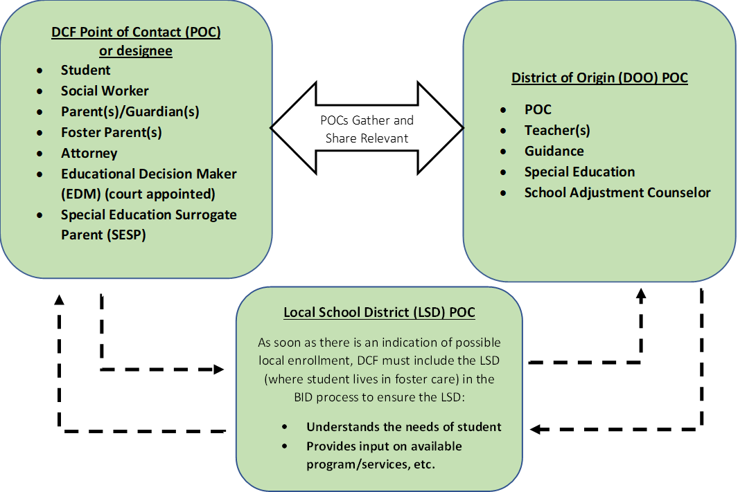
Identification and Enrollment- Collaboration
Step 2 – School Districts and DCF Collaborate
Note
Collaborators may want to consider if the school of origin is in the best interest but only for a limited duration of time.
Collaborators involved in the decision may wish to determine a time to revisit the question of whether it is in the student’s best interest to remain in the school of origin or enroll locally.
Transportation costs should not be a factor in determining the best interest for the purpose of school selection.
Gather and Share Relevant Factors
Gather and Share Relevant Factors

Slide 52
Identification and Enrollment- Determination
Step 3 – Upon Completion of BID
Note
Notice to School District from DCF - includes Emergency contact, residence, social worker, record release, transportation needs, etc.

Slide 53
Identification and Enrollment- BID Disputes
Upon completion of the best interest determination, DCF has the authority to make final decisions about a student’s best interest, but a school district may dispute DCF’s best interest determination.
During the dispute resolution process, the student must attend the school selected by DCF following the local BID process. Transportation must be provided for the student, if needed.
The dispute process and form can be found on DESE’s Foster Care Webpage: http://www.doe.mass.edu/sfs/foster/ and should be submitted to DESE at achievement@doe.mass.edu.

Slide 54
Identification and Enrollment - Migrant Students
Trained recruiters determine the eligibility of students for the migrant program.
Identification and recruitment: school and agency Screeners; in-person canvasing of businesses, local community resources; MSIX referral; word of mouth.
If determined to be eligible, a Certificate of Eligibility is completed for the MMEP and CES will contact the school to obtain data on DESE’s behalf and notify the school of migrant status. A request for Data on DESE’s behalf is available to CES to share with schools.
Once a student is determined to be eligible, if not enrolled in school, the CES representative may initiate enrollment with the school on behalf or with the parent/guardian.
Eligibility to the MMEP is three years from qualifying arrival date.

Slide 55
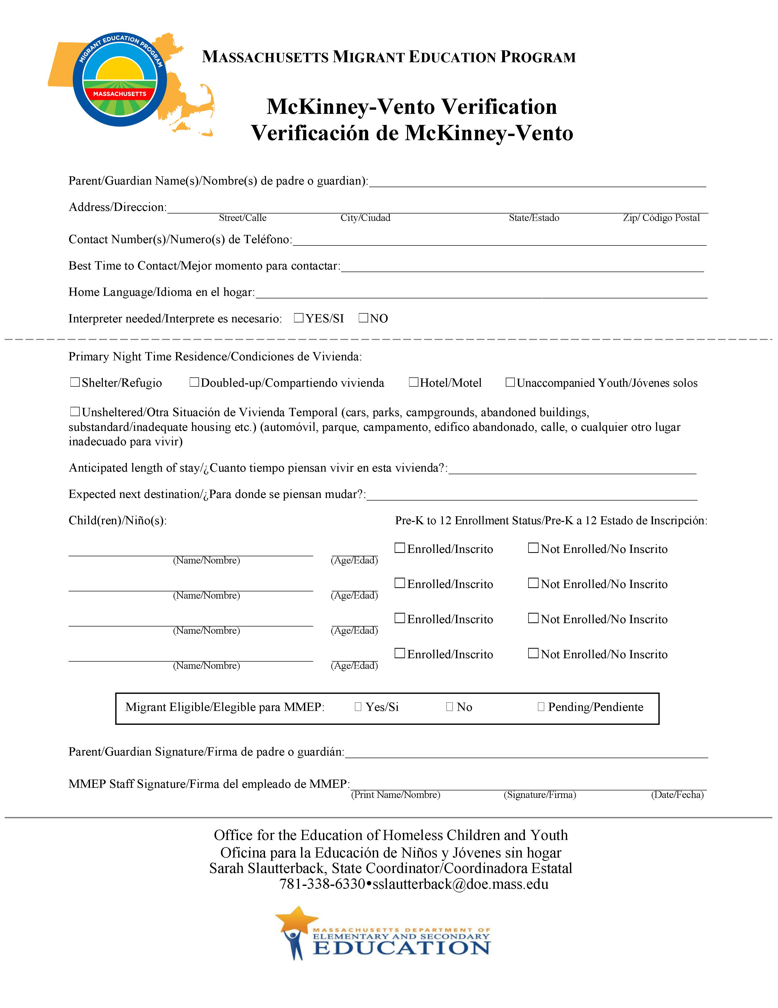
Identification and Enrollment – Migrant Education Program
Screeners Translated in Google

Slide 56
Identification and Enrollment –Students who are homeless
Enrollment is when many homeless students are identified and connected to services.
Red Flags to look for:
Lack of documentation
Doubling up with friends or relatives
Child has been out of school for awhile
An address that is not residential
Child and adult do not seem to be together
Older and/or controlling “boyfriend”
“We are only staying for a little while.”
“We can’t stay long…”

Slide 57
Identification and Enrollment – Red Flags Continued
Some children experience change and continue to come to school.
Red Flags to look for …
Change of address but have no documentation
Doubling up with friends or relatives
An address that is not residential
Hungry, tired, distracted
Wearing the same clothes

Slide 58
What can you do?
Strategies to try …
A longer conversation with the parent(s)/youth in a safe place.
Ensure staff contact the homeless liaison or POC.
Posters or flyers with the educational rights of homeless students.
Enrollment forms that acknowledge highly mobile students
When there are siblings, communicate with staff in other buildings.
Establish a “Handle with care” policy with local police or social service providers
In domestic violence cases:
Restraining orders
Transfer records using a third party
Determine educational decision-making rights

Slide 59
Identification and Enrollment – Students who are homeless
For families that are homeless the parent/guardian is the decisionmaker and may select:
The school of origin
the last school attended,
the school where student went homeless, or
a designated receiving school
with transportation
thru the end of the year in which the student becomes housed
OR

Slide 60
Identification and Enrollment – Students who are homeless (continued)
Enroll locally:
Immediate
With or without documentation
Academic records Health records
Residency/shelter Special education records
Discipline Guardian ship
The school may require emergency contact information
Best Practice: Statement on enrollment forms indicating that parents should talk with the district if they do not have required forms for enrollment.

Slide 61
Identification and Enrollment – Homeless Disputes
Enrollment Disputes
The parent always has the right to appeal a district’s enrollment decision
Forms are in the Homeless Education Advisory and posted.
One form for the districts - Notification
One form for the parent - Appeal
Homeless liaison is responsible to facilitate the process
All forms go to Compliance@doe.mass.edu
All parties must supply all relevant information

Slide 62
Military-Connected Students
MA is a member of the Military Interstate Children's Compact Commission
Provide an opportunity to voluntarily self-identify
Ensure timely enrollment*
Appropriate grade placement
Remain on track for graduation
Attendance due to deployment

Slide 63
Military Connected Students: *Remote Registration
(b) A military-connected student whose parent or guardian is being relocated to the commonwealth under military orders and is transferred to, or is pending transfer to, a military installation within the commonwealth shall be deemed a resident pupil of the applicable school district for the purposes of enrollment. A school district shall permit a military-connected student to enroll preliminarily by remote registration without charge and shall not require a parent or guardian of the military-connected student or the military-connected student to physically appear at a location within the district to register the student; provided, however, that a parent or guardian of a military-connected student shall present evidence of military orders that the parent or guardian will be stationed in the commonwealth during the current or following school year. To enroll a student, the parent or guardian shall use an address that: (i) is within the school district where the military-connected student is to be enrolled; and (ii) is either: (A) a temporary on-base billeting facility; (B) a purchased or leased home or apartment; or (C) federal government or public-private venture off-base military housing. Proof of residency shall not be required at the time of the remote registration but shall be required not later than 10 days of the military-connected student’s attendance in the school district.

Slide 64
Military Connected Students: Purple Star Designation
NEW! NEW! NEW! NEW! NEW! NEW!
An application process for designation as a purple star school is forthcoming.

Slide 65
Transportation
Maintaining a school of origin for a student in foster care or who is homeless and placed or sheltered beyond their district often relies on transportation.
For both groups of student transportation must be
comparable to what is being provided to their peers and
meet state pupil transportation requirements.

Slide 66
Identification and Enrollment – Transportation Standards
Pupil Transportation
Federal law mandates comparable service
State law regulates pupil transportation
7D licensed driver and inspected vehicle
Public transportation per district policy
Parent provided (reimbursed)
DCF provided temporarily
Best practice: Communicate clearly with the district you are sharing transportation with to find the most cost-effective option.

Slide 67
Identification and Enrollment – Foster Care Transportation
Districts must collaborate with DCF to establish policies and procedures to ensure that students who need transportation to remain in their school of origin get it.
Absent another agreement, districts of origin are responsible for providing transportation to and from the school of origin.

Slide 68
Identification and Enrollment Foster Care Transportation - Reimbursement
Social Security Act Title IV E
Federal funds available for transporting students in foster care back to their schools of origin.
Procedures (posted on School Finance/Transportation webpage)
Sign MOU and approval from Town Meeting/City Council
Complete report of costs (excluding SPED and Title 1)
Maintain documentation
Anticipated reimbursement
20%
For costs starting 4th Quarter of FY19
Districts should document all costs associated with this transportation.

Slide 69
Identification and Enrollment – Homeless Transportation
Transportation if needed to remain in the school of origin
In district
Across district lines
Shared responsibility of:
District where child is enrolled and
District where the child is sheltered
State reimbursement
Special education transportation covered by the fiscally responsible district
Across state lines (RI exception)

Slide 70
Identification and Enrollment Homeless Transportation - Reimbursement
State funds are available for transporting students who are homeless back to their schools of origin.
Your transportation manager should maintain documentation for transportation across district lines
Total cost is included in the End of Year Final Fiscal Report
Anticipated reimbursement depends on the state budget
FY21 rate was approximately 70%
This does not include special education transportation.

Slide 71
Identification and Enrollment - Caregiver’s Affidavit
In the absence of a parent or legal guardian…
MA state law allows for a caregivers affidavit for medical and educational decision making rights.
Must identify the student (name and DOB)
Must be signed by the parent and the caregiver
Must be notarized
Good for up to two years
Can be revoked or overridden by the parent at any time
Note: Students with a caregiver’s affidavit are considered housed unless the caregiver lacks fixed, regular, and adequate housing.

Slide 72
Break
Please take 30 minutes
to stretch, get lunch and
say hello to someone new.

Slide 73
Your thoughts?
When you return
Find one or two people wearing the same color shirt you are.
Take a 5 minutes to introduce yourselves and share something you are feeling.
Write it down on a sticky and post it on the feeling/heart poster

Slide 74
Support and Resources

Slide 75
Supports and Resources- What schools can and cannot offer
What schools can offer but cannot offer
Safety 24 hours safety
Day shelter Housing
Free lunch/breakfast Food 7 days/week
Cash /SNAP benefits
First aid Medical services
Showers/washing machines
Guidance and support Therapy/family mediation
College/career counseling Adult Education
Education Job training for parent
Peers/social connections

Slide 76
Support and Resources - What helps?
Predictability
Daily routines
Avoid sudden changes in the classroom
Consistent rules and expectations
Mentoring, daily check ins
Engaging in group activities
Sports
community service learning
afterschool clubs, student newsletter…
Focus on student strengths

Slide 77
Support and Resources - What helps? (continued)
Collaborate with community providers and resources
Public libraries
Housing and shelter providers
Family Resource Centers
Local food pantries
Boys & Girls Club, YMCA/YWCA
Local Board of Health and/local clinic
State’s Family Resource Center (FRCs)
DCF

Slide 78
Supports and Resources - Migrant Education Program
Subgrantee for DESE:
Collaborative for Educational Services (CES)
Emily Hoffman
ehoffman@collaborative.org
978-604-4935
MMEP @ CES

Slide 79
Supports – Migrant Education Program
Services Provided to Support the Migrant Student
Facilitation of Enrollment
Ensure Equal Access & Comparable Services
Collaborate with School Districts
Provide Summer School
Provide Supplemental Educational Support Services during the Academic Year
Regional and State Parent Advisory Councils
Migrant Students automatically qualify for free lunch!
The rights of homeless students if they meet the definition
No district level data collection on migrant status

Slide 80
Supports – Migrant Education Program (continued)
Migrant students experience:
Educational disruption
Social isolation
Cultural and language differences
Health related problems
Extreme poverty
Any other factor that inhibits the ability of a migratory child to do well in school

Slide 81
Supports for Migrant Education Program
More Information:
DESE Migrant Education webpage: MMEP
Results Webpage: Results

Slide 82
Support and Resources- Military Interstate Children’s Compact Commission (MIC3)
More Information:
DESE Military Connect Student webpage:
MIC3

Slide 83
Supports - Homelessness in Massachusetts
State Shelter system
Income eligible+ child + MA resident+ nowhere to stay
Family shelters:
congregate shelter,
scatter site shelter
Motels
Unaccompanied youth in adult and youth shelters
Moving out of shelter & signing a Lease
HomeBase, RAFT, Section 8, and MRVP

Slide 84
Educational Rights of Homeless Students
Verification of homelessness
FASFA and college admissions purposes, Moving to College
HUD funded programs
MA residency
Best Practice: To avoid FERPA concerns address verification letters to the parent or unaccompanied youth for them to share. Enrollment verification letter is accepted as proof of MA residency to access shelter
Free school meals (eligibility is for the school year)
Best Practice: The homeless liaison must notify the Food Service Director of students that have been identified as homeless. Students in foster care can be verified through the Virtual Gateway.

Slide 85
Supports - Educational Rights of Homeless Students
Title I
Students who are homeless have the right to access Title 1 programming even if that programming is offered in a different school building.
School-wide & targeted programs
Addressing the non-traditional needs of homeless students
Needs assessment and coordination
Homeless reservation
Liaison
Transportation

Slide 86
Supports and Resources – Students who are homeless
The student’s living arrangement is protected and cannot be shared without parental consent
This prohibits talking to a landlord or neighbors without a parent’s consent.
Student’s name/address shouldn’t be listed on class lists that are shared with families, etc.
Equal access to all school courses, activities, and events including:
summer programming and extracurricular activities
EL services, special education, gifted & talented
alternative education, vocational schools, school choice

Slide 87
What Are Your thoughts?
Please turn to your right and
share with the person next to you
something you can do
to ensure educational stability.
Write it down on a sticky and post it on the action/hand poster.

Slide 88
General Topics

Slide 89
General Topics - Monitoring and Compliance
Educational Stability Desk Reviews
Follow the DESE Tiered Focused Monitoring (TFM) schedule
Notification in late January
Documentation due beginning of June
DESE response Early Fall
Covers legal criteria for all homeless, foster care and military connect students.
Desk reviews
Documentation Submissions through Survey Gizmo

Slide 90
General Topics for Monitoring and Compliance
Educational Stability Desk Reviews
Initial review covers three areas of focus
Designation of staff
Training
Designated Staff
District Staff
DESE, NCHE, School House Connections, NAEHCY, ICHP
Policies and procedures
Homeless, Foster Care, Military
Subsequent review will cover remaining topics

Slide 91
General Topics - Data Collection – Foster Care, Homeless
USED requires homeless liaisons to report:
enrolled students identified as homeless
their living arrangement at the time they are identified, and
whether they are unaccompanied.
DESE collects:
A cumulative annual count of students who are homeless/in foster care
Students that are enrolled with you
SIF collection and legacy districts
Certify/submit in June/July in the security portal
Guidance on homeless education webpage
Best Practice: keep your student information system complete and up-to-date.

Slide 92
General Topics – Data Collection – Migrant
Data Collection:
MMEP through CES collects and reports to DESE and to the national database (MSIX)
Districts do not have to collect or report this data
DESE required to report it to Federal Government

Slide 93
General Topics – Data Collection - MIC3
Data Collection:
Parents voluntarily self-identify as active military or if retired(newly)(one year from date)
Schools required to collect data and report to DESE
DESE required to report it to Federal Government

Slide 94
Immigration
Migrant families
Established immigrant families
Caregiver’s affidavit
Current emergency contact information
Newly arrived families
Homeless? Sponsor?
Lacking documentation (held until court appearance)
Enrollment
Immigrant children have the right to enroll locally regardless of immigration status.

Slide 95
Contact Information & Resources

Slide 96
Contact Information – District, DCF
Current list of homeless liaisons and local foster care POCs on the DESE website.
Updated by the district’s Directory Administrator
Please verify your contact information
DCF Contacts
DCF Area Directors (serving as local POCs):
http://www.mass.gov/eohhs/gov/departments/dcf/contact-us/dss-directory.html

Slide 97
Resources: State Homeless Regional Liaisons
Network of Regional Liaisons
Jennifer Gonzalez-Morales, Holyoke Public Schools
Julie Mador, New Bedford Public Schools 508-997-4511 x3424
Katie Turner, Cape Cod Collaborative
Meaghan Pearless, Framingham Public Schools 508-782-6894
Rebecca Duda, Lowell Public Schools
Stacy Parsons, North Adams Public Schools 413-776-1677

Slide 98
Resources: DCF Educational Specialists
DCF Ed Specialists
Davean Wilson
Janet Duncan
Karen Collins
Kathy Monahan
Yvette Cammock

Slide 99
Resources
National Center for Homeless Education (NCHE)
Massachusetts Family Resource Centers
Your local community

Slide 100
Contact Information – Educational Stability Team
Webpage:
Educational Stability - Student and Family Support (SFS) (mass.edu)
Staff:
Bridget O’Shaughnessy, Educational Stability Specialist, Bridget.G.OShaughnessy@mass.gov
Christine Cowen, Migrant Education, Military Connected Students, Christine.H.Cowen@mass.gov
Jim Morrison, DCF Central Office, James.J.Morrison@mass.gov
Kristen McKinnon, State Foster Care Point of Contact Kristen.A.McKinnon@mass.gov
Lisa Hanafin, LEA Assignment Coordinator, Lisa.Hanafin@mass.gov
Sarah Slautterback, State Coordinator for Homeless Education, sarah.e.slautterback@mass.gov

Slide 101
THANK YOU
Educational Stability, Office of Student and Family Support
781.338.3010
achievement@doe.mass.edu
www.doe.mass.edu/sfs/

