Slide 1
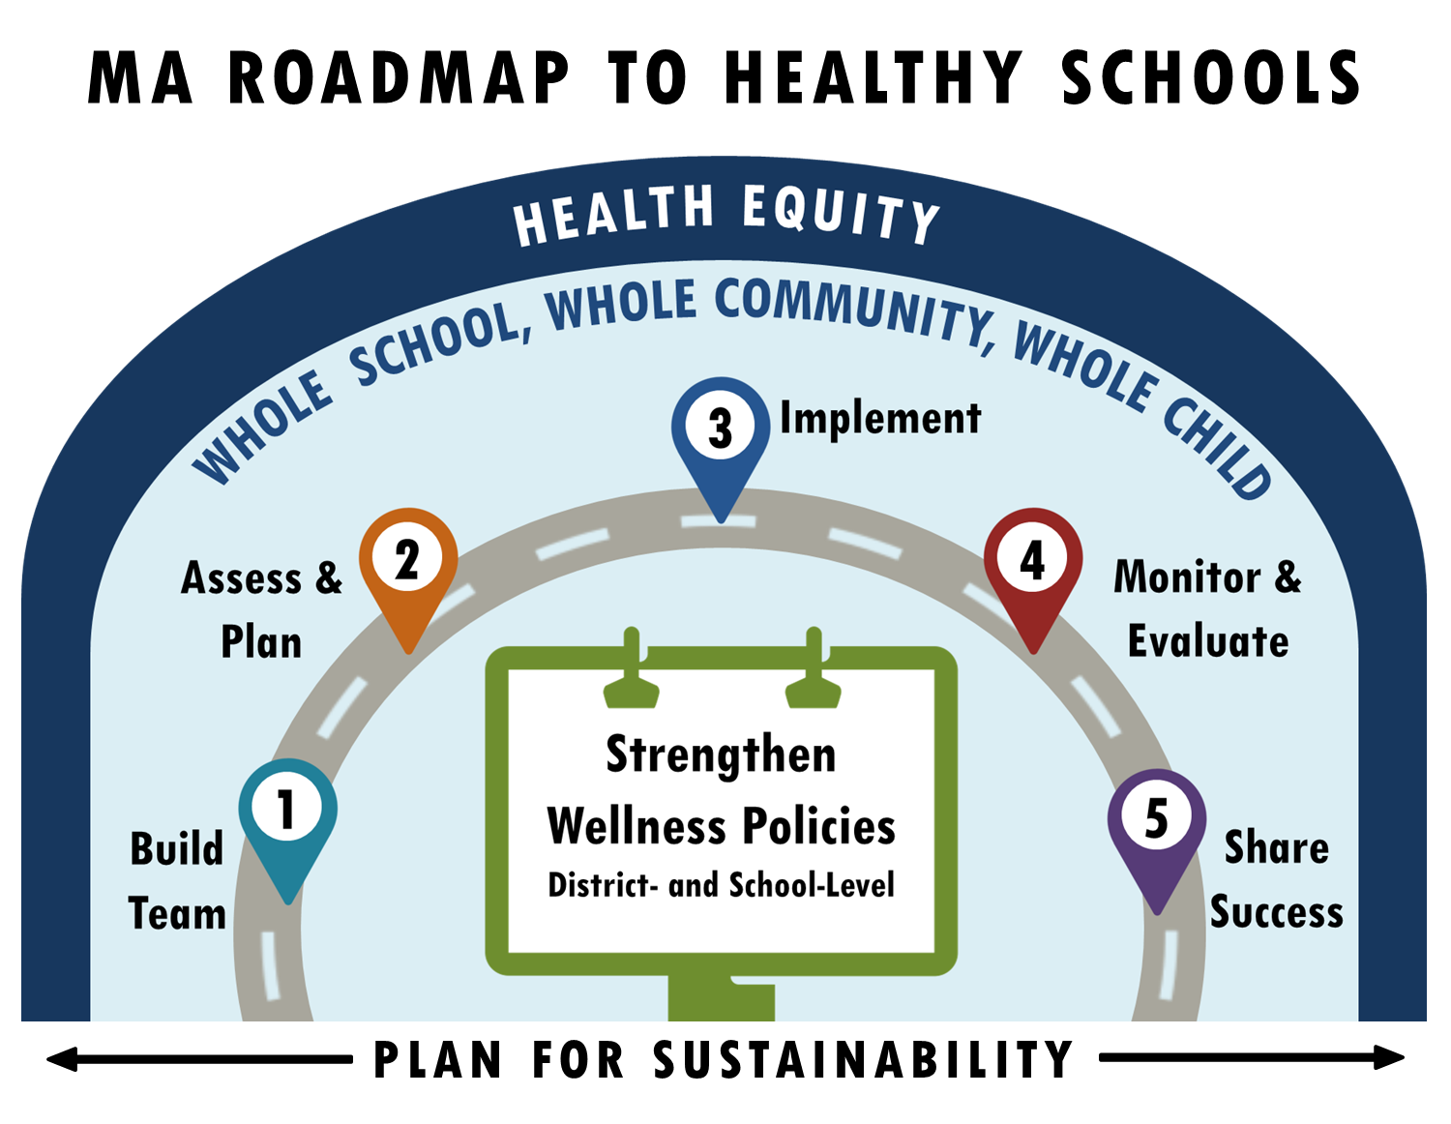
MA Roadmap

Slide 2
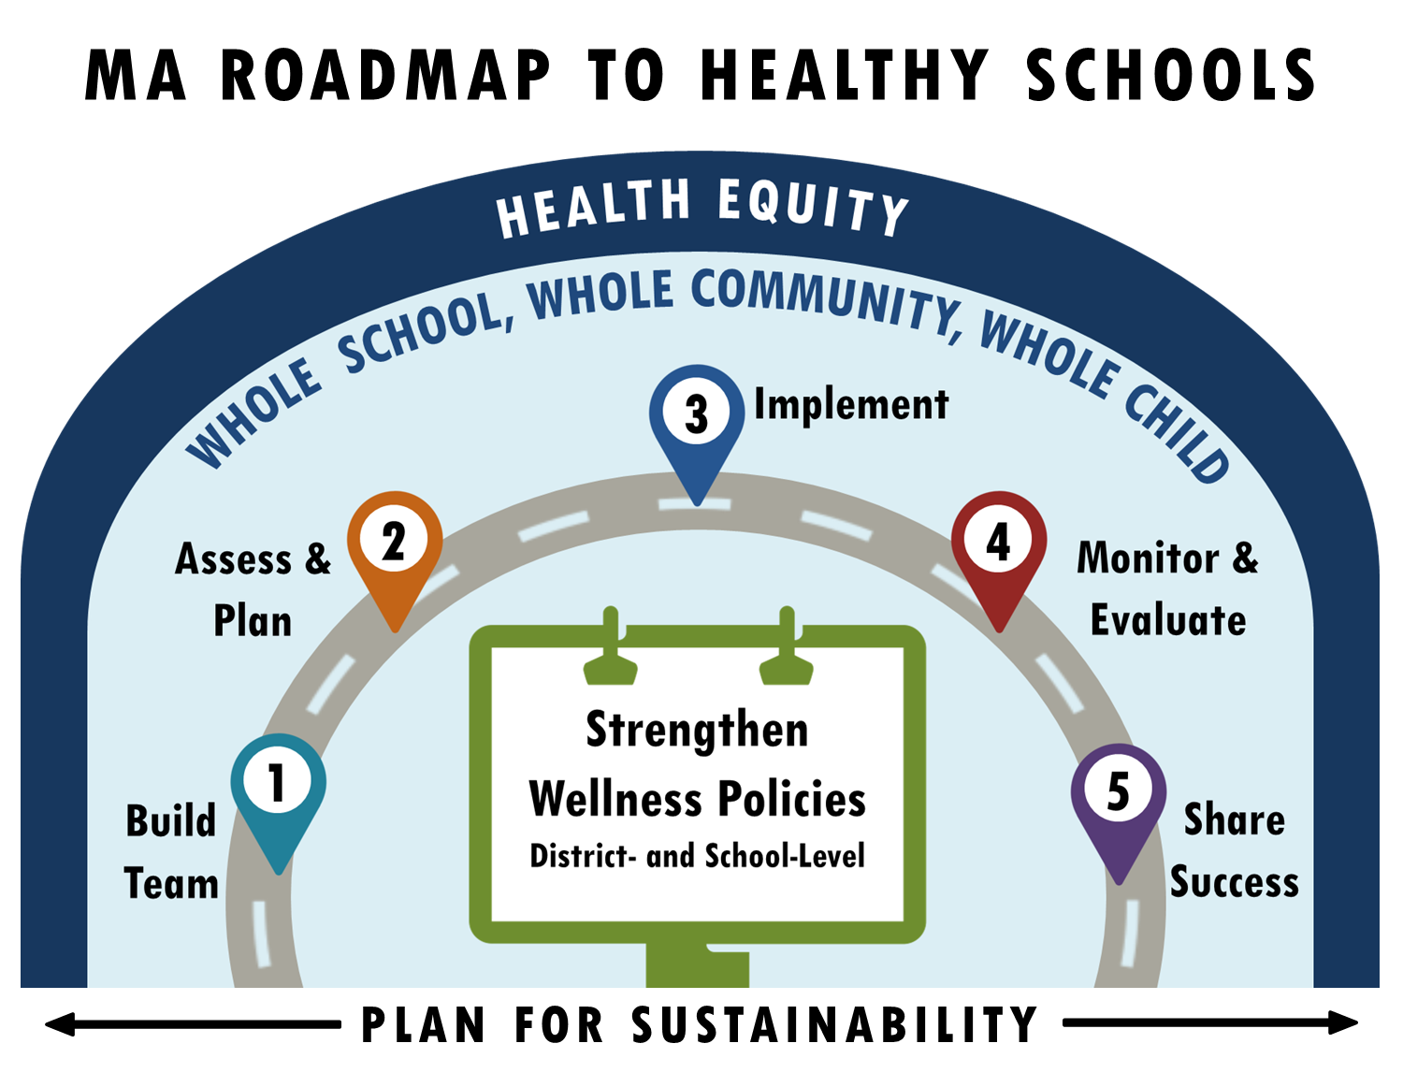
Massachusetts Roadmap To Healthy Schools
Step 1: Build comprehensive, diverse School Wellness Teams
that coordinate progress through a District Wellness Advisory Council, ensuring ongoing communication of progress improvements that can impact local wellness policy and school health improvement plans
Step 2: Assess local wellness policy, programs and practices
to identify priorities for improving your school environment using evidence-based tools and Plan which structural improvements and activities to prioritize based on findings from the assessments
Step 3: Implement your activities, ensuring alignment with and update to the local wellness policy as needed
Step 4: Monitor and Evaluate implementation of the local wellness policy and other school health, wellness and safety activities
Step 5: Share your successes with the whole school community (district, school, parents, students and other key stakeholders)!
Central to building a healthy school is recruiting a comprehensive, diverse team to strengthen the Local Wellness Policy,
using the WSCC framework for improving student health and ensuring that Health Equity is addressed throughout the process.

