Slide 1





Cover Page
When students go deep in their learning, they turn every challenge into an opportunity to shine.
Student Opportunity Act Long Form Webinar
February 7, 2020

Slide 2
Introductions
Commissioner Jeffrey C. Riley
Senior Associate Commissioner Russell Johnston
Associate Commissioner Daniel Anderson

Slide 3
Welcome!
Agenda
Please note...
Commissioner’s Remarks
Student Opportunity Commitments
Suggestions for Successful Planning
Evidence-Based Programs
Quick Poll
Commitments Checklist
Budget Template
Next Steps: how to get started
Q&A
This webinar is being recorded.
Questions may be submitted via chat.
We will pause at a few points during the conversation to answer clarifying questions.

Slide 4
Student Opportunity Act
The Student Opportunity Act (Chapter 132 of the Acts of 2019) requires districts to submit three-year, evidence-based plans to the Department by April 1, 2020. The plans will address four areas outlined in the law:
Identify specific evidence-based programs the district intends to implement to effectively reduce disparities among student subgroups;
Outline how G.L. c. 70 funds, as well as other local, state, and federal funds, will be used to implement the plan, including an explanation of the relationship between the allocation of the funds and the educational needs of English learners and low-income students;
Establish targets and outcome measures for addressing persistent disparities in achievement among student subgroups; and
Specify ongoing plans to effectively engage families and measure family engagement efforts.

Slide 5
Student Opportunity Commitments
The Department has established a template that asks each district to make 4 “Student Opportunity Commitments” in order to close opportunity and achievement gaps among student subgroups:
Intentionally focus on student subgroups who are not achieving at the same high levels as their peers;
Adopt, deepen or continue specific evidence-based programs to close opportunity and achievement gaps for student subgroups and allocate resources to support these programs;
Monitor success in reducing disparities in achievement among student subgroups over three years with a small number of metrics and targets; and
Engage families, particularly those families representing student subgroups most in need of support, about how best to meet their students’ needs.

Slide 6
Suggestions for Successful Planning
Focus on evidence-based program selection
The primary focus will be on which evidence-based programs a district is selecting and the resources being allocated to those programs. The commissioner and his leadership team selected 17 examples of programs based both on evidence and experience seeing these programs move the needle for students.
Districts that select from this menu, assuming their specific program generally matches the features of the example provided, can expect that their selection will satisfy the statutory requirement to include evidence-based programs in their plans.
Districts may also identify their own evidence-based programs outside of the menu, so long as they align to one or more of first nine categories in the law.
Thoughtfully engage your community
We will look for districts to confirm they engaged groups outlined in the statute alongside other local community groups, so that plans reflect student needs as identified by the community and so communities can in turn support districts in their implementation of evidence-based programs.

Slide 7
Suggestions for Successful Planning
Do a few things well
Commit to a small number of high-impact, evidence-based programs to close opportunity and achievement gaps among student subgroups. A completed Student Opportunity Plan should not look and feel like a comprehensive strategic plan.
Remember that districts can “adopt, deepen or continue” evidence-based programs. Short form districts may focus primarily on describing evidence-based programs already underway that are supporting student subgroups with disparities in achievement. Districts could also propose deepening certain features of these programs or expanding their scope to more students.
If districts do not currently have programs to support student subgroups, districts should reallocate resources to ensure evidence-based programs are in place beginning in FY21. SOA programs are not limited to incremental Chapter 70 funding; districts should consider all resources in developing these programs.
Focus on implementation
We are interested in concise, thoughtful commitments that will be backed up by high-quality implementation. We strongly recommend districts keep their plans to a similar length as the sample template in this guidance document. Rather than filling out additional paperwork, DESE encourages districts to spend that time with their teams ensuring that new programs will be implemented well. The commissioner intends to focus future school visits and DESE monitoring on observing the evidence-based programs that districts described in their plans.

Slide 8
Questions
Questions

Slide 9
Evidence-based programs: 17 examples of high-quality programs
Enhanced Core Instruction
Targeted Student Supports
Expanded access to full-day, high-quality pre-kindergarten for 4-year-olds, including potential collaboration with other local providers*
Research-based early literacy programs in pre-kindergarten and early elementary grades*
Early College programs focused primarily on students under-represented in higher education*
Supporting educators to implement high-quality, aligned curriculum
Expanded access to career-technical education, including “After Dark” district-vocational partnerships and innovation pathways reflecting local labor market priorities
Increased personnel and services to support holistic student needs
Inclusion/co-teaching for students with disabilities and English learners
Acceleration Academies and/or summer learning to support skill development and accelerate advanced learners
Dropout prevention and recovery programs

Slide 10
Evidence-based programs: 17 examples of high-quality programs (cont.)
Talent Development
Conditions for Student Success
Diversifying the educator/administrator workforce through recruitment and retention*
Leadership pipeline development programs for schools
Increased staffing to expand student access to arts, athletics, and enrichment, and strategic scheduling to enable common planning time for teachers
Strategies to recruit and retain educators/administrators in hard-to-staff schools and positions
Community partnerships for in-school enrichment and wraparound services
Parent-teacher home visiting programs
Labor-management partnerships to improve student performance
Facilities improvements to create healthy and safe school environments
* The commissioner is encouraging the adoption of Priority Programs and will likely offer competitive grant funds
The above evidence-based programs correspond to the program categories outlined in the SOA. See the footnote on page 6 for the full list of SOA program categories.

Slide 11
SOA Program Categories
The SOA outlines 9 evidence-based program categories and provides opportunity for additional programs determined to be evidence-based by the commissioner.
Expanded learning time in the form of a longer school day or year;
Increased opportunity for common planning time for teachers;
Social services to support students’ social-emotional and physical health;
Hiring school personnel that best support improved student performance;
Increased or improved professional development;
Purchase of curriculum materials and equipment that are aligned with the statewide curriculum frameworks;
Expanded early education and pre-kindergarten programming within the district in consultation or in partnership with community based organizations;
Diversifying the educator and administrator workforce;
Developing additional pathways to strengthen college and career readiness;
Any other program determined to be evidence-based by the commissioner.

Slide 12
Quick Poll!
Tell us what programs your district is currently thinking of implementing.
Take our poll (https://bit.ly/386SyLg)

Slide 13
Checklist (1 of 3)
Commitment #1 – Focusing on Student Subgroups
Provide a narrative of district data that identifies opportunity and achievement gaps for student subgroups, including students of color, low income students, English learners, and students with disabilities. Data sources could include: DESE’s accountability system, local measures of student performance, and the ability of all students to access district programs, wraparound services, and other opportunities.
Commitment #2 – Using Resources and Evidence-Based Programs to Close Gaps
Consider selecting from the evidence-based program examples identified by DESE.
Describe each program in detail, making sure to include the number of students impacted by the program in FY21 and in the following 2 years, details of the program model in FY21 and the expected evolution of the program over the next 2 years, which schools in the district will be impacted by the program (answer can be district-wide), and which student subgroups the program will address.
Please note that the federal definition of supplanting does not apply to incremental Chapter 70 funding.
Identify how the program is evidence-based.
Fill in the table with the following budget information for FY21: 1) Input budget line items (staff, PD, purchases, etc.), 2) provide the cost of the items, and 3) identify the foundation budget category for each cost listed (see page 13 of this document).

Slide 14
Checklist (2 of 3)
Commitment #3 – Monitoring Success with Outcome Metrics and Targets
Select at least 3 outcome metrics to include in your plan. These can include metrics from the list provided by DESE (p 14) or custom district metrics.
Where possible, align outcome metrics with the evidence-based programs described in Commitment 2.
Each district must also identify targets for each metric. Targets will be added to plans in fall 2020. If you choose a DESE metric, we will notify you of the targets. Districts choosing their own metrics will be required to update their plans with targets in the fall. For more information, see pages 13-14.
Commitment #4 – Engaging All Families
Describe your district’s ongoing plan for engaging families, including targeted strategies for families of low-income students, English learners, and students with disabilities. See page 15 for suggestions.
Explain how your district will measure increases in family engagement based on these efforts.

Slide 15
Checklist (3 of 3)
Certifications
Certify that you engaged stakeholders as specified by the law: “Each plan must be developed by the superintendent in consultation with the school committee and shall consider input and recommendations from parents/guardians and other relevant community stakeholders, including special education and English learner parent advisory councils, school improvement councils and educators in the district.”
Describe your district’s stakeholder engagement process and provide a list of stakeholders that were engaged. See pages 15-16 for suggestions.
School committees should vote on the plan, as it will have budgetary and policy implications. Confirm that school committee voted on the plan and provide the date of the vote and the outcome.

Slide 16
Questions
Questions

Slide 17
Budget Requirements for Long Form Districts
Long form districts must complete a separate budget file that provides further details about the evidence-based programs they have committed to adopting or expanding.
The Department is providing a budget file template (Long Form SOA Programs Budget File) and a sample long form budget file aligned to the sample long form narrative plan in this document.
The budget file will span Year 0 (FY20) and Year 1 (FY21). Year 0 is included so that DESE can understand a district’s starting point for existing programs that will be expanded.
While districts will not submit detailed budgets for FY22 and FY23 at this time, please be sure to include a description in your narrative plan of how the implementation of selected programs is expected to unfold over Years 2 and 3 of the plan, considering high-level budget projections.
All districts will be expected to make sustainable, multi-year commitments to their selected programs, which will be further detailed in annual budget submissions for Years 2 and 3 as amendments to their plans in subsequent years. More information will be provided about the amendment process in the coming months.

Slide 18
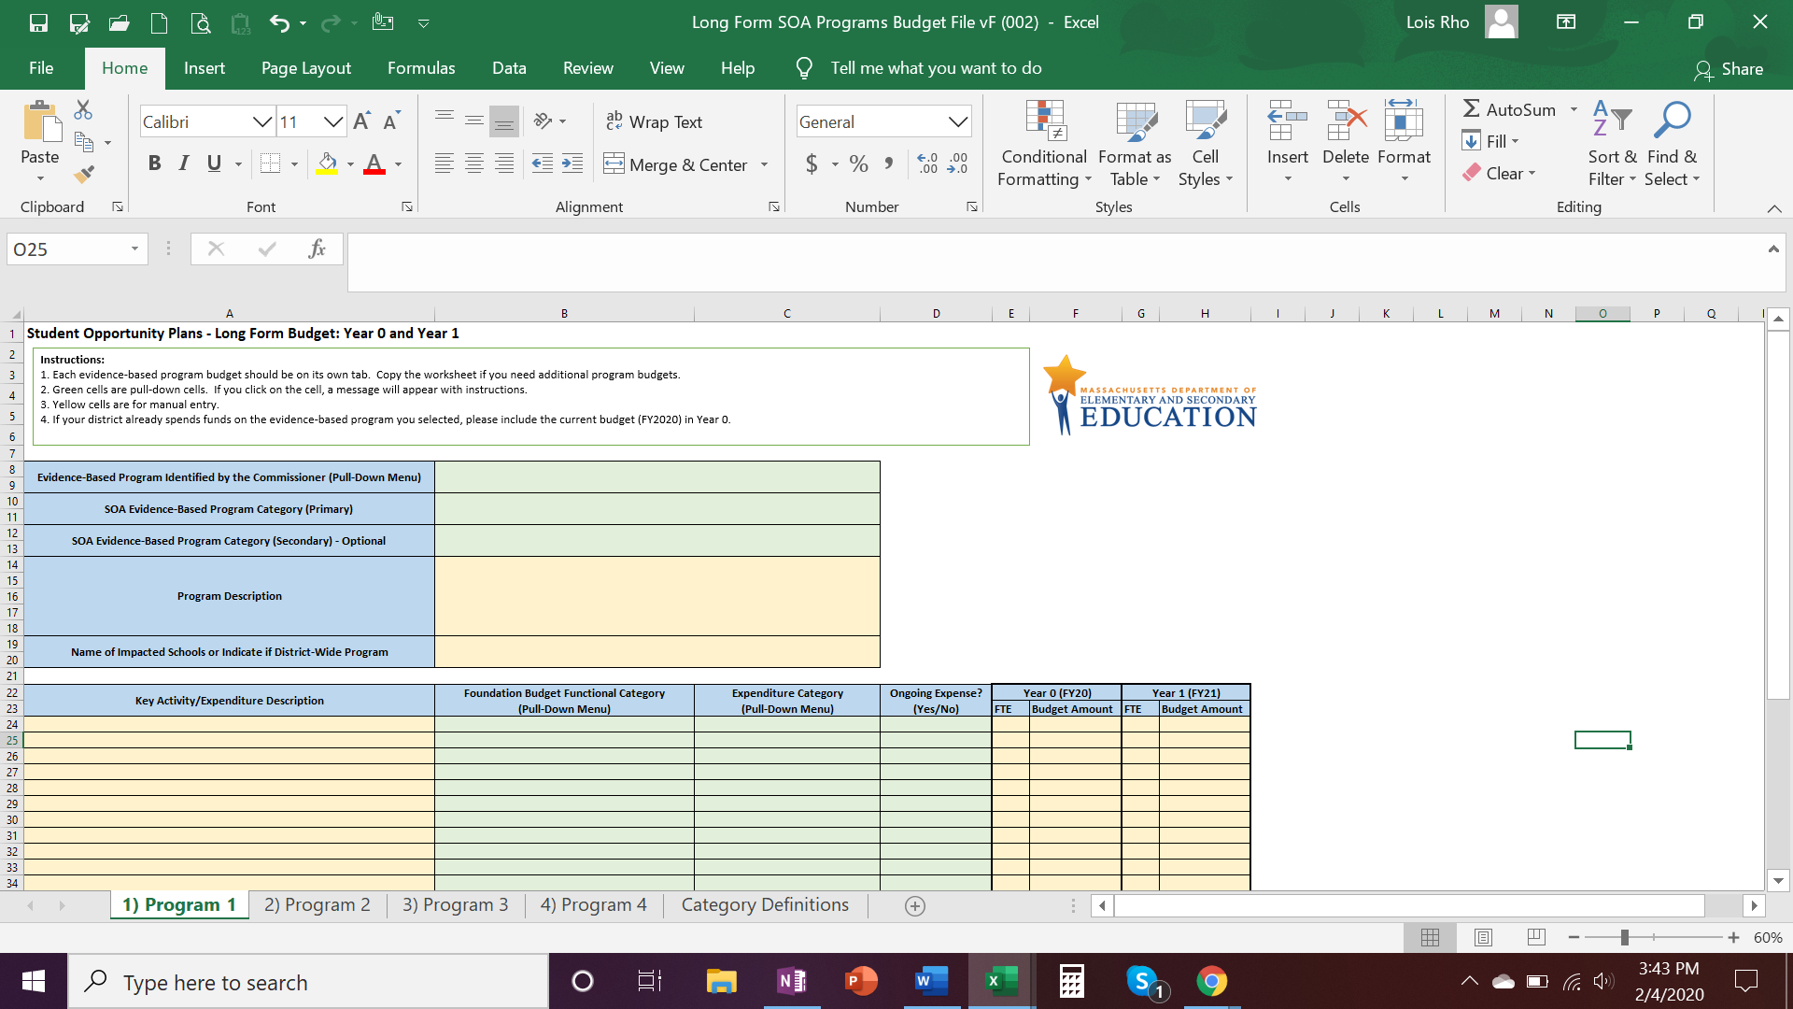
The Budget File - A Quick Review
Each evidence-based program budget should be on its own tab. Copy the worksheet if you have selected more than four programs.
Green cells are pull-down cells. If you click on the cell, a message will appear with instructions.
Yellow cells are manual entry.
If your district already spends funds on the evidence-based program you selected, please include the current budget (FY2020) in Year 0.
Foundation Budget Functional Category definitions can be founds at: http://www.doe.mass.edu/finance/accounting/eoy/chartofaccounts.docx

Slide 19
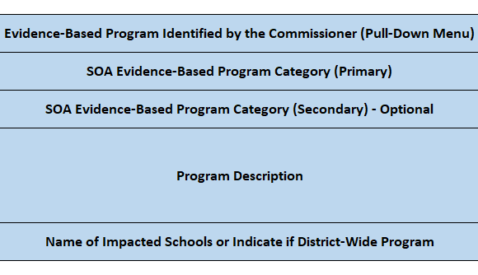
Step-by-Step Instructions on Completing the Budget File
Evidence-based Program Identified by the Commissioner:
Choose one from 17 programs in the pull-down menu.
To enter district’s choice, select #18 from the pull-down menu and then enter the program name in the “Program Description” section below.
Primary SOA Evidence-Based Program:
These are program categories in the SOA law.
Pg 6 in the guidance document lists the 17 evidence-based programs and shows how they are aligned to the categories in the SOA law.
Secondary SOA Evidence-Based Program (Optional):
If the chosen program aligns with multiple categories in the SOA law, choose a second one from Categories A to J in the pull-down menu.
Program Description:
Type in a brief (1 to 2 paragraph) description of the chosen program.
Schools or District-Wide:
If the program will impact select schools within the district, name the impacted schools. If the program impacts all students, indicated “District-Wide”.

Slide 20
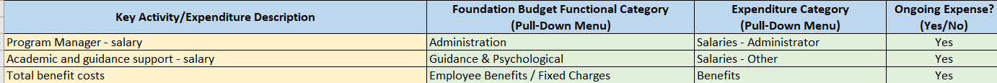
Step-by-Step Instructions on Completing the Budget File
Please refer to the provided Sample Long Form Programs Budget file for concrete examples.
Key Activity/Expenditure Description:
Type in a brief description of the cost incurring activity or item (e.g. Benefits, Teacher Salary).
Foundation Budget Functional Category:
These are the functional categories used in the Foundation Budget Funding Formula.
For definitions of the categories, please refer to the Chart of Accounts document at the top of the worksheet.
Choose one of the 11 categories in the pull-down menu and if the expense does not belong to any of the categories (e.g. Capital expenditures), then choose “Other”.
Expenditure Category:
These categories essentially serve as detailed “Object” codes.
Choose on of the 10 categories in the pull-down menu and if the expense does not belong to any of the categories, choose “Other Costs”.
Ongoing Expenses:
Choose “Yes” if the line item is a recurring expense that you anticipate in year 2 and 3.
Choose “No” if the line item is a one time expense that will not be recurring in the year 2 or 3 budgets.

Slide 21
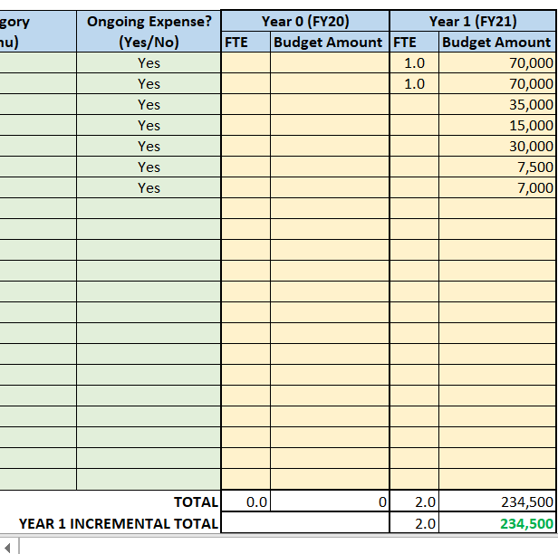
Step-by-Step Instructions on Completing the Budget File
Year 0 (FY20): If your district already spends funds on the evidence-based program you selected, please include the current budget (FY2020) in Year 0.
Year 1 (FY21): If your district spent funds on the evidence-based program you selected in Year 0, Year 1 data should be the combined total amount and FTE for both years (Year 0 and Year 1).
The incremental Year 1 total will be automatically calculated once all data have been entered for Years 0 and/or 1.
The incremental Year 1 total amount across all programs combined should be close to or exceed the recommended minimum amount to be spent on SOA programs as indicated in column F of “Recommended SOA Programs Budget - Chapter 70” file. (see next slide for details)

Slide 22
Recommended Spending Amount on Evidence Based Programs
While DESE acknowledges that all districts are facing rising costs associated with their core operating budgets, the spirit of the SOA calls for districts receiving significant incremental state aid to devote the bulk of their new Chapter 70 revenue to evidence-based programs.
Districts are encouraged to allocate other new or existing resources to evidence-based programs, sufficient to significantly improve student outcomes and close achievement gaps over time.
Refer to spreadsheet called Recommended SOA Programs Budget – Chapter 70 for details on:
  The minimum amount recommended for districts to spend on SOA evidence-based programs, which is the difference between the incremental FY21 Chapter 70 aid (House 2) and inflation related costs for ongoing expenses (and increase of 15-yr avg inflation rate of 2.4% above FY20 Foundation Budget). This recommendation only pertains to districts’ incremental FY21 aid.
All districts, even those receiving smaller amounts of incremental aid, are expected to invest in evidence-based programs to support student subgroups, including by using other local, state or federal funding sources or re-allocating existing resources if necessary.
If districts expect to deviate from the recommendation on budgeting for SOA programs, please contact SOAplans@doe.mass.edu so we can follow up with you. We will want to better understand your district’s current financial condition in advance of your plan submission.

Slide 23
How To Get Started
Next Steps
  Plan for and organize stakeholder engagement.
  Use the provided template to start drafting responses (the online form will be available in mid-March).
  If you have a question about whether a program you are considering meets requirements, please email SOAplans@doe.mass.edu.
Support
  A full list of district funding to be distributed by February 10.
  Detailed summaries for each of the 17 programs will be provided soon. Each summary will list a DESE contact person who can provide additional information.
  An FAQ will be distributed and posted online.
  For districts receiving assistance from the Statewide System of Support, regional staff can serve as thought partners for districts considering how to proceed or integrate improvement efforts.
  Other questions? Reach out to SOAplans@doe.mass.edu

Slide 24

Thank you
Thank You
http://www.doe.mass.edu/commissioner/spec-advisories/soa.html

