Slide 1
Special Education Assistance Webinar
Jamie Camacho, Special Education Planning and Policy Development (SEPP)
Holly Neal, Special Education Planning and Policy Development (SEPP)
Erica Gonzales, District & School Accountability Systems
Caitlin Hogan, Audit & Compliance
Amy Paulin, Public School Monitoring (PSM)
Abi Slayton, District & School Assistance Centers

Slide 2
Webinar
Objectives
Understand the calculations used to make the special education determinations
Identify appropriate DESE office to assist with questions related to the determinations
Understand fiscal implementation of special education determinations
Recognize LEA leadership roles related to the special education determinations
Integrate data from the special education determinations in school and district improvement planning
Extend Become familiar with various frameworks and evidenced-based practices for improvement planning

Slide 3

Help Us Better Support You
Don’t forget to provide feedback!
https://survey.alchemer.com/s3/7228151/2022-2023-Webinar-Posting-Understanding-LEA-Determinations-Next-Steps-for-Improvement-Special-Education-TA

Slide 4
CONTENTS
01
Special Education Accountability & Assistance – The Big Picture
02
Understanding Determination Calculations
03
Maintenance of Effort (MOE)
04
Tiered Focused Monitoring
05
PRS / Complaints
06
Closing Gaps

Slide 5
Special Education Accountability and Assistance – The Big Picture

Slide 6
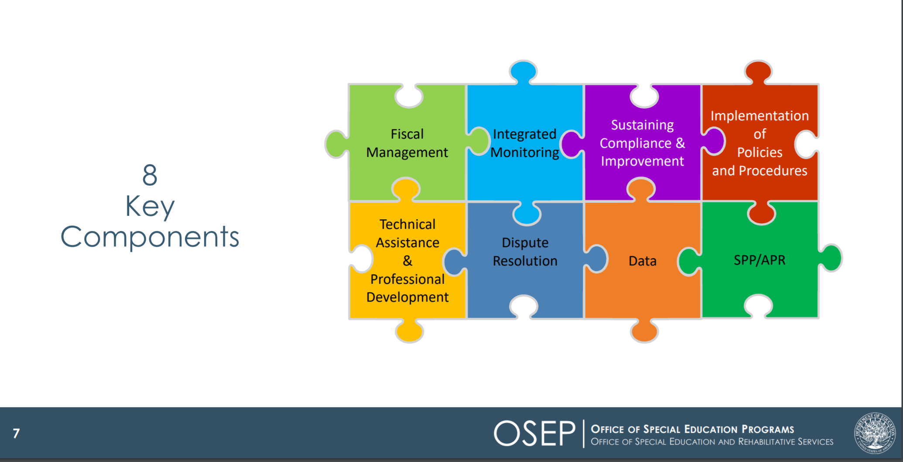
Components of General Supervision

Slide 7
General Supervision
Primary focus:
  Educational Results
  Functional Outcomes
“…so that every student is prepared to succeed in postsecondary education, compete in the global economy, and understand the rights and responsibilities of American citizens, and in so doing, to close all proficiency gaps.”

Slide 8
Special Education Determinations
IDEA requires the Department to make annual special education determinations.
  Meets Requirements (MR)
  Needs Assistance (NA)
  Needs Intervention (NI)
  Needs Substantial Intervention (NSI)

Slide 9
Understanding Determination Calculations

Slide 10
Special Education Determination Rubric - 1
Determinations are made using the following seven measures:
Accountability for all students
    Annual Dropout Rate (2021)
    5-Year Cohort Graduation Rate (2020)
Special Education Compliance
    Public School Monitoring Compliance (SY2021-2022)
    Problem Resolution System Findings per 1000 SWD (SY2021-2022)
State Performance Plan/Annual Performance Report (SPP/APR)
    Special Education SPP/APR Compliance Indicators (4B, 9, & 10) (SY2020-2021)
    Special Education SPP/APR Performance Indicators (5 & 6) (SY2021-2022)
Other
    Significant Disproportionality Data (SY2021-2022 & SY2022-2023)

Slide 11
Special Education Determination Rubric - 2
Points are assigned based on each district’s performance on each of the measures
Points | Annual Dropout Rate (2021) | 5-Year Cohort Graduation Rate (2020) Points x1.5 | Public School Monitoring Compliance (SY2021-2022) | Problem Resolution System Findings per 1000 SWD (SY2021-2022) | Special Education SPP/APR Compliance Indicators (4B, 9, & 10) (SY2020-2021) | Special Education SPP/APR Performance Indicators (5 & 6) (SY2021-2022) Points x2 | Significant Disproportionality Data (SY2021-2022 & SY2022-2023)
4 | Annual dropout rate for students with disabilities at or below the state's all students rate (1.5%) | 5-year cohort graduation rate for students with disabilities at or above the state's all students rate (91.0%) | No findings of special education noncompliance in previous Tiered Focused Monitoring (TFM) review | Less than 1.0 letters of finding issued (per 1000 SWD) | No compliance findings | Combined full inclusion rate of 75.0% or higher for students ages 3–21 | No Status in both of the last 2 years
3 | Annual dropout rate for students with disabilities at or below the state's students with disabilities rate (2.4%), but above the state's all students rate (1.5%) | 5-year cohort graduation rate for students with disabilities at or above the state's students with disabilities rate (79.3%), but below the state's all students rate (91.0%) | 1–2 findings of special education noncompliance in previous TFM review | 1.0 to 2.9 letters of finding issued (per 1000 SWD) | At Risk for any 1 indicator (4b, 9, 10). All others must be labelled No Status | Combined full inclusion rate from 50.0% to 74.9% for students ages 3–21 | At Risk in both of the last 2 years, or At Risk in 1 of the last two years & No Status in 1 of the last 2 years

Slide 12
Special Education Determination Rubric - 3
Points are assigned based on each district’s performance on each of the measures
Points | Annual Dropout Rate (2021) | 5-Year Cohort Graduation Rate (2020) Points x1.5 | Public School Monitoring Compliance (SY2021-2022) | Problem Resolution System Findings per 1000 SWD (SY2021-2022) | Special Education SPP/APR Compliance Indicators (4B, 9, & 10) (SY2020-2021) | Special Education SPP/APR Performance Indicators (5 & 6) (SY2021-2022) Points x2 | Significant Disproportionality Data (SY2021-2022 & SY2022-2023)
2 | Annual dropout rate for students with disabilities from 2.5% to 4.9% | 5-year cohort graduation rate for students with disabilities from 66.7% to 79.2% | 3–4 findings of special education noncompliance in previous TFM review | 3.0 to 3.9 letters of finding issued (per 1000 SWD) | Identified for any 1 indicator | Combined full inclusion rate from 35.0% to 49.9% for students ages 3–21 | Identified in only 1 of the last 2 years
1 | Annual dropout rate for students with disabilities of 5.0% or higher | 5-year cohort graduation rate for students with disabilities below 66.7% | 5 or more findings of special education noncompliance in previous TFM review | 4.0 or more letters of finding issued (per 1000 SWD) | Identified for 2 or more indicators | Combined full inclusion rate below 35.0% for students ages 3–21 | Identified in both of the last 2 years

Slide 13
Calculation
Sum of Points Earned across all Categories with Reportable Data | = | Special Education Determination Percentage
Total Number of Possible Points in Categories with Reportable Data
Meets Requirements (MR) | Needs Assistance (NA) | Needs Intervention (NI) | Needs Substantial Intervention (NSI)
LEA determination percentage 75.0 – 100.0 | LEA determination percentage 65.0 – 74.9 | LEA determination percentage 0 – 64.9 | A substantial failure to comply with a condition of LEA eligibility under Part B of the IDEA (300.200-300.213)

Slide 14
Data Resources
Measure | Resources/Reports
Annual Dropout Rate | Profiles: https://profiles.doe.mass.edu/statereport/dropout.aspx Security Portal: Dropout Data Summary Report
Graduation Rate | Profiles: https://profiles.doe.mass.edu/statereport/gradrates.aspx Security Portal: Graduation Rate Reports
Public School Monitoring Compliance | Public School Tiered Focused Monitoring Reports: https://www.doe.mass.edu/psm/tfm/reports/
Problem Resolution System Complaints | PRS Specialist Assignments: https://www.doe.mass.edu/prs/specialist.html
Special Ed. SPP/APR Compliance (4B, 9, & 10) | Flagged and Identified Districts have data emailed to the Superintendent and Special Education Director Publicly reporting on LEA status: https://profiles.doe.mass.edu/statereport/special_education.aspx
Special Ed. SPP/APR Performance (5, & 6) | 3-21 LRE rate is calculated by DESE specifically for these determinations Indicator 5: SIMS element DOE034 – 10 Indicator 6: SIMS elements DOE032 – 31 & 34
Significant Disproportionality | Data available to all LEAs as Edwin Report (SP301) in the ESE Security Portal If you do not have access to the Security Portal or Edwin Analytics, contact your district directory administrator.

Slide 15
Who do I Contact with Additional Data Questions?
Frequently Asked Questions can be found at https://www.doe.mass.edu/sped/osep/determinations-faq.docx.
Other general questions about Special Education Determinations should be sent to specialeducation@doe.mass.edu.
Measure | Resources/Reports
Annual Dropout Rate Graduation Rate | data@doe.mass.edu
Public School Monitoring Compliance | https://www.doe.mass.edu/psm/contact-info.html
Problem Resolution System Complaints | https://www.doe.mass.edu/prs/specialist.html
Special Ed. SPP/APR Compliance (4B, 9, & 10) | Specialeducation@doe.mass.edu
Special Ed. SPP/APR Performance (5, & 6) | Specialeducation@doe.mass.edu
Significant Disproportionality | Specialeducation@doe.mass.edu

Slide 16
Maintenance of Effort (MOE)

Slide 17
Special Education Determinations and MOE ….
MOE is required for all LEAs
Any LEA receiving IDEA Part B funds must budget and spend at least the same amount of local or state and local funds for the education of children with disabilities on a year-to-year basis
Ways to Meet MOE
  The law gives LEAs 4 options to demonstrate they have met MOE:
    Total amount of local funds*,
    Total amount of State and local funds in the aggregate,
    Per capita (e.g., per child with disability) amount of local funds*, or
    Per capita amount of State and local funds.

Slide 18
Special Considerations for MOE
Please note that in Massachusetts LEAs can use only methods:
  2. Total amount of state and local funds in the aggregate and
  4. Per capita amount of state and local funds.
In Massachusetts, we cannot separate out Chapter 70 state aid and funding from the local tax base because Chapter 70 goes into a community’s General Fund and therefore loses its identity as State funds when appropriated to the school department.
The only true State funds are Circuit Breaker funds.

Slide 19
Special Education Determinations and MOE
2 Parts to MOE
Eligibility standard – MOE levels for budgeting (Collected in the IDEA Consolidated Grant Application)
Compliance standard – MOE levels for spending (Collected in the End of Year Financial Report)

Slide 20
Eligibility Standard – MOE levels for budgeting (Collected in the IDEA Consolidated Grant Application)
For purposes of establishing the LEA's eligibility for a fiscal year, the LEA must budget for the education of children with disabilities, at least the same amount of funds as the LEA spent in the most recent fiscal year for which information is available.
The LEA may demonstrate MOE eligibility through either of these two calculations: (1) the combination of State and local funds in the aggregate; or (2) the combination of State and local funds on a per capita basis. See 34 CFR §300.203(a)(1).
Using the budgeted amounts to meet MOE that the LEA reports on the IDEA Consolidated Application DESE will determine the LEA’s eligibility for IDEA funding.
It is important that the LEA demonstrates compliance with the eligibility standard and if not, indicates on the grant application the reason for not meeting the eligibility standard.

Slide 21
Compliance Standard – MOE levels for spending (Collected in the End of Year Financial Report)
The compliance standard prohibits an LEA from reducing the level of expenditures for the education of eligible children with disabilities made by the LEA from state and local funds by measuring against the last year the district met MOE.
In other words, an LEA must maintain (or increase) the amount of state and local funds it spends for the education of children with disabilities when compared to last year it met MOE (for most, the preceding fiscal year). 34 CFR §300.203(b)

Slide 22
Exceptions to MOE
Allowable exceptions are those due to:
  a) voluntary or for-cause departure of special education staff,
  b) decrease in enrollment of IDEA eligible children,
  c) termination of an exceptionally costly program for a particular child, under certain circumstances,
  d) termination of costly expenditures for long-term purchases, and
  e) assumption of cost by DESEs high-cost fund (see 34 CFR §300.204).
*Exceptions are allowed for all LEAs regardless of determination level.

Slide 23
Adjustments to MOE
Allowable adjustment:
  An LEA may: reduce its MOE obligation by up to 50 percent of any increase over the preceding year in its IDEA Part B Section 611 allocation (fund code 240) (see 34 CFR §300.205(a)),
  Voluntarily use up to 15 percent of IDEA Part B Sections 611 and 619 funds (fund codes 240 and 262) to provide coordinated early intervening services (CEIS) or a combination of both.
*Adjustments can ONLY be used if the LEA has a special education determination level of ‘Meets Requirements’

Slide 24
Fiscal Review and Consequences for Failing to Meet MOE: Eligibility Standard
Eligibility Standard
An LEA is not eligible to receive IDEA Part B funds until it has met the MOE eligibility (i.e., budget) standard.
The LEA will be contacted by DESE to resolve MOE eligibility non-compliance based on review of the LEAs’ IDEA consolidated application and allowable exceptions.

Slide 25
Fiscal Review and Consequences for Failing to Meet MOE: Compliance Standard
Compliance Standard
If DESE determines following a review of EOY reports that an LEA has failed to meet its MOE compliance (i.e., expenditure) standard and there are not acceptable reasons to allow reduction of MOE as described above, the LEA must repay either the difference between what the LEA actually spent and what it should have spent to meet the MOE requirement, or the amount of the LEA’s Part B subgrant for that fiscal year, whichever is less.

Slide 26
Resources for MOE
DESE LEA MOE Quick Reference Guide
CIFR LEA MOE Calculator
CIFR LEA MOE Organizer
34 CFR §300.203
34 CFR §300.204
34 CFR §300.205

Slide 27
Tiered Focused Monitoring

Slide 28
Tiered Focused Monitoring
Point values based on 2020-2021 TFM special education findings
Group A or B special education standards
TFM Special Education Findings | Point Value
No findings | 4
1-2 findings | 3
3-4 findings | 2
5 or more findings | 1

Slide 29
Resources - PSM
Specific to particular findings
PSM Webpage
TFM Toolkit
TFM Chairperson
CIMPs and CAPs
Progress Updates and Reports

Slide 30
PRS / Complaints

Slide 31
State Regulations: Special Education and General Education
The Department maintains a Problem Resolution System that provides for the investigation of complaints and the enforcement of compliance with 603 CMR 28.00, as well as with other statutes and regulations relating to the provision of publicly funded education.
The Department can make findings on procedural issues and issues related to implementation of requirements.
Any party wishing to file a complaint may do so.
Use of the Department Problem Resolution procedures shall not prevent a party from requesting alternative administrative remedies of mediation or hearing on any matter, at any time.
Findings and orders issued by the Department on complaints and the Department's processing of a complaint are not reviewable by the Bureau of Special Education Appeals. Additionally, the pendency of a complaint before the Department does not make the Department a necessary party to actions on related issues pending before the Bureau of Special Education Appeals.

Slide 32
What is PRS?
PRS Mission Statement
The Problem Resolution System (PRS) Office ensures that students, families, school districts, and other community members have easy access to information regarding learners' rights and educational options and to a forum for the resolution of disputes that is prompt, accurate, and fair.
PRS Complaint Management System
DESE's process for receiving, reviewing and resolving concerns alleging that a student or group of students is not receiving:
procedural protections
educational services including IEPs
equal access to the programs or services of the district

Slide 33
Minimum State Complaint Procedures
Time limit; minimum procedures. Each SEA must include in its complaint procedures a time Iimit of 60 days after a complaint is filed
(a) An organization or individual may file a signed written complaint under the procedures described in i§)§ 300.151 through 300.152.
(b) The complaint must include-
  (1) A statement that a public agency has violated a requirement of Part B of the Act or of this part;
  (2) The facts on which the statement is based;
  (3) The signature and contact information for the complainant; and
  (4) If alleging violations with respect to a specific child
    (i) The name and address of the residence of the child
    (ii) The name of the school the child is attending·
    (iii) ln the case of a homeless child or youth (within the meaning of section 725(2) of the McKinney-Vento Homeless Assistance Act (42 U.S.C. 11434a (2)). available contact information for the chiId, and the name of the school the chiId is attending;
    (iv) A description of the nature of the problem of the child, including facts relating to the probIem; and
    (v) A proposed resolution of the problem to the extent known and available to the party at the time the complaint is filed.
(c) The complaint must allege a violation that occurred not more than one year prior to the date that the complaint is received in accordance with § 300.151.

Slide 34
What Types of Issues Might PRS Address?
Categories...
…And More Categories
504
Approved Special Education Schools
Bullying
Career Vocational Technical Education
Diploma/Graduation
Discrimination/Harassment
English Language Learners
Gen Ed Discipline
Gen Ed Licensure
General Ed Transportation
Home Hospital
Language Access
Structured Learning Time Requirements
METCO
Privacy/Confidentiality
Provision of Student Records
Residency/Admissions/Enrollment
Restraint/Time Out Procedures/Reporting
School Facilities
SE Implementation
SE Procedural

Slide 35
Contacting PRS
Online: http://www.doe.mass.edu/prs/
By phone: 781-338-3700
Our PRS Information Guide is posted at https://www.doe.mass.edu/prs/guide/default.html
By telephone-speak with a staff person 8:45-5:00 weekdays
By email: compliance@doe.mass.edu mailbox monitored throughout the day and response made usually same day.
Online: www.doe.mass.edu/prs
PRS Specialist Assignments by district
http://www.doe.mass.edu/prs/specialist list.html

Slide 36
Questions?

Slide 37
Closing Gaps – Part 2

Slide 38




What does the Research Show?
In schools where the general education population is successful, all students are more likely to do well.
Unequal access to high-quality core instruction beginning in early childhood and early elementary may be one reason for a system to identify some children as in need of special education services and subsequently place them in separate classrooms.
All students can benefit from evidence-based core instructional practices.
The achievement of PreK-12 students with disabilities and that of their general education peers is tightly linked.
O’Hara, N., Munk, T.E., Reynolds, H., and Collins, T. (2021, August). Success Gaps Toolkit: Addressing Equity, Inclusion, and Opportunity. IDEA Data Center. Rockville, MD: Westat.

Slide 39


Take 10 seconds…
Jot down three strengths of your district/school.

Slide 40
Special Education Can’t Do It Alone!
Equity Team Member Representatives
Team Members Organizational Meeting Roles and Responsibilities
Sample Email/Letter for Inviting Equity Team Members
Template for Recording Equity Team Meeting Notes
Example: Group Norms for Equity Team Meeting

Slide 41

What is a gap?
Gaps may be in any outcome differences between groups of students
These poor outcomes may include the following:
  increased dropout and lower graduation rates;
  lack of achievement in reading or math;
  decreased postschool outcomes such as employment rates and college completion;
  increased likelihood of disciplinary actions;
  increased likelihood of identification of a disability;
  increased more-restrictive placements.
  Success Gaps Toolkit: Addressing Equity, Inclusion, and Opportunity. Handbook, page 9

Slide 42
Overarching Framework for Data Analysis
Gaps are not about an individual child or a group of children’s failure to perform.
Rather, work should center on the structural components of education (and other) systems that may have failed to provide equitable opportunities for some groups of students.
Specifically, using LEA data districts or schools should examine the differences in:
  opportunities that the group of students with disabilities identified with a success gap (e.g., children who are migrant, Black children, Hispanic/Latinx children) have experienced, and
  the outcome area where the gap is occurring (e.g., graduation rates, reducing suspensions, mathematics proficiency, or special education disproportionality).
Success Gaps Toolkit: Addressing Equity, Inclusion, and Opportunity. Handbook, page 13

Slide 43
Target Areas for Analysis & Improvement Planning
Categories with LEA data in rows 1 and 2 of the rubric.
Points | Annual Dropout Rate (2021) | 5-Year Cohort Graduation Rate (2020) Points x1.5 | Public School Monitoring Compliance (SY2021-2022) | Problem Resolution System Findings per 1000 SWD (SY2021-2022) | Special Education SPP/APR Compliance Indicators (4B, 9, & 10) (SY2020-2021) | Special Education SPP/APR Performance Indicators (5 & 6) (SY2021-2022) Points x2 | Significant Disproportionality Data (SY2021-2022 & SY2022-2023)
2 | Annual dropout rate for students with disabilities from 2.5% to 4.9% | 5-year cohort graduation rate for students with disabilities from 66.7% to 79.2% | 3–4 findings of special education noncompliance in previous TFM review | 3.0 to 3.9 letters of finding issued (per 1000 SWD) | Identified for any 1 indicator | Combined full inclusion rate from 35.0% to 49.9% for students ages 3–21 | Identified in only 1 of the last 2 years
1 | Annual dropout rate for students with disabilities of 5.0% or higher | 5-year cohort graduation rate for students with disabilities below 66.7% | 5 or more findings of special education noncompliance in previous TFM review | 4.0 or more letters of finding issued (per 1000 SWD) | Identified for 2 or more indicators | Combined full inclusion rate below 35.0% for students ages 3–21 | Identified in both of the last 2 years

Slide 44
Strategic Intersections Example
Points | Annual Dropout Rate (2021) | 5-Year Cohort Graduation Rate (2020) Points x1.5 | Public School Monitoring Compliance (SY2021-2022) | Problem Resolution System Findings per 1000 SWD (SY2021-2022) | Special Education SPP/APR Compliance Indicators (4B, 9, & 10) (SY2020-2021) | Special Education SPP/APR Performance Indicators (5 & 6) (SY2021-2022) Points x2 | Significant Disproportionality Data (SY2021-2022 & SY2022-2023)
4 | Annual dropout rate for students with disabilities at or below the state's all students rate (1.5%) | 5-year cohort graduation rate for students with disabilities at or above the state's all students rate (91.0%) | No findings of special education noncompliance in previous Tiered Focused Monitoring (TFM) review | Less than 1.0 letters of finding issued (per 1000 SWD) | No compliance findings | Combined full inclusion rate of 75.0% or higher for students ages 3–21 | No Status in both of the last 2 years
3 | Annual dropout rate for students with disabilities at or below the state's students with disabilities rate (2.4%), but above the state's all students rate (1.5%) | 5-year cohort graduation rate for students with disabilities at or above the state's students with disabilities rate (79.3%), but below the state's all students rate (91.0%) | 1–2 findings of special education noncompliance in previous TFM review | 1.0 to 2.9 letters of finding issued (per 1000 SWD) | At Risk for any 1 indicator (4b, 9, 10). All others must be labelled No Status | Combined full inclusion rate from 50.0% to 74.9% for students ages 3–21 | At Risk in both of the last 2 years, or At Risk in 1 of the last two years & No Status in 1 of the last 2 years
2 | Annual dropout rate for students with disabilities from 2.5% to 4.9% | 5-year cohort graduation rate for students with disabilities from 66.7% to 79.2% | 3–4 findings of special education noncompliance in previous TFM review | 3.0 to 3.9 letters of finding issued (per 1000 SWD) | Identified for any 1 indicator | Combined full inclusion rate from 35.0% to 49.9% for students ages 3–21 | Identified in only 1 of the last 2 years
1 | Annual dropout rate for students with disabilities of 5.0% or higher | 5-year cohort graduation rate for students with disabilities below 66.7% | 5 or more findings of special education noncompliance in previous TFM review | 4.0 or more letters of finding issued (per 1000 SWD) | Identified for 2 or more indicators | Combined full inclusion rate below 35.0% for students ages 3–21 | Identified in both of the last 2 years

Slide 45
Three Goals for Engaging in Closing Gaps
Use data and evidence to:
discover the root cause of the prioritized success gap(s);
fully understand how to address, compensate, or learn from any underlying issues within the root cause; and
apply what is learned from this analysis to systematically prevent future issues.
Success Gaps Toolkit: Addressing Equity, Inclusion, and Opportunity. Handbook, page 5

Slide 46
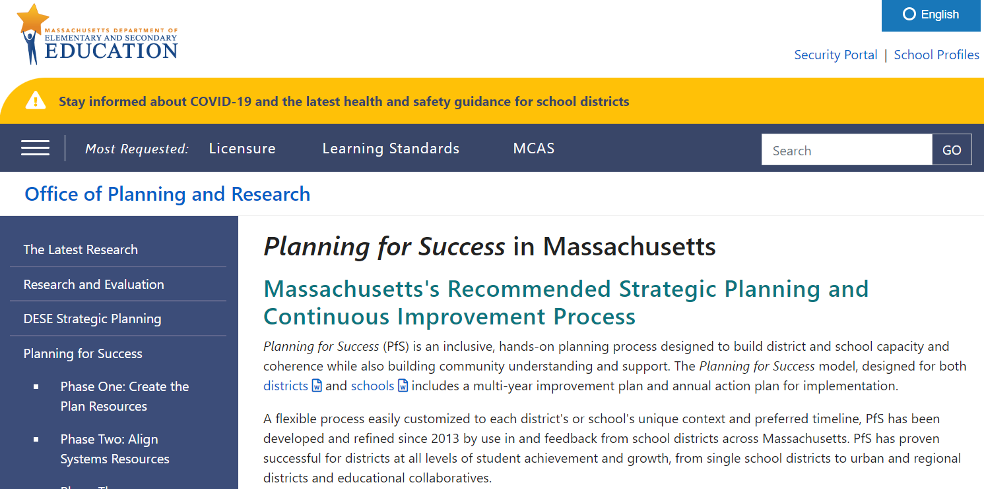

Research-based Planning Framework
Identification and use of a research-based planning framework that includes process benchmarks is required.
For example:
  Planning for Success in Massachusetts
  Success Gaps Toolkit: Addressing Equity, Inclusion, and Opportunity

Slide 47
Essential Elements of Improvement Planning
1. Data-based Decision Making
2. Cultural Responsiveness
3. Core Instructional Program
4. Ongoing assessment - Universal Screening and Progress Monitoring
5. Evidenced-Based Instructional and Positive Behavioral Interventions and Supports
6. District/School Leadership that Facilitates Improvement
7. Parent/Family Engagement throughout the Educational Process and System
Success Gaps Toolkit: Addressing Equity, Inclusion, and Opportunity. Handbook, page 9-13

Slide 48
Poll #1
Do you already use a planning framework? If so, which one?
  Planning for Success
  Success Gap Toolkit
  Active Implementation
  Data Wise
  Using Formative Assessment for Results (FAR)
  Other
  None

Slide 49

Take 10 seconds…
Jot down the names of two people who can help you select a planning framework.

Slide 50
Last Year’s Webinar & Resources
Identify the Gap(s)
Assemble an Equity Data Team - with a Focus on SwD Outcomes
Prepare, Share, and Analyze multiple sources of data
Identify and validate root causes of the success gap & Prioritize actionable root causes
Success Gaps Toolkit: Addressing Equity, Inclusion, and Opportunity. Handbook, page 15
To review the initial four steps and resources begin on slide 36 at:
  Recording: https://youtu.be/MRcia3Wo-7E
  PowerPoint: https://www.doe.mass.edu/sped/osep/2022-0408webinar-presentation.pptx

Slide 51
Today - Next Steps
Envision the Future
Draft an Action Plan
Implement the Plan & Monitor Progress
Revise the Plan, if necessary
Success Gaps Toolkit: Addressing Equity, Inclusion, and Opportunity.

Slide 52

If you don’t know where you’re going,
you might not get there.
-- Yogi Berra

Slide 53
Step 5: Envisioning the Future
The vision, as defined by the Massachusetts Planning and Implementation Framework, articulates:
  the aspirations for students;
  what you value and why;
  what future success will look like for
    students and families,
    educators and staff, and
    administrators and leaders.
Planning for Success (PfS):
Integrating Resource Considerations into the Planning Process Envisioning the Future Synthesizing Visioning Feedback Identifying Mission, Vision, and Core Values

Slide 54
Ensuring Diverse Perspectives
How can we design an inclusive and equitable planning process that creates a shared vision for all students while strengthening community understanding and support?
Consider:
  What visioning protocol will you use?
  What are culturally responsive ways to outreach to the communities you serve?
  When and where will you conduct visioning sessions for various stakeholder groups?
  How will you ensure the engagement of stakeholder voices that are less often heard?

Slide 55
Foundation for the Action Plan
Synthesize root cause data & stakeholder feedback to
identify common themes:
  Analyze feedback
  Identify common themes and key outliers
  Explore connections to root causes
  Share back to the community

Slide 56
Additional Resources: Envisioning the Future
Back to the Future Protocol, by Scott Murphy
Community Feedback: Common Themes Worksheet
Identifying Mission, Vision, and Core Values

Slide 57

Take 10 seconds…
Jot down the name of the person(s) who can help you design an inclusive and equitable planning process that creates a shared vision for all students.

Slide 58
Step 6: Develop an action plan that addresses actionable root cause(s).
Describe in detail:
  Goals (SMART)
  Tasks
  Timelines
  Plan for evaluation
PfS Resources: |  | Success Gaps Toolkit:
Identifying Strategic Objectives and Initiatives Selecting Evidence-Based Practices and Programs Selecting Outcome Measures and Setting Targets Resource Mapping Aligning Systems |  | Video: Create an Action Plan PowerPoint: Create an Action Plan Facilitation Agenda: Create an Action Plan Equity Team Meeting Agenda: Create an Action Plan
And/Or

Slide 59
Developing
SMART Goals
Specific,
Measurable,
Actionable (and aligned),
Reasonable, and
Time-bound.
Success Gaps Toolkit: Addressing Equity, Inclusion, and Opportunity. Handbook, page 36

Slide 60
Outlining Action Steps
Consider the following questions:
  Are there connections to other work in the LEA?
  What tasks are needed to create improvement (actions, resources, policies, procedures, etc.)?
  How can you break the desired improvement down into manageable steps in the first year & over time?
  Who is responsible for implementing each action in the first year?
  How can you plan for continuity if there are personnel changes? What actions can be consistently replicated?
Success Gaps Toolkit: Addressing Equity, Inclusion, and Opportunity. Handbook, page 37

Slide 61
Determining Your Timeline
For each action step, consider the following:
  What is the needed time frame for implementing the planned action?
  Does this action warrant additional discussion and check-ins? If yes, how often?
  If decisionmakers outside the group must approve proposed actions, when and how will you update team members (e.g., at the next meeting, via email)?
  How will those implementing the actions communicate their progress and challenges, and to whom?
Success Gaps Toolkit: Addressing Equity, Inclusion, and Opportunity. Handbook, page 38

Slide 62
Planning for Evaluation
Consider the following questions:
How will you know implementers carried out the intended action as you planned?
What data will help you determine if the systems supporting implementation are sufficient?
What data points will serve as key markers throughout the improvement cycle?
What intermediate outputs and short-term outcomes will you look at to help you know you are on the right track?
What data may let you know that there are adjustments you need to make?
How will you know whether the actions worked? What data will show improvement has occurred?
Success Gaps Toolkit: Addressing Equity, Inclusion, and Opportunity. Handbook, page 38=39

Slide 63
Additional Resources: Developing an Action Plan
PfS Plan Template
Template for Success Gap Action Plan
PfS Strategic Objective/Strategic Initiative Organizer
PfS Outcomes Worksheet
PfS Quality Review Feedback Form
Resource Mapping Worksheet

Slide 64
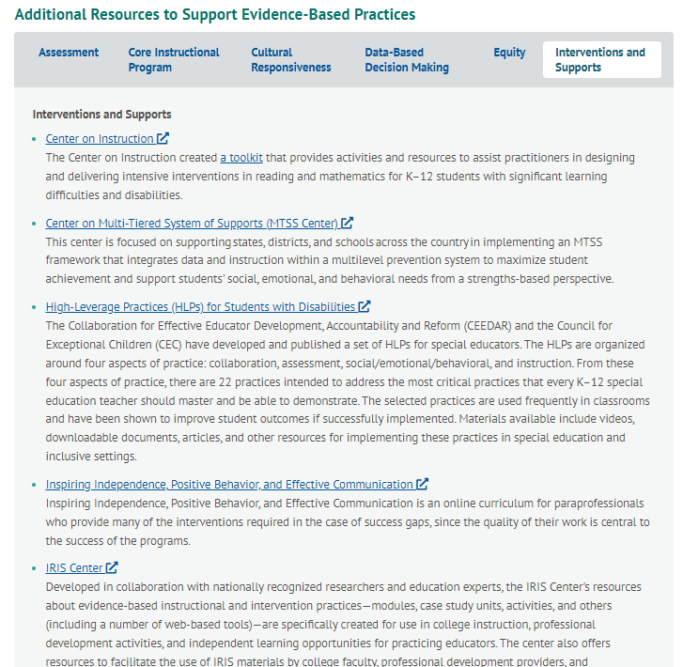
Additional Resources to Support Evidence-Based Practices https://ideadata.org/toolkits/resources/

Slide 65

Take 10 seconds…
Jot down the names of three other people who can help you design a cohesive set of resources and tools.

Slide 66
Step 7. Implementing the Plan and Monitoring Progress
Ongoing check-ins provide an opportunity to:
  Monitor and report progress on specific action steps
  Review the implementation and outcome data collected during the implementation
  Consider new data received or collected or challenges that have arisen
  Evaluate how the work is going
  Determine when incremental changes or course corrections are needed
  Share progress with all stakeholders and partners
PfS Resources: |  | Success Gaps Toolkit:
Monitoring and Reporting on Action Plan Progress |  | Video: Implement and Monitor Progress PowerPoint: Implement Plan and Monitor Progress Facilitation Agenda: Implement Plan and Monitor Progress Equity Team Meeting Agenda: Implement Plan and Monitor Progress
And/Or

Slide 67
Small Group - Monthly Monitoring Meetings
(at least in the beginning)
Steps to consider when preparing for monthly meetings:
  Set Up a regular schedule of monthly meetings for the equity team to monitor implementation of the plan and progress toward intended results.
  Review the action plan timeline and add the additional staff who may provide specific feedback or update the equity team on relevant items.
  Identify needed data and updates from team members on the action plan.
  Create the meeting agendas prior to the meetings and provide them to those scheduled to attend.
  Update action plans at the monthly meetings.
Success Gaps Toolkit: Addressing Equity, Inclusion, and Opportunity. Handbook, page 40-41

Slide 68
Additional Resources: Implement the Plan and Monitor Progress
Designing the Monitoring Process
Gathering Progress Information

Slide 69
Step 8. Revising the Plan, if necessary
Remember to celebrate the successes!
Continuing the Cycle to
Address Success Gaps
Your team(s) should expect to carry on
this work as a continuous cycle.
As your team(s) work through the process, you will benefit from periodically reassessing your district’s or school’s current operations and identifying new priorities.
Success Gaps Toolkit: Addressing Equity, Inclusion, and Opportunity. Handbook, page 41

Slide 70

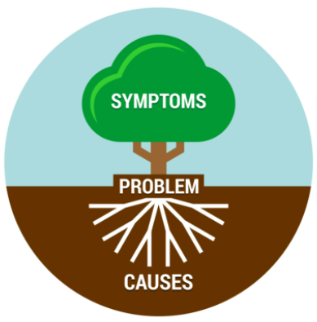
Take 10 seconds…
Jot down any Thoughts? Questions? Epiphanies?

Slide 71

Fiscal Considerations to Serve Your Students Better
Making Money Matter ($M^{3}$)
Coordinated Early Intervening Services (CEIS)
At least 2% of IDEA set aside required for systemic improvements at LEAs with Needs Intervention Special Education Determination
Supports systemic activities and strategic planning, such as data collection, root cause analysis, action planning, & implementation of systemic interventions, with emphasis on equity, gap closing, and culturally responsive & inclusive practices.
For more information:
  https://www.doe.mass.edu/turnaround/redesign/m3/
  Email: Abigail.T.Slayton@mass.gov
Services provided to students in K-12 who are not identified as needing special education or related services, but who need additional academic or behavioral support to succeed in general education.
Allows any LEA to reserve up to 15 percent of their IDEA Part B for CEIS services to address needs of students.
For more information:
  https://ideadata.org/sites/default/files/media/documents/2017-09/idc_ceis_chart.pdf
  Email: specialeducation@doe.mass.edu

Slide 72
Poll #2
In which areas would you benefit from additional support? (choose up to three)
  Utilizing a planning framework
  Assembling an Equity Data Team
  Preparing and analyzing multiple sources of data
  Identifying and prioritizing actionable root causes
  Developing and implementing an action plan
  Addressing LRE rates
  Addressing graduation and drop-out rates for students with disabilities
  PRS complaints
  Significant disproportionality
  Other

Slide 73
Questions?

Slide 74
THANK YOU

Slide 75
Stakeholder Capacity-Building Resources
Family Engagement Initiatives and Resources
Building a School Culture that Promotes Teacher Leadership, Advice from DESE's Teacher and Principal Advisory Cabinets
Creating and Sustaining Teacher Leadership Roles, Lessons Learned from Districts through DESE's Teacher Leadership Professional Learning Network

Slide 76
Supports and Resources
Center for Strategic Initiatives Resources
Center for Systemic Improvement (NCSI)
Center to Improve Social and Emotional Learning and School Safety (SEL)
Culturally Responsive Teaching & Leading
Curate
CSDP Targeted Partnership Program Catalog — SY 2022-2023
DESE Newsletters, Updates, and Livestreams
IDEA Data Center Significant Disproportionality Resources
Kaleidoscope Collective for Learning
Making Money Matter (M3) - Grants - Special Education (mass.edu)
MTSS
  MTSS Blueprint
Significant Disproportionality Fiscal Implications Reference Guide
Search Registered PD Providers
What is Significant Disproportionality Quick Reference Guide
Clarifying the Relationship Between HLPs and EBPs | High-Leverage Practices (highleveragepractices.org)
High-Leverage Practices | High-Leverage Practices (highleveragepractices.org)
HLP Leadership Guides | High-Leverage Practices (highleveragepractices.org)

Slide 77
Discipline and Student Behavior Resources
Rethinking Discipline Initiative – More resources available here
Addressing the Root Causes of Disciplinary Disparities: An Educator's Action Planning Guide — from the National Center on Safe Supportive Learning Environments
Rethink School Discipline: Resource Guide for Superintendent Action — from the U.S. Department of Education
Guiding Principles: A resource Guide for improving School Climate and Discipline
Foundations for Inclusive Practice: Online Courses for PDPs
Toolkit for Educators: How We Can Fix School Discipline
Positive School Discipline Interactive Course for School Leaders
Positive Behavior Interventions and Supports (PBIS) Self-Assessment
Examples of MA DESE SEL Guidance Documents, Resources, and PD
Charter School Resources
Charter School Discipline: Examples of Policies and School Climate Efforts from the Field
Student Discipline Best Practices for Charter Schools to Employ
Discipline Tool Kit for Charter Schools to implement Discipline Reform
Charter Schools, Civil Rights, and School Discipline

