Slide 1
Indicator 14 District Reports
Based on 2022 Indicator 14 Data Collection
SEPP and PIAR
April 4, 2023
Notes:
Greg Tobey will Open the Session

Slide 2
Today’s Agenda
Welcome and Introductions
Overview of Indicator 14
Purpose
Reports
  Factors to Consider
  Overview of the Content
  Overview of Statewide Data
Questions and Wrap-up
Notes:
Greg T.: Welcome and Introduction of presenters: Slide 1
Greg T: Review of Indicator B 14 and its Measures of Post High School Engagement: Slides 2, 3, 4 & 5
Pat T.: Factors to consider when considering the reports: Slide 6
Robert S.: Overview of the content of District Reports: Slides 7
Robert S.: Overview of Statewide Data: Screen Share Statewide version of District Reports
Moderated by Greg T.: Questions from participants
Moderated by Greg T.: Wrap-up and DESE and PIAR Contact info: Last Slide

Slide 3
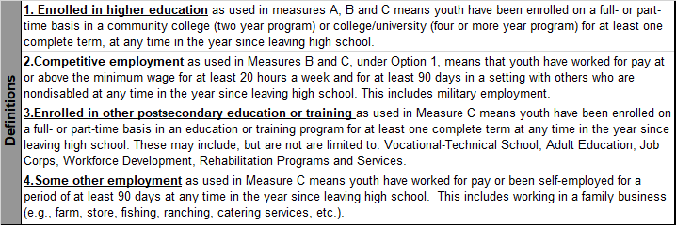
Overview - Engagement Types
Notes:
This slide provides a review of Indicator 14 types of Engagement.

Slide 4
Overview - Measurement
Percent of youth who are no longer in secondary school, had IEPs in effect at the time they left school, and within one year of exiting high school were:
A. Enrolled in higher education
B. Enrolled in higher education or competitively employed
C. Enrolled in higher education or in some other postsecondary education or training program or competitively employed or in some other employment
Notes:
Read Slide
See the Indicator 14 Refresher document for a primer on Indicator 14.

Slide 5
Overview - Calculations
Notes:
Each Exiter is counted and reported in one Measure even though many have participated in both post high school education and employment.
For Example, an Exiter who reports meeting the criteria for college (Measurement 1) and Competitive Employment (Measurement 2) would be counted under Measurement 1, Higher Education.

Slide 6
Purpose
Provide districts with:
  An in-depth view of their exiter data
  More than just a simple percentage of engagement
  A tool to do a deep dive into demographic categories across each measurement
Question(s) to Consider:
  How does this data impact programmatic decisions during high school?

Slide 7
Factors to Consider
Three Main Factors:
  The Number of Respondents;
  Your District's Response Rate; and
  If your Response Group is Demographically Similar to your Exiter Group.
District reports are structured to facilitate your focus upon these factors as you consider how Representative your data is.
Notes:
When considering survey data many factors can affect the accuracy of the results. Three of the most important factors are the number of Respondents, the Response Rate, and the representativeness of the Respondents. For all of these factors more is better, i.e. larger groups of Respondents, groups with higher Response Rates and Response Groups demographically similar to the Exiter group will produce more accurate results. Relevant demographic characteristics include gender, ethnicity, exit type, level of need, type of disability, and economic status (advantaged or disadvantaged.
In addition to the factors depicted on this slide, Interviewer bias, Respondent bias, Non-response bias can also affect the results. These are much harder to estimate.

Slide 8
Organization of Reports
Page One:
  Indicator 14 Introduction
  District and Statewide Engagement Totals represented in pie charts.
  Introduction to Representativeness
Page Two:
  Table displaying your Exiters’ demographics compared to Respondents’ demographics
Pages Three and Four:
  Indicator 14 Engagement across six demographic categories
Notes:
Read/review slide content

Slide 9
Demographic Groups
Gender
Ethnicity
Exit Type
Level of Need
Type of Disability
Economically Disadvantaged
Notes:
After reviewing how accurate and representative your survey results are, consider the demographic categories included. Each is disaggregated by their reported type of engagement , Measures 1 through 4
Looking at one demographic group at a time, as we do here, helps to focus on each one, but ignores how all characteristics interact. So, remember to consider how each characteristic may interact with others.

Slide 10
Let’s look at today’s sample, the statewide report.

Slide 11
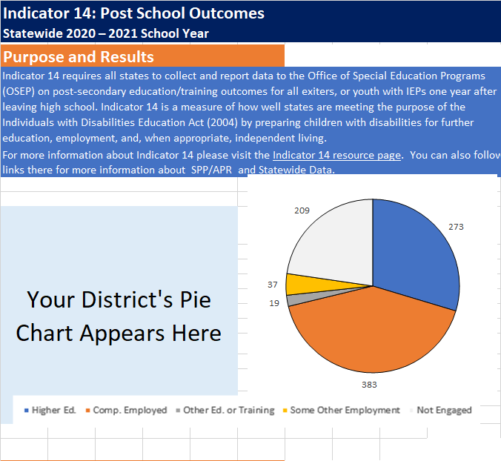
Page One
Report Title
Short introduction with link to information about Indicator 14
District Engagement
Statewide Engagement
Each pie chart includes each measurement in Indicator 14:
  Higher Education
  Competitive Employment
  Other Education
  Other Employment
  Not Engaged
Notes:
Read Slide
Highlight link to DESE’s Indicator 14 Webpage
Side by Side pie charts provide a quick comparison between your district’s Indicator 14 Engagement compared to Statewide reported Engagement
Draw attention to the GREY pie segment including Exiters who are not Engaged

Slide 12
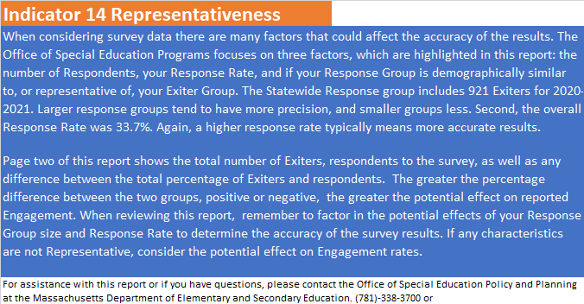
Page One (continued)
Reviews the factors to consider:
The number of Respondents
Your district’s Response Rate
Introduces Page Two and explains how to determine if your Response Group is demographically similar your Exiter Group
Notes:
Read slide and review the contents of paragraph one highlighting how many of the district’s Exiters responded and their Response Rate, and their opportunity to compare their response rate to the states.
Three out of seventy-five districts that surveyed Exiters for this report had 100% Response Rate: n= 2,14 &15
Two other districts had an 80% or higher Response Rate: n= 10 & 58
Then finish reading slide and review the contents of paragraph two

Slide 13
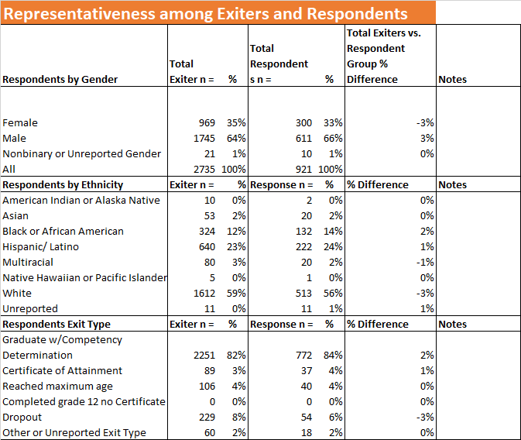
Page Two
Comparison of Exiters and Respondents by:
Gender
Ethnicity
Exit Type
Notes:
Review the subpopulations included on this slide, the contents of the first three columns.
Then highlight the slight differences in proportional representation listed in column four, and how the slight underrepresentation of “Female”, -3%, might reduce reported participation in Higher Education slightly. Two things to take note of:
1)”Females” tend to enroll in higher education more often than “Males”.
2) Highlight that the number of” Females” is about half that of “Males”.
Which means increase or decreases in percentages have half the impact that similar changes for “Males” would have.
Data: Higher Ed: F = 36%, M = 27%
Third, discuss how the slight underrepresentation of “Dropout”, -3%, might reduce report overall engagement.
Data: All Engaged = 75% “Dropout” = 46% “Not Dropout” = 79%
Next Slide

Slide 14
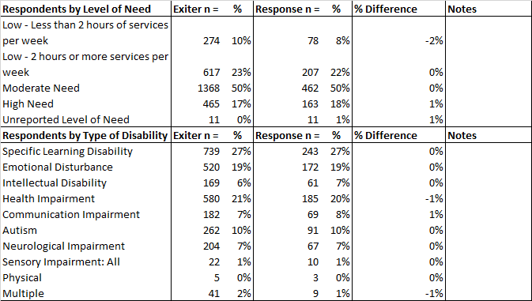
Page Two
Comparison of Exiters and Respondents by:
Level of Need
Type of Disability
Notes:
As we look at the rest of page two, we see that the percent difference is very low +1% to -2%, indicating good representativeness.
Know that three low incidence disability appear on the another slide.
Note and model how the proportions within each Demographic group might skew results if they were disproportionally represented.
i.e.: “Moderate Need” is the largest, comprising 50% of all respondents (n = 462 out of 921). Therefor large over- or underrepresentation will change the Engagement rate much more than say “Low-Less than 2 Hours…” at 8% of respondents (n = 78 out of 921).

Slide 15
Page Three
Includes a table of Indicator 14 Engagement by demographic groups, by each measurement type:
1 - Higher Ed
2 - Competitive Employment
3 - Other Education
4 - Other Employment
E - Total Engagement
NE - Not Engaged
Start by comparing E and NE for all:
Then consider the detail that is provided
Let’s look at the first Demographic group, Gender
Notes:
Pages three and four display Engagement across the four Measures by subpopulation.
Read content in left text box
Remind participants that each respondent is report only once.
Gender:
Starting with E, Engagement vs NE Not Engaged we see these are identical at 77%
Then by reviewing M1 through M4, we see that “Females” are reported under M1 Higher Ed, more frequently than “Males”: F 36% vs M 27%, and that “Females” are reported under M2 Competitive Employment, less frequently than “Males”: 37% vs 44%
Next Slide

Slide 16
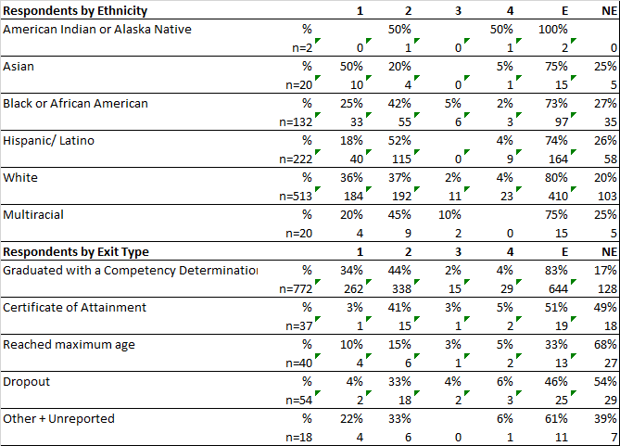
Page Three
Ethnicity:
  First review the proportion of all for each Ethnic group focusing on groups including larger numbers of respondents
  Then consider Engagement vs Not Engaged percentages
  Then consider detail provided under each of the Measures, especially M1 and M2
Exit Type
Notes:
Ethnicity: There are six Ethnicities reported including from 2 to 513 out of 921 respondents. Only three have counts that provide much precision: “Black or African American” n=132, “Hispanic/Latino” n=222. and “White” n=513. Overall engagement for “White” slightly above the statewide average and “Black or African American” and “Hispanic/Latino” are slightly below the statewide average.
Looking at the detail under M1 and M2 we find wider variation among groups that may inform our efforts to increase equity across ethnicity groups.
Exit Type: The only group large enough for statistical precision is “Graduated with a Competency Determination”: with 772 respondents. This group reports above average Engagement, the other types report below average Engagement.

Slide 17
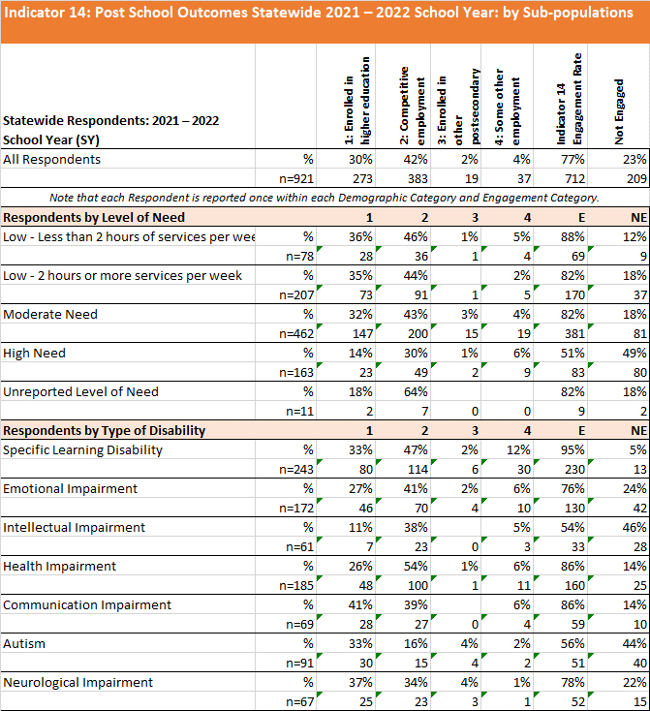
Page Four
Respondents by Level of Need
Respondents by Type of Disability
Notes:
Respondents by Level of Need: Three groups have larger respondent groups and Engagement decreases as perceived need increases. Those included in the “High Need” group report very low engagement at 49%... Considering the intent of Transition Planning and services, is this difference explainable?
Type of Disability: Those included in “Learning Disabilities” report very high Engagement at 95%.
Take a moment to review the rest of the detail provided within this section.

Slide 18
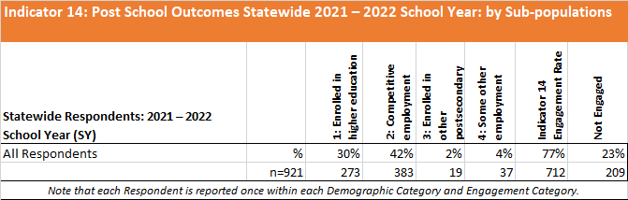
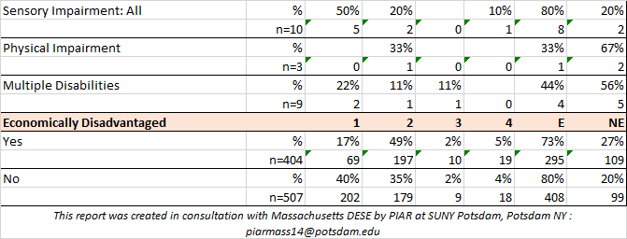
Page Four (continued)
Type of Disability
Economically Disadvantaged:
Although overall Engagement is similar for each group, there is great variation in the type of Engagement reported, for example:
1 Higher Education: Yes 17% vs No 40%
Considering what you know as educators, what might explain this?
Notes:
Read lefthand text box.

Slide 19
Contact Information
DESE
PIAR
Greg Tobey
Indicator 14 Lead and SPP/APR Coordinator
gregory.tobey@mass.gov
781-338-3378
Dr. Patrick Turbett
turbetjp@potsdam.edu
Robert Shepherd
shephers@potsdam.edu
315-267-2718

