Slide 1
Indicator 14: Post-School Outcomes Data Collection Updates for 2023 (FFY22)
Spring-Summer 2023

Slide 2
Agenda
01
Overview of Indicator 14
02
How to Prepare for the Online Survey
03
How to Administer the Online Survey
04
A Couple of Reminders
05
Wrap-up
Notes:
Here’s an outline of the content of this presentation. First, there is an overview of Indicator 14. Then, a review about how to prepare for the online survey and how to administer it. Finally, it wraps up with some things to keep in mind.

Slide 3
01
Overview of Indicator 14
Notes:
Let’s begin with a general overview of Indicator 14

Slide 4
Why is Indicator 14 important?
The focus of Pre-K – Age 22 education in Massachusetts is to prepare our students for success in their adult lives.
Using the Indicator 14 survey, you will follow up with your former students with IEPs one year after they leave high school to find out whether they have been engaged in employment and/or further education or training.
This summative information gives us an indication of the success of our educational efforts at the state and local level.
Notes:
Let’s start by reflecting on why Indicator 14 is important.
In Massachusetts, the focus in Pre-K to Age 22 education is to prepare students for success in their adult lives. The data we gather through Indicator 14 helps us to find out if our students did become successful.
Using the Indicator 14 survey, you are following up with your former students with IEPs one year after they leave high school to find out if they have been engaged in employment and/or further education or training.
The responses to this survey and the summative information it collects provide us with an indication of the success of our educational efforts at the state and local level.

Slide 5
What is Indicator 14?
At the district and state leveI, Indicator 14 measures the percent of youth who are no longer in secondary school, had IEPs in effect at the time they left school, and within one year of leaving secondary school are:
Enrolled in higher education,
Competitively employed,
In some other postsecondary education or training program, or
In some other employment.
Notes:
Indicator 14 is a federal reporting requirement mandated by the Individuals with Disabilities Education Act (IDEA). It is one of 17 Indicators of Special Education Compliance and Performance that MA DESE reports to the Office of Special Education Programs, or OSEP, in the annual State Performance Plan/Annual Performance Report, or SPP/APR. Specifically, Indicators 14 aligns well with Massachusetts’ focus on preparing all students for success after high school.
The federal criteria for successfully attaining one or more of these four outcomes are more modest than many former students and their families set for the first year out of high school. For example, the federal criteria for “Enrolled in higher education within one year of leaving high school” is completing one or more semesters or terms at a 2- or 4-year college. Completing even one class in a semester meets this criteria.
Perhaps this is why we call this reporting an “Indicator.” It doesn’t give us the full picture, but it gives us a useful snapshot.

Slide 6
Changes for 2023 and Beyond
As a reminder, the Cohort Model for Indicator 14 collection ended in 2022.
DESE has moved to a census model
Every district, every year
Provide a closer alignment to Indicators 1 and 2
More comprehensive picture of outcomes for our students with disabilities across the entire state
Notes:
Add notes and Update slide wording

Slide 7
How is Indicator 14 data collected?
Your district will use an online survey in English, Spanish, Haitian Creole, Vietnamese, Chinese (simplified), or Portuguese to collect information from your former students with IEPs.
https://bit.ly/WorkSchoolSurvey2023
This can be done in one of two ways:
District staff complete the online survey with the former student OR
The former student will complete the survey themselves.
Note: Since the last time your district collected Indicator 14 data, one new question has been added. Some questions have been modified.
Notes:
How is Indicator 14 data collected?
Indicator 14 data is gathered using surveys. For many of you the last time your district conducted Indicator 14 surveys, staff used paper surveys and submitted survey data using an Excel Spreadsheet. In 2019, an online version of the survey was developed and used successfully. This online survey simplifies the data collection process. It automatically compiles and saves data and you no longer will submit your data using the Excel Spreadsheet. This year staff will use an online survey, available in English, Spanish, Haitian Creole, Vietnamese, simplified Chinese, and Portuguese, to collect information from your former students with IEPs. The website address is: https://bit.ly/WorkSchoolSurvey2023.
District staff may complete the online survey with the former student, or the former student may complete the survey themselves. In situations where the web survey is not available, paper surveys can be used to record responses which can be entered online later.
Later in our presentation, we will show one new question that has been added.

Slide 8
When is Indicator 14 data due?
All data is due and surveys must be completed by: September 15, 2023.
All online surveys must be complete by this date.
Please ensure that all surveys are completed submitted online by September 15th, since we must meet federal reporting requirements including timelines.
Notes:
All district Indicator 14 data is due September 15, 2023. This means that all online surveys must be completed and submitted by this date.
So please ensure that all online surveys are completed and submitted on time, since we must meet federal reporting timelines and requirements.

Slide 9
02
How to Prepare for the Online Survey

Slide 10
Indicator 14: Getting Started
Identify your Indicator 14 survey team and plan how you will train and orient them.
Review all of the documents that will be emailed to your district’s special education administrator in May.
To collect data effectively, your team will need to know:
What is an exiter?
Who are your district’s exiters, and how will you contact them?
How will you administer the survey and submit data?
Notes:
Getting started.
To get the process started, we recommend you identify your Indicator 14 survey team and plan how you will train and orient them to their work and timelines. If you are in a very small district, the team may be just one person – it might be you! Larger districts will necessarily involve more people. As we will discuss later in this presentation, survey response rates are improved if exiters are contacted by people they already know, such as teachers or counselors.
It is important that you review all the documents that were emailed to your district’s special education administrator in May. Each of the Technical Assistance documents that will be emailed include detailed instructions and step by step directions for completing these activities.

Slide 11
What is an exiter?
Exiters are students with IEPs who during the 2021-2022 school year:
Graduated from high school, OR
Aged out of special education, with or without a certificate of attainment, OR
Dropped out of high school, i.e., didn’t return for the 2021-2022 school year, even though they had been expected to return. (Don’t forget to include students who were in Out-of-District Placements.)
Notes:
Review of what an “Exiter” is under Indicator 14:
Since you are surveying exiters, it is important to understand how exiters are defined under Indicator 14. For this year’s group, exiters are students with IEPs who during the 2021-2022 school year who either:
graduated from high school,
OR aged out of special education, with or without a certificate of attainment,
OR dropped out of high school, in other words, didn’t return for the 2021-2022 school year, even though they had been expected to return.
Don’t forget that districts are responsible for surveying any exiters who were in out-of-district placements for which districts were programmatically responsible. For example, even if you are an elementary district, if one of your students with IEPs attended an approved special education high school, you are responsible for collecting and reporting Indicator 14 data for that student.

Slide 12
Who are your district’s exiters?
DESE will provide each district with an exiter list generated using the data your district submitted to SIMS in 2022.
Each district’s list is available in the DESE Security Portal.
Once logged in, browse to Dropbox Central and then to Indicator 14.
Download and save your district’s SIMS exiter file securely.
Notes:
For your convenience, to help your district to identify who your exiters are, DESE has provided each district with an exiter list generated using the data your district submitted to SIMS in 2020.
Your district’s list is available in the DESE Security Portal.
Once logged in, browse to Dropbox Central and then to the Indicator 14 drop box.
Download and save your district’s SIMS exiter file securely.
Ultimately, you are responsible for identifying which exiters meet the Indicator 14 data collection criteria and should therefore be included in the Indicator 14 survey. Please verify that the list provided by DESE matches any internal lists that you have of students who exited in the 2021-2022 school year.
If you see a mistake in the list you download from SIMS, the next slide will tell you how to report to DESE that there is a mistake. But you are responsible for verifying that the list is correct, and you can proceed with data collection once you have made that verification. There is no need to wait to hear anything from DESE or PIAR.

Slide 13
Confirm Your Exiter List
Using your district’s records and the Indicator 14 Student Contact Information Sheets your district completed last school year, carefully review the list to verify it is correct and complete.
Per the Step-by-Step instructions your district administrator will recieve, create an Excel spreadsheet on which you list your district name and org code, as well as the SASID, name, and birthdate for each discrepant record.
Indicate whether you are adding the individual to the official list of exiters, or whether you are removing them.
Enter the reason for adding or removing the individual.
Upload this spreadsheet to the Indicator 14 dropbox on the DESE Security Portal.
Contact Patrick Cerio at PIAR (piarmass14@potsdam.edu) to request that exiters be added or removed. Patrick has DESE clearance to discuss individual exiter information with school staff.
Notes:
How to verify the accuracy of the downloaded list of 2021-22 Exiters.
Your goal is to survey every individual who meets the Indicator 14 data collection criteria, and not to survey anyone who does not. For example, you should not survey anyone who enrolled in another district after leaving yours, who did not have an IEP, or who exited in some other year.
Two Thousand Nineteen was the first time districts were provided with a list of Indicator 14 exiters by DESE. Districts reported that it was a helpful change. As expected, only a few exiters were removed or added by districts statewide.
To check the list, we suggest that you compare your district’s downloaded list of 2019-20 Exiters to the Indicator 14 Student Contact Information Sheets collected from your students while they were still in school to verify it is correct and complete. Ascertain whether the SIMS list is correct, or whether the internal list is correct, or if there are differences and why.
If there are discrepancies between the list of exiters you obtain from SIMS and any internal district lists, this may indicate a data reporting error when your district originally submitted data to DESE.
If changes need to be made to your list of exiters, create a simple Excel spreadsheet on which you list your district name and organization code as well as the SASID, name, and birthdate for each discrepant record, and indicate whether you are adding the individual to the official list of exiters or removing them. Also, enter the reason for adding or removing the individual.
Upload this spreadsheet to the Indicator 14 dropbox on the DESE Security Portal. Patrick Cerio at PIAR (piarmass14@potsdam.edu) will make these changes to the master list of 2019-20 exiters who should be contacted and interviewed. He will email you to confirm he has made these changes, but you do not need to wait for Patrick’s confirmation to begin collecting data. Be assured Patrick has DESE clearance to discuss individual exiter information with school staff. This process is included in the Step-by-Step instructions your district administrator received in July.

Slide 14
Compile Exiters’ Contact Information
Once all 2021-2022 exiters have been identified:
Use the Student Contact Information Forms that were completed by students in Spring 2022 to compile contact information
If you don’t have the Student Contact Information Forms for any exiters, there is no need to worry. You can review exiters’ emergency contact forms and other information in their cumulative records.
Notes:
Once all 2021-22 exiters have been identified and verified, use the Student Contact Information Forms that were completed by students in Spring 2022 to compile contact information.
If you don’t have the Student Contact Information Forms for any exiters (for example, for former students who dropped out before completing a Student Contact Information Form, or perhaps if there was a change in personnel and your district never asked students to complete the Contact Information Form), you can review exiters’ emergency contact forms and other information in their cumulative records for contact information.
Accurate contact information will facilitate your interviewers’ work and can save time for them.

Slide 15
03
How to Administer the Online Survey

Slide 16
Plan Ahead
Make a plan to contact your exiters so that all surveys are completed online at https://bit.ly/WorkSchoolSurvey2023 by September 15th, 2023.
Will you use email, phone calls, mail, social media?
How often will you contact exiters?
Which district staff will reach out to your exiters?
Your district’s response rates will be higher if exiters are contacted by school staff whom they know and trust.
Notes:
Planning ahead pays off.
Develop a plan with your team to contact your exiters so that all surveys are completed and submitted online (at https://bit.ly/WorkSchoolSurvey2023) by September 15th, 2023.
It is important to discuss many topics with your data collection team, including:
Will you use email, phone calls, mail, and/or social media to let former students and their family know that they will be contacted?
Will you publicize the survey?
How often and at what times will interviewers attempt to contact exiters?
Which district staff will reach out to your exiters?
Remember:
Your district’s response rates will be higher if exiters are contacted by school staff whom they know and trust. More on this later in the presentation.

Slide 17
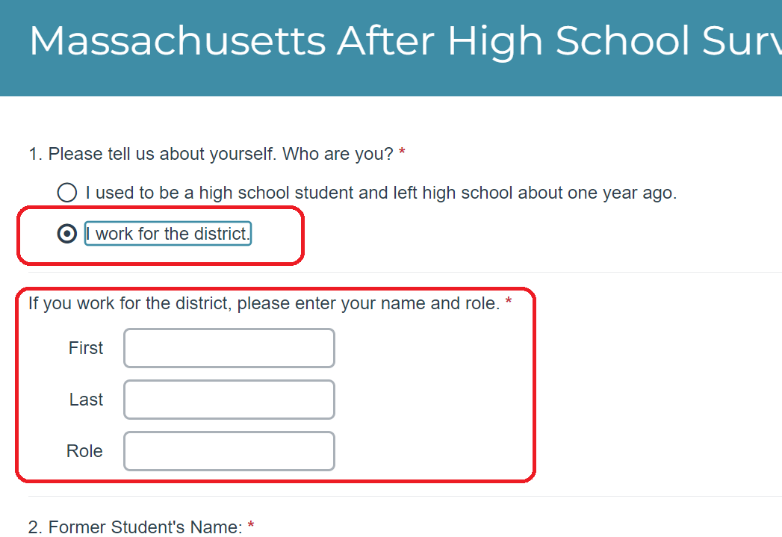
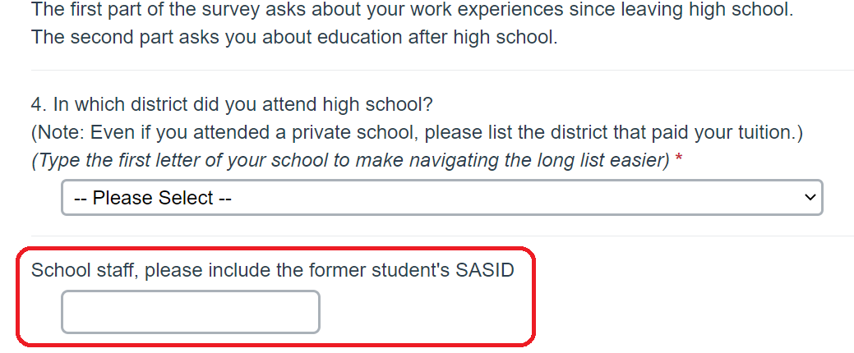
Please help ensure every survey count remind staff to:
Click “I work for the district and enter their name”…
… and enter the former student’s SASID.
Notes:
Your district’s response rates will be higher if exiters are contacted by school staff whom they know and trust. More on this later in the presentation.
Once survey are done staff at PIAR must match completed surveys to an Exiter from their district. In the past we have been unable to do this because not enough fields were completed to do so.
Obviously, we need the Exiters name and birthdate entered accurately, and these usually are..
At the top of the first page of the web survey, please remind staff to click the “”I work for the district” and enter their name (at least Last Name). At the bottom of the first page ensure that the correct district is entered and be sure to include the Exiters SASID.

Slide 18
Plan Your Outreach
The procedure you use is up to you.
We suggest that you:
Mail and/or email your exiters shortly before you plan to start calling. Allow time to complete the survey online.
Consider sending a follow-up letter after a week or two to encourage completing the survey online.
If more than a month has passed from the initial mailing, consider sending additional reminders that staff will be trying to contact them soon.
Please make at least three attempts to reach your exiters.
Contact = Phone calls or emails, Letters or texts all count as contact attempts.
When calling, try different days of the week and different times of day.
Districts with high response rates tend to attempt outreach to exiters more than three times.
Notes:
How will you reach your exiters? You choose which methods to use.
Based on our experience, we suggest that you mail and/or email your exiters shortly before you plan to start calling. Include information about how exiters can complete the survey online, and allow enough time to for them to complete the survey online before interviewers start making contacts.
Remember to check emails from Patrick Cerio at PIAR to remove exiters who have completed survey from your to-contact list.
Consider sending a follow-up letter after a week or two to encourage completing the survey online.
If more than a month has passed from the initial mailing, consider sending additional reminders that staff will be trying to contact households soon.
Please make at least three attempts to reach your exiters. DESE strongly recommends trying different days of the week and different times of day. Districts with high response rates tend to attempt outreach to exiters more than three times.

Slide 19
How will you know whether students have completed the online survey?
PIAR staff will send regular emails to your Indicator 14 district contact (usually the special education administrator), to let you know which exiters have completed the survey.
If you want someone other than your district’s special education administrator to receive these updates, please email the correct contact information to PIAR staff person Patrick Cerio, piarmass14@potsdam.edu, cc’d to Greg Tobey, Gregory.Tobey@mass.gov.
Notes:
How will you know whether your exiters have completed the online survey?
PIAR staff, typically Patrick Cerio, will send regular emails to your Indicator 14 district contact (in most cases the special education administrator), to let you know which exiters have completed the survey.
If you want someone other than your district’s special education administrator to receive these updates, please email the correct contact information to PIAR staff person Patrick Cerio, piarmass14@potsdam.edu, cc’d to Greg Tobey, Greg.Tobey@mass.gov. These updates can be sent to multiple people.

Slide 20
How will you know..? continued
Email updates from PIAR will be sent to each district about every two weeks through the summer until early August, and then weekly thereafter.
Let PIAR staff person Patrick Cerio, piarmass14@potsdam.edu, know if you need additional information about who has completed surveys or have other questions.
Notes:
… Continued:
To allow districts to monitor their Indicator 14 progress, email updates from PIAR will be sent to each district about every two weeks until early August, and then weekly thereafter.
Districts can contact Patrick Cerio at PIAR, piarmass14@potsdam.edu, for any additional information they need about who has completed surveys or for other questions.

Slide 21
04
A Couple of Reminders

Slide 22
Review the definition of Competitive Employment
Critical characteristics of Competitive Employment:
Youth have worked for pay at or above the minimum wage:
but not less than the customary wage
with the same level of benefits that the employer provides for the same or similar work performed by individuals who are not disabled
in the competitive labor market
on a full-time or part-time basis
in a setting with others who are nondisabled/in an integrated setting
includes military employment
Notes:
Most people with disabilities work at jobs and jobsites that are much the same as those where their peers without disabilities work. We also know that only a small fraction of former students with disabilities are likely to work in non-competitive employment. Typically, students who needed low levels of support while in school are unlikely to be employed in non-competitive employment. However, the minority of special education students who receive intensive levels of support while in school may be employed in non-competitive employment.
Anyone who is conducting interviews with former students should be familiar with Competitive Employment and its characteristics. Although there are some school staff who are familiar with this, not all staff are. We recommend that this information be reviewed during the orientation of your interviewers. This topic is briefly covered in the TA-2 document “Sample Script for Telephone Contact: Directions for School Staff Conducting Interviews” under Question 9 on page 3, so this topic can logically be covered during the review of the TA-2 document.
Critical characteristics of Competitive Employment are:
Youth have worked for pay at or above the minimum wage:
but not less than the customary wage
with the same level of benefits that the employer provides for the same or similar work performed by individuals who are not disabled
in the competitive labor market
on a full-time or part-time basis
in a setting with others who are nondisabled/in an integrated setting.
This includes military employment.

Slide 23
Improving Response Rates
Benefits of increasing response rates
To understand the experience of all types of former students with disabilities (SWD), we need to hear from all types of former SWD proportionately.
Higher response rates generally provide a more accurate picture of the actual engagement rates of SWD after high school.
The Statewide and your District reports will be more complete
With better survey data, better decisions can be made.
Notes:
To have the most complete snapshot of your former students’ engagement one-year post high school, attempt to contact and interview all of your exiters. The greater the proportion interviewed is compared to all exiters on your list, the more complete and representative of all of your exiters it will be. Every additional completed interview provides additional detail and insight.

Slide 24
Improving Response Rates Continued
Use interviewers whom former students know and trust.
Have on hand information about helpful local resources.
The information you provide can help your former students to connect with programs and services in their community that can assist them in attaining their goals.
Sharing these kinds of resources will improve the reputation of the survey and may encourage other exiters to contact you to complete the survey.
Notes:
Recognizing the importance of response rates, it is a good idea to choose survey techniques which produce higher response rates whenever possible. Most people are more comfortable talking with people with whom they are familiar. Therefore, choosing interviewers whom former students know and trust is a good strategy.
Another strategy is to have information on hand about local resources helpful to the former students. Not only will this information help them in attaining their goals but providing it could improve the reputation of the survey and motivate other exiters to contact you and complete the survey. This information may be in greater demand this year due to the pandemic.

Slide 25
Improving Response Rates…continued
Consider publicizing the survey effort.
Make plans to provide assistive technology, translation, or other support to help ensure that exiters who need them can participate in the survey.
Plan strategically the times when staff will try to contact former students and revise times as needed to reach your former students with fewer attempts.
Notes:
Publicize the survey. The more often your exiters hear about the survey, the more likely they are to respond when asked to complete it.
Be sure to provide technical assistance for the technology that exiters are using to complete the survey, if needed. Be prepared to offer translation services and other support so exiters will be able to participate.
Attempting to contact exiters at different times of day and on different days of the week is recommended for the greatest success. At least three attempts should be made to reach exiters. Districts reaching the largest percentage of exiters made more than three attempts.

Slide 26
Manchester Essex
Allison Brown Collins – Director of Student Services
Before exiting, confirm contact information with Seniors
Initial outreach with an email and follow up with a call
Contact family to ask for assistance
Personal connections with former students

Slide 27
Northern Berkshire
Kristin Steiner – Director of Student Services, McCann Tech.
Developed a set of internal procedures
Explain the importance of the survey to Seniors before leaving
Multiple contact points
Staff familiar with former students - Contacted student, then parent
Used Student Contact Information Sheet to track information and record survey answers

Slide 28
Somerville
Konstantina Kalogridis – Special Education Department Head
Inform exiters before leaving they will be contacted- Explain the importance of the survey.
Created internal tracking system and student information collection system.
Students may request a certain individual (case manager, adjustment counselor, guidance counselor) contact them.
Multiple ways of outreach and various times of day.
Maintain an ongoing relationship with the family.

Slide 29
Lowell
Frank Vicente – Director of Special Education
Multiple contact sources
Staff familiar with former students – stipend offered for staff
Multiple attempts (phone calls and home visits)
Persistence is key

Slide 30
05
Wrap-up

Slide 31
Whom should districts contact for Indicator 14 assistance?
For questions about the online survey, e.g., how to access it or whether your district’s exiters have completed the survey yet, please contact PIAR representative Patrick Cerio at piarmass14@potsdam.edu, 888-419-2697, or 315-267-2743. Please know that Patrick has clearance to discuss individual exiter information with school staff, should schools wish to know whether specific exiters have responded to the survey.
For all other Indicator 14 questions, please contact Greg Tobey, Greg.Tobey@mass.gov or 781-338-3378.
Notes:
This concludes the PowerPoint about Indicator 14, how to identify whom to contact (“exiters”), and how to access and use the online survey.
Thank you for your interest,
Robert Shepherd
Indicator 14
PIAR at SUNY Potsdam
Potsdam, NY
shephers@potsdam.edu
Link to DESE’s Secondary Transition webpage;
https://www.doe.mass.edu/sped/secondary-transition/
Link to DESE’s Indicator 14: Post-School Outcomes
https://www.doe.mass.edu/sped/secondary-transition/indicator14.html

Slide 32
Thank You
Robert Shepherd, Survey Coordinator
315-267-2718
shephers@potsdam.edu

