Slide 1
Indicator 7 Overview and Introduction to the ECOS Database
What We Measure Matters

Slide 2
Agenda
01
Indicator 7 overview
02
Early Childhood Outcomes Summary (ECOS) database
03
Indicator 7 timeline and process
04
Questions and answers

Slide 3
Indicator 7 Overview
01

Slide 4
Why Do We Collect Indicator 7 Early Childhood Outcomes Data?
The U.S. Department of Education’s Office of Special Education Programs requires states to report on three child outcomes annually.
The goal is to move the focus beyond compliance to achieving results.
Child outcome data helps districts understand the impact they are making for their students and can be used to guide program improvement.

Slide 5
Indicator 7 Measures Three Child Outcomes
States are required to report on the percentage of preschool-age children with individualized education programs (IEPs) who demonstrate improved
positive social-emotional skills (including social relationships),
acquisition and use of knowledge and skills (including early language/communication and early literacy), and
use of appropriate behaviors to meet their needs.

Slide 6
Child Outcome Summary Process
The COS summarizes information on a child’s functioning in all three child outcome areas using a 7-point scale and a progress question.
Involves a team of individuals who are familiar with a child (including parents).
Includes multiple sources of information about the child’s functioning, including parent/provider observation and results from direct assessment.
At exit, the team assesses whether the child exhibited any new skills and therefore made progress, regardless of the rating.

Slide 7
The Early Childhood Outcomes Summary Database
02

Slide 8
What Is ECOS and Why Was It Created?
The Indicator 7 ECOS database is
web-based,
accessible via browsers on both PCs and Macs (suggest Chrome or MS Edge), and
not as slow or error prone as SmartForms!
DESE invested in creating ECOS because it will
be more user friendly for data entry,
capture more complete and accurate data,
allow the state AND districts to USE the data for program improvement, and
be a tool for educators’ professional development.

Slide 9
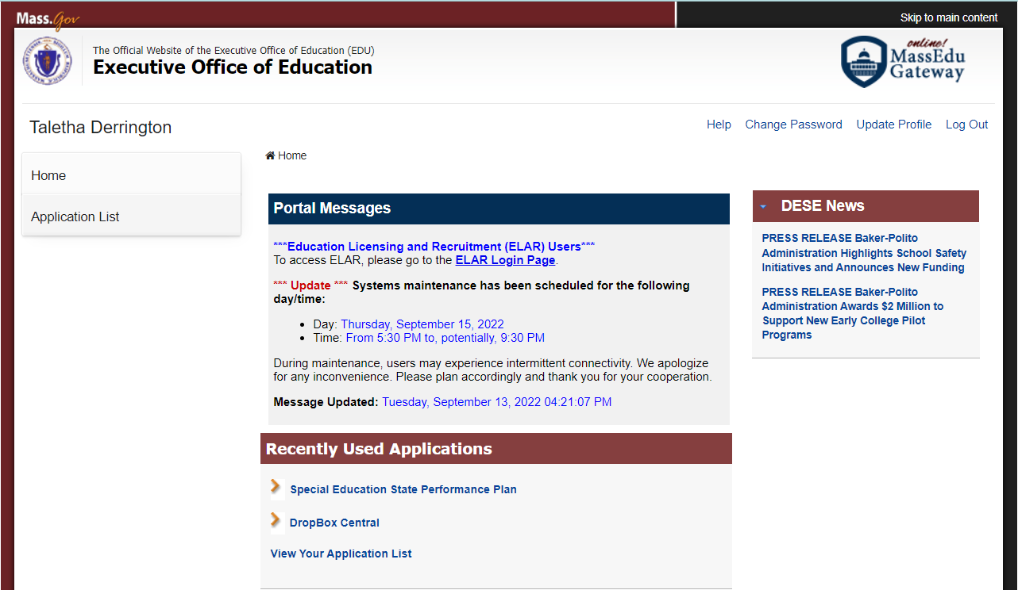
What Is ECOS? Same Login, New Application

Slide 10
What Is ECOS? Accessing the ECOS Application
District Administrators must give access to both
Indicator 7
Special Education State Performance Plan

Slide 11
What Is ECOS? ECOS Landing Page

Slide 12
What Data Do I Need to Enter?
Entry
Exit
Date the child started receiving preschool special education services; may not always be the IEP date
COS ratings (1–7 scale) for all three outcomes
Data should be collected within 4 – 6 weeks of first day of services
Date the child exited preschool special education services
When the child entered kindergarten in the same district or left the district or state
“Exit Exception”
Y = student left without the district being able to collect exit COS ratings
N = you have exit COS ratings to enter
COS exit ratings and progress question (Y/N) for all three outcomes

Slide 13
Data Entry and Common Errors (Part 1)
When you enter and save entry information for a child, the child will move from Part 1 Entry Data to Part 2 Exit Data.
All fields (services start date and ratings for all three outcomes) must be entered, or you will get an error.
Pressing Save Entry Data button will show any errors in red font near the fields requiring correction for each child.

Slide 14
Data Entry and Common Errors (Part 2)
When you enter and save exit information for a child, they will still appear in the Part 2 Exit Data table.
The following must be entered, or you will get an error.
Exit exception = Y (child exited without exit ratings being collected), date of exit
Exit exception = N (exit ratings were collected), date of exit, ratings for all three outcomes, progress question (Y/N) for all three outcomes
Progress question errors
Pressing Save Exit Data button will show any errors in red font near the fields requiring correction for each child.

Slide 15
View of Part 1 Entry Data Panel

Slide 16
View of Part 2 Exit Data Panel

Slide 17
School-level Error Status

Slide 18
Error: Only Entering Entry Date

Slide 19
Error: Entering N for Exit Exception, No Other Exit Data

Slide 20
Error: Entering Y for Exit Exception, No Exit Date

Slide 21
Error: Answer to Exit Progress Questions for Outcomes 1-3 is “Impossible”

Slide 22
Error: Exit Data Missing Answers to Progress Questions

Slide 23
Error: Exit Date Is In the Future (Compared with Date of Data Entry)

Slide 24
Notification After Selecting “Reset” to Correct a Student’s Exit Data

Slide 25
Successfully Saving Entry Data

Slide 26
Successfully Saving Exit Data

Slide 27
Final Step: Certification

Slide 28
Certification Is Complete

Slide 29
Indicator 7 Timeline and Process
03

Slide 30
Change 1: Annual Reporting for All Districts
All districts report annually on children entering and exiting preschool special education anytime during the school year.
No longer following a cohort schedule for Indicator 7 reporting.
More data entry but easier for districts to know what they are required to report and enables more frequent data use.

Slide 31
Change 2: ECOS Database
Use ECOS to submit data rather than the SmartForms and Dropbox.
All students designated as receiving early childhood special education will appear in ECOS following SIMS (Student Information Management System) certification.
ECOS has built-in edit checks that prevent common errors and promote data completeness.
Please continue to use Dropbox when needing to communicate with DESE or the evaluation team when requesting assistance. Please do not send personal information by email.

Slide 32
Enter Data After Each SIMS Recertification
Fall SIMS Recertification
Add entry data for new students.
Spring SIMS Recertification
Add entry data for new students.
Summer SIMS Recertification
Add entry data for new students.
Update exit data for any students who exited.
Update exit data for any students who exited.
Update exit data for any students who exited.
Certify the Indicator 7 data to complete submission.
Due by August 31 each year.
Plan to enter data beginning mid- to late November
Plan to enter data beginning mid- to late April.
Plan to enter data beginning August 1.

Slide 33
Cohorts 1 and 2 Reporting Schedule
2022-2023 | 2023-2024 | 2024-2025
No exit data on 2020-2021 student cohort to report (if no entry data reported). | No exit data on 2021-2022 student cohort to report (if no entry data reported). | Report exit data for 2022-2023 student cohort.
No exit data on 2021-2022 student cohort to report (if no entry data reported). | Report exit data for 2022-2023 student cohort. | Report exit data for 2023-2024 student cohort.
Report entry and exit data for 2022-2023 student cohort. | Report entry and exit data for 2023-2024 student cohort. | Report entry and exit data for 2024-2025 student cohort.

Slide 34
Cohort 3 Reporting Schedule
2022-2023 | 2023-2024 | 2024-2025
No exit data on 2020-2021 student cohort to report (if no entry data reported). | Report exit for 2021-2022 student cohort. | Report exit data for 2022-2023 student cohort.
Report exit data for 2021-2022 student cohort. | Report exit data for 2022-2023 student cohort. | Report exit data for 2023-2024 student cohort.
Report entry and exit data for 2022-2023 student cohort. | Report entry and exit data for 2023-2024 student cohort. | Report entry and exit data for 2024-2025 student cohort.

Slide 35
Cohort 4 Reporting Schedule
2022-2023 | 2023-2024 | 2024-2025
Report exit for 2020-2021 student cohort. | No exit data for 2021-2022 student cohort to report (if no entry data reported). | Report exit data for 2022-2023 student cohort.
No exit data on 2021-2022 student cohort to report (if no entry data reported). | Report exit data for 2022-2023 student cohort. | Report exit data for 2023-2024 student cohort.
Report entry and exit data for 2022-2023 student cohort. | Report entry and exit data for 2023-2024 student cohort. | Report entry and exit data for 2024-2025 student cohort.

Slide 36
Data Collection Process Suggestions
Set up collection deadlines around SIMS
Establish systems for scaling the COS process to all students
How are you all doing it?

Slide 37
ECOS Reports Table of Summary Statements and Progress Categories

Slide 38
ECOS Reports Graphs of Progress Categories

Slide 39
Questions and Answers
04

Slide 40
Resources for the COS Process
Early Childhood Technical Assistance (ECTA) Center and IDEA Center for Early Childhood Data Systems (DaSy) Center
Online module
Definitions for COS ratings
Decision tree
Practice scenarios
Quick reference guide
https://ectacenter.org/eco/pages/cospd.asp

Slide 41
References
The Center for IDEA Early Childhood Data Systems. (n.d.). OSEP progress categories. http://olms.cte.jhu.edu/data/ck/sites/4048/files/progress-categories.pdf
The Center for IDEA Early Childhood Data Systems and Early Childhood Technical Assistance Center. (2022a). Child Outcomes Summary (COS) process quick reference guide. https://ectacenter.org/~pdfs/eco/cos-quick-reference-guide.pdf
The Center for IDEA Early Childhood Data Systems and Early Childhood Technical Assistance Center. (2022b). Resources for more information about the Child Outcomes Summary (COS) process. https://ectacenter.org/~pdfs/eco/cos-resources.pdf
Early Childhood Technical Assistance Center. (n.d.). COS process professional development. https://ectacenter.org/eco/pages/cospd.asp

Slide 42
THANK YOU
Dr. Zach Weingarten and Dr. Taletha Derrington
202.403.5567
zweingarten@air.org
202.403.6947
tderrington@air.org

