Slide 1
2026 Back to School Meeting
August 18, 2026

Slide 2
Welcome Back for the 2026-2027 School Year!
In the chat, please share one highlight from your summer!

Slide 3
Objectives & Agenda
Reconnect and Introduce Our Team
Share Our 2026-2027 Priorities
Highlight Key Updates
Answer Questions

Slide 4
DESE’s Educational Vision
To ensure that all students have an equitable education, we must ensure that all educators are prepared to be effective, meaning they use evidence-based practices, including anti-racist and culturally and linguistically sustaining practices, that support all students to thrive.

Slide 5
Our Beliefs
All students:
  can thrive
  deserve access to effective educators
  are best supported when families, communities,
  and educators work together
All educators:
  must support every student in their care
  can be effective on day one through strong preparation
DESE, sponsoring organizations, and PK-12 schools/districts will need to:
  take action to disrupt inequities​
  partner to build a system that lives up to these beliefs​

Slide 6
The Educator Effectiveness Team A to Z
Claire Abbott
Siobhan Allen
Lakia Baymon
Kenzie Chin
Shannon Clancy
AJ Cote
Sarah Falvey
Caitlin Haapaoja
Liz Losee
Leah Murphy
Bobby Earle O’Brien
Eveliny (Pina) Peddie
Claire Smithney
Marianna Spera
Aubree Webb
Lindsay Zorich

Slide 7
DESE Commitment:
Building A Diverse and Effective Educator Workforce
Strengthen the systems that recruit, prepare, and retain a diverse and well-prepared educator workforce so that all students are taught and led by an effective educator who holds each and every learner to high expectations with targeted support.

Slide 8
2026-2027 Ed Prep Priorities
Equitable & Accessible Communications
Conducting Formal and Interim Reviews
Early Literacy in Ed Prep
Resources & Supports
Supporting Innovative Pathways to Licensure (including RTAP)
Ongoing Research about Effective Educators
Planned Updates to Align Guidelines
No Updates to New or Existing Guidelines Anticipated

Slide 9
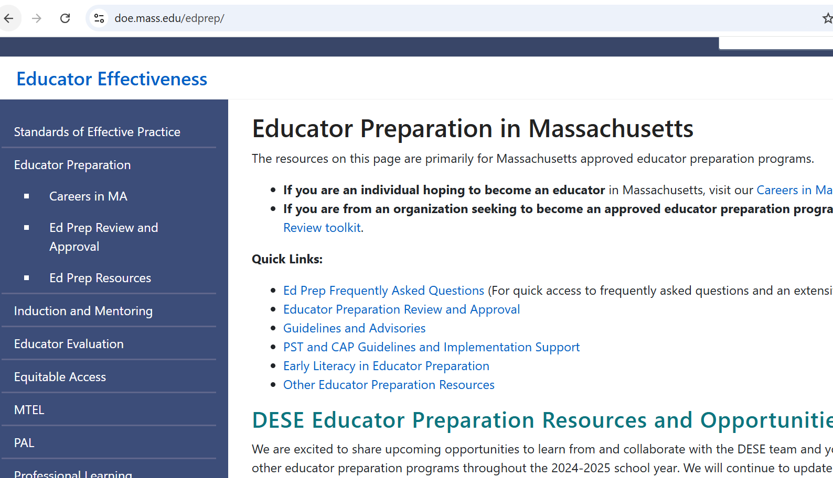
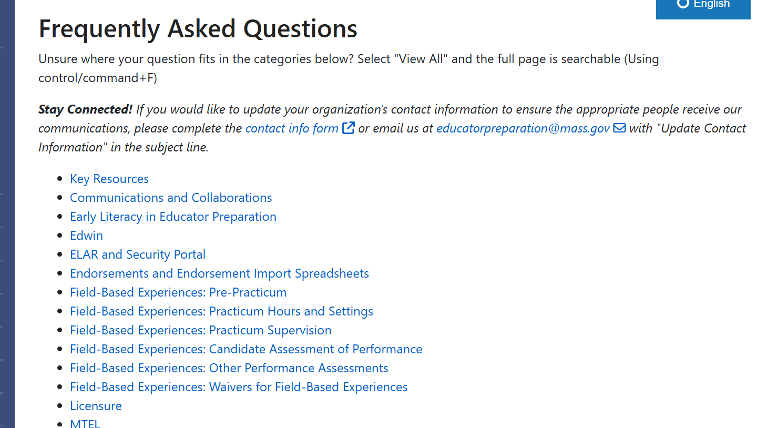
Equitable & Accessible Communications
doe.mass.edu/edprep/
Updated Ed Prep Homepage
Review Toolkits & Planning Guides
One-Stop FAQ Resource
If you can’t find what you’re looking for on these pages, contact the Ed Prep Inbox: educatorpreparation@mass.gov

Slide 10
Conducting Formal Reviews
Cohort A2 (5 SOs)
SY 25-26
SY 26-27
Cohort B (6 SOs)
SY 25-26
SY 26-27 and SY 27-28
SY 27-28
Cohort C (6 SOs)
SY 26-27
SY 27-28
SY 28-29

Slide 11
Early Literacy Interim Reviews
The Interim Review process includes the same key stages as the Formal Review, condensed into a shorter period and narrowly focused on the Early Literacy Program Approval Criteria.
There are detailed planning guides and resources for each stage of the Interim Review process online.
Submit Program Materials
Surveys Out
Focus Groups, Interviews and Course Observ.
Targeted Follow-Up Inquiry
Receipt of Final Report
Cohort 1: Complete!
Cohort 2: Focus Groups this Fall

Slide 12
Early Literacy in Ed Prep Resources
The Resource Hub was developed over the course of the last year and published in May.
The hub has information about all grants, professional learning, and other resources to support programmatic alignment to the 2024 Early Literacy Program Approval Criteria.

Slide 13
Early Literacy Ed Prep Resources
Downloadable Resources​: A collection of materials created by EPP faculty and organized by domain to support programmatic shifts​
Literacy Launch Institutes​: A professional learning track specifically designed for Educator Preparation Faculty, Program Supervisors, and Supervising Practitioners​
Consortium Grant: Entering its 4th year, the consortium grant supports mutually beneficial partnerships between EPPs and PK12 districts​
Launchpad Schools​: Designed to support EPPs with identifying high-quality practicum placement sites​ More to come!​
DESE is currently planning additional professional learning opportunities … stay tuned!​

Slide 14
Launchpad Schools
Have school-wide systems that support each and every student’s literacy development
Are committed to partnering with EPPs
Have supervising practitioners and classrooms well-suited to fostering teacher candidates’ literacy practice
Countdown to Launch Grant
Schools will receive funding for initiatives that build capacity to support teacher candidates' development of evidence-based early literacy instruction
Schools will also receive compensation for their participation in DESE walkthroughs, touchpoint meetings, and data collection
Schools will be evaluated as Launchpad Schools at the conclusion of the school year

Slide 15
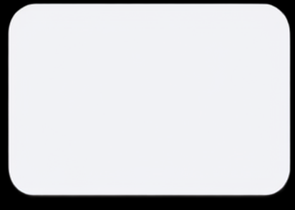



Massachusetts Registered Teacher Apprenticeship Program (RTAP)
Massachusetts Registered Teacher Apprenticeship Program (RTAP)
WHAT IS RTAP?
WHO PARTICIPATES?
GOALS OF RTAP IN MASSACHUSETTS
A paid pathway into teaching that combines full-time employment in an instructional role with educator preparation, job-embedded mentoring, and licensure support. Apprentices work in a school district while completing at least 2,000 hours of on-the-job training and preparation requirements for teacher licensure.
Apprentices — Aspiring teachers employed by a participating district and completing preparation toward licensure.
Journeyworkers — Experienced, appropriately licensed educators who mentor, coach, and supervise apprentices.
Approved Educator Preparation Providers — State-approved licensure programs providing flexible coursework, supervision and evaluation, and licensure endorsements.
  Expand access to the teaching profession
  Grow and diversify the educator pipeline
  Address teacher shortages
  Reduce financial barriers to becoming a teacher
  Develop educators through strong, job embedded preparation
  Build sustainable local teacher pipelines
HOW WAS IT DEVELOPED?
Developed in 2024 through a partnership among DESE, the Division of apprentice Standards (DAS), school districts, and approved educator preparation providers.
Designed to create a high-quality, affordable, job-embedded pathway into hard-to-staff roles, including special education, early childhood, and secondary math and science.
A paid, supported pathway that helps aspiring educators become licensed teachers while working in Massachusetts schools.
RTAP IN MASSACHUSETTS
  Massachusetts RTAP currently includes 41 registered teacher apprentices across 7 districts, supported by 5 state-approved educator preparation providers. An additional 16 districts are in the planning year, expanding pathways in high-needs areas such as special education, early childhood, and ESL.
RTAP IN ONE SENTENCE
A paid, supported pathway that helps aspiring educators become licensed teachers while working in Massachusetts schools.

Slide 16
Educator Workforce Research
SPARC (The Special Educator Workforce: A Research Collaborative) (multiple research partners)
Educator Workforce Research Collaborative (CALDER)
IES-funded research on the Bilingual Educator Workforce in MA (WestEd)
Paraprofessional Workforce Research (Harvard University)
Alternative Licensure Pathway Evaluation (CALDER)
Principal Pipeline Research (Boston University)
Early Childhood Educator Workforce Study (Boston University)
Literacy Launch Program Evaluation (Brown University)
MTEL Research (CALDER)
What Makes an Effective Teacher? (Brown University)

Slide 17
Key Program Approval Updates
Formal Review Timeline
Updates to the timeline to clarify times when there is active work for organizations and to streamline the early stages.
Program and Organization-Level Approval
There were no changes to the definitions or implications of approval designations; we added language to clarify that program-level approval designations resulting from an Interim Review will not change the overall organization-level approval determination.
Professional Teacher Program and Endorsement Instruction Domain Criteria
Differentiated criteria to reflect the purpose of these program types. The updates to the guidelines include additional definitions to clarify expectations for subject matter knowledge and pedagogy.
Virtual Delivery Models – Asynchronous Parameters
The intent of the limitation on asynchronous delivery models is to ensure candidates have opportunities to meaningfully practice the skills essential for their role; for PSTs at the practice level or higher for Initial Teacher programs, there must be at least one synchronous component prior to the practicum. Similar expectations for other license types.
Informal Review – New High-Needs Pathway
To align with DESE priorities, defined a high needs pathway for new programs (even in licensure areas that are not on our high needs list) that are designed with a PK-12 district partner to support job-embedded pathways to licensure.

Slide 18
SY2026-27 Reminders and Updates
Title II and SAR Reporting
Title II reporting: No anticipated changes
State Annual Report: Adding questions related to LEADS Act requirement for ed prep program diversity plans, will align with Program Approval Criteria. More details coming soon!
No changes in the timeline:
  By October 31st verify their ELAR data because we pull it in early November to send to Pearson and by March have to verify pass rate data
  Systems live in February, submissions due April 30th, 2027
CAP Data Reporting
This year, we will be holding a webinar in the Fall to help SOs set themselves up for success in collecting and ultimately reporting their CAP data. More details coming soon!

