Slide 1
Data Collection Changes for 2024-25 school year
Melissa Marino – Data Collection Supervisor

Slide 2
SIF Profile only
01
General Reminder
02
SIMS Changes
CONTENTS
03
SCS Changes
04
EPIMS Changes
05

Slide 3
General Reminder
General Reminder
01

Slide 4
Reminder
Updated documention will be posted to our public site by mid-July: Data Collection - Information Services (mass.edu)

Slide 5
SIMS Changes
SIMS Changes
02

Slide 6
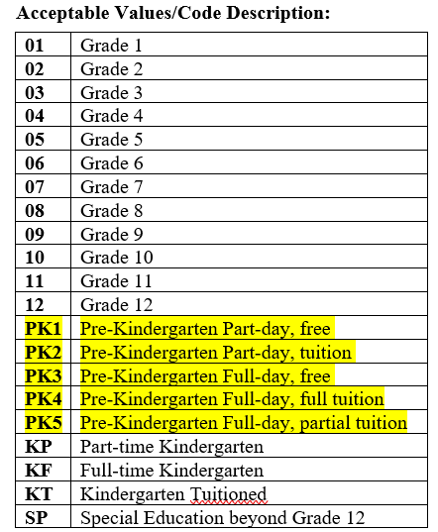
DOE016: Grade Level
The grade level values for PK are being expanded to 5 different categories
Full day = 5+ hours (or 25 hours per week)
Rationale: As the Governor and Legislature continue to invest in the expansion of preschool through the Department of Early Education and Care’s Commonwealth Preschool Partnership Initiative (CPPI), the state seeks to better understand the impact of these funds in expanding the number of 3- and 4-year olds who have access to high quality preschool programs and the extent to which public schools are expanding their options to be inclusive of both part-day and full-day options.

Slide 7
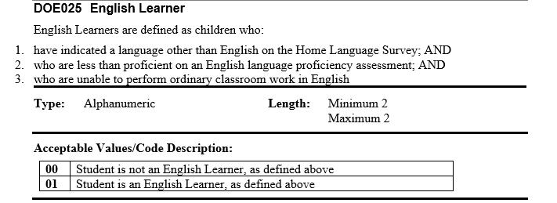
New validation related to EL status (DOE025)
A new SIMS validation will check students reported as 01 (EL) in DOE025 against ACCESS score data from assessment, and an error will be produced if the student has met exit criteria and should be considered no longer EL.
Rationale: All students who have at least 4.2 over all and 3.9 literacy ACCESS scores are an automatic exit from English Learner status. The Office of Language Acquisition (OLA) will be providing guidance on this to EL Directors.

Slide 8
DOE041: SLIFE
Rationale: As a result of extensive stakeholder engagement, research in collaboration with OPR and national SLIFE experts, we are making a change to the SLIFE definition for 2024-25. This will not impact the DOE041 codes themselves. They will still be:
Updated definition:
To be classified as SLIFE, a student must meet all the following criteria:
The DOE025 SIMS field indicates the student is an English learner.
The student is 8 to 21 years old.
The student entered a United States school after grade 2 or exited the U.S. for six months or more and did not attend school during this time.
Prior exposure to formal schooling is characterized by one of the following:
No formal schooling;
Interruptions in formal schooling, defined as at least two or fewer years of schooling than their typical peers;
Consistent, but limited formal schooling (e.g., school days were significantly shorter or student didn’t regularly attend school every day)

Slide 9
DOE045: HQCCP Program Type
Rationale: The new value of 04 is to allow districts to report students who are enrolled in both Innovation Career Pathway program and Early College

Slide 10
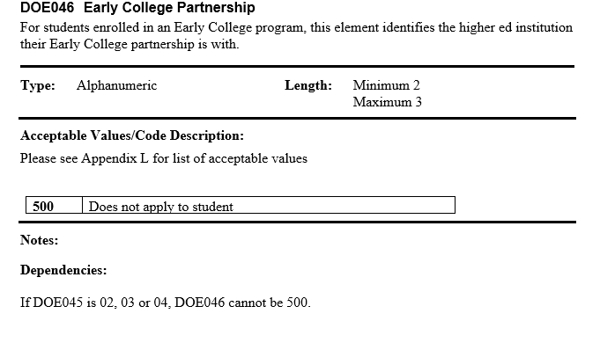
DOE046: Early College Partnership
Rationale: This element will now be specifically for identifying the code for the higher ed institution for Early College program enrollment. Appendix L will contain the same list of higher ed institution codes that it currently has. The Innovation Career Pathway sector codes will be removed from this element and moved to a separate element.

Slide 11
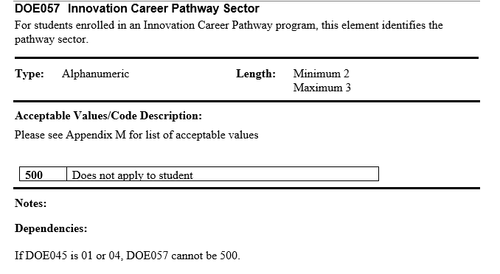
DOE057: Innovation Career Pathway Sector
Rationale: This new element will now be specifically for identifying the code for the Innovation Career Pathway. Appendix M will contain the sector codes.
This new element will be on the studentschoolenrollment object
Will have one new value “Clean Energy”

Slide 12
SCS Changes
SCS Changes
03

Slide 13
SCS05: Subject Area Course Code
New course code: 04112 AP African American Studies (code is replacing the 2023-24 pilot code 04146)
Updated Appendices document will be posted here by mid-July: EPIMS - Information Services/Data Collection (mass.edu)
The below courses will be added to the list of advanced courses for accountability
21005 - Engineering- Comprehensive
21047 - Engineering—Independent Study
21013 - Aerospace Engineering
21014 - Biotechnical Engineering
21011 - Civil Engineering
21008 - Digital Electronics

Slide 14
EPIMS Changes
EPIMS Changes
04

Slide 15
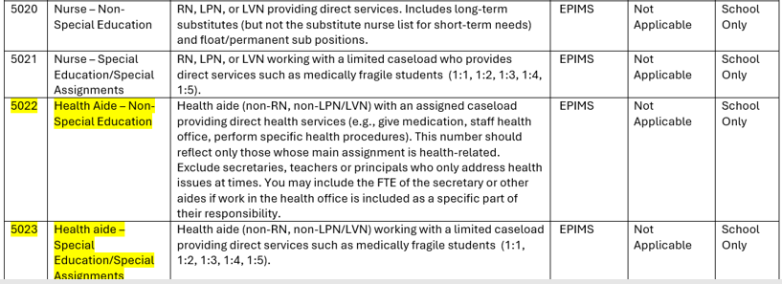
WA07 Job Classification
The below updates will be made to the job classification codes for School Nurse related categories

Slide 16
EPIMS Summary Reports 9 and 10 (Staff Attendance Rates)
New for EOY: Summary reports 9 and 10 have been updated to reflect three new data points – Staff Count, Percentage of Staff with 10 or More Absences, and Average Number of Absences. The updated parameter for the report is staff who have at least 20 days of attendance in SR36.
Rationale: To provide more detail in the reports and improve data quality in SR36 and SR37
Staff attendance FAQ is on the EPIMS page: EPIMS - Information Services/Data Collection (mass.edu)

Slide 17
SIF Profile only
SIF Profile only
05

Slide 18
SIF Profile Update
New Element in the StudentPersonal object
This is a SIF Profile only element – a yes/no flag for “CPPI Funded Student”. It will not be extracted as part of the SIMS data collections. It will be used to identify which students are funded by the Commonwealth Preschool Partnership Initiative (CPPI) grant.
Through CPPI, the Department of Early Education and Care (EEC) funds districts across the state to develop partnerships between school districts and local early education and care programs to expand access to high quality preschool within the district.The districts that have this CPPI funding apply for SASIDs for these students, including those who are in community based programs.
This flag on the StudentPersonal object will allow DESE to compile a list of all CPPI funded students – those enrolled in the public district preschool as well as those who are in community based programs. Early childhood coordinators in the district are familiar with CPPI and which students this applies to.

Slide 19
Thank you
THANK YOU
Please reach out to DESE Data Collection with questions
781.338.6797
Melissa.r.marino@mass.gov
Data Collections Support Specialists by District

