Slide 1
Massachusetts District Review
CLASS Observation Process
Alex Marken, Researcher
Matt Welch, Senior Researcher
Notes:
MATT

Slide 2
Agenda
Welcome and Introductions
CLASS Overview
CLASS Domains and Dimensions
CLASS Data Collection Process
CLASS Observation Data Report
Questions and Answers

Slide 3


Welcome and Introductions
Please use the chat to let us know which district you are representing today.
Alex Marken
Matt Welch
American Institutes for Research
Researcher
amarken@air.org
American Institutes for Research
Senior Researcher
mwelch@air.org

Slide 4
CLASS Tool Overview
Notes:
MATT

Slide 5
CLASS Overview - The Tool
The CLASS tool was developed by the Center for Advanced Study of Teaching and Learning (CASTL) at the University of Virginia (Now Teachstone)
    Research-based observation method
    Measures interactions between students and teachers associated with improved outcomes
    Tools for Early Elementary, Upper Elementary, and Secondary Levels
    Captures 10–11 classroom dimensions related to four consistent domains:
    Emotional support
    Classroom organization
    Instructional support
    Student engagement (upper elementary and secondary only)
Notes:
CLASS was originally developed by researchers at the Center for Advanced Study of Teaching and Learning (CASTL) at the University of Virginia and is now sold by Teachstone.

Slide 6
CLASS Overview – The Rationale
AIR has used CLASS in Massachusetts schools and districts since 2015
    High reliability across classrooms, schools, and districts
    Quantifiable, anonymous teacher data
    Correlation with student achievement
      Greater gains in social skills and academic success with higher scores (Allen et al., 2013; Hamre & Pianta, 2010; MET Project, 2010)
      Associated with growth in student achievement in Massachusetts schools (Therriault et al., 2020)
Notes:
What is meant by quantifiable- all dimensions are rated on a scale from 1-7, which comparability across schools and over time.

Slide 7

CLASS Overview – Additional Information
CLASS observations
  capture the frequency and depth of teacher-student interactions
  provide a snapshot of average classroom instruction during a one-day visit
  should not be used in isolation, out of context, or to single out classrooms or teachers
CLASS observers participate in a rigorous training and testing process to become certified observers
Notes:
Important to note that it is unlikely that a teacher would score high on all dimensions in a short amount of time during the observations; this is why scores are averaged across all classrooms in the school and we do not report identifiable individual classroom scores.

Slide 8
CLASS Domains and Dimensions
Notes:
ALEX

Slide 9
CLASS Domains and Dimensions: Emotional Support
Emotional Support
Positive Climate
Teacher Sensitivity
Classroom Organization
Behavior Management
Instructional Support
Instructional Learning Formats (UE & Secondary)
Instructional Dialogue (UE & Secondary)
Productivity
Negative Climate (UE & Secondary)
Concept Development/ Content Understanding
Quality of Feedback
Analysis & Inquiry (UE & Secondary)
Language Modeling (K-3 Only)
Negative Climate
(K-3 Only)
Instructional Learning Formats (K-3 Only)
Regard for Student Perspectives
Warm and supportive relationships, sharing positive affect, demonstrating mutual respect, awareness of and responsiveness to students’ needs, encouraging student responsibility and autonomy
Student Engagement (Upper Elementary & Secondary)
Notes:
CLASS is organized into four domains- emotional support, classroom organization, instructional support, and student engagement (for upper grades only). The dimensions vary slightly by level to ensure that the tool is developmentally appropriate for the grade range.
The first domain, emotional support, is comprised of 3-4 dimensions, including positive climate, teacher sensitivity, negative climate (for grades K-3 only), and regard for student perspective.
Positive climate reflects the emotional connection and relationships between teachers and students as seen through verbal and non-verbal interactions.
Teacher sensitivity reflects the teacher’s timely responsiveness to students’ academic, social emotional, and behavioral needs both individually and the entire class.
Negative Climate reelects the overall level of negativity among teacher and students in the class; this dimension is reverse coded, with high scores reflecting severe and consistent negativity.
Regard for student perspectives captures the degree to which the teacher provides developmentally appropriate opportunities for student autonomy and leadership during the lesson and the extent to which student ideas and opinions are valued.

Slide 10
CLASS Domains and Dimensions: Classroom Organization
Emotional Support
Positive Climate
Teacher Sensitivity
Classroom Organization
Behavior Management
Instructional Support
Instructional Learning Formats (UE & Secondary)
Instructional Dialogue (UE & Secondary)
Regard for Student Perspectives
Productivity
Negative Climate (UE & Secondary)
Concept Development/ Content Understanding
Quality of Feedback
Analysis & Inquiry (UE & Secondary)
Language Modeling (K–3 Only)
Negative Climate
(K-3 Only)
Instructional Learning Formats (K-3 Only)
Clear behavioral expectations, overall level of negativity among teachers and students, well-managed instructional time, maximizing students’ interest and engagement in activities
Student Engagement (Upper Elementary & Secondary)
Notes:
The second domain, classroom organization, is comprised of 3 dimensions, including behavior management, productivity, negative climate (for the upper grades and secondary), and instructional learning formats (for K-3):
Behavior management encompasses the teacher’s use of effective methods to encourage positive behaviors and prevent/direct misbehavior.
Productivity considers how well classroom time is managed and maximized using consistent routines, and downtime for students is minimized.
Negative climate was previously described. Where this dimension is located varies by level.
Instructional learning formats focuses on the ways the teacher maximizes student engagement by clearly presenting materials, actively facilitating, and using interesting and engaging lessons and materials.

Slide 11
CLASS Domains and Dimensions: Instructional Support
Emotional Support
Positive Climate
Teacher Sensitivity
Classroom Organization
Behavior Management
Instructional Support
Instructional Learning Formats (UE & Secondary)
Instructional Dialogue (UE & Secondary)
Regard for Student Perspectives
Productivity
Negative Climate (UE & Secondary)
Concept Development/ Content Understanding
Quality of Feedback
Analysis & Inquiry (UE & Secondary)
Language Modeling (K–3 Only)
Negative Climate
(K-3 Only)
Instructional Learning Formats (K-3 Only)
Use of multiple modalities, depth of lesson content, promotion of students’ higher-order thinking skills, focus on understanding, explicit feedback that expands learning, amount and quality of language-stimulation
Student Engagement (Upper Elementary & Secondary)
Notes:
The third domain, instructional support, is comprised of 3-5 dimensions, including instructional learning formats (for upper elementary and secondary, concept development or content understanding (variation by grade range), analysis and inquiry (for upper elementary and secondary), quality of feedback, instructional dialogue (upper elementary and secondary) and language modeling (K-3).
Instructional learning formats was previously described. Where this dimension is located varies by level.
Concept development/ content understanding refers to the depth of lesson content and interactions that lead to an integrated understanding of facts, skills, concepts, and principles.
Analysis and inquiry assesses the degree to which students are engaged in higher-level thinking skills through application of knowledge and skills to open-ended problems, tasks, and questions.
Quality of feedback assesses the degree to which feedback expands and extended learning and understanding and encourages student participation.
Instructional dialogue captures the purposeful use of content-focused discussion among teachers and students
Language modeling focuses on how teachers use language to stimulate and support children’s language development by encouraging open-ended conversations, introducing new vocabulary, and promoting higher-order thinking through back-and-forth exchanges

Slide 12
CLASS Domains and Dimensions: Student Engagement
Emotional Support
Positive Climate
Teacher Sensitivity
Classroom Organization
Behavior Management
Instructional Support
Instructional Learning Formats (UE & Secondary)
Instructional Dialogue (UE & Secondary)
Regard for Student Perspectives
Productivity
Negative Climate (UE & Secondary)
Concept Development/ Content Understanding
Quality of Feedback
Analysis & Inquiry (UE & Secondary)
Language Modeling (K–3 Only)
Negative Climate
(K-3 Only)
Instructional Learning Formats (K-3 Only)
Degree to which students are focused and participating, emphasis on active rather than passive engagement
Student Engagement (Upper Elementary & Secondary)
Notes:
Lastly, student engagement captures the degree to which all students are focused and participating in the learning activity. The difference between passive engagement and active engagement is of note here.

Slide 13
CLASS Dimensions At-A-Glance
    PC=Positive climate
    NC=Negative climate
    TS=Teacher sensitivity
    RSP=Regard for student perspectives
    BM=Behavior management
    PD=Productivity
    ILF=Instructional Learning Formats
    CD=Concept Development
    QF=Quality of Feedback
    LM=Language Modeling
    CU*=Content Understanding
    AI*=Analysis & Inquiry
    ID*=Instructional Dialogue
    SE*=Student Engagement
Each dimension is scored on a seven-point scale.
Dimension scores within each domain are averaged together to create overall domain scores.
Scores are classified into three categories, from developing effectiveness to highly effective.
Notes:
Color coded by dimensions:
Red= emotional support
Yellow= classroom organization
Green= instructional support
Blue= student engagement
Score range: 1 (low) to 7 (high)
Dimension scores within each domain are averaged together across all classrooms to create an overall domain score

Slide 14
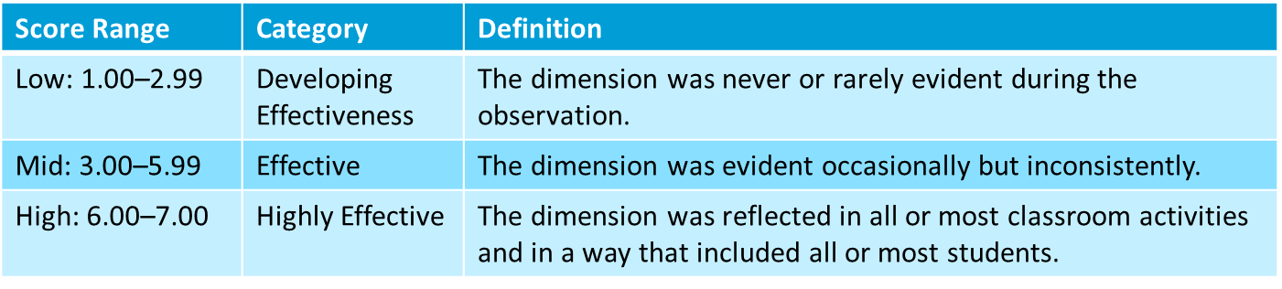
CLASS Ratings
Notes:
We often get questions about how to interpret the CLASS score ratings.
Scores between 1-2.99 are in the low range and considered to be developing effectiveness. In this rating, the dimension was never or rarely evident during the observation.
Scores between 3-5.99 are in the mid-range and considered to be generally effective. The dimension was evident occasionally but not inconsistently. For example, there may be evidence observed for part of the lesson but not most of the lesson, or for some students but not the majority of students.
Scores between 6-7 are in the high range and considered to be effective. The dimension was reflected in most classroom activities and most students were able to engage and benefit.

Slide 15
CLASS Data Collection Process
Notes:
ALEX
In this section, we briefly describe the data collection process. As a reminder, your AIR lead will be in contact to schedule an overview call to answer your specific questions about data collection.

Slide 16
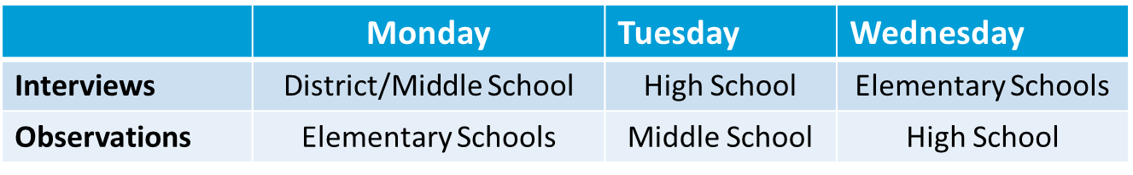
CLASS Data Collection - Overview
  Observations take place the week of the district review site visit
  Observers will look for the dimensions in the CLASS tool associated with the classroom’s grade-level as well as the instructional materials visibly in use during the observations
  Observations and interviews/focus groups do not take place in the same building on the same day
  Example schedule:
Notes:
An overview for the observations:
Observations take place during the week of the district reviews, during the same time period as interviews/focus groups
Observersions will look for the dimensions in the tool associated with the classroom’s grade-level; for example, the K-3 tool will be used in lower elementary grades, and UE will be used in upper elementary grades. As a result, it is possible to have two different versions of the tool in use depending on the grades served
To help with data collection, observations and focus groups do not take place in the same building on the same day. We want to avoid a situation where the observer is going to visit a classroom at the same time that the classroom teacher is participating in a focus group. Therefore, your site lead will work with you to create an observation schedule that offsets the interviews/focus groups and observation. An example of this schedule is seen here, but it can be updated to reflect the dates that would work best for your schools.

Slide 17
CLASS Data Collection - Process
Pre-Visit
AIR collects master schedules, school maps, and bell schedules
District provides information on events such as testing, assemblies, and field trips
District and AIR finalize CLASS observation schedule
District and school inform staff members of the date for observations
Day of Visit
AIR onsite team checks in at the main office
School provides information on absences, sensitive environments (e.g., 1:1 settings, medically fragile)
AIR team proceeds to complete observations unaccompanied
AIR team will check out with the principal at end of the day
Notes:
A brief overview of the process that your AIR lead will revisit. In advance of the visit….
During the visit…

Slide 18
CLASS Observation Data Report
Notes:
MATT

Slide 19
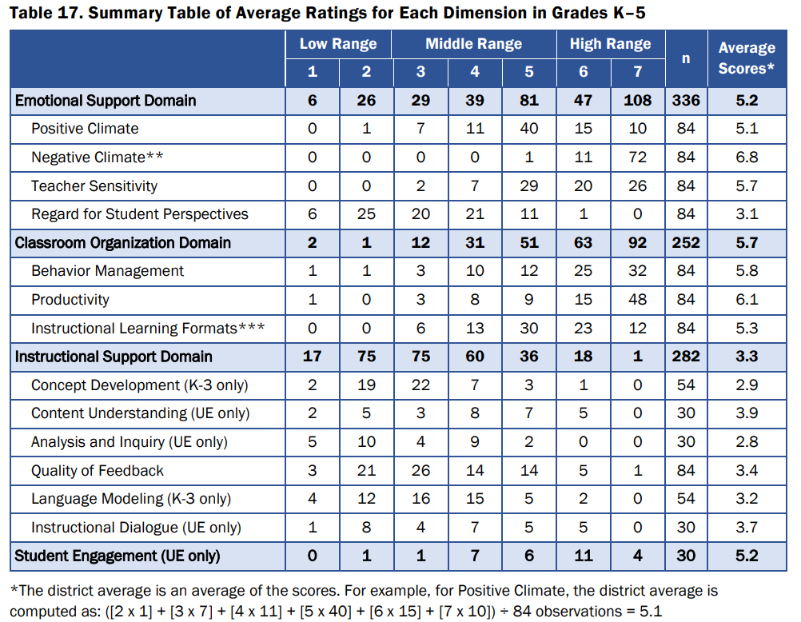
CLASS Summary Tables by Grade Band
Separate tables for each of 3 grade bands (where appropriate)
Average rating by domain and dimension.
Total N of classrooms at each rating level.

Slide 20
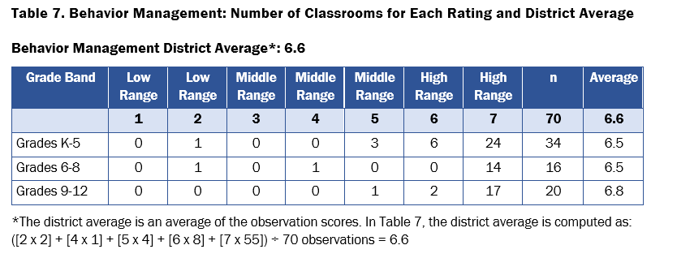
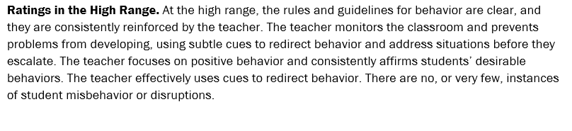
Reading the CLASS Report
This chart shows the total # of observations for each grade band, how many classrooms scored at each level, and average scores on this dimension for each grade band.
For each CLASS indicator, the report includes a paragraph explaining what the overall range (high, medium, or low) on the CLASS rating system looks like in practice (general description).

Slide 21
Questions and Answers

Slide 22
Frequently Asked Questions
Do teachers get feedback?
      No. Observers will not spend enough time to give individual feedback, nor will they collect any identifying information.
Does the principal need to greet or accompany the team?
      No. The principal may choose to greet the observers, but it is not mandated. Observers will check in at the office upon arrival. Maps and schedules allow the team to proceed without an escort.
How many people should we expect at a school?
      Generally, 1-2 people for 1 day or less, depending on school size. Larger schools (e.g., large high schools) will have larger teams.

Slide 23

Additional Questions?

