Slide 1
District Reviews 101
As you join, please rename yourself to include your name, role, and district name
2025-2026 District Orientation
Please be advised that DESE does not authorize attendees to record or to use AI transcription tools during the meeting and DESE does not endorse any unauthorized transcripts created by third parties of its meetings.

Slide 2
Introductions
Office of District Reviews and Monitoring (ODRM) Team
Erica Gonzales, Associate Commissioner of Data and Accountability
Robbie Havdala, Director of District and School Accountability
Kevin Daly, Data Analyst
Corinne Thomas, District Review Support Specialist
If you have not already, please rename yourself to include your district name. Also, please share the thing you are most looking forward to this summer in the chat.

Slide 3
Questions we are answering today
What is a district review? How does it differ from other reviews?
What do I have to do for the review?
What are we being reviewed on?
Agenda:
About district reviews
Review process
Introduction to the District Standards and Indicators
Questions and discussion

Slide 4
About District Reviews

Slide 5
District Reviews
Required by state statute (M.G.L. Ch.15 § 55A, Ch.16 § 1K)
DESE’s Office of District Reviews and Monitoring (ODRM) reviews approximately 20 districts each year
Since 2021, reviews have been conducted via a partnership between ODRM and the American Institutes for Research (AIR)

Slide 6
The Purpose of District Reviews
Theory of Action
The Office of District Reviews and Monitoring (ODRM) examines district systems, policies, and practices through written reports. These reports provide information and recommendations that promote systemic improvements and advance equitable student outcomes and experiences.
Provide a snapshot of a district’s systems, policies, and practices relative to the District Standards and Indicators
Highlight key strengths, areas for growth, and recommendations through an equity lens

Slide 7
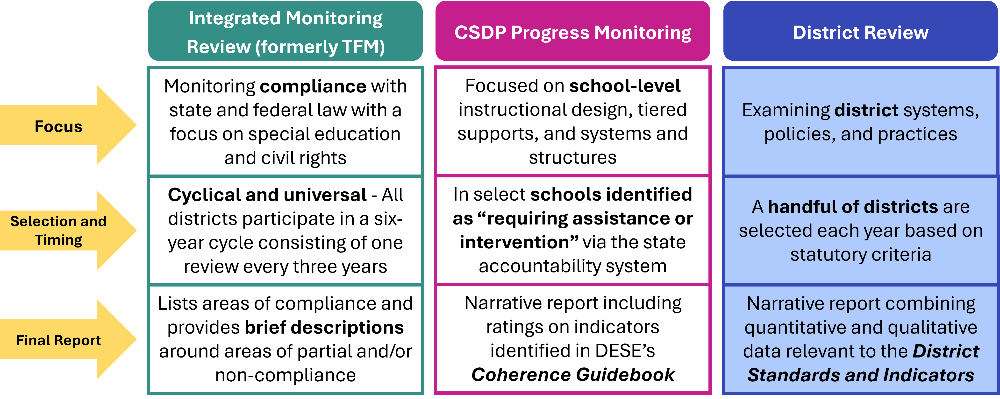
District Reviews vs. Other DESE Reviews

Slide 8
Making the Most of a District Review
District leaders have leveraged their reviews to:
Facilitate meaningful conversations with leaders and staff around opportunities for improvement
Highlight progress and celebrate strengths
Develop a meaningful and data-driven district strategic plan
“I thought it was really comprehensive…it's a bit of work at the beginning, but if you look at it like a free, expensive consultant coming in it's very helpful.”
– District Leader
“I wish I had this resource (the District Standards and Indicators) on day one as a superintendent!”
– Accountability and Assistance Advisory Council Member
“We are really excited about the work we are doing and we happy the report substantiated what we are doing.”
- District Leader

Slide 9
Review Process

Slide 10
ODRM and AIR Partnership
ODRM’s Role
AIR’s Role
Selecting and notifying districts of review
Providing resources to support districts through the review process
Editing, finalizing, and publishing all reports
Scheduling and liaising with districts
Collecting documents and data
Conducting onsite focus groups, interviews, and classroom observations
Synthesizing evidence
Drafting all reports
Developing and presenting orientation and information sessions
Sharing findings with the district

Slide 11
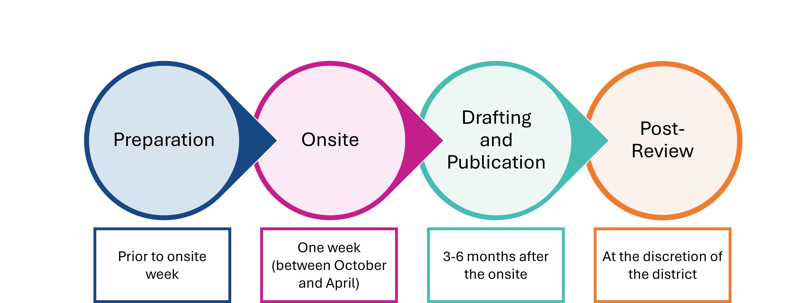
The District Review Process

Slide 12
Preparation
Preparation is typically the most labor-intensive phase of the review process for districts. We recommend starting document collection this summer.
District
Identifies district liaison
Notifies stakeholders of the district review using resources provided in the Pre-Review Communications Kit (coming soon on DESE’s website!)
Submits district self-assessment (optional)
Submits required documents
Provides access to educator evaluation files
Completes District Liaison and School Leader questionnaires
AIR
Develops and refines data collection, analysis, and reporting tools and processes
Sends scheduling survey to all participating districts
Establishes connection with district liaison for introduction and planning purposes
Reviews submitted district documents and extant data
Develops detailed schedule for onsite week in collaboration with the district

Slide 13
Document Collection
Full document checklist was sent to meeting attendees via email and is posted on DESE’s website
Generally, districts are not expected to create documents that do not already exist (with a few specific exceptions)
Documents will be securely uploaded to AIR’s SharePoint site
  AIR will send a link and share document upload instructions
Preparation Documents
  Self assessment (optional)
  List of all administrators
  Completed Curriculum and Ratings Table
  Completed Assessment Inventory
  Map of each school
  Daily schedule for each school
  Master schedule for each school
  District organizational chart

Slide 14
Educator Evaluation Files
Teacher Documents
Teacher self-assessment
Educator Plan, including professional practice and student learning goals
Announced or unannounced observation reports
Formative assessment or evaluations
Summative evaluations if teachers were evaluated during the previous school year
Administrator Documents
Self-assessment
Educator Plan, including professional practice and student learning goals
Observation or school visit reports or documentation
Formative assessment or evaluations
Summative evaluations (also called administrator evaluations)

Slide 15
DESE-Provided Data Review
AIR will incorporate data and documents compiled by DESE as supporting evidence in the final district review report.
District Profile data
District Analysis and Review Tool (DART) data
Edwin Analytics data
Resource Allocation and District Action Report (RADAR)
Latest Tiered Focused Monitoring (TFM) reports or Integrated Monitoring Reviews (IMR) and relevant follow-up documents, if applicable
Student Opportunity Act (SOA) plan
Collective bargaining agreement for teachers, including the teacher evaluation tool
Report on staffing
Induction and Mentoring Report
Long-term enrollment trends
End-of-Year Report
Current Turnaround or Improvement Plans for any underperforming schools
Most recent Monitoring Site Visit Reports for underperforming schools

Slide 16
Onsite
General Information
One week, taking place between October and April
Team of 3 or more AIR staff members in person in the district
Data Collection Activities
Interviews and focus groups (primarily in person)
Instructional observations (using CLASS tool)
Additional document review (as needed)

Slide 17
Interviews and Focus Groups
Stakeholder(s) | Type | Optimal number of participants
Superintendent | Interview
District leaders | Interview | As required
Town Manager (or equivalent) | Interview
School committee members | Focus group | 3+
School leaders | Focus groups | All school leaders
Instructional staff | Focus groups | 8–10 per group
Student support staff | Focus group | 8-10
Teacher association leadership | Focus group | 3–5
Family members | Focus groups | At least 3–5 per group
Students (middle and high school) | Focus groups | 8–10 per group

Slide 18
Instructional Observations
CLASS Protocol
CLASS tool developed by Teachstone
Evidence base that high scores in CLASS domains are associated with improvements in student outcomes
Accounts for grade level
(lower elementary, upper elementary, secondary)
Interrater reliability
Logistics
One CLASS certified observer per classroom
(not all classes will be observed, but all schools will be visited)
AIR District lead develops observation schedule
Approximately 20 minutes per classroom
Results will be aggregated by grade level (elementary, middle, and high)
The process is designed to gauge the quality of instruction overall in the district
Next Thursday (Aug 14th), AIR will host an optional training on the CLASS protocol to familiarize district leaders with the tool and how it will be used to support the district review.

Slide 19
Drafting and Publication
AIR
Analyzes data
Drafts report and findings
Drafts and shares District Instructional Observation Report (DIOR)
DESE
Conducts exit call in collaboration with AIR (20 minutes, approximately 1-2 weeks after the onsite)
Reviews and edits draft report prior to sending to district
Drafts recommendations
Conducts findings call in collaboration with AIR to review the report with district liaison and superintendent
District
Reviews draft report for factual accuracy

Slide 20
Post-Review
DESE
Publishes report on DESE’s websites and communicates as appropriate
Provides optional monitoring to support districts in planning for and implementing recommendations from the review
District
Uses Post-Review Action Kit
  Leadership team reviews report findings, celebrates successes, and identifies priorities
  Shares review findings and next steps with district stakeholders

Slide 21
District Standards and Indicators (DSI) 101

Slide 22
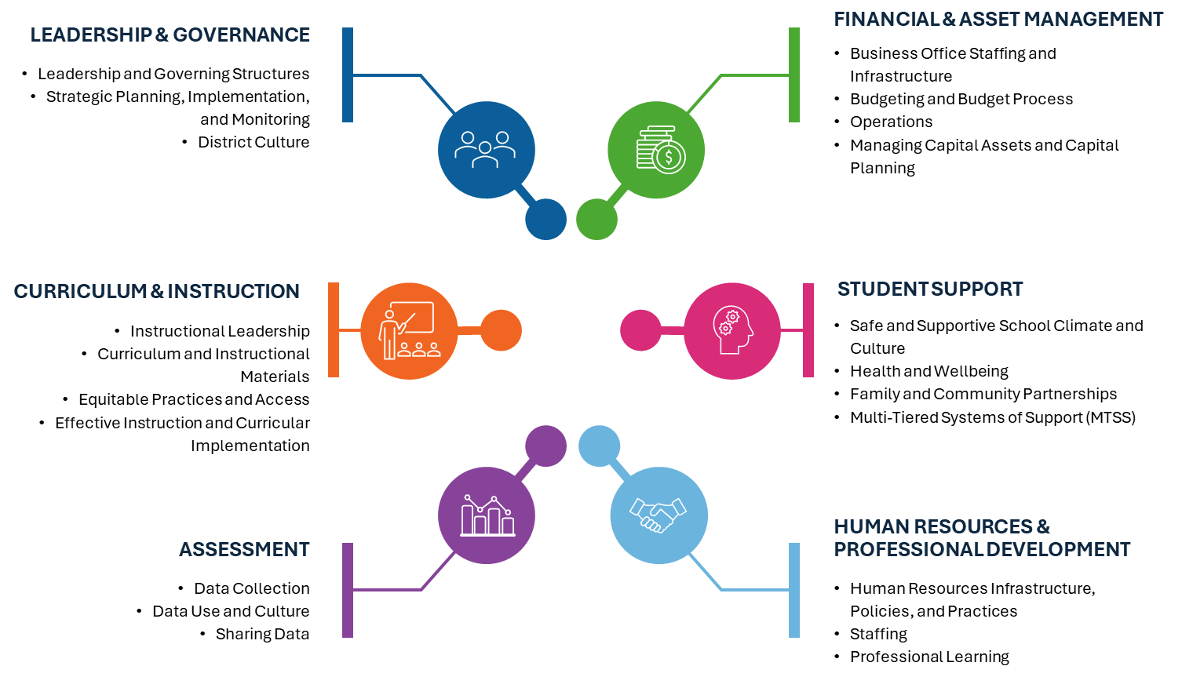
6 Standards, 21 Indicators

Slide 23
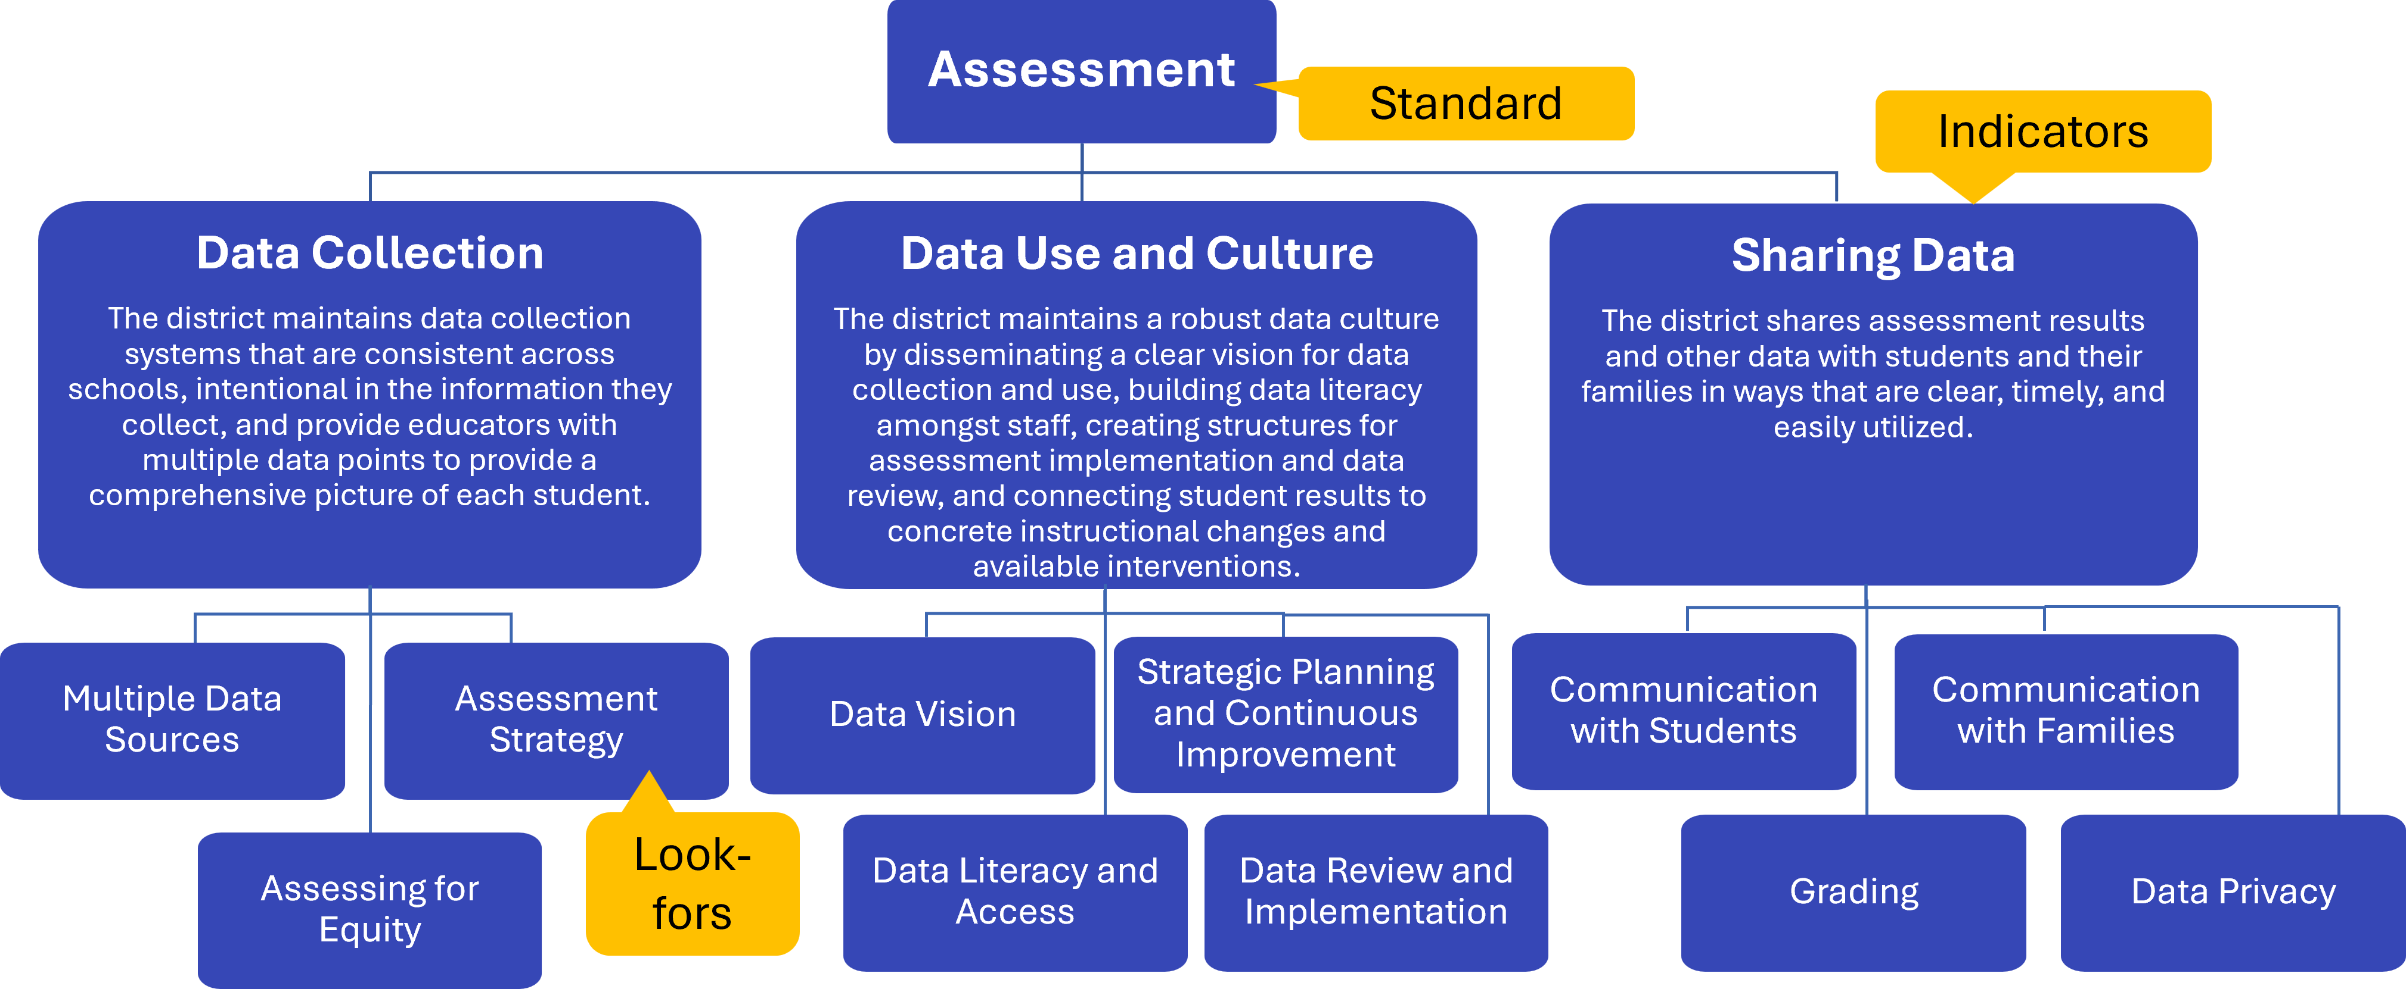
Example: Assessment

Slide 24

Warm-up
Click the link in the chat to open the District Standards and Indicators
Guiding questions
  What do you notice about how the document is structured?
  What stands out to you in the standards and indicators?
  What questions do you have?

Slide 25
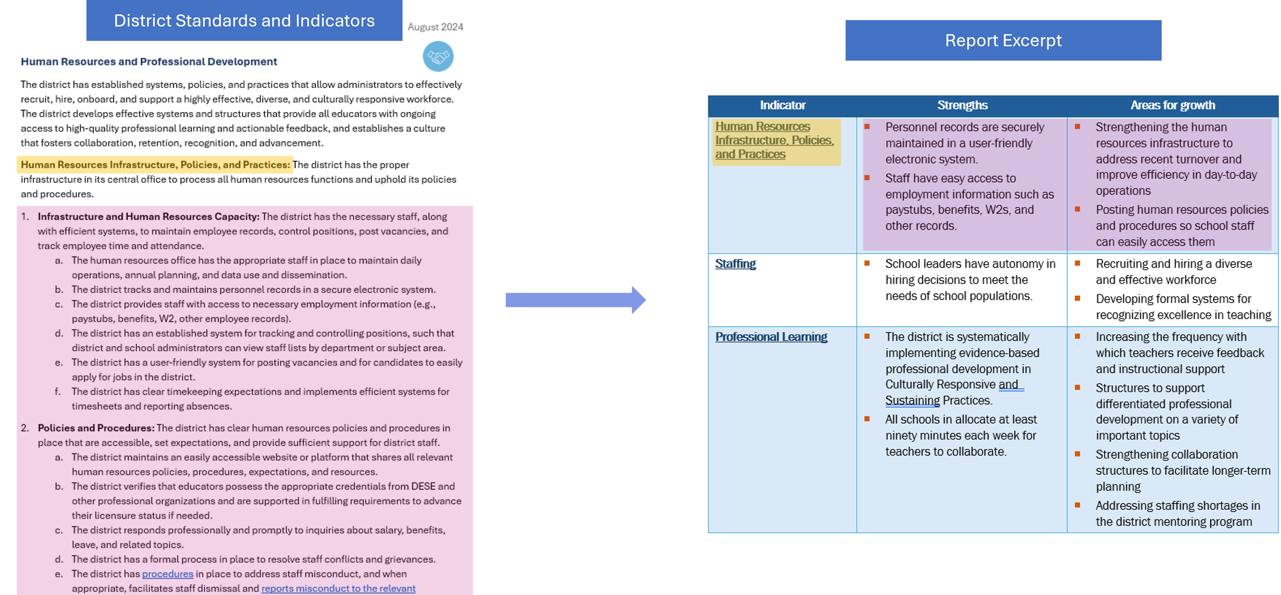
From the District Standards and Indicators to District Review Reports

Slide 26
Indicator Analysis
Let’s dig into a report!

Slide 27
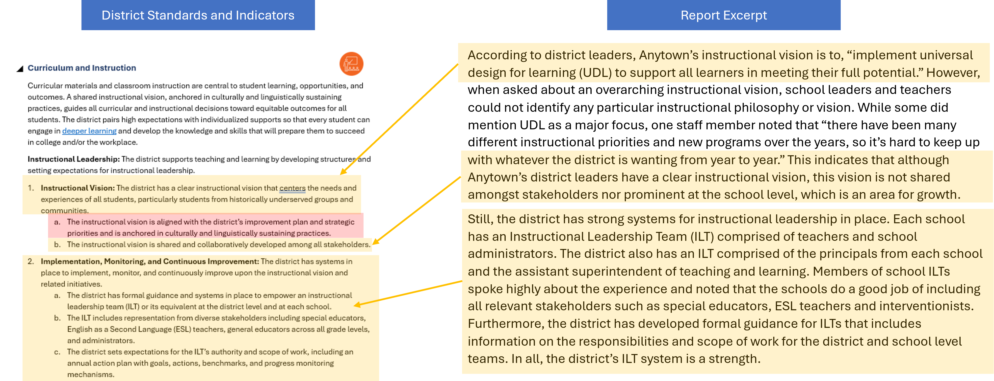
Indicator Analysis Example

Slide 28
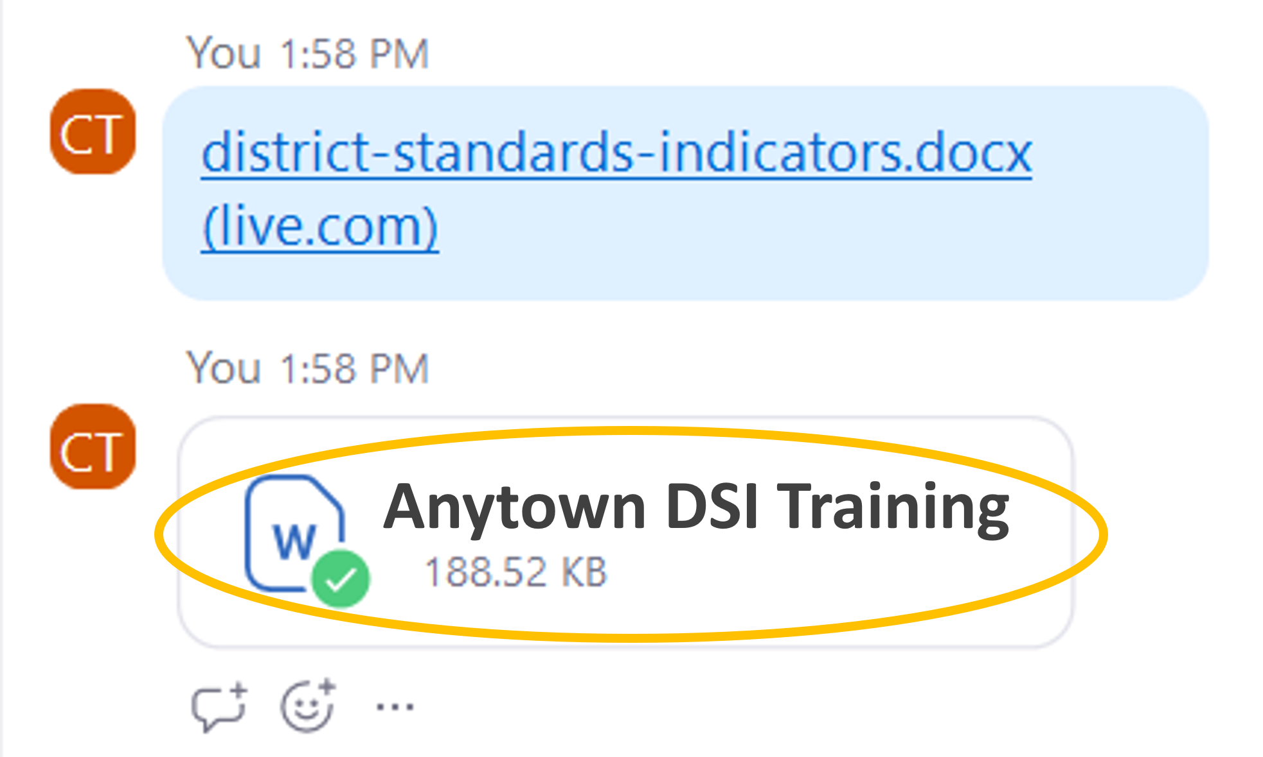
Indicator Analysis: Directions
Download the “Anytown DSI Training Activity” from the chat
Read the Professional Learning indicator within the Human Resources and Professional Development standard and the Anytown document
Compare the two
  Identify 2-3 ways in which the “look fors” for your indicator are represented in the report section you’ve read

Slide 29
Activity Reflection
What are your takeaways from comparing the text in the District Standards and Indicators to the narrative in the report?
In what ways is the indicator reflected in the narrative you read?
Was there anything that surprised you while you were doing this exercise?

Slide 30
Key Points on the DSI
The District Standards and Indicators are the foundation of district review reports. Therefore, they are worth reviewing as a district leadership team.
The District Standards and Indicators highlight the components of effective district systems, policies, and practices. It is NOT a rubric.
Each standard and indicator is reported on, but not all look-fors are highlighted in every report. The reports are customized for each district.

Slide 31
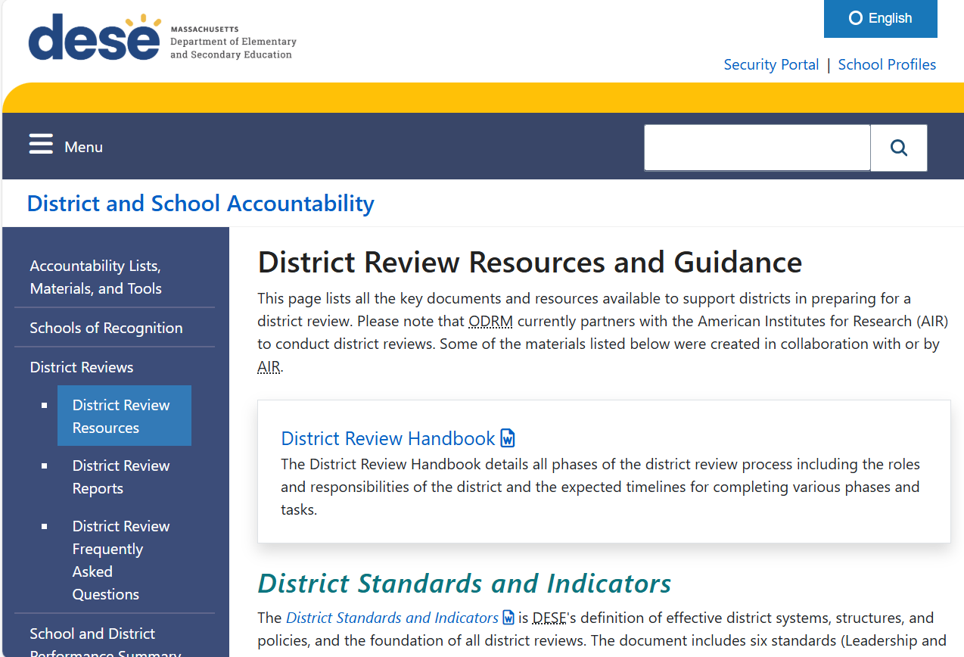
District Review Resources
District Review Resources page includes links to all district-facing documents and tools
Includes the District Review Handbook, District Standards and Indicators, Pre-Review Communications Kit (coming soon), and the document checklist

Slide 32
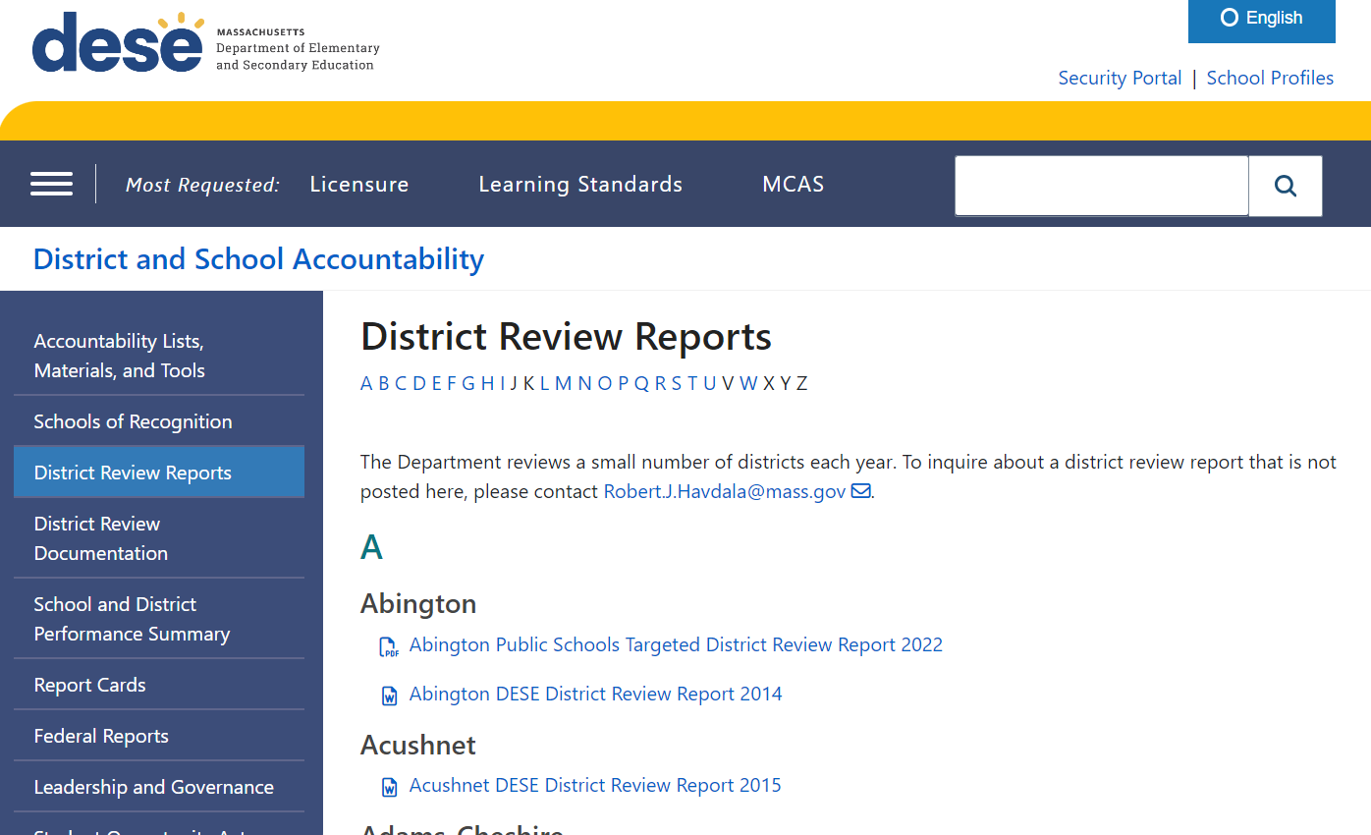
Explore Past Reports
Past reports are available on our website
Reports published before 2025 are based on an old version of the District Standards and Indicators

Slide 33
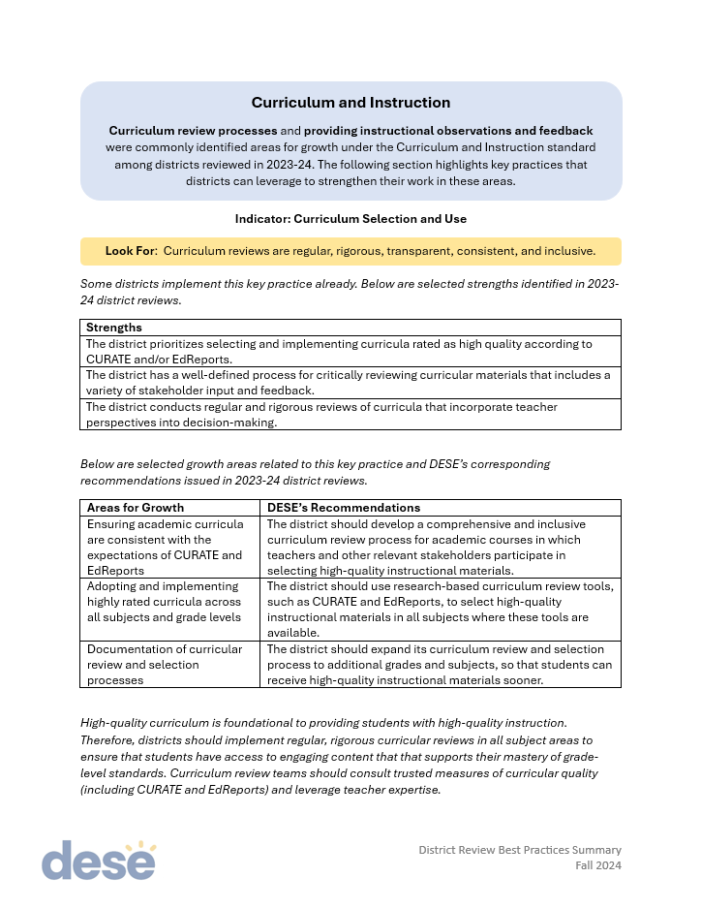
Best Practices Summary
Summarizes key findings from the 2023-24 district review cycle
  A summary for the 2024-25 school year will be posted in the fall
Provides additional insight into the findings published in past reports

Slide 34
Next Steps
Review the District Review Handbook, the documents in yesterday’s email, and a report from this year
Start collecting documents
Attend the (optional) training on the CLASS protocol
  August 14th 10:30-11:30am on zoom
Begin to communicate information about the review to relevant stakeholders

Slide 35
Q & A
Contacts
Robert Havdala
Massachusetts Department of Elementary and Secondary Education, Office of District Reviews and Monitoring
robert.j.havdala@mass.gov
781-338-3641
Notes:
robbie

