Slide 1
Massachusetts’
District and School Accountability System
Summer/Fall 2024

Slide 2
Topics
Overview of 2024 Reporting
Accountability Indicators
Normative Component
Criterion-Referenced Component
Assessment Participation
Categorization of Schools and Districts
Reporting
Resources
Questions

Slide 3
1. Overview of 2024 Reporting

Slide 4
Explaining “Accountability”
An accountability system brings together a set of measures in order to provide clear, actionable information about district & school performance. Massachusetts’ system helps schools improve the performance of all students, & helps communities & the state decide how to assign resources. ​
Accountability results answer two questions:
  How is the school doing?
  What kind of support does the school need?​

Slide 5
Refresher: MA Accountability System 101
2
…that measure performance of groups, schools, and districts on specific indicators…
The Massachusetts accountability system consists of two components…
1
Achievement
English Learner Proficiency
Student Growth
Additional Indicators
Normative Component
(Accountability Percentile)
High School Completion
measures the performance of all students in a school compared to other schools in the state that serve similar grades, and is reported as a percentile from 1 to 99
3
…and are used to categorize schools and districts as requiring assistance/intervention or not.
Criterion-Referenced Component (Targets)
Not requiring assistance or intervention |  |  |  |  | Requiring assistance or intervention
Schools of recognition Recognized for high achievement, high growth, or exceeding targets | Meeting or exceeding targets Cumulative criterion-referenced target percentage 75-100 | Substantial progress toward targets Cumulative criterion-referenced target percentage 50-74 | Moderate progress toward targets Cumulative criterion- referenced target percentage 25-49 | Limited or no progress toward targets Cumulative criterion- referenced target percentage 0-24 | Focused/ targeted support Percentiles 1-10 Low graduation rate Low performing group(s) Low participation | Broad/ comprehensive support Underperforming schools Chronically underperforming schools
measures a district’s or school’s progress towards improvement targets, and is reported as a percentage

Slide 6
Normative vs. Criterion-Referenced
Normative Component
Criterion-Referenced Component
Also Known As
“Percentile”
“Progress towards targets”
A district, school, or group’s performance to individualized targets, which are based on its own historical performance
A school (or group) to similar schools (or groups)
Compares
SY 2021-2022 (weighted at 15%)
SY 2022-2023 (weighted at 25%)
SY 2023-2024 (weighted at 60%)
Progress from SY 2021-2022 to SY 2022-2023 (weighted at 40%)
Progress from SY 2022-2023 to SY 2023-2024 (weighted at 60%)
Years of Data and Weights

Slide 7
Revisions to 2024 Accountability Reporting
Description | 2023 Results | 2024 Results
Years of Data and Weights | Normative: 2022 (weighted at 40%) 2023 (weighted at 60%) Criterion-Referenced: One annual criterion-referenced percentage: Progress from 2022 to 2023 (weighted at 100%) | Normative: 2022 (weighted at 15%) 2023 (weighted at 25%) 2024 (weighted at 60%) Criterion-Referenced: Two annual criterion-referenced percentages: Progress from 2022 to 2023 Progress from 2023 to 2024 One cumulative criterion-referenced percentage (2023 weighted at 40%, 2024 weighted at 60%)
Middle-High Schools / K-12 Schools | A district, school, or student group needs sufficient data in both gradespans to receive a percentile or criterion-referenced percentage. | A district, school, or student group only needs sufficient data in one gradespan to receive a percentile or criterion-referenced percentage.
Grade 10 Lowest Performing Group | No grade 10 lowest performing group (due to COVID-19) | Grade 10 lowest performing group established

Slide 8
2. Accountability Indicators

Slide 9
Indicators in Accountability System
Indicator | Measure
Achievement | English language arts (ELA) average composite scaled score Math average composite scaled score Science average composite scaled score
Student Growth | ELA mean student growth percentile (SGP) Math mean SGP
High School Completion | Four-year cohort graduation rate Extended engagement rate (five-year cohort graduation rate plus the percentage of students still enrolled) Annual dropout rate
English Language Proficiency | Progress made by students towards attaining English language proficiency (percentage of students in grades 1-12 meeting annual targets required in order to attain English proficiency in six years)
Additional Indicator(s) | Chronic absenteeism (percentage of students in grades 1-12 missing 10% or more of their days in membership) Percentage of 11th and 12th graders completing at least one advanced course (Advanced Placement, International Baccalaureate, Project Lead the Way, dual enrollment for credit, Ch. 74-approved voc/tech cooperatives and articulation agreement courses, and/or other rigorous courses)

Slide 10
Weighting of Indicators: Non-High Schools
Indicator | Measures | Weighting (3:1)
 |  | With EL | No EL
Achievement | ELA, math, and science MCAS average composite scaled scores | 60% | 67.5%
Student Growth | ELA and math SGPs | 20% | 22.5%
English Language Proficiency | Percent of ELs making progress towards attaining English language proficiency | 10%
Additional Indicators | Chronic absenteeism rate | 10% | 10%

Slide 11
Weighting of Indicators: High Schools
Indicator | Measures | Weighting (3:1)
 |  | With EL | No EL
Achievement | ELA, math, and science average scaled score | 40% | 47.5%
Student Growth | ELA and math SGPs | 20% | 22.5%
High School Completion | Four-year cohort graduation rate Extended engagement rate Annual dropout rate | 20% | 20%
English Language Proficiency | Percent of ELs making progress towards attaining English language proficiency | 10%
Additional Indicators | Chronic absenteeism rate Advanced coursework completion rate | 10% | 10%
Note: The high school completion indicators are considered part of achievement when measuring the ratio of achievement to growth

Slide 12
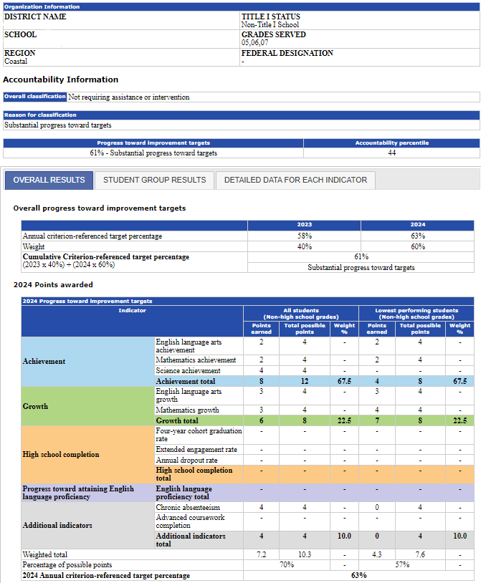
3. Normative Component (Accountability Percentile)

Slide 13
Overview: Normative Component
Accountability percentile 1-99, calculated using all available indicators for a school
Compares schools within one of three groups:
  Non-high schools
  Middle/High/K-12 schools
  High schools
Used to identify the lowest performing schools in the state, as required by state and federal laws
Same calculation used at the student group level to identify low performing student groups
Weighted average of 2022 data (15%), 2023 data (25%), and 2024 data (60%)

Slide 14
School Comparison Groups
Schools are grouped and compared based on the grades served in 2024:
Non-High Schools
Serving only a combination of grades 3-8
Middle/High/K-12 Schools
Serving grade 10 and at least one other grade 3-8
High Schools
Schools in which the only tested grade is grade 10

Slide 15
Comparing Percentiles Across Years and Grades
2024 accountability percentiles should not be compared to school percentiles from 2012-2017
  Different comparison “universe”
  Inclusion of additional indicators
  Fewer years of data used in calculation
Use caution when comparing 2018, 2019, 2022, 2023, and 2024 percentiles
  Percentiles were not calculated in 2020 and 2021
Percentiles should not be compared across gradespans
  Compare a non-high school to another non-high school
  Compare a non-high school to a middle/high or K-12 school

Slide 16
4. Criterion-Referenced Component
(Targets)

Slide 17
Overview: Criterion-Referenced Component
Federal law requires states to establish long-term goals and measures of interim progress
DESE calculates targets for each district, school, and student group
2024 targets for the achievement indicators are determined by the district, school, or group’s “path”
Targets for non-assessment indicators are based on analysis of past trends and reasonable expectations for improvement
Points are assigned based on progress toward each indicator’s target (0-4 scale, where 0 = decline and 4 = exceeded target)
Overall progress towards targets is reported as a percentage
Weighted average of progress from 2022 to 2023 (40%), and progress from 2023 to 2024 (60%)

Slide 18
Lowest Performing Student Group
In addition to school results, DESE will also measure the performance of the lowest performing students in each school
  Every school has a group of lowest performers
  Identified from a group of students who have been enrolled in the school for more than one year
For most schools, eligible students were:
  Officially enrolled in current school* for two consecutive years;
    October 1, 2022 through October 1, 2023 (SIMS)
  Tested in current school in 2023 and 2024 or tested in current school in 2024 and in current district in 2023; and
  Not a first- or second-year English learner in 2024
  Not assessed using MCAS-Alt in both ELA and math
The lowest performing group represents the lowest performing 25 percent of eligible students, identified using a combined 2024 ELA and math average scaled score
In schools where a legitimate cohort cannot be identified (fewer than 20 students), accountability results will be based on the performance of the “all students” group only
*Current district, for schools serving grade 10

Slide 19
Point Assignments
Points assigned based on progress toward target for each indicator for the all students group, the lowest performing student group, and each student group with sufficient data:
Category | Declined | No change | Improved | Met target | Exceeded target
Points | 0 | 1 | 2 | 3 | 4
Target % | 0% | 25% | 50% | 75% | 100%

Slide 20
Sample Criterion-Referenced Component Calculation (Non-High School)
Indicator | All students (50%) |  |  | Lowest performing students (50%)
 | Points earned | Total possible points | Weight (%) | Points earned | Total possible points | Weight (%)
ELA scaled score | 1 | 4 | - | 0 | 4 | -
Math scaled score | 3 | 4 | - | 3 | 4 | -
Science scaled score | 4 | 4 | - | - | - | -
Achievement total | 8 | 12 | 60.0 | 3 | 8 | 67.5
ELA Student Growth Percentile | 2 | 4 | - | 2 | 4 | -
Math Student Growth Percentile | 3 | 4 | - | 2 | 4 | -
Growth total | 5 | 8 | 20.0 | 4 | 8 | 22.5
EL progress | 2 | 4 | 10.0 | - | - | -
Chronic absenteeism | 4 | 4 | 10.0 | 2 | 4 | 10.0
Weighted total | 6.4 | 9.6 | - | 3.1 | 7.6 | -
Percentage of possible points | 67% |  |  | 41%
Annual criterion-referenced target % | 54%

Slide 21
Sample Criterion-Referenced Component Calculation (High School)
Indicator | All students (50%) |  |  | Lowest performing students (50%)
 | Points earned | Total possible points | Weight (%) | Points earned | Total possible points | Weight (%)
ELA Scaled Score | 4 | 4 | - | 4 | 4 | -
Math Scaled Score | 4 | 4 | - | 0 | 4 | -
Science Scaled Score | 3 | 4 | - | 2 | 4 | -
Achievement total | 11 | 12 | 40.0 | 6 | 12 | 67.5
ELA Student Growth Percentile | 2 | 4 | - | 1 | 4 | -
Math Student Growth Percentile | 1 | 4 | - | 0 | 4 | -
Growth total | 3 | 8 | 20.0 | 1 | 8 | 22.5
Four-year cohort graduation rate | 3 | 4 | - | - | - | -
Extended engagement rate | 3 | 4 | - | - | - | -
Annual dropout rate | 3 | 4 | - | - | - | -
High school completion total | 9 | 12 | 20.0 | - | - | -
EL progress | 3 | 4 | 10.0 | - | - | -
Chronic absenteeism | 4 | 4 | - | 2 | 4 | -
Advanced coursework completion | 2 | 4 | - | - | - | -
Additional indicators total | 6 | 8 | 10.0 | 2 | 4 | 10.0
Weighted total | 7.7 | 10.0 | - | - | - | -
Percentage of possible total points | 77% |  | - | 44% |  | -
Annual criterion-referenced target % | 61%

Slide 22
Cumulative Criterion-Referenced Calculation
Step 1: Calculate the annual criterion-referenced target percentage for each year separately (2023 & 2024)
Step 2: Calculate the cumulative criterion-referenced target percentage
  Districts, schools, or groups with two annual criterion-referenced percentages (2023 & 2024) will use a 40/60 weighting in the calculation of the overall criterion-referenced target percentages
  In districts, schools, or groups with no 2023 annual percentage, the cumulative criterion-referenced target percentage will be the 2024 percentage (100%)
 | 2023 | 2024
Annual criterion-referenced target percentage (%) | 68 | 83
Weight (%) | 40 | 60
Cumulative criterion-referenced target percentage (2023 x 40%) + (2024 x 60%) | 77%

Slide 23
5. Assessment Participation

Slide 24
Overview: Assessment Participation
Districts and schools are required to maintain a 95% participation rate for the district/school as a whole and for each student group
Calculation includes:
  ELA, math, and science MCAS
  ACCESS for ELLs (included in ELA rate)
Rate for All Students calculated separately for ELA, math, and science
Rate for each student group represents the percentage of all tests combined
Calculated two ways, with higher rate used in determination:
  Actual 1-year rate for current year, and
  Combined 2-year rate (if actual 1-year rate is <95%)

Slide 25
6. Categorization of Schools and Districts

Slide 26
Overview: Categorization of Schools
Accountability determinations for schools will be based on 5 factors:
  Accountability percentile (1-99)
  Criterion-referenced target percentage (0-100%)
  Student group performance (Student group percentile 1-99)
  Graduation rate (if less than 66.7%)
  Assessment participation (if less than 95%)
Underperforming and chronically underperforming decisions made at the discretion of the Commissioner (designation and exit)
Additional contexts:
  Schools ending in grade 3 will be classified based on criterion-referenced component only
    No student growth, therefore no accountability percentile
  New schools, and schools with no tested grades will be classified as “insufficient data”

Slide 27
Categorization of Schools
Not requiring assistance or intervention |  |  |  |  | Requiring assistance or intervention
Schools of recognition Recognized for high achievement, high growth, and/or exceeding targets | Meeting or exceeding targets Cumulative criterion-referenced target percentage 75-100 | Substantial progress toward targets Cumulative criterion-referenced target percentage 50-74 | Moderate progress toward targets Cumulative criterion- referenced target percentage 25-49 | Limited or no progress toward targets Cumulative criterion- referenced target percentage 0-24 | Focused/ targeted support Percentiles 1-10 Low graduation rate Low performing group(s) Low participation | Broad/ comprehensive support Underperforming schools Chronically underperforming schools

Slide 28
Overview: Categorization of Districts
Districts are classified based on the performance of the district as a whole (i.e., treated like one big school)
District accountability percentiles are not calculated
Classified based on criterion-referenced component
  Adjustments made for low graduation rates and low assessment participation
Board may designate a district as underperforming or chronically underperforming

Slide 29
Categorization of Districts
Not requiring assistance or intervention |  |  |  | Requiring assistance or intervention
Meeting or exceeding targets Cumulative criterion-referenced target percentage 75-100 | Substantial progress toward targets Cumulative criterion-referenced target percentage 50-74 | Moderate progress toward targets Cumulative criterion- referenced target percentage 25-49 | Limited or no progress toward targets Cumulative criterion- referenced target percentage 0-24 | Focused/ targeted support Low graduation rate Low participation | Broad/ comprehensive support Underperforming districts Chronically underperforming districts

Slide 30
7. Reporting

Slide 31
Overview: Accountability Reports
Each fall, DESE publishes accountability reports for each district and school (found through Profiles page on DESE website)
Reports include:
  Overall classification
    Including reason(s) for classification (e.g., low graduation rate, low-performing student group, participation)
    Federal designation (if applicable, schools only)
  Accountability percentile (schools and groups only, not districts)
  Criterion-referenced target percentages
  Data related to performance on each accountability indicator for each student group meeting the minimum group size (20 students)
    All students
    Lowest performing students
    High needs students
    English learners (ELs) and former ELs
    Students with disabilities
    Low income students
    Major racial/ethnic student groups

Slide 32
Accountability Report: Summary Information

Slide 33
Accountability Report: Overall Results

Slide 34
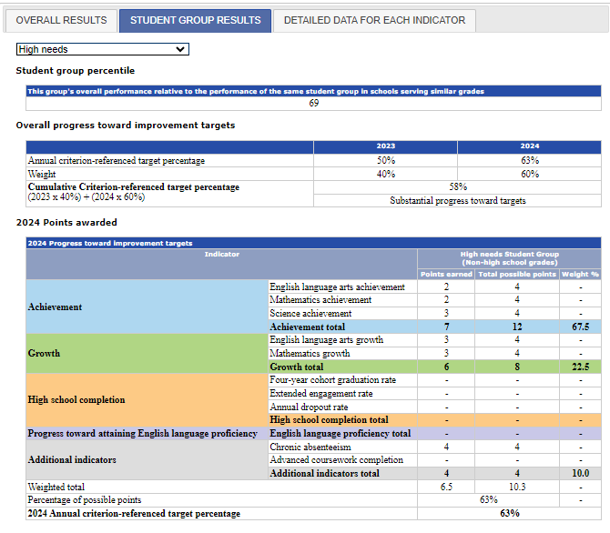
Accountability Report: Student Group Results
It is possible for a school or group to have a “high” normative percentile but a “low” criterion-referenced target percentage (or vice versa).

Slide 35
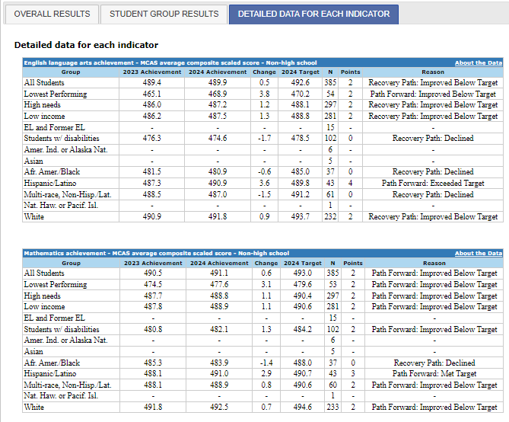
Accountability Report: Detailed Data for Each Indicator

Slide 36
2024 Accountability Reporting Schedule
Date | Deliverable/Event | Location
September 11th | Preliminary embargoed accountability data available to districts and schools | Accountability Data application in the Department’s Security Portal
Mid-September | Official embargoed accountability data available to districts and schools | Accountability Data application in the Department’s Security Portal
Late September | Official accountability data released to the public | Department’s School and District Profiles website
Preliminary and official embargoed accountability reports are in a separate Accountability Data application in the Security Portal (not in dropboxes). Appropriate security roles are assigned by district Directory Administrators:
  Accountability (District Level) – to access district-level reports
  Accountability (School Level) – to access individual school reports
Preliminary and official accountability data are confidential and may not be discussed publicly until DESE releases official results in late September

Slide 37
8. Resources

Slide 38
Accountability Resources
https://www.doe.mass.edu/accountability/lists-tools/default.html
  Accountability system summaries
  Detailed/technical documentation
  Lists/data files
  …and more!
  School and District Performance Summary: Microsoft Power BI (powerbigov.us)
    PowerBI will be updated after the public release
Email us at ElementarySecondaryEd.Act@mass.gov

Slide 39
9. Questions

