Slide 1
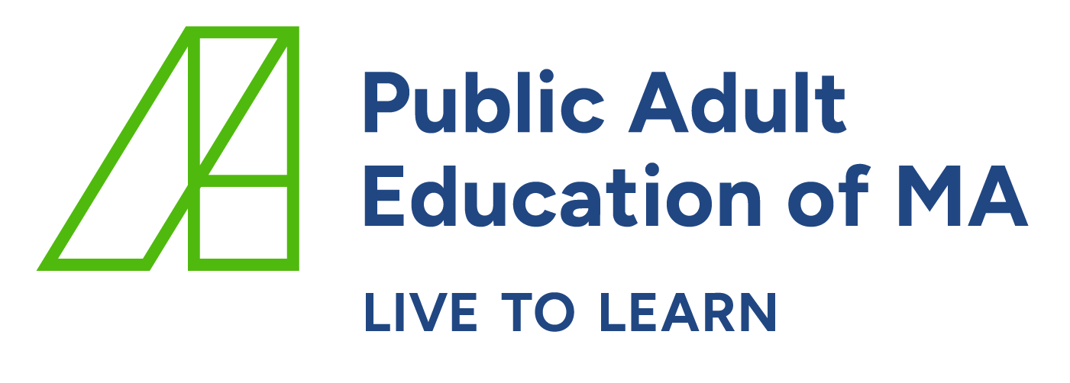

Visit
Introduction
Prepare
Visit
Follow Up
Resources
Classroom Visit Toolkit May 2023
A Holistic Approach to Classroom Observations
Key considerations:
  Class visits, when conducted effectively, help improve teaching and learning.
  Meaningful, collaborative, and collegial conversations with teachers support teacher growth and student outcomes.
  Class observation checklists do not capture the complexity of the classroom experience and may not lead to improvement in instructional practices.
This class visit toolkit is intended to support adult education leadership and teaching staff by providing tools that can enhance teacher practice and increase student outcomes.
Programs can use this toolkit as is or adapt it:
  to develop a class visit process that fits their circumstances or modify the process they are currently using based on guidance from this toolkit.
  to comply with the ACLS staff supervision and evaluation policy.
  to conduct both formal and informal (i.e., walk-throughs) class visits in both in-person and remote instructional settings.
Components of the toolkit: guidance on each stage of a class visit, What to Look for Guides, class visit forms, Three R’s Guidance.
WHAT
ACLS Policy
WHY
ACLS Indicator of Program Quality 9.1
HOW
ACLS Professional Standards
Stages of A Class Visit
Prepare
Follow up
1. Communicate expectations
2. Establish a focus
3. Review relevant documents
4. Keep the focus in mind
5. Record what you see and hear
Share what you saw and heard
Reflect on what you saw and heard
Discuss with the teacher
Provide written feedback
10. Check for growth

Slide 2
Prepare
Introduction
Prepare
Visit
Follow Up
Resources
  Communicate Expectations
    Have a pre-visit meeting with the teacher.
    Ensure the teacher understands the purpose of the visit.
    Tell the teacher if you want to see the lesson plan and materials and when.
    For informal visits (i.e., walkthroughs), plan to observe for at least 10 to 15 minutes.
    For formal visits, plan to observe for at least 30 minutes.
  Establish a Focus
    Use the ABE or ESOL Professional Standards as a guide
      The instructional planning, delivery, and assessment standards are good standards to start with.
    Use data to inform your focus
      Sources of data could include:
        input from the teacher
        a problem of practice identified by the program’s teachers
        the goals in the program’s continuous improvement plan
        the goals in the teacher’s professional development plan
        one or more elements of a specific professional standard
        program analytics (e.g., MSG, student attendance/retention)
        student feedback
  Review Relevant Documents
    Include the teacher in this process whenever possible.
    Along with the teacher, discuss what to look for from the Professional Standards, Content Standards, or What to Look for Guides.
    Examples of relevant documents include:
      the What to Look for Guides
      the ESOL and/or ABE Professional Standards
      the ESOL and/or the ABE Content Standards
      the ELA and/or Math Proficiency Guides
      lesson plans and materials
      student work
Planning Standards
Delivery
Standards
Assessment Standards

Slide 3
Visit
Introduction
Prepare
Visit
Follow Up
Resources
4. Keep the Focus in Mind
  Keeping the focus in mind will help you accomplish the purpose of your visit.
  However, if you observe something outside your focus that requires attention, you may want to jot it down for a future conversation.
5. Record What You See and Hear
  With the focus in mind, record what the teacher and students are
  saying and doing without judgement or conclusions on section 1 of the class visit form.
  In some instances, it might be beneficial to capture what the teacher and students are saying verbatim.
  Weigh the pros and cons of engaging with the students during the visit
  (e.g., Will your conversation with students interrupt the lesson?).
Equity Pause
Are all students being engaged? Who does/doesn’t the teacher call on?
What is the teacher doing and saying to give all students equitable airtime?
How are the students’ voices centered?
  You may want to filter your observation through the lens of the three R’s. Ask yourself:
Where do I see/hear rigor? Where do I see/hear relevance? Where do I see/hear evidence of relationships?
  For more details on the three R’s, see the Three R’s Guidance in the Resources tab of this toolkit.
Are students engaged in higher order thinking and do they struggle productively?
Are students engaged with appropriately challenging activities (at their level but just beyond their comfort zone)?
Is instruction contextualized to adult learners’ lives?
Does instruction connect with students’ cultural identities, community contexts, interests, and academic goals?
Are students known and honored as individuals?
Is the classroom culture welcoming and affirming of all backgrounds and perspectives?
Are students working together and negotiating meaning?

Slide 4
Remote Visits
Introduction
Prepare
Visit
Follow Up
Resources
Key Considerations
Prioritize learning over tools
  Effective teachers select digital tools to support the objectives of the lesson and enhance student learning.
  Students learn academic content and digital literacy skills concurrently.
Filter your class visit through the lens of student-centered digital literacy.
From Teacher-Centered
To Student-Centered
Digital tools are mainly used by the teacher. Students spend most of the time in the main room and little to no time in breakout rooms. Most instructional time is spent on learning technology instead of using technology to learn. | Students use multiple digital tools to support their language development and/or knowledge in the main content areas (i.e., math, social studies, ELA). Students use technology to collaborate on authentic tasks. There is balance between teacher and student use of the digital tools. Students use the digital tools to engage in higher-order thinking.

Slide 5
Follow Up
Introduction
Prepare
Visit
Follow Up
Resources
Why Share the Notes?
Sharing notes with the teacher puts the teacher and the visitor on an equal platform.
Sharing notes with the teacher helps recreate the lesson and spur collegial conversations.
When observer and teacher analyze the notes together, it provides an opportunity for targeted conversations that support professional learning.
6. Share What You Saw and Heard
  Review the completed section 1 for accuracy and clarity before sharing it with
  the teacher.
  Share the completed section 1 of the class visit form h the teacher
7. Reflect on What You Saw and Heard
  Analyze the notes you recorded in section 1
  Before your conversation with the teacher:
    Review your notes: What do they tell you?
    Plan the conversation you will have with the teacher:
      What will you talk about?
      What do you want the teacher to think about?
      What support can you provide?
Discuss with the Teacher
  Have a follow-up meeting with the teacher and make this conversation a collegial learning experience with opportunities for reflection and growth.
  Use section 3 to drive your conversation:
    Acknowledge what the teacher tells you.
    Ask probing questions.
    Ask what strengths and areas in need of improvement they observe.
    Be ready to provide scaffolded support.
    Decide on actionable, meaningful and time-bound next steps together.
Equity Pause
What role did your identity play into what you observed? What did you pay attention to?
What biases/blind spots might you need to be aware of?
Avoid starter questions such as: How do you think the lesson went?
Instead start with:
  What do you observe in the notes I shared with you?
  What do they tell you?
  What implication(s) does this have for your practice?

Slide 6
Follow Up
Introduction
Prepare
Visit
Follow Up
Resources
Provide Written Feedback
Use the class visit form to complete the observation.
1. Include section 1 notes.
2. If post-visit meeting occurs, include section 2 notes as well.
3. Identify 1-2 effective instructional strategies.
4. Identify 1-2 areas in need of improvement.
5. Recommend 1-2 instructional strategies for the teacher to try.
6. Identify 1-2 resources.
7. If post-visit meeting doesn’t occur, identify 1-2 open-ended questions to prompt teacher reflection and extend their thinking.
8. Provide teacher with the opportunity to reflect on the process.
10. Check for Growth
  This could include:
    Working with the teacher on a professional development plan.
    Having short one-on-one check-in meetings.
    Doing a follow-up class visit.
    Working with a colleague.
    Working with a SABES instructional coach.

Slide 7
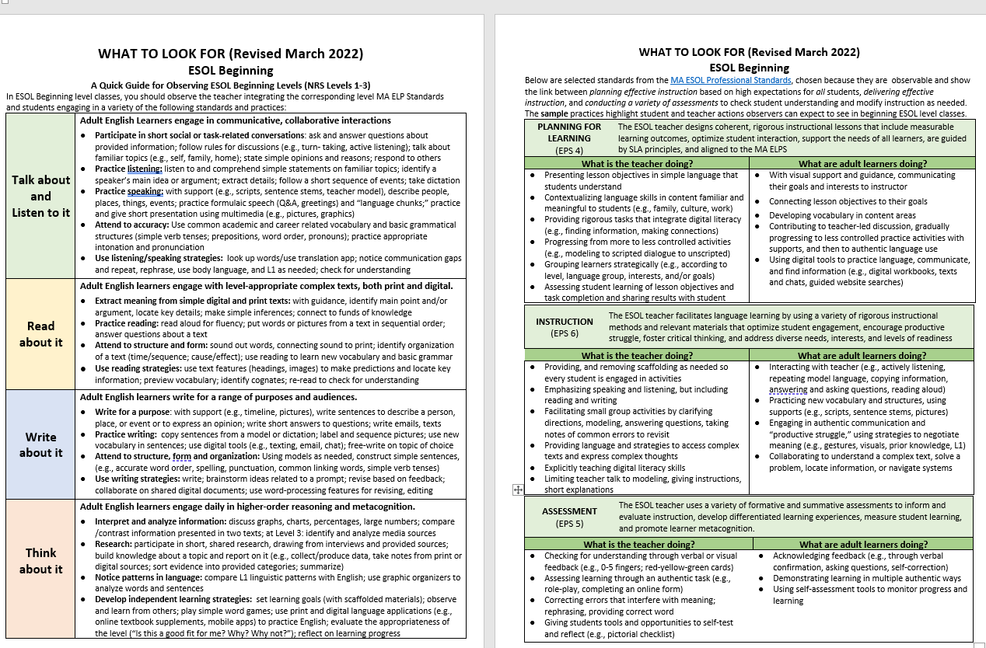
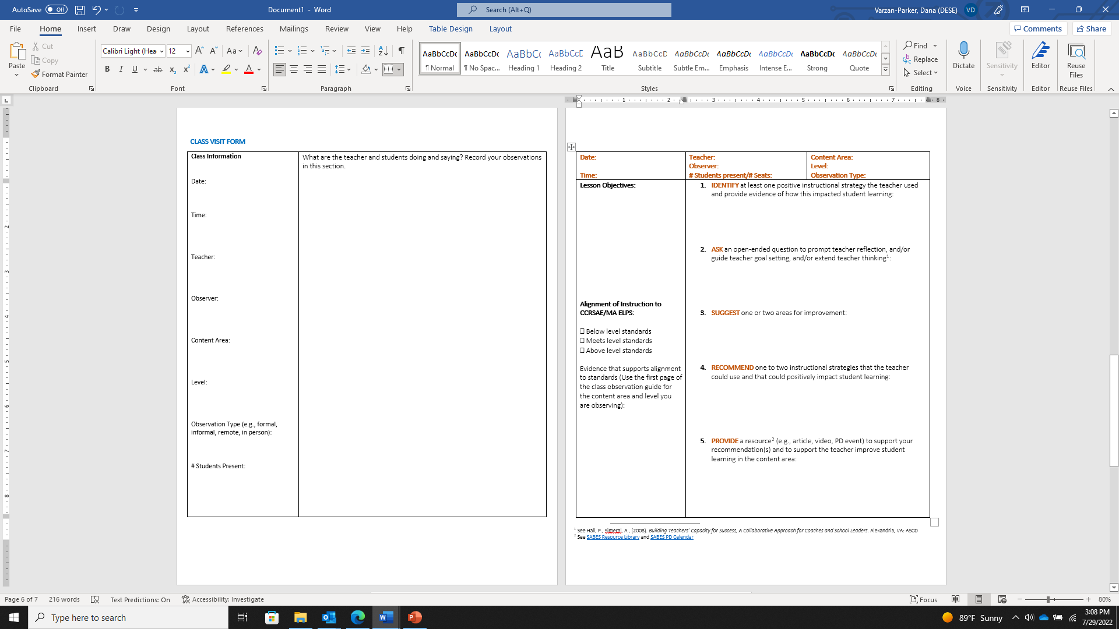
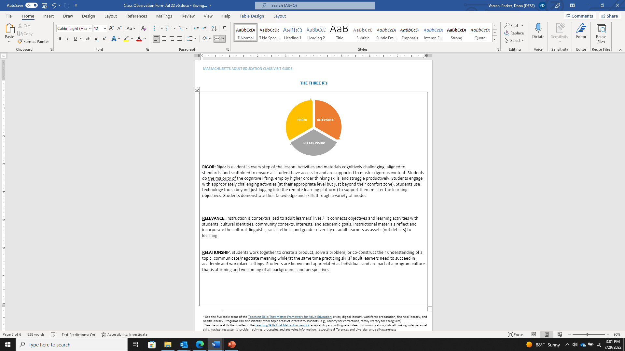
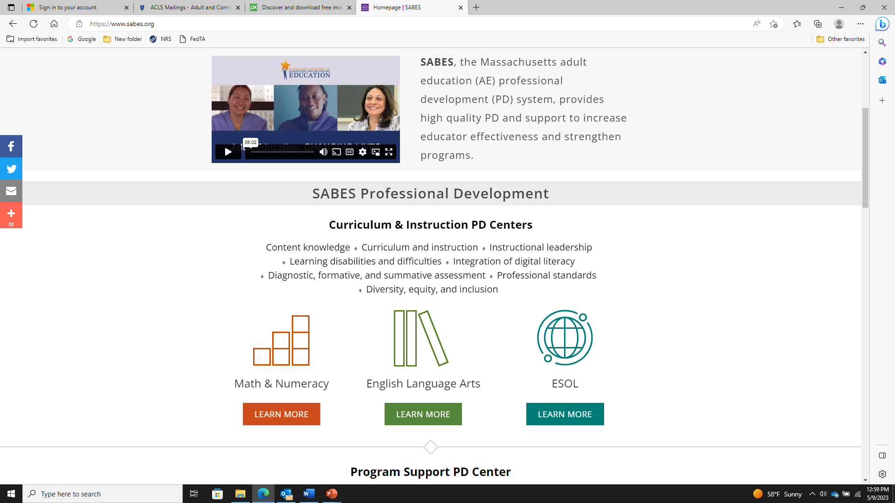
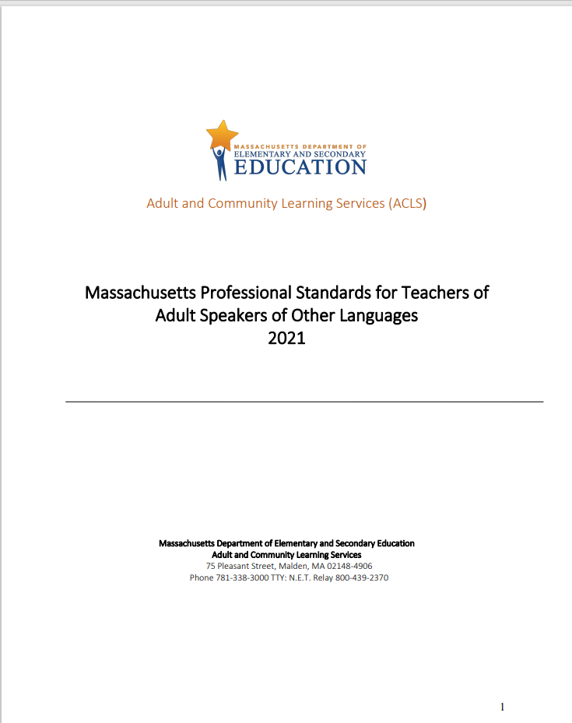
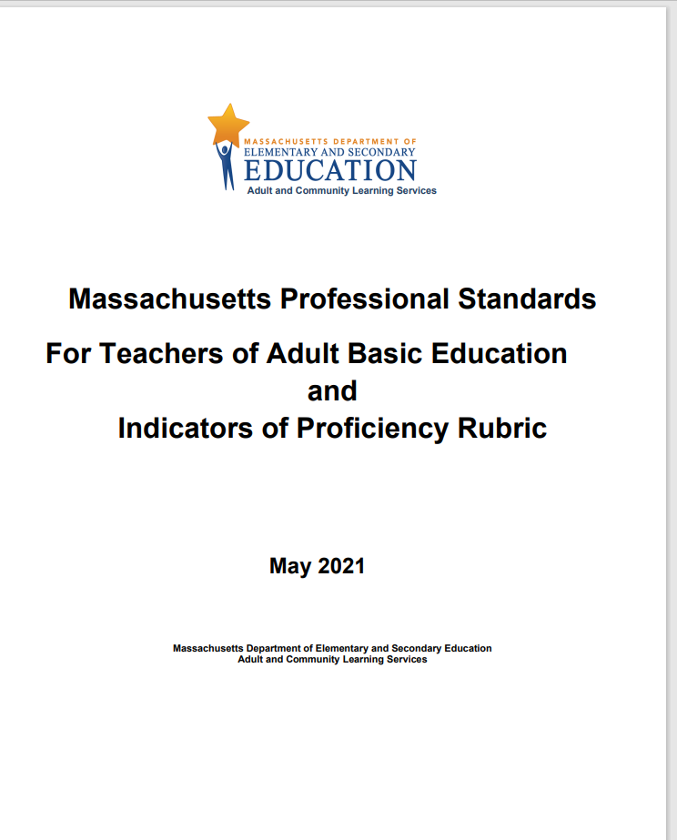
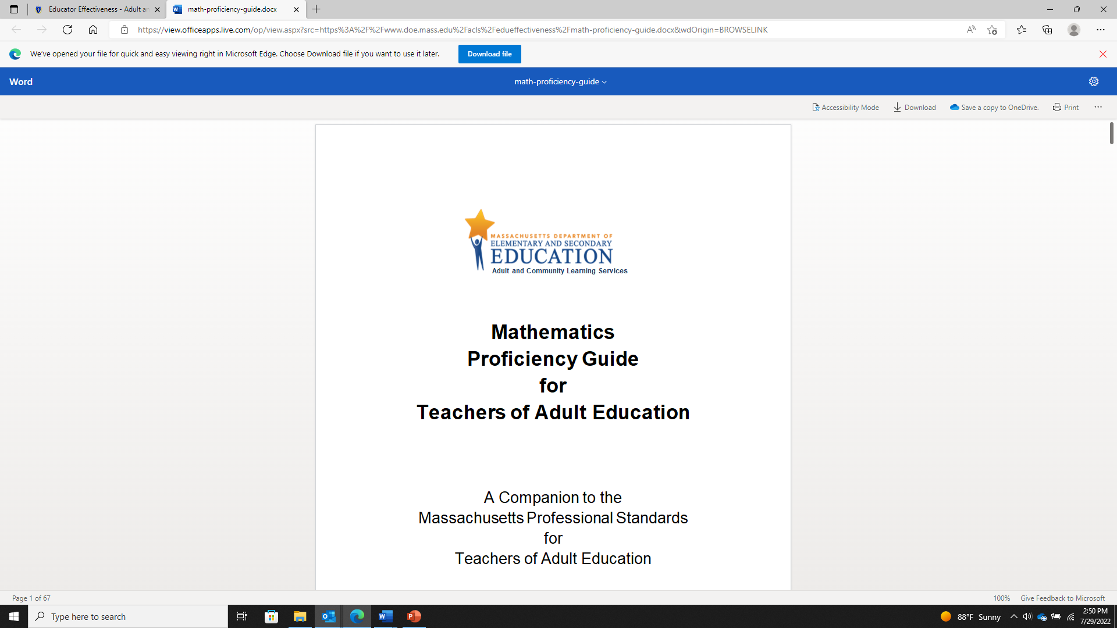

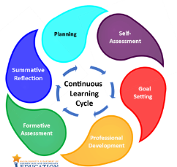
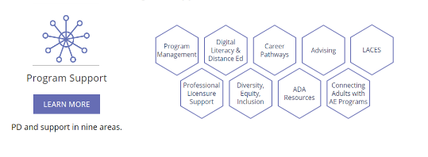
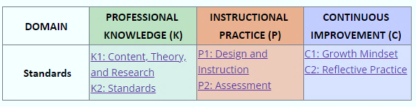
Resources
Introduction
Prepare
Visit
Follow Up
Resources
What to Look For Guides for Math, ELA, and ESOL
Class Visit Forms
Three R’s Guidance
Instructional coaching SABES ESOL, ELA and Math Curriculum and Instruction Professional Learning Centers
ESOL Professional Standards
ABE Professional Standards
Math and ELA Proficiency Guides
EGE-related professional learning and resources
SABES Program Support Center
Standards-aligned professional learning
SABES ESOL, ELA and Math
Curriculum and Instruction PD Centers
Adult Education Educator Growth and Effectiveness (EGE) Model

Slide 8
References
Introduction
Prepare
Visit
Follow Up
Resources
Achieve the Core. Instructional Practice Guides. Available: Achieve the Core
Bader, Justin (2018) Now We’re Talking! 21 Days to High-Performance Instructional Leadership, Bloomington, IN: Solution Tree Press
East Carolina University, College of Education. (2021). Project I4-Observation Tools. Available: Project I4 – Overview | College of Education | ECU
Hall, Pete; Simeral, Alissa (2008) Building Teachers’ Capacity for Success, A Collaborative Approach for Coaches and School Leaders. Alexandria, VA: ASCD
LINCS. (2015). Adult Education Teacher Induction Toolkit. Available: Adult Education Teacher Induction Toolkit | Adult Education and Literacy | U.S. Department of Education
Marshall, Kim (2013), Rethinking Teacher Supervision and Evaluation: How to Work Smart, Build Collaboration, and Close the Achievement Gap. San Francisco: Jossey-Bass
New Jersey Department of Education. Providing High-Quality Observation Feedback. Available: Providing High Quality Observation Feedback (state.nj.us)
The Council of Chief State School Officers.(April 2019). Promoting Success for Teachers of English Learners through Structured Observations. Available: Promoting Success for Teachers of English Learners Through Structured Observations | American Institutes for Research (air.org)
The Danielson Group. The Framework for Teaching. Available: The Framework For Teaching - Danielson Group
The Leadership Academy. (2022). Culturally Responsive In-Person Observation Guide. Available: Ed leadership training for equity | The Leadership Academy
The Leadership Academy. (2022). Culturally Responsive Remote Observation Guide. Available: Ed leadership training for equity | The Leadership Academy
The Marshall Memo. Teacher Supervision, Coaching and Evaluation. Available: The Marshall Memo - Kim's writing
The Massachusetts Department of Elementary and Secondary Education. The Massachusetts Educator Evaluation Framework. Available: Educator Evaluation - Educator Effectiveness (mass.edu)
Transcend Education. (October, 2018). Instructional Look Fors, Resources to Enable Personalized Learning. Available: Transcend (transcendeducation.org)
Treadway, Lynda; Militello, Matt; Simon, Ken (2021). Making Classroom Observations Matter [online article]. Available: Making Classroom Observations Matter - ASCD
World Education. (June, 2021). Remote Instruction Observation Tool. Available: Remote Instruction Observation Tool - EdTech Center @ World Education

