Slide 1




FY27 Bidder’s Conference for Primary Instruction by Volunteers
May 4, 2026
Notes:
Introductions: Marie, Kathy, Yvonne

Slide 2

Agenda
01
Grant priorities and fund use
02
Grant funding and dates
03
Application in GEM$
04
Grant section: Required documents
05
Grant section: Required program information
06
GEM$ submission instructions; questions
[#] | [INSERT PRESENTATION TITLE]

Slide 3
Grant priorities
One statewide standalone program
Offers volunteer tutoring services
Serves approximately 600-800 eligible adults annually in MA cities and towns (including Gateway cities)

Slide 4
Fund use
Provide adult education instructional services
Includes basic skills, pre-adult secondary education, adult secondary education, and/or English for Speakers of Other Languages (ESOL)
Delivered by well-trained volunteers
See FY27-30 Massachusetts Policies for Effective Adult Education in Primary Instruction by Volunteers Programs for guidance.

Slide 5
Grant funding and dates
Grant funding:
Approximately $550,000 is available.
Funds are contingent upon satisfactory performance, the appropriation of state and federal funds, and the continuance of federal authorizing legislation.
Dates:
Last day to submit questions to the online portal: Friday, May 15, 2026 at 7PM.
Applications are due Thursday, May 28, 2026 by 3pm. Late applications will not be reviewed.
Project duration: 7/1/2026 -- 6/30/2027; conditionally renewable in FY 2028-2030.
[#] | [INSERT PRESENTATION TITLE]

Slide 6
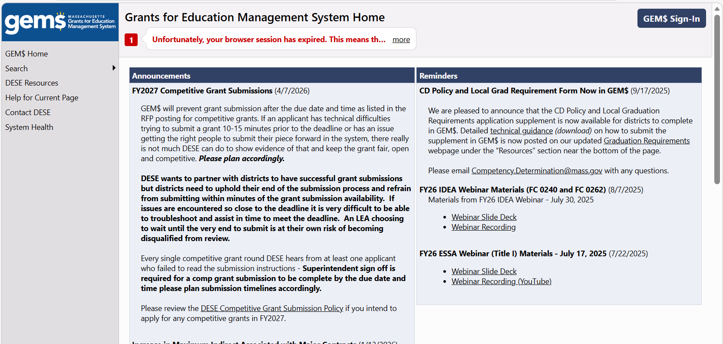
GEM$ homepage
[#] | [INSERT PRESENTATION TITLE]

Slide 7
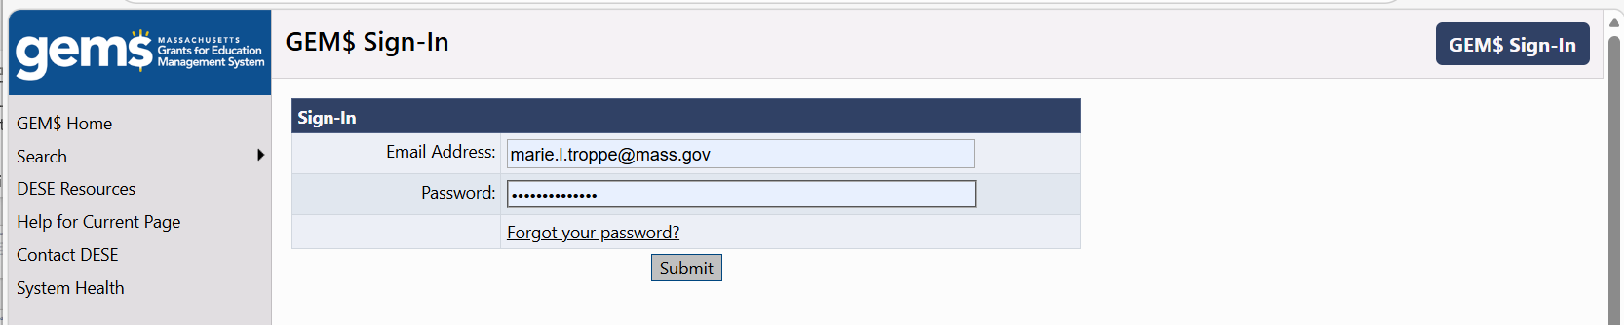
GEM$ login page

Slide 8
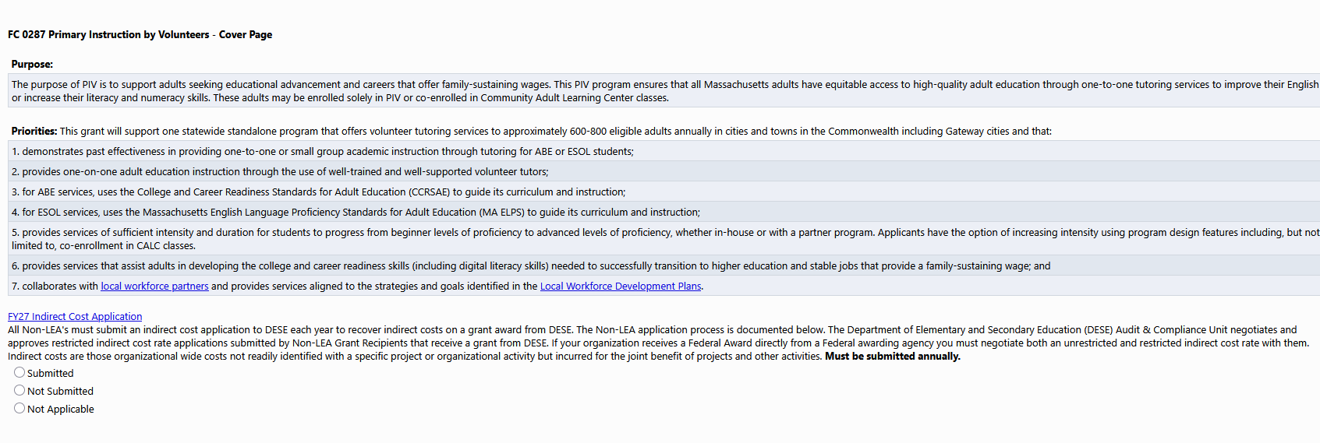
FY27 Indirect Cost Rate Application
[#] | [INSERT PRESENTATION TITLE]

Slide 9
Grant section: Required documents
GEM$:
Budget (in GEM$)
Required Program Information (in GEM$)
Planned Volunteer Tutors and Tutor-Student Matches (in GEM$)
Applicant-created (need to upload under Related documents):
Service Map
MOA Template
Board Roster and Organizational Chart
Job Descriptions and Minimum Qualifications
[#] | [INSERT PRESENTATION TITLE]

Slide 10
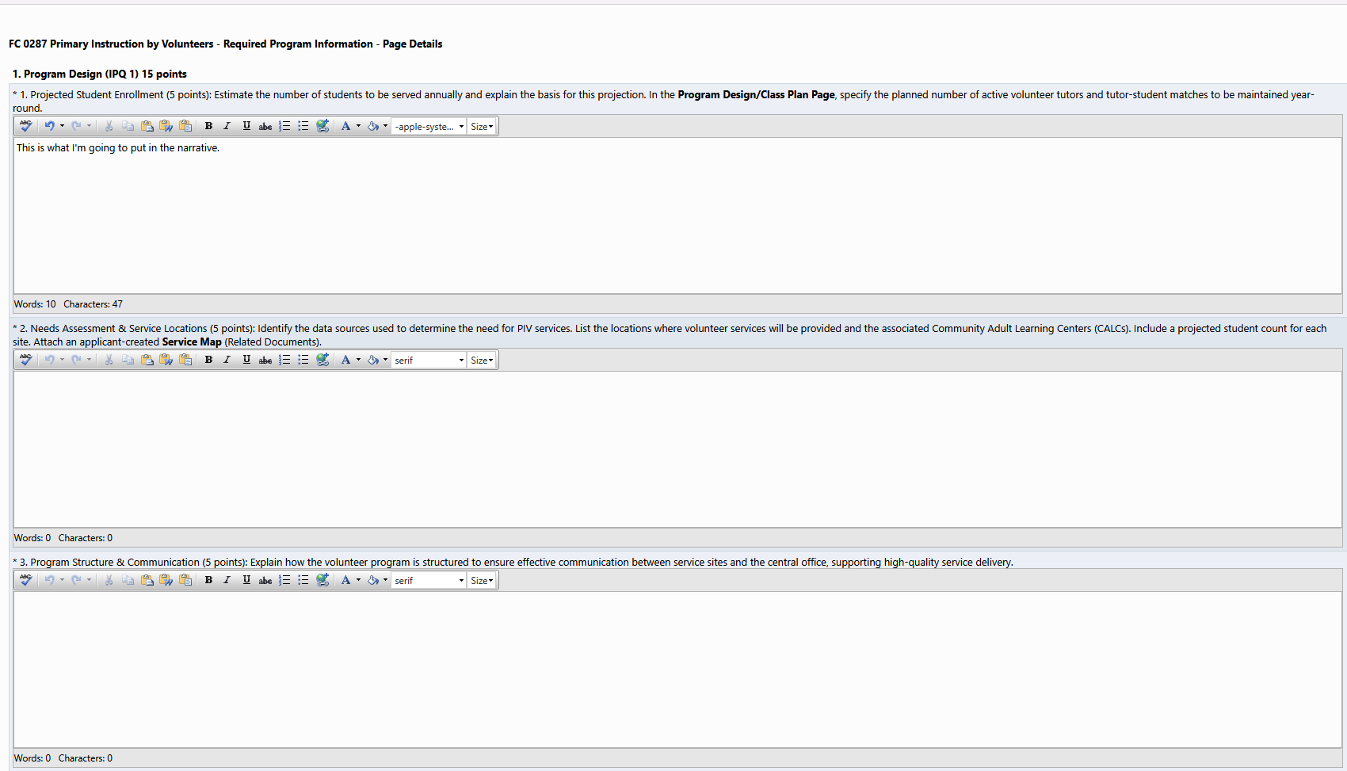
Grant section: Required program information
Character limit: 3,000 characters for each response
Font size: Arial 12
[#] | [INSERT PRESENTATION TITLE]

Slide 11
GEM$ submission instructions
New applicants that do not have an established LEA with DESE skip to Step 3.
Step 1: Establish and assign proper roles before the grant due date/time (Thursday, May 28, 2026 by 3pm). ​
Grant Submission at the LEA level requires roles to be established for Grant Writer for the specific fund code, LEA Fiscal Representative for financial review/approval, & LEA Superintendent/Chief Executive sign off.​
Step 2: Submit the grant through all LEA steps in GEM$.​
Competitive grant applications are considered submitted once the grant application is submitted by the Superintendent or their designee through the “LEA Superintendent / Chief Executive Approved” step in GEM$.​
Step 3: (If applicable) New applicants (organizations that have not been DESE-funded before) must request temporary organization access at GEM$ Temp Organization Access Request at a minimum 5 business days prior to the grant due date. Request access for program unit Adult and Community Learning Services (ACLS). Send the form to the RFP contact on the grant, Marie Troppe at Marie.L.Troppe@mass.gov.
[#] | [INSERT PRESENTATION TITLE]

Slide 12
Any clarifying questions?
[#] | [INSERT PRESENTATION TITLE]

Slide 13
Thank you!

