Slide 1
Accountability & Assistance Advisory Council Meeting
Virtual Meeting
March 8, 2023

Slide 2
Agenda
Welcome, Introductions, and Review of Norms
Assistance Updates
Accountability Updates
Next Steps and Closing

Slide 3
Welcome, Introductions, and Review of Norms

Slide 4
Virtual Meeting Housekeeping
Council members should rename themselves on Zoom by adding a 1 in front of their name
Council members should use video if possible
Mute your phone/audio when not speaking
Monitor airtime
Remember that virtual council meetings are public meetings – members of the public may observe all or part of the discussion

Slide 5
Welcome and Introductions
Introductions:
Council Co-Chairs: Heidi Driscoll & Tim Piwowar
New Council member:
Noah Berger – Massachusetts Teachers Association
Returning Council members
DESE staff

Slide 6
Discussion Norms and Meeting Protocols
Promote risk-taking by not assigning specific comments to individual members in meeting summaries & minutes.
Maintain respect before, during, & after meetings.
Seek clarification & check understanding to avoid mistakenly attributing ideas to an individual or organization represented on the council.
Keep improvements in student learning at the core of the discussions. Students should drive the conversation.
Stay engaged in the issues.
Actively address implicit biases & instill cultural proficiency in discussions.
Encourage discussion from all voices of members. Be additive, not repetitive.
Let members know if pre-reading or other pre-meeting assignments require more than 30 minutes of preparation time.
Make it fun!

Slide 7
Assistance Updates

Slide 8
Assistance Updates
Prioritization Institute
SY24 District Submission
Alignment with...
Student Opportunity Act (SOA) plans
School and district accountability targets
DESE’s Educational Vision for supporting Culturally and Linguistically Sustaining Practices
March 21, 22; May 10, 11
Support districts to identify an instructional priority to close equity and opportunity gaps

Slide 9
Accountability Updates

Slide 10
Topics for Discussion
Staffing update
Lowest Performing Group
Accountability Targets

Slide 11
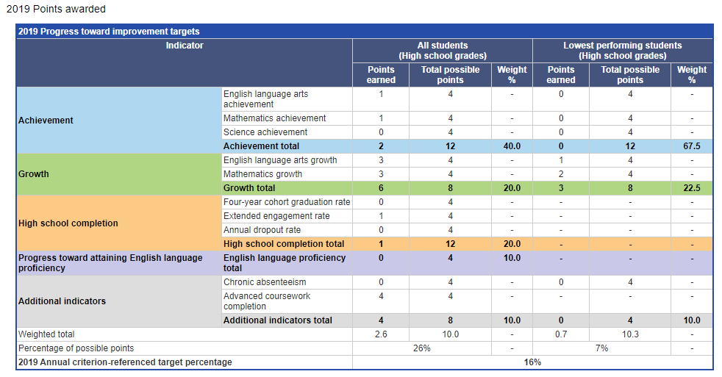
Lowest Performing Group
Focus on closing the achievement gap by raising the "achievement floor"
The lowest performing students group accounts for half of the school's overall calculation of performance against targets
Points are assigned for achievement, growth, and chronic absenteeism indicators

Slide 12
Lowest Performing Group
Identified from cohort of students who were enrolled in the school for more than one year
Not first or second year English learners, or students who take the Alt assessment
Average of ELA and Math results in 2022
Not calculated for Grade 10 for 2023 reporting

Slide 13
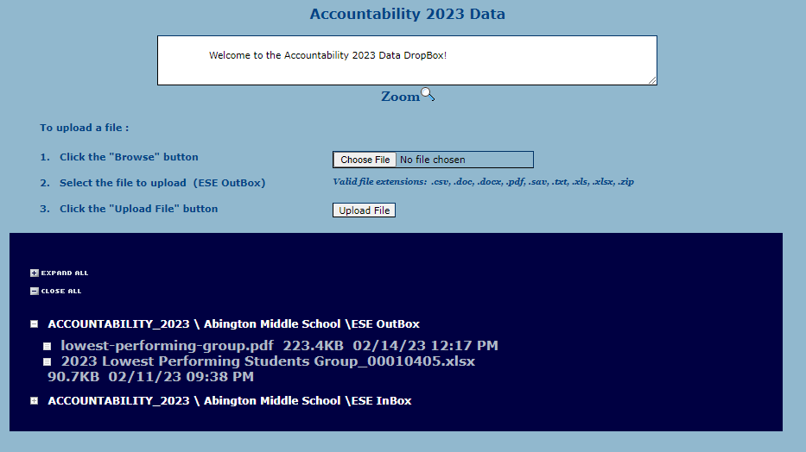
Lowest Performing Group
Available in security portal, in the Accountability 2023 folder

Slide 14
Target Setting
Targets are set for the following indicators:
New methodology – Recovery path and path forward | Traditional methodology – Looking at past improvers
Achievement ELA Math Science | High School Completion 4-year graduation rate Extended engagement rate Dropout rate Progress toward attaining English language proficiency Additional Indicators Chronic Absenteeism (10%) Advanced Coursework Completion

Slide 15
Target Setting - Achievement
To set achievement targets, each subject/group in a school/district is assigned one of two paths – Recovery Path or Path Forward
Recovery Path:
2022 Achievement < 2019 Achievement
Path Forward:
2022 Achievement > 2019 Achievement, or
Recovery Path increment is less rigorous than 2019 increment

Slide 16
Target Setting - Achievement
Number of Schools by Achievement Path – All Students Group
 | ELA |  | Math |  | Science
 | NonHS | HS | NonHS | HS | NonHS | HS
Recovery Path | 1,226 | 242 | 1,070 | 196 | 424 | 306
Path Forward | 105 | 95 | 261 | 141 | 670 | 29
Notes:
Majority of schools all students group is on the recovery path (with exception of NonHS Science)

Slide 17
Recovery Path
Each district/school/student group will have a “full recovery target” reflecting their 2019 scaled scores
The amount of the decline between 2019 and 2022 will determine the group's "time to recovery" quartile
Groups in the bottom quartiles (largest declines) will have a longer timeline to reach recovery than those with smaller declines in assessment scores
Annual targets will be calculated by dividing the difference between full recovery and 2022 scores by the number of years to reach full recovery as determined by the quartile in which each group falls

Slide 18
Recovery Path – ELA Non-High School Example
25th percentile = -10.0 SSP
Median = -7.3 SSP
75th percentile = -4.5 SSP
Time to recovery =
4 years
Time to recovery =
3 years
Time to recovery =
2 years
Time to recovery =
1 year
Districts, schools, and student groups with the largest declines in MCAS scores will have the longest time for recovery but will still need demonstrate steady growth towards targets.

Slide 19
Recovery Path – ELA Non-High School Example
Annual expected improvement is comparable, even though the schools have different "time to recovery" quartiles.
School | 2019 Achievement | 2022 Achievement | Change | Full Recovery Target | Quartile | Years to Recovery | 2023 Achievement Target
School X | 492 | 483 | - 9 | 492 | 4 | 3 | 486
School Y | 487 | 485 | - 2 | 487 | 1 | 1 | 487

Slide 20
Path Forward
Each district/school/student group is assigned an improvement increment based on their 2022 school percentile
Improvement increments used are those from 2019
The median of improvers
Improvement increments are capped at 5.1 scaled score points (the most rigorous increment used in 2019)
Targets are calculated by adding the improvement increment to the group’s 2022 baseline

Slide 21
Next Steps and Closing

Slide 22
Upcoming Council Meetings
Meeting schedule
May 17, 2023 (TBD)
Building meeting agendas
DESE staff will follow-up with a survey tool through which Council members can propose potential meetings topics for upcoming meetings

