Slide 1
Accountability and Assistance Advisory Council Meeting
Virtual Meeting
May 17, 2023

Slide 2
Agenda
Welcome, Introductions, and Review of Norms
Assistance Updates
Accountability Updates
Next Steps and Closing

Slide 3
Welcome, Introductions, and Review of Norms

Slide 4
Virtual Meeting Housekeeping
Council members should rename themselves on Zoom by adding a 1 in front of their name
Council members should use video if possible
Mute your phone/audio when not speaking
Monitor airtime
Remember that virtual council meetings are public meetings – members of the public may observe all or part of the discussion

Slide 5
Welcome and Introductions
Introductions:
Council Co-Chairs: Heidi Driscoll & Tim Piwowar
Returning Council members
DESE staff

Slide 6
Thank you for your service!
Craig Martin
Mike Barth

Slide 7
Discussion Norms and Meeting Protocols
Promote risk-taking by not assigning specific comments to individual members in meeting summaries & minutes.
Maintain respect before, during, & after meetings.
Seek clarification & check understanding to avoid mistakenly attributing ideas to an individual or organization represented on the council.
Keep improvements in student learning at the core of the discussions. Students should drive the conversation.
Stay engaged in the issues.
Actively address implicit biases & instill cultural proficiency in discussions.
Encourage discussion from all voices of members. Be additive, not repetitive.
Let members know if pre-reading or other pre-meeting assignments require more than 30 minutes of preparation time.
Make it fun!

Slide 8
Assistance Updates

Slide 9
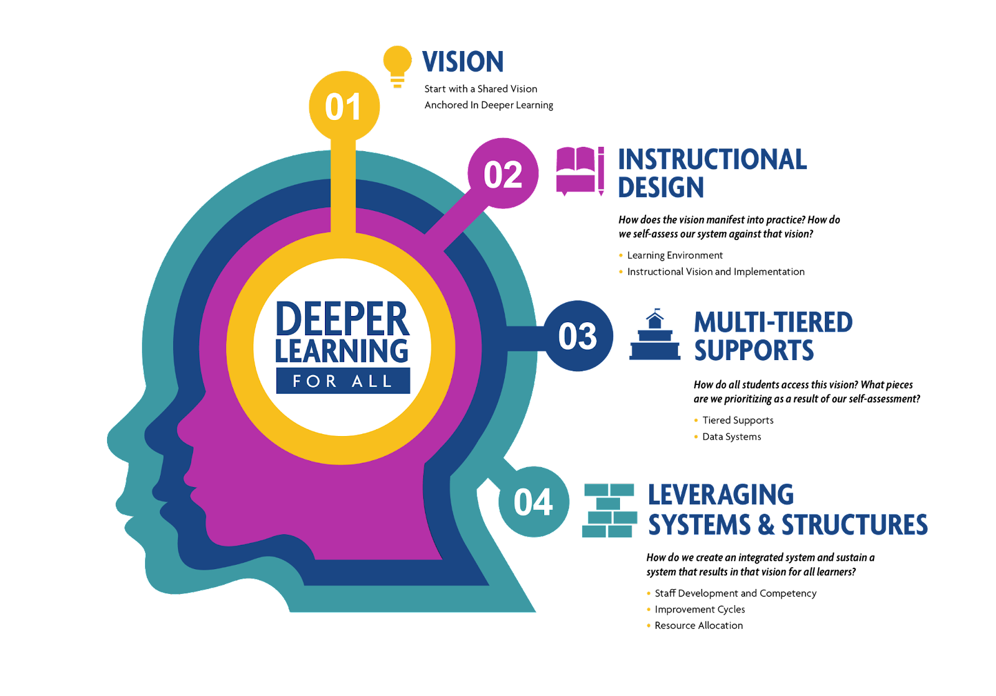
Creating Coherence in our Guidance for School Improvement

Slide 10
CSDP Progress Monitoring System Vision
Align support for schools and districts to the Coherence Guidebook and DESE's Educational Vision, with a particular emphasis on deeper learning, culturally and linguistically sustaining practices, and centering equity and racial equity
Design tools that can be used across offices in our work with schools and districts
Build a sustainable progress monitoring system that allows the Center to understand and communicate the impact of its work
The Center for School & District Partnership Progress Monitoring System aims to:
Notes:
It is important to note here that our previous system of "MSVs and TSVs" centered on what low performing schools needed to do to improve, but our new system intends to shift away from "turnaround" focus toward supporting all schools engaging in CSDP assistance in determining where they are in implementing evidence-based practices outlined in the Coherence Guidebook in support of deeper learning and culturally and linguistically sustaining practices.

Slide 11
Progress Monitoring System Timeline
April-May: Pilot Guidebook-aligned tools; Provide reports to schools with clear guidance on focus areas for improvement; Gather input from stakeholder groups
May-June: Build data dashboard for CSDP office; Gather input from stakeholder groups
June-August: Review, revise data collection tools and processes; Gather input from stakeholder groups
Fall: Continue piloting additional tools, including student, family/caregiver data collection
Winter: Roll out new progress monitoring system with schools and districts supported by CSDP
January-May 2023: CSO observed classrooms and conducted student focus groups at every Underperforming School with prior MSV reports in hand.
Notes:
Coherence Cabinet: 10 district leaders​, 6 school leaders​, 2 teachers​, 2 parents​, 1 researcher; Role: Provide input on information needed to understand how schools are serving students equitably (Meeting 1)​
Review and provide feedback on key data collection tools (Meeting 2)​
Provide input to the reporting plan

Slide 12
Progress Monitoring Pilot
Sample Indicators
SY23 Underperforming School Site Visits
Teacher, staff focus groups, instructional staff survey, student focus groups, classroom observations
17 Guidebook-aligned indicators with a focus on equity
Reports to schools will highlight critical areas for improvement
Effective Instructional Practices
Existence of Data Systems and a Data-Informed Culture
High Quality-aligned Curriculum
High Expectations for Students
Safe Learning Environment
Sense of Belonging
Tiered Systems of Support

Slide 13
Questions?

Slide 14
Discussion Prompts
What information are you looking at to assess how equitably your school(s) are serving students (specifically students of color, multilingual learners, and students with disabilities) and closing gaps?​
What types of information and feedback would be most useful to receive through an external site visit and feedback process to improve outcomes for students of color, multilingual learners, and students with disabilities?

Slide 15
Accountability Updates

Slide 16
2023 Accountability Reporting
Represents a return to the full accountability system (first time since 2019)
Reports will include:
Performance of the lowest performing students group
Criterion-referenced component (progress toward targets)
Normative component (school and student group percentiles)
Overall classifications (requiring assistance/intervention)
Schools of recognition

Slide 17
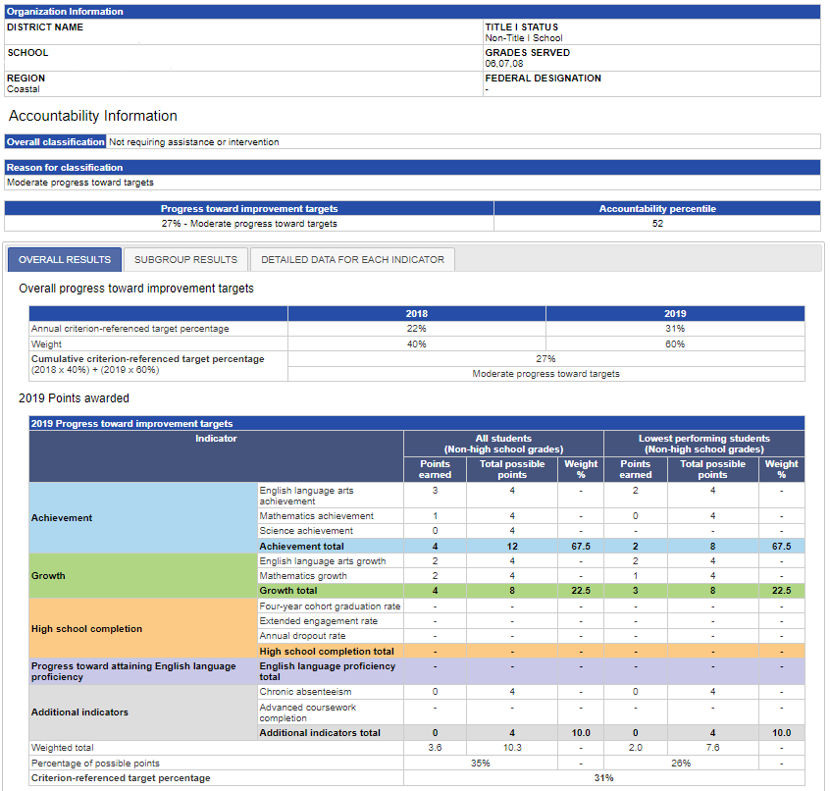
Accountability report example

Slide 18
Process for Redesigning the Accountability System
How should the redesign process be structured?
Who should be involved? Which stakeholder groups should we engage with?
What timeframe should we be considering for implementation?
Notes:
Council’s role in this process: Review and advise DESE and BESE on the policies and practices surrounding DESE’s accountability and assistance efforts. The AAAC is an advisory council to the BESE.
Acknowledgment: The membership of this council is intentional, and members represent a wide range of opinions on issues related to assessment, accountability, and assistance.
Guardrails for discussion: Today, we are not talking about what the system should look like, what indicators it should include, what tools or measurements are used (e.g., MCAS). We will have opportunities to discuss these topics in future meetings. Today we are thinking about the process: what we need to know to do this work, who we must include, ways in which we can engage with stakeholders, and what sort of timeframe should be considered.

Slide 19
Next Steps and Closing

Slide 20
Upcoming Council Meetings
Meeting schedule for SY2023-24 will be set over the summer
In-person vs. virtual meetings?
DESE to solicit nominations for three open at-large AAAC seats, to be filled in time for the fall meeting
Building meeting agendas
DESE staff will follow-up with a survey tool through which Council members can propose potential meetings topics for upcoming meetings

