Slide 1
Accountability and Assistance Advisory Council Meeting
October 16, 2024

Slide 2
Topics
Welcome, Introductions, and Review of Norms
2024 MCAS and Accountability Results
Early Data from CSDP Progress Monitoring Visits
Report from the Accountability System Review Advisory Committee
Next Steps and Closing

Slide 3
Welcome, Introductions, and Review of Norms

Slide 4
Welcome and Introductions
Introductions:
Council Co-Chairs: Heidi Driscoll & Tim Piwowar
Returning Council members
DESE staff

Slide 5
Discussion Norms and Meeting Protocols
Promote risk-taking by not assigning specific comments to individual members in meeting summaries & minutes.
Maintain respect before, during, & after meetings.
Seek clarification & check understanding to avoid mistakenly attributing ideas to an individual or organization represented on the council.
Keep improvements in student learning at the core of the discussions. Students should drive the conversation.
Stay engaged in the issues.
Actively address implicit biases & instill cultural proficiency in discussions.
Encourage discussion from all voices of members. Be additive, not repetitive.
Let members know if pre-reading or other pre-meeting assignments require more than 30 minutes of preparation time.
Make it fun!

Slide 6
Thank You!
Tim Piwowar (MASS representative), has served on the Council since 2018 (Co-Chair since 2022)

Slide 7
Board Liaison to the AAAC
Dr. Martin West – Given his expertise and his service as a member of the BESE, Chair Craven asked him to be the liaison between the BESE and the AAAC

Slide 8
AAAC Charge for SY24-25
The School and District Accountability and Assistance Advisory Council (AAAC) advises the Commissioner of Elementary and Secondary Education on matters pertinent to the development of school and district accountability in the Commonwealth. To accomplish that goal, the Council will:
Continue to advise the Department and the Board of Elementary and Secondary Education on the implementation of the currently approved district and school accountability and assistance system.
Provide input and feedback on potential changes to the district and school accountability system, ensuring that the system produces high-quality, objective, and unbiased information that allows the Department, districts, and schools to partner together to advance the Department’s Educational Vision and Strategic Objectives.

Slide 9
2024 MCAS and Accountability Results

Slide 10
MCAS Data Results
ELA results show lower achievement in all grades from 2023
Math results show improved achievement in 3rd grade amongst relatively flat results in most grades
Science results show improved achievement in grades 5 and 10 with lower achievement in grade 8

Slide 11
2024 ELA Results by Grade
 | 2024 |  |  |  |  | % M or E change compared to
 | % NM | %PM | % ME | % EE | % M or E | 2023 | 2019
Grade 3 | 18 | 40 | 36 | 6 | 42 | -2 | -14
Grade 4 | 19 | 45 | 32 | 4 | 37 | -3 | -15
Grade 5 | 16 | 46 | 32 | 6 | 38 | -6 | -14
Grade 6 | 25 | 35 | 29 | 11 | 40 | -2 | -13
Grade 7 | 22 | 42 | 30 | 6 | 36 | -4 | -12
Grade 8 | 24 | 34 | 32 | 11 | 43 | -1 | -9
Grades 3-8 | 21 | 40 | 32 | 7 | 39 | -3 | -13
Grade 10 | 12 | 31 | 43 | 14 | 57 | -1 | -4

Slide 12
2024 Math Results by Grade
 | 2024 |  |  |  |  | % M or E change compared to
 | % NM | %PM | % ME | % EE | % M or E | 2023 | 2019
Grade 3 | 20 | 35 | 35 | 10 | 44 | +3 | -5
Grade 4 | 16 | 38 | 38 | 8 | 46 | +1 | -4
Grade 5 | 14 | 46 | 34 | 6 | 40 | -1 | -8
Grade 6 | 17 | 43 | 33 | 7 | 40 | -1 | -12
Grade 7 | 19 | 44 | 30 | 8 | 37 | -1 | -11
Grade 8 | 19 | 42 | 31 | 8 | 38 | 0 | -8
Grades 3-8 | 18 | 42 | 33 | 8 | 41 | 0 | -8
Grade 10 | 13 | 39 | 36 | 12 | 48 | -2 | -11

Slide 13
2024 STE Results by Grade
 | 2024 |  |  |  |  | % M or E change compared to
 | % NM | %PM | % ME | % EE | % M or E | 2023 | 2019
Grade 5 | 20 | 36 | 37 | 7 | 45 | +3 | -4
Grade 8 | 20 | 41 | 34 | 6 | 39 | -2 | -7
Grades 5 & 8 | 20 | 38 | 36 | 6 | 42 | +1 | -6
Grade 10 | 11 | 40 | 37 | 12 | 49 | +2 | NA

Slide 14
MCAS Achievement Results for Students Who Were Chronically Absent
ELA | 2024 Average Scaled Score |  |  | 2024 % Meeting or Exceeding
 | Not Chronically Absent | Chronically Absent | Difference | Not Chronically Absent | Chronically Absent | Difference
Grades 3-8 | 495 | 481 | -14 | 42 | 22 | -20
Grade 10 | 508 | 490 | -18 | 63 | 36 | -27
Math | 2024 Average Scaled Score |  |  | 2024 % Meeting or Exceeding
 | Not Chronically Absent | Chronically Absent | Difference | Not Chronically Absent | Chronically Absent | Difference
Grades 3-8 | 497 | 481 | -16 | 45 | 19 | -26
Grade 10 | 504 | 485 | -19 | 55 | 22 | -33

Slide 15
Refresher: MA Accountability System 101
2
…that measure performance of groups, schools, and districts on specific indicators…
The Massachusetts accountability system consists of two components…
1
Achievement
English Learner Proficiency
Student Growth
Additional Indicators
Normative Component
(Accountability Percentile)
High School Completion
measures the performance of all students in a school compared to other schools in the state that serve similar grades, and is reported as a percentile from 1 to 99
3
…and are used to categorize schools and districts as requiring assistance/intervention or not.
Criterion-Referenced Component (Targets)
Not requiring assistance or intervention |  |  |  |  | Requiring assistance or intervention
Schools of recognition Recognized for high achievement, high growth, or exceeding targets | Meeting or exceeding targets Cumulative criterion-referenced target percentage 75-100 | Substantial progress toward targets Cumulative criterion-referenced target percentage 50-74 | Moderate progress toward targets Cumulative criterion- referenced target percentage 25-49 | Limited or no progress toward targets Cumulative criterion- referenced target percentage 0-24 | Focused/ targeted support Percentiles 1-10 Low graduation rate Low performing group(s) Low participation | Broad/ comprehensive support Underperforming schools Chronically underperforming schools
measures a district’s or school’s progress towards improvement targets, and is reported as a percentage

Slide 16
Overall Accountability Classification
All schools receive an overall accountability classification that describes the need for assistance or intervention
Total of 1,827 schools in the 2023-24 school year
217 received a classification of “Insufficient data” primarily because the school did not serve any tested grades (e.g., PK-2 school)
Of the remaining 1,610 schools:
285 (18%) were classified as “Requiring assistance or intervention” for one or more reasons
1,325 (82%) were classified as “Not requiring assistance or intervention”
Including 57 Schools of Recognition

Slide 17
Progress Towards Targets
60% of schools in MA made substantial progress towards, met,
or exceeded their accountability targets
Grade Span | Number of Schools | 0-24% Limited or No Progress Towards Targets |  | 25-49% Moderate Progress Towards Targets |  | 50-74% Substantial Progress Towards Targets |  | 75-100% Meeting or Exceeding Targets
 |  | 2023 | 2024 | 2023 | 2024 | 2023 | 2024 | 2023 | 2024
ES/MS | 1,231 | 6.0% | 2.4% | 30.2% | 35.4% | 41.6% | 47.0% | 22.2% | 15.2%
MS/HS | 117 | 4.9% | 8.5% | 46.6% | 50.4% | 40.8% | 35.0% | 7.8% | 6.0%
HS only | 240 | 8.8% | 2.9% | 34.9% | 37.1% | 28.6% | 45.0% | 27.7% | 15.0%
Total | 1,588 | 6.5% | 3.0% | 31.7% | 36.8% | 39.8% | 45.8% | 22.1% | 14.5%

Slide 18
Early Data from CSDP Progress Monitoring Visits

Slide 19
DESE Educational Vision Goals

Slide 20
Advancing the Educational Vision: Thinking About Systems

Slide 21
CSDP Progress Monitoring Visits
Criteria/Process
High-level Stats
Prioritize schools designated as Underperforming
Prioritize schools from districts that engage in programs across multiple CSDP offices
Prioritize schools across multiple grade spans, performance, program participation
91 schools across 36 districts (roughly 9% of total districts in MA)
74% of schools visited receive support from the Statewide System of Support (SSoS)
77% schools identified as “requiring assistance” vs. 23% not requiring assistance

Slide 22
Key findings

Slide 23
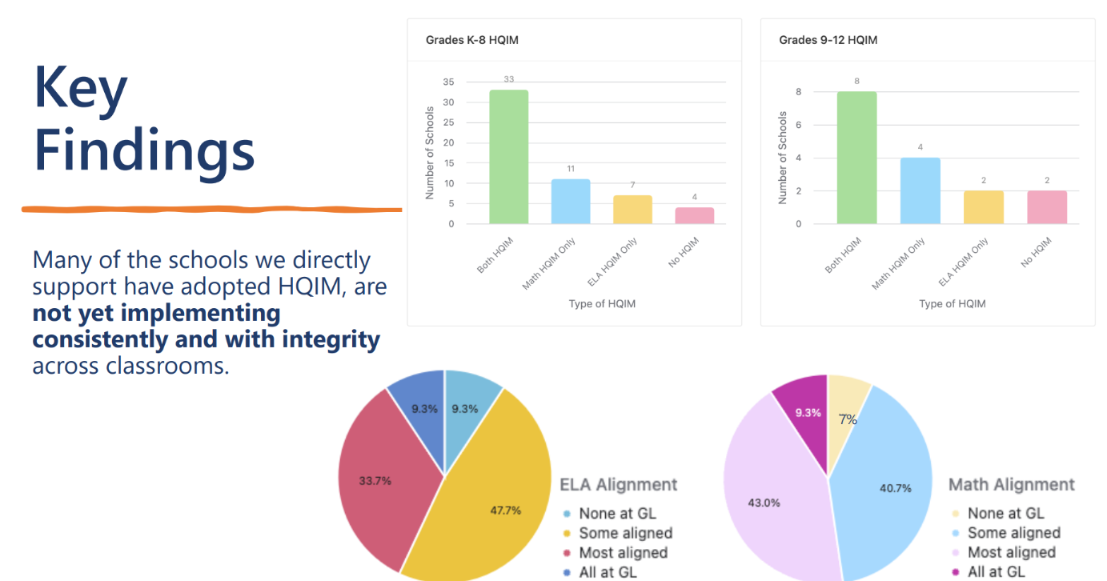
Key findings

Slide 24
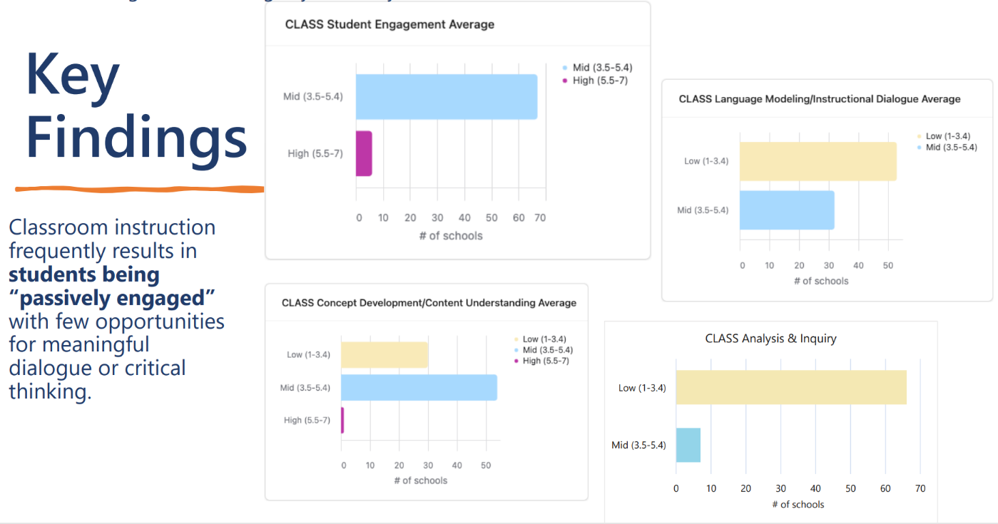
Key findings

Slide 25
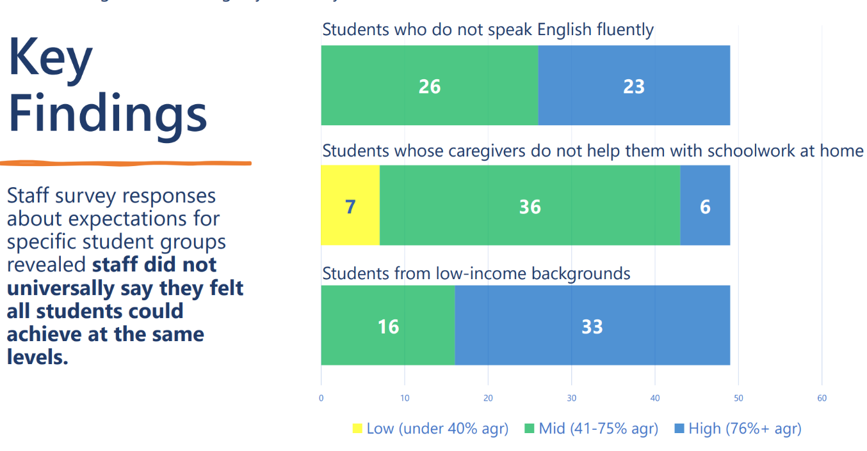
Key findings
Students who do not speak English fluently have the ability to achieve the same levels of academic performance as their native English-speaking peers.
Students whose caregivers do not help them with schoolwork at home have the ability to achieve the same levels of academic performance as their peers who receive more family support.
Students who live in poverty have the ability to achieve the same grade-level standards as their more affluent peers.

Slide 26
Discussion
What are your general reactions to these early findings?
Given the Council’s charge, where can we go from here?

Slide 27
Overview of the Massachusetts Accountability System Review Advisory Committee Report
Dr. Chris Domaleski & Dr. Carla Evans The National Center for the Improvement of Educational Assessment
September 23, 2024
Virtual Presentation to the Massachusetts Board of Elementary and Secondary Education

Slide 28
Agenda
Background
Foundations
Design Recommendations
Next Steps
DESE Follow-Up

Slide 29
Background

Slide 30
Advisory Committee Purpose
The goal of the Accountability System Review Advisory Committee was to develop a set of guiding principles and recommendations for DESE to consider in the review of the district and school accountability system.
The goal was to assist DESE in the development of an improved measure of school quality that complies with existing federal and state laws, as well as honors Massachusetts’ Educational Vision and priorities.

Slide 31
Background
Massachusetts Parent-Teacher Association (MPTA)
National Parents Union - Massachusetts (NPU-MA)
American Federation of Teachers - Massachusetts (AFT-MA)
Massachusetts Teachers Association (MTA)
District staff with specific accountability expertise
Massachusetts Association of School Committees (MASC)
Massachusetts Association of School Superintendents (MASS)
Massachusetts Association of Vocational Administrators (MAVA)
Urban Superintendent Network (USN)
Massachusetts School Administrators Association (MSAA)
Democrats for Education Reform (DFER)
Massachusetts Charter Public School Association (MCPSA)
Massachusetts Consortium for Innovative Education Assessment (MCIEA)
Massachusetts Business Alliance for Education (MBAE)
Latinos for Education*
National Association for the Advancement of Colored People (NAACP)*
Massachusetts Advocates for Children (MAC)*
Student Advisory Council (SAC)*
*Invited, but did not participate
Fall 2023
Committee Invited
DESE staff identified and invited a broadly representative group from many organizations and stakeholder groups to participate.

Slide 32
Background
Fall 2023
Dec 2023
June 2024
July 2024
Committee Invited
Meetings Started
Meetings Ended
Feedback Solicited
The committee met in person for full-day meetings six times and remotely for 3 hours one time.
DESE staff identified and invited a broadly representative group from many organizations and stakeholder groups to participate.
The Center hosted three, optional virtual feedback sessions and invited written feedback on a draft version of the report.

Slide 33
Scope of this Advisory Committee
Within scope: accountability indicators (e.g., student growth, achievement, high school completion), measures (e.g., student growth percentiles (SGPs), MCAS average scaled scores, graduation rates), the weighting of indicators, the number of years of data included in the system, performance categories, reporting/report design, connection to assistance work, and the community engagement process.
Out of scope: The competency determination (CD), MCAS design, and the designation of underperforming or chronically underperforming schools and districts/receivership (MGL Chapter 69, Section 1J and 1K).

Slide 34
II. Foundations

Slide 35
Final Report
This report documents the process and recommendations produced by the advisory committee.

Slide 36
Moving From Vision to Design
Characteristics and Features
Design Recommendations
Design Principles
Foundations
Theory of Action

Slide 37
System Goals
The advisory committee emphasized that accountability systems are most effective when they:
1) provide information about inputs and outcomes that are valued the most, and
2) integrate with improvement systems that specify the conditions, resources, and supports that can help promote improved actions and outcomes.
Accordingly, the committee clarified the high-priority goals that the system should support for students, educators, and leaders in the Commonwealth.

Slide 38
Design Principles
Collect and report a broad range of indicators
“Right-size” federal requirements
Leverage flexibility where possible and where appropriate
Develop and integrate robust systems of support

Slide 39
III. Design Recommendations

Slide 40
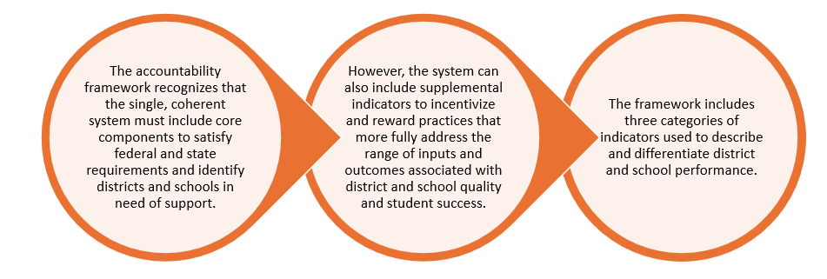
System Framework
Key Takeaway: The committee recommended one coherent federal and state accountability system with three categories of indicators.

Slide 41
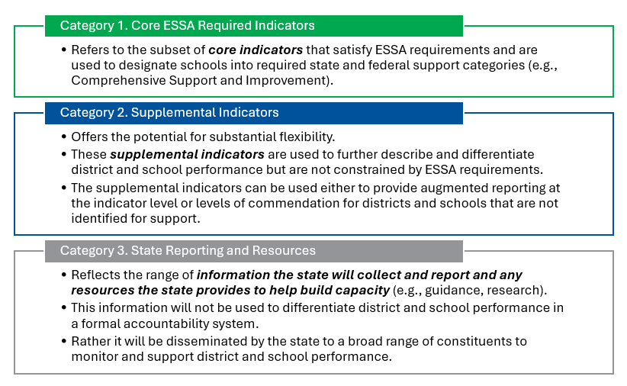
Indicator categories

Slide 42
Indicator & System Design Recommendations
The advisory committee reviewed a range of candidate indicators and made recommendations regarding whether they should be included in the system and, if so, which category was most appropriate.
The advisory committee’s recommendations go beyond the minimum ESSA required indicators in the accountability system.
The committee also provided some guidance for the manner in which indicators should be combined and reported.

Slide 43
Category 1 - Core Indicators
Determines federal and state support designations; complies with ESSA requirements
Proposed Indicators:
4 year and extended graduation rate
Academic achievement
Advanced coursework
Growth
Progress in achieving English Language Proficiency
School Climate

Slide 44
Category 2 - Supplemental Indicators
Further differentiates school performance (e.g., schools of commendation) based on a broader set of inputs and outcomes associated with school success
Leverages more flexible approaches (e.g., choice among qualifying options)
Proposed Indicators:
9th grade persistence/ promotion
Access to effective teaching
Access to high quality academic supports
Curricular breadth
Curricular quality
Educator absenteeism
Student absenteeism

Slide 45
Category 3
Additional indicators collected and reported by the state for transparency and support
Proposed Indicators:
Builds on DESE’s broad range of public information such as additional performance measures, research, and promising practices

Slide 46
IV. Next Steps

Slide 47
Next Steps
Additional indicator-level and system-level design specifications are needed to support implementation. Next steps should include at minimum:
Establish Operational Definitions and Business Rules
Establish Aggregation Rules and Performance Expectations
Address Exceptions
Examine and Refine

Slide 48
V. DESE Follow-Up

Slide 49
Proposed Next Steps
Review report and recommendations
DESE staff
Accountability and Assistance Advisory Council (AAAC)
Develop a project plan, aligned with REDT, including:
Discussion of potential changes to the system, alignment with the Educational Vision
DESE staff and leadership
AAAC and other BESE advisory councils
Data analysis and simulations
Stakeholder engagement and feedback opportunities
Required by federal law and state accountability regulations
Seek appropriate BESE and federal approval
Opportunities for engagement with BESE throughout

Slide 50
Discussion
What are your reactions to the recommendations?
Given the Council’s charge, where do we go from here?
How can we leverage our upcoming meetings to continue this work?
Who else should we seek input from?

Slide 51
Next Steps and Closing

Slide 52
Looking Ahead
Upcoming meetings:
December 4
February 5
April 2 (in-person)
May 14
June 4
Looking for nominations for a Council Co-Chair

