Slide 1
Accountability and Assistance Advisory Council Meeting
April 2, 2025

Slide 2
Agenda
Welcome, Introductions, and Review of Norms
District Instructional Prioritization Plan Guidance and the Integration of the District Standards and Indicators
2025 Accountability Reporting
Feedback on DESE’s Draft Regulations Related to the Competency Determination (CD) and Considerations for Future Accountability Reporting
Next Steps and Closing

Slide 3
Welcome and Introductions
Introductions:
  Council Co-Chairs: Heidi Driscoll & Barish Icin
  New member: Dr. Dianne Kelly (MASS)
  BESE Liaison: Dr. Marty West
  Returning Council members
  DESE staff

Slide 4
Thank You!
Heidi Driscoll has served on the Council since 2019 (Co-Chair since 2022)

Slide 5
Discussion Norms and Meeting Protocols
Promote risk-taking by not assigning specific comments to individual members in meeting summaries & minutes.
Maintain respect before, during, & after meetings.
Seek clarification & check understanding to avoid mistakenly attributing ideas to an individual or organization represented on the council.
Keep improvements in student learning at the core of the discussions. Students should drive the conversation.
Stay engaged in the issues.
Actively address implicit biases & instill cultural proficiency in discussions.
Encourage discussion from all voices of members. Be additive, not repetitive.
Let members know if pre-reading or other pre-meeting assignments require more than 30 minutes of preparation time.
Make it fun!

Slide 6
AAAC Charge for SY24-25
The School and District Accountability and Assistance Advisory Council (AAAC) advises the Commissioner of Elementary and Secondary Education on matters pertinent to the development of school and district accountability in the Commonwealth. To accomplish that goal, the Council will:
Continue to advise the Department and the Board of Elementary and Secondary Education on the implementation of the currently approved district and school accountability and assistance system.
Provide input and feedback on potential changes to the district and school accountability system, ensuring that the system produces high-quality, objective, and unbiased information that allows the Department, districts, and schools to partner together to advance the Department’s Educational Vision and Strategic Objectives.

Slide 7
District Instructional Prioritization Plan Guidance and the Integration of the District Standards and Indicators

Slide 8
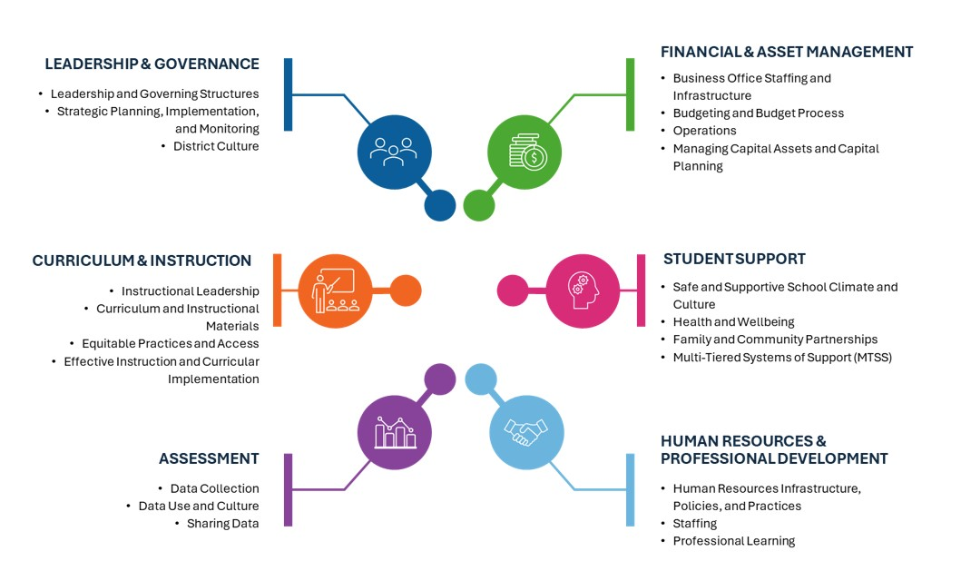
FY26 District Instructional Prioritization Plan
One district plan vs. separate plans for each school identified as requiring assistance
Alignment to key DESE priorities: Educational Vision, SOA Plans, Accountability targets
  NEW: Alignment to District Standards and Indicators
Instructional Priority is the focus of support from the Statewide System of Support (SSoS)
Notes:
Educational Vision -
SOA – all districts have a 3-year gap-closing plan and are expected to spend funds in alignment with those priorities – SOME districts also have additional priorities for EBP grant (e.g. Gateway)
Accountability Targets –
More info coming later in March
We know districts will have lots of questions
- Don’t let it become a detour… if the priorities are informed by data and grounded in standards, then we already know we are doing the right work.
Analysis: We should not be allowing priorities to be developed without ensuring districts dig into student input and student work
Feedback: should be ongoing. We will determine specifics for summer review later (eg calibration on criteria and quality)

Slide 9
District Instructional Prioritization Plan
Sections of SSoS Guidance
Intro: HQIM Status
Instructional Priority
Analysis of Strengths and Challenges
Stakeholder Engagement
Outcomes
Role Clarity
Monitoring Implementation
Resources
Targeted Support for Priority Schools
Notes:
SOA – all districts have a 3-year gap-closing plan and are expected to spend funds in alignment with those priorities – SOME districts also have additional priorities for EBP grant (e.g. Gateway)
Accountability Targets – More info coming later in March -- We know districts will have lots of questions-- Don’t let it become a detour… if the priorities are informed by data and grounded in standards, then we already know we are doing the right work.
Analysis: We should not be allowing priorities to be developed without ensuring districts dig into student input and student work
Feedback: should be ongoing. We will determine specifics for summer review later (eg calibration on criteria and quality)
Two goals between now and June:
Help districts meet this year’s goals
Help districts prepare for next year -- This year’s mid-course corrections inform next year’s work

Slide 10



Cycle of Continuous Improvement
  In the spring, districts identify an instructional priority, anchored in culturally and linguistically responsive, grade appropriate instruction
#1
Prioritize
District develops a plan, based on the District Instructional Prioritization Plan guidance that outlines roles, key actions, and benchmarks to achieve the priority
Plan is differentiated for schools that require assistance
Plan includes supporting instructional systems and structures and skillful implementation of high-quality instructional materials.
#2
Create
a Plan
#3
Track Progress
Track implementation of the selected strategies and supports
Monitor changes in adult practice and student learning outcomes
Troubleshoot challenges and adjust the plan as needed

Slide 11
2025 Accountability Reporting

Slide 12
Plans for 2025 Reporting
2025 accountability reporting will remain unchanged from 2024:
No additional years of data included
Results based on 3 years of data (2023, 2024, 2025)
No changes to indicators or weightings
Grade 8 Civics MCAS results not included
No changes to participation rate requirements
Districts and schools are expected to maintain rates of 95% or higher
Chronic absenteeism rates reflect missing 10% or more of the school year
New Competency Determination (CD) law does not affect graduation rates used in 2025 results
System uses the 2024 four-year and 2023 five-year rates
Same weighting of years (15%, 25%, 60%)
Same general timeframe for reporting
Results available in late summer/fall

Slide 13
Accountability System Review
September 2024
Accountability System Review Advisory Committee Report released, including recommendations for potential changes to the accountability system
Winter – Summer 2025
Internal discussions with DESE staff
Late Fall 2025
Stakeholder engagement (including advisory councils)
Winter –
Spring 2026
BESE discussions
Public comment on proposed changes
System approval (state and federal)
Fall 2027
System implementation (results reported)
BESE discussions
Operationalizing System
* Tentative timeline

Slide 14
Feedback on DESE’s Draft Regulations Related to the Competency Determination (CD) and Considerations for Future Accountability Reporting

Slide 15
Background Information
The "competency determination" shall be based on the academic standards and curriculum frameworks for tenth graders in the areas of mathematics, science and technology, history and social science, foreign languages, and English, and shall represent a determination that a particular student has demonstrated mastery of a common core of skills, competencies and knowledge in these areas, as measured by the assessment instruments described in section one I by satisfactorily completing coursework that has been certified by the student's district as showing mastery of the skills, competencies, and knowledge contained in the state academic standards and curriculum frameworks in the areas measured by the MCAS high school tests described in section one I administered in 2023, and in any additional areas determined by the board.

Slide 16
Background Information
Since the passage of the ballot question, the Board has discussed the matter of the CD and the new statutory requirements.
  November, December, January, February regular meetings
  February special meeting
The proposed amendments are informed by the Board’s discussions and are designed to focus on student learning and promote academic equity for all students.

Slide 17
Overview of Proposed Changes to Regulations
Align the regulations to the new statutory language.
  This includes the deletion of obsolete language.

Slide 18
Overview of Proposed Changes to Regulations
Propose new definitions.
  Satisfactorily completing coursework shall mean a student earns full credit in accordance with the district’s grading policy.
  Showing mastery shall mean a student successfully completes in accordance with the district’s grading policy: (1) the final assessment for a course; or (2) a capstone or portfolio project; or (3) an equivalent measure identified in the district’s Competency Determination policy.

Slide 19
Overview of Proposed Changes to Regulations
Specify minimum requirements to earn the Competency Determination.
  Beginning with the graduating class of 2026:
    Student must show mastery in Math, ELA, and Science
    Student must satisfactorily complete coursework in two years of high school English language arts, Algebra I and Geometry or Integrated Math I and Integrated Math II courses, and one year of Biology, Physics, Chemistry, or Technology or Engineering

Slide 20
Overview of Proposed Changes to Regulations
Add United States History as “an additional area determined by the Board."
  Beginning with the graduating class of 2027:
    Student must show mastery and satisfactorily complete coursework in Math, ELA, and Science, and
    Student must show mastery in United States history and satisfactorily complete coursework in a one-year United States history course.

Slide 21
Overview of Proposed Changes to Regulations
Offer options to address students’ needs.
  In the limited circumstance where a district is unable to document a student’s prior coursework, a student may earn the Competency Determination by: (i) attaining a qualifying score of at least “Meeting Expectations” or “Exceeding Expectations” achievement levels on the relevant high school MCAS assessment; or (ii) meeting the standard for a substituted equivalent that the district certifies satisfies the same academic standards.

Slide 22
Overview of Proposed Changes to Regulations
Provide oversight. Each district shall adopt a Competency Determination policy. The policy shall:
  Be approved by the governing body
  Include an appeal process
  Be posted publicly and translated
  Be submitted to the Department along with the district’s local graduation requirements
Allow for audit. The Department shall implement a system to audit the quality of districts’ Competency Determination policies.

Slide 23
Possible Non-Regulatory Steps
Public posting of both district CD policies and local graduation requirements
  DESE does not have a comprehensive database of local graduation requirements
Public reporting of performance in school courses in relation to other outcome measures
  Would provide information to the public about how grading aligns with other outcome measures
Include review of local graduation policies in DESE’s district review process

Slide 24
Follow-Up Discussion from February 10th Special BESE Meeting
Whether to use MCAS more broadly as a path to show mastery and satisfactorily complete coursework to earn the Competency Determination.

Slide 25
Public Comment Period
Public comment may be submitted via an online form, or sent via email to Competency.Determination@mass.gov, or sent via mail to Regulations Public Comment, c/o Commissioner’s Office, Department of Elementary and Secondary Education, 135 Santilli Highway, Everett, MA 02149.
The deadline for the public comment period is April 4, 2025 at 5:00pm.
The Board is expected to vote on the proposed amendments at its regular monthly meeting scheduled for May 20, 2025.

Slide 26
Discussion
General comments and/or comments specific to the following sections of the proposed regulations:
  Definitions (30.02)
  Standards for Competency Determination (30.03)
  District Certification (30.04)
  Audit (30.05)
In addition to the pathway proposed in the amendments to the regulations, the Department of Elementary and Secondary Education is seeking public comment on the question of whether to include a second, alternate pathway for earning the competency determination. The second pathway would be an additional route available to all students. It would be based on earning a qualifying score on the relevant high school MCAS assessment, which high school students are required to take.
Given the federal requirement to include graduation rates in the accountability system, what considerations should be given to this measure as we continue our work to review and potentially revise the existing system?

Slide 27
Next Steps and Closing

Slide 28
Looking Ahead
Upcoming meetings:
  May 14
  June 4
Looking for nominations for another Council Co-Chair

