Slide 1
Accountability and Assistance Advisory Council Meeting
October 22, 2025

Slide 2
Topics
Welcome and Introductions
Discussion of Norms
2025 MCAS and Accountability Results
Update on DESE’s District Review Process
Update on DESE’s Accountability System Review Process
Next Steps and Closing

Slide 3
Welcome and Introductions
Council Co-Chairs: Barish Icin and Andrew O'Leary
Returning Council Members
DESE Staff

Slide 4
Thank You!
Brandi Kwong has served on the council since 2022

Slide 5
Discussion Norms and Meeting Protocols
Are there any norms you would like to remove/add/update?
  Promote risk-taking by not assigning specific comments to individual members in meeting summaries and minutes.
  Maintain respect before, during, and after meetings.
  Seek clarification and check understanding to avoid mistakenly attributing ideas to an individual or organization represented on the council.
  Keep improvements in student learning at the core of the discussions. Students should drive the conversation.
  Stay engaged in the issues.
  Actively address implicit biases and instill cultural proficiency in discussions.
  Encourage discussion from all voices of members. Be additive, not repetitive.
  Let members know if pre-reading or other pre-meeting assignments require more than 30 minutes of preparation time.
  Make it fun!

Slide 6
1. Overview of 2025 Reporting
2025 MCAS and Accountability Results

Slide 7
2025 ELA Results for Grades 3-8
Grade | 2025 % NM | 2025 % PM | 2025 % M | 2025 % E | 2025 % M/E | 2025 % M/E compared to 2024 | 2025 % M/E compared to 2019
Grade 3 | 19 | 39 | 37 | 6 | 42 | 0 | -14
Grade 4 | 19 | 41 | 36 | 4 | 40 | +3 | -12
Grade 5 | 15 | 47 | 33 | 5 | 38 | 0 | -14
Grade 6 | 22 | 36 | 32 | 10 | 42 | +2 | -11
Grade 7 | 22 | 36 | 34 | 7 | 42 | +6 | -6
Grade 8 | 22 | 34 | 33 | 11 | 44 | +1 | -8
Grades 3-8 | 20 | 39 | 34 | 7 | 42 | +3 | -10
Due to rounding, the sum of the performance level categories may not equal 100.

Slide 8
2025 ELA Results by Student Group for Grades 3-8
Student Group | 2025 % NM | 2025 % PM | 2025 % M | 2025 % E | 2025 % M/E | 2025 % M/E compared to 2024 | 2025 % M/E compared to 2019
American Indian or Alaska Native | 30 | 43 | 25 | 3 | 28 | +3 | -12
Asian | 9 | 26 | 47 | 18 | 64 | +2 | -8
Black or African American | 30 | 44 | 23 | 3 | 26 | +2 | -7
Hispanic or Latino | 34 | 43 | 20 | 2 | 22 | +2 | -11
Multi-Race, Not Hispanic or Latino | 15 | 35 | 38 | 11 | 49 | +3 | -7
Native Hawaiian or Pacific Islander | 25 | 37 | 30 | 7 | 38 | -1 | -13
White | 13 | 38 | 41 | 9 | 50 | +3 | -9
English Learners | 59 | 36 | 4 | 0 | 5 | 0 | -10
Low Income | 33 | 44 | 21 | 2 | 23 | +2 | N/A
Students with Disabilities | 48 | 40 | 11 | 1 | 12 | +1 | -4
Due to rounding, the sum of the performance level categories may not equal 100.

Slide 9
2025 ELA Results for Grade 10
Student Group | 2025 % NM | 2025 % PM | 2025 % M | 2025 % E | 2025 % M/E | 2025 % M/E compared to 2024 | 2025 % M/E compared to 2019
All Students | 15 | 35 | 41 | 10 | 51 | -6 | -10
American Indian or Alaska Native | 21 | 41 | 31 | 7 | 38 | -10 | -15
Asian | 5 | 18 | 52 | 24 | 76 | -2 | -2
Black or African American | 23 | 42 | 31 | 4 | 35 | -7 | -3
Hispanic or Latino | 28 | 41 | 28 | 3 | 31 | -5 | -6
Multi-Race, Not Hispanic or Latino | 11 | 33 | 43 | 12 | 56 | -5 | -9
American Indian or Alaska Native | 21 | 41 | 31 | 7 | 38 | -10 | -15
Native Hawaiian or Pacific Islander | 15 | 42 | 32 | 11 | 43 | -15 | -9
White | 9 | 33 | 47 | 12 | 59 | -6 | -10
English Learners | 65 | 32 | 2 | 0 | 2 | -1 | -1
Low Income | 26 | 43 | 28 | 3 | 31 | -7 | N/A
Students with Disabilities | 38 | 46 | 15 | 1 | 17 | -4 | -5
Due to rounding, the sum of the performance level categories may not equal 100.

Slide 10
2025 Math Results for Grades 3-8
Grade | 2025 % NM | 2025 % PM | 2025 % M | 2025 % E | 2025 % M/E | 2025 % M/E compared to 2024 | 2025 % M/E compared to 2019
Grade 3 | 21 | 36 | 34 | 10 | 44 | 0 | -5
Grade 4 | 17 | 40 | 35 | 8 | 43 | -3 | -7
Grade 5 | 17 | 43 | 33 | 7 | 40 | 0 | -8
Grade 6 | 17 | 42 | 34 | 7 | 41 | +1 | -11
Grade 7 | 20 | 41 | 30 | 9 | 39 | +2 | -9
Grade 8 | 21 | 41 | 31 | 8 | 38 | 0 | -8
Grades 3-8 | 19 | 40 | 33 | 8 | 41 | 0 | -8
Due to rounding, the sum of the performance level categories may not equal 100.

Slide 11
2025 Math Results by Student Group for Grades 3-8
Student Group | 2025 % NM | 2025 % PM | 2025 % M | 2025 % E | 2025 % M/E | % M/E change compared to 2024 | % M/E change compared to 2019
American Indian or Alaska Native | 28 | 45 | 24 | 3 | 27 | 0 | -10
Asian | 7 | 22 | 44 | 27 | 71 | 0 | -5
Black or African American | 32 | 46 | 20 | 2 | 22 | 0 | -6
Hispanic or Latino | 33 | 47 | 18 | 2 | 20 | 0 | -9
Multi-Race, Not Hispanic or Latino | 16 | 36 | 36 | 12 | 48 | +1 | -3
Native Hawaiian or Pacific Islander | 23 | 41 | 27 | 9 | 36 | -3 | -8
White | 12 | 39 | 41 | 8 | 49 | 0 | -7
English Learners | 49 | 42 | 9 | 1 | 9 | -1 | -8
Low Income | 32 | 47 | 19 | 2 | 21 | 0 | N/A
Students with Disabilities | 46 | 41 | 11 | 1 | 13 | 0 | -2
Due to rounding, the sum of the performance level categories may not equal 100.

Slide 12
2025 Math Results for Grade 10
Student Group | 2025 % NM | 2025 % PM | 2025 % M | 2025 % E | 2025 % M/E | 2025 % M/E compared to 2024 | 2025 % M/E compared to 2019
All Students | 16 | 39 | 33 | 12 | 45 | -3 | -14
American Indian or Alaska Native | 19 | 43 | 31 | 7 | 38 | +5 | -6
Asian | 4 | 18 | 37 | 41 | 78 | -1 | -4
Black or African American | 25 | 49 | 23 | 3 | 26 | -1 | -9
Hispanic or Latino | 30 | 47 | 20 | 3 | 23 | -2 | -10
Multi-Race, Not Hispanic or Latino | 13 | 39 | 31 | 17 | 47 | -4 | -13
American Indian or Alaska Native | 19 | 43 | 31 | 7 | 38 | +5 | -6
Native Hawaiian or Pacific Islander | 14 | 48 | 28 | 11 | 38 | -14 | -25
White | 10 | 37 | 40 | 13 | 53 | -5 | -14
English Learners | 55 | 39 | 5 | 0 | 5 | 0 | -4
Low Income | 28 | 48 | 20 | 4 | 24 | -3 | N/A
Students with Disabilities | 42 | 46 | 11 | 2 | 12 | -2 | -6
Due to rounding, the sum of the performance level categories may not equal 100.

Slide 13
2025 STE Results by Grade
Student Group | 2025 % NM | 2025 % PM | 2025 % M | 2025 % E | 2025 % M/E | 2025 % M/E compared to 2024 | 2025 % M/E compared to 2019
Grade 5 | 20 | 34 | 37 | 9 | 46 | +1 | -3
Grade 8 | 19 | 44 | 31 | 6 | 37 | -2 | -9
Grades 5 & 8 | 19 | 39 | 34 | 8 | 42 | 0 | -6
Grade 10 | 16 | 38 | 35 | 11 | 46 | -3 | N/A
Due to rounding, the sum of the performance level categories may not equal 100.

Slide 14
2025 Civics Results for Grade 8
Student Group | 2025 % NM | 2025 % PM | 2025 % M | 2025 % E | 2025 % M/E
All Students | 16 | 45 | 33 | 6 | 39
American Indian or Alaska Native | 21 | 56 | 21 | 2 | 23
Asian | 7 | 28 | 49 | 16 | 65
Black or African American | 24 | 53 | 21 | 2 | 23
Hispanic or Latino | 28 | 53 | 18 | 2 | 19
Multi-Race, Not Hispanic or Latino | 14 | 40 | 38 | 9 | 47
Native Hawaiian or Pacific Islander | 13 | 43 | 35 | 9 | 43
White | 10 | 43 | 40 | 7 | 47
English Learners | 53 | 44 | 3 | 0 | 3
Low Income | 27 | 53 | 18 | 2 | 20
Students with Disabilities | 39 | 47 | 12 | 1 | 13
Due to rounding, the sum of the performance level categories may not equal 100.

Slide 15
Refresher: MA Accountability System 101
2
…that measure performance of groups, schools, and districts on specific indicators…
The Massachusetts accountability system consists of two components…
1
Achievement
English Learner Proficiency
Student Growth
Additional Indicators
Normative Component
(Accountability Percentile)
High School Completion
measures the performance of all students in a school compared to other schools in the state that serve similar grades, and is reported as a percentile from 1 to 99
3
…and are used to categorize schools and districts as requiring assistance/intervention or not.
Criterion-Referenced Component (Targets)
Not requiring assistance or intervention
Requiring assistance or intervention
Schools of recognition Recognized for high achievement, high growth, or exceeding targets | Meeting or exceeding targets Cumulative criterion-referenced target percentage 75-100 | Substantial progress toward targets Cumulative criterion-referenced target percentage 50-74 | Moderate progress toward targets Cumulative criterion- referenced target percentage 25-49 | Limited or no progress toward targets Cumulative criterion- referenced target percentage 0-24 | Focused/ targeted support Percentiles 1-10 Low graduation rate Low performing group(s) Low participation | Broad/ comprehensive support Underperforming schools Chronically underperforming schools
measures a district’s or school’s progress towards improvement targets, and is reported as a percentage

Slide 16
Progress Towards Targets – State Results
55% of schools in MA made substantial progress towards, met,
or exceeded their accountability targets as compared to 60% in 2024
Grade Span​ | 2025 Number of Schools​ | 2024 Limited or No Progress Towards Targets​ (0-24%) | 2024 Moderate Progress Towards Targets​ (25-49%) | 2024 Substantial Progress Towards Targets​ (50-74%) | 2024 Meeting or Exceeding Targets ​(75-100%) | 2025 Limited or No Progress Towards Targets​ (0-24%) | 2025 Moderate Progress Towards Targets​ (25-49%) | 2025 Substantial Progress Towards Targets​ (50-74%) | 2025 Meeting or Exceeding Targets ​(75-100%)
ES/MS​ | 1,216 | 2.4%​ | 35.4%​ | 47.0%​ | 15.2%​ | 3.1% | 35.6% | 46.1% | 15.1%
MS/HS​ | 120 | 8.5%​ | 50.4%​ | 35.0%​ | 6.0%​ | 5.8% | 59.2% | 28.3% | 6.7%
HS only​ | 236 | 2.9%​ | 37.1%​ | 45.0%​ | 15.0%​ | 9.3% | 60.2% | 23.3% | 7.2%
Total​ | 1,572 | 3.0%​ | 36.8%​ | 45.8%​ | 14.5%​ | 4.3% | 41.1% | 41.3% | 13.3%

Slide 17
Schools of Recognition
DESE has identified 61 Schools of Recognition for high achievement and growth and meeting or exceeding targets, including six National Blue Ribbon School nominees
Notation for both on public accountability report and DESE website

Slide 18
Update on DESE’s District Review Process

Slide 19
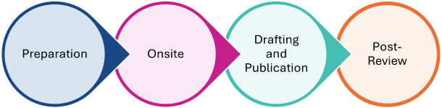
What’s New in District Reviews?
Preparation
Earlier notification and orientation sessions
Website with all district-facing resources and guidance
New CLASS training for district leaders
Pre-Review Communications Kit
Onsite
Collecting curriculum implementation data
Debrief call 1-2 weeks after onsite
Post-Review
Post-Review Action Kit
Monitoring pilot
Drafting and Publication
Findings call before factual corrections

Slide 20
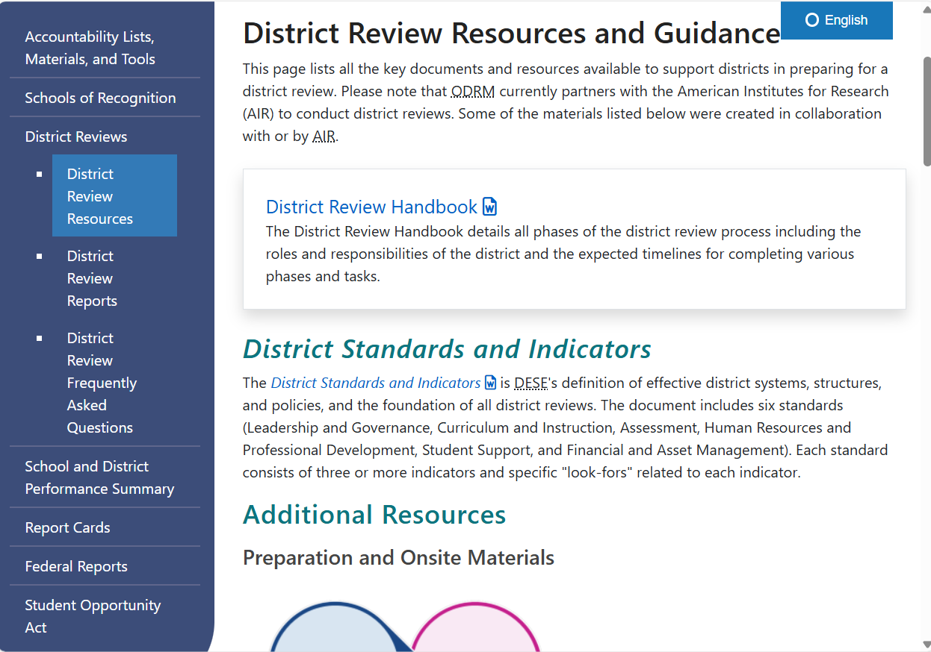
Preparation Phase:
New Resources for Districts
The updated district review website centralizes all district-facing resources. There are many resources to support districts through the preparation phase of the review including
District Review Handbook
CLASS 101 for district leaders – recording and materials will be posted to the website
Pre-Review Communications Kit
  CLASS information for teachers
  Interview and focus group invitations
  Community notification letter

Slide 21
Onsite Phase: Collecting Curriculum Data
CLASS observers will take note of the curricular materials being used in each classroom they observe
Purpose: Obtain information about curriculum implementation
  Is the district using the curriculum it reports to us?
ODRM hopes this data can be used to triangulate findings
Example:
District leaders reported that the Wonders ELA curriculum is in the implementation phase for grades K-5. However, in observations of elementary ELA classes across the district, observers saw concrete evidence of Wonders’ implementation in only six of 20 classrooms. Furthermore, teachers stated that although the Wonders curriculum has been provided by the district, they have not received training in its implementation. The district professional development calendar for 2024-25 did not include any sessions specific to the elementary ELA curriculum or its implementation. Thus, supporting elementary teachers in implementing the Wonders curriculum is an area of growth for the district.

Slide 22
Onsite Phase: Debrief Calls
Example Agenda
Welcome, initial feedback and reflections on the onsite visit
Presentation of CLASS data
Brief discussion of high-level themes/lines of inquiry
  “District documents outlined _______, but _______ indicated that this may not be in place just yet. Therefore, our team asked probing questions to identify where some of the implementation gaps are showing up. We look forward to triangulating the evidence we gathered and giving you a more comprehensive picture of this in the final report”
Preview of next steps in the process
Opportunity to connect with the district and keep them involved and invested in the process
ODRM will build the agenda/template for the call
AIR district leads will share high-level themes emerging from CLASS data and high-level themes if possible

Slide 23
Drafting and Publication Phase: Findings Calls
Opportunity to share report findings prior to the district’s factual correction window
ODRM will lead, AIR staff will support
AIR’s final touchpoint with the district
Review factual correction guidance
Preview optional next steps
Example Agenda
Welcome
ODRM presents of a selection of report findings (largely focused on the tables for each standard)
District asks questions and provides further reflections on the process
  AIR answers questions to the extent possible
ODRM provides instructions for factual correction and confirms timeline with the district
ODRM previews Post-Review Action Kit and optional follow-up support

Slide 24
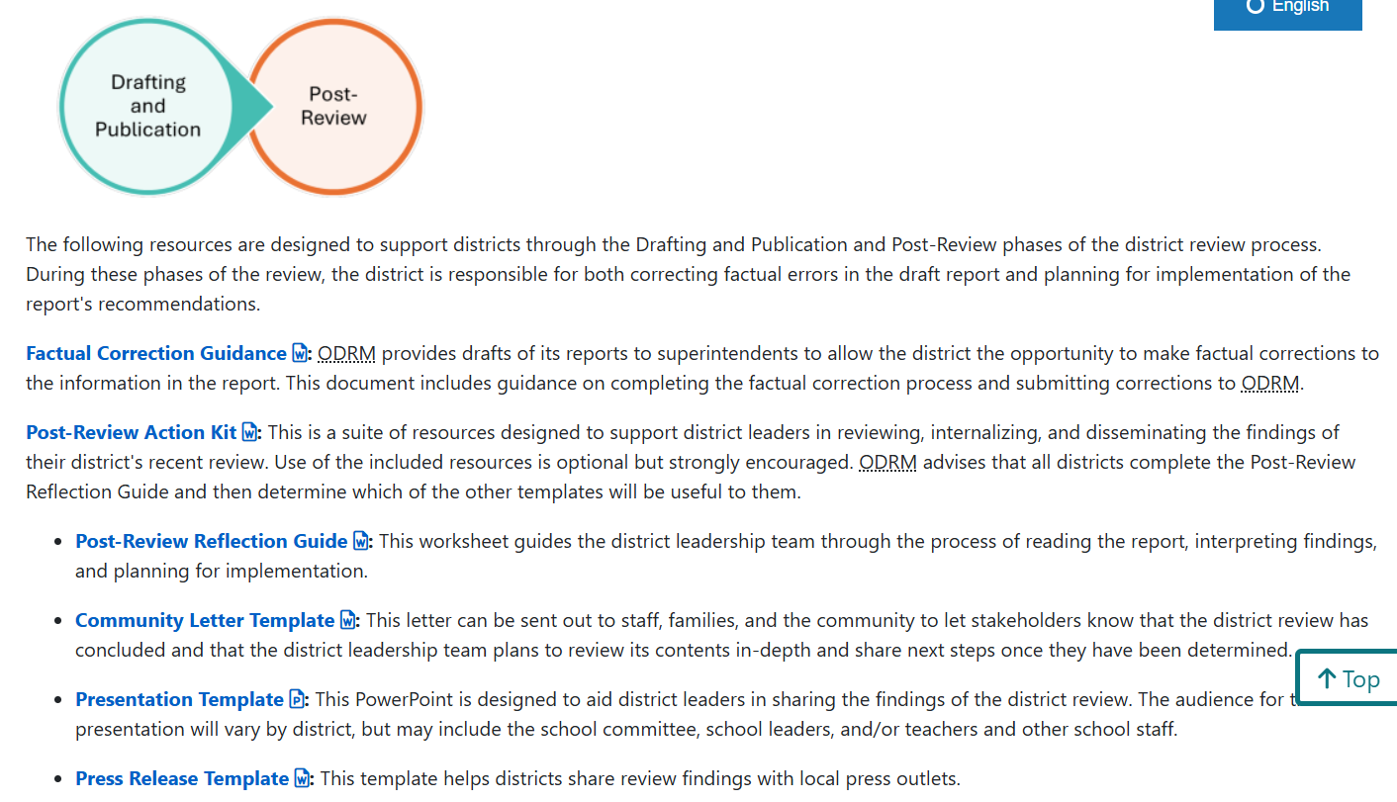
Post-Review Phase:
Post-Review Action Kit
Optional resources that support districts with reviewing, internalizing, and disseminating the review findings
All districts are strongly encouraged to complete the Post-Review Reflection Guide with their central office teams

Slide 25
Post-Review Phase:
Follow-Up Support
Starting in Spring 2026, ODRM will pilot an optional follow-up support opportunity to districts post-review
In response to district feedback stating that DESE does not provide adequate support after the review is published
Support will be customized for each district that enrolls and may include
  Support identifying goals based on the results of the district review
  Discussing implementation of the district’s stated goals
  Connecting district leaders to resources available at DESE

Slide 26
Update on DESE’s Accountability System Review Process

Slide 27
Project Timeline
External Advisory Committee
(December 2023 -September 2024)
Internal Accountability Working Group
(February 2025 – Fall 2025)
Additional Stakeholder Feedback, BESE Approval, USED Approval
(TBD)
New System Implementation
(TBD)
Development of Business Rules
(TBD)
REDT Steps 2, 3, and 4
REDT Steps 5 and 6

Slide 28
Next Steps and Closing

Slide 29
Looking Ahead
Upcoming Meetings (Virtual)
  Wednesday, December 3rd (9:30 - 11:00 am)
  Wednesday, February 11th (9:30 - 11:00 am)
  Wednesday, April 15th (9:30 - 11:00 am)
  Wednesday, June 3rd (9:30 - 11:00 am)

