Slide 1
Accountability and Assistance Advisory Council Meeting
April 15, 2026

Slide 2
Agenda
Welcome and Introductions
WIDA ACCESS Transition Discussion
Update on DESE’s District Review Process
Next Steps and Closing
Please be advised that DESE does not authorize attendees to record or to use AI transcription tools during the meeting and DESE does not endorse any unauthorized transcripts created by third parties of its meetings.

Slide 3
Welcome and Introductions
Council Co-Chairs: Barish Icin and Andrew O'Leary
New Members: April Camuso and Andrea Wolfe
Council Members
DESE Staff

Slide 4
Thank You!
Bill Cameron (MASC) has served on the council since 2024
Noah Berger (MTA) has served on the council since 2023

Slide 5
Discussion Norms and Meeting Protocols
Promote risk-taking by not assigning specific comments to individual members in meeting summaries and minutes.
Maintain respect before, during, and after meetings.
Seek clarification and check understanding to avoid mistakenly attributing ideas to an individual or organization represented on the council.
Keep improvements in student learning at the core of the discussions. Students should drive the conversation.
Stay engaged in the issues.
Actively address implicit biases and instill cultural proficiency in discussions.
Encourage discussion from all voices of members. Be additive, not repetitive.
Let members know if pre-reading or other pre-meeting assignments require more than 30 minutes of preparation time.
Make it fun!

Slide 6
WIDA ACCESS Transition Spring 2026 & Beyond

Slide 7
WIDA ACCESS Topics
Alignment to 2020 English Language Development Standards Framework and field testing
Spring 2026 reports
Summer 2026 standard setting
2026–2027 school year and beyond

Slide 8
2020 Edition of the WIDA English Language Development (ELD) Standards Framework
The 2020 ELD standards replaced the 2012 ELD standards editions.
The updates of 2020 ELD standards included:
A reorganization of the standards under
ELD Standards Statements,
Key Language Uses,
Language Expectations, and
Proficiency Level Descriptors
A progression towards English proficiency anchored in content area learning; language for social and instruction purposes is embedded throughout the standards.

Slide 9
Field Testing
The 2020 revision of standards requires assessment redesign, because state summative assessments are assessments of learning.
Field test items that incorporated the new 2020 standards were embedded into operational WIDA ACCESS Online and Paper in grades 1-12 over the past several years.
Field test for WIDA ACCESS for Kindergarten was a standalone test with students who were also administered an operational form.

Slide 10
Spring 2026 Reports
The scaled scores provided will be on the new scale (new scale has the same range 100–600).
Scaled scores this year are considered baseline data and should not be used to measure domain growth from prior years.
These scaled scores have been linked with the current proficiency levels.
The linking method allows for Spring 2026 results to be used for exit determinations and preliminary planning (alongside multiple other formative and interim data) for the upcoming school year.

Slide 11
Summer 2026 Standard Setting for WIDA ACCESS
Standard setting is a process when a group of select trained educator panelists set cut scores for an assessment.
A cut score separates one proficiency level from another.
Since WIDA ACCESS has been revised to be fully aligned to the updated standards, standard setting is necessary to determine the language skills a student needs to demonstrate in order to reach the revised proficiency levels on the updated 2026 WIDA ACCESS test.
EL educators and state agencies from across the WIDA Consortium will be reviewing the proficiency level descriptors to establish new cut scores for each grade level along the updated scale.

Slide 12
School Year 2026–2027 and Beyond – Reporting
New scaled cut scores and updated proficiency level information will be reviewed by technical experts and shared with WIDA Consortium States in fall 2026 (i.e., the meaning of cut scores in terms of proficiency will be updated).
Beginning in spring 2027, WIDA ACCESS and WIDA ACCESS for Kindergarten will be reported according on the new scaled scores and updated proficiency levels.
DESE will continue to share timely updates from WIDA through the 2026–2027 school year, including any implications for reporting.

Slide 13
School Year 2026-2027 and Beyond – Accountability
Updates to the WIDA ACCESS will not affect the 2026 district and school accountability calculations.
Updates did not require DESE to make changes to the accountability system for the 2025–2026 school year.
Future impacts to accountability will be communicated in a clear and timely manner as information becomes available.

Slide 14
Timeline of Important Dates for WIDA ACCESS Transition
April 2026:
Reports in WIDA AMS, including re-weighted scores
Scores are on new scale
Current proficiency levels
Summer 2026:
Standard setting
Approval of new cut scores and updated proficiency levels
Fall 2026:
DESE shares reporting updates with districts and schools
Spring 2027:
Reports in WIDA AMS reflect updated SS and proficiency levels
DESE will provide info for schools to determine progress on ACCESS 2027

Slide 15
Discussion
Which communication mechanisms and audiences should DESE prioritize when sharing information about the WIDA ACCESS Transition?
What recommendations do you have related to the accountability system, given the timing of this change (i.e., targets currently set out through SY2027)?

Slide 16
Update on DESE’s District Review Process

Slide 17
Topics
Refresher on previous AAAC discussions
Updates to the review process
Feedback from districts so far

Slide 18
Previous AAAC Discussions
2024 – DESE presented a draft of the updated District Standards and Indicators for feedback from the council
Members shared insights that informed the final draft and its dissemination
2025 – DESE presented an overview of the district review process and solicited feedback around potential changes
Members weighed in on what would be helpful to district leaders and shared thoughts around ways to streamline processes

Slide 19
Since we last met…
DESE has updated elements across all phases of the district review process.
Preparation
Onsite
Drafting and Publication
Post-Review

Slide 20

Preparation Phase
Documents
Selection and Notification Timelines
Trainings

Slide 21
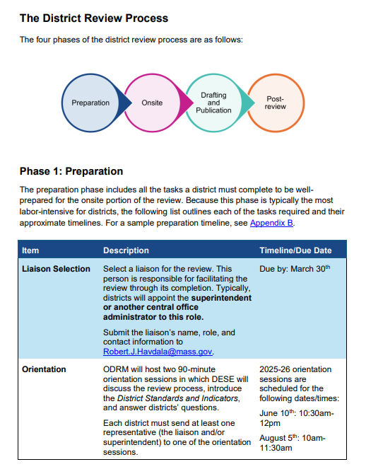
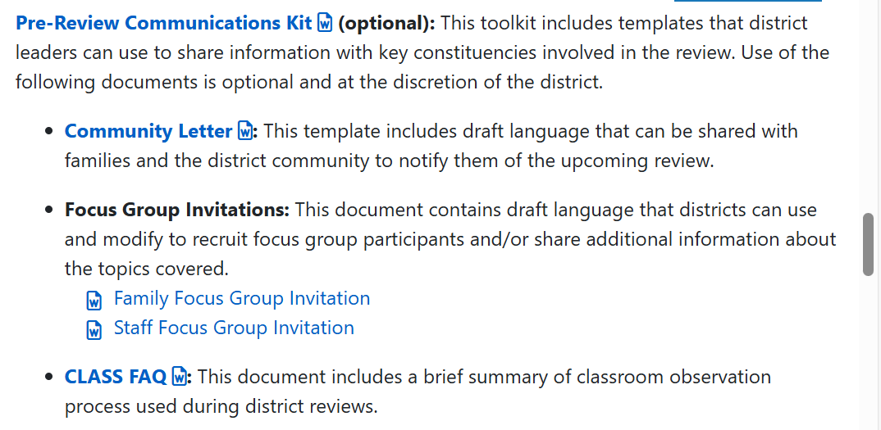
Preparation Phase – Documentation
Updated District Review Handbook
Developed the Pre-Review Communications Kit

Slide 22
Preparation Phase – Timelines and Trainings
Began selecting and notifying districts significantly earlier in the year
Late spring → winter
Started offering the first district orientation option before the end of the preceding school year
Implemented an optional training on the classroom observation tool used in district reviews (CLASS by Teachstone)

Slide 23

Onsite Phase
High Quality Instructional Materials (HQIM) Observations
Debrief Calls

Slide 24
Onsite Phase: HQIM Use
Began collecting and reporting data on evidence of High-Quality Instructional Materials use in classrooms
Example:
Teachers were using HQIM in 32 percent of all classrooms observed, but this further varies by grade level: teachers were using HQIM in 46 percent of elementary (Grades K-5) classrooms observed, in 21 percent of middle school (Grades 6-8) classrooms observed, and in 21 percent of high school (Grades 9-12) classrooms observed. These rates also varied by content: teachers were using HQIM in 68 percent of ELA lessons or classrooms observed, and in 11 percent of mathematics lessons or classrooms observed.

Slide 25
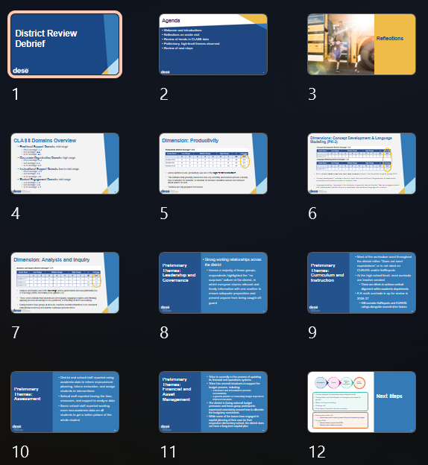
Onsite Phase: Debrief Calls
Began conducting debrief calls with district leaders approximately 10 days after each onsite visit

Slide 26

Drafting and Publication
District Profile
Appendix C

Slide 27
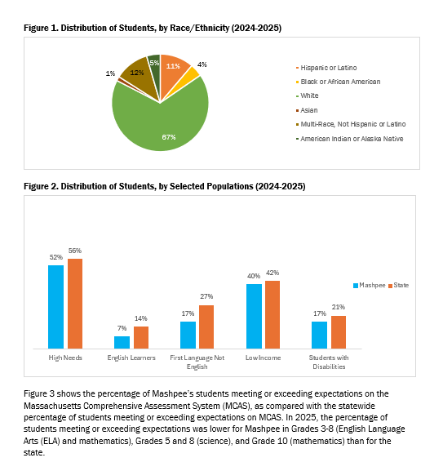
Drafting and Publication Phase
Revamped the District Profile section of the reports
Tailored Appendix C to include only relevant resources

Slide 28

Post-Review Phase
Findings Calls
Post-Review Action Kit
District Review Support Pilot

Slide 29
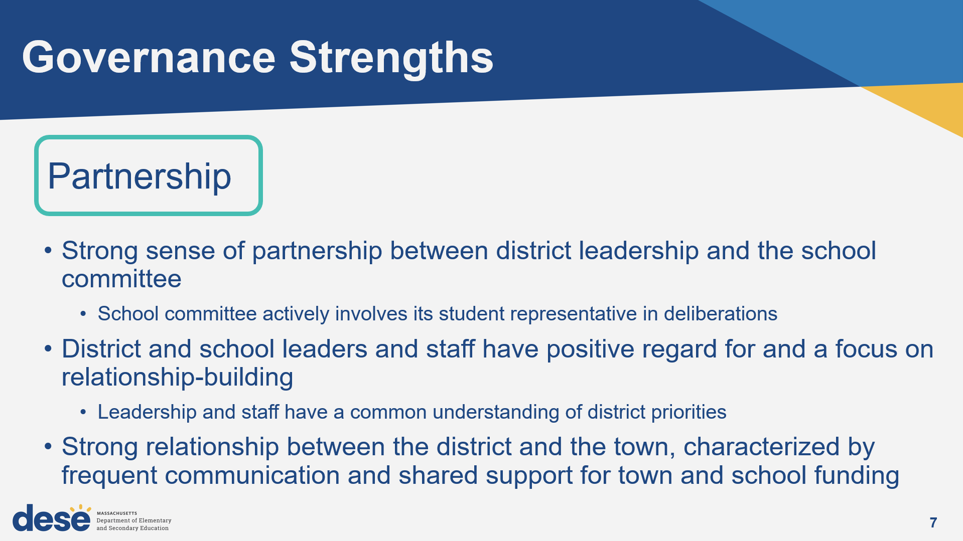
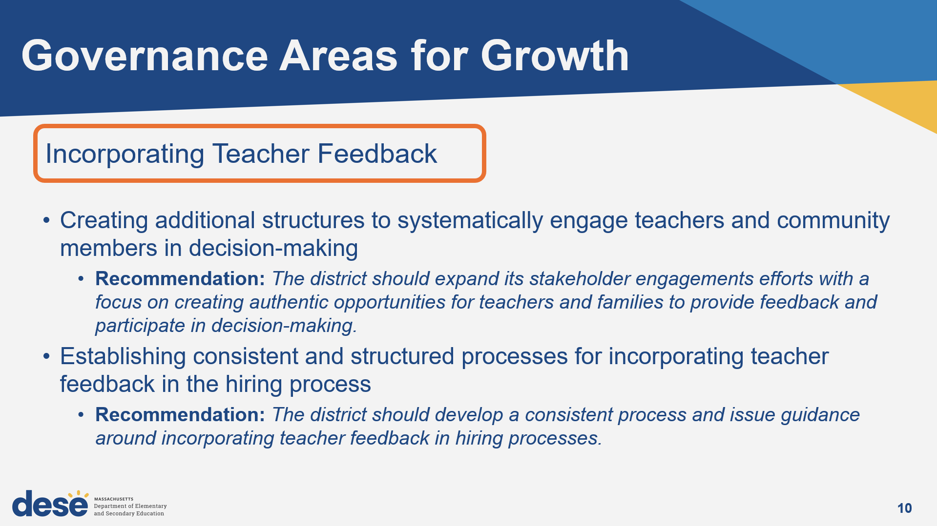
Post-Review Phase: Findings Calls
Began conducting Findings Calls with district leaders prior to report publication

Slide 30
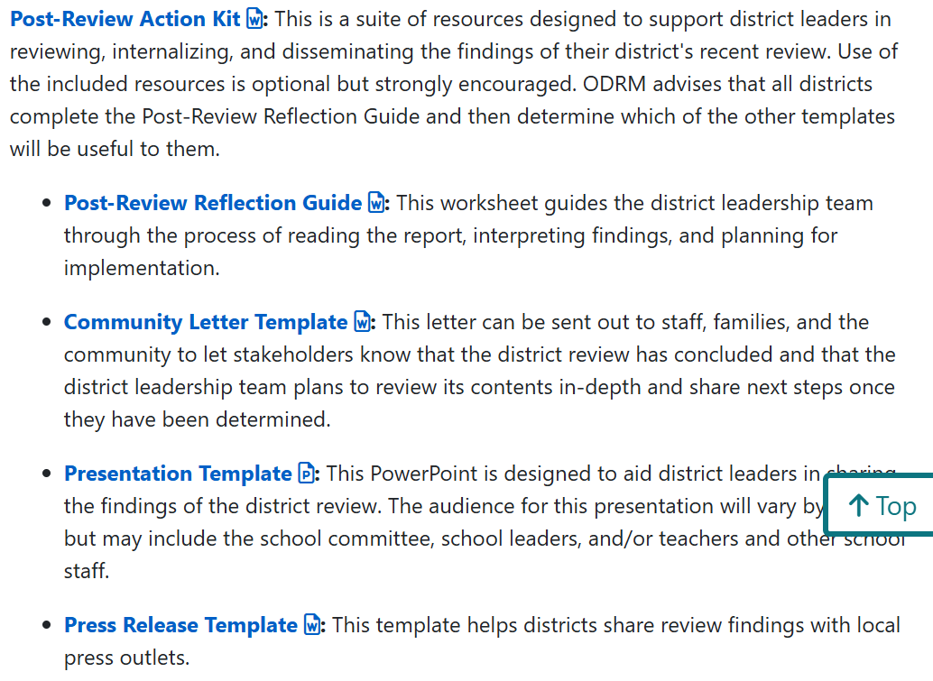
Post-Review Phase: Post-Review Supports
Developed the Post-Review Action Kit to support with planning, dissemination, and implementation
Launched District Review Support Pilot – light-touch implementation supports

Slide 31
District Review Support Pilot: Deeper Dive
Vision: Districts use the district review as a lever for progress and make substantive changes in district systems, policies, and practices based on recommendations in the report.
Information
The district review team at DESE serves as navigators, connecting district leaders to resources, individuals, and teams
Impact

Slide 32
Potential Pilot Structure
Planning Call
Step 1: Planning call
Select one or more recommendations to focus on for implementation
Set meeting cadence
Identify immediate next steps
Step 2: Ongoing check-ins and resource sharing
Share connections to people, programs, and resources within and beyond DESE to support the district’s efforts
Serve as thought-partners to district leadership
Step 3: Close out and reflection
Assess progress toward stated goals
Identify district’s next steps
3-Month
Check-in
6-Month
Check-in
9-Month
Check-in
12-Month
Close Out

Slide 33
Feedback
Nearly all districts send at least one representative to the optional CLASS training
Leaders express higher confidence in the validity and utility of CLASS data
Leaders appreciate the opportunities for facetime with DESE and the AIR team in the debrief and findings calls
Findings typically align with and/or reinforce what leaders are seeing in their districts
Reviews offer leverage for district leaders as they pursue continuous improvement
“This was the most useful of all of the DESE reviews we’ve been through in recent years”
– Superintendent

Slide 34
Discussion Questions
What other changes would you want DESE to investigate or pursue regarding changes to the district review process?
How can DESE balance the work of producing high quality reports, providing support, and limiting the burden we place on districts?

Slide 35
Next Steps and Closing

Slide 36
Looking Ahead
Last Meeting (virtual)
Wednesday, June 3rd (9:30 - 11:00 am)

