Slide 1
Accountability and Assistance Advisory Council Meeting
June 3, 2026

Slide 2
Agenda
Welcome
Accelerating Achievement Partnership (AAP) Discussion
Planning for SY2026-2027
Closing
Please be advised that DESE does not authorize attendees to record or to use AI transcription tools during the meeting and DESE does not endorse any unauthorized transcripts created by third parties of its meetings.

Slide 3
Welcome and Introductions
Council Co-Chairs: Barish Icin and Andrew O'Leary
New Member: Sarah Wilfred
Council Members
DESE Staff

Slide 4
Discussion Norms and Meeting Protocols
Promote risk-taking by not assigning specific comments to individual members in meeting summaries and minutes.
Maintain respect before, during, and after meetings.
Seek clarification and check understanding to avoid mistakenly attributing ideas to an individual or organization represented on the council.
Keep improvements in student learning at the core of the discussions. Students should drive the conversation.
Stay engaged in the issues.
Actively address implicit biases and instill cultural proficiency in discussions.
Encourage discussion from all voices of members. Be additive, not repetitive.
Let members know if pre-reading or other pre-meeting assignments require more than 30 minutes of preparation time.
Make it fun!

Slide 5
Accelerating Achievement Partnership (AAP)

Slide 6
Goals for Today
#1
Shared Understanding: Bring the AAAC up to speed on the genesis and goals of the Accelerating Achievement Partnership
#2
Current Updates: Provide updates on how the initiative is progressing to date
#3
Questions & Feedback: Solicit your questions and feedback about the initiative

Slide 7
Shared Understanding:
Bring the AAAC up to speed on the genesis and goals of the Accelerating Achievement Partnership
#1

Slide 8

Statewide Context
An Inspiring, Ambitious Vision…
…Amidst Sobering Results
MCAS pandemic recovery in MA has been far slower than in other states: many states have recovered most of their pandemic losses, with some states surpassing pre-pandemic levels. MA is still well below where we were.
It’s not just about the pandemic: NAEP declines have been long-term, significant, and impacting all student groups. The decline in MA began in 2017.
Gaps are widening: Until 2013, gaps were narrowing, with lowest performing students gaining at a higher rate than the highest performing students. Since 2013, that trend has reversed with Black and Hispanic students experiencing the steepest declines.
This is a Statewide challenge that is even further magnified
in our schools with the greatest needs

Slide 9
As a State, We Can Do Better
To achieve our educational vision,
DESE must figure out how to create optimal conditions for LEAs and schools (particularly those with the greatest needs) to deliver the highest quality teaching and learning environments,
so that schools and LEAs can create the conditions for all students to achieve
academic excellence.
Key Feedback from Districts Through Public Consulting Group’s Review of DESE
High-quality resources for the field
Highly invested DESE workforce
Ineffective and inconsistent external communications and information sharing
Lacking alignment between DESE’s work and local education agencies’ stated needs
Gaps in trust between DESE and external stakeholders

Slide 10
Implications for DESE’s Approach to LEA and School Assistance
Prioritization: DESE must be very intentional about how we prioritize our supports for the schools with the greatest needs – not only from its District and School Assistance unit – but across the entire agency.
Coordination: That support must be far more coherent, aligned, and coordinated in order to have the desired impact for those LEAs, schools, and the students that they serve.
Partnership: DESE must strengthen its two-way partnerships with these schools and LEAs to build trust, foster a culture of shared learning, ensure that supports are aligned with LEAs’ needs, and sustain meaningful change.

Slide 11
This Leads Us to the Commissioner’s Accelerating Achievement Partnership
Introduced as a DESE-wide strategic priority by Commissioner Martinez in 2025, the Accelerated Achievement Partnership is designed to:
  Provide school improvement supports (technical assistance, peer learning cohorts, grants, etc.) over the next 3-5 years to a priority set of LEAs and schools
  Align and prioritize resources across DESE to support partner LEAs and schools
  Build capacity at all levels (school, LEA, DESE) to comprehensively understand and respond to school improvement needs
  Simultaneously meet state and federal accountability requirements

Slide 12
Prioritized LEAs & Schools
  DESE is prioritizing close to 300 schools across 80 LEAs.
  These schools are currently performing in the bottom quartile of the accountability system and achieving less-than-expected progress toward targets:
    Less than "substantial" progress if school accountability percentile is between 11-25
    Less than "meeting targets" if school accountability percentile is between 1-10.
BY THE NUMBERS …
Approximately 200,000 students 14 single school districts (including 6 charters and 1 virtual school) 25 districts with a single school identified (representing 8-100% of the district) 26 districts with 2-4 schools identified (representing 11-75% of the district) 15 districts with 5-44 schools identified (representing 38-90% of the district)

Slide 13
A New Approach to Providing School Supports
Participation in this partnership is not a new accountability designation, and the partnership is not introducing any changes to the current Massachusetts’ District and School Accountability System.
The partnership includes both schools with state/federal designations (~60%) and schools without designations (~40%).
By including a significant opt-in audience, the partnership challenges DESE to better prioritize and organize how it provides supports to schools and LEAs, while still meeting statutory assistance obligations.
  Note: Schools with state or federal designations (i.e., Underperforming, Chronically Underperforming, Comprehensive Support and Improvement, Lowest 10th%, TSI, ATSI) will have specific requirements that reflect statutory assistance provisions.

Slide 14
Early Feedback Themes from LEA Leaders
All 80 LEA leaders were invited to initial conversations with the Commissioner and/or Deputy Commissioners. Key feedback themes included:
  Honor and do not disrupt existing supports that are working.
  Support LEAs with messaging; avoid punitive impacts on schools.
  Be aware of planning and assessment fatigue; planning time must yield significant value to the school.
  DESE should strengthen its own coherence and impact.

Slide 15
Current Updates
Provide updates on how the initiative is progressing to date
#2

Slide 16
Spring 2026 Supports
Key Objectives
What's Next?
Objective #1: Galvanize school and LEA leaders around a shared “why” for Accelerating Achievement Partnership ​
Objective #2: Strengthen data literacy among school and LEA leaders to influence data-informed improvement planning ​
Objective #3: Build a shared understanding of what the systems and practices outlined in the School-Level Standards and Indicators look like in practice and begin assessing areas of strength and need in each school’s local context. ​
Summer:
  Review and analyze school needs assessment data
  Review and analyze school and district improvement plans
  Match emerging needs to assistance ​

Slide 17
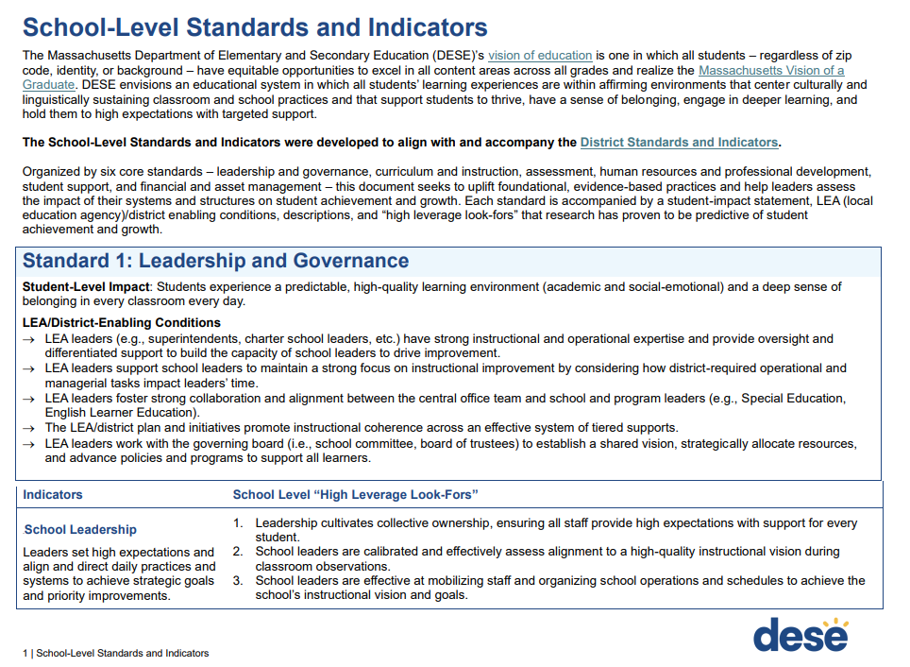
School-Level Standards & Indicators
Uplifts foundational, evidence-based practices to help leaders assess the impact of their systems and structures on student achievement and growth.
Each standard is accompanied by:
  A student-impact statement
  LEA (local education agency)/district enabling conditions
  Indicators & descriptions with “high leverage look-fors”

Slide 18
Questions & Feedback:
Solicit your questions and feedback about the overall initiative
#3

Slide 19
Reflection/Shareout/Questions
What are your reactions to the goals and objectives shared today?
What questions do you have?
What are your reflections as you hear about the objectives of the supports this spring and what is coming next?
Are there any significant missing pieces that may hinder DESE's ability to:
  Implement the appropriate supports to schools and LEAs?

Slide 20
Planning for SY2026-2027

Slide 21
Previous Council Topics
Assistance: Progress Monitoring
MCAS and Accountability Results
DESE’s District Review Process
DESE’s Accountability System Review Process
Statewide Graduation Council Updates
WIDA ACCESS Transition

Slide 22
SY2026-2027 Meetings
Potential agenda items:
  Update on the Statewide Graduation Council
  Update on the WIDA ACCESS Transition
What topics would you like to see covered during SY2026-27?

Slide 23
Closing

Slide 24
Looking Ahead
Five meetings for SY2026-27 (October, December, February, April, June)
  Virtual format
  Schedule TBD

