Slide 1
Civic Learning and Engagement
Heather Peske, Senior Associate Commissioner
David Buchanan, Assistant Director of Literacy and Humanities
Panel discussion with members of the Civic Learning and Engagement Task Force
Board of Elementary and Secondary Education
April 18, 2017

Slide 2
Goals for Today
Introduce new Civic Learning and Engagement Strategic Plan/Report on current and planned initiatives
Talk with members of the Civic Learning and Engagement Task Force
Gain Board feedback

Slide 3
Background

Slide 4
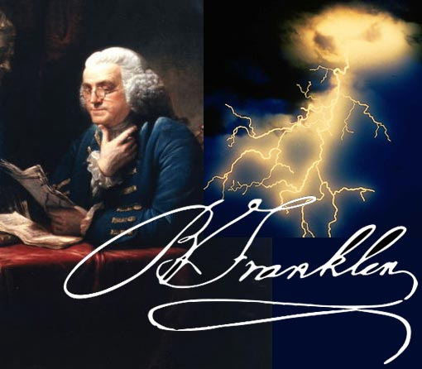
…A republic, if you can keep it
Notes:
The continued health of our republic depends on us, to understand and participate in civic life.

Slide 5
Cause for Concern
Nationally –
2014 NAEP US history, geography, civics:
Less than one third of 8th graders (similar results for 12th graders) scored proficient or higher; only 3% or fewer scored advanced
Massachusetts-
2015 MA Association of School Superintendents Survey – 60% of superintendents rated the level of civic learning in their districts as insufficient
Notes:
But, many students today lack basic knowledge about civics and are not engaged.

Slide 6
Civic Empowerment Gap
Low participation, especially among youth
low participation in national elections and non-electoral activities – volunteering, working with others to fix a community problem
Same demographic gaps as Achievement Gap (by level of education, income and race)
Source: US Census Bureau, Corp for National and Community Service, National Conference on Citizenship, cited in:
Levinson, Meira (2012). No Citizen Left Behind . Cambridge: Harvard University Press.

Slide 7
Students who experience effective civic learning are…
More likely to vote and discuss politics at home
Four times more likely to volunteer and work on community issues
More confident in their ability to speak publicly and communicate with their elected representatives
Campaign for the Civic Mission of Schools Report, Guardian of Democracy: The Civic Mission of Schools

Slide 8
Schools with strong civic learning programs are…
… more likely to be “safe, inclusive, and
respectful.”
Campaign for the Civic Mission of Schools Report, Guardian of Democracy: The Civic Mission of Schools

Slide 9
What is Effective Civic Learning?
Students need explicit instruction and experience in civic engagement to live it. How?
Six Promising Practices
Instruction in government, history, economics, law, democracy
Discussion of current events and controversial issues
Service learning
Extracurricular activities
School governance
Simulations of the democratic process
Campaign for the Civic Mission of Schools Report, Guardian of Democracy: The Civic Mission of Schools
Notes:
Service Learning-Active community-based experience, but also connection to academic content.
Extracurricular activities - calls for students to participate in activities related to civic learning and engagement – Model UN, Debate team etc
School governance – students actively engage in student government – and that body should have some actual authority in the school.

Slide 10
Review of Recent Department Actions

Slide 11
Working Group/Preparing Citizens Report Recommendations
Include readiness for civic life in definition of college and career readiness
Establish statewide network of regional advisory councils
Convene an annual conference
Revise the 2003 History and Social Science Curriculum Framework
Establish funding to support civic learning
Assess each school and district’s effectiveness in developing and delivering sound civic instruction
Preparing Citizens Report on Civic Learning and Engagement, MA Board of Elementary and Secondary Education Working Group on Civic Learning and Engagement, June 2015

Slide 12
Current ESE Initiatives
Revised Definition of College and Career Readiness, to include readiness for civic life
Civic Learning and Engagement Task Force
Civics Literacy Conference – May 8, 2017
Student Government Day
Revision of the 2003 MA History and Social Science Curriculum Framework
Proposed Next Generation MCAS in History and Social Sciences, integrating civics

Slide 13
Civic Learning and Engagement Task Force
Met February–December 2016
Charge: To make recommendations on how ESE can most effectively support civic engagement and learning

Slide 14
The Plan - 3 Strategies
1. Develop a communications strategy about the importance of civic learning and engagement in students’ success
2. Increase visibility of civic learning and engagement offerings and highlight best practices using data
3. Strengthen the teaching and learning of civics
See Strategic Plan, p. 1

Slide 15
Implementation Overview Years 1 - 2
2016-17 – See Current Initiatives slide
2017-18
Continue revision of the 2003 MA History Social Science Curriculum Framework
Pursue development of proposed Next Gen MCAS in History and Social Science, integrating civics
Promote definition of CCR and civic readiness
Make connections to other ESE initiatives, other disciplines
Convene Civic Education Partners
See Strategic Plan, p. 14
Note: projects in italics depend on additional funding

Slide 16
Implementation Overview –Year 3
2018-19
Launch implementation of revised framework
Pursue development of proposed Next Gen MCAS in History and Social Sciences, integrating civics
Maintain other 2017-18 projects
Establish communications campaign
Establish school/district recognition program
Develop inventory of civic learning and engagement; research statewide data reporting system
Note: projects in italics depend on additional funding

Slide 17
Implementation Overview –Year 3
Update standards of Subject Matter Knowledge (SMKs)
Develop regional support system
Pursue creation of state budget line item for PD/grant program
Note: projects in italics depend on additional funding

Slide 18
Task Force Member Presentations/Discussion
Alan Melchior, Associate Director of the Center for Youth and Communities – Brandeis University
Nadine Ekstrom, Superintendent - Berlin-Boylston Public Schools

Slide 19
Thank you!
David Buchanan dbuchanan@doe.mass.edu
Jason Hilton jason.hilton@doe.mass.edu
historycivics@doe.mass.edu

