Slide 1
Educator License Actions: Report to Board of ESE
October 24, 2017

Slide 2
Office of Professional Practices Investigations (OPPI): Mission
Protect students from potentially harmful educators
Maintain the integrity of the education profession
Provide due process to licensed educators who are alleged to have committed misconduct
Preserve high quality standards for 96,000 MA licensed educators

Slide 3

Legal Framework
Commissioner may suspend, revoke or
limit a license if the licensee:
  Lacks “sound moral character”
  Pleads guilty to or is convicted of a crime
  Commits gross misconduct or negligence
  Is dismissed from a school for just cause
  Misrepresents their history on application
  Has another professional license revoked, suspended or surrendered
  See G.L. c. 71, § 38G; 603 C.M.R. 7.15(8)(a).
Notes:
Our statute requires individuals to have SOUND MORAL CHARACTER to receive a license from the Commissioner. What does that mean? The additional grounds specified in our regulation help flesh out that concept.
Our investigations and recommendations are very fact-specific—we exercise discretion and aim to be consistent in what we recommend.
We also examine the educator’s character as a whole, not just the indiscretion for which we are investigating him or her. Also, not every criminal conviction is disqualifying [unless the crime was committed against a child]: We recognize the difference between a convictions for selling cocaine in 2013 and marijuana possession 20 years ago or shoplifting a lipstick in college or receiving a first conviction for driving under the influence of alcohol or drugs. But maybe the third offense looks more serious . . .
See M.G.L. c. 71, § 38G; 603 C.M.R. 7.15(8)(a).
Presenter: CCC

Slide 4

Reporting Misconduct
Sources of Reports:
School administrators
  Dismissals, non-renewals and resignations (for cited reasons)
Licensees
Other sources
  Media, law enforcement, DCF, school staff, parents
Notes:
How do we find out about the misconduct? The majority of the reports come from school administrators.
Failure to report may constitute grounds for revocation of the administrator’s license.
Administrators Required to Report:
The dismissal, non-renewal or resignation of a licensed educator for misconduct
Certain national criminal history information about licensees
Must report within 30 days of discovery
Licensees Required to Report:
Certain life events:
- Appeared as a defendant in a criminal case
- Sanction or surrender of another professional license
- e.g., educator licensed in NH and MA; NH license revoked; have to report it to us
- e.g., guidance counselor also licensed as a psychologist; license as a psychologist revoked due to inappropriate conduct with a patient; must report it to us
Must report within 10 days
Other Sources of Misconduct Reports:
Media
Law enforcement and district attorneys offices
Department of Children & Families (DCF)
Reports from school staff (e.g., paraprofessionals), concerned parents, others (tipline; referrals from other units in agency e.g., Student Assessment)
Other States
Presenter: AT

Slide 5


Employment vs. Licensure
District
State
Notes:
OPPI is not second guessing employment decisions by schools and districts. School employees may have certain statutory rights to have employment decisions reviewed in arbitrations. But the licensing agency must focus on whether the misconduct which caused the employer to take an action casts doubt on the educator’s fitness or professional integrity. So even if an educator was fired for what the employer deems unprofessional conduct, like throwing a soft object at a student in anger or swearing at a group of students or insubordination or failure to follow school policies, like too many absences—after investigation, we may determine that this conduct is unlikely to be repeated, that the educator has been severely punished by losing the job or that some form of additional training is needed, e.g. anger management or training in professional boundaries.
Presenter: JA

Slide 6

What do we investigate?
  Boundary violations
  Grooming students for inappropriate relationships
  Sexual relationships with students
  Inflicting physical harm on students
  MCAS cheating
  Criminal conduct
  Inappropriate language and acts
  Substance abuse
6
Notes:
Allegations of the following:
Boundary violations [over-sharing, invading personal space]
Sexual relationships with students
Inflicting physical harm on students
MCAS cheating
Other criminal conduct [drugs, larceny, crimes of violence, multiple OUIs]
Inappropriate language & demeanor
Grooming students for future inappropriate relationships
Substance abuse in school
Presenter: JA

Slide 7
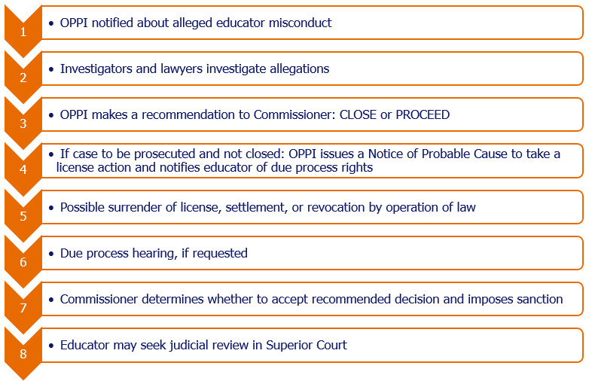
Licensee Investigations
Notes:
Investigation may include : interviews; review of docs, court papers, school records, personnel file; , request for educator’s version of events; review of social media, forensic examination etc
If after investigation, allegations appear unproven or the evidence is just not sufficient or relatively minor misconduct is not likely to be repeated or educator needs additional training and is salvageable or for other good reason, we may recommend settlement or closing without action.
Presenter: JA

Slide 8
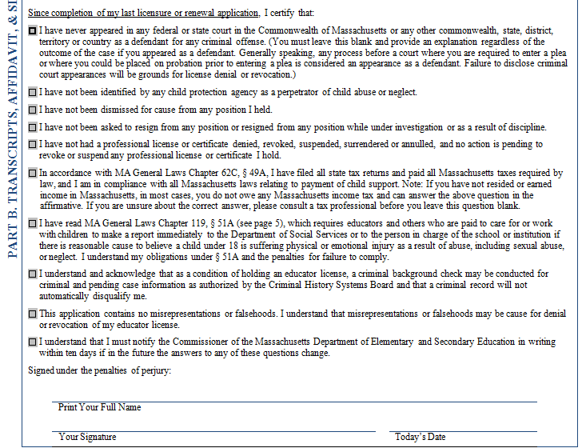

Applications for Licensure
Applicants must disclose:
Criminal court appearances and convictions
Child neglect or abuse findings
Employment dismissals for cause
Applicants also must certify:
There are no misrepresentations on the application
To disclose any future changes to their answers
Notes:
Given the volume of applications and renewals [Last year, Licensure set a record, handling over 100,000 applications and renewals] we depend on self-disclosure by those applying for licensure. OPPI SCREENED ABOUT 800 APPLICANTS FOR LICENSE OR RE-LIC ENSE LAST YEAR. The affidavit seeks information about the individual’s history of criminal offenses and child abuse or neglect findings. It also asks about dismissals for cause and resignations while under investigation. Note that applicants for licensure or renewal must attest to the truthfulness of their answers or risk denial or revocation of their license. Applicants are directed to add an explanation for any unchecked boxes. Also, license holders are required to notify the Commissioner in writing within 10 days if any of their answers change. Since OPPI often finds out about an individual’s past through other means, it makes good sense to disclose one’s history on this affidavit and then explain the circumstances.
QD

Slide 9

Applicant Investigations
800 licensure applicant reviews per year
Investigation: interviews, contact references, obtain court and employment records, track professional discipline
Recommend licensure or denial
Notes:
Presenter: QD

Slide 10

Background Checks
  MA Criminal Background Checks (CORI)
    Cost absorbed by the state
    Free for public school educators & volunteers
    Must be repeated at least every 3 years
  Federal Criminal Background Checks
    All public & private school employees and contractors, phased in by September 2016
    License holders’ Fee: $55
    Others (i.e. cafeteria workers, bus drivers): $35
  See G.L. c. 71, sec. 38R, as amended
Notes:
See GL c. 71, sec. 38R. January 2013, Chapter 459 of the Acts of 2012, “An Act Relative to Background Checks."This new law expands what public, private, and parochial schools already do in conducting state Criminal Offender Record Information (CORI) checks on all employees at least once every three years. In MA, the Commonwealth has always absorbed the cost of the state criminal record checks for public school employees. The new law now requires at least one fingerprint-based state and national criminal record check for all school employees and contractor employees, including substitute and student teachers, and if districts so choose, for volunteers. The standard for who must be checked is those who may have DIRECT UNMONITORED CONTACT with students. Licensed educators must pay $55 for their fingerprint based check; everyone else pays $35, including school secretaries, cafeteria workers, janitors, bus drivers. MA is the 50th state to gain access to the FBI national database. Like many other states, MA has contracted with a vendor who maintains kiosks around the state to take fingerprints electronically. Those are submitted to the FBI and the State Police, and the resulting reports are vetted by the MA DCJIS to comply with our strict CORI law about what can be disclosed. These reports can ONLY go to schools—not directly to ESE, not to contractors, not to anyone else. If something shows up in a criminal history report that is concerning about a licensed educator, schools must report that to OPPI for possible investigation.
Presenter: CCC

Slide 11
Data, Jan. 2012-July 2017
License holders: 371 licensees sanctioned (educator license revoked, suspended, etc.)
Applicants: 74 significant investigations; 17 applicants denied
Total cases closed: 448
Total open investigations: 326
Questions, discussion

