Slide 1
2017 MCAS Reporting
Michol Stapel, Associate Commissioner
Bob Lee, MCAS Chief Analyst
October 23, 2017

Slide 2
What is the Next-Generation MCAS?
Updated version of the nearly 20-year-old MCAS assessment
Focuses on students’ critical thinking abilities, application of knowledge, and ability to make connections between reading and writing
Gives a clearer signal of readiness for the next grade level or college and career
Designed to be given on a computer (paper versions remain available)
First given in spring 2017 in grades 3-8 in English language arts & math
Will eventually replace all older (“legacy”) MCAS tests in grades 3-10

Slide 3

Computer-Based Testing
Spring 2017:
  60% of all grades 3-8 students took the test on computers; >93% in grades 4 and 8
Phasing in computer-based testing by grade level
  Spring 2017: Grades 4 and 8 English language arts (ELA) & math
  Spring 2018: Grades 4-5 and 7-8 in ELA and math and grades 5 and 8 in science and tech/eng
  Spring 2019: All tests in grades 3-8, grade 10 ELA and math

Slide 4
MCAS Participation Rates
 | ELA | Math | Science/TE
Grade 3 | 99.3% | 99.5%
Grade 4 | 99.3% | 99.5%
Grade 5 | 99.3% | 99.4% | 99.4%
Grade 6 | 99.2% | 99.3%
Grade 7 | 99.1% | 99.2%
Grade 8 | 98.9% | 98.9% | 98.7%
Grade 10 | 97.9% | 98.3% | 99.0%
All Grades | 99.0% (+.3) | 99.2% (+.6) | 99.0% (+.1)

Slide 5
Next Generation MCAS Transition
  1. Higher, but achievable, expectations
    New achievement levels (Exceeding Expectations, Meeting Expectations, Partially Meeting Expectations, Not Meeting Expectations)
    New scale (440-560)
  2. Educator participation and involvement
    Framework revisions, test item review, standard setting
  3. Coherence across grade spans
    Expectations are similar across grades
  4. Aligned to readiness at the next level
    Signaling preparedness for college and career
  5. Next-gen results cannot be directly compared to legacy results
    Trends and accountability reporting on hold

Slide 6
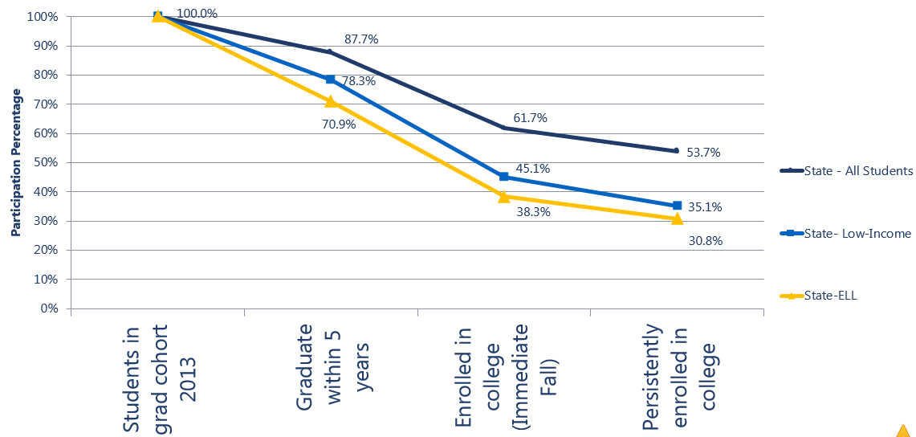
Baseline readiness for the next level (Class of 2013)

Slide 7
Evidence of Academic Readiness
62% of students attending 2-year-colleges require remedial coursework; 27% in four year colleges
Massachusetts College Graduation Rates*
  76% - Private 4-year-colleges – 1st in the nation
  58% - Public 4-year-colleges – 21st in the nation
  16% - Public 2-year-colleges – 34th in the nation
*Source: NCES graduates from the college class of 2013 finishing within 150% of the expected time
Notes:
Only 10% of the students enrolled in remedial courses graduate from 2 year colleges in 3 years in MA. Just 50% of the students enrolled in remedial course complete college within 6 years. Source Remediation: Higher Education’s Bridge to Nowhere”, by Compete College America funded by the National Governor’s Association

Slide 8
MCAS Legacy Results:
Science and Technology/Engineering and High School
 | Percent of Students Scoring Proficient or Higher
 | English Language Arts |  |  | Mathematics |  |  | Science & Tech/Eng.
 | 2017 | 2016 | Change | 2017 | 2016 | Change | 2017 | 2016 | Change
Grade 5 |  |  |  |  |  |  | 46% | 47% | -1%
Grade 8 |  |  |  |  |  |  | 40% | 41% | -1%
Grade 10 | 91% | 91% | 0% | 79% | 78% | +1% | 74% | 73% | +1%

Slide 9
2017 Statewide MCAS Results: Class of 2019
Percentage of Students Scoring Needs Improvement or Higher in ELA, Mathematics, and STE through the Spring 2017 Administration*
Subgroup | ELA | Math | ELA and Math | STE | All Three Tests
All Students | 95 | 90 | 89 | 93 | 88
Female | 96 | 92 | 91 | 94 | 89
Male | 94 | 89 | 88 | 92 | 86
Race/Ethnicity
African American/Black | 92 | 82 | 81 | 87 | 78
Asian | 97 | 96 | 95 | 96 | 93
Hispanic or Latino | 88 | 77 | 75 | 82 | 71
Multi-Race, Non-Hispanic or Latino | 96 | 91 | 91 | 94 | 89
White | 97 | 94 | 94 | 96 | 93
Student Status
Non-Disabled | 97 | 95 | 94 | 96 | 93
Students with Disabilities | 85 | 69 | 67 | 78 | 64
English Language Learner (ELL) | 68 | 55 | 47 | 59 | 40
Economically Disadvantaged | 90 | 80 | 78 | 85 | 75
* Includes all students enrolled as 10th graders through June 2017, including those who were absent or exempt from grade 10 results due to their status as first year English Learners

Slide 10
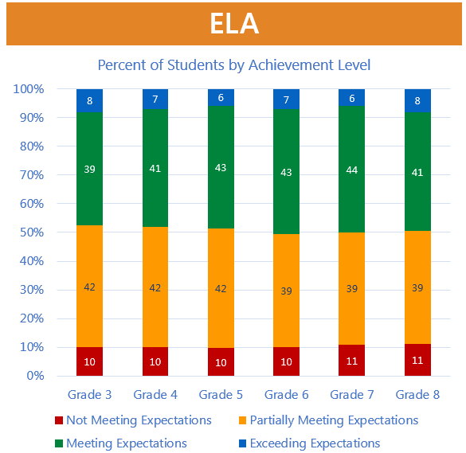
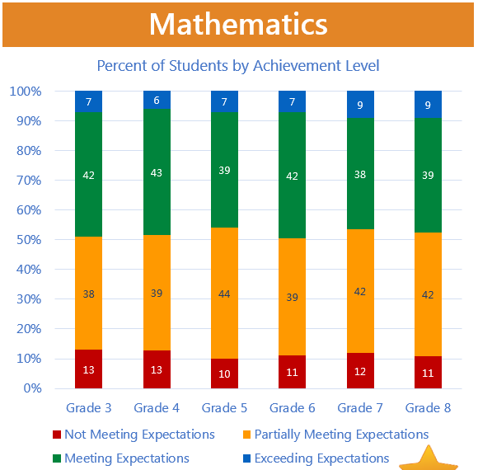
Next-Generation (3-8) 2017 State Results

Slide 11
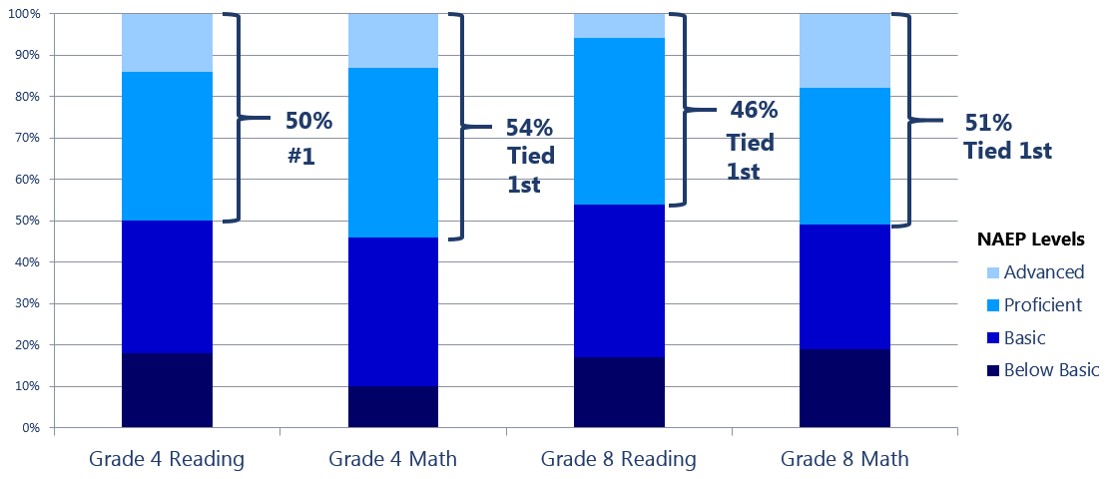
Massachusetts 2015 National Assessment of Educational Progress (NAEP) Results

Slide 12
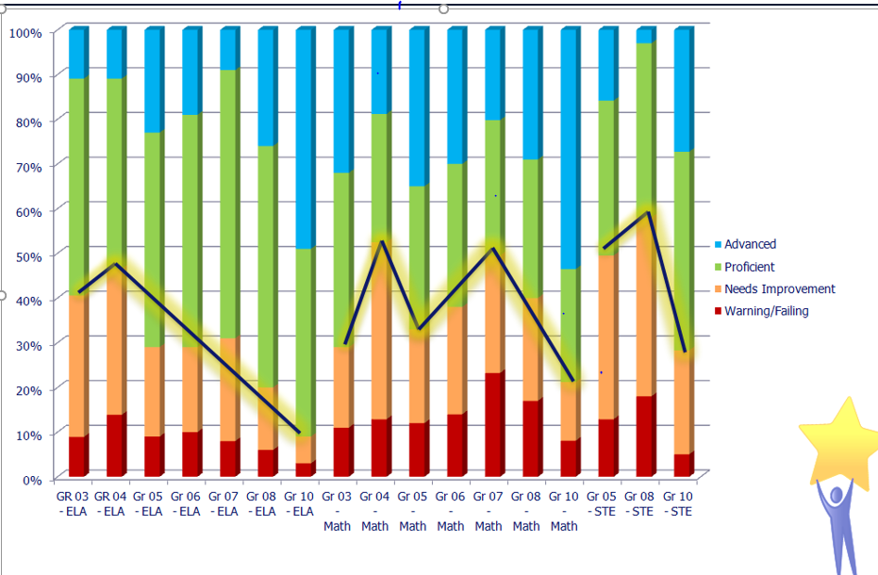
MCAS 2015 (Legacy) Results

Slide 13
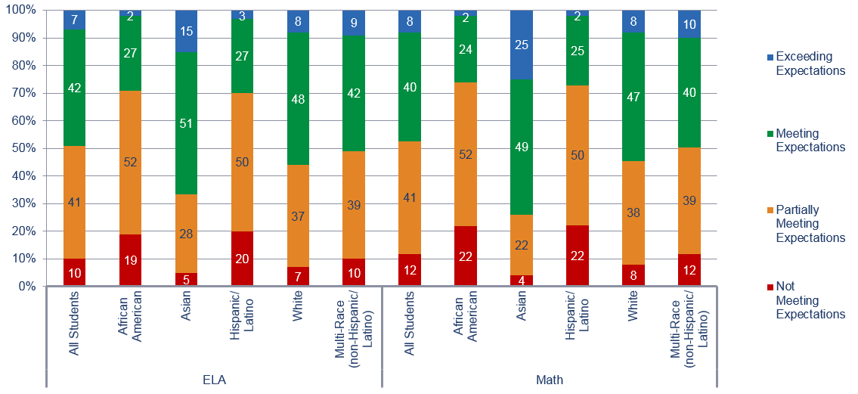
2017 Next-Generation Grades 3-8:
MCAS Results by Major Race/Ethnic Groups

Slide 14
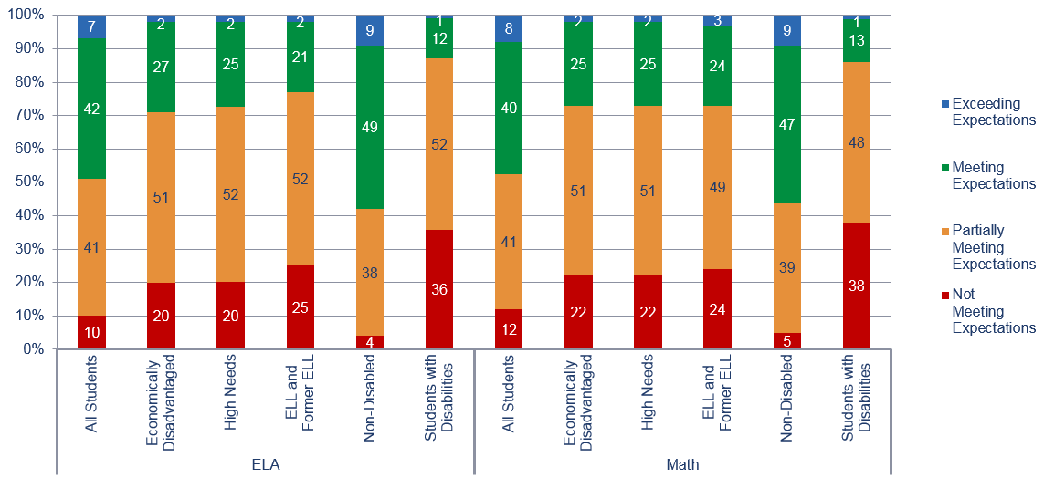
2017 Next-Generation MCAS Grades 3-8: Percent of Students in Achievement Levels Among Select Student Groups

Slide 15
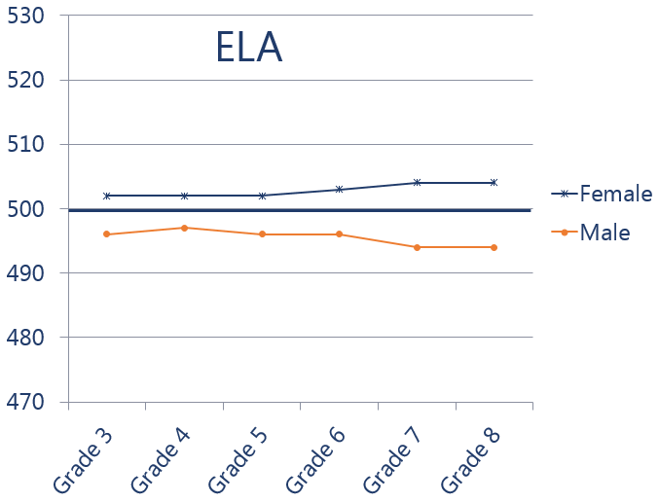
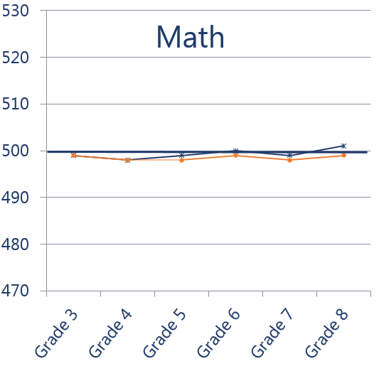
2017 Next-Generation 3-8 Results by Gender

Slide 16
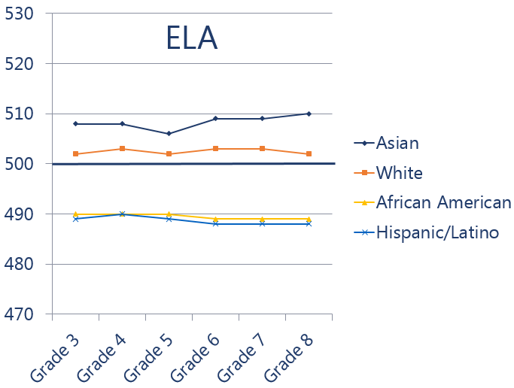
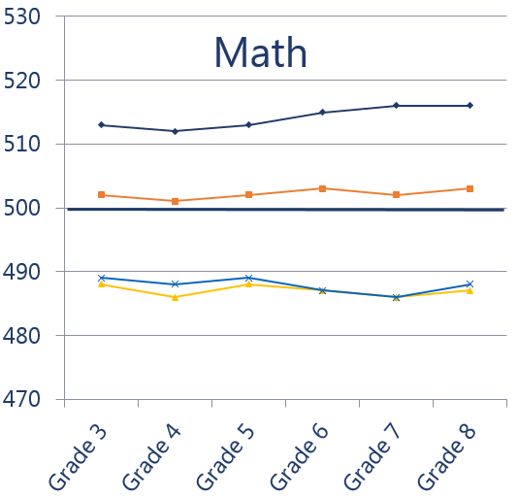
2017 Next Generation 3-8 Results by Race/Ethnicity

Slide 17
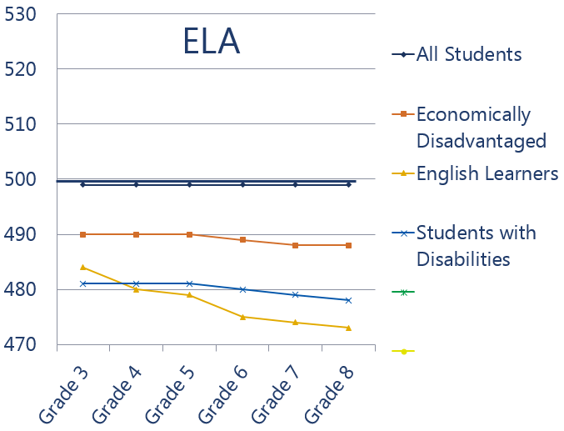
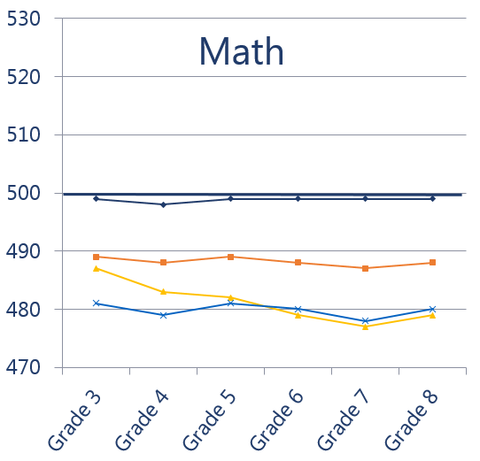
2017 Next Generation 3-8 Results by Selected Groups

Slide 18
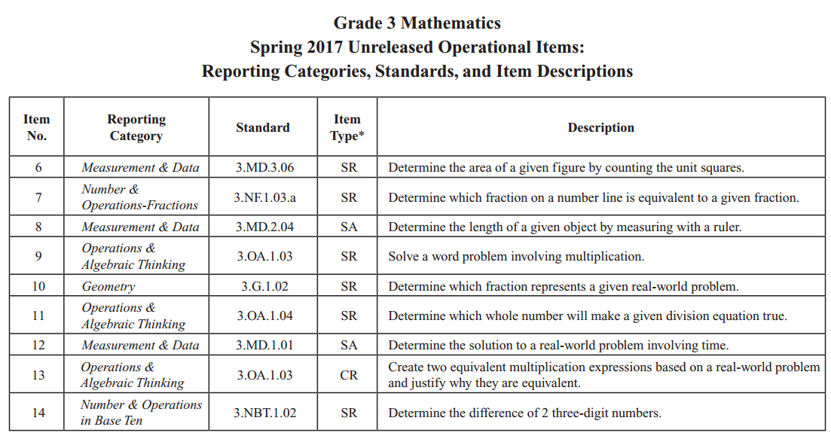
Resources for Released & Unreleased Items
View released CBT student essays in school DropBoxes (grades 4 & 8).
View CBT & PBT released item sets (CBT in practice test format)
http://mcas.pearsonsupport.com/released-items.
Scoring guides and samples of student work for open-response & constructed-response items, essays, and grade 10 writing prompts posted at:
http://www.doe.mass.edu/mcas/student/2017
Item descriptions available for all NextGen questions in the released items document at: http://www.doe.mass.edu/mcas/2017/release.

Slide 19
Resources/more information (posted on a rolling basis)
For parents
For educators
www.doe.mass.edu/mcas/parents
Parent Guide to the MCAS (available in several languages
Annotated Parent/Guardian Reports (PPT)
Frequently Asked Questions (FAQs)
What are the Achievement Level Descriptors?
Item Descriptions for Grades 3-8 ELA and Mathematics
Parent/guardian report templates and translations
www.doe.mass.edu/mcas/results-supplement.html
Links to Released Items, Answer Keys, and Item Descriptions
Information about the Next-Generation Achievement Levels
Sample Letter for Districts to Families
Understanding the Next-Generation MCAS (PPT)
Recording of October 16 Reporting Session for Grades 3-8 ELA and Mathematics Results
Board of Elementary and Secondary Education October Meeting Materials

