Slide 1
2017 Accountability Reporting Update on Overall District & School Accountability Determinations
Presentation to the Board of Elementary & Secondary Education
October 23, 2017

Slide 2
Goals of this presentation
Provide an overview of 2017 district & school accountability determinations
Share assessment & accountability results for Level 5 schools & districts

Slide 3
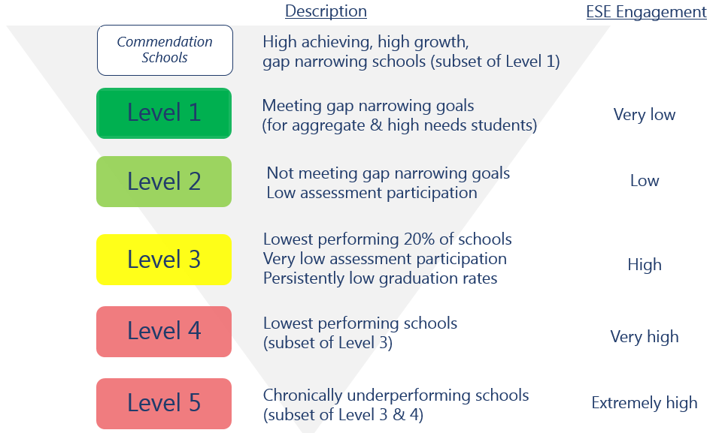
Current framework for district & school accountability & assistance

Slide 4
Amendment to 603 CMR 2.00: Accountability & Assistance for School Districts & Schools
Approved at the April 2017 BESE meeting
Allows ESE to refrain from placing certain schools into Levels 1-3 at the beginning of the 2017-18 school year
Applies to one year only
Impacts schools serving grades 3-8 that administered Next-Generation MCAS tests in spring 2017
Does not impact high schools serving grades 9-12 that did not administer Next-Generation MCAS

Slide 5
Reporting details
Schools & districts administering Next-Generation MCAS in grades 3-8 that have participation rates below 90% were placed into Level 3
Schools serving a combination of grades 3-8 & 9-12 that have persistently low graduation rates for any group were placed into Level 3
Level 4 or 5 schools or districts that did not exit maintained their level designation
All other Next-Generation MCAS schools meeting participation & graduation rate requirements did not receive a school percentile, Progress & Performance Index (PPI), or accountability & assistance level (1-3)
No new Level 4 or Level 5 schools were identified among schools serving grades 3-8 in 2017
Low-performing high schools were eligible for Level 4 & 5 designations
2017 assessment results will serve as the new baseline for target-setting in 2018 & beyond

Slide 6
Data reported in 2017
Schools administering legacy MCAS tests only (high schools)
Schools administering Next-Generation MCAS tests in grades 3-8
Performance on all accountability indicators
Progress & performance index (PPI) data
School accountability percentiles
Accountability & assistance levels (1-5)
Schools identified for low or very low assessment participation
Schools identified for persistently low graduation rates
Next-Generation MCAS achievement percentiles (ELA & math, by grade & subgroup)
Transitional student growth percentiles
Accountability & assistance levels:
No level
Level 3
Very low assessment participation
Persistently low graduation rates
Current Level 4 & Level 5 schools

Slide 7
2016 & 2017 District levels
District Totals by Level | 2016 |  | 2017
 | # | % | # | %
Level 5 | 3 | 1% | 3 | 1%
Level 4 | 7 | 2% | -- | --
Level 3 | 62 | 16% | 13 | 3%
Level 2 | 233 | 61% | 20 | 5%
Level 1 | 80 | 21% | 16 | 4%
No level | -- | -- | 344 | 87%
Total | 385 | 100% | 396 | 100%
Insufficient Data¹ | 22 | -- | 8 | --
¹ Districts with insufficient data to be eligible for a level are those ending in grade PK, K, 1, or 2, very small districts, & districts without four full years of data.

Slide 8
2016 & 2017 School levels
School Totals by Level | 2016 |  | 2017
 | # | % | # | %
Level 5 | 4 | 0% | 4 | 0%
Level 4 | 33 | 2% | 31 | 2%
Level 3 | 265 | 16% | 81 | 5%
Level 2 | 794 | 49% | 129 | 8%
Level 1 | 525 | 32% | 70 | 4%
No level | -- | -- | 1324 | 81%
Total | 1621 | 100% | 1639 | 100%
Insufficient Data¹ | 233 | -- | 211 | --
¹ Schools & single-school districts with insufficient data to be eligible for a level are schools ending in grade PK, K, 1, or 2, very small schools, & schools without four full years of data.

Slide 9
Next-Generation MCAS schools by accountability level
 |  | # | %
Next-Generation MCAS schools |  | 1385 | 100.0
Insufficient data |  | 10 | 0.7
No level |  | 1324 | 95.6
Level 3 |  | 24 | 1.7
 | Very low assessment participation (less than 90%) | 23
 | Persistently low graduation rates¹ | 3
Level 4 |  | 22 | 1.6
Level 5 |  | 4 | 0.3
¹“Persistently low” is defined as a 2016 four-year cohort graduation of less than 67 percent & 2015, 2014, & 2013 five-year cohort graduation rates of less than 70 percent.

Slide 10
Legacy MCAS schools by accountability level
 |  | # | %
Legacy MCAS schools (high schools) |  | 298 | 100.0
Insufficient data |  | 33 | 11.1
Level 1 |  | 70 | 23.5
Level 2 |  | 129 | 43.3
 | Low assessment participation (90% - 95%) only | 6
Level 3 |  | 57 | 19.1
 | Very low assessment participation (less than 90%) only | 9
 | Persistently low graduation rates only | 3
Level 4 |  | 9 | 3.0

Slide 11
2017 Commendation schools
School | Commendation Reason
Abington High | High progress & narrowing proficiency gaps
Lynnfield High | High achievement & high progress
Swampscott High | Narrowing proficiency gaps
Westwood High | High achievement & high progress
Apponequet Regional High (Freetown-Lakeville) | High progress
Blackstone Valley RVT High | High achievement & high progress
Minuteman Regional High | High progress & narrowing proficiency gaps
Heights Elementary (Sharon) | 2017 National Blue Ribbon School - Gap Closing
White Street (Springfield) | 2017 National Blue Ribbon School - Gap Closing
Old Post Road (Walpole) | 2017 National Blue Ribbon School - High Performing

Slide 12
2017 Level 4 decisions
Randolph Public Schools exited Level 4
No new Level 4 schools
Previously designated Level 4 schools remained in Level 4 (no exits)

Slide 13
Level 5 school update: Morgan Full Service Community (Holyoke)
Achievement
 | % EE | % ME | % PME | % NME | Avg. SS | Ach. %ile
ELA | 0 | 14 | 60 | 26 | 481.1 | 4
Math | 0 | 11 | 56 | 33 | 478.0 | 4
 | % A | % P | % NI | % W/F | CPI
Science | 0 | 9 | 45 | 45 | 44.1
Growth
 | 2012 | 2013 | 2014 | 2015 | 2016 | 2017
ELA | 58.0 | 44.0 | 46.0 | 33.0 | 57.0 | 49.0
Math | 62.0 | 49.5 | 54.0 | 35.0 | 61.0 | 37.0

Slide 14
Level 5 school update: John Avery Parker (New Bedford)
Achievement
 | % EE | % ME | % PME | % NME | Avg. SS | Ach. %ile
ELA | 0 | 14 | 62 | 24 | 482.9 | 5
Math | 0 | 16 | 57 | 27 | 481.3 | 6
 | % A | % P | % NI | % W/F | CPI
Science | 0 | 11 | 44 | 44 | 44.4
Growth
 | 2012 | 2013 | 2014 | 2015 | 2016 | 2017
ELA | 52.0 | 50.0 | 46.5 | 39.0 | 47.0 | 46.0
Math | 58.5 | 60.0 | 61.0 | 18.0 | 70.0 | 31.0

Slide 15
Level 5 school update: UP Academy Holland (Boston)
Achievement
 | % EE | % ME | % PME | % NME | Avg. SS | Ach. %ile
ELA | 1 | 21 | 51 | 26 | 485.7 | 8
Math | 0 | 20 | 49 | 31 | 483.0 | 7
 | % A | % P | % NI | % W/F | CPI
Science | 2 | 10 | 46 | 41 | 52.0
Growth
 | 2012 | 2013 | 2014 | 2015 | 2016 | 2017
ELA | 49.0 | 37.5 | 35.0 | 47.0 | 67.0 | 55.0
Math | 60.5 | 47.0 | 38.0 | 47.0 | 46.0 | 46.0

Slide 16
Level 5 school update: Paul A. Dever (Boston)
Achievement
 | % EE | % ME | % PME | % NME | Avg. SS | Ach. %ile
ELA | 1 | 29 | 48 | 22 | 488.2 | 12
Math | 5 | 40 | 40 | 16 | 494.4 | 30
 | % A | % P | % NI | % W/F | CPI
Science | 0 | 4 | 59 | 37 | 47.1
Growth
 | 2012 | 2013 | 2014 | 2015 | 2016 | 2017
ELA | 51.0 | 26.0 | 58.0 | 68.0 | 33.0 | 55.0
Math | 36.0 | 49.0 | 64.0 | 42.0 | 31.0 | 70.0

Slide 17
Level 5 district update: Lawrence
Achievement
 | % EE | % ME | % PME | % NME | Avg. SS
ELA (3-8) | 2 | 24 | 51 | 23 | 487.3
Math (3-8) | 3 | 30 | 49 | 19 | 491.0
 | % A | % P | % NI | % W/F | CPI
ELA (HS) | 29 | 47 | 16 | 9 | 90.9
Math (HS) | 27 | 27 | 24 | 22 | 76.0
Science (all grades) | 4 | 23 | 44 | 29 | 61.9
Growth
 | 2012 | 2013 | 2014 | 2015 | 2016 | 2017
ELA | 43.0 | 47.0 | 52.0 | 49.0 | 52.0 | 52.0
Math | 40.0 | 57.0 | 57.0 | 53.0 | 48.0 | 49.0

Slide 18
Level 5 district update: Southbridge
Achievement
 | % EE | % ME | % PME | % NME | Avg. SS
ELA (3-8) | 2 | 19 | 47 | 32 | 481.9
Math (3-8) | 1 | 18 | 47 | 34 | 480.9
 | % A | % P | % NI | % W/F | CPI
ELA (HS) | 22 | 52 | 18 | 8 | 88.5
Math (HS) | 21 | 27 | 29 | 23 | 71.5
Science (all grades) | 4 | 17 | 39 | 40 | 52.4
Growth
 | 2012 | 2013 | 2014 | 2015 | 2016 | 2017
ELA | 41.0 | 34.0 | 45.0 | 34.0 | 39.5 | 43.0
Math | 32.0 | 32.0 | 37.0 | 30.0 | 30.0 | 39.0

Slide 19
Level 5 district update: Holyoke
Achievement
 | % EE | % ME | % PME | % NME | Avg. SS
ELA (3-8) | 1 | 13 | 50 | 36 | 479.0
Math (3-8) | 0 | 10 | 47 | 42 | 475.7
 | % A | % P | % NI | % W/F | CPI
ELA (HS) | 18 | 56 | 16 | 11 | 86.9
Math (HS) | 20 | 27 | 27 | 26 | 71.0
Science (all grades) | 3 | 15 | 36 | 46 | 50.9
Growth
 | 2012 | 2013 | 2014 | 2015 | 2016 | 2017
ELA | 46.0 | 43.0 | 39.0 | 43.0 | 48.0 | 37.0
Math | 51.0 | 53.0 | 45.0 | 40.0 | 42.0 | 31.0

