Slide 1
Special Board Meeting on Social and Emotional Learning
April 25, 2016

Slide 2
Chad d’Entremont, Ph.D.
Executive Director,
Rennie Center for Education Research & Policy

Slide 3
CASEL Definition of SEL
Presented by Linda Dusenbury, Ph.D.
Director of CASEL’s Collaborating States Initiative

Slide 4
SEL is a Process of Acquiring and Applying the Knowledge, Skills, and Attitudes Related to Five Core Competencies
Recognize one’s emotions, values, strengths, and limitations
Manage emotions and behaviors to achieve one’s goals
Self-awareness
Make ethical, constructive choices about personal and social behavior
Self-management
Responsible decision making
SEL
Social awareness
Relationship
skills
Show understanding and empathy for others
Form positive relationships, work in teams, deal effectively with conflict

Slide 5
The research base for SEL is strong, with a long history of rigorous studies, longitudinal follow-ups and multiple replications finding desired behavioral and academic outcomes. A few examples…

Slide 6
Students who receive SEL programing, compared with controls, perform…
9%ile Points Higher in Prosocial Behavior
9%ile Points Lower in Conduct Problems
Social and Emotional Learning
10%ile Points Lower in
Emotional Distress
11%ile Points Higher in Academic Achievement
(Durlak, Weissberg, Dymnicki, Taylor, & Schellinger, 2011)
Notes:
We look at everything through a research-based/evidence-based lens.

Slide 7
The Economic Value of SEL
Benefit-Cost Analysis of SEL:
Programs: 4Rs, Positive Action, Life Skills Training,  Second Step, Responsive Classroom, and Social and Emotional Training (Sweden).
Conclusion: “…the weighted average benefit-cost ratio across all six interventions with prior evidence of effectiveness indicates that identified benefits outweigh the costs by a factor of 11:1, with an average net present value per 100 participants of $618,380.” (p. 46)
(Belfield, Bowden, Klapp, Levin, Shand & Zander, 2015)

Slide 8
Nationally, Teachers Believe SEL Benefits Students in School, Work, and Life (Bridgeland et al., 2013)
Students from all types of backgrounds, both 97%
affluent and poor would benefit from learning SEL
skills in school
Preparing students for the workforce 87%
Students becoming good citizens as adults 87%
Students ability to move successfully through 80%
school and stay on track to graduate
Preparing students to get to/through college 78%

Slide 9
Conclusion: Across the country, we see growing momentum for statewide implementation of SEL.
The example of state learning standards…

Slide 10
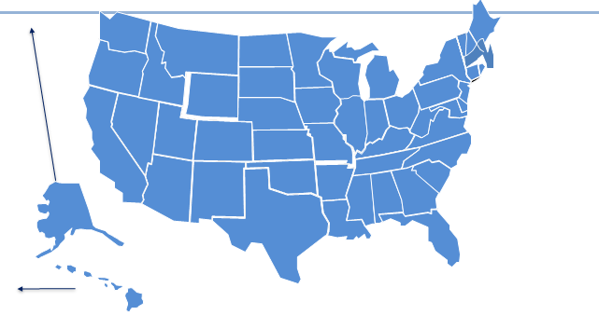
Free-Standing Standards for SEL at the Preschool Level

Slide 11
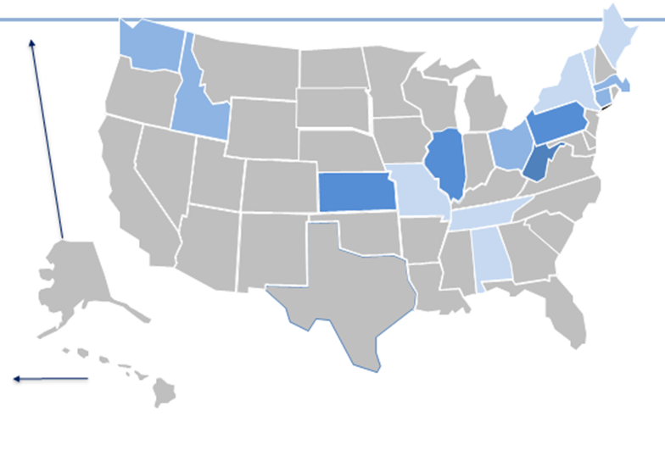
Free-Standing Standards for SEL at the K-12 Level

Slide 12
Teaching and the Development of Agency: What we can measure and for what purposes Ronald F. Ferguson, PhD The Malcolm Wiener Center at the Harvard Kennedy School, the Achievement Gap Initiative at Harvard University, and Tripod Education Partners, Inc.

Slide 13
TESTED OUTCOMES
Reading Skills
Math Skills
Reasoning Skills
Academic Knowledge
AGENCY-RELATED FACTORS
Growth Mindset
Conscientiousness
Future Orientation
Social Emotional Skills
Interpersonal
Intrapersonal
SUCCESS
IN SCHOOL AND LIFE

Slide 14
Student Survey Responses
Tripod 7Cs™ of Effective Teaching
items
Teaching Quality Index
1 Care
2. Confer
3. Captivate
4. Clarify
5. Consolidate
6. Challenge
7. Classroom Management
items
items

Slide 15
Status versus Development
Example of a status item:
I am the type of person who pays attention to the quality of my work.
Example of a development item:
In this class we learn to pay attention to the quality of our work.

Slide 16
Tripod 7Cs™ Composite of Student-Survey Based Teaching Quality Measures Predicts
Development of Agency Related Factors, Irrespective of Student Socioeconomic Backgrounds
Numbers are in student-level standard deviation units defined on a sample of over 300,000 students in over 16,000 6th to 9th grade classrooms.

Slide 17
Student perceptions of teaching (at least using the Tripod 7Cs composite) help predict between-school differences in learning gains.
This suggests that between school differences in student perceptions of teaching can be valid measures for distinguishing between schools. However, for any measure of instructional quality, there is much more variation within than between schools.
Whether student perceptions of their own status dispositions and mindsets should be used for between-school comparisons and interpreted as reflecting school quality is questionable.

Slide 18
Sara Bartolino Krachman
Co-Founder and Executive Director,
Transforming Education

Slide 19
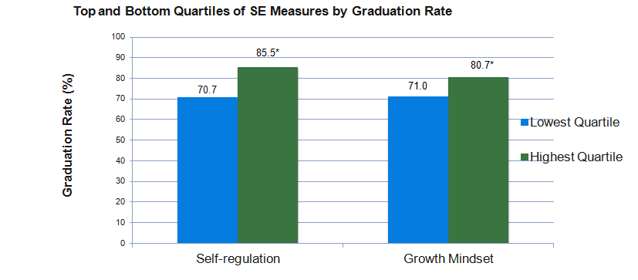
Longitudinal analyses from Massachusetts show that 8th grade social-emotional skills predict on-time graduation rates
Note: *Indicates the difference is statistically significant at 95% confidence level
Source: Harvard CEPR & TransformEd 8th grade study, 2011-2016

Slide 20
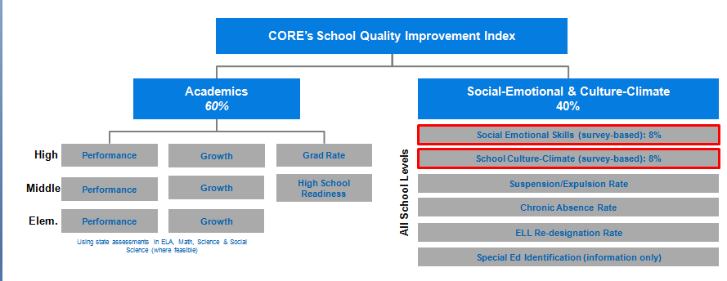
CORE’s accountability and continuous improvement system balances academic, social-emotional, and culture/climate outcomes

Slide 21
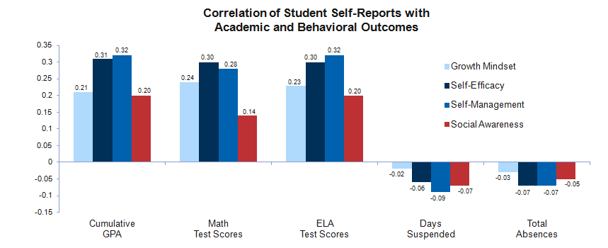
A 450,000-student field test showed that self-reported SE competencies correlate with academic and behavioral outcomes
Note: All correlations shown are statistically significant
Source: CORE / TransformEd Field Test (spring 2015)

Slide 22
Meg Mayo-Brown
Superintendent,
Fall River Public Schools

Slide 23
Operationalizing SEL at a district level
Notes:
Fall River was one of seven WAZ districts supported by DESE through RTTT funds in 2011
Provided opportunity to develop a comprehensive SEL agenda
Piloted in 2 Level 4 schools before going to scale

Slide 24
Building Capacity for SEL
Accelerated Improvement Plan
Details 4 strategic objectives for district improvement
Strategic Objective 3:
Ensure success for all students through the development of students’ social and emotional wellness.
S03.1 Create a positive school and classroom climate.
S03.2 Empower parents through enhanced home school connections.
S03.3 Develop and enhance positive youth development opportunities.
SO3.4 Provide differentiated support to students based on identified social emotional needs.
Notes:
A. Responsive Classroom and Guided Discipline Training continues.
B. SEL District network continue to meet monthly and share best practices around a tiered model for behavior as well as analyze SEL data.
C. Schools refine their SEL RTI process.
D. Fall River Parent Academy is launched offering over 60 free courses to parents (http://www.fallriverparentacademy.org/).
E. Attendance Task Force continues to meet monthly.

Slide 25
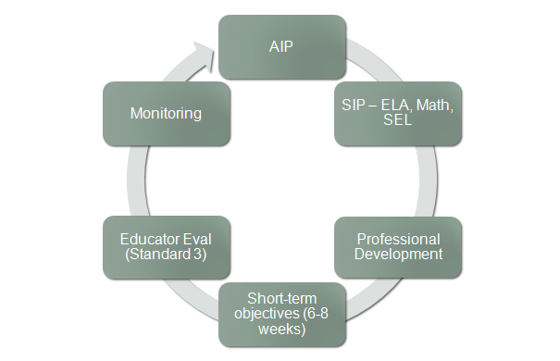
Building a district system to support SEL
Notes:
AIP – district level SEL team
SIP – school based SEL team
PD – to support SIP goals
Ed Eval – Standard 3, Parent and Family Engagement
Monitoring informs

Slide 26
Results?
American Institutes for Research (AIR) 2015 evaluation:
“Students attending WAZ schools gained 5.8 percentage points on state English language arts tests and 7.9 percentage points on state mathematics tests. During the same period, scores in the state as a whole dropped 0.4 percentage points in English language arts, and gained 1.4 percent in math.”
“The program also appears to have played a role in school turnaround. Among WAZ schools, those that started 2010 in Level 4 status… 66 percent had exited that status by 2014, compared to 40 percent among non­WAZ schools.”
Notes:
Kuss exited to Level 1 status
Doran exited to Level 2, and the year following, Level 1

Slide 27
MASS Position Paper
Supporting the social, emotional, behavioral, and mental health needs of students is applicable to every district in the Commonwealth.
Necessary partnerships to support the SEL needs of students:
Social service agencies
DESE
Higher education
Legislation
Notes:
Social service agencies – develop and deliver services within school
DESE – technical assistance and funding to assist districts to develop capacity
Higher Ed – preK-16 vertical alignment, and licensure competency
Legislation – inter agency collaboration

Slide 28
Dana Brown
Principal,
Malden High School

Slide 29
Audrey Jackson
Fifth Grade Teacher,
Joseph P. Manning School, Boston
& 2016 Massachusetts Teacher of the Year

