Slide 1
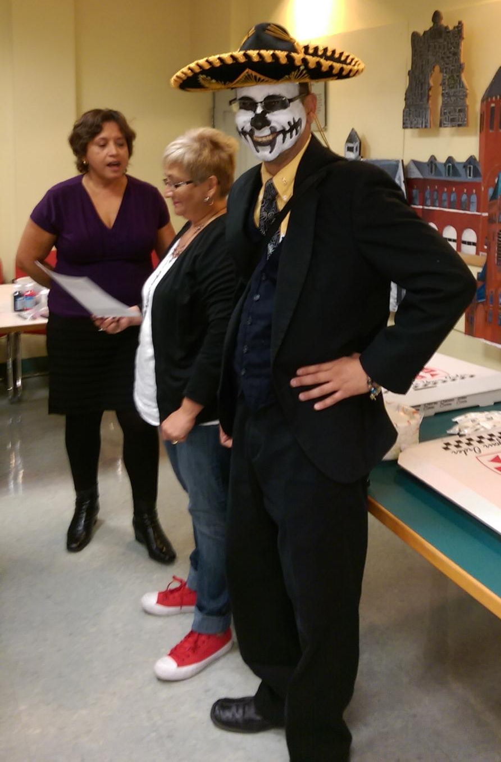
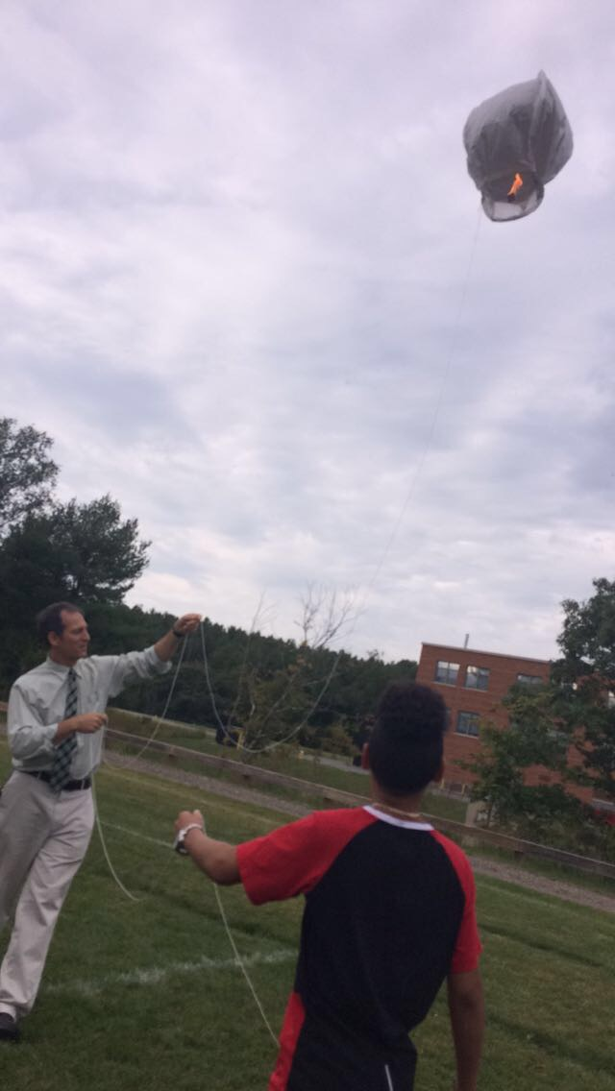
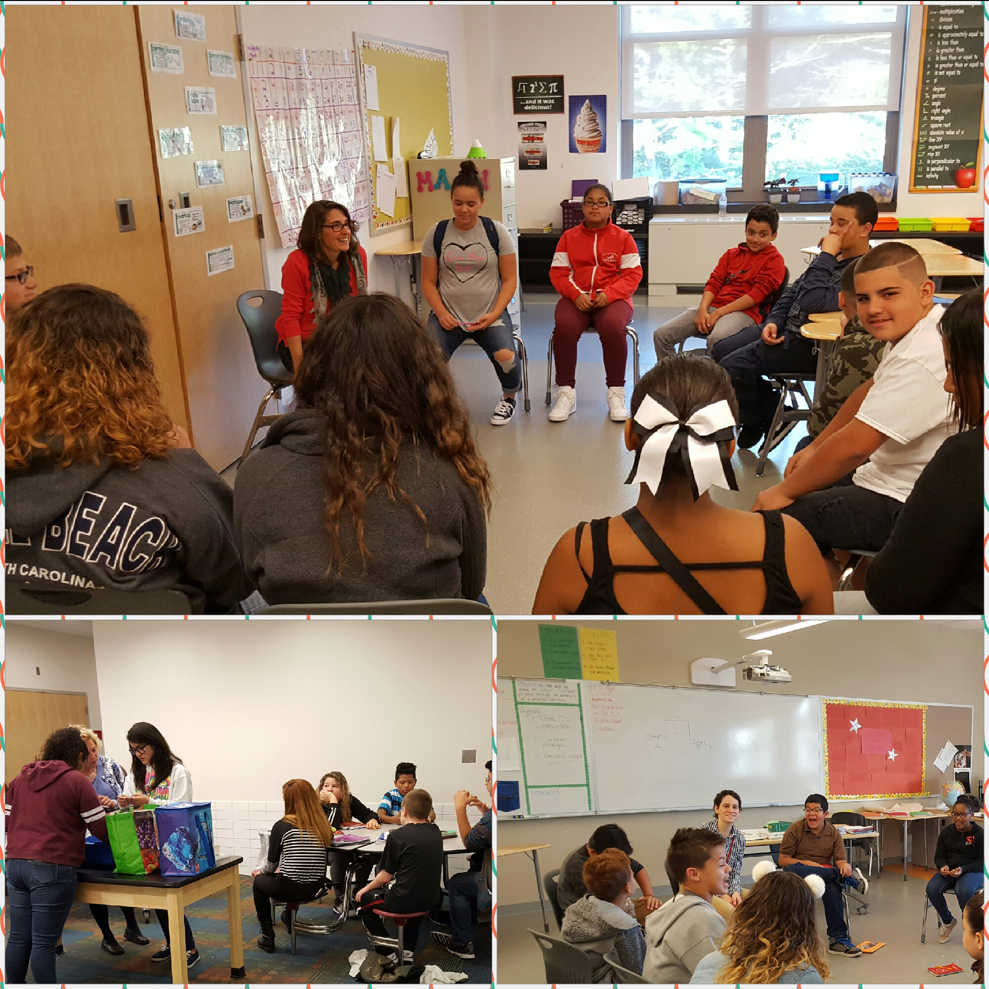
Southbridge Public Schools
Dr. Jessica Huizenga, Receiver
October 25, 2016

Slide 2
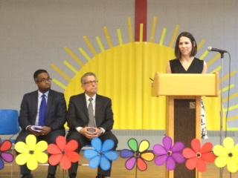
Receivership At-A-Glance
Receiver’s first day was on May 2, 2016.
Southbridge Public Schools Level 5 Turnaround Plan was released on June 24, 2016.
In the Southbridge Public Schools,
ALL STUDENTS
will experience a world class education, and will graduate as engaged citizens who demonstrate the essential skills required for success in college and career.

Slide 3
Turnaround Plan Priority Areas
Ensuring an inclusive and supportive school community with high expectations and rigorous, equitable, and personalized instruction for all students, including students with disabilities (SWDs) and English learners (ELs).
Developing a district-wide professional culture of highly effective teaching and leadership.
Creating the conditions to enable and apply evidence-informed decision-making.
Establishing systems and processes to cultivate and leverage family engagement and community partnerships.
Organizing the district and reallocating resources to ensure high-quality management, accountability, system-wide coherence, and sustainability.

Slide 4
The First 6 Weeks
Academic and Instructional Improvements
Family and Community Engagement
Social and Emotional Learning
Systems

Slide 5
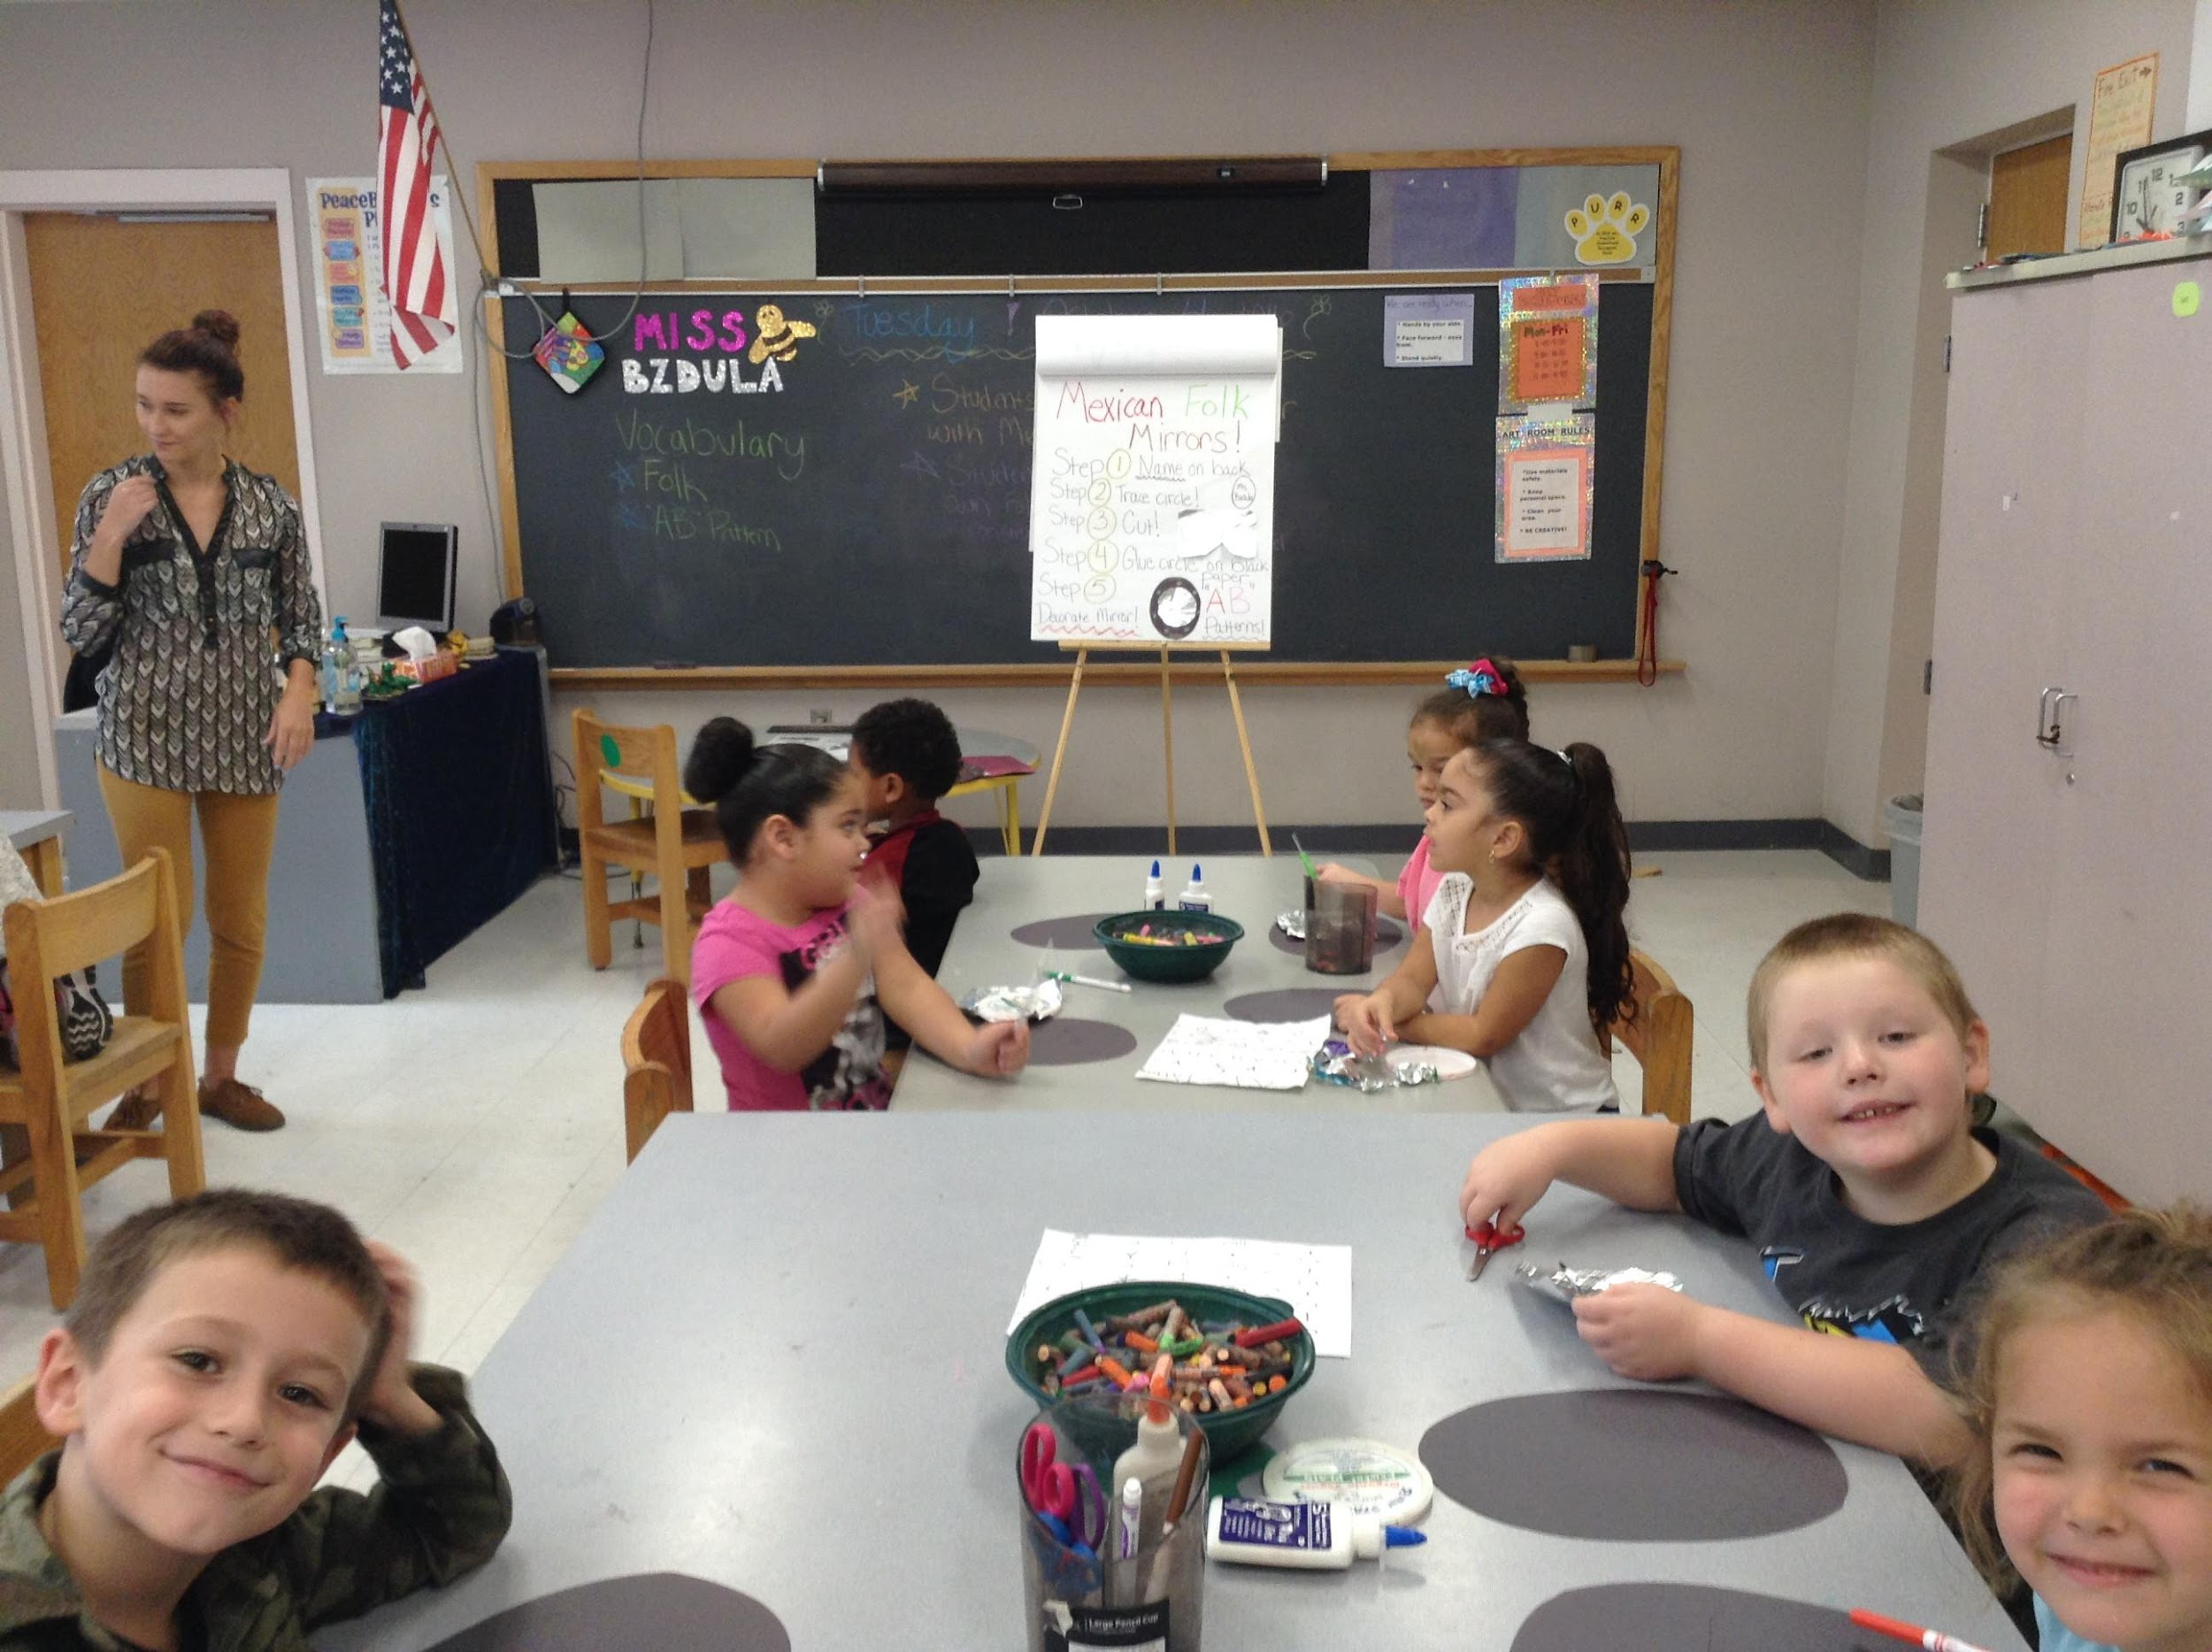
Academic and Instructional Improvement
Southbridge Public Schools

Slide 6
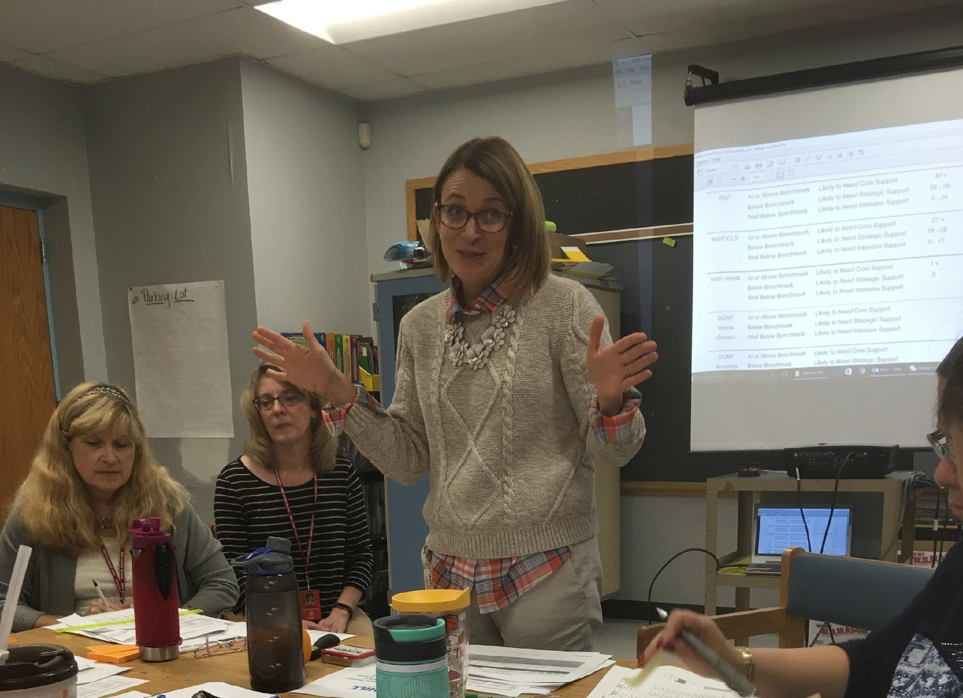
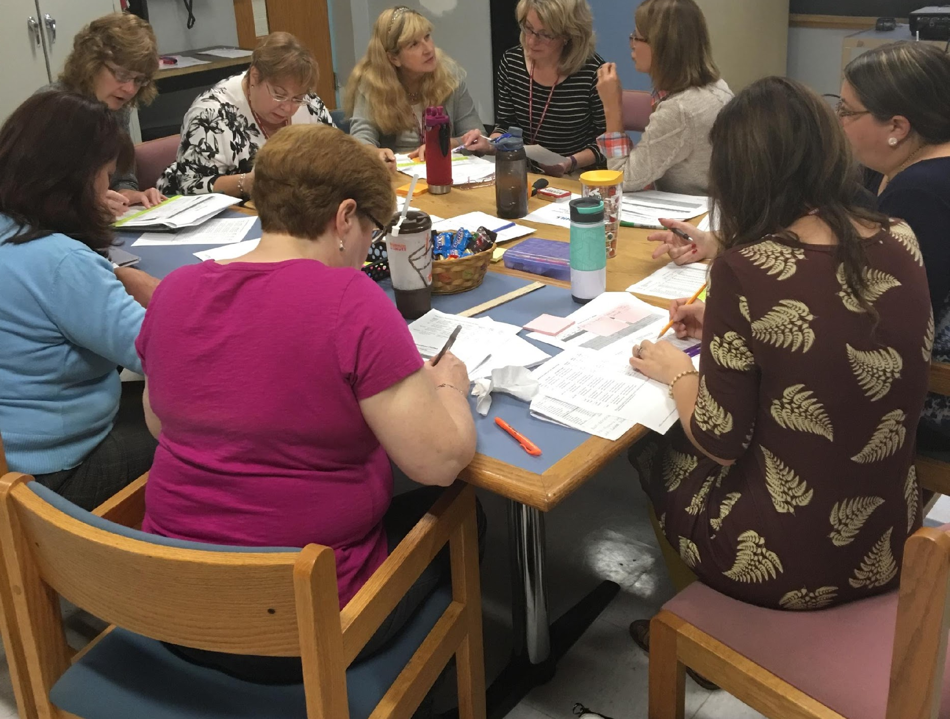
Academic and Instructional Improvement
Hill Literacy working district-wide to develop systems necessary to institute evidence based literacy practices within a tiered instructional model.
District literacy leadership team (grades K-5) developing action plan to guide work at each school.
K-12 math curriculum has been mapped and Math Common Assessments created and administered through grades 1-8 with SchoolCity.

Slide 7
Academic and Instructional Improvement
Bi-weekly walkthroughs have been implemented.
Monthly district instructional rounds began October 17; focus on a school-based problem of practice.
Research for Better Teaching (RBT) delivering 42-hour ATSR PD to all administrators and evaluators.
RBT delivering PD to staff on creating rigorous tasks that align with mastery learning objectives.

Slide 8
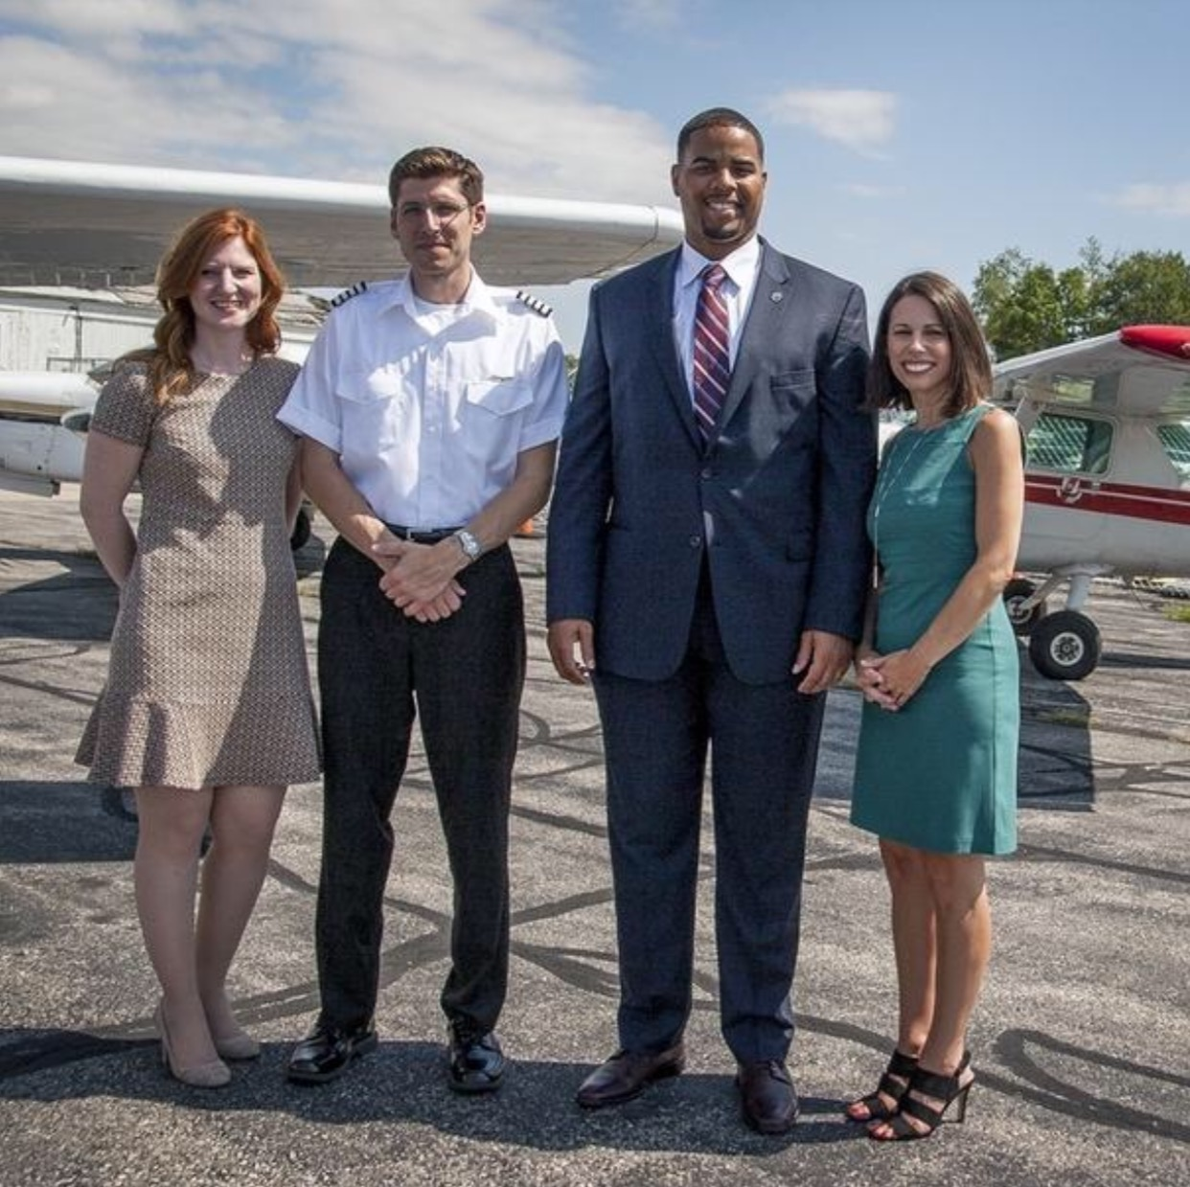
Academic and Instructional Improvement
15 Better Lesson virtual coaches added to our teacher mentoring program.
7 building-based tech leaders stipend positions created to improve tech integration.
Partnership with AeroVenture Institute, a career pathway for 26 HS students to take aviation science, gain 2 college credits, and attain hours toward flight licensure.
Credit Recovery Program offered after school, Tuesday through Thursday, utilizing the Edmentum learning platform.

Slide 9
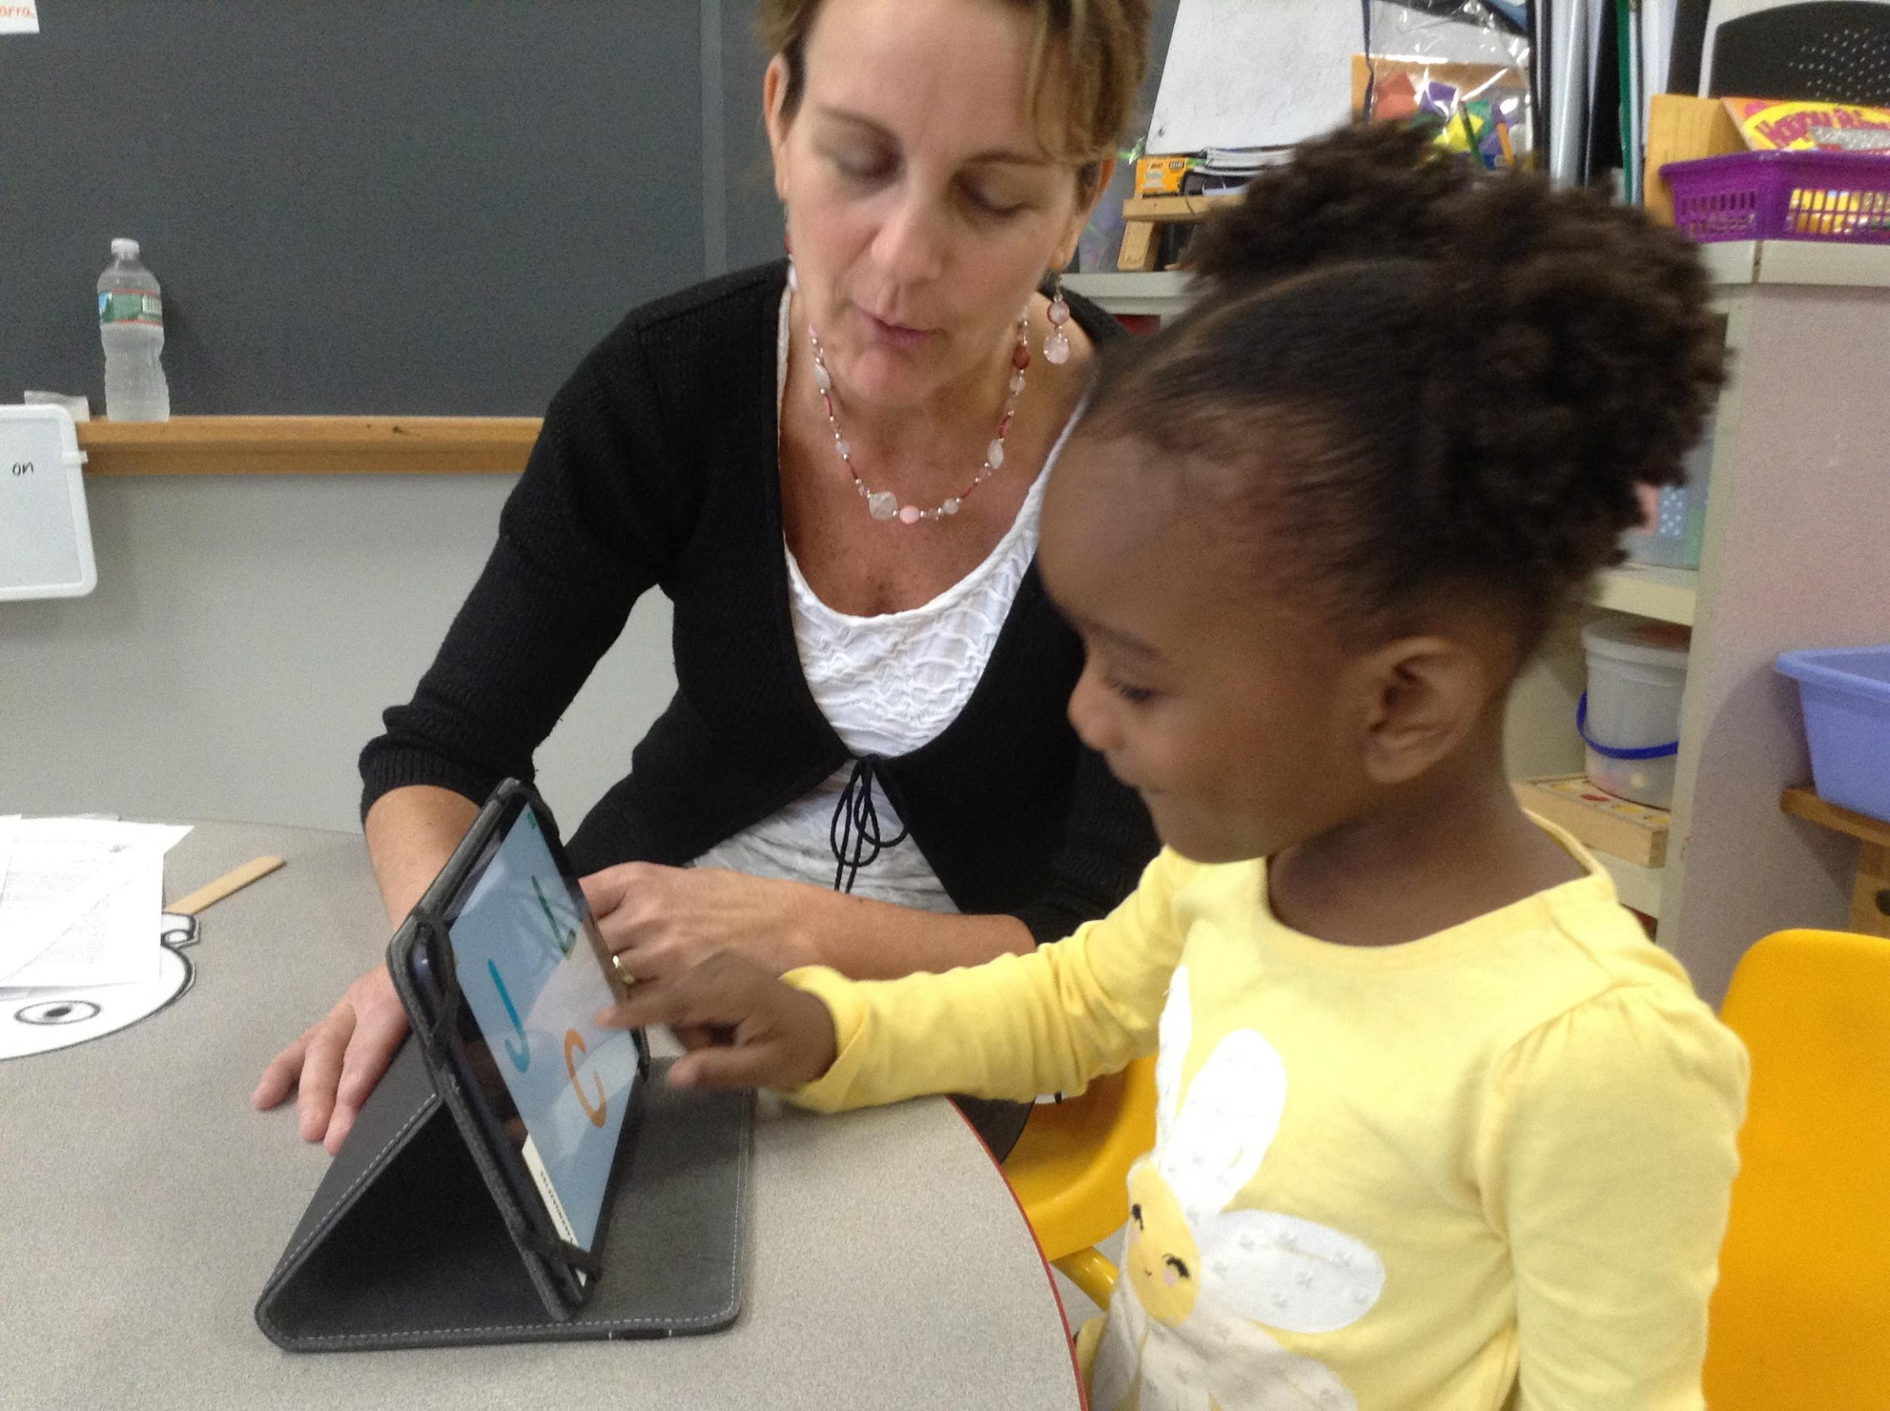
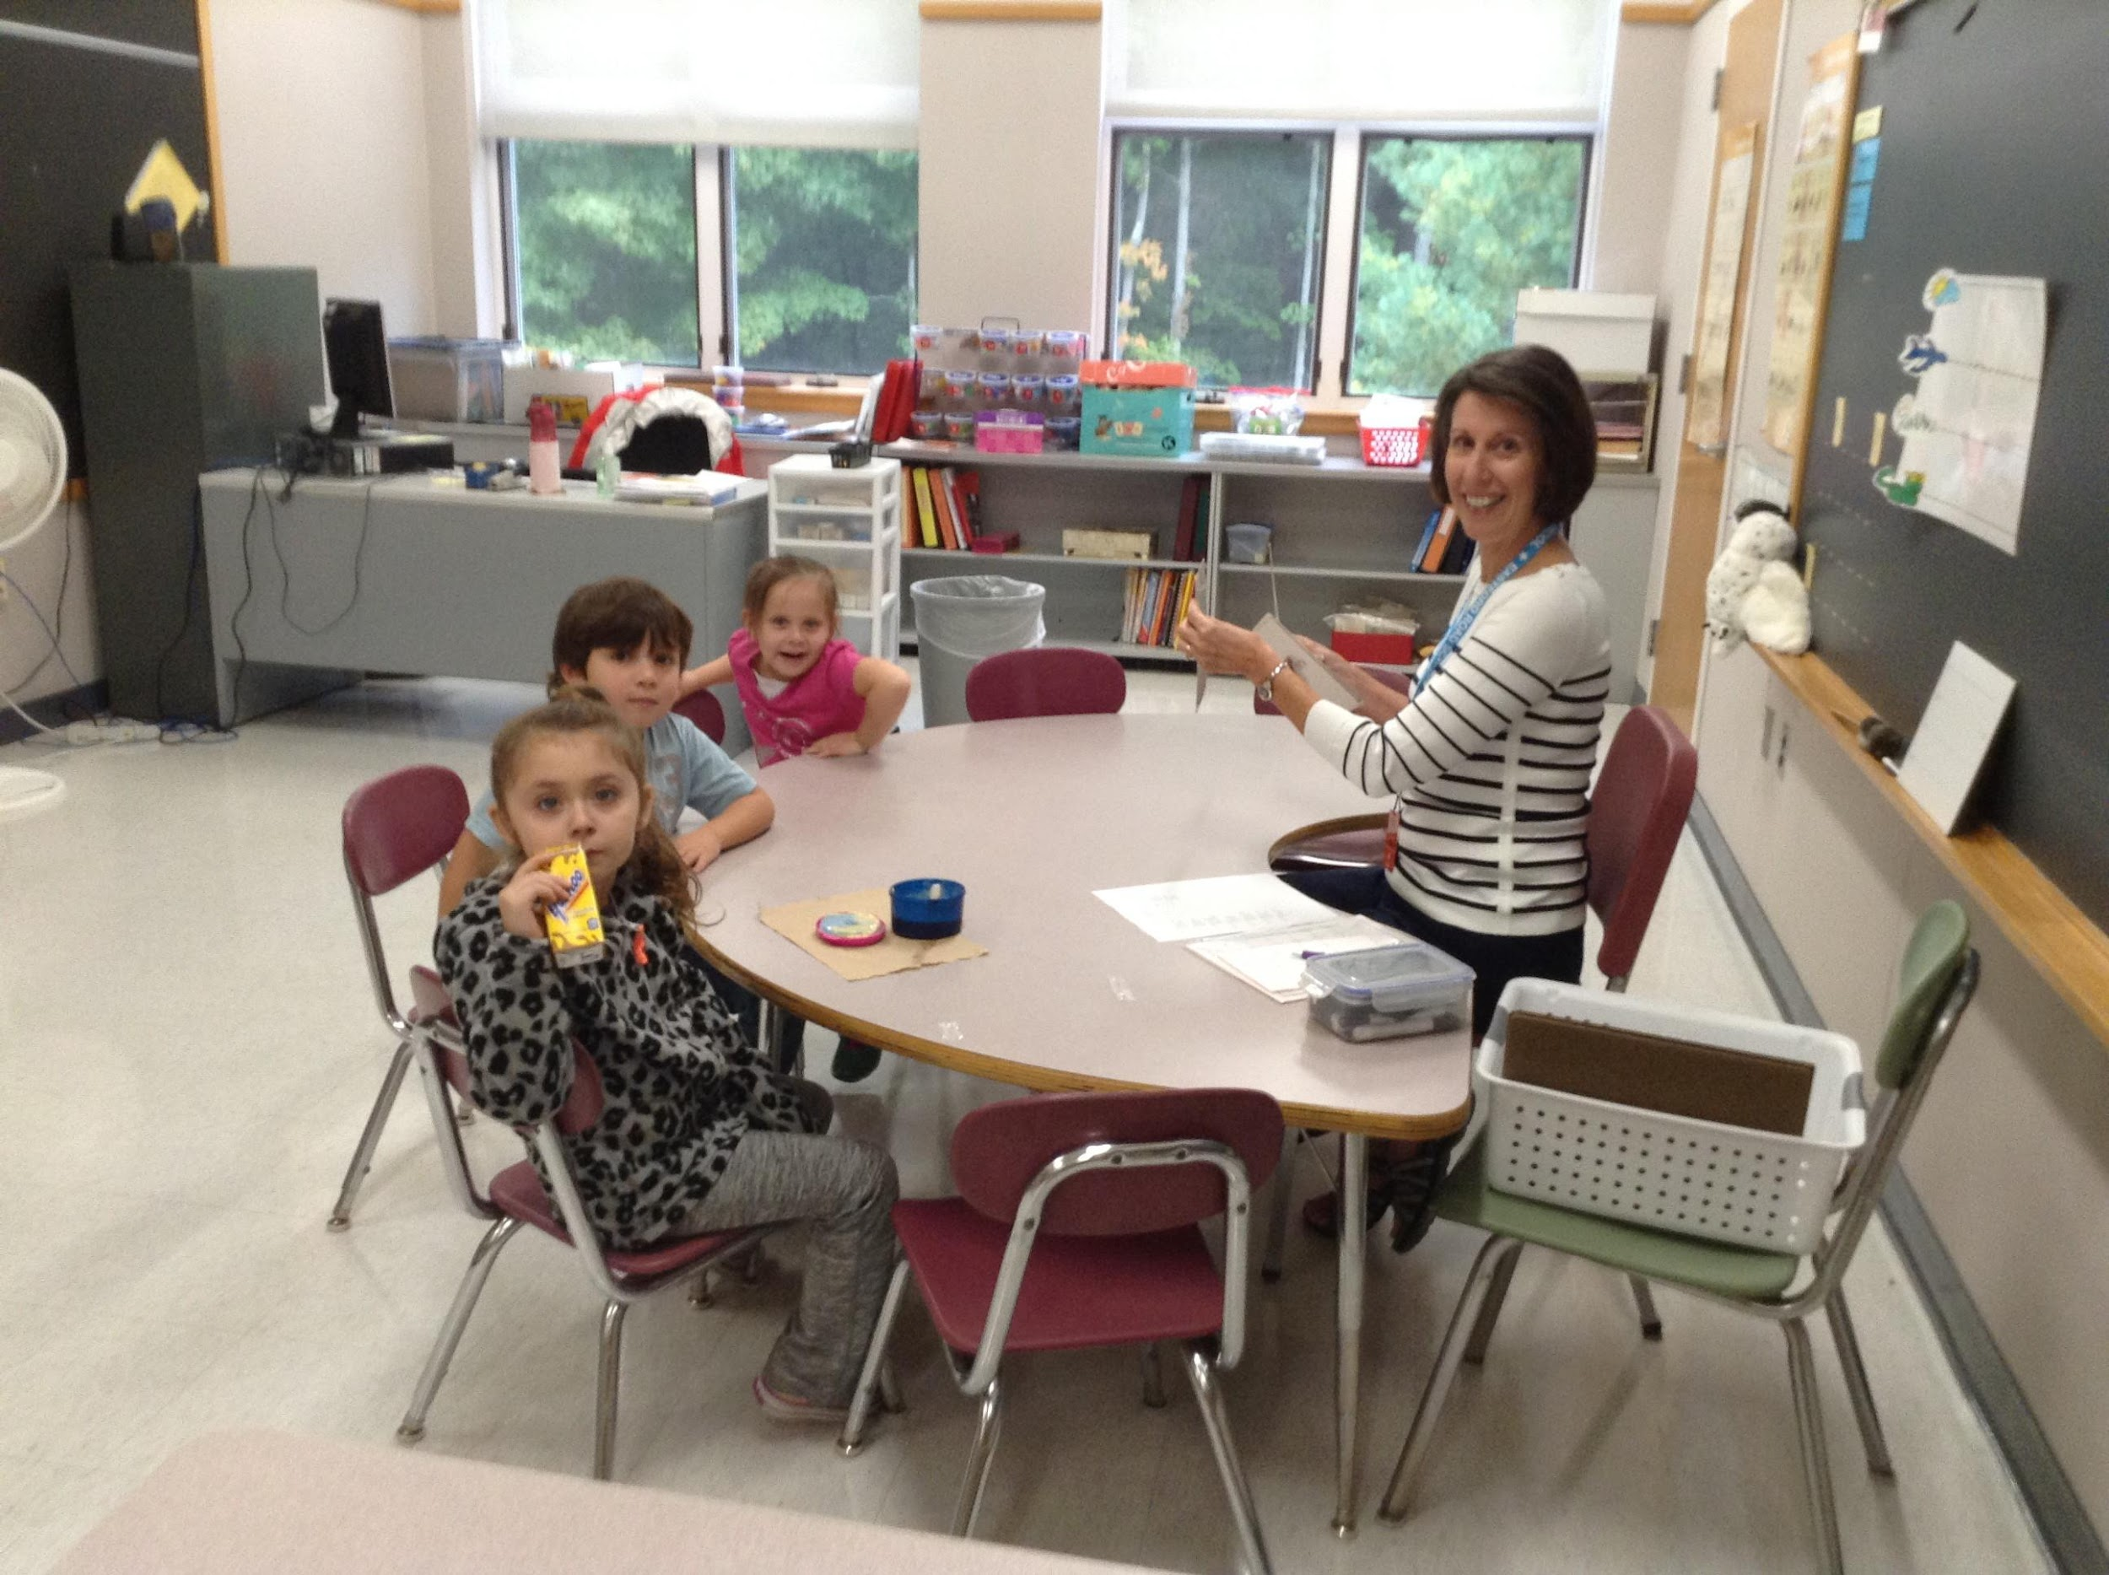
Family and Community Engagement
Southbridge Public Schools

Slide 10
Family and Community Engagement
Community Meetings with the Receiver
Superintendent’s Roundtable
PTO forming at SMS
School Councils forming
Corporate & Community Partnerships
Early College Program with QCC

Slide 11
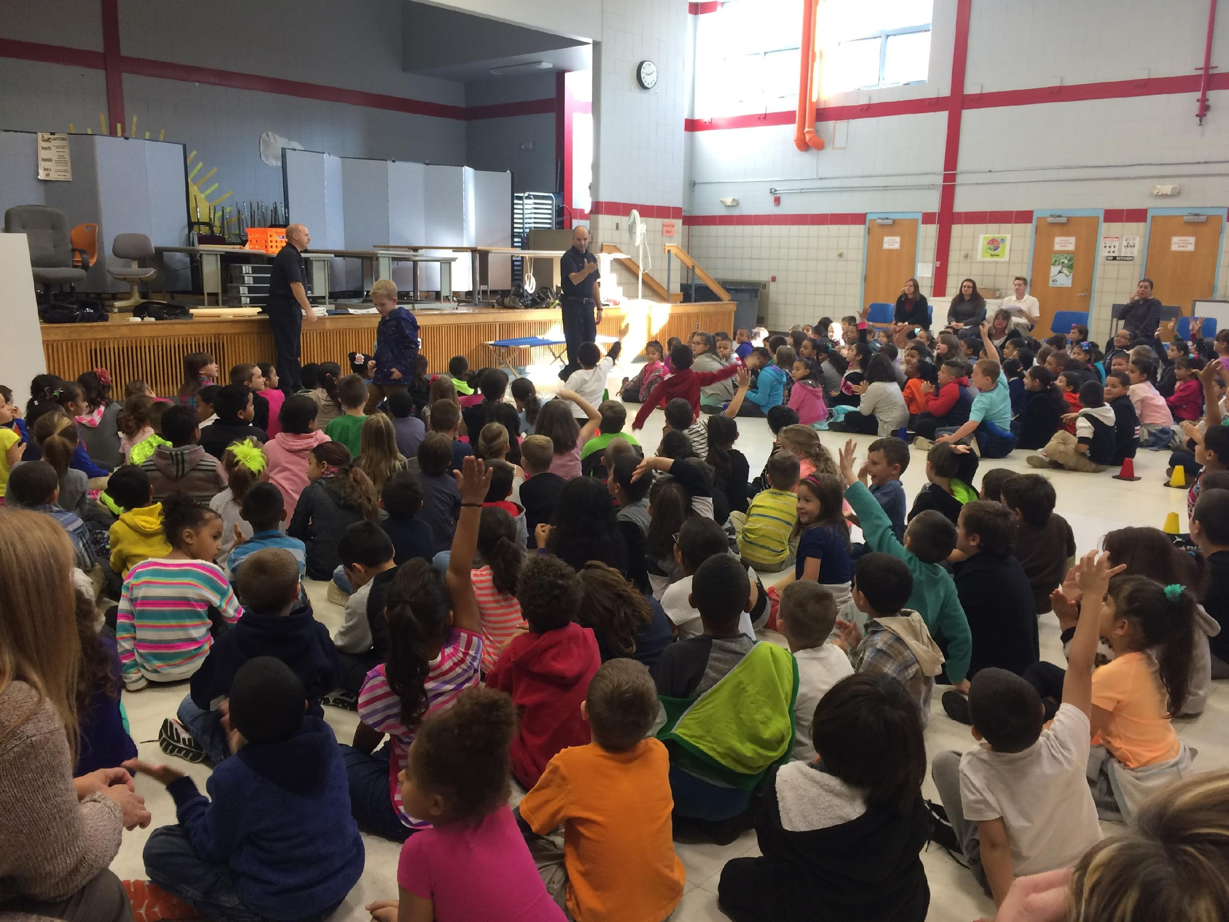
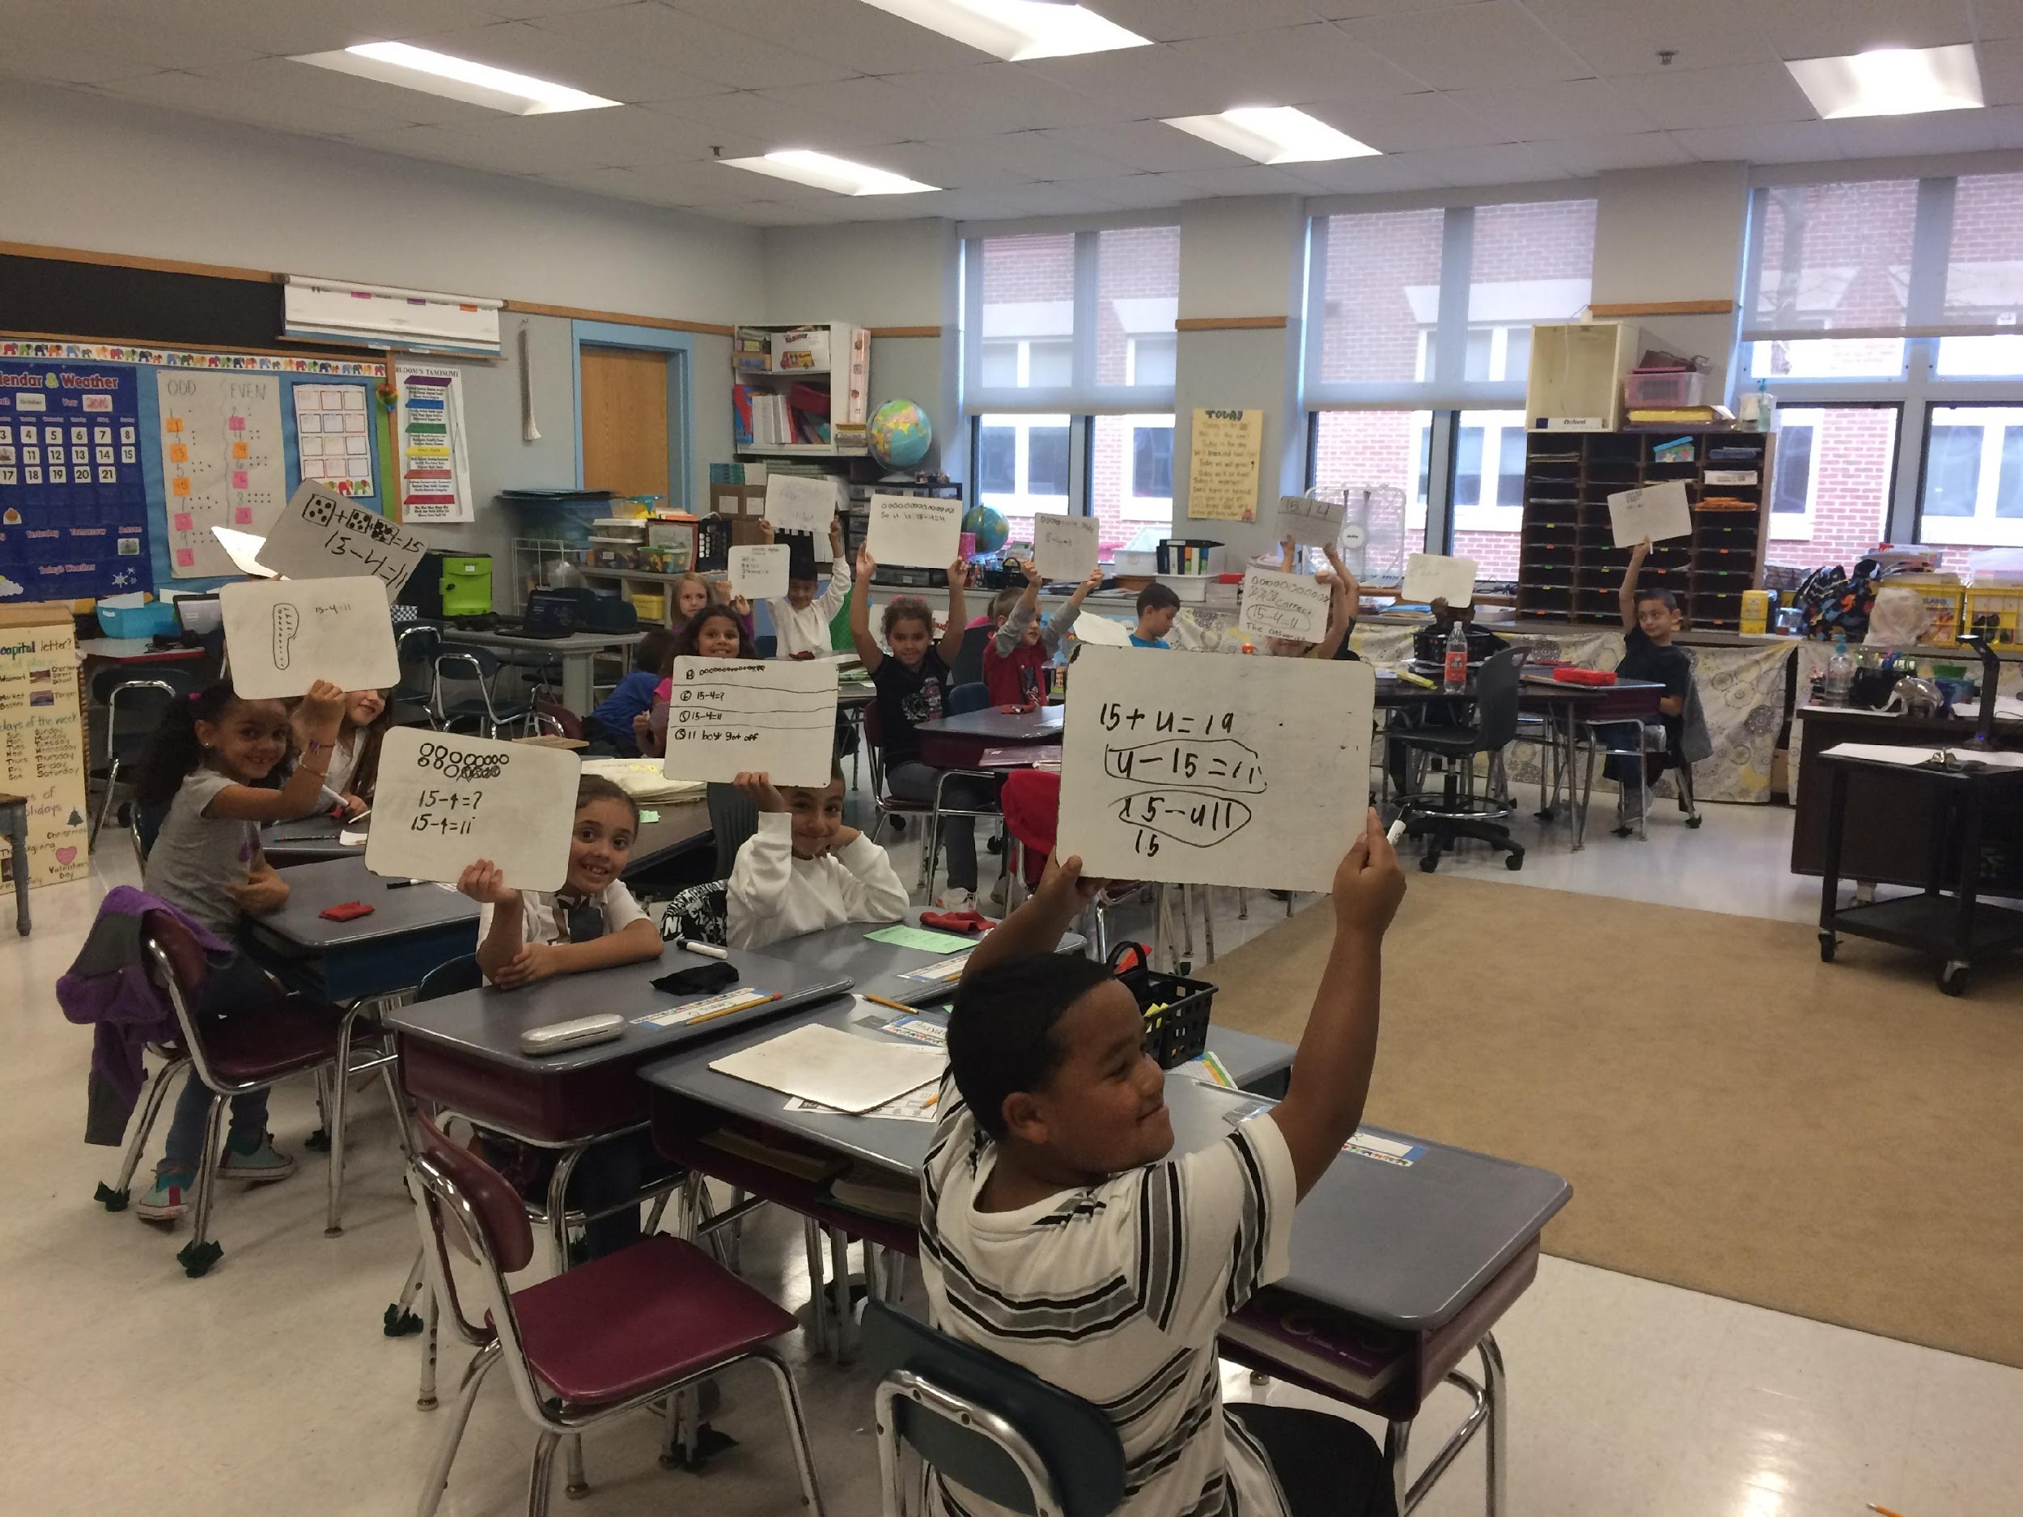
Social and Emotional Learning
Southbridge Public Schools

Slide 12
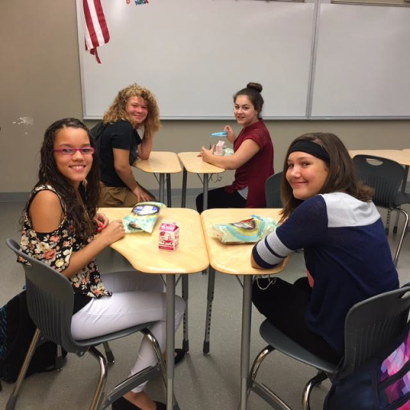
Social-Emotional Learning
Breakfast in the Classroom Grant awarded and started at the West Street School and Middle School
District Climate Committee, meets monthly, includes all building admin - purpose to collaborate on SEL initiatives and deliver SEL PD
District Wellness Committee created with several mental and physical health goals
Two Family Resource Centers with food pantries being created at ERS and the HS- estimated date of completion - winter 2017

Slide 13
Social-Emotional Learning
Collaboration with Boston Day and Evening Academy in support of developing alternative program
Staff trained district-wide on Positive Action curriculum which is being taught as Tier 1 intervention K-12
Planning has begun to create HS Advisory Program
PBIS, SBST and Crisis Teams created and have begun implementing MTSS systems and supports

Slide 14
Social-Emotional Learning
Career Center at the HS staffed by a free guidance counselor for the next 5 years through Mass EDCO grant
Community Planning Group of local business and community agency representatives has been formed.
Initial trainings done with new staff on mental illness, trauma and mandated reporter procedures

Slide 15
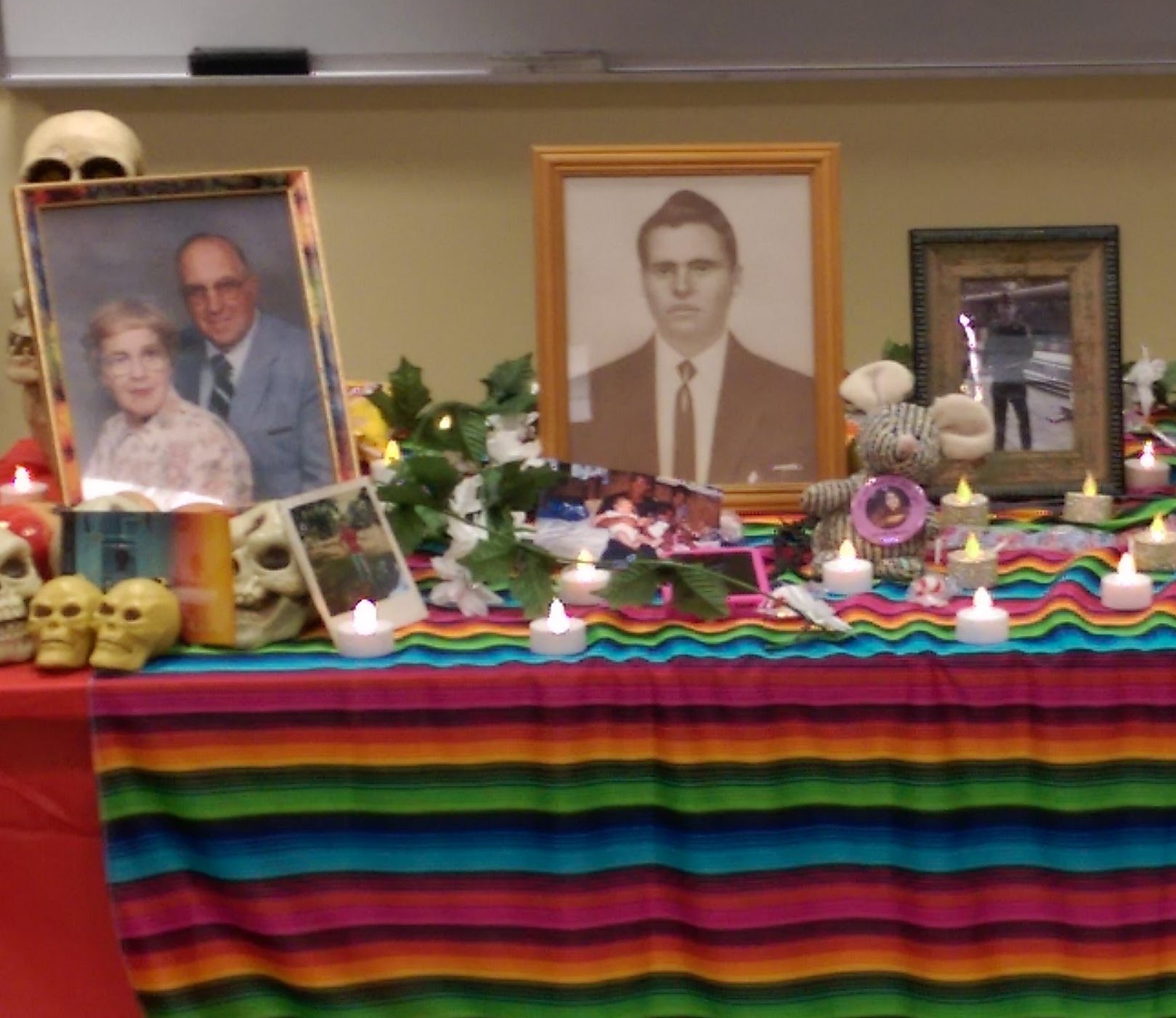
Systems
Southbridge Public Schools

Slide 16
Systems
Business office able to process POs up to $10k
ALICE training completed district-wide on October 7
New district student information system is being vetted
1300 Chromebooks have been distributed district-wide

Slide 17
Systems
A complete wireless network overhaul is in progress
A system has been created to identify incoming ELs and to monitor FEL and opt-out students.
District language acquisition team created to build school-based systems to ensure adherence to ELE guidance

Slide 18
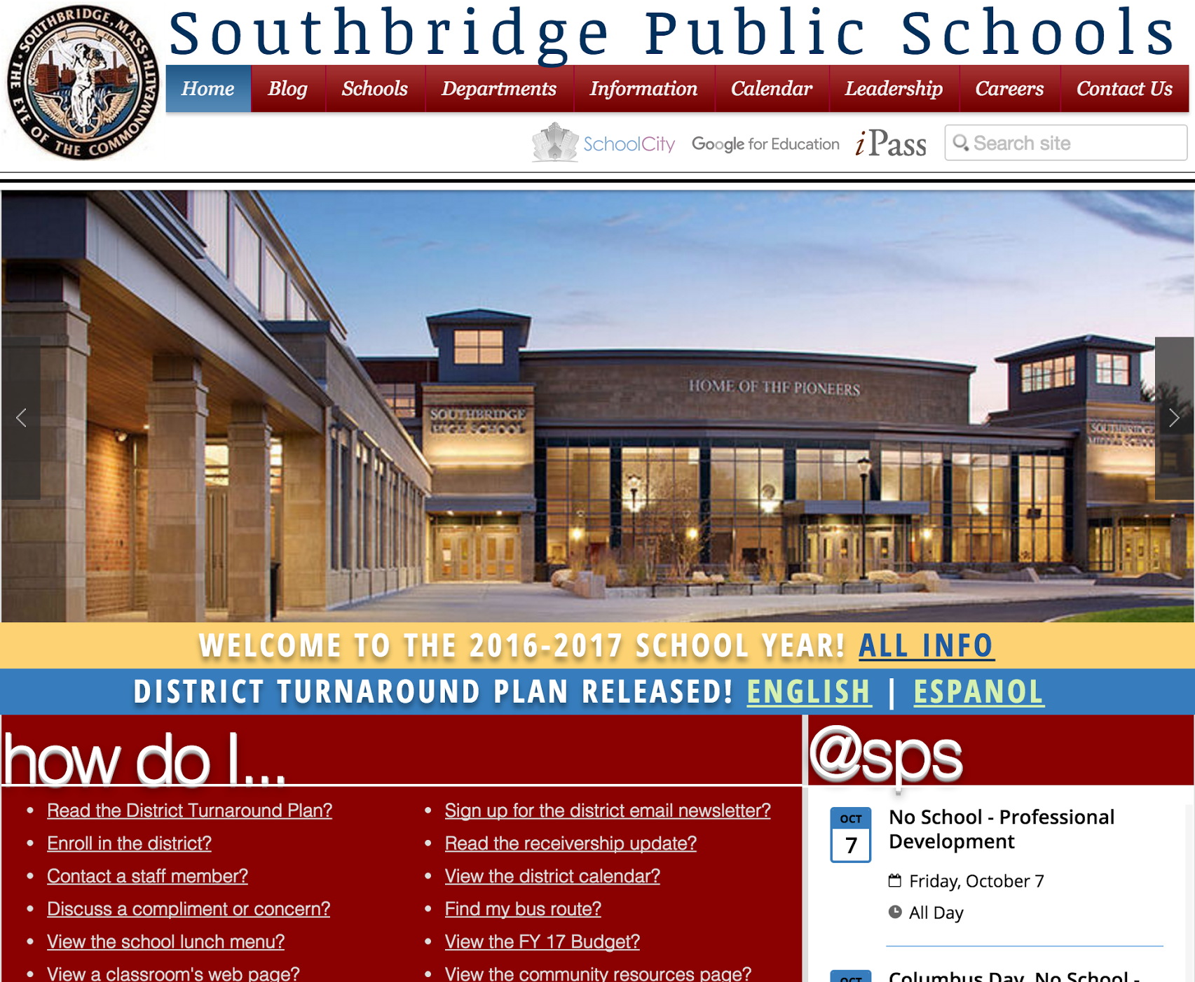
Systems
Brand-New, Modern, and Cost-Effective District Web Site

Slide 19
Theory of Action
District Leadership Team

Slide 20
IF
We establish clarity around what good educational practice looks like and model it
We create and leverage systems & opportunities for feedback, reflection, and continuous improvement
We establish a system of accountability based on reciprocity and outcomes
We deliberately collaborate with constituents through the work in ways that promote strong engagement, relationships, ownership, and equity
We build internal capacity that supports and sustains long-term change
THEN
Schools and educators will engage in more effective continuous improvement around our priorities, we will have a coherent and sustainable system grounded in equity/social justice, and will provide our students with a world class education preparing them for success in college and career

Slide 21
Questions?

